Slide 1
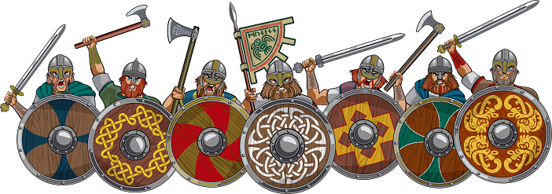
How to make a Viking shield
This is just a guideline. You can use whatever materials you want to.

Slide 2


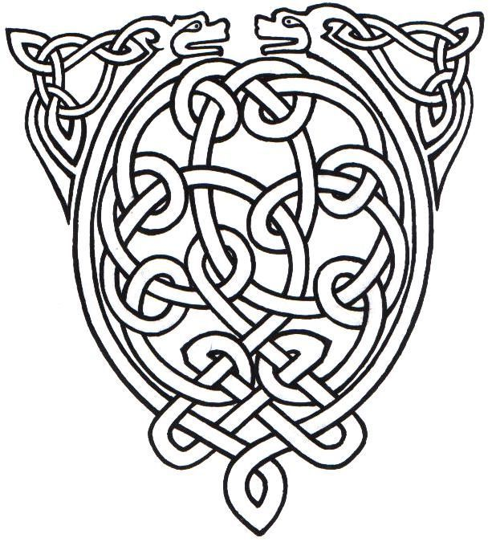
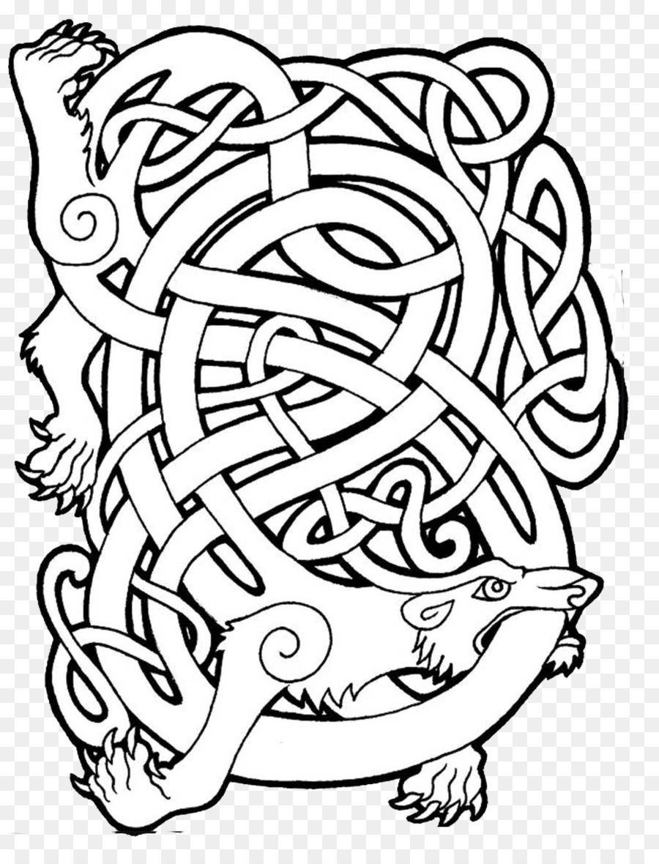

First decide on the design for your shield. The Vikings liked their designs to be symmetrical. They like knot designs with creatures amongst them.

Slide 3
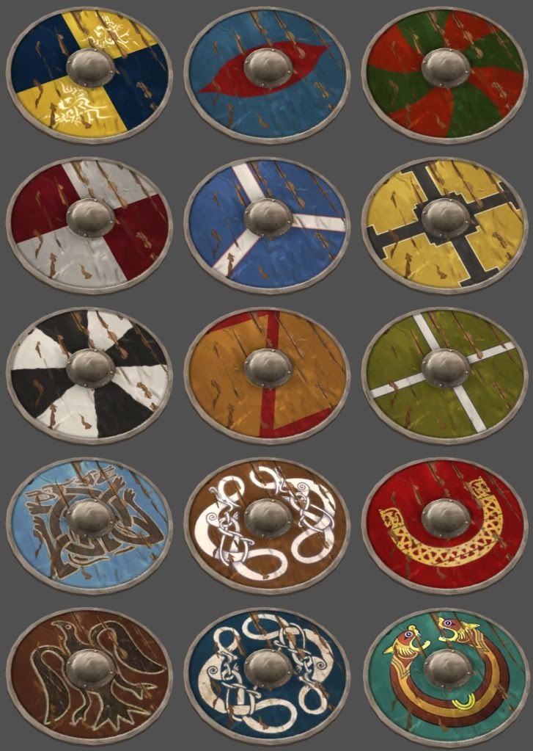
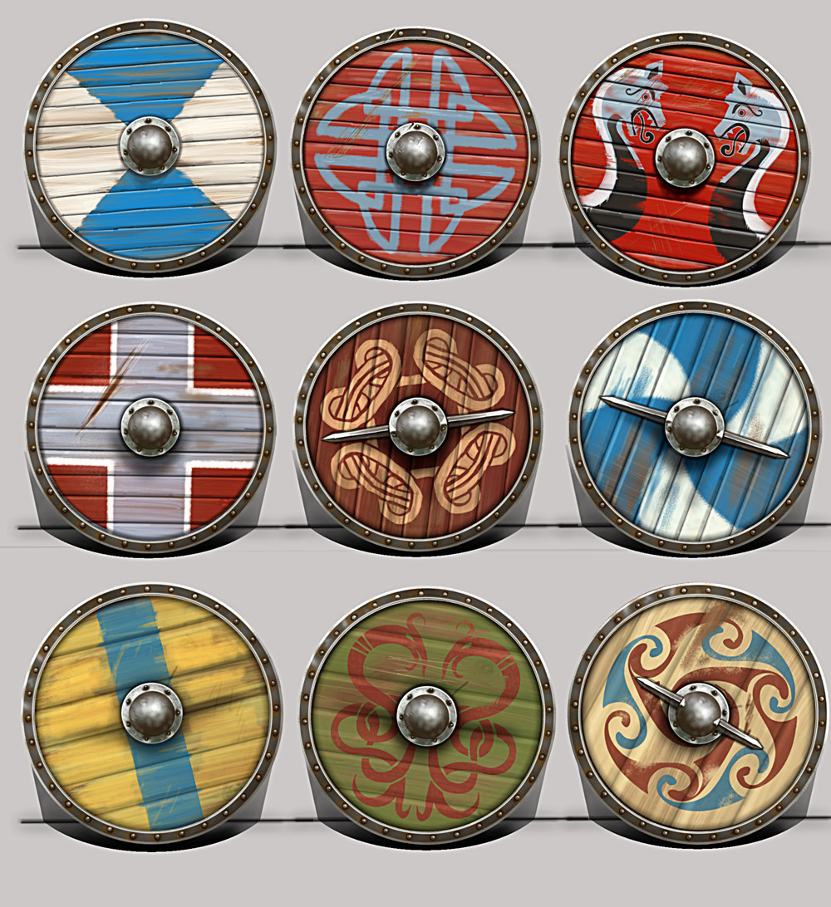
Here are some ideas for designs you could use for your shield.

Slide 4
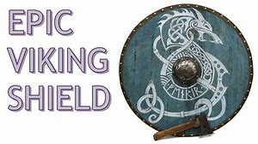
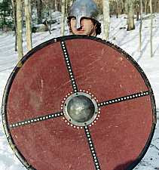
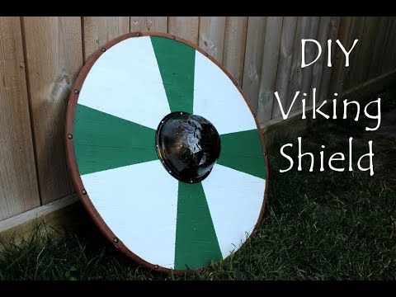
Now it’s time to make your shield. The following instructions are for a basic design and are just a guidance.

Slide 5
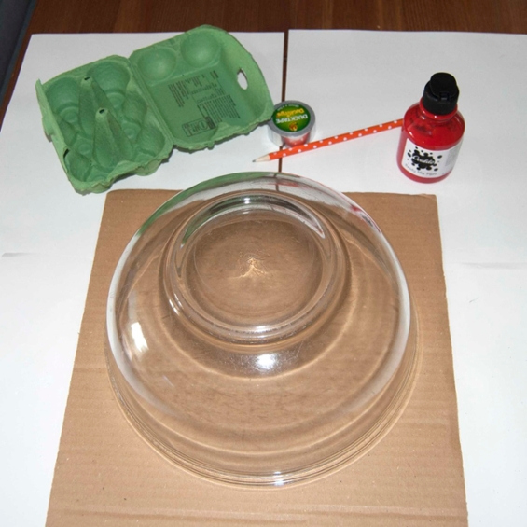
First you will need some card or cardboard. Find something round to draw around, like a large plate or mixing bowl and place it on your cardboard. Draw around it and cut it out.

Slide 6
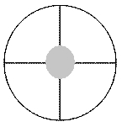
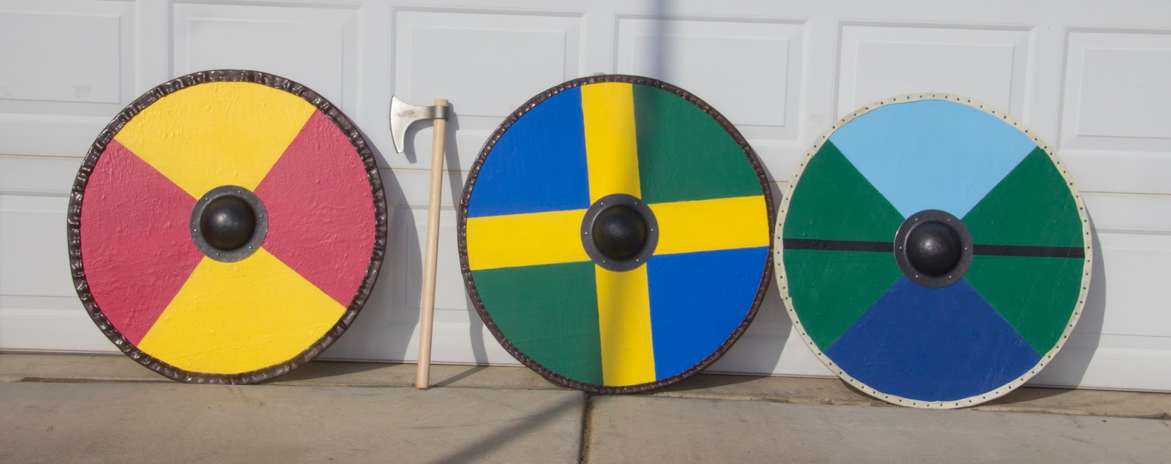
Mark out the four sections of your shield by drawing a vertical line down the middle and a horizontal line across.

Slide 7
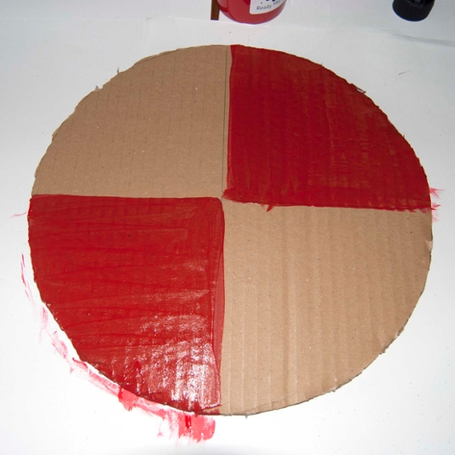
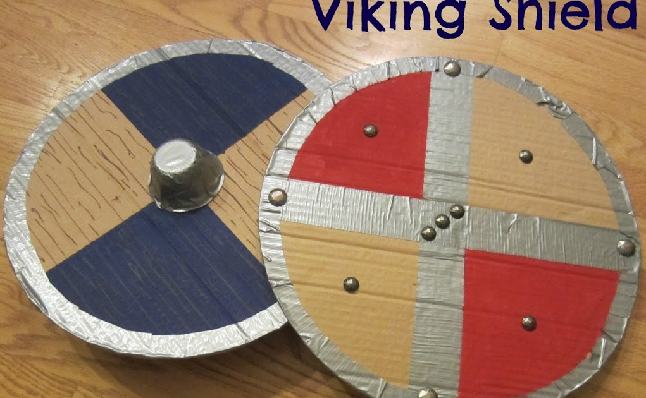
Paint two opposite corners of your shield with the paint.

Slide 8
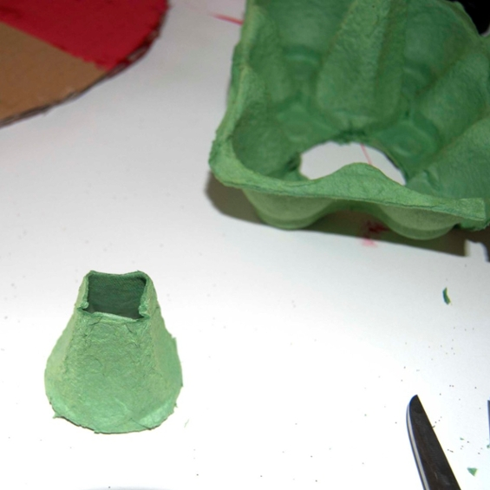
While the paint is drying, take your egg box and cut out one of the
raised sections – this will form the centre 3D part of your shield.
Cover it in silver Duck tape, Gas tape or silver foil.
Yoghurt pots make good
centres for your shield too.

Slide 9
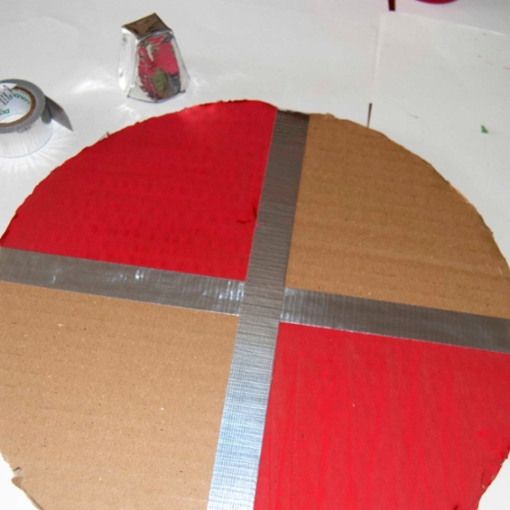
Stick duck tape along the centre lines of your shield so it divides it into four sections. Then stick duck tape around the edge. You will need to cut lots of smaller lengths of tape and overlap them as you go round. You can use Sellotape to join silver foil.

Slide 10
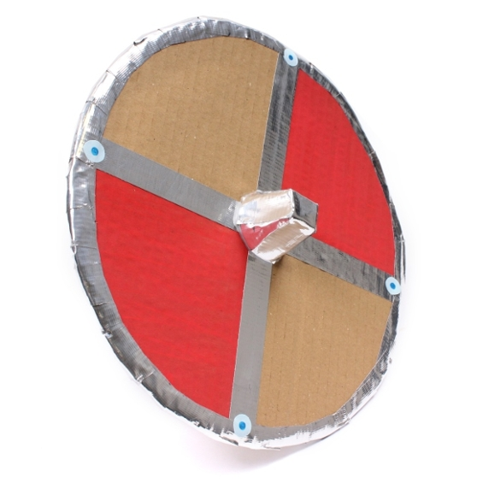
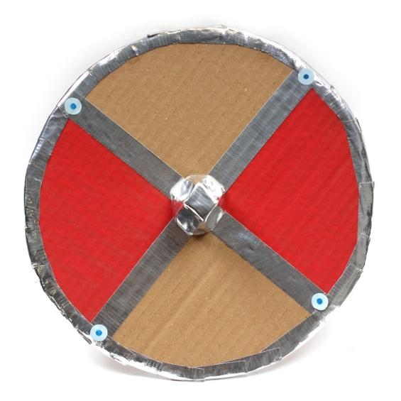
Now you need to make a handle for your shield. Cut a strip of cardboard and using sellotape fix it to the back.
With the glue, stick your egg box piece onto the centre of your
shield.

Slide 11
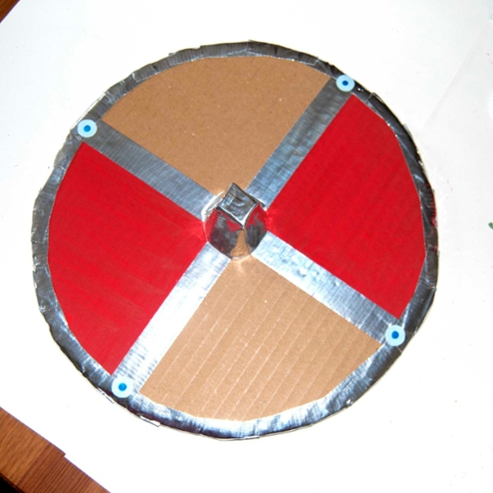
Choose some coloured paper and cut out four small circles. Draw a little spot in the middle of each with your pen. Stick the circles on each join around the edge of the shield. This is just one idea. Decorate your shield however you like but remember to keep the pattern symmetrical.

Slide 12
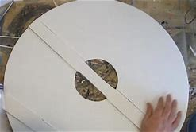
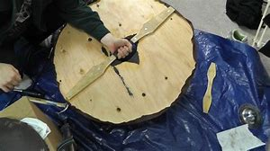
Now you need to make a handle for your shield. Cut a strip of
cardboard and using Sellotape fix it to the back.

Slide 13


