Slide 1
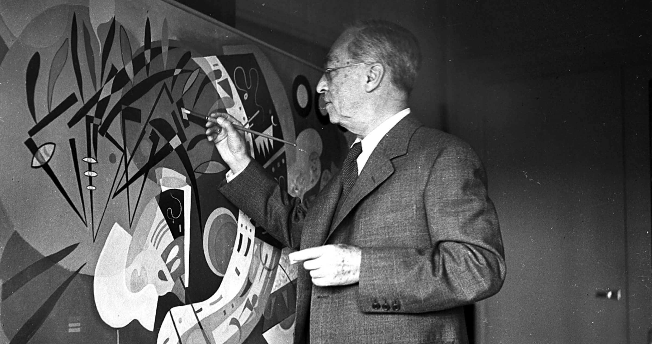
Wassily Kandinsky in monochrome

Slide 2
Learning objectives;
To use and identify 2D shapes and lines to create a composition in the style of Kandinsky.
To use overlapping, partial shapes and shading to create depth and texture
Success Criteria;
I can translate shapes so they look different.
I can use and overlap shapes and lines to create a texture to my work.

Slide 3
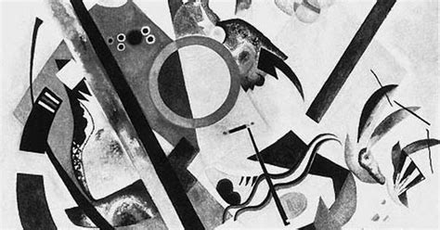
Composition 1 in Black & White
by Wassily Kandinsky

Slide 4
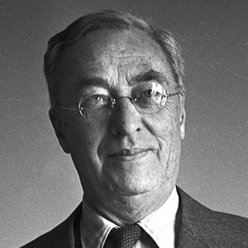
What do you remember about Wassily Kandinsky?
(1866 - 1944)
He was the first painter to stop painting pictures of things and instead paint just using colours and shapes. He believed that this let him paint honestly about his feelings.
Often Kandinsky would listen to music while he painted and try to paint what he heard.
He worked in mono-tone as well as colour.

Slide 5
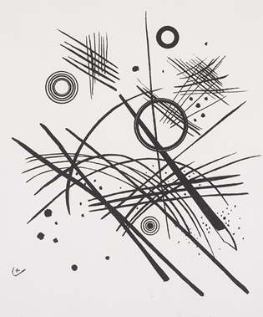
Many people consider Kandinsky to be the first abstract artist.
Although he is best known for his colour compositions, he created many black and white pieces too.
Abstract Painting
by Wassily Kandinsky

Slide 6
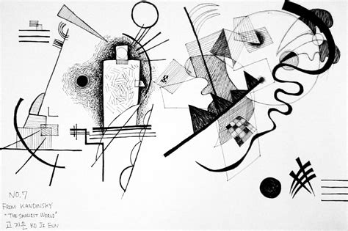
‘The Smallest World No 7’
What do you see in this composition?
What do you think of it?
Look carefully, what media do you think he used?

Slide 7

Look at the way Kandinsky has used line and form in this composition. By varying the thickness of the lines and mixing the straight with the curved, he creates a depth to the composition.

Slide 8
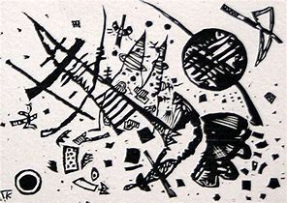
Your turn.
Think about how you want your drawing to look like.
Which shapes will you use?
How many lines?
Straight, curved or both?

Slide 9

You are now going to create your own black and white composition in the style of Kandinsky.
Think about the shape of lines
(or 2D shapes you want to use.
Are you going to make you lines
thick or thin?
How much will you shapes interact
with each other?
Think about how the shapes will change
as they cross over.
Use your ruler to draw straight lines.

