Slide 1
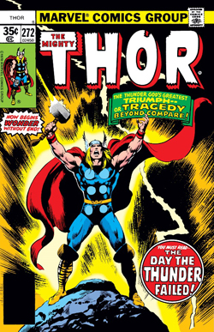
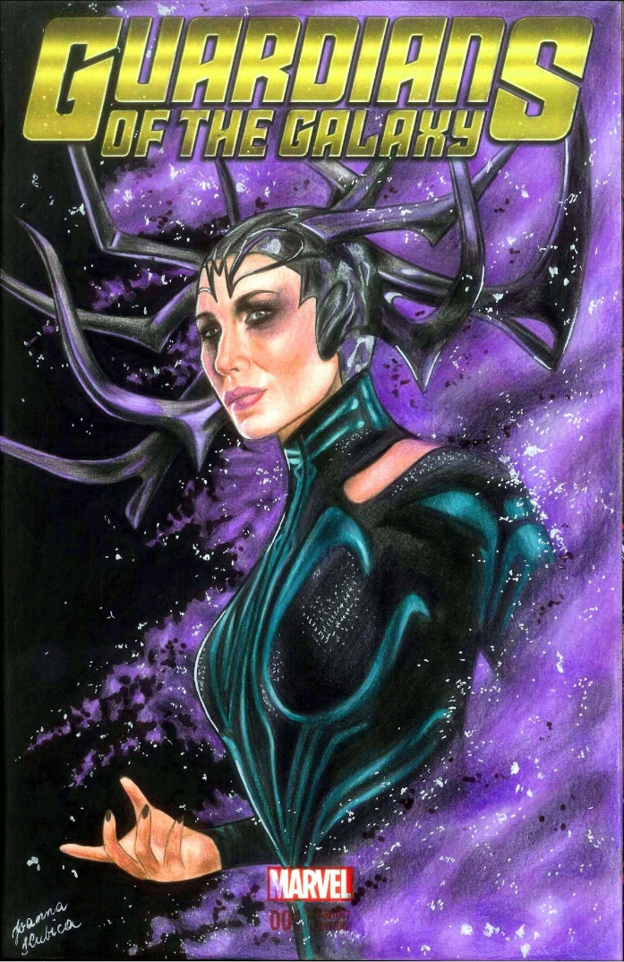
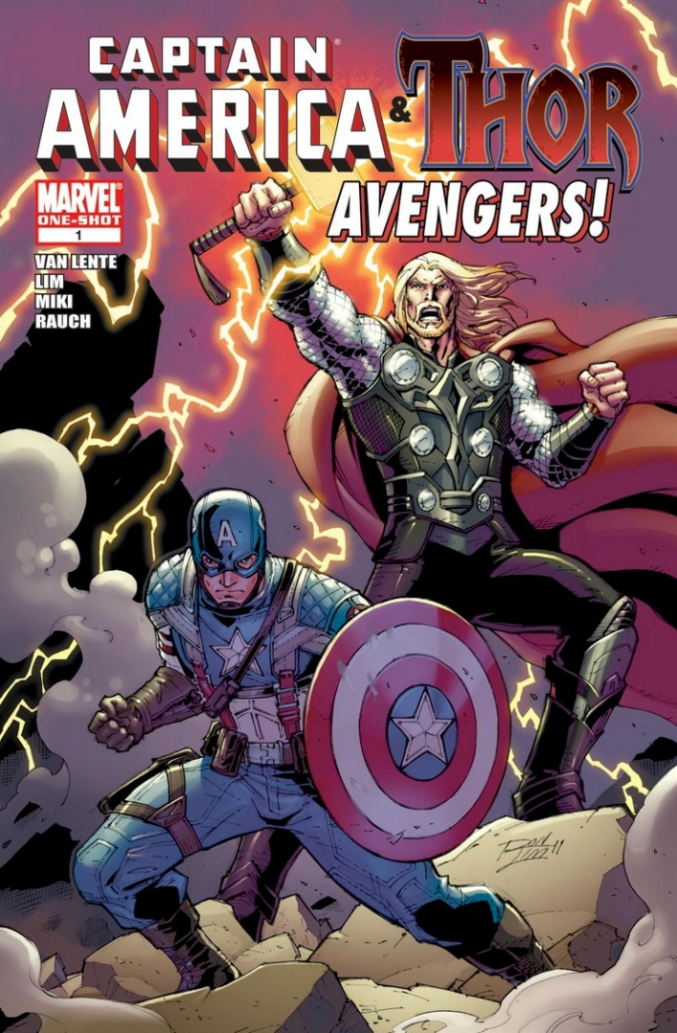
Marvel Comic Covers

Slide 2
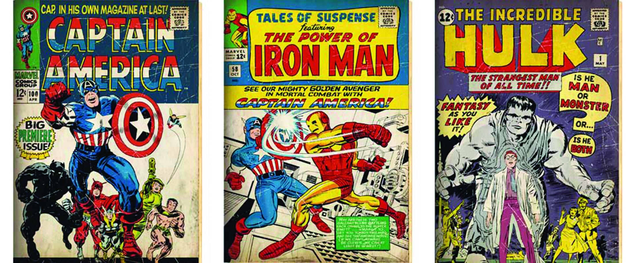
Look at the way these Marvel comic covers have been illustrated. They usually show the main superhero in action.

Slide 3
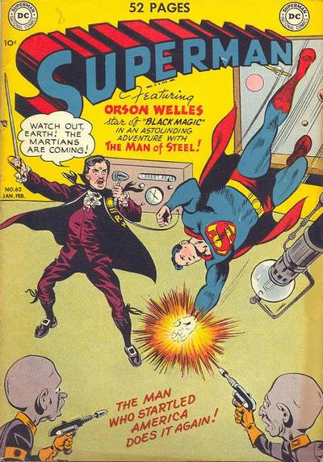
The superhero’s name is in bold lettering and usually in a well-known style.
Often a speech bubble included.
Front page action to draw the reader in!
A caption about the superhero!

Slide 4
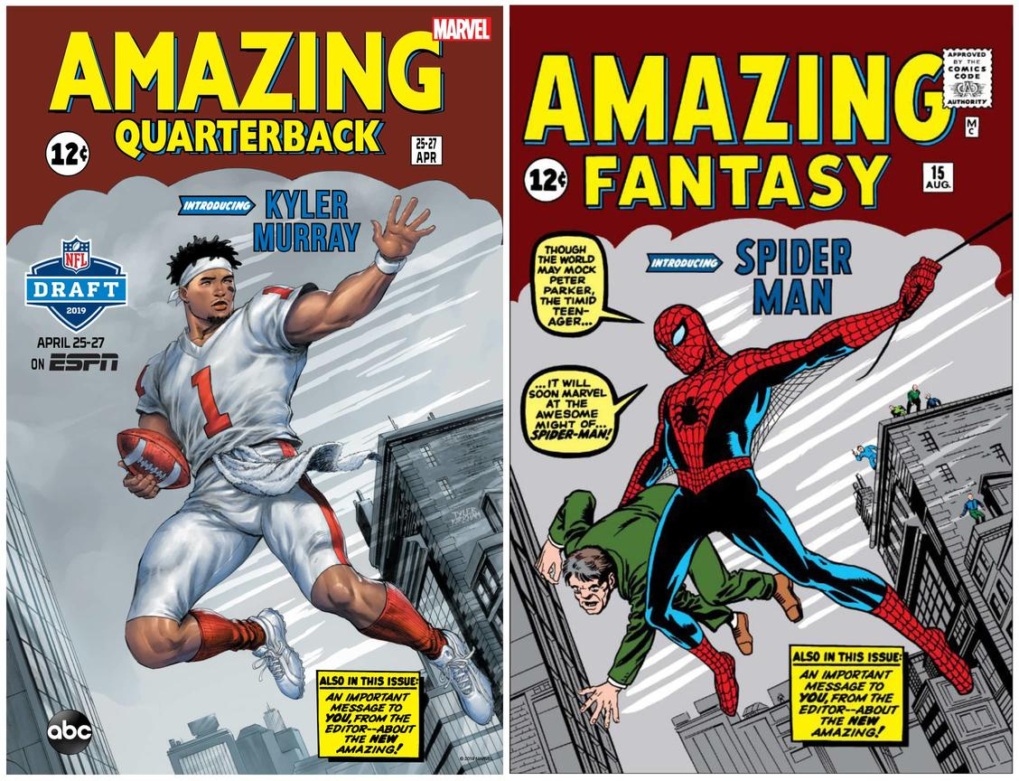
On this cover, they have included part of the story by the addition of speech between the characters.
There is also a box telling you what is inside this issue. They want entice you into buying and reading the comic.

Slide 5
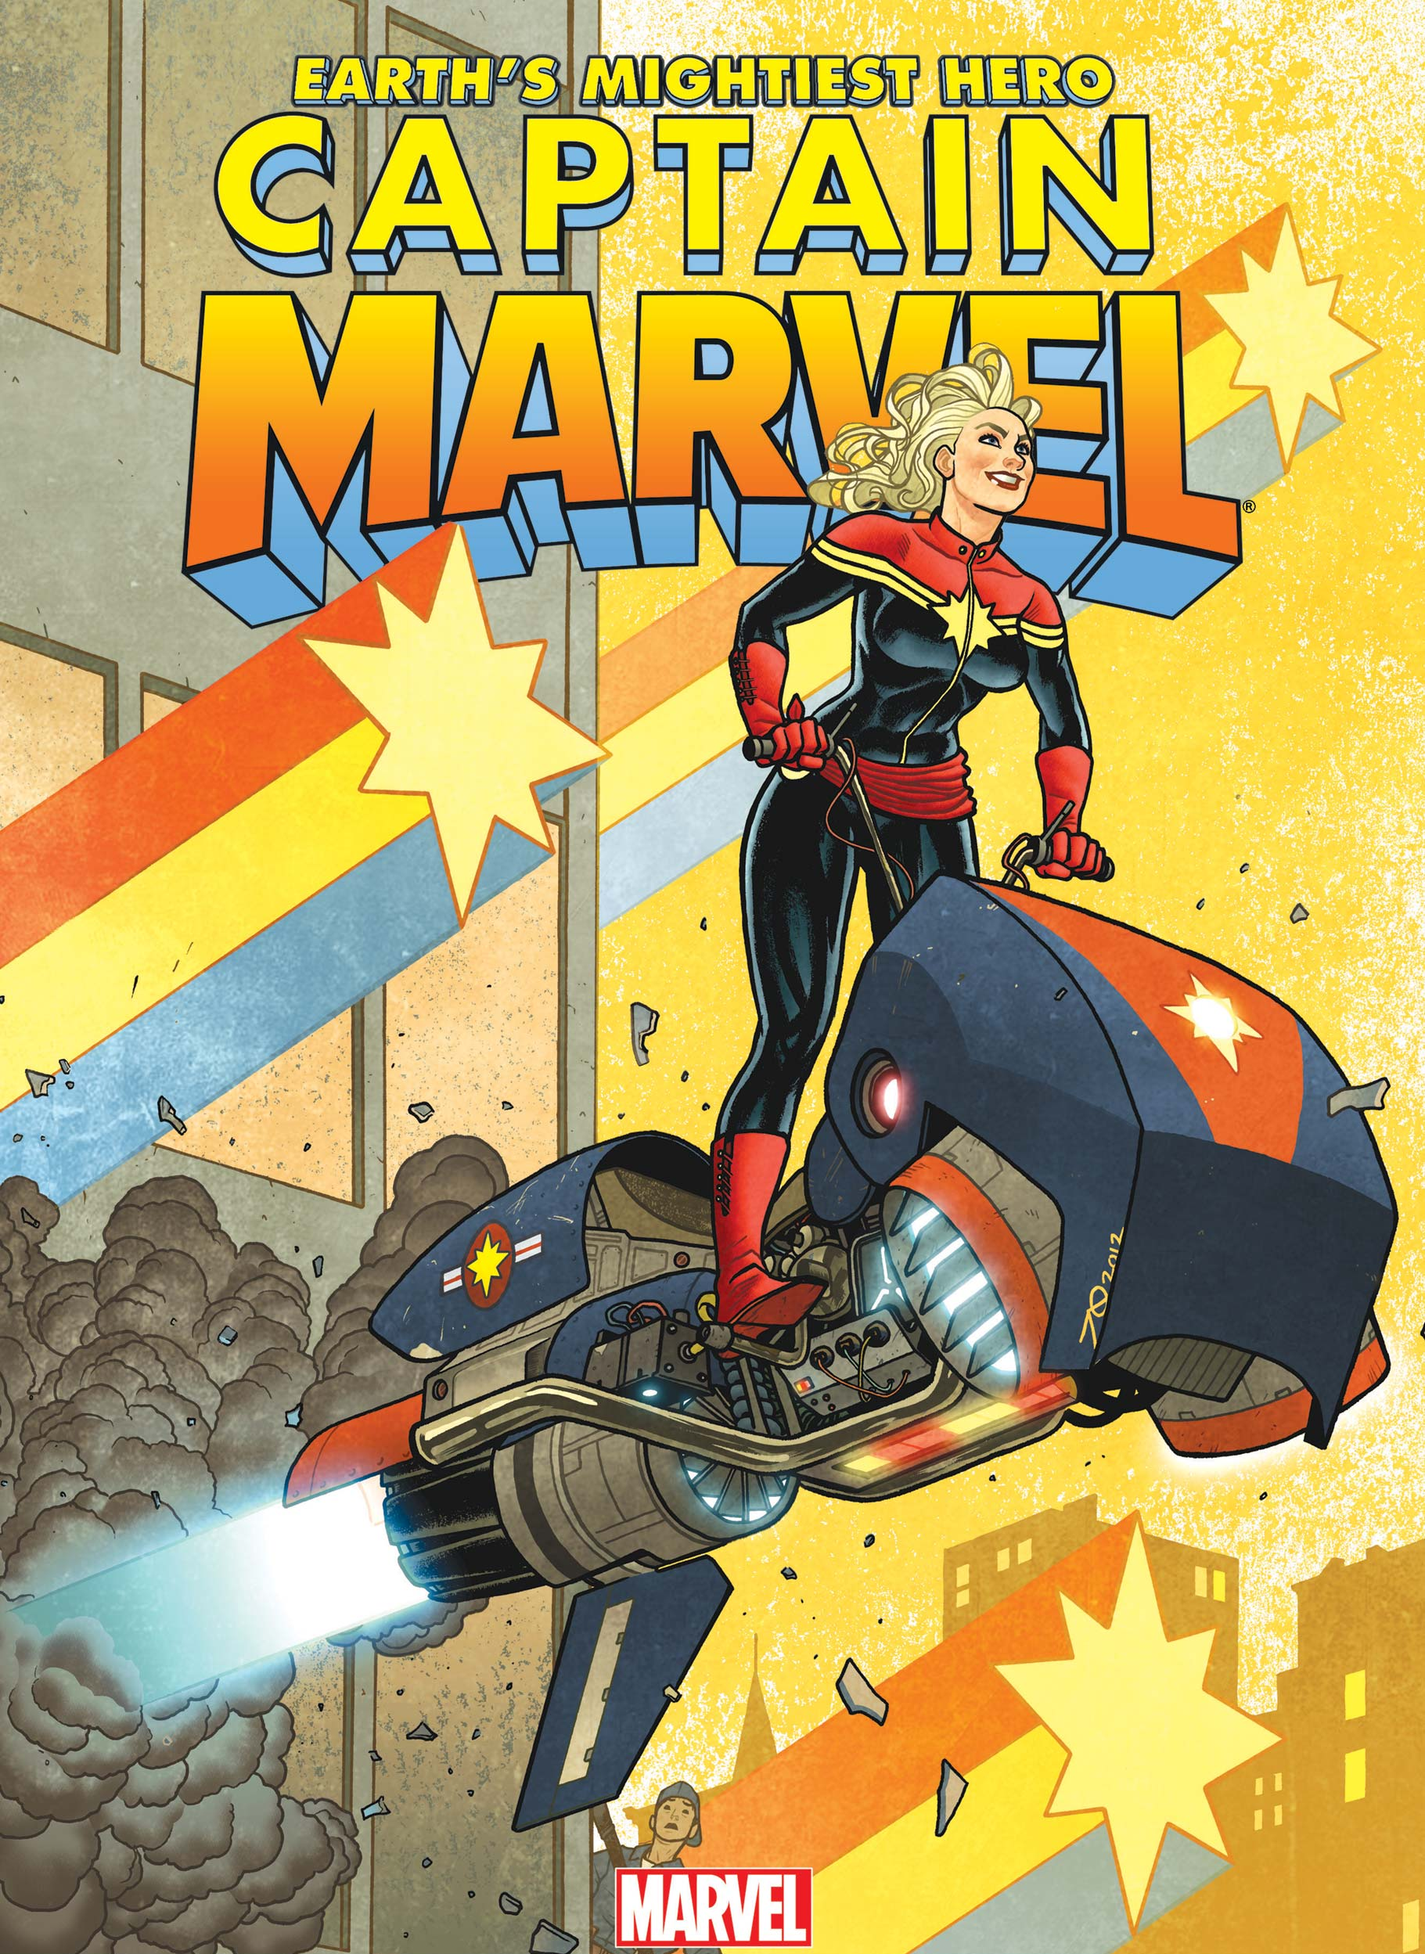
Some comic characters and their Superhero titles are used as posters to advertise the comics. These usually have less information on them. Just the name and a picture- an action picture works best.

Slide 6
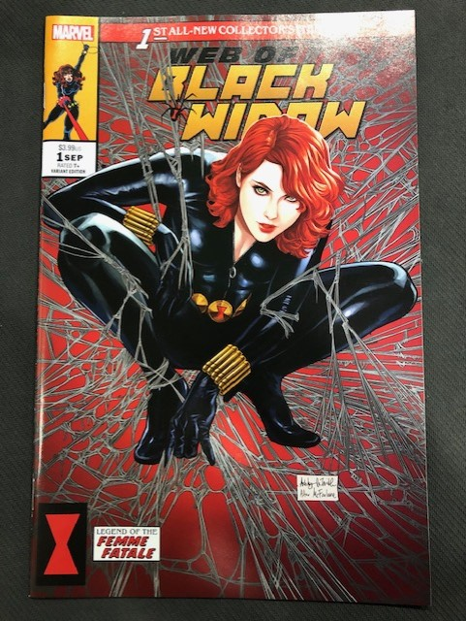
This comic cover has been designed with the image of the character, in this case Black Widow as the focus. She is surrounded by a web using spider imagery .
It also includes a symbol known to readers as the symbol of the Black Widow.

