Slide 1
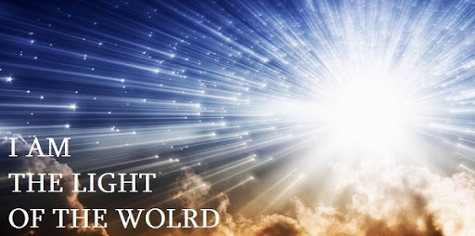

LO: To understand the symbolism of light and explore why it is a good metaphor for Jesus

Slide 2
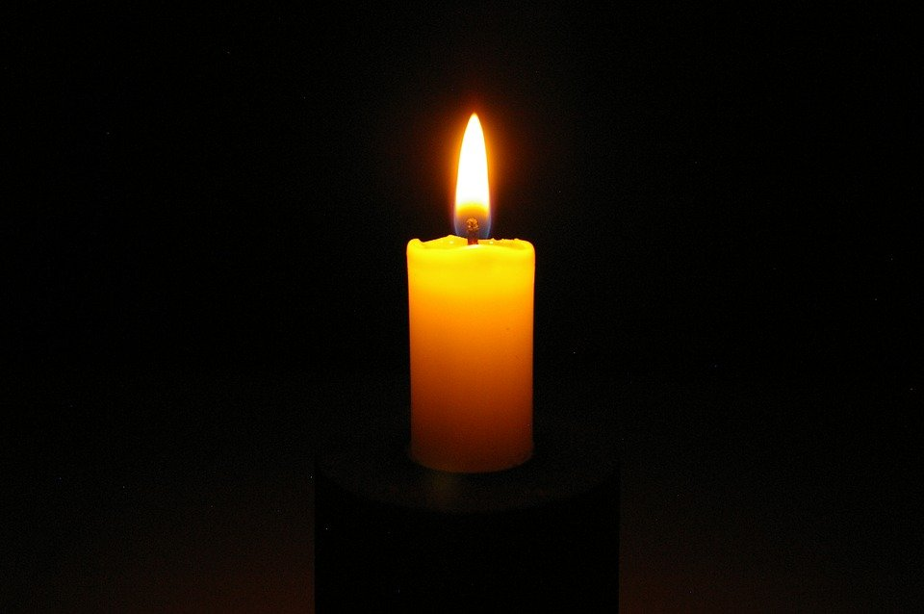
Jesus is considered to be a symbol of light and is described as the ‘Light of the Word’. What do you think is meant by this?

Slide 3
We are going to light a candle and turn off the lights – whilst the lights are off think about how our feelings change. How does it make you feel?
https://www.youtube.com/watch?v=gr5Y63bDNNg

Slide 4
Lord, the light of your love is shining
In the midst of the darkness, shining
Jesus, Light of the world, shine upon us
Set us free by the truth you now bring us
Shine on me, shine on me
Shine, Jesus, shine
Fill this land with the Father's glory
Blaze, Spirit, blaze
Set our hearts on fire
Flow, river, flow
Flood the nations with grace and mercy
Send forth your word
Lord, and let there be light
Lord, I come to your awesome presence
From the shadows into your radiance
By the blood I may enter your brightness
Search me, try me, consume all my darkness
Shine on me, shine on me
Shine, Jesus, shine
Fill this land with the Father's glory

Slide 5
Blaze, Spirit, blaze
Set our hearts on fire
Flow, river, flow
Flood the nations with grace and mercy
Send forth your word
Lord, and let there be light
As we gaze on your kingly brightness
So our faces display your likeness
Ever changing from glory to glory
Mirrored here may our lives tell your story
Shine on me, shine on me
Shine, Jesus, shine
Fill this land with the Father's glory
Blaze, Spirit, blaze
Set our hearts on fire
Flow, river, flow
Flood the nations with grace and mercy
Send forth your word
Lord, and let there be
Send forth your
Send forth your word
Lord, and let there
Send forth your word
Send forth your word
Lord, and let there be light

Slide 6
Light as a Simile and Metaphor
Talk to the person next to you…
What is a metaphor?
What is a simile?

Slide 7


Slide 8

Jesus guides people’s way like a light
Is this a simile or a metaphor?

Slide 9

Jesus is a bright light in the darkness
Is this a simile or a metaphor?

Slide 10
J"I am the light of the world. Whoever follows me will never walk in darkness, but will have the light of life."
Why do you think Jesus is a symbolism of light? Can you think of a simile and metaphor to help you understand the ways in which Jesus is like a light?
Metaphor: _______________________________________________________
_______________________________________________________
Simile: _________________________________________________________
_________________________________________________________

Slide 11
How can we use Jesus’ light?
1. Share Your Faith in Christ
God takes an ordinary person and uses them to share His message to people who needed Him. When we share our faith, we spread His light. You are meant to shine!
2. Take Light Where It’s Dark
Jesus describes what we are - the light of the world, not the light of the church. That means we have to get beyond the church walls and take the light out to where it is dark.

