Slide 1
LO: To describe the features of a Christingle

Slide 2
Quick Questions!
Can you remember how we make a Christingle?
Can you name the features of a Christingle?
Why do we make Christingles?

Slide 3
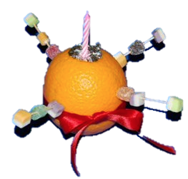
Christingle

Slide 4
Christingle
Christingle means Christ’s Light
and is a symbol of
the Christian faith.

Slide 5
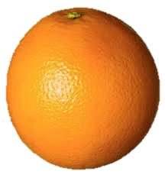

The Orange
Represents the world.

Slide 6


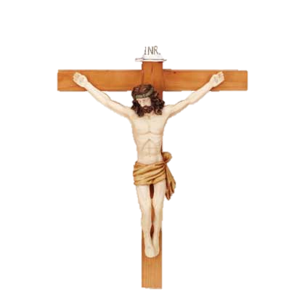
The Red Ribbon
Represents love and that Jesus died for us

Slide 7
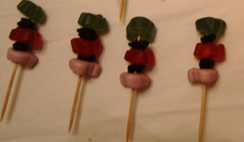
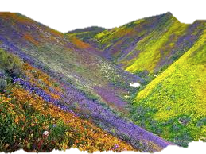
The Fruit and Sweets
Represents all of God’s creations

Slide 8
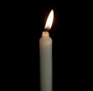
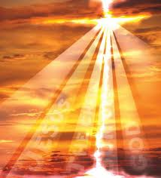
The Candle
Represents how Jesus is the Light of the World

Slide 9

The Children’s society collect money at Christingle Church Services to help children all over the country.

