Slide 1
Tuesday 5th January
LO: To understand the meaning of authority and to discuss how we know that Jesus had power and authority.

Slide 2
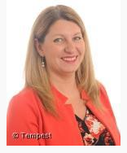
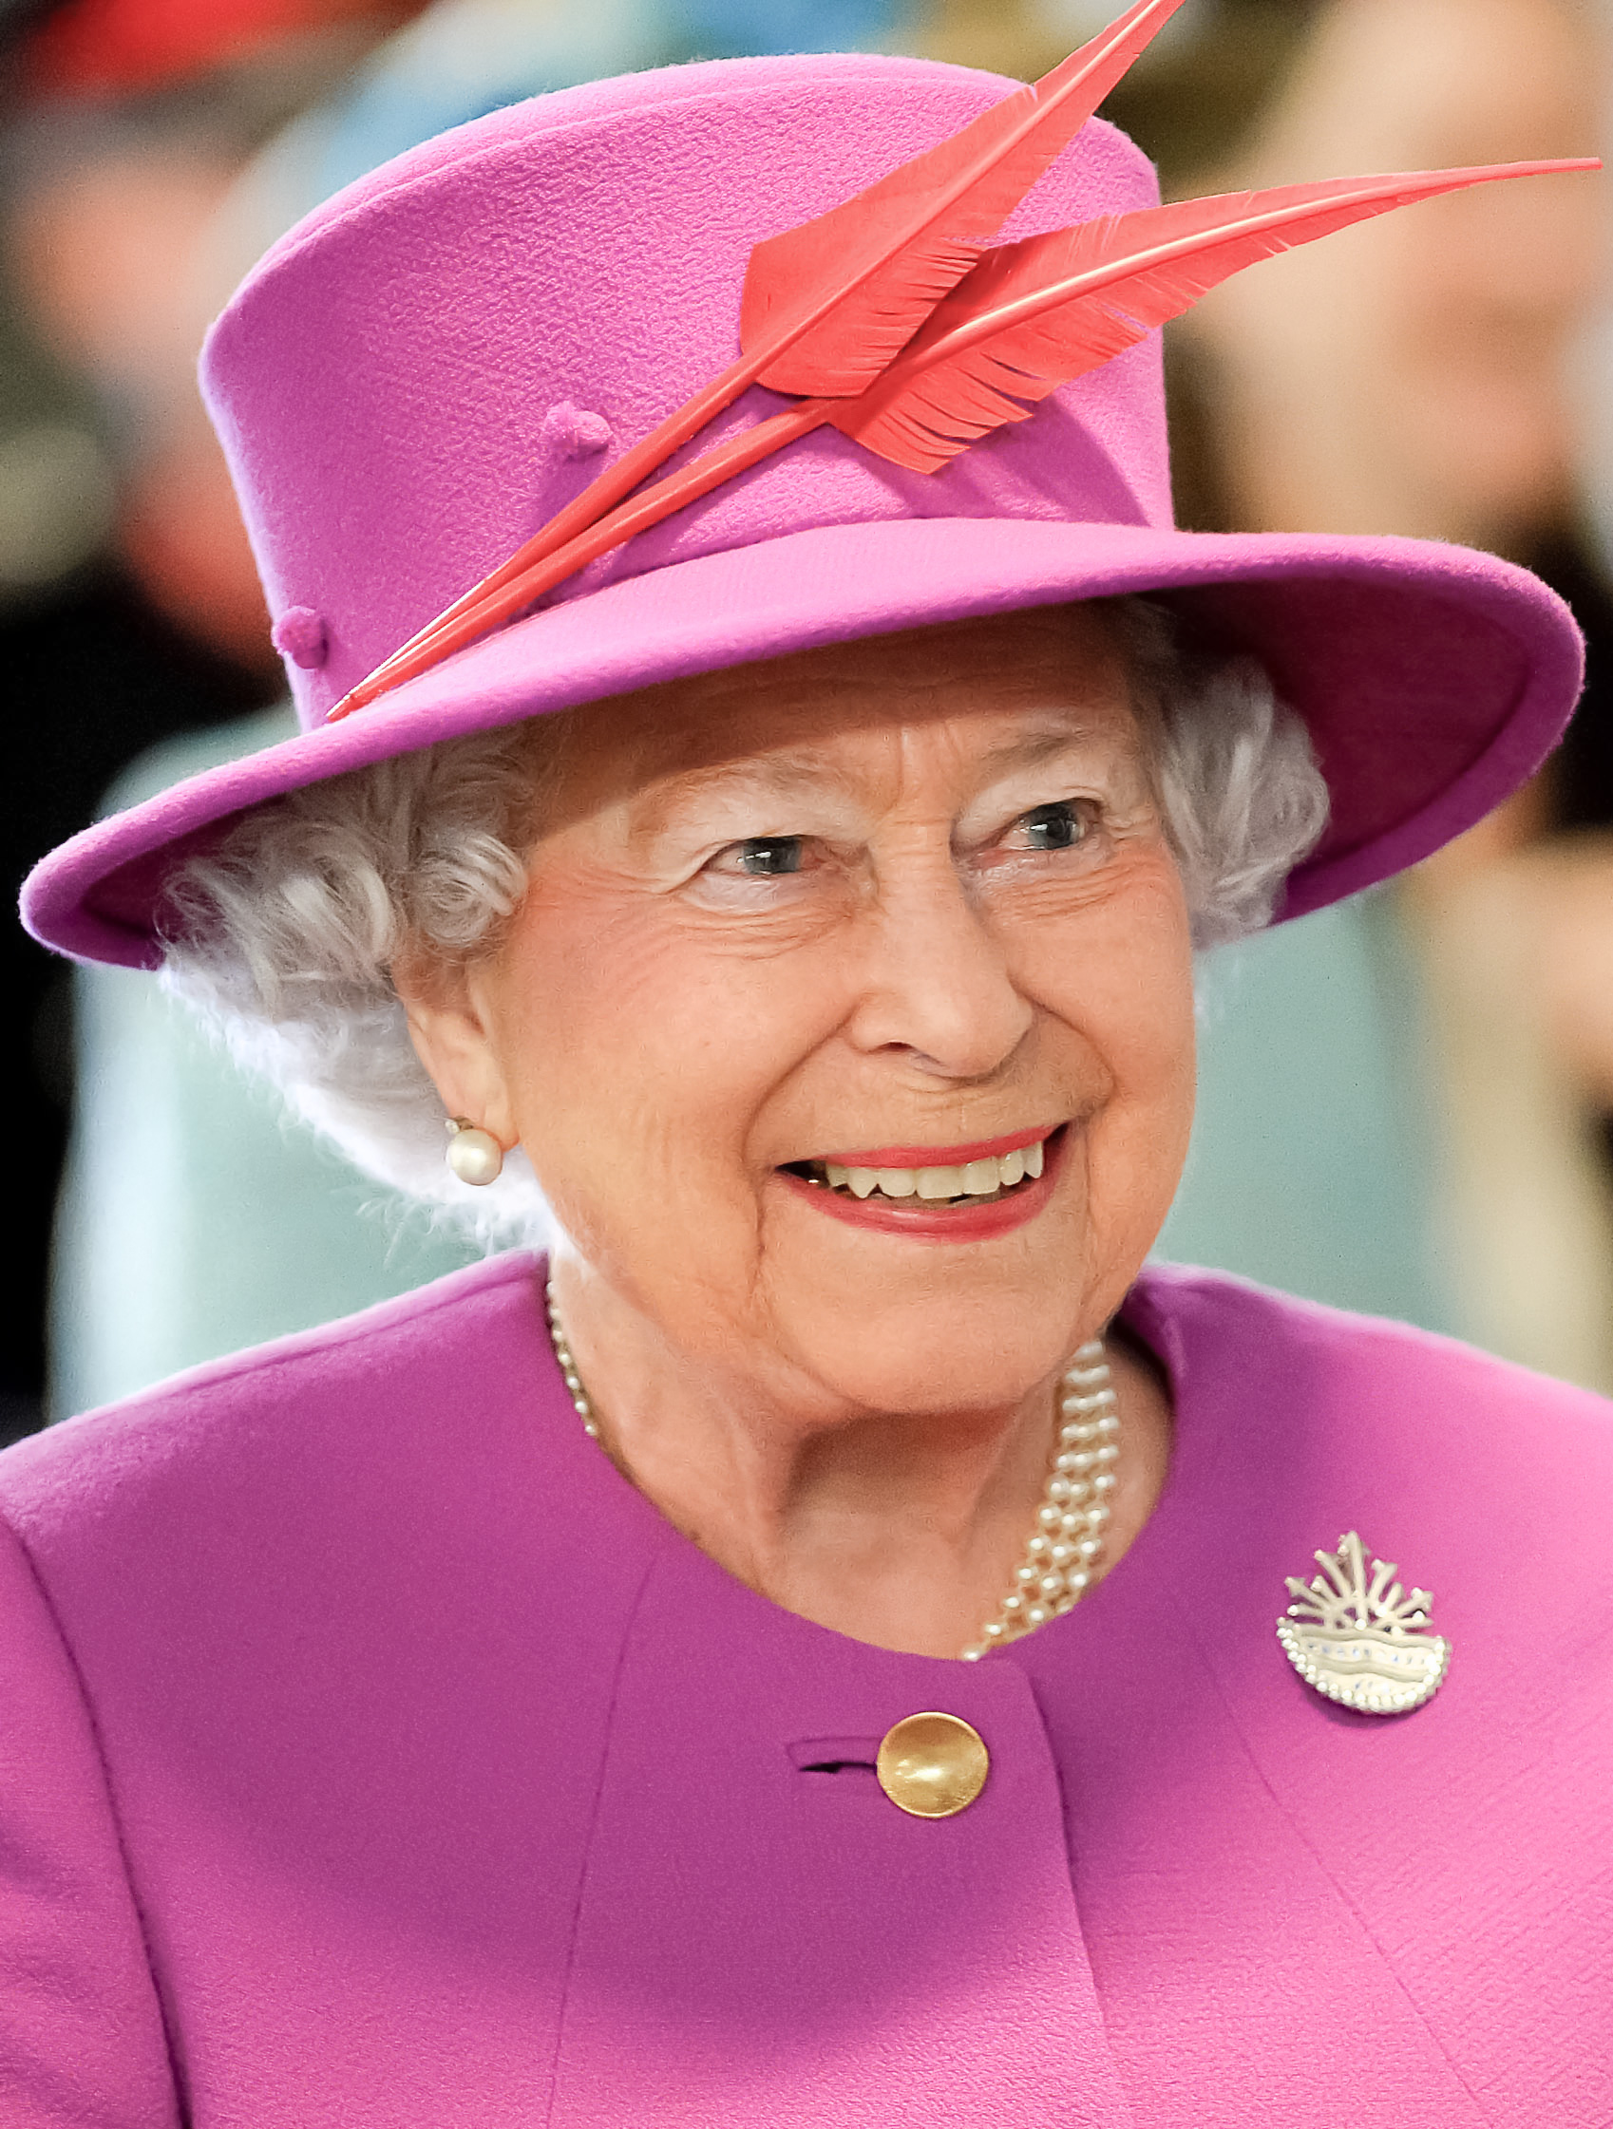
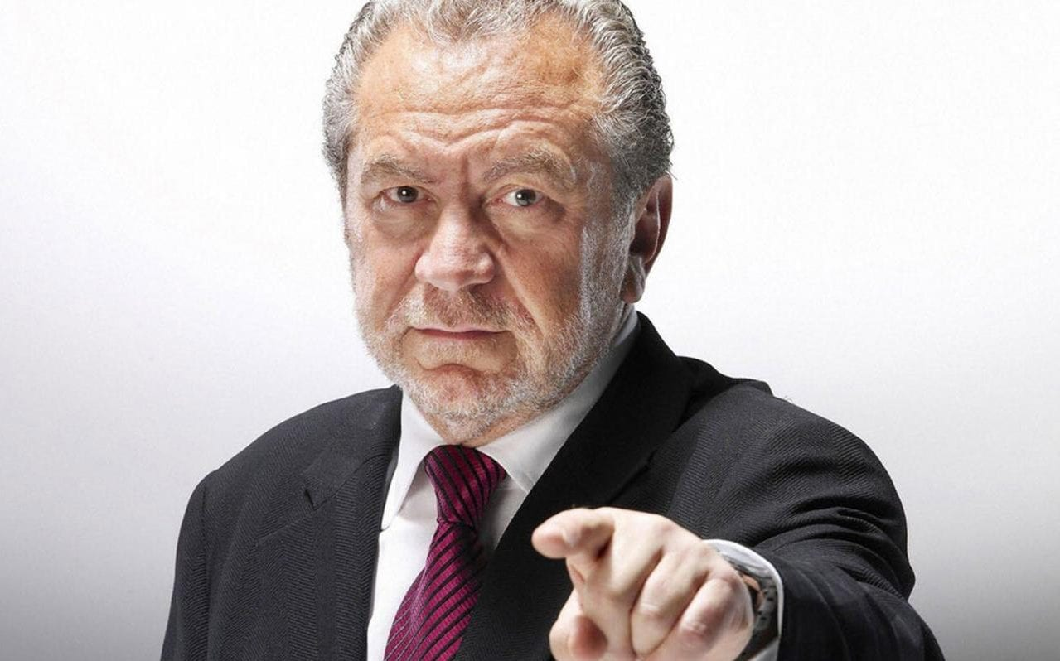
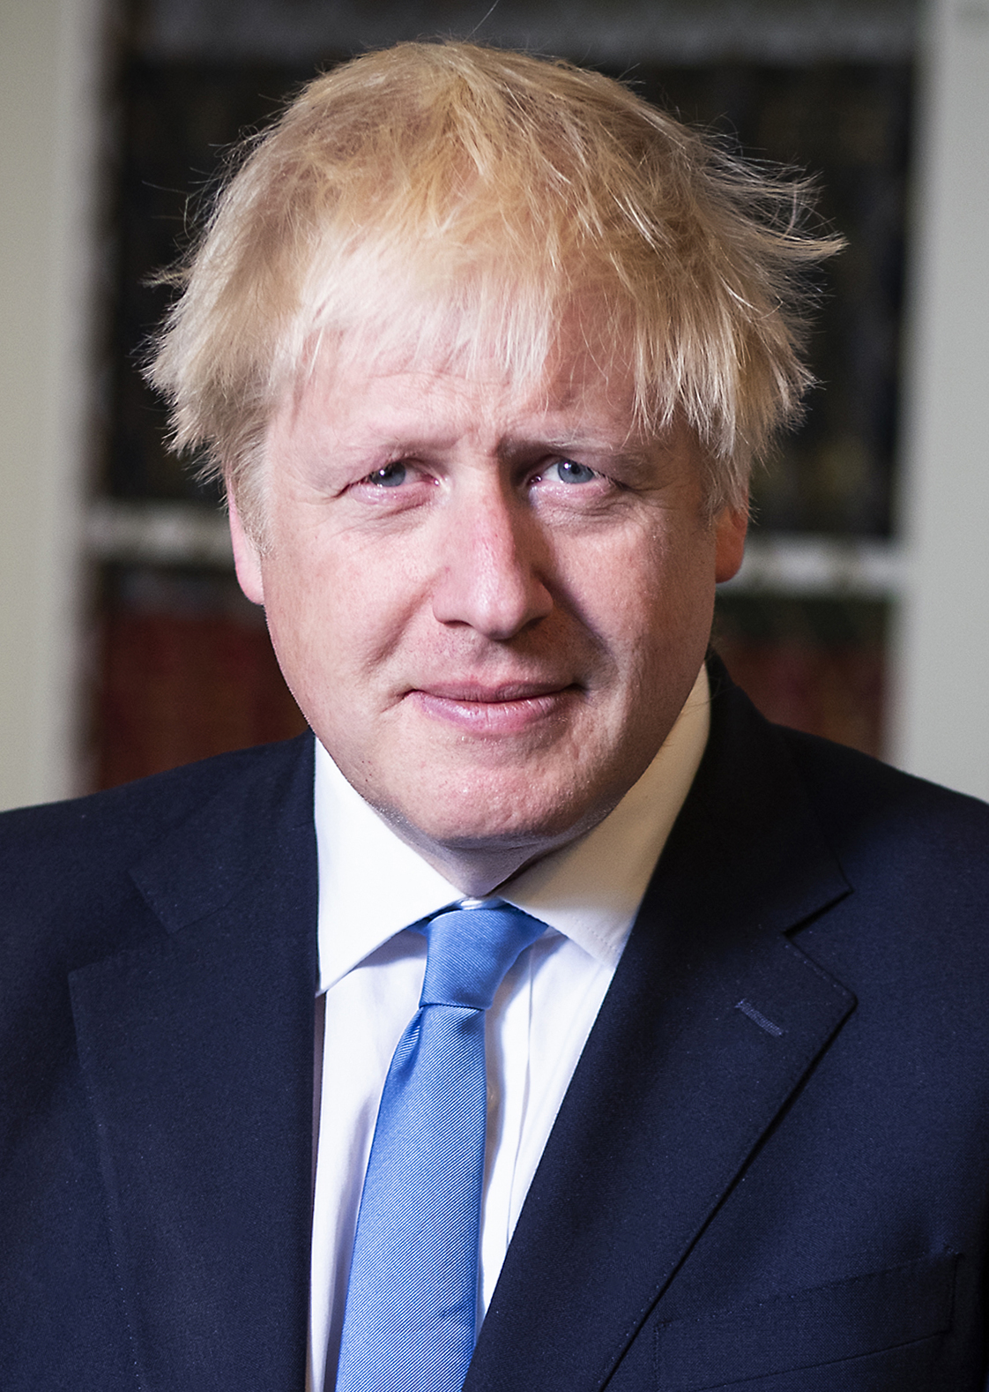
What do these people have in common? Think about how they could be similar! *Hint – think about our LO*
Mrs Edward
The Queen
Sir Alan Sugar
Boris Johnson

Slide 3
They all have authority…
In a school, a head teacher is able to make decisions that impact staff and children, they therefore are an authoritative figure.
Can you think how The Queen has authority?
Sir Alan Sugar has a television series where he holds an authoritative role as he is able to chose which contestants leave at the end of each episode!
Can you think how Boris Johnson has authority?

Slide 4
Task One
What does the word ‘authority’ mean to you? Can you think of somebody who has authority?

Slide 5
Authority is the power or right to give orders, make decisions, and enforce obedience.
Task Two
Definition of authority:

Slide 6
Task Three
Read the Bible extract ‘Jesus Walks on Water’ (Matthew 14:22- 25) whilst listening, think about how Jesus has power and authority – does he have power over the sea? The elements?

Slide 7
Jesus Walks on the Water (Matthew 14:22 – 25)
²² Immediately Jesus made the disciples get into the boat and go on ahead of him to the other side, while he dismissed the crowd. ²³ After he had dismissed them, he went up on a mountainside by himself to pray. Later that night, he was there alone, ²⁴ and the boat was already a considerable distance from land, buffeted by the waves because the wind was against it.
²⁵ Shortly before dawn Jesus went out to them, walking on the lake. ²⁶ When the disciples saw him walking on the lake, they were terrified. “It’s a ghost,” they said, and cried out in fear.

Slide 8
²⁷ But Jesus immediately said to them: “Take courage! It is I. Don’t be afraid.”
²⁸ “Lord, if it’s you,” Peter replied, “tell me to come to you on the water.”
²⁹ “Come,” he said.
Then Peter got down out of the boat, walked on the water and came toward Jesus. ³⁰ But when he saw the wind, he was afraid and, beginning to sink, cried out, “Lord, save me!”
³¹ Immediately Jesus reached out his hand and caught him. “You of little faith,” he said, “why did you doubt?”
³² And when they climbed into the boat, the wind died down. ³³ Then those who were in the boat worshiped him, saying, “Truly you are the Son of God.”

Slide 9
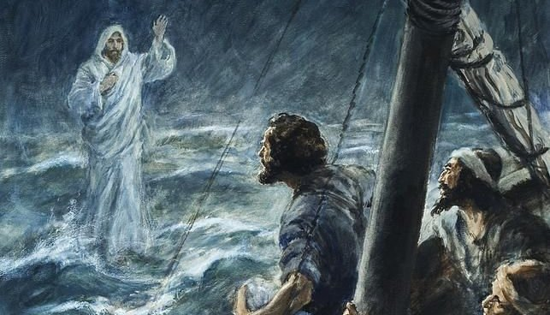
When they had crossed over, they landed at Gennesaret. ³⁵ And when the men of that place recognized Jesus, they sent word to all the surrounding country. People brought all their sick to him ³⁶ and begged him to let the sick just touch the edge of his cloak, and all who touched it were healed.

Slide 10
Final task
After reading the Bible extract, think carefully and answer the following question:
How was Jesus able to walk on water but Peter was not?
How did he use his authority to command the sea?
Consider why those on the boat said “Truly you are the Son of God.”

Slide 11
Extension
Can you think of any other stories that provide evidence of Jesus having power and authority?

