Slide 1
PSHE and Citizenship
Health and Wellbeing | Safety First
PSHE and Citizenship | Year 4 | Health and Wellbeing | Safety First | New Responsibilities | Lesson 1

Slide 3
Aim
I can be responsible for making good choices to stay safe and healthy.
Success Criteria
I can name some things I can now do independently.
I can discuss my responsibilities.
I can identify who is responsible for helping to keep me safe
and healthy.
This resource is fully in line with the Learning Outcomes and Core Themes outlined in the PSHE Association Programme of Study.

Slide 4

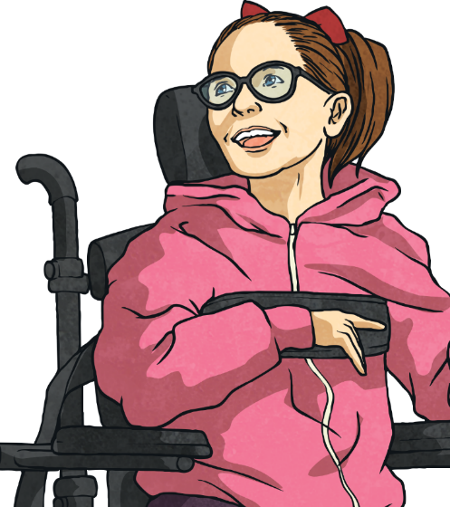
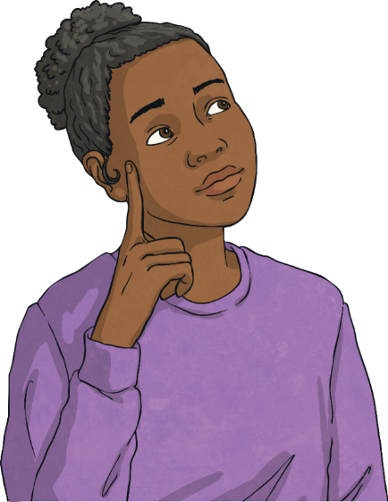
The Big Questions
How are we becoming more independent now we are growing older?
What new responsibilities do we have as we get older?

Slide 5
Reconnecting

Slide 6

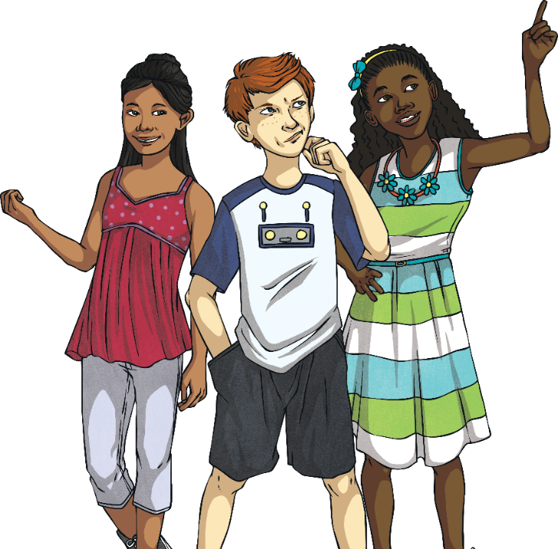
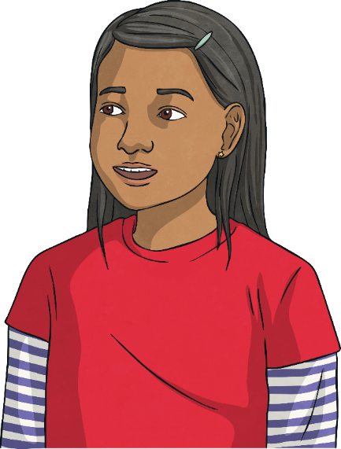
I Am Independent
What can you think of that you used to need more help with but that you can now do all by yourself? Let’s go around the class and share ideas of things we do independently.
Being independent means being able to do things for yourself or by yourself.
Does anyone know what being independent means?
As we get older,
we can do more and more things on our own – things we used to need a lot of help with.

Slide 7
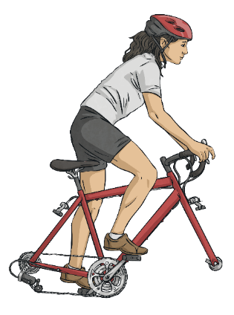
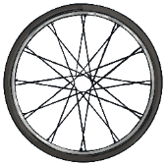
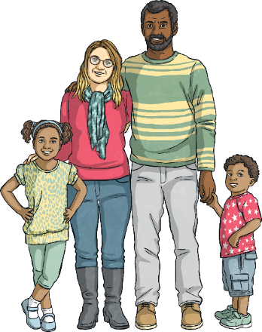
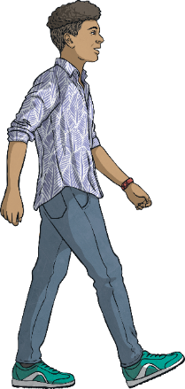
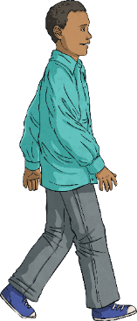

I Am Independent
Part of becoming more independent includes looking after ourselves and staying safe and healthy.
As babies and very young children, we need
looking after all the time by our parents or
carers. They make sure we are not in risky
situations and that we are safe from
potential dangers or hazards.
As we grow older, we learn about risks, dangers and hazards so that we can look out for them and take care of ourselves and others.

Slide 8
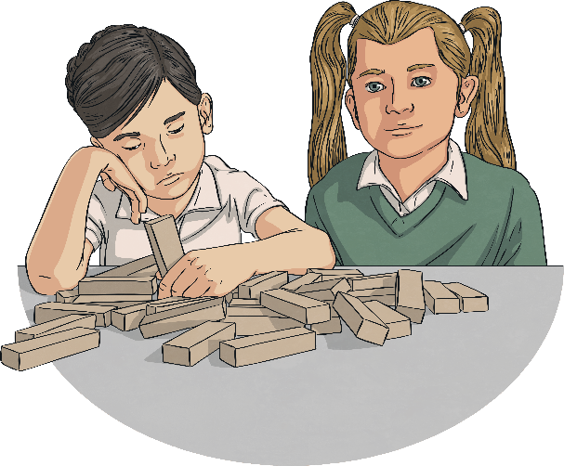
I Am Independent
As we become more independent and take care of ourselves more, we need to learn to speak out about things that worry or upset us, or make us feel uncomfortable.
This might include something we have done, something someone has said or done to us or a problem we have at school. It is important to tell a trusted adult about concerns you have, even if that concern is about another adult.
It is our responsibility to ask for advice or get help if we feel unsafe.
If you ask for help and nothing happens, ask again or ask
someone different.

Slide 9
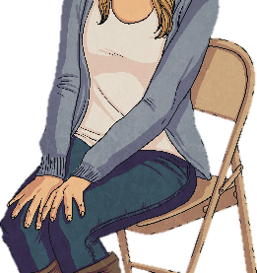
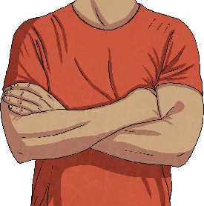
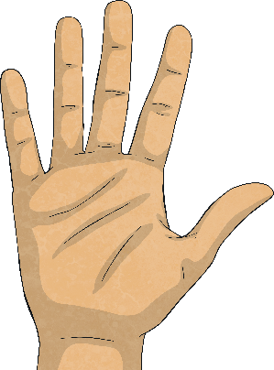
I Am Independent
Remember - your body belongs to you and you are in charge of what happens to it. If someone ever tries to touch you in a place on your body that you are not comfortable with, or in a way that does not feel right, you must tell them to stop, say it is not appropriate and push
them away.
You should then tell a trusted adult straight away so that it doesn't happen again. It's never your fault if somebody touches you in a way that makes you feel uncomfortable, and it's very important that you tell someone so that they can help to keep you safe.

Slide 10
Exploring

Slide 11
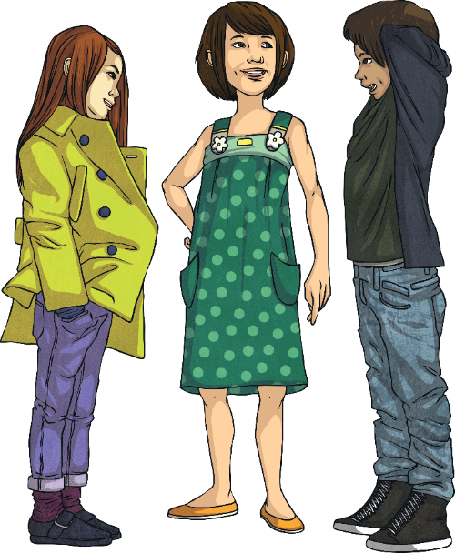
Different Responsibilities
Our responsibilities might depend on our family, our culture, our ability to do something, our age and our experience.
Different people have different responsibilities.
Have a think about whether their responsibilities are similar to yours or very different
Let’s take a look at some children and their responsibilities.

Slide 12
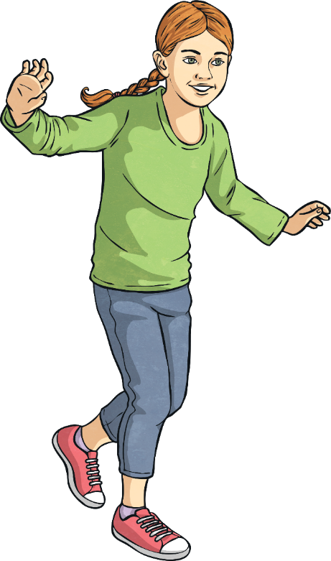
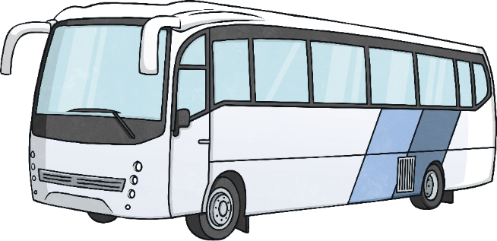
Different Responsibilities
This is Fran. She has a condition called diabetes. Fran has to be careful that her
sugar levels don’t get too high.
When she goes on a school trip, Fran has to make sure she has a snack on the long
coach journey.
What are Fran’s responsibilities?
She also has to make sure she gets up and takes her insulin injection at the right time
if she sleeps over at a friend’s house.
Fran has the responsibility to look after herself with the help of adults, like doctors and her parents, when she needs them.

Slide 13
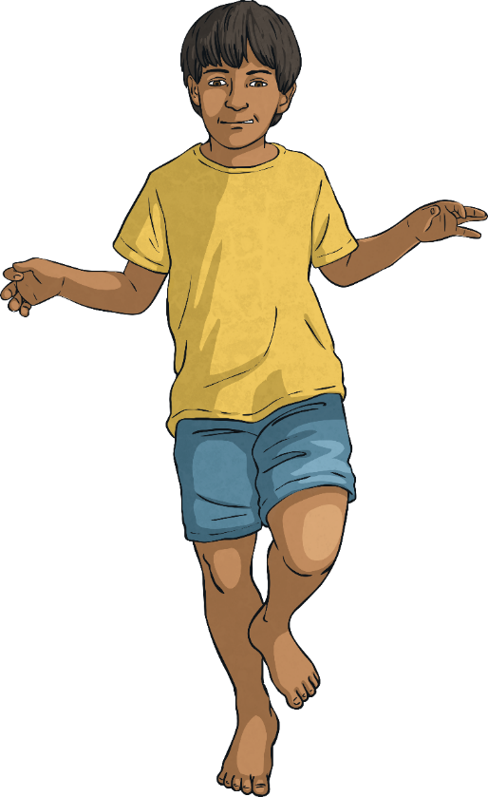
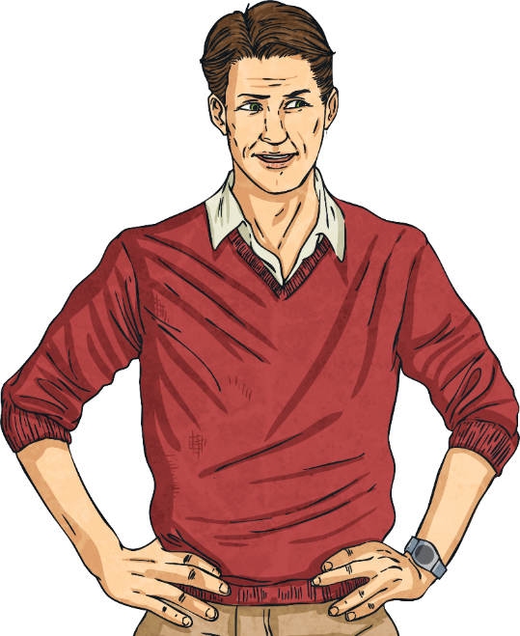
Different Responsibilities
This is Elio. He lives with his dad and his gran. Elio’s Dad works early morning shifts and has to leave at three o’clock in the morning.
What are Elio’s responsibilities?
Elio’s gran is not very well so she can’t really look after him. Every morning, Elio gets himself up and ready for school, makes breakfast for himself and his gran then walks to school on his own.
Sometimes, Elio meets one of his friends on the way. It isn't far but he does have to cross three roads.

Slide 14
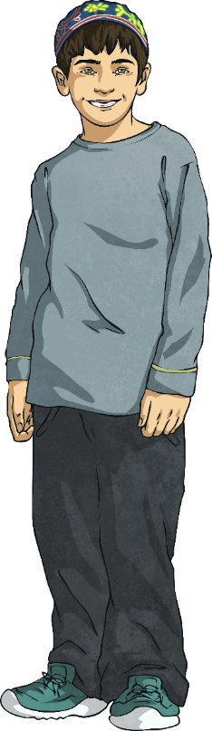
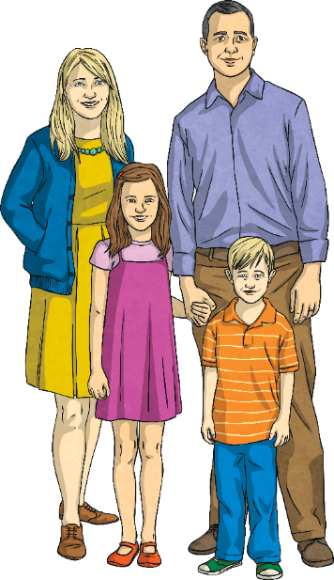
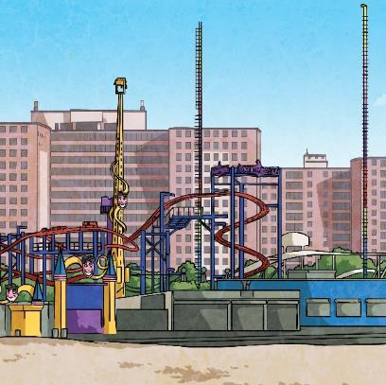
Different Responsibilities
This is Scotty. Scotty’s family travel around quite a lot, as they set up funfairs in
different towns.
What are Scotty’s responsibilities?
Scotty helps set up the stalls and rides, which involves using certain tools and doing some heavy lifting.
Scotty watches the adults to see how to do it and listens to the instructions they give him so that he stays safe.

Slide 15
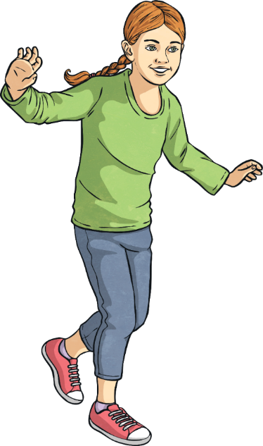


Different Responsibilities
Some responsibilities might seem challenging at first but with experience and maturity, we get more confident and can look after ourselves and others.
Some people have greater responsibilities than others. The older we get and the more independent we get, the more responsibilities we take on.

Slide 16
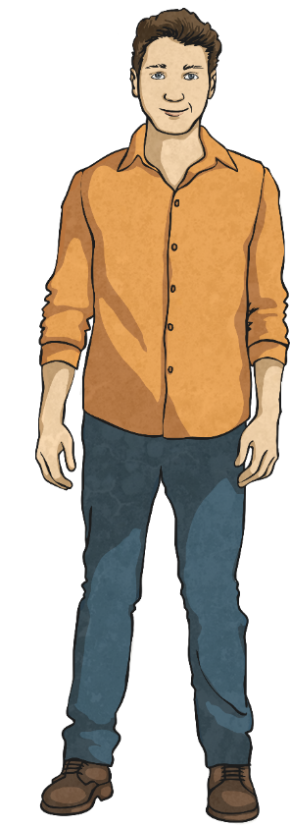
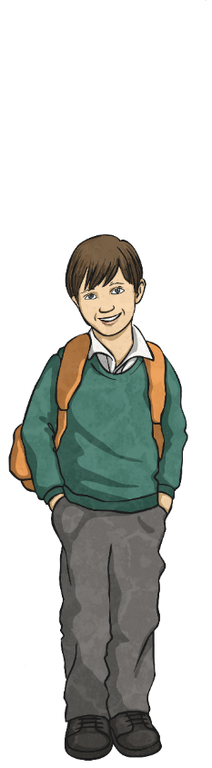
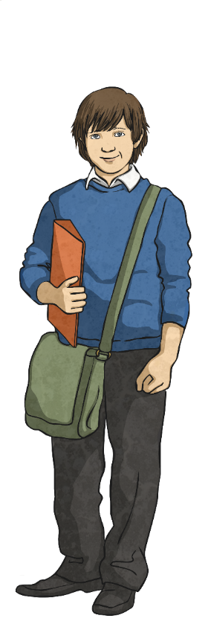
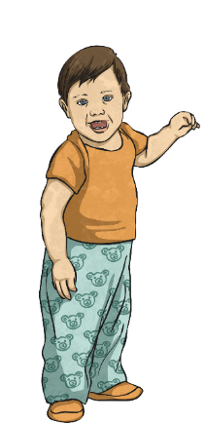
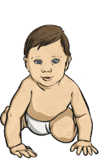
Choices and Consequences
As we get older, we have the responsibility to make good choices.
Did you know that the choices and decisions we make can lead to certain consequences?
If we decide to do or not do something, then the outcome will be affected by that decision.
For example, if we choose to consume sweet, sugary food and drinks all the time, then we might find that the consequence of that choice is that we suffer with tooth decay.

Slide 17
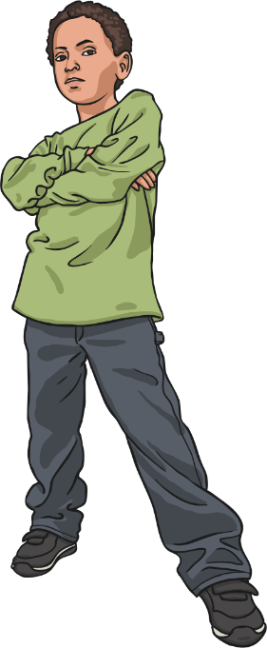
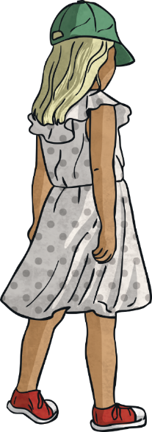
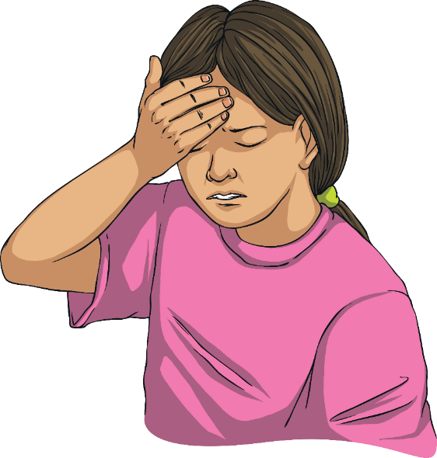
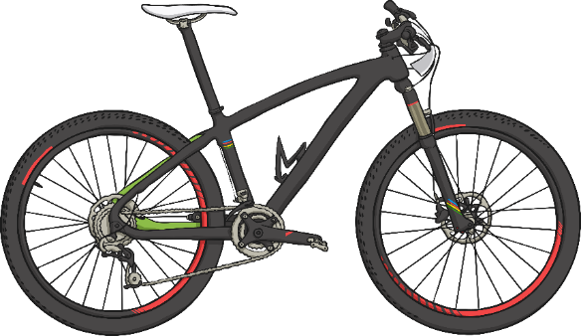
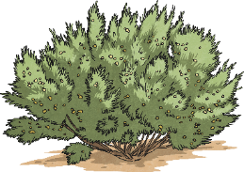
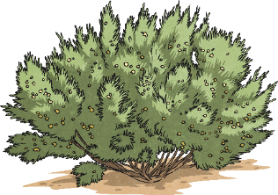
Choices and Consequences
What do you think the consequences of these children’s choices might be?
I’m going to play at the park with the older kids but I’m not telling my parents.
I’m going for a bike ride but I’m not wearing a helmet.
I have a headache so I’m going to
get myself
some medicine.

Slide 18
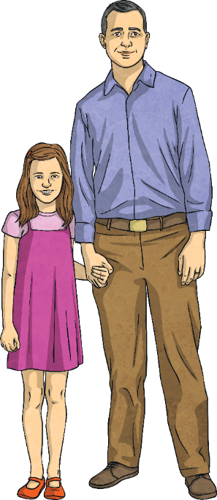
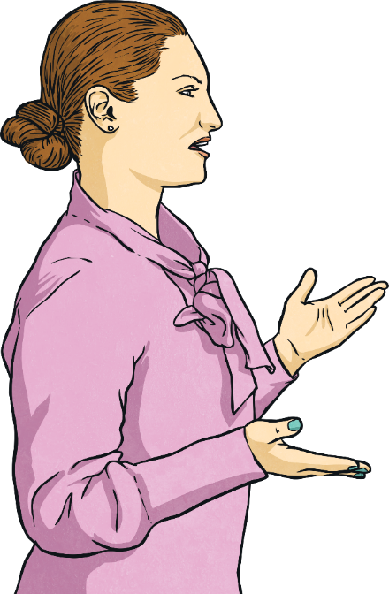
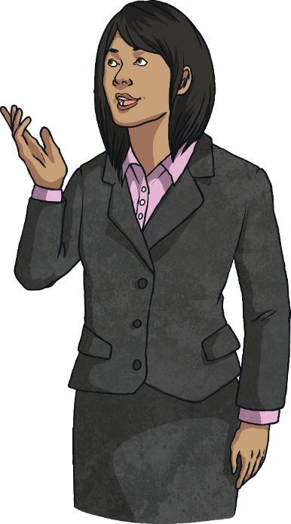
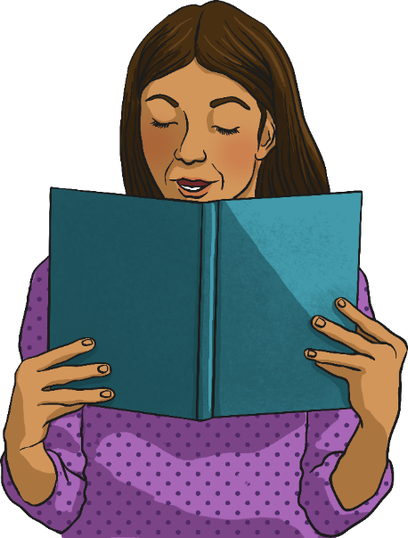
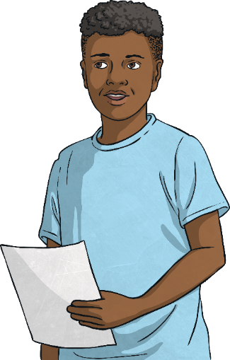

Acting Responsibly
What do you think acting responsibly means?
We can all choose to act responsibly. To act responsibly, there are a few important things we need to do.
Listen to and
follow instructions.
Ask for advice if we are unsure of what to do.
Be aware of and stick to the rules.
Know who can help us and ask for help when we need it.
RULES
BOOK

Slide 19
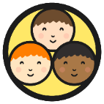
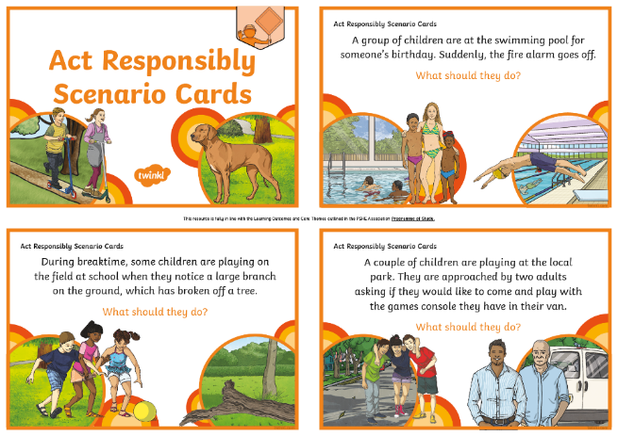
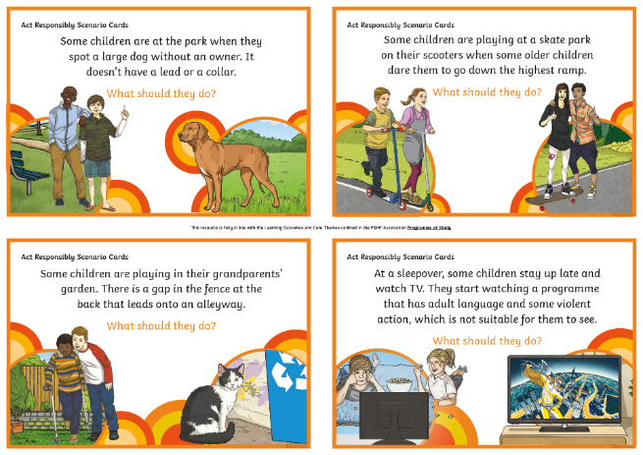
Acting Responsibly
In your groups, you are going to be looking at some scenarios and thinking about how you could act responsibly in the situation given.
Discuss what you would do then act it out!
Remember, acting responsibly means thinking about the choices you have and the consequences of those choices. Consider an action that will lead to a safe outcome.

Slide 20
Acting Responsibly
Consolidating
Reflecting

Slide 21
Consolidating

Slide 22
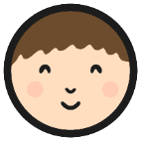
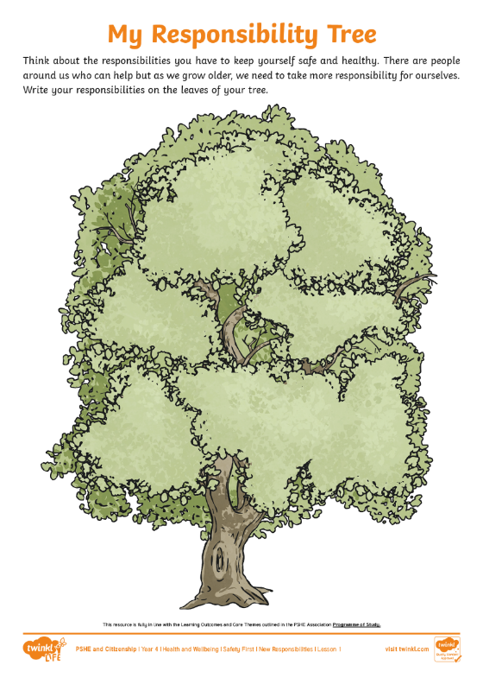
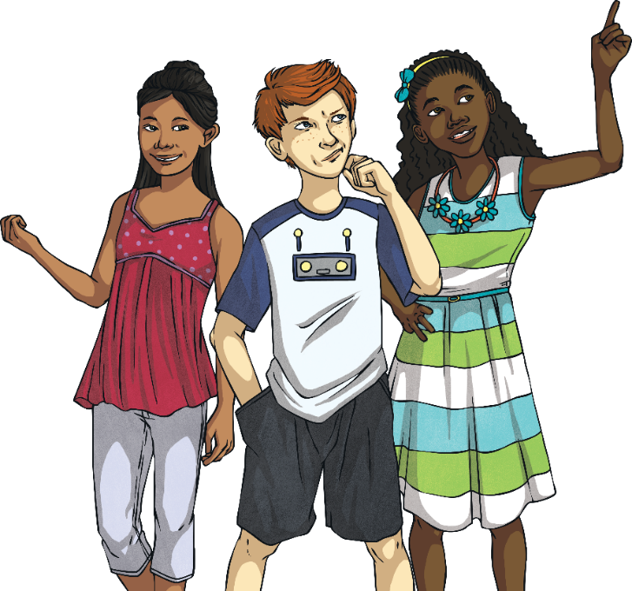
My Responsibility Tree
On your Responsibility Tree, write down any responsibilities you have.
We all have different responsibilities in our lives. We can take responsibility
for ourselves and we might have responsibilities for others as we get older.

Slide 23
Reflecting

Slide 24
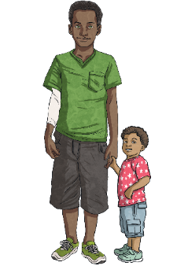
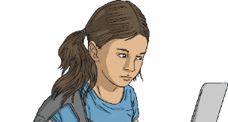

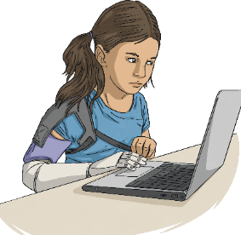
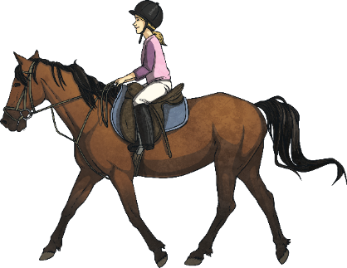
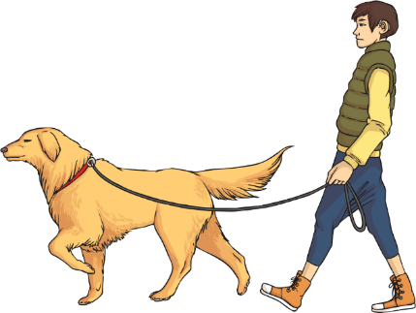
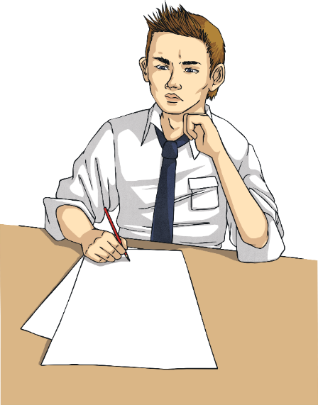

Looking Ahead
Some of you might not have
many responsibilities right now. Some of you might already have quite a lot of responsibilities.
With your partner, think of three things you are likely to have responsibility for over the next few years.
These responsibilities could be at
home or at school. They could
be specific family or health responsibilities or everyday responsibilities that lots of
people have.

Slide 25


The Big Questions
How are we becoming more independent now we are growing older?
What new responsibilities do we have as we get older?
What have you learnt today that will help you in everyday life?

Slide 26
Aim
I can be responsible for making good choices, to stay safe and healthy.
Success Criteria
I can name some things I can now do independently.
I can discuss my responsibilities.
I can identify who is responsible for helping to keep me safe and healthy.
This resource is fully in line with the Learning Outcomes and Core Themes outlined in the PSHE Association Programme of Study.

