Slide 1
LO:
To understand what causes tooth decay and how I can prevent it.
To carry out a fair test.

Slide 2
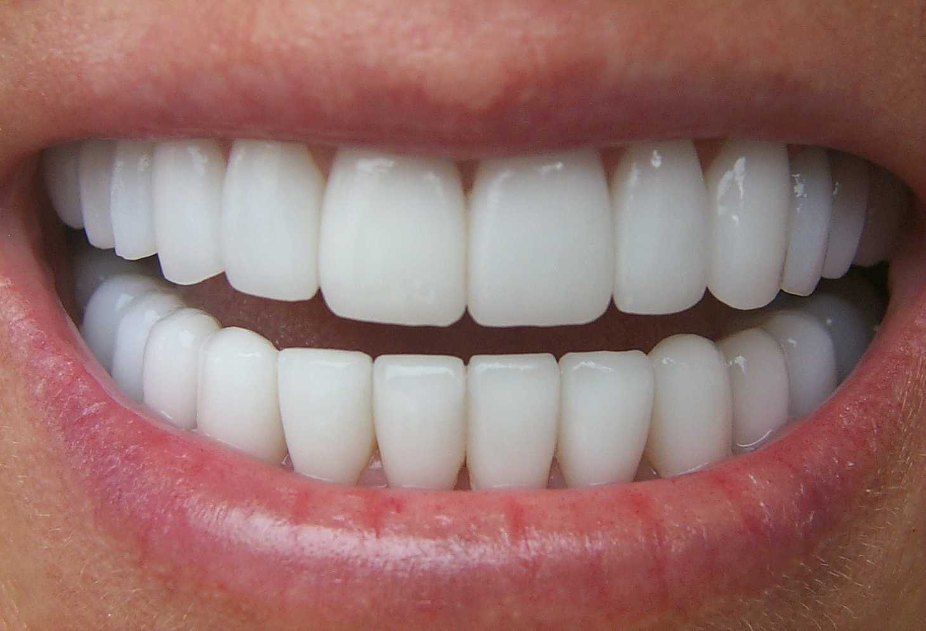
SCIENCE – TEETH!
Let’s recap!

Slide 3
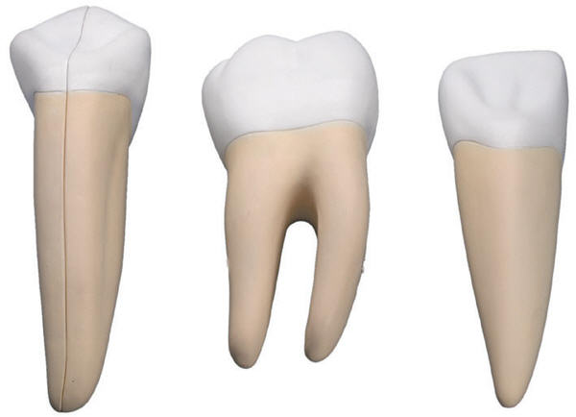
Can you remember the different types of teeth?
Which teeth would a carnivore need most and why?
Which teeth would a herbivore need most and why?

Slide 4
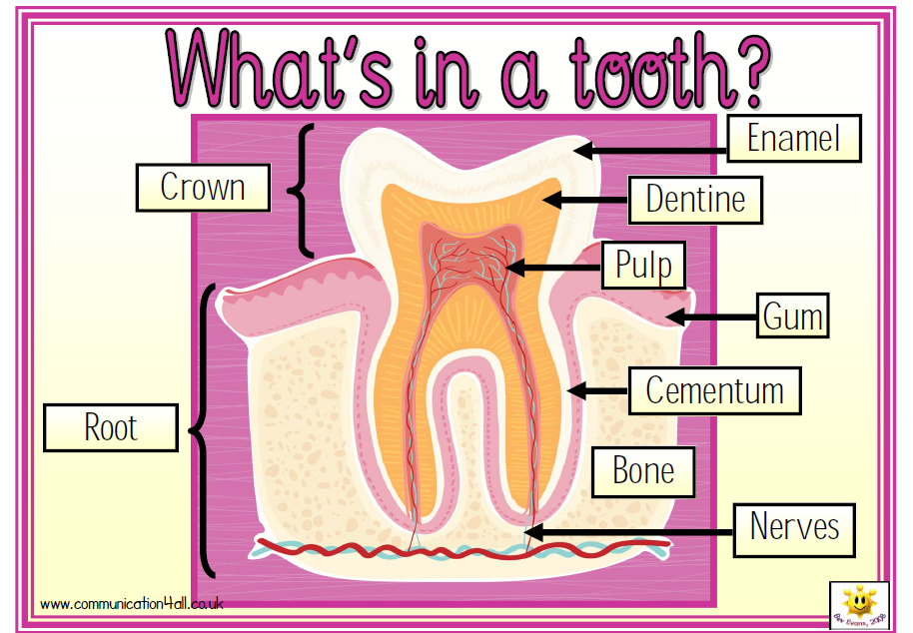

Slide 5
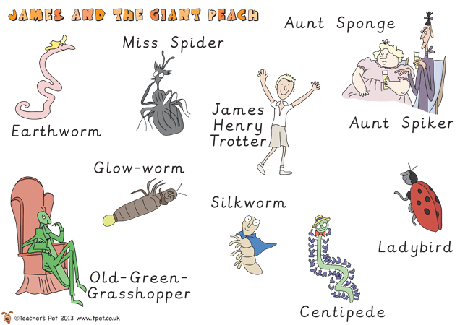
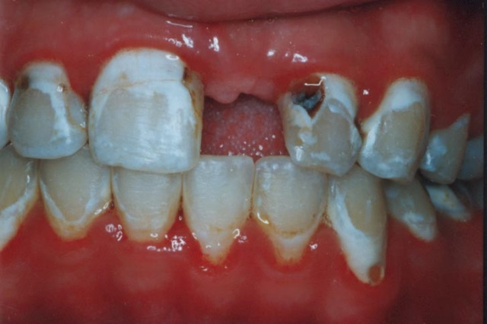
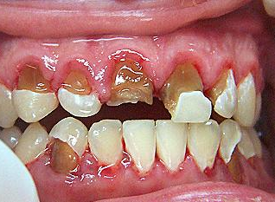
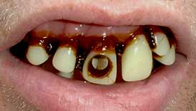
Can you remind me why you humans brush and look after your teeth?

Slide 6
Tooth decay is damage to a tooth caused by dental plaque turning sugars into acid. If plaque is allowed to build up, it can lead to problems, such as holes in the teeth (dental caries) and gum disease.

Slide 7
I’ve been talking to my new friends about their favourite drinks.
I’m a little concerned about whether their drinks are healthy for their teeth.
Can you help me find out please?

Slide 8
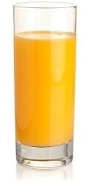
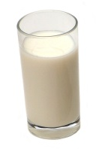
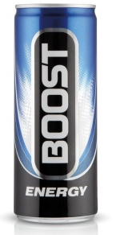
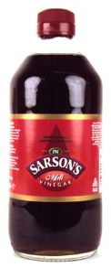
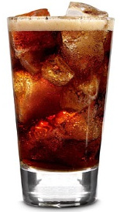
Oh, I love a bit of milk! It’s my favourite drink in the world!
Oh, the juicy refreshing taste of orange juice is my favourite!
Me? Ha ha ha! I can’t get enough of those energy drinks! I NEED them to keep all my legs going! Yeah!
Hmmm, I’m afraid I rather enjoy vinegar!! I sprinkle it on my crickets and have a glass every night before bed!
There’s nothing better than an ice cold cola! We have it every day!

Slide 9
Goodness me!! I enjoy drinking plain old water to be honest..
In order to help James, you are all going to have to be scientists!!

Slide 10
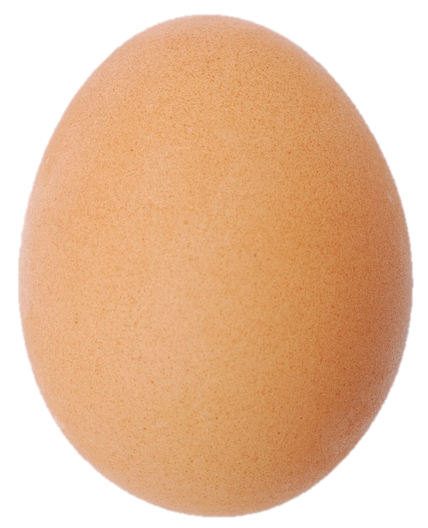
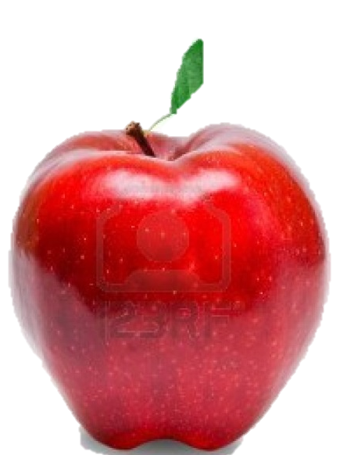
So could we use your real teeth to test these liquids? I’m sure Harley and Spencer would let us wouldn’t you?
NO!!!
We can use different things as a model of a tooth! Here, we have two options!
Discuss how these might be similar to a tooth.

Slide 11
James wants us to find out which drink is the best (or worse!) for our teeth. Form your question now:
Which…..
How are we going to do this? We have eggs and different liquids.
How will we make it fair?
What will we change? (posh WOW word – things that we change are called the variables!)
Which liquid do you think will be best/worst for the teeth? Why?
When should we take observations?

Slide 12
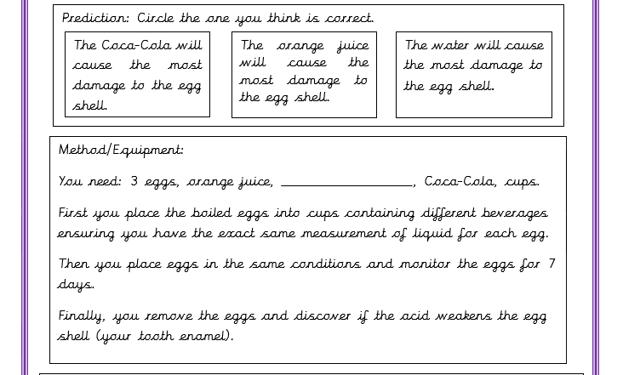
Lets investigate!

Slide 13
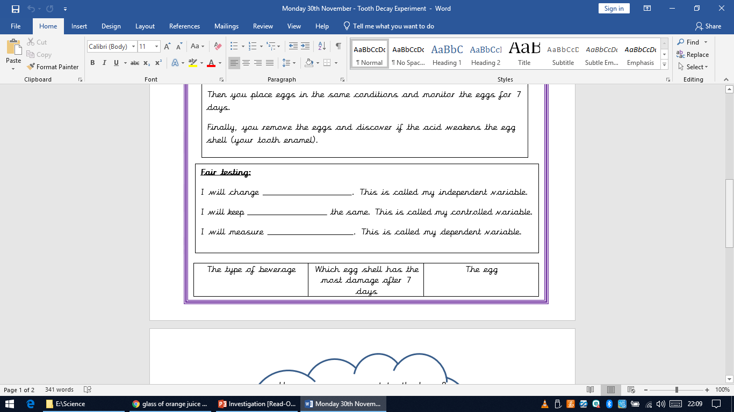

Slide 14
How can we prevent tooth decay?

Slide 15
Thank you for being super scientists and helping me. I couldn’t have done it without you. I look forward to seeing your results next Monday!

