Slide 1
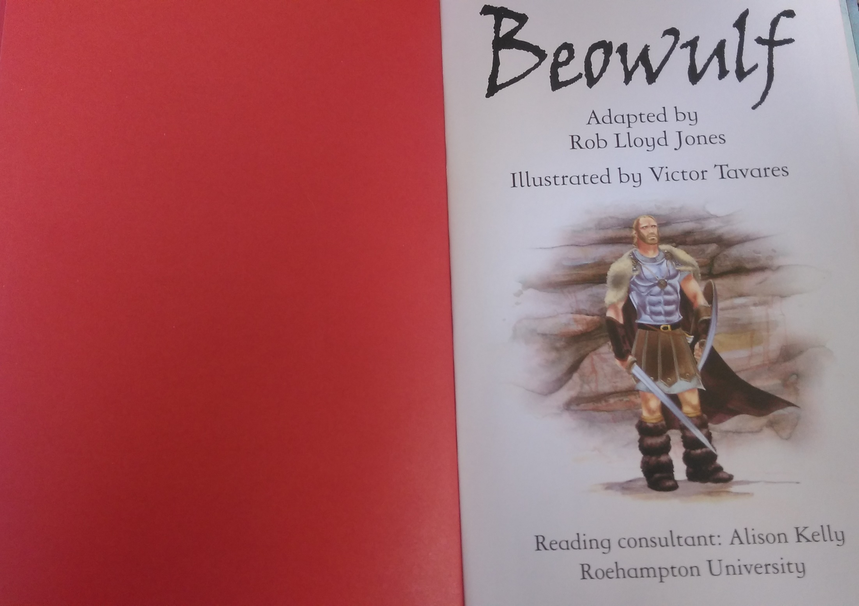

Slide 2
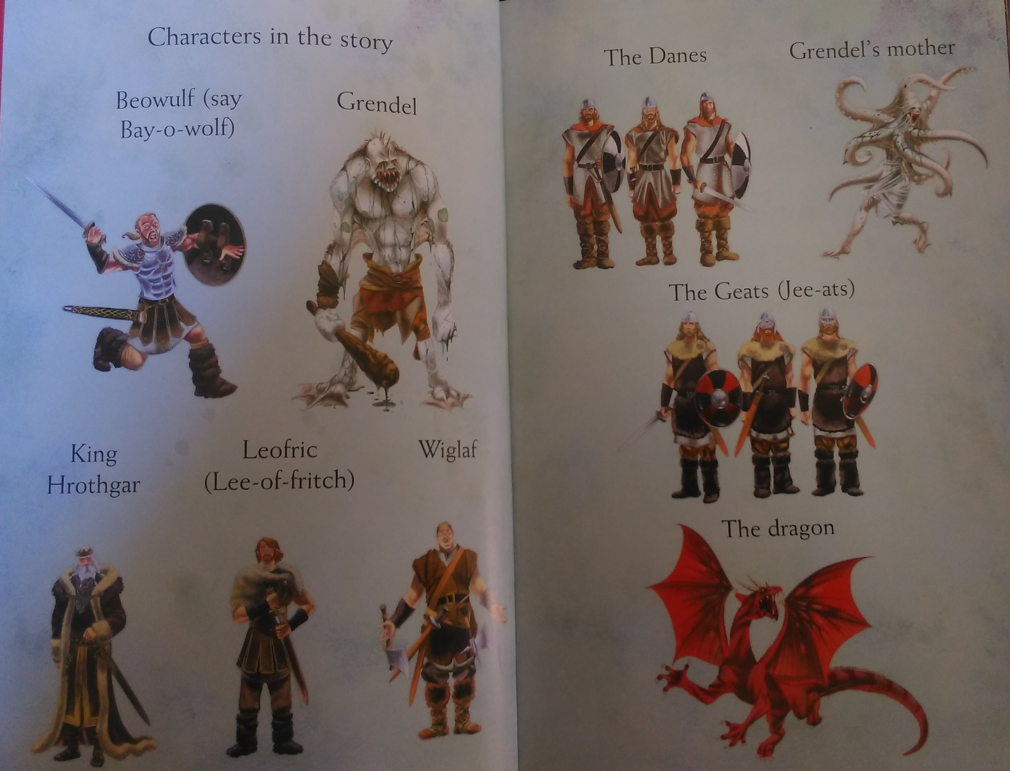

Slide 3
Think of expanded noun phrases to describe one of these characters.
The dragon’s mouth was full of sharp, terrifying teeth that could rip through bones!
The scarlet, snarling dragon roared ferociously.
It had four deadly claws on each foot.

Slide 4
You could use this slide, or write your own on your computer or on paper!
Type here
Type here
Type here
Type here

