Slide 1
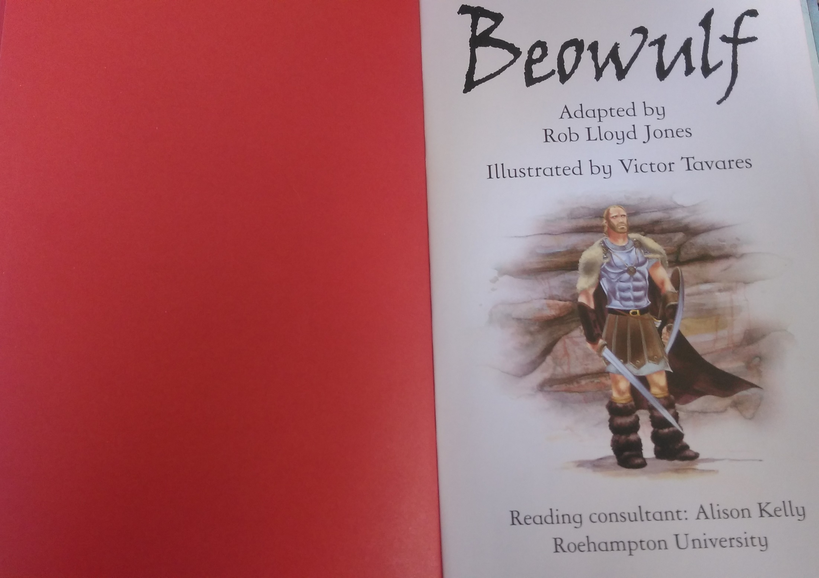

Slide 2
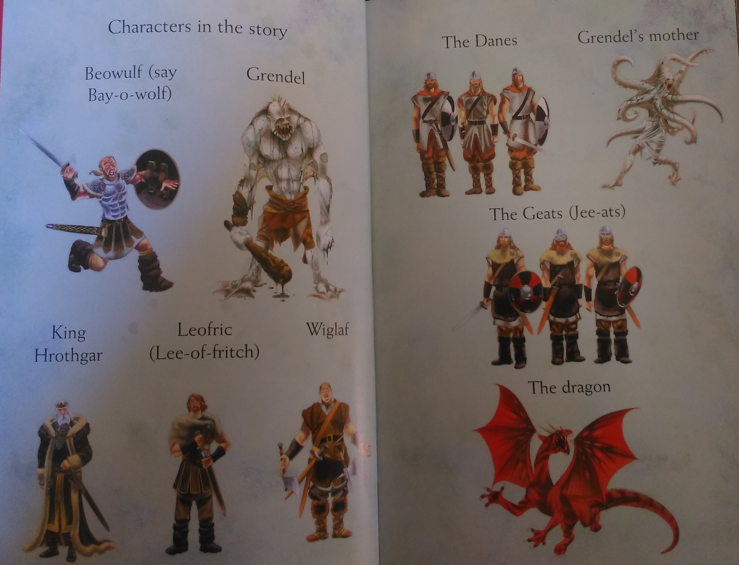

Slide 3
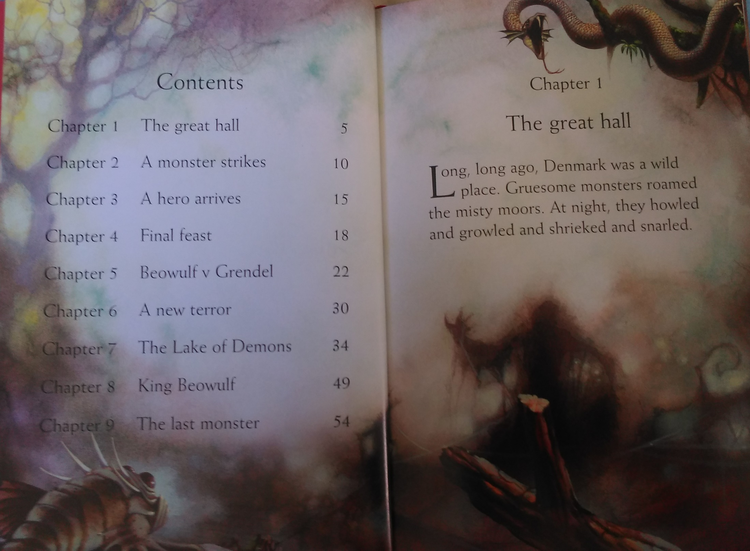
is
roam
howl
growl
shriek
snarl

Slide 4
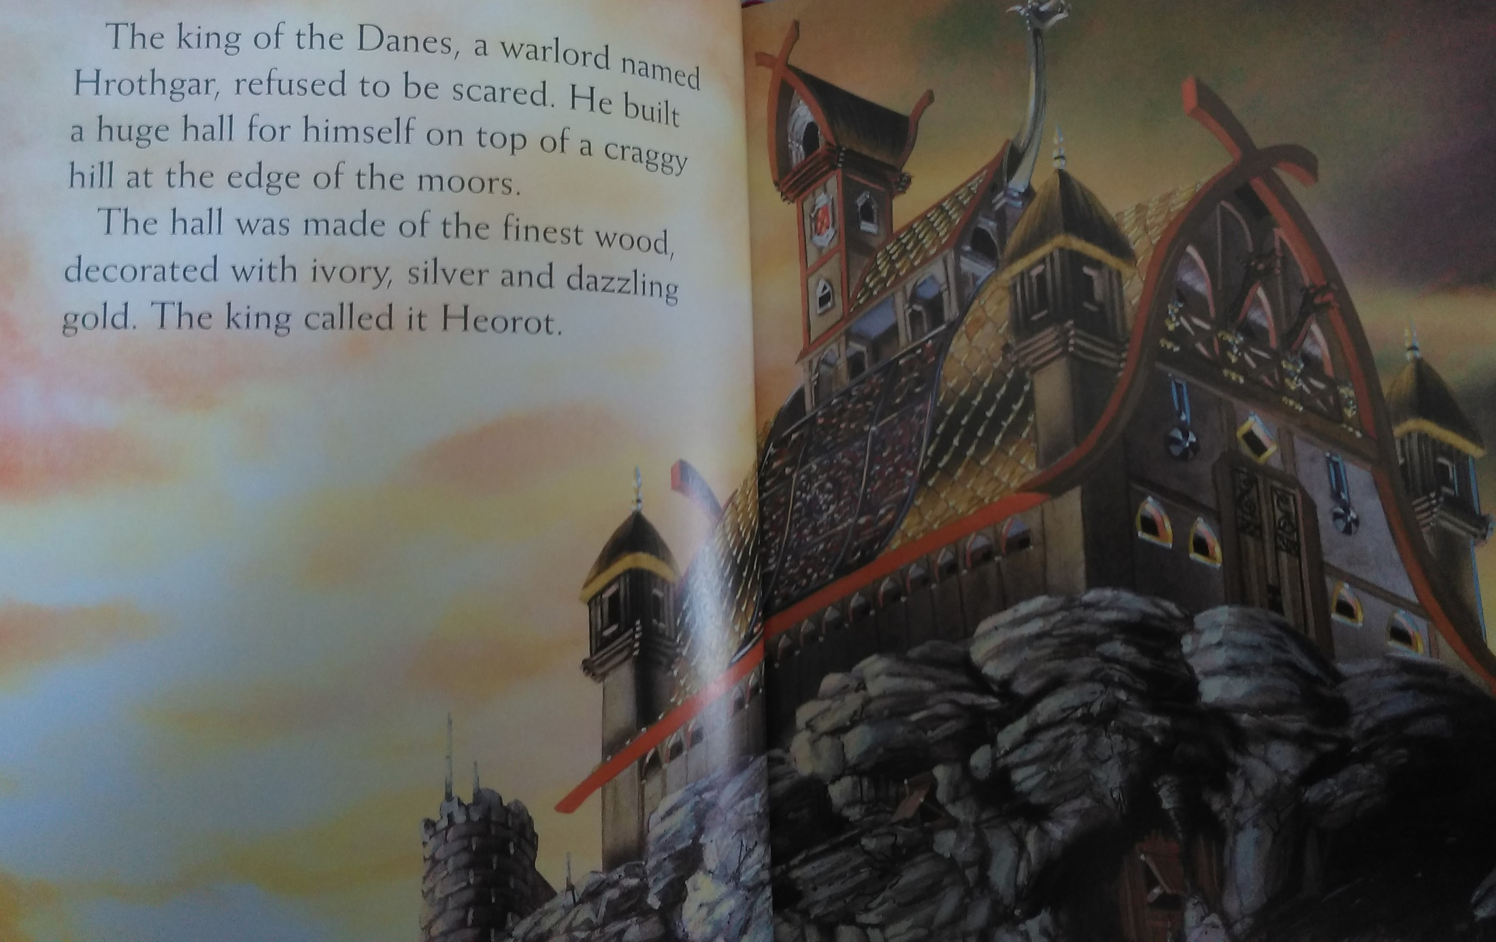
refuse
scare
build
make
decorate
call

