Slide 2
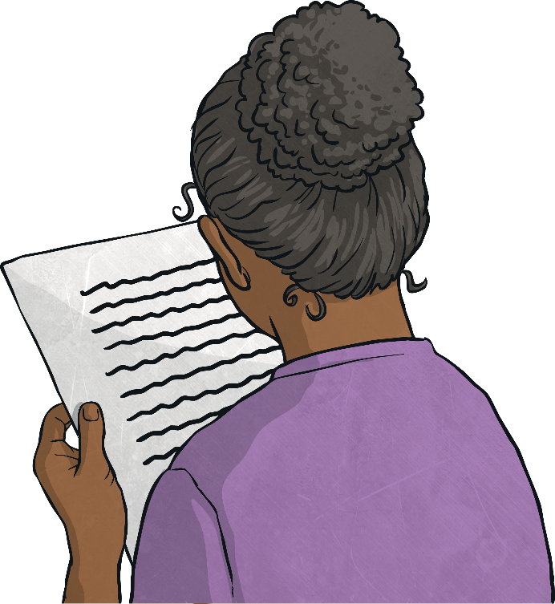
Poetry
Poetry is a form of literature and a very wide genre of writing. It is a form of imaginative writing that can be written by anybody. People choose to write poetry based on many different things. Expressing thoughts and feelings about something in a creative way is what poetry is all about.
The main aim of poetry is to involve and stimulate the thoughts of the reader. Poetry can connect with a reader on an emotional level too.
Poetry has many different forms, and can be written in many different ways. They can be short or long, fun or sad, real or imagined, structured or unstructured, rhyming or not. There is a lot of freedom when writing poetry and because of this, the writer is able to express their thoughts and feelings in very unique ways.

Slide 3
Poetry
There are many different types of poem including:
acrostic | sonnet | epic | blank verse
simile | colour | tetractys | pantoum
diamante | ballad | haiku | echo verse
limerick | renga | kenning | riddle
shape | cinquain | ode | free verse
tyburn | senryu | lyric | tanka

Slide 4
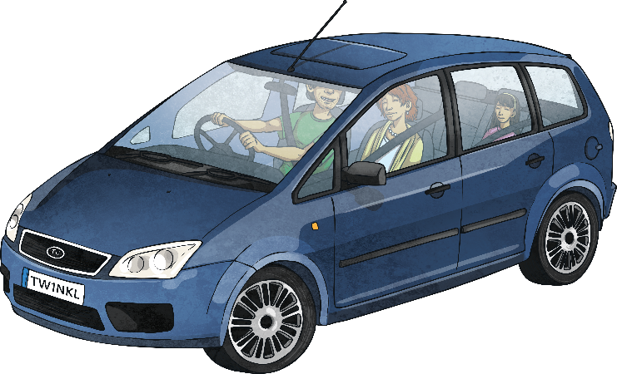
Adjective Poetry
Adjectives are describing words. They are used in poetry to create many different effects and visual pictures to the reader. The adjectives can be used for a more in-depth description of a noun, or they can be used to add more excitement and attention within a line or verse.
Some examples of couplets within poems:
Roaring roads,
Noisy cars,
Beaming headlights,
Tall streetlamps,
Dark, cold night.

Slide 5
Couplet Poetry
A couplet is a pair of lines. These two lines typically rhyme together. They are also the same length due to same number of syllables present.
Couplets are used in poetry in order to create a rhyming flow.
Some examples of couplets within poems:
It’s hard to see the butterfly,
As it flies across the night sky.
I made the biscuits one by one,
I’m waiting for the bell, they’re done.
Lightning, thunder all around,
So much rains falls to the ground.

Slide 6
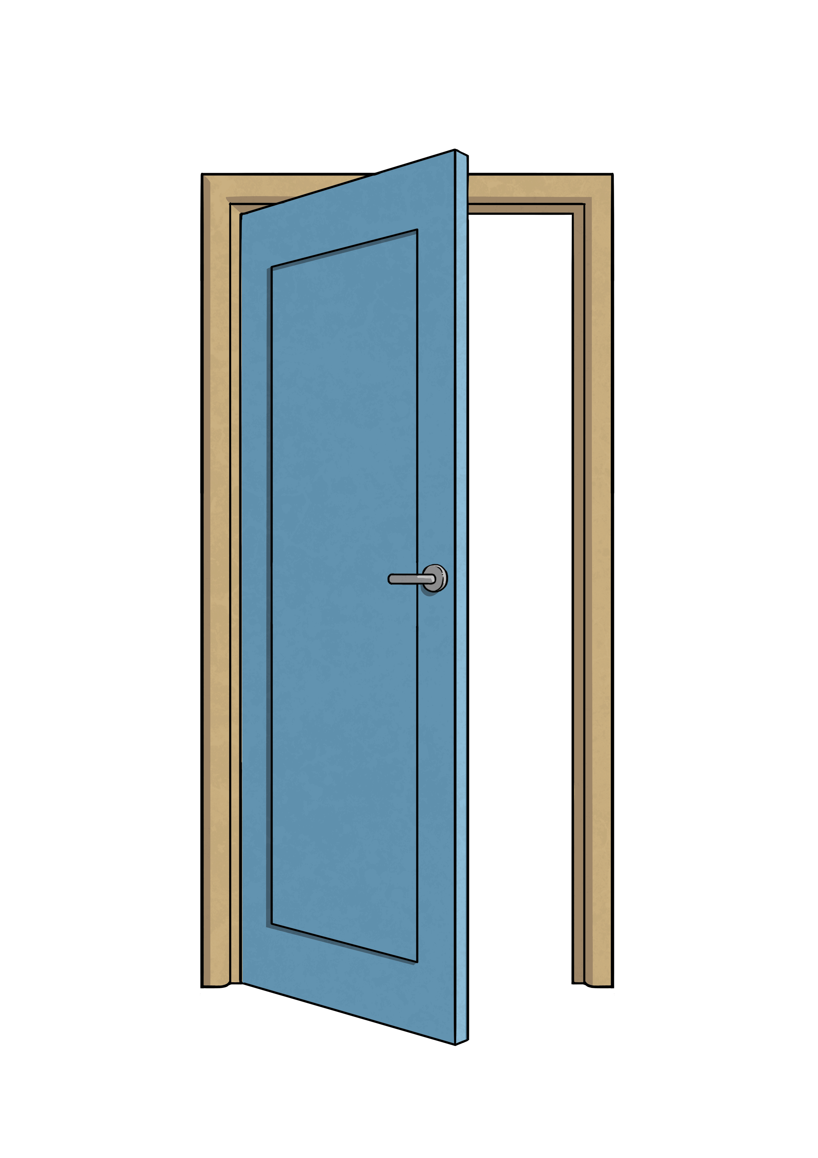
Using Onomatopoeia
Onomatopoeia is when a word imitates its natural sound,
or suggests the sound a certain object makes.
It is used in poetry to create a sound effect to make
the description more expressive and interesting.
Some examples of onomatopoeia:
bang
crash
pop
smash
drip
buzz
tick tock
whoosh
wham
pow

Slide 7
Using Repetition
Repetition is when a certain word, sentence or
phase is written more than once in a poem.
Repetition is used in poetry to help make the poem more
interesting, and to help create patterns. Depending on the word
or phrase that is repeated, repetition allows for more emphasis to be placed on certain themes, ideas or objects.
Some examples of where repetition can be used in poetry:
Using a refrain in a poem. This is where a verse or phrase is repeated during different stages of a song or poem.
Using a chorus in a poem. This is where a verse or phrase is repeated following each verse within a song or poem.
In an echo poem, the last word of each line can be repeated as a response in the next line.

Slide 8
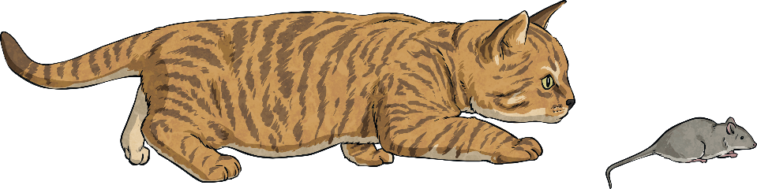
Using Syllables
A syllable is a unit of written or spoken words.
Syllables are broken up sounds that are used to create words.
One syllable = monosyllabic
More than one syllable = polysyllabic
Syllables are used in poetry to create rhythm.
Look at the syllable pattern in this poem:
Cat, (1)
Fluffy, (2)
Catches mice, (3)
My faithful pet. (4)

Slide 9

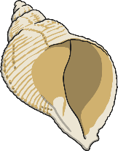
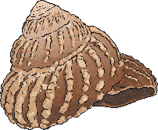

Alliteration
Alliteration is when the sound or letter at the beginning of each or most of the words in a sentence is the same.
Alliteration is used in poetry to create many different effects.
It can be used to create a greater and more interesting description
of different themes, people and objects.
Some examples of alliteration:
Sally sells sea shells by the sea shore.
All authors allow authority after midnight.
Theresa tripped and tumbled tremendously over the tree.

Slide 10
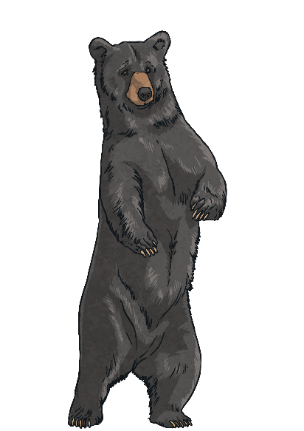

Rhyme
Rhyme occurs when two words sound the same when spoken out loud. These words usually have the same ending sounds,
however they don’t need to be spelt the same.
Rhyme is used in poetry to create something interesting to read.
It is used to create a pattern within a poem.
Some examples of rhyme:
Fright and night
Would hood
Should could
Hail and pale
Male and stale
Air and fare
Two and do
Day and sway
Pause and claws
Bears and stairs

Slide 11

Simile
A simile is a figure of speech. It is when one thing
is compared to another using the words ‘like’ or ‘as’.
Similes can be as descriptive as the writer chooses.
Similes are used in poetry to give the reader a more descriptive and
in-depth understanding about a particular object or person.
Some examples of simile:
As busy as a bee – This is comparing someone’s level of energy to the speed of a bee.
As snug as a bug in a rug – This is comparing someone who is very cosy to how comfortable a bug would be in a rug.
Runs like a cheetah – This is comparing the speed that someone can run to the speed of a cheetah which is quite fast.
As white as a ghost – This is comparing a person’s skin colour to a ghost, usually because they are frightened, sick or scared of something.

Slide 12

Synonym
A synonym is a word that has the same, or similar, meaning
as another word. Synonyms can be found in a thesaurus.
Synonyms are used in poetry to be more graphic
and to give a broader description.
Some examples of synonyms:
Beautiful – attractive, pretty, gorgeous, stunning
Funny – hysterical, humorous, amusing, entertaining
Student – pupil, scholar, schoolboy, schoolgirl
Lazy – idle, sluggish, indolent, slothful

Slide 13
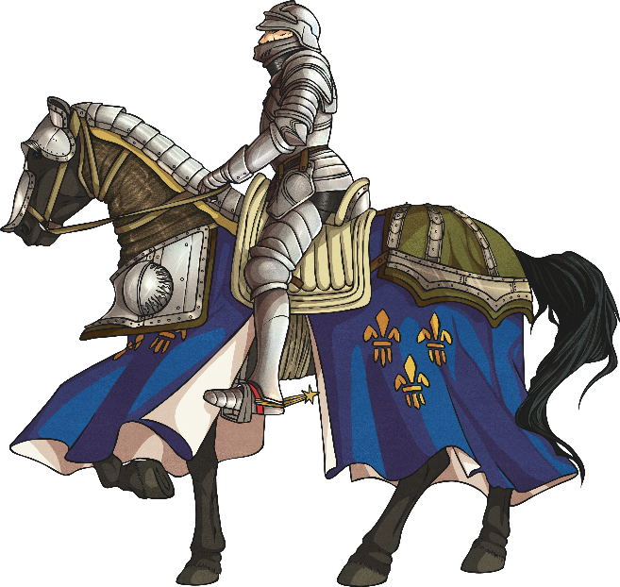
Metaphor
A metaphor is a figure of speech which describes a place,
object or subject as something unlikely and uncommon.
Metaphors are used in poetry to create an image of
judgement and comparison in the mind of the reader.
Some examples of metaphor:
Her eyes were glistening jewels.
She is the sunshine which brightens up our day.
The kids at school are all brains.
In Andrew’s eyes, Rebecca is the sun.
He is my knight in shining armour.
The world is a stage.

