Slide 2
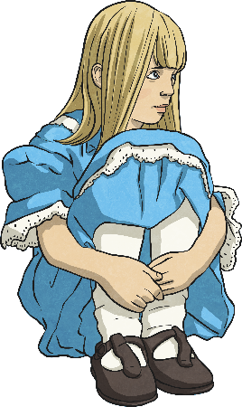
Features of a Play Script:
Character List
Characters Alice In Wonderland
Alice
The main character – A young girl who is lost in Wonderland. Has a great imagination.
The Mad Hatter
As the name suggests, he is ‘crazy’. He gives out riddles, dresses fashionably and likes tea.
Hare
A friend of the Mad Hatter, thinks it is always time for afternoon tea, is also mad.
Dormouse
Incredibly sleepy friend of the Mad Hatter.
At the beginning of a play script, you’ll find a list of all the characters that are in the play.
Sometimes they will have a short description with them.
How might this help someone who wanted to perform the play?
This tells people what the characters are like before reading the play.
Why do you think this is?
This helps anyone who wants to perform the play know how many actors they need.

Slide 3
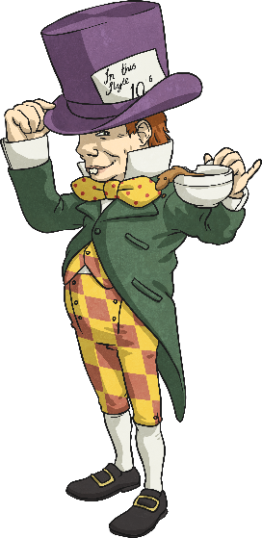
Features of a Play Script:
Scene Number, Title and Setting Description
A bit like chapters in a book, the sections of a script are broken down into ‘scenes’. A new scene usually means a new setting.
Scene 7 – A Mad Tea Party
The Mad Hatter, Dormouse and Hare are sitting at a table having afternoon tea.
Just after the scene number and title is a short description of the setting. This tells you what the stage looks like.

Slide 4
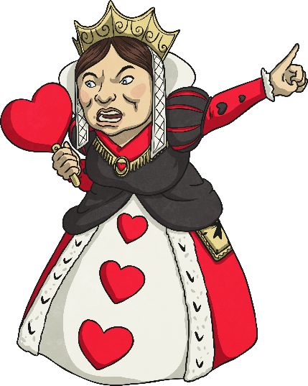
Features of a Play Script:
Speaker Name, Colon and Dialogue
A colon always comes after the name.
Queen of Hearts:
Guards! Get her! Off with her head! Off with her head!
In a script, the name of the character who is speaking goes on the left.
After the colon is the dialogue (the words the character says).
How is this different to writing speech in a story?
No inverted commas!

