Slide 2
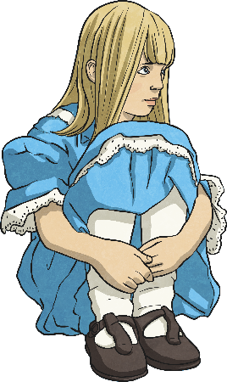
Features of a Play Script
Let’s recap on what you learned last week:
Character List
At the beginning of a play script, you’ll find a list of all the characters that are in the play.
Sometimes they will have a short description with them.
Scene Number, Title and Setting Description
A bit like chapters in a book, the sections of a script are broken down into ‘scenes’. A new scene usually means a new setting.
Just after the scene number and title is a short description of the setting. This tells you what the stage looks like.
Speaker Name, Colon and Dialogue
In a script, the name of the character who is speaking goes on the left.
A colon always comes after the name.
After the colon is the dialogue (the words the character says).

Slide 3
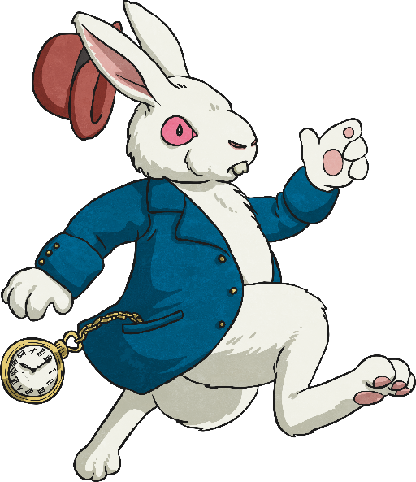
Features of a Play Script:
Stage Directions
Words in brackets are stage directions. These are instructions to the actors so they know what their character should be doing.
White Rabbit:
Alice:
(anxiously, whilst rushing across the stage) I’m late! I’m late!
(confused) A talking rabbit? It can’t be…
Sometimes they tell the actor how to say their words.
The actors don’t say the stage directions.

Slide 4
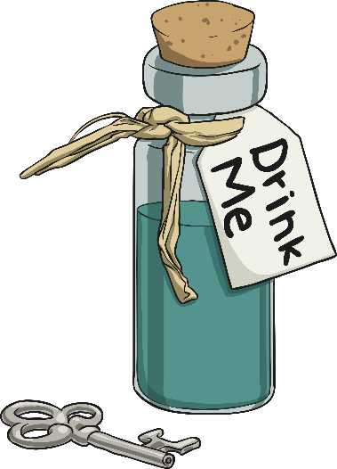
Features of a Play Script:
Stage Directions and Narrators
Some plays have a narrator to help set the scene for the audience, but lots of plays don’t.
Narrator:
Alice found herself in a strange room, inside was a small table. On top of it, sat a small, peculiar-looking bottle with a label on.
(Alice looks around, confused, then goes over to the table and studies the bottle.)
Stage directions can be given to any character, not just the ones speaking. They are always written in present tense.

Slide 5
Can you find the play script features in the text here?
Scene number
and title
Scene 7 – A Mad Tea Party
The Mad Hatter, Dormouse and Hare are sitting at a table having afternoon tea.
Lost and lonely, Alice continued towards the sound. She didn’t know what to expect when she reached a clearing…
(Alice enters the scene, stage left)
(starts for a moment, pauses and a broad grin appears across his face. He gets up out of his chair and walks across the table towards Alice)
(exasperated)
(gasps and throws his hands against his head)
You’re absolutely Alice, I’d know you anywhere.
(to the rest of the characters at the table)
I’d know him anywhere!
(Dormouse and Hare laugh manically)
Well, as you can see we’re still having tea.
You’re terribly late you know… naughty.
I’m incredibly intrigued.
Narrator:
Mad Hatter:
Dormouse:
Hare:
Mad hatter:
Alice:
Setting description
Speaker’s name, followed by a colon (:)
It’s you.
No it’s not! Hare brought us the wrong Alice!
It’s the wrong Alice!
Stage directions in brackets
Speech – without inverted commas!
click the different features to show the answers
Present tense

