Slide 1

The Wolves in the Walls continued…
Are you ready to find out what happens next?

Slide 2
Tuesday 3rd November
LO: To draw inferences such as inferring characters’ feelings, thoughts and motives from their actions, and justifying inferences with evidence.

Slide 3
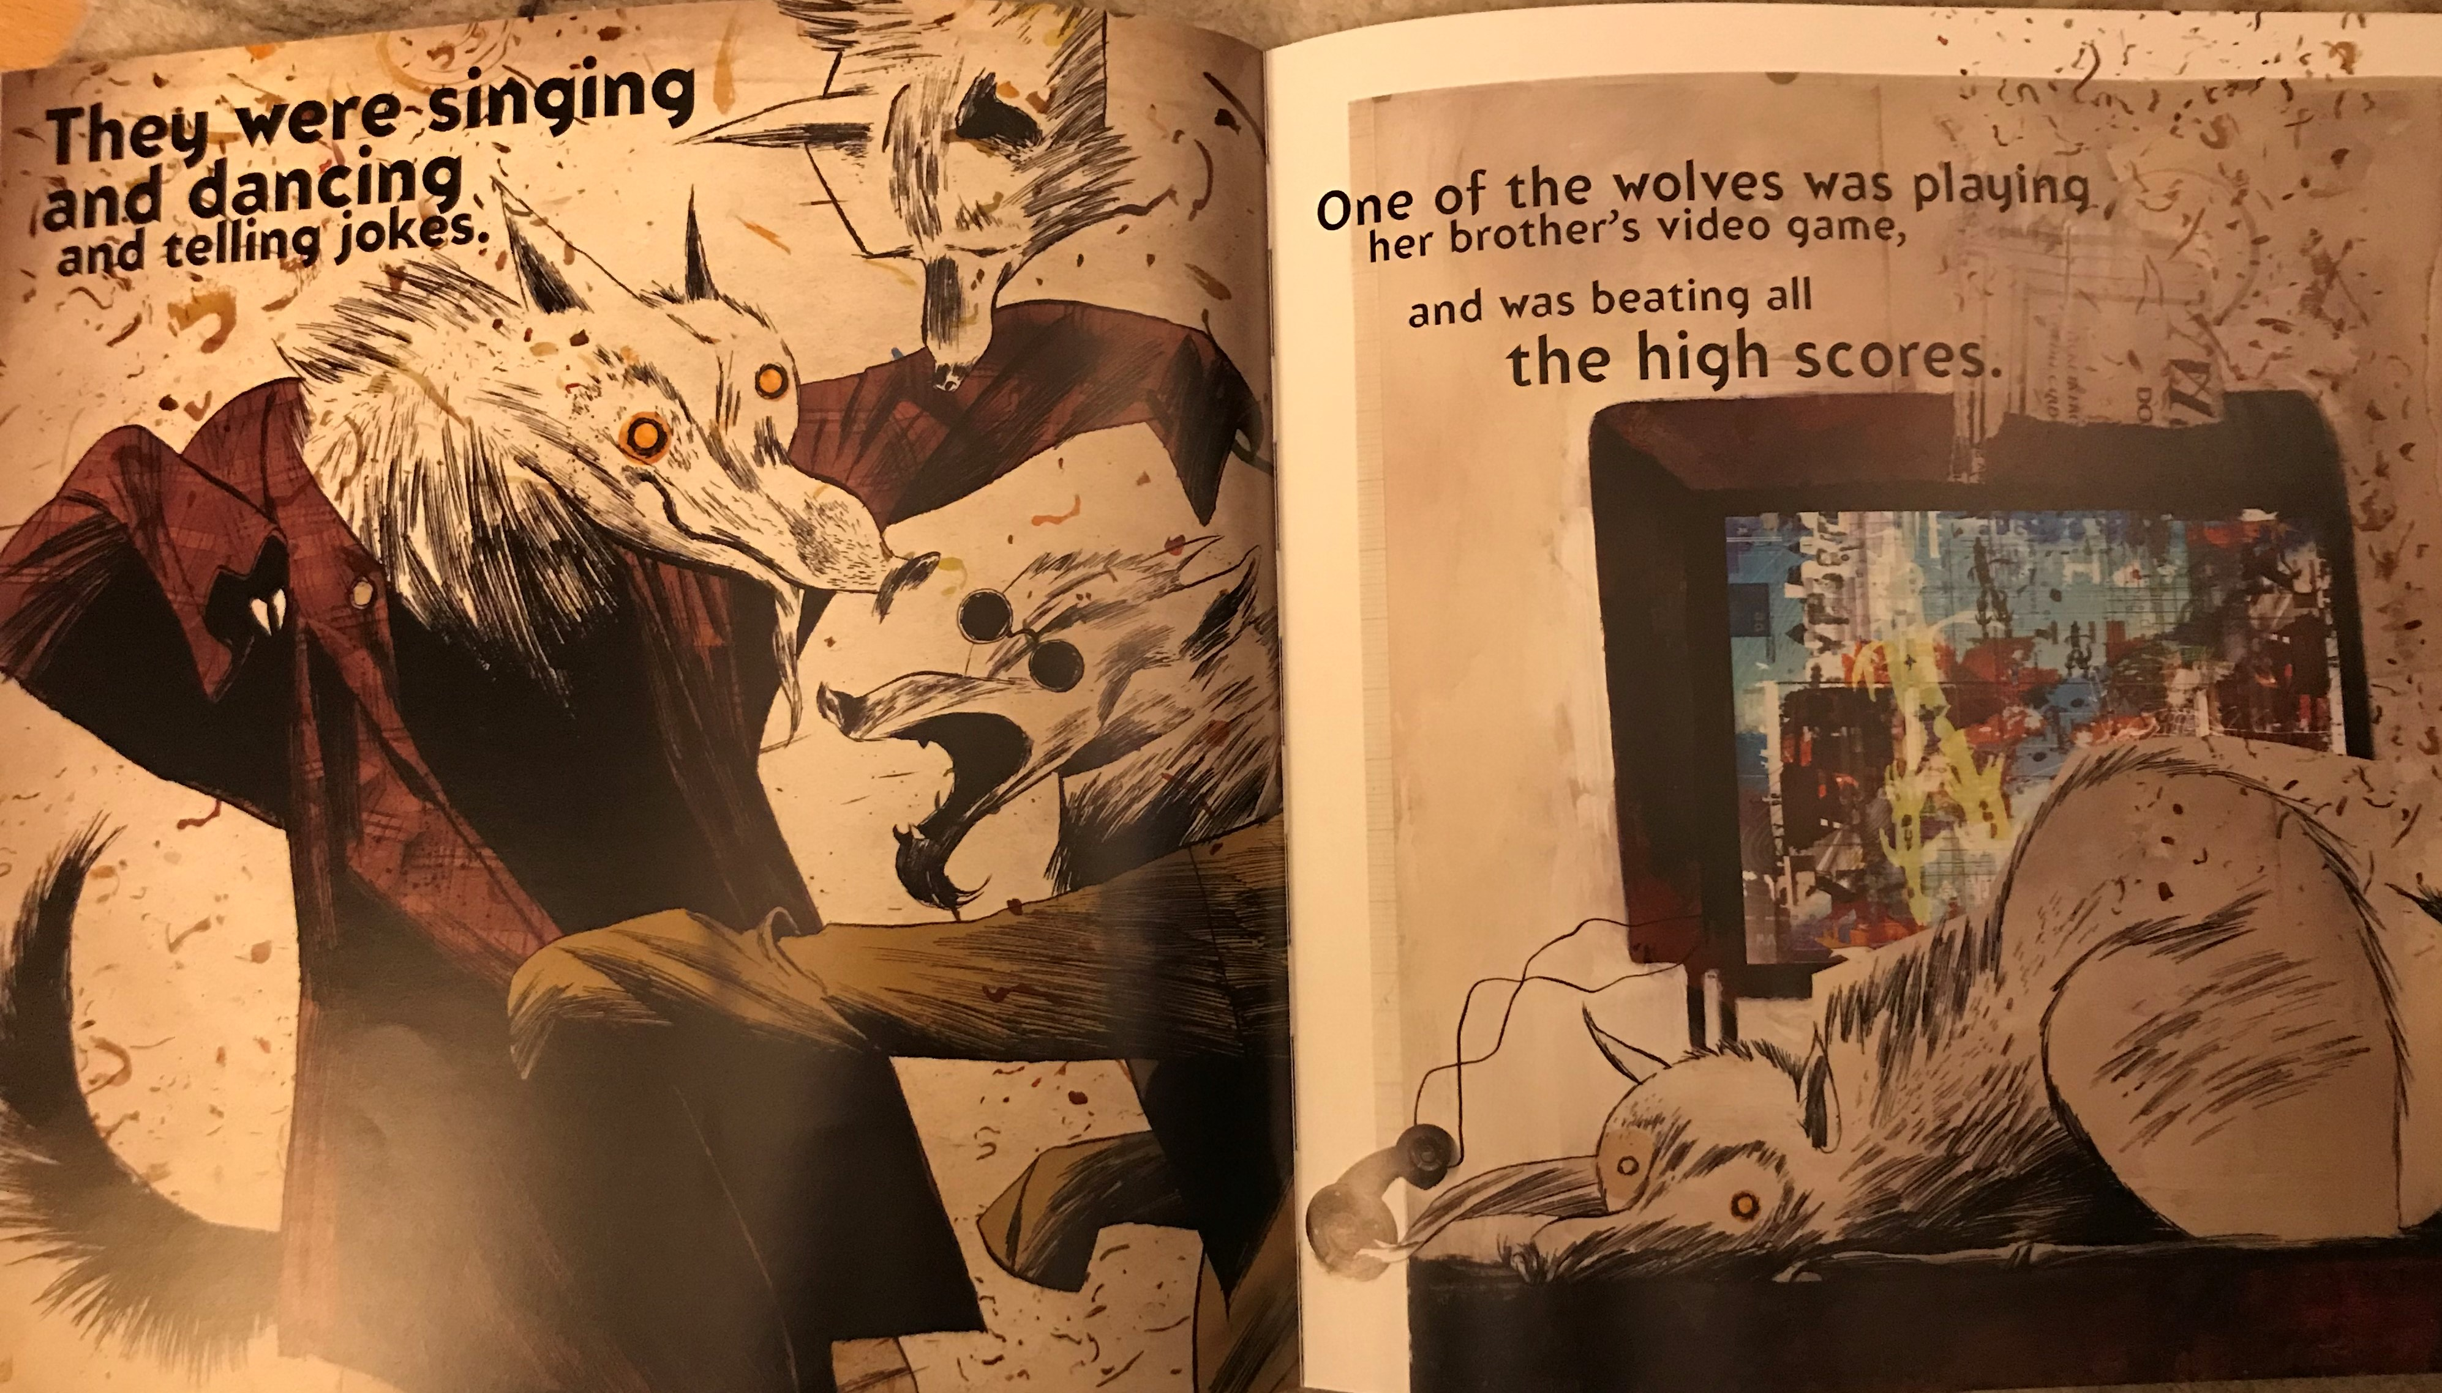
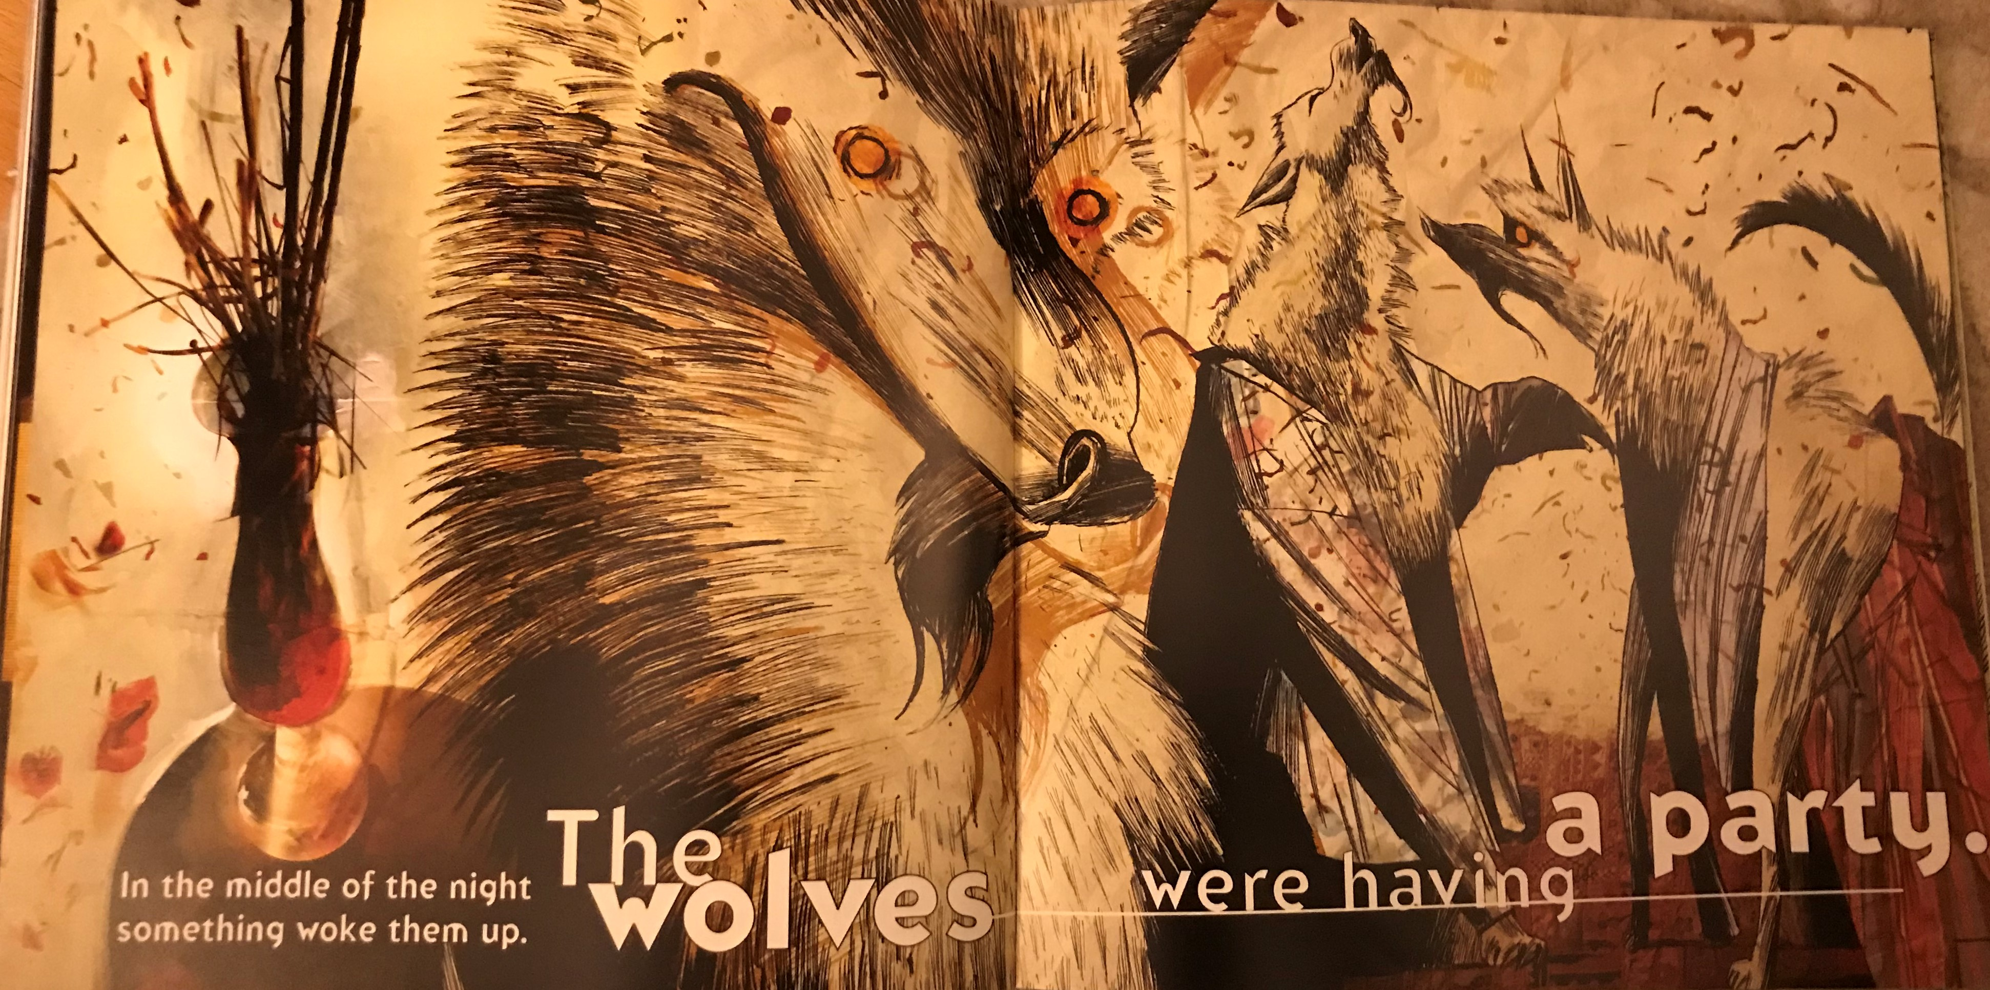

Slide 4
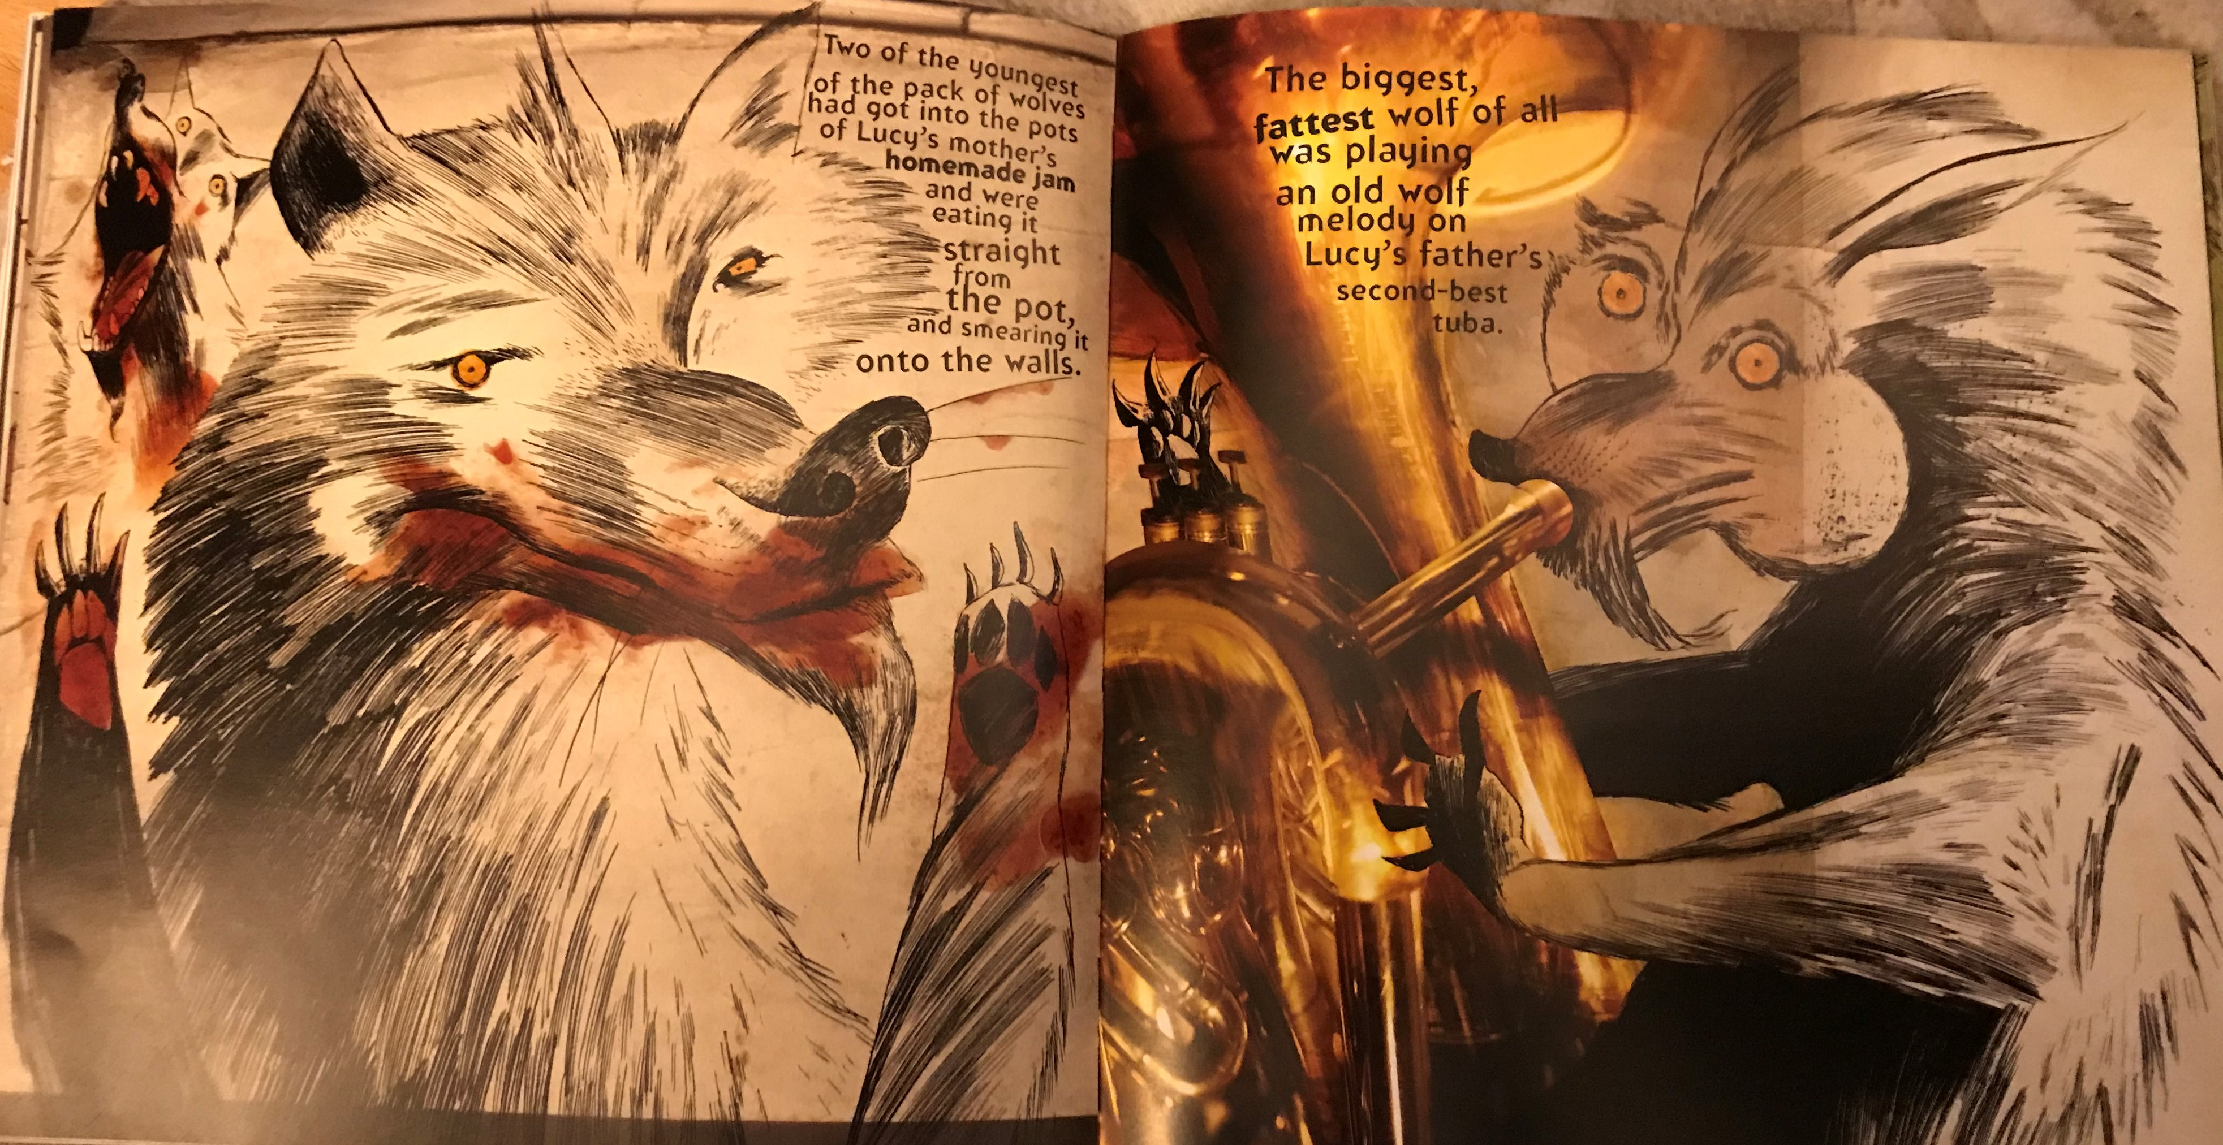

Slide 5
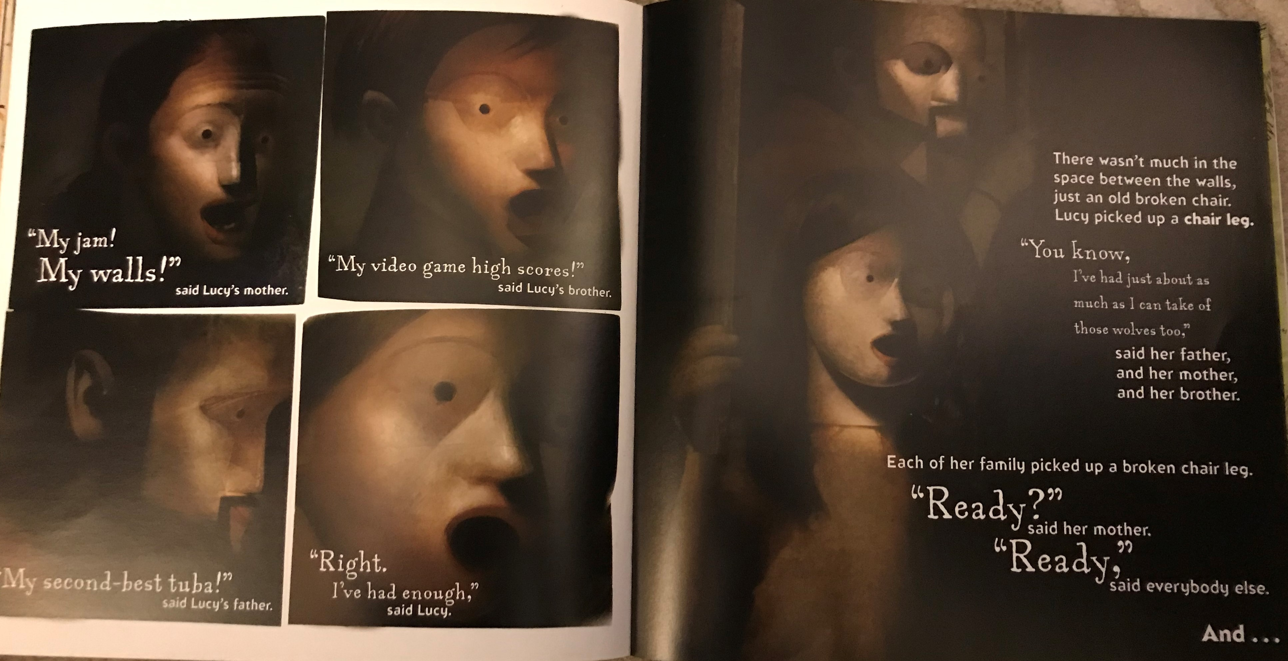

Slide 6
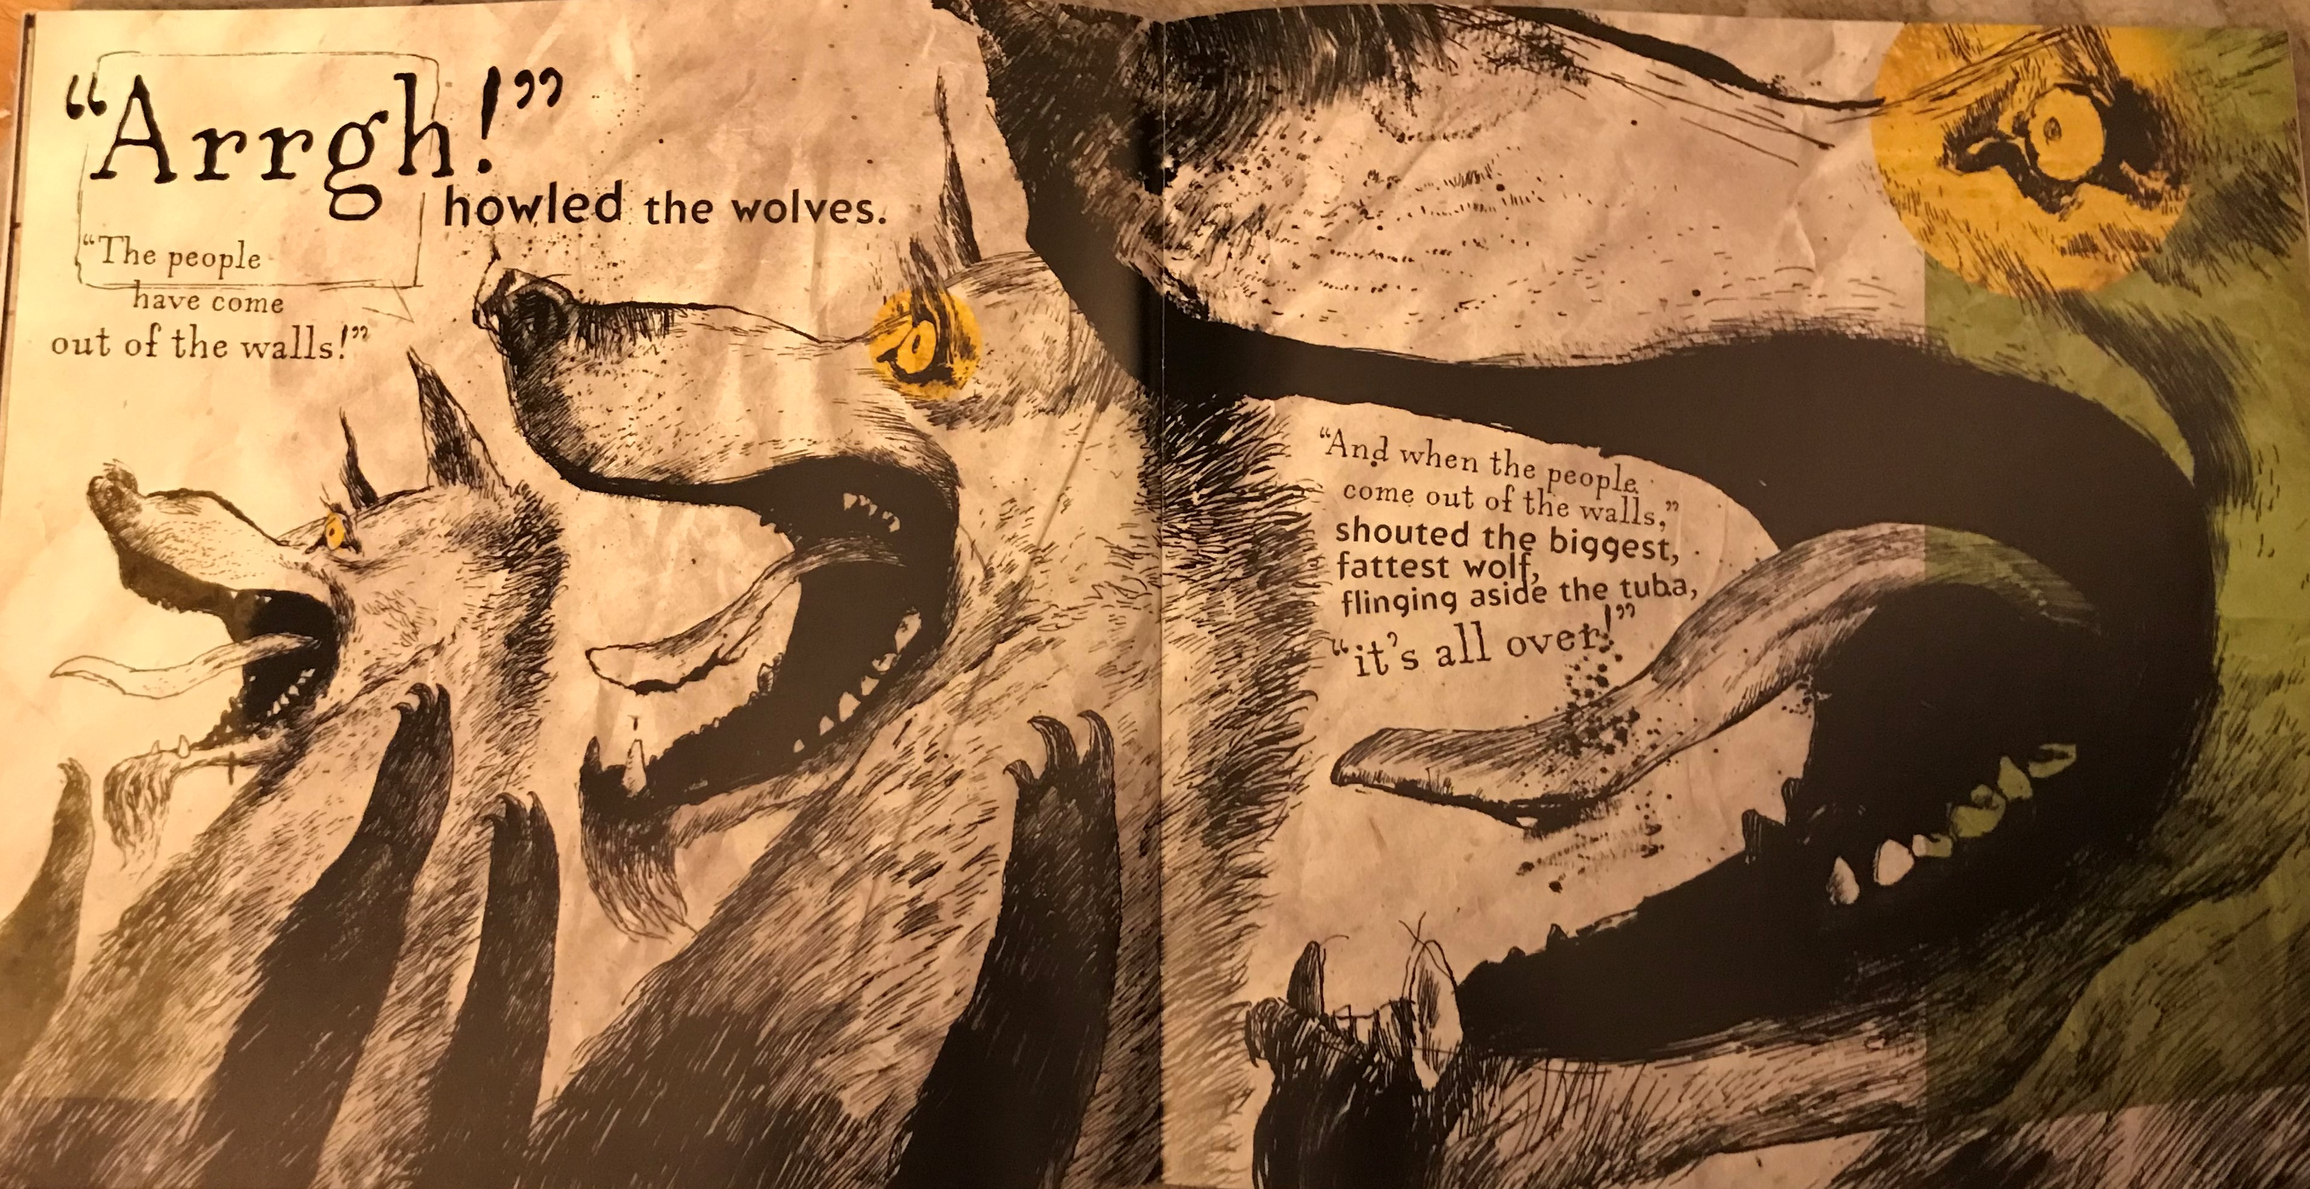

Slide 7
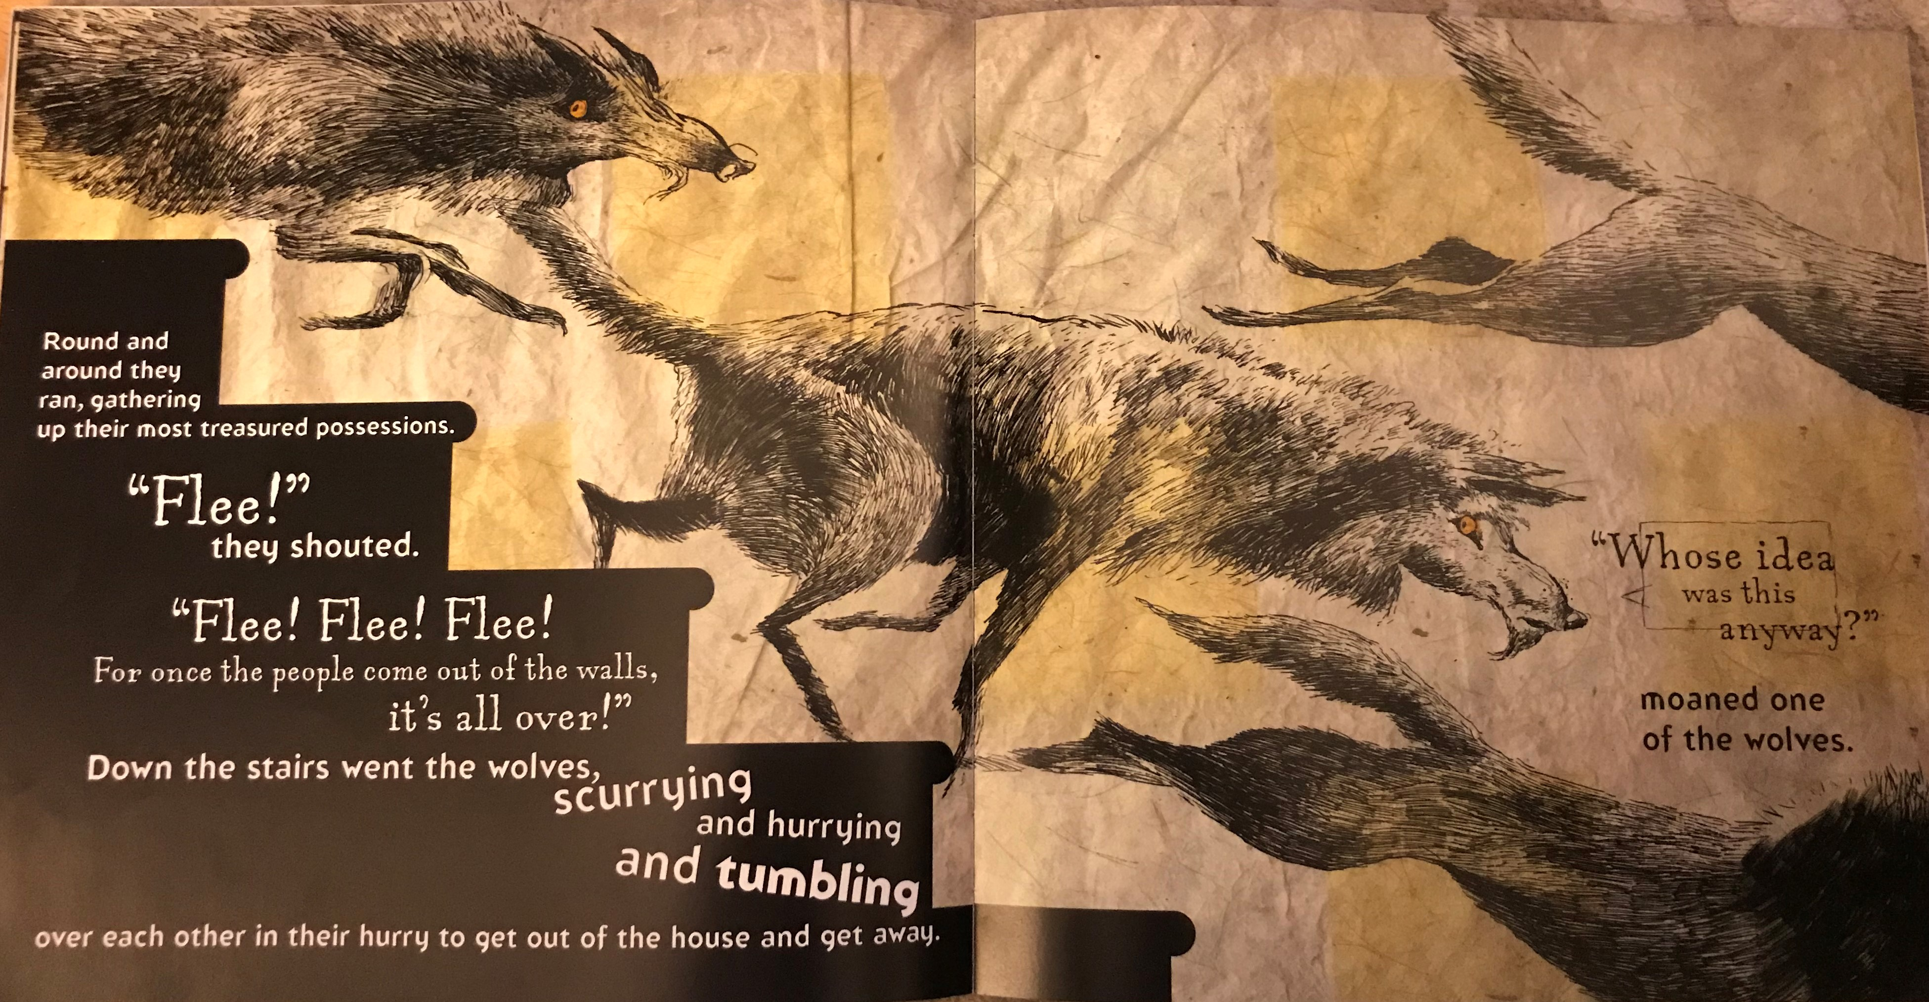

Slide 8
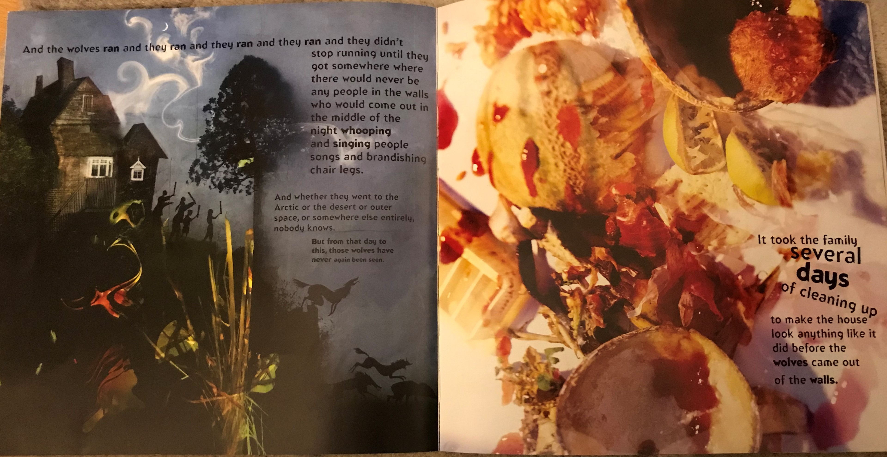

Slide 9
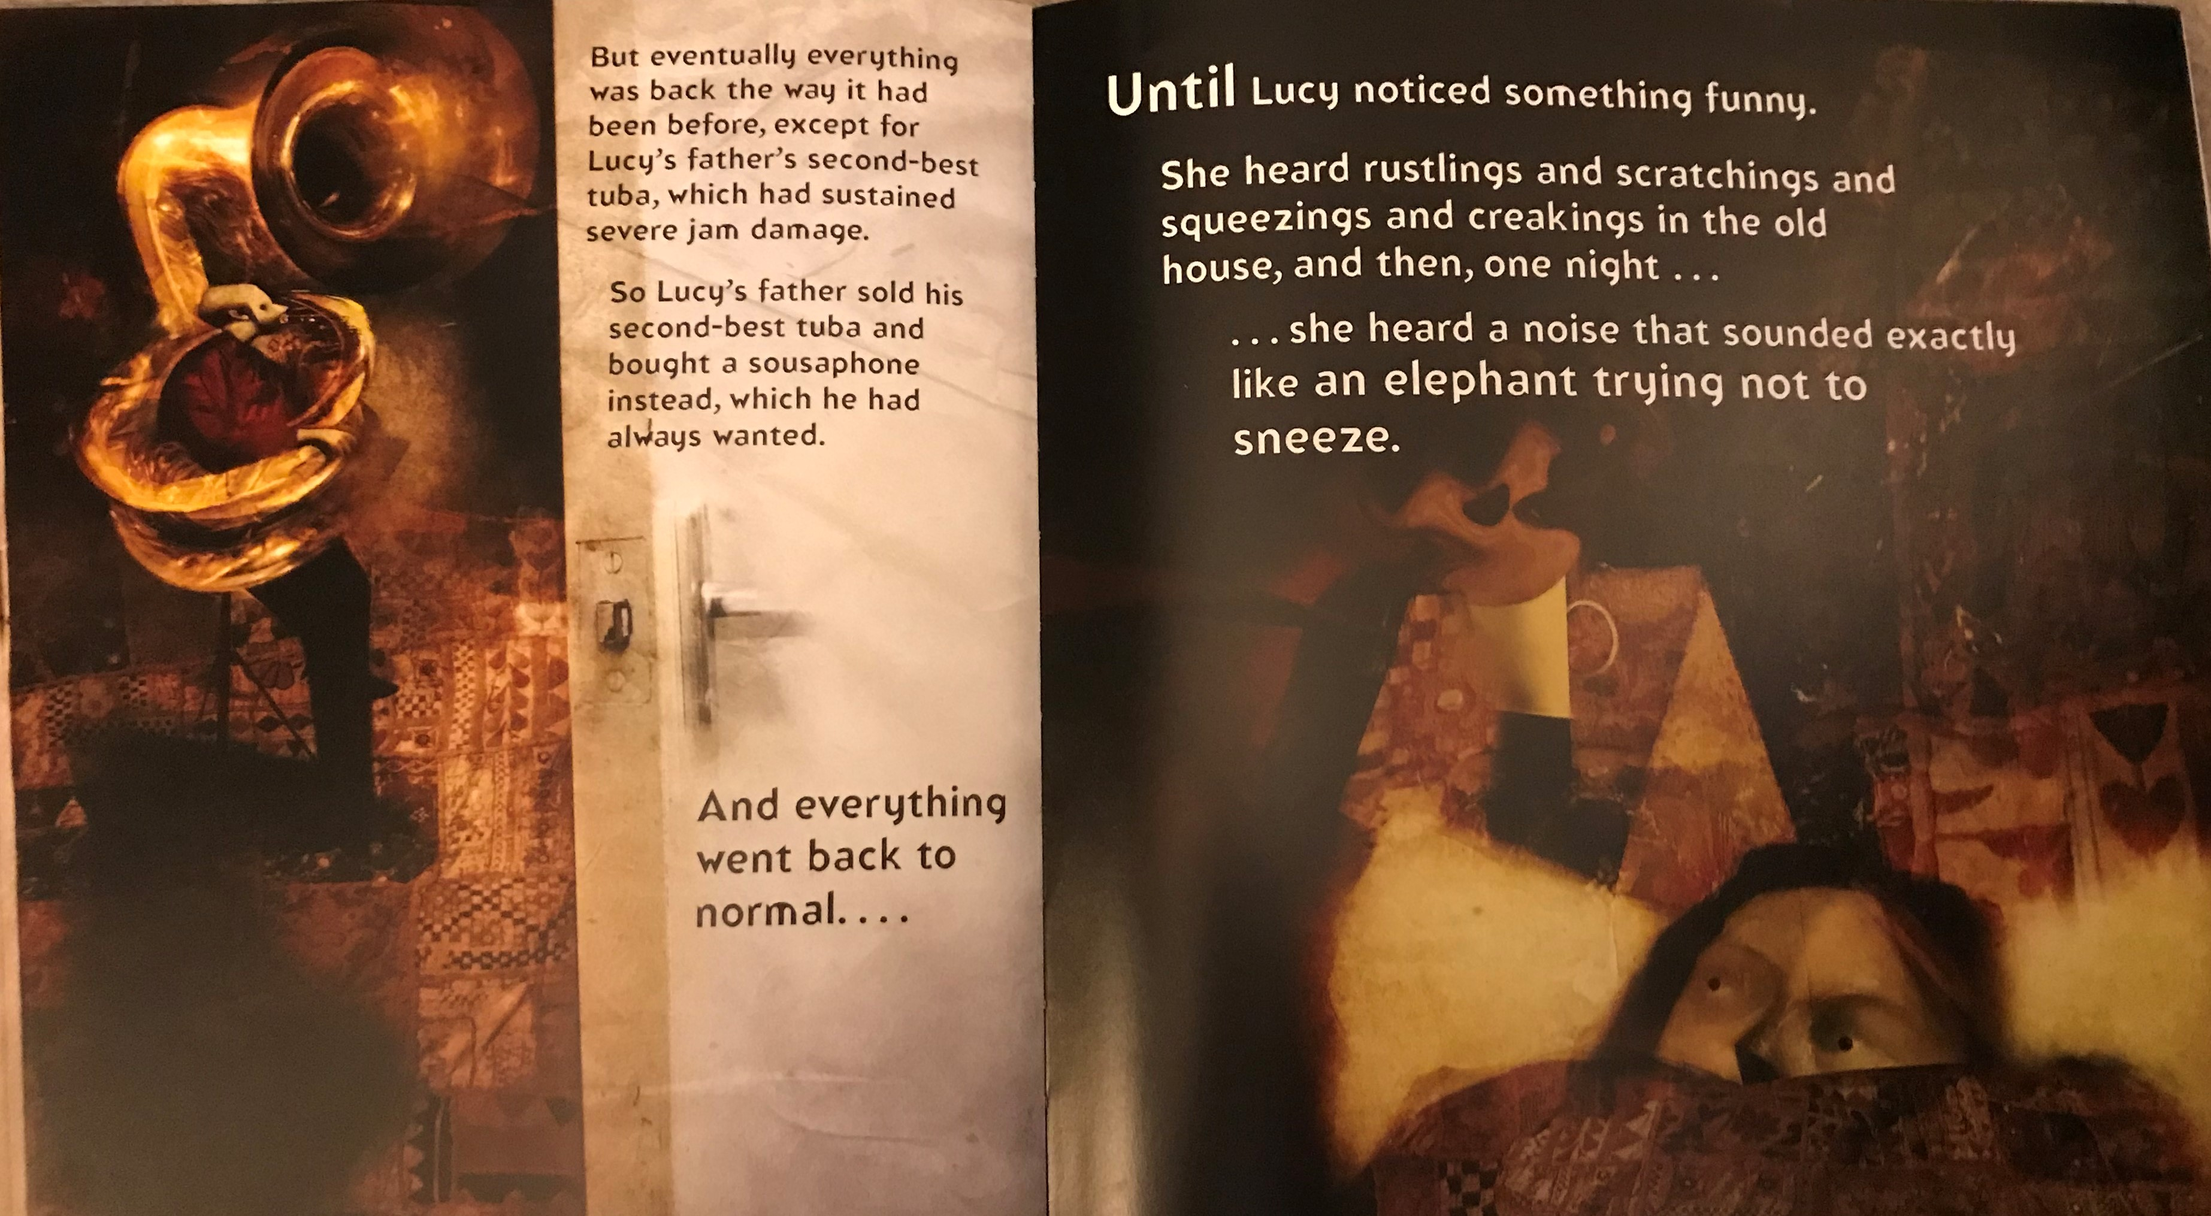

Slide 10
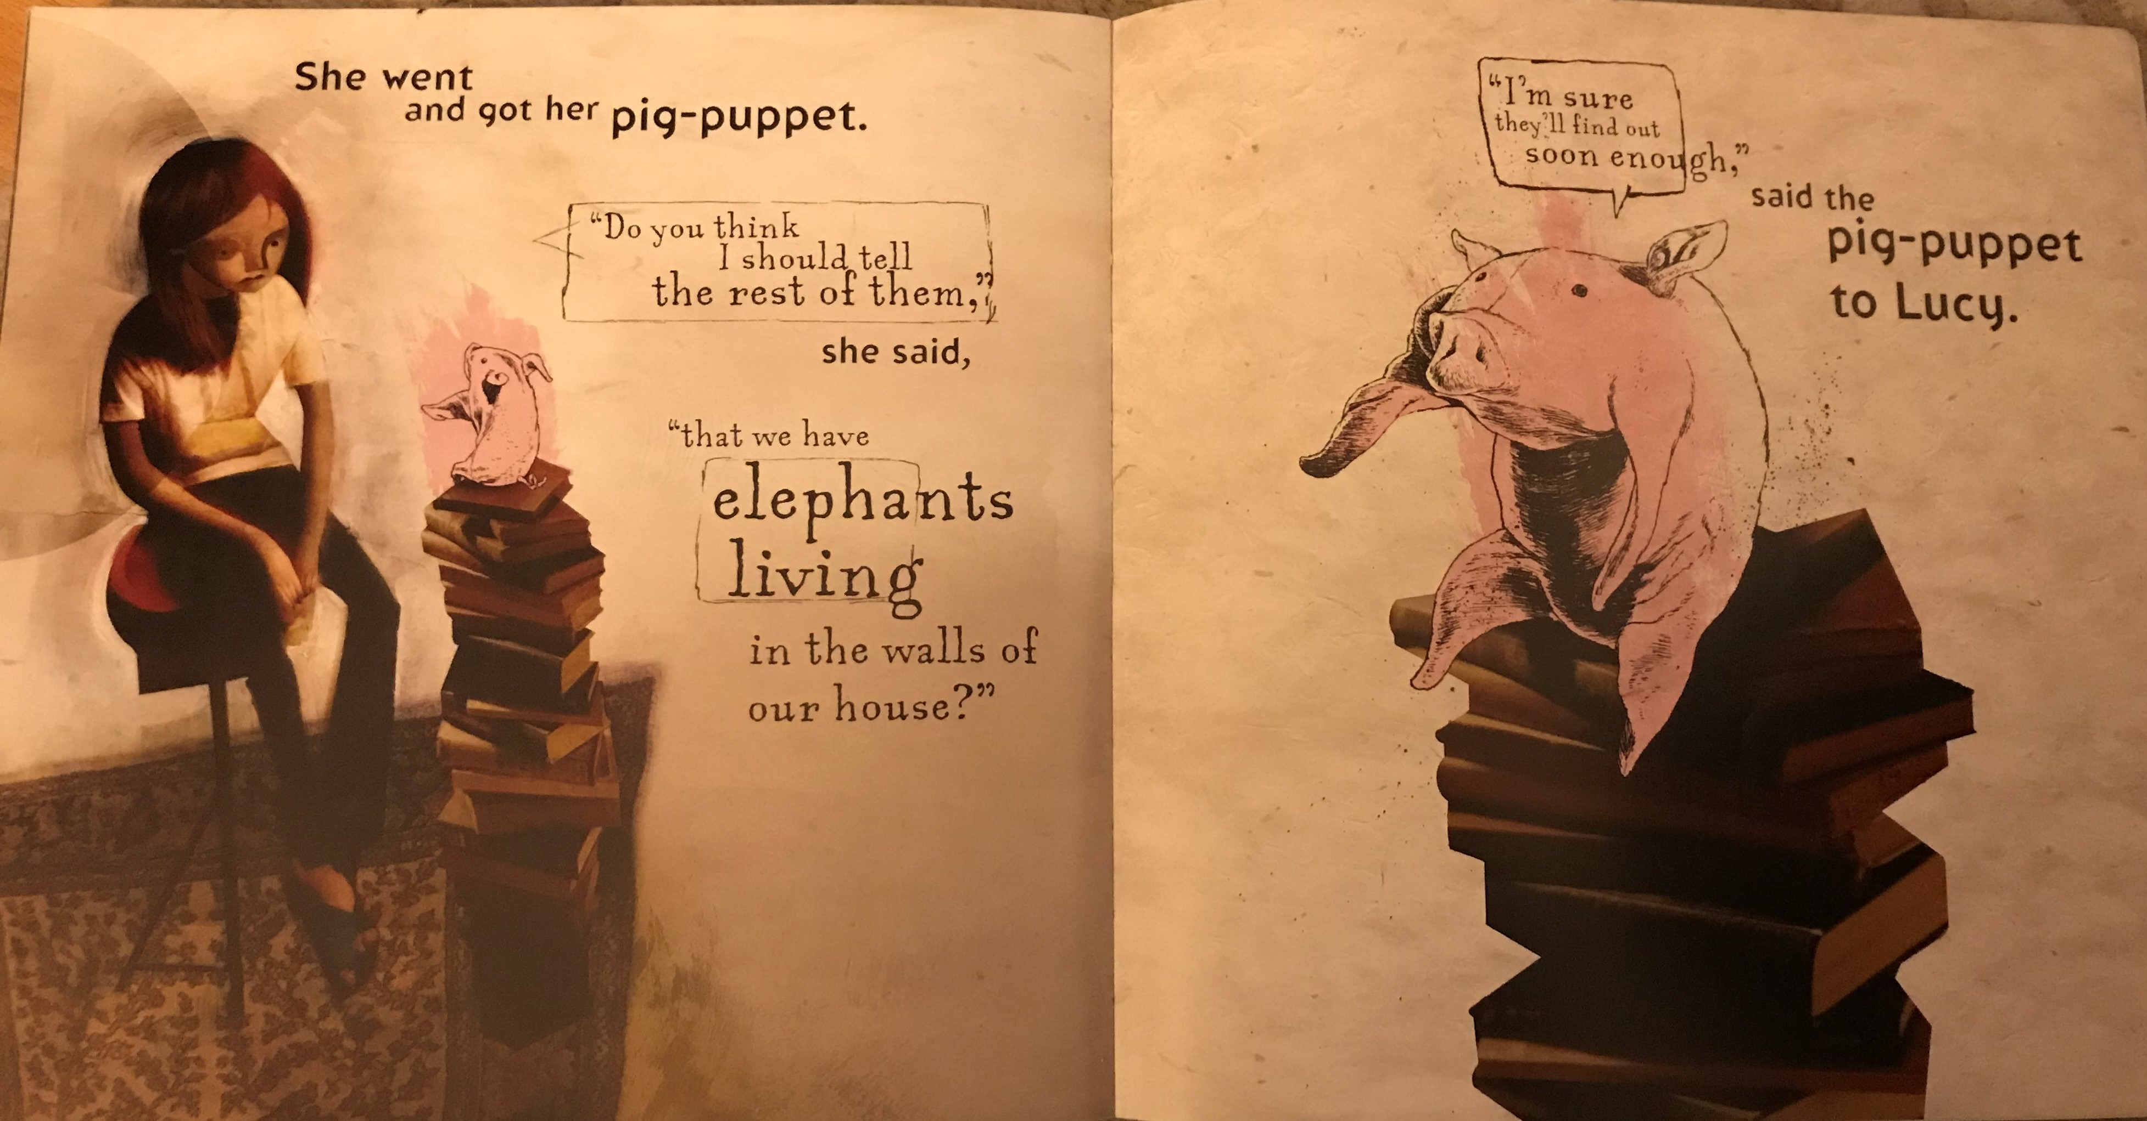

Slide 11
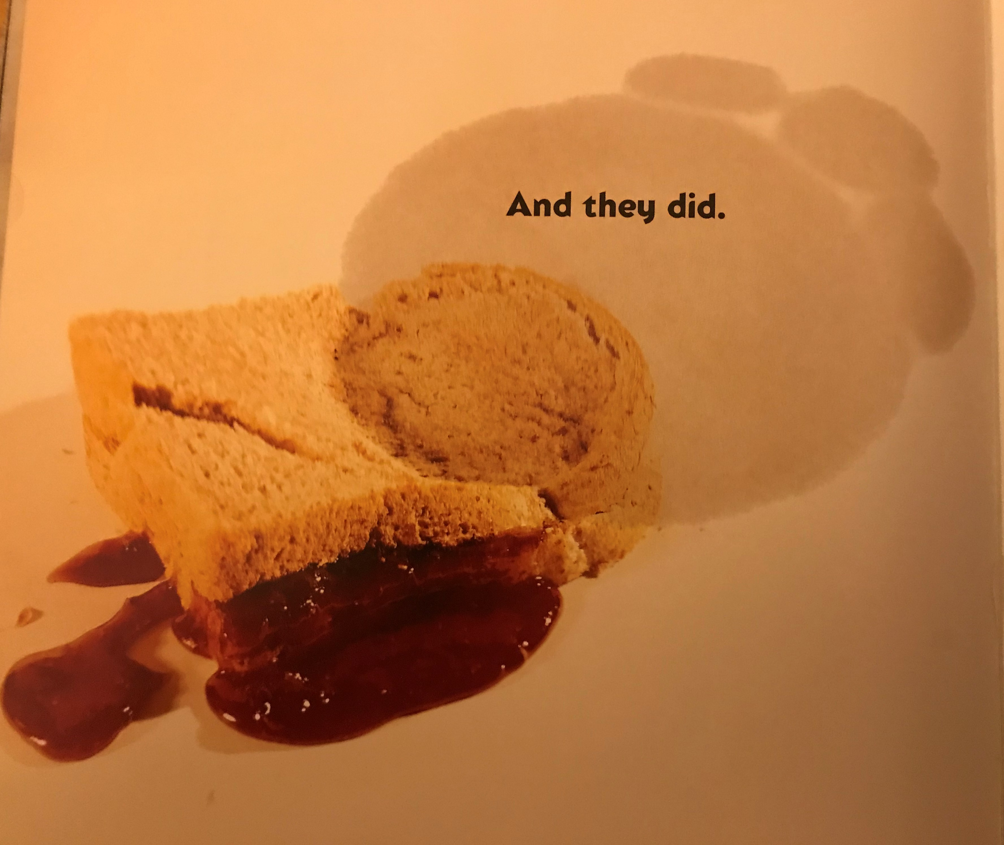

Slide 12
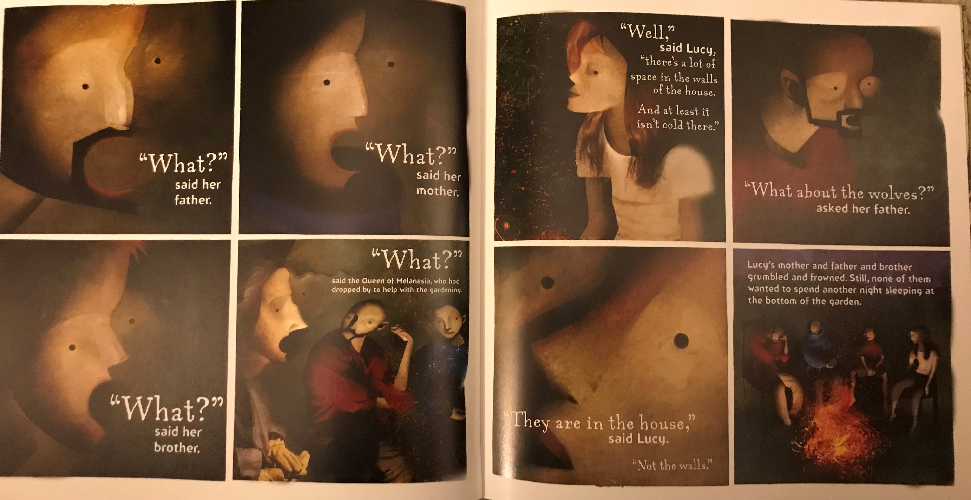
Have your questions from yesterday been answered?
Was the book as you expected?
What puzzles remain?
What does the book say about wolves?
Think about the four human characters from the book.
How is their response to the wolves different?
How is it similar?
What do they each seem to think about the
wolves?
How can you tell this?
Let’s record some of your ideas.

Slide 13


Now you are going to prepare an imaginary press conference where the family are interviewed about their experiences.
In pairs one of takes the role of reporter and will base your questions on those from the Interview Questions.
Work and talk together about how each character will answer the questions and add or adapt the questions.
In your pairs, record your responses below each question.

Slide 14
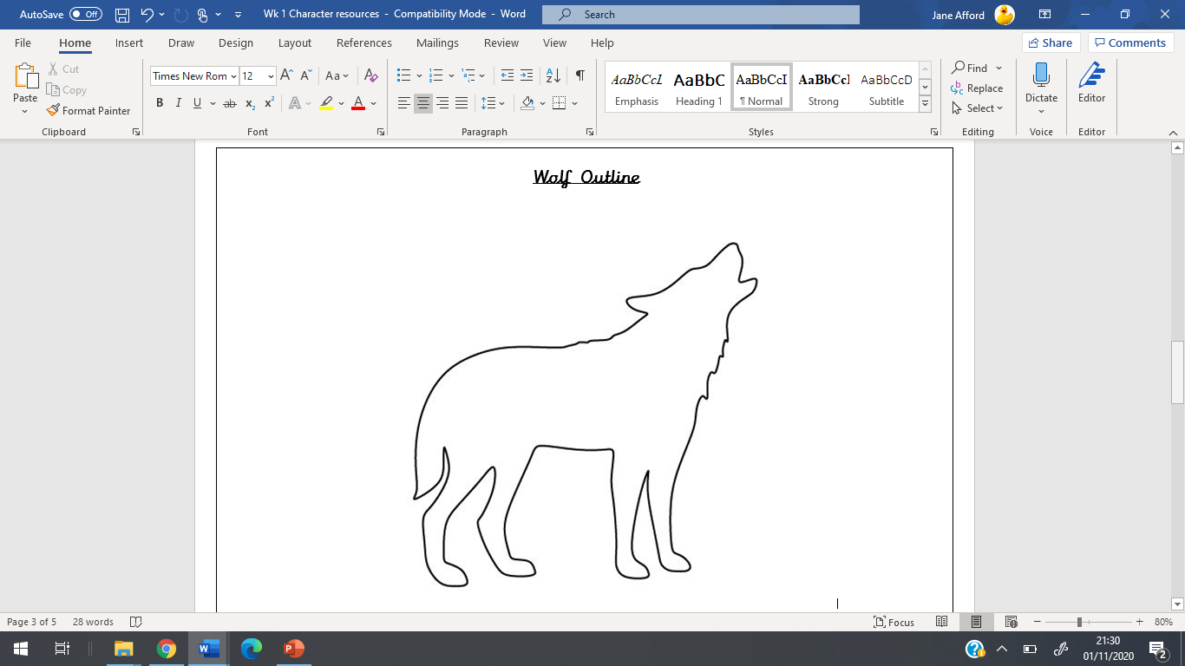
Plenary
We are going back to our Wolf Outline to add your additional ideas.
What else does the book tell us about wolves?
Are we supposed to think of these as facts?
Think about how we can tell that this book is fiction.
Compare our list with Fiction Features

Slide 15
Fiction Features
Imaginary situations even if realistic.
About a particular situation or story, not general facts.
Importance given to characters.
Might include dialogue or the character’s thoughts.
Poetic language – alliteration, similes, metaphors, repeated patterns.
Mysterious – posing questions and puzzles.
Often humorous.
Can be organised in chapters, to tell the story.

