Slide 1

The Wolves in the Walls continued…
Are you ready to find out what happens next?

Slide 2
Tuesday 3rd November
LO: To draw inferences such as inferring characters’ feelings, thoughts and motives from their actions, and justifying inferences with evidence.

Slide 3
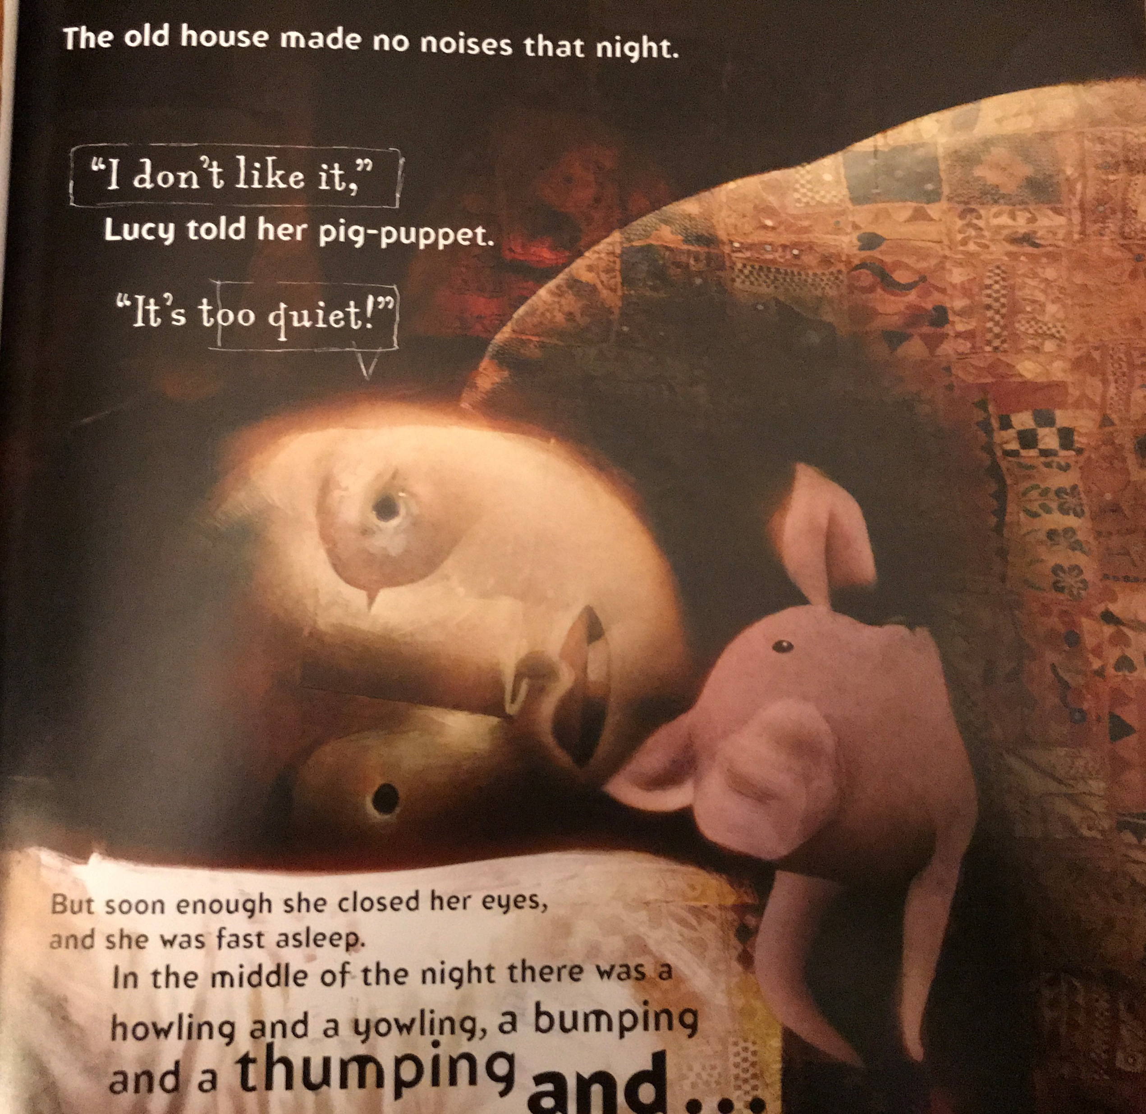
Can you remember where we were up to in the story?
That’s right. All was quiet and Lucy was asleep in bed when suddenly there were noises!
Howling yowling, thumping and bumping…
And…!

Slide 4
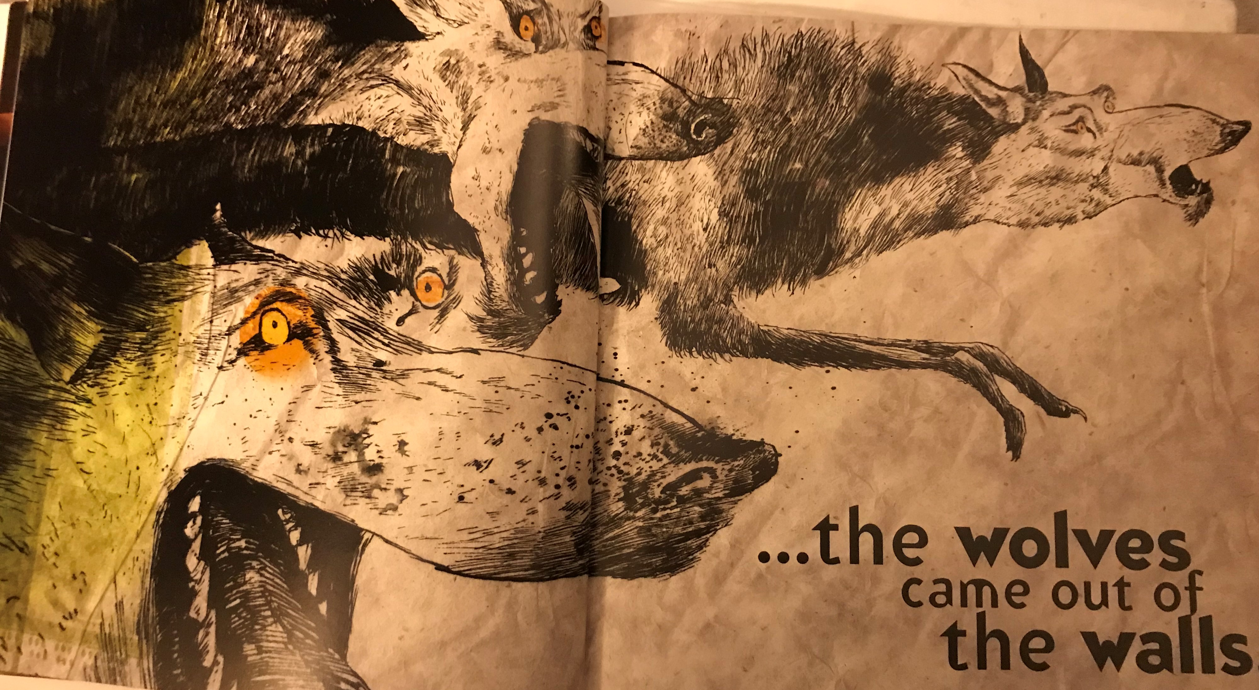

Slide 5
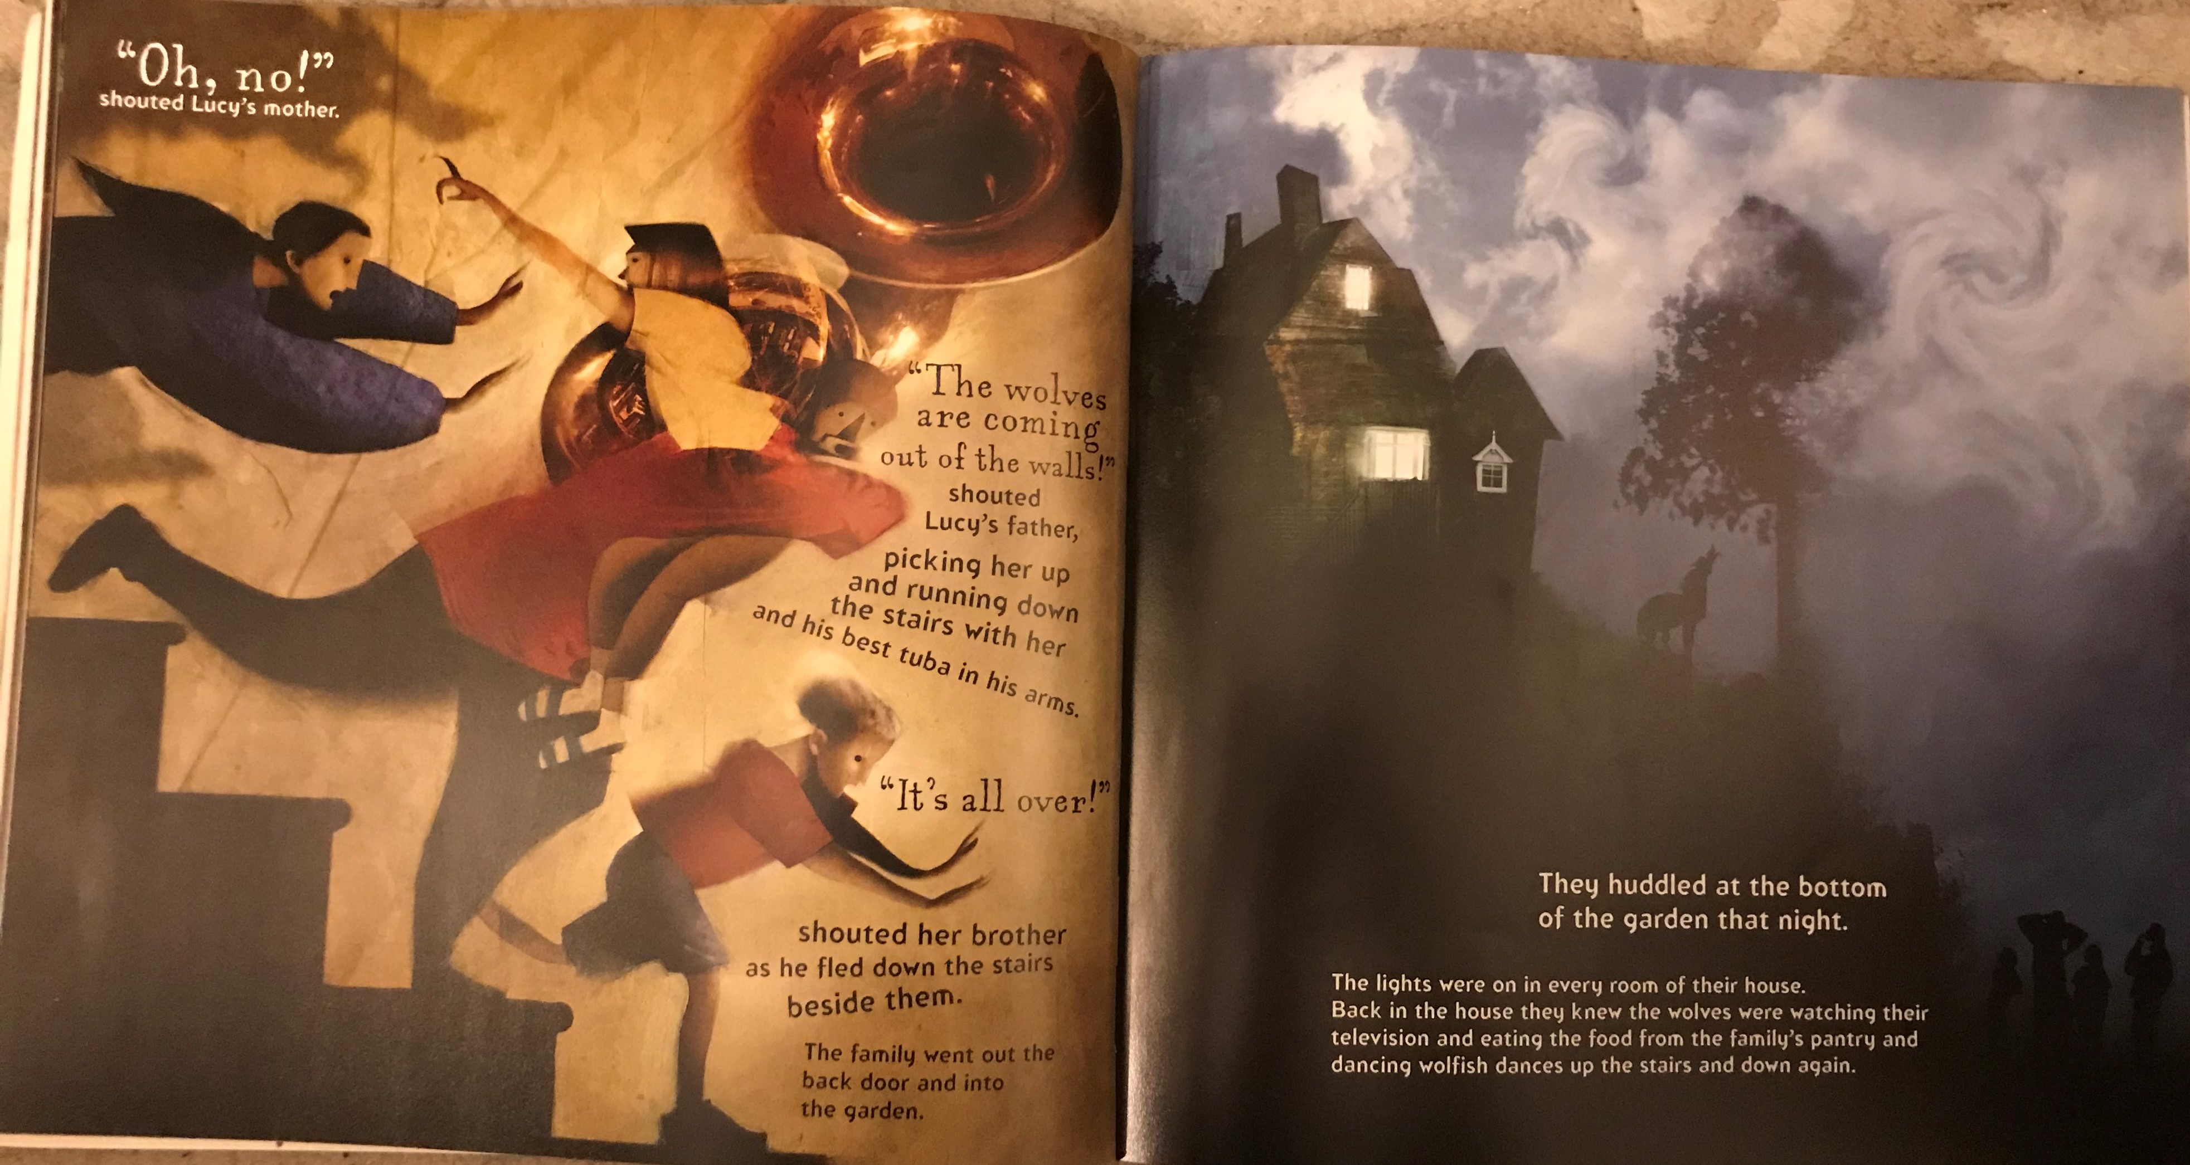

Slide 6
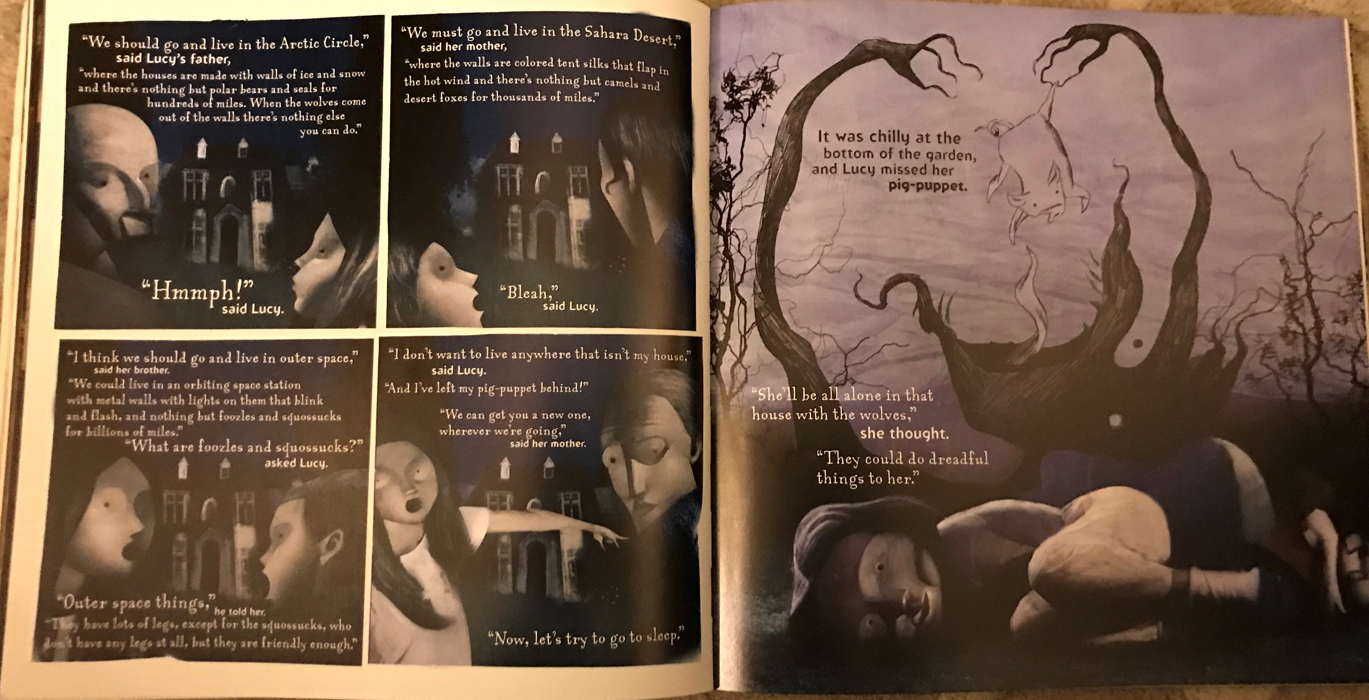

Slide 7
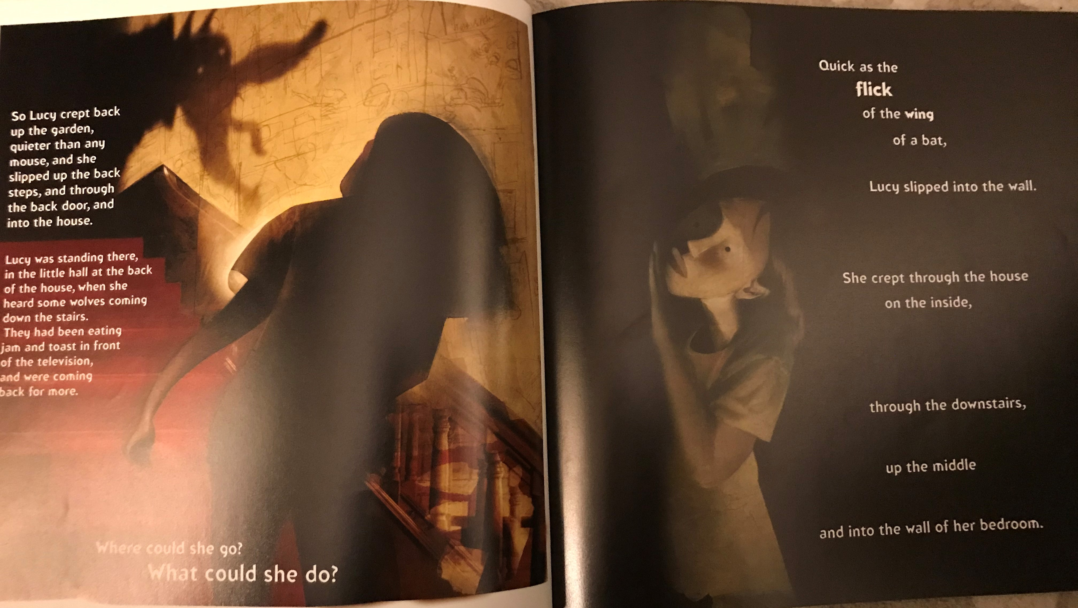

Slide 8
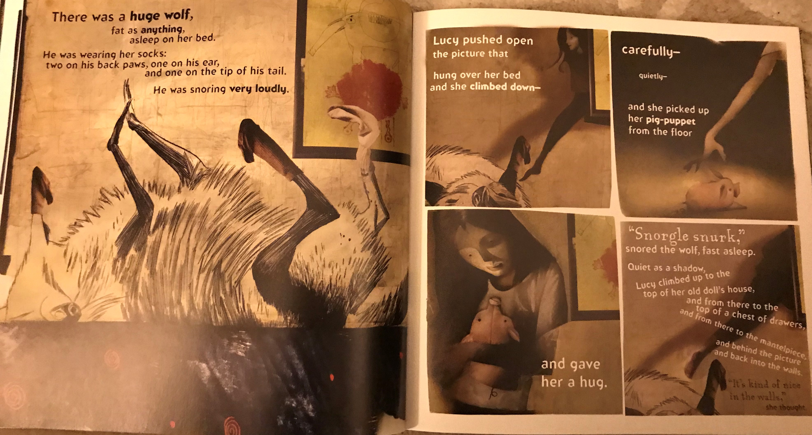

Slide 9
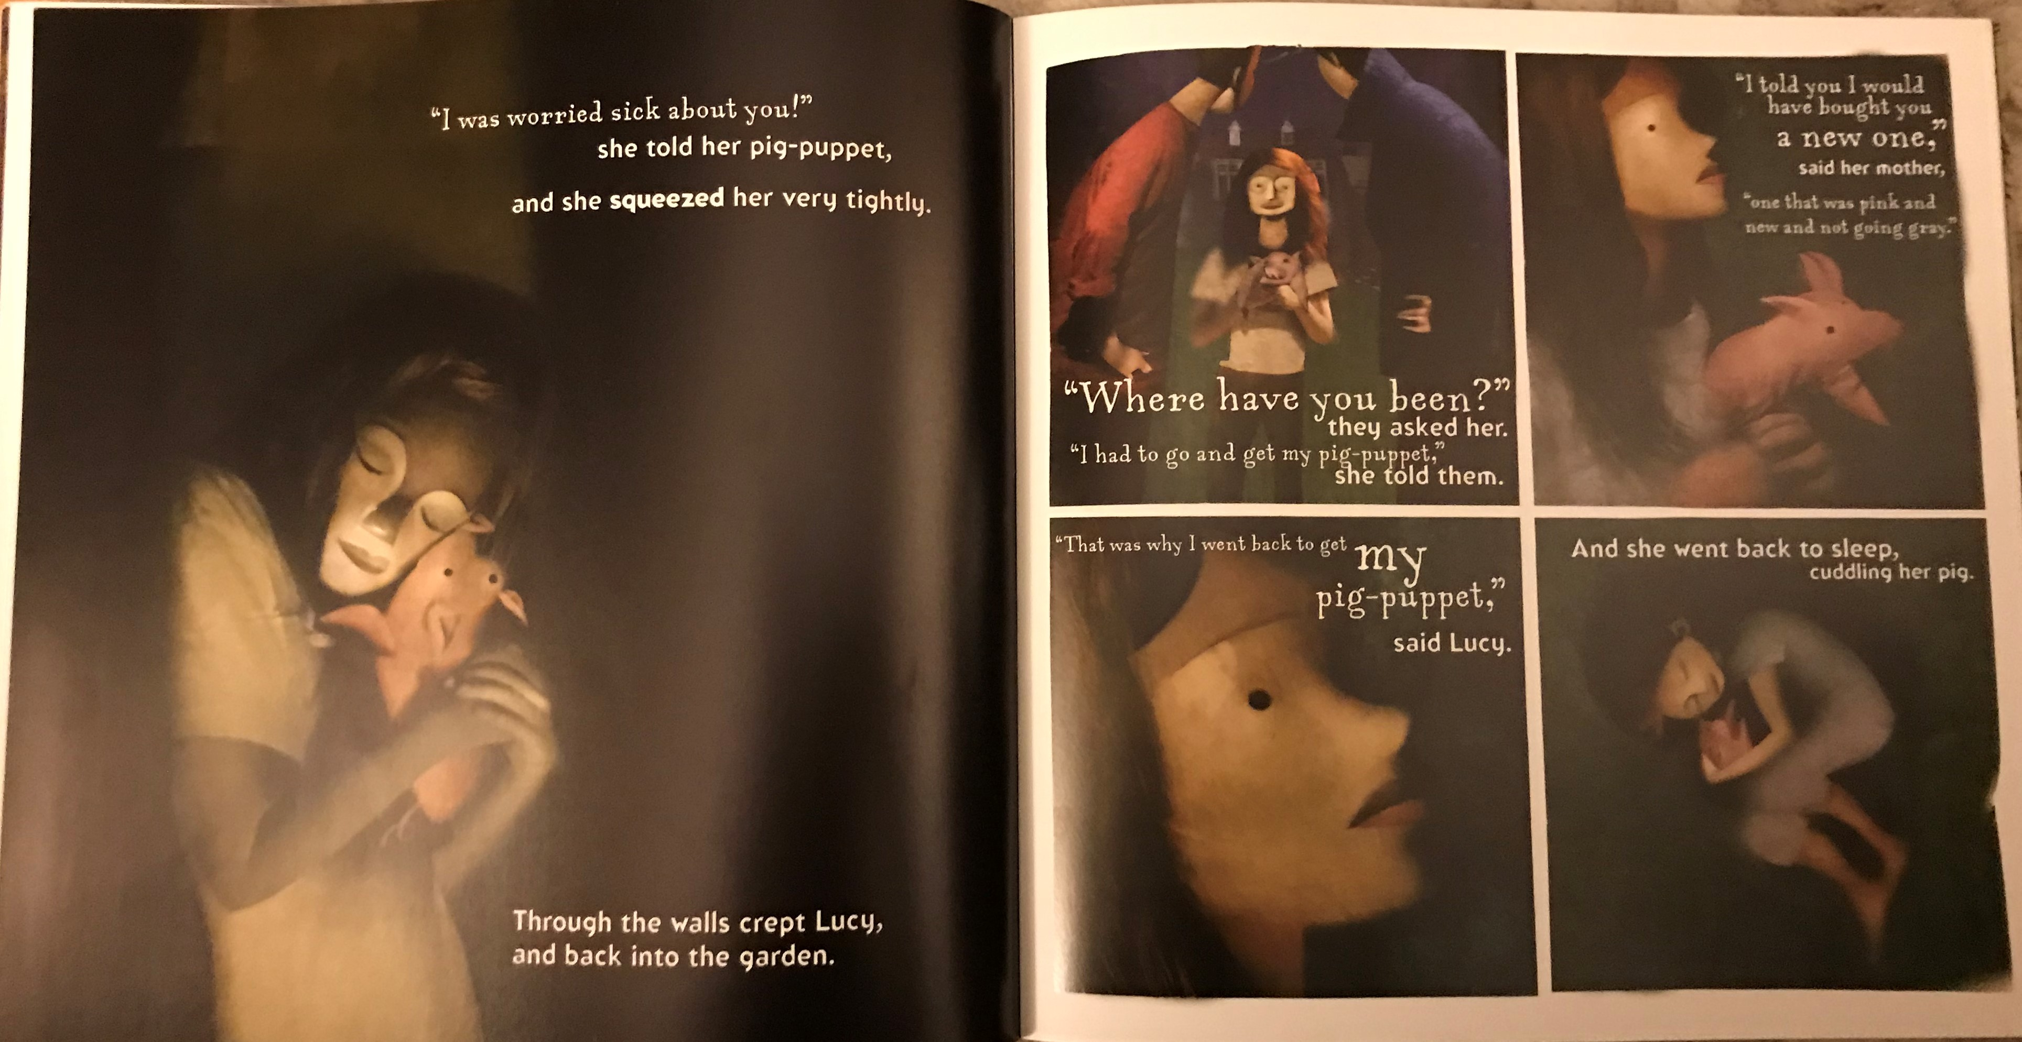

Slide 10
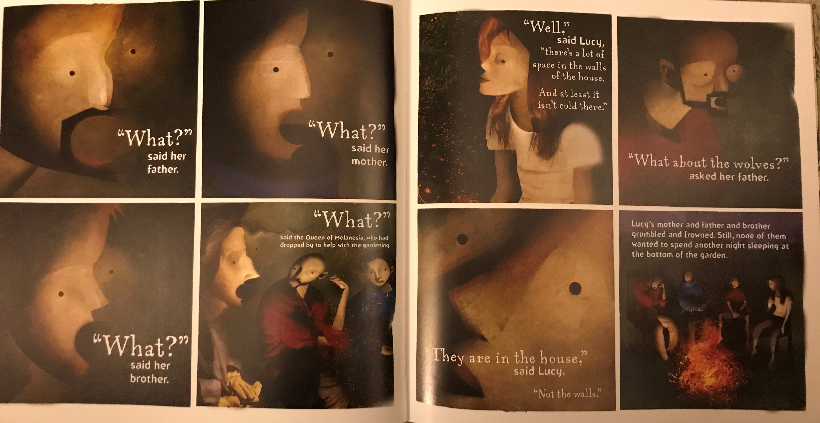

Slide 11
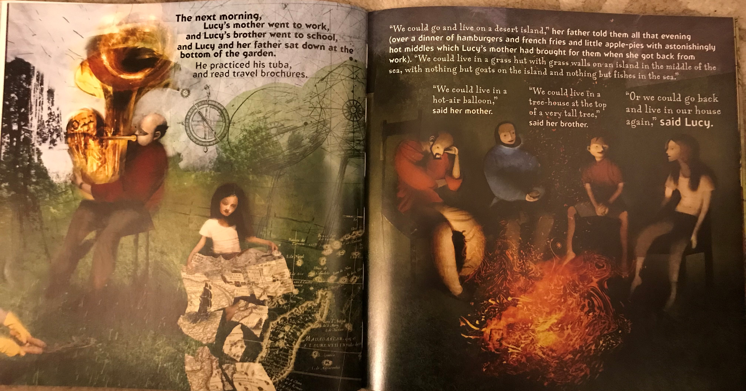

Slide 12
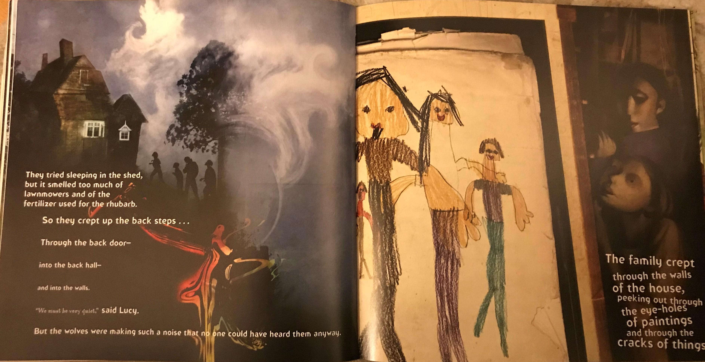

Slide 13
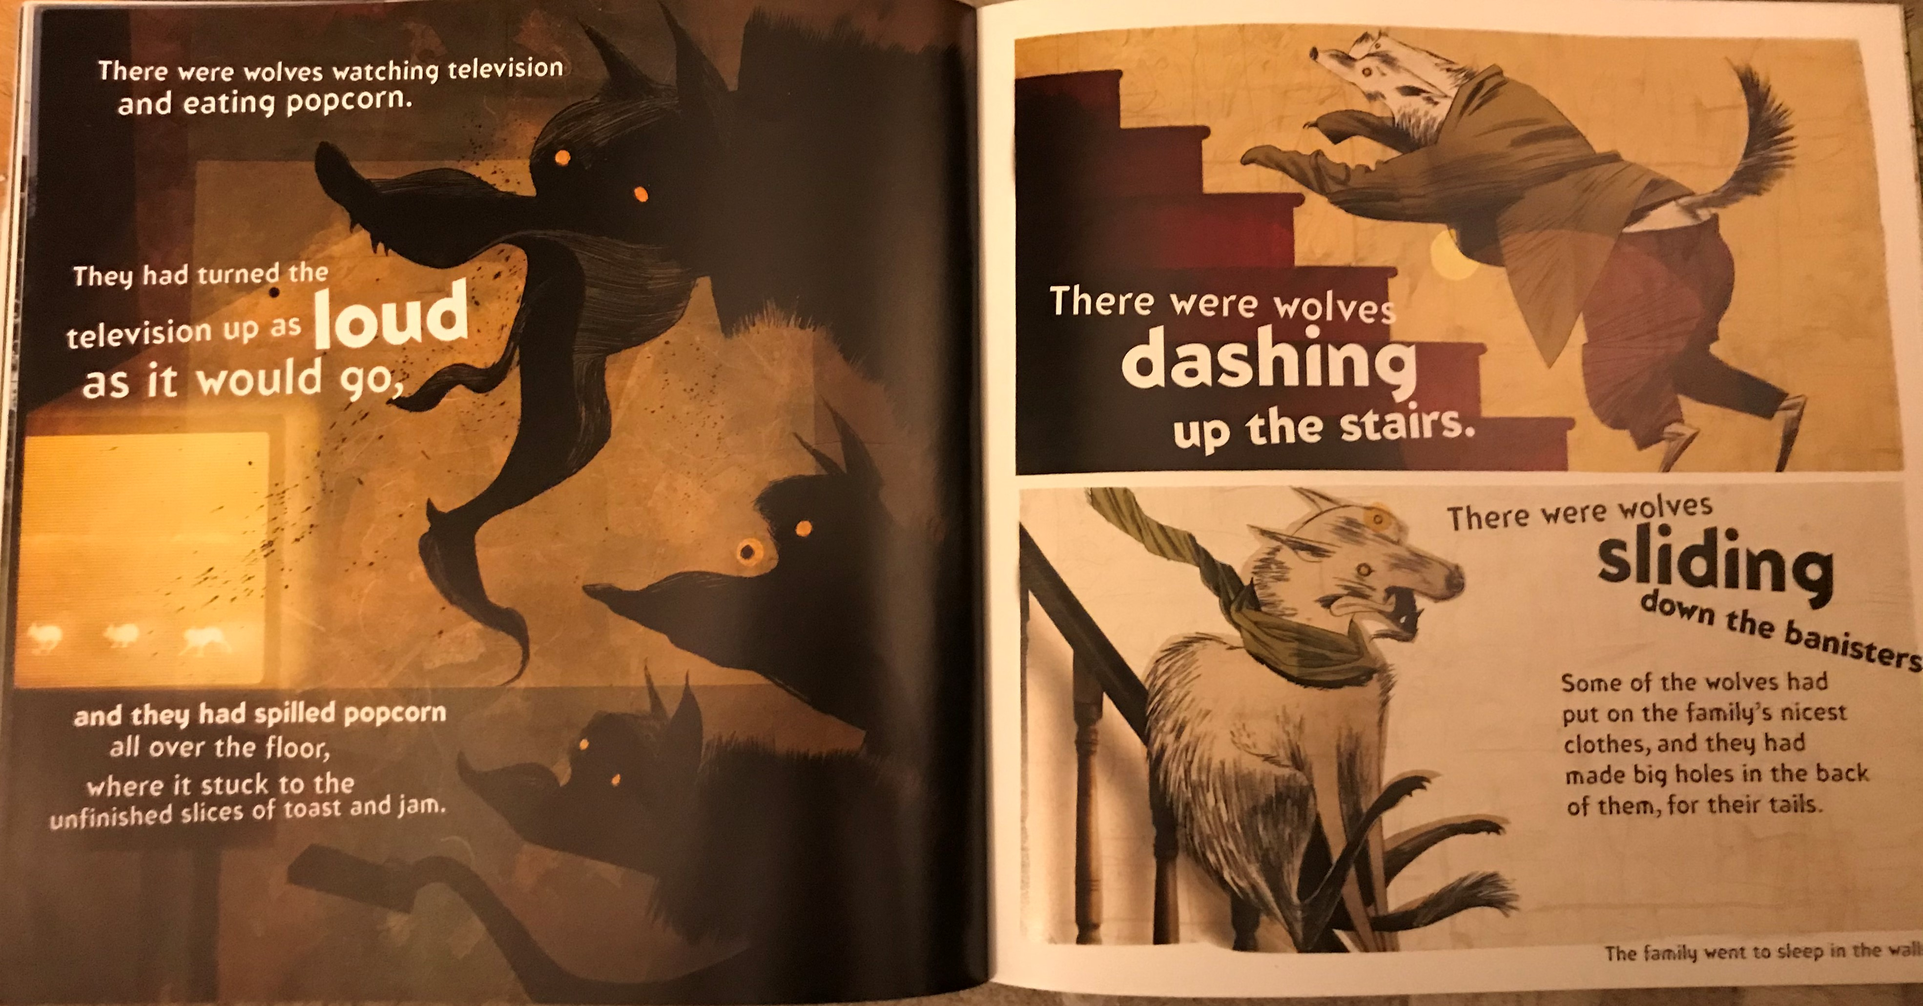

Slide 14


