Slide 1
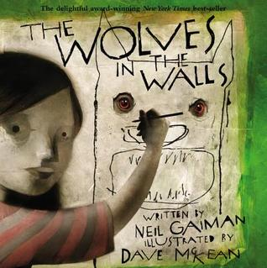
Wolves in the Walls
By Neil Gaiman

Slide 2
Monday 2nd November
LO: To predict what might happen from details stated and implied.
LO: To discuss words and phrases that capture the reader’s interest and imagination

Slide 3
Look at the front cover.
Do you think it is a
fiction or a non-fiction
book?
How can you tell?

Slide 4
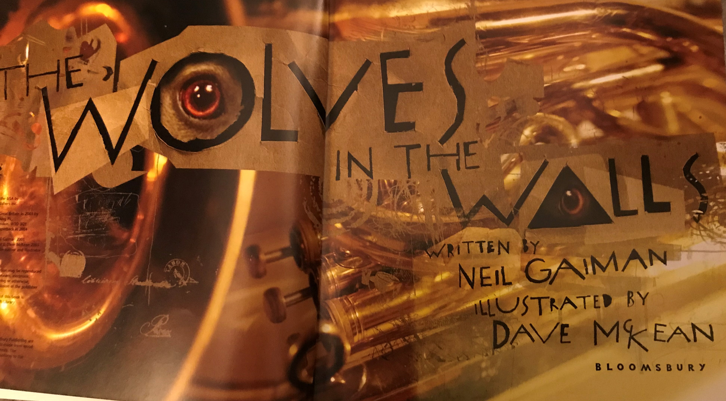
Now, look at the cover again and the title page and think about what questions you would like to ask about the book; such as,
Who is the girl?
Are there wolves in the walls?
Why are they there?

Slide 6
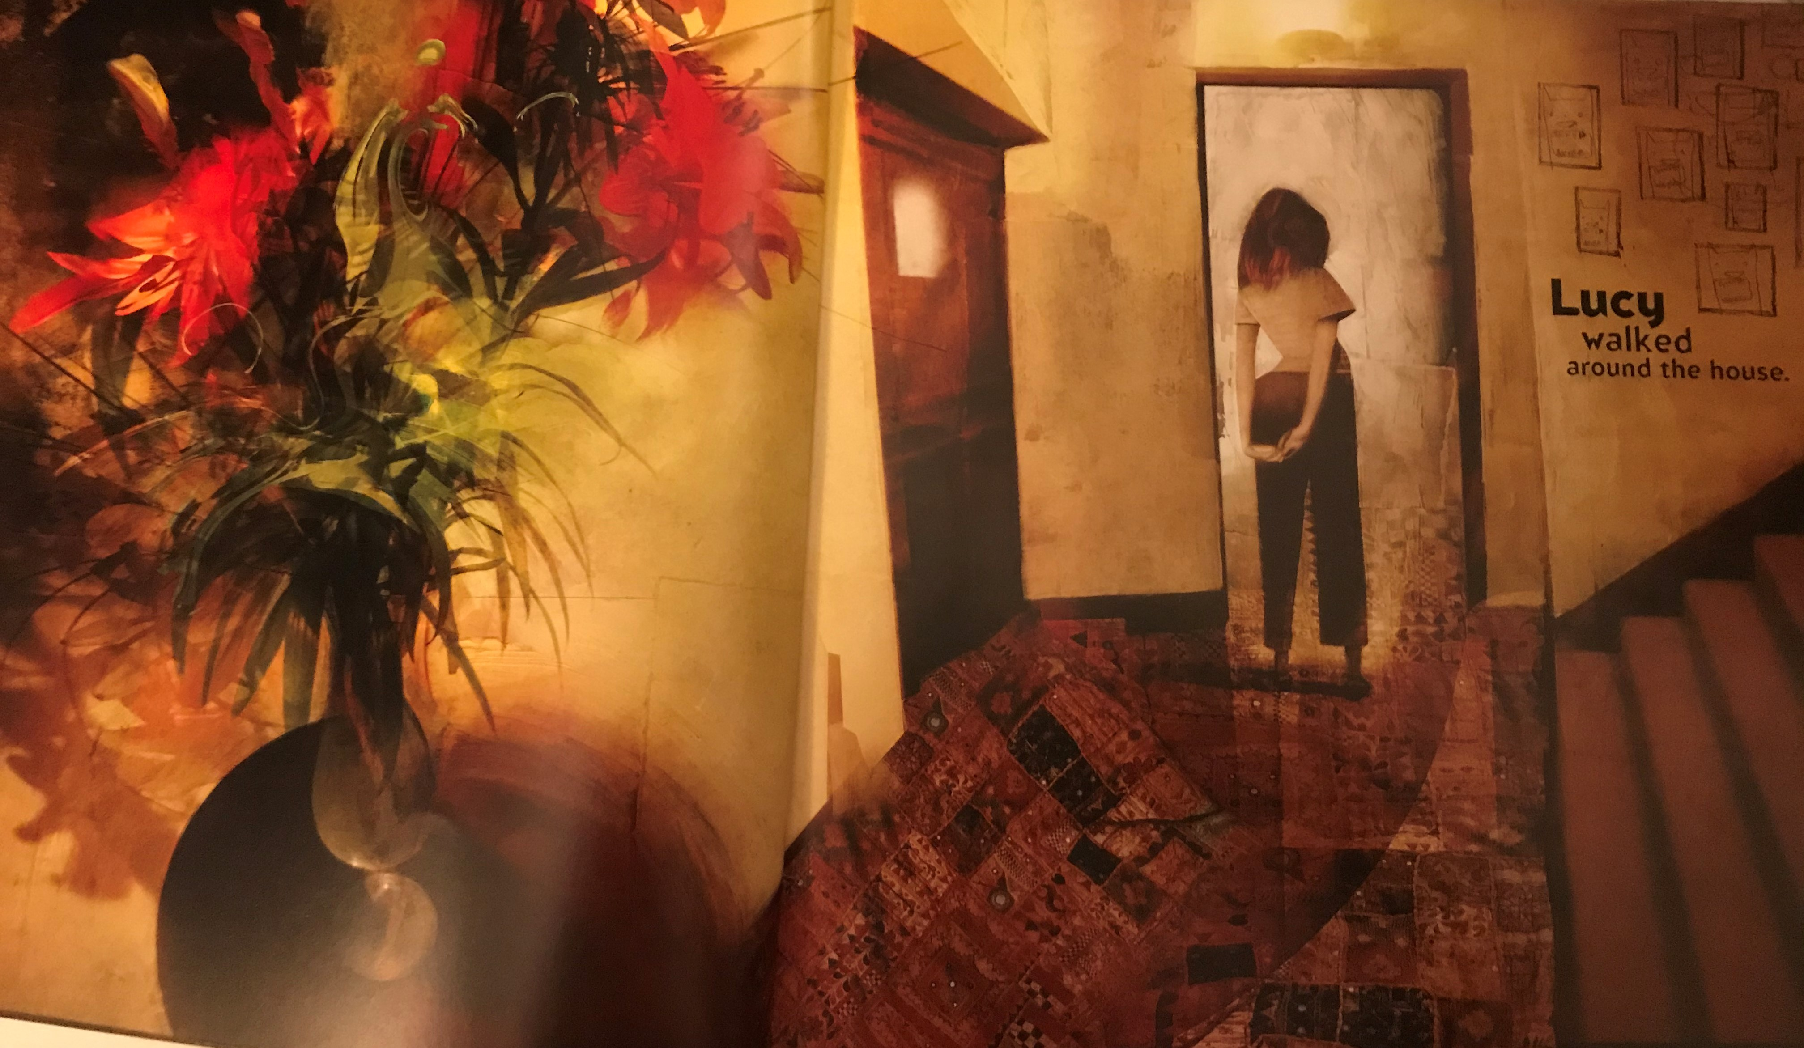

Slide 7


Slide 8
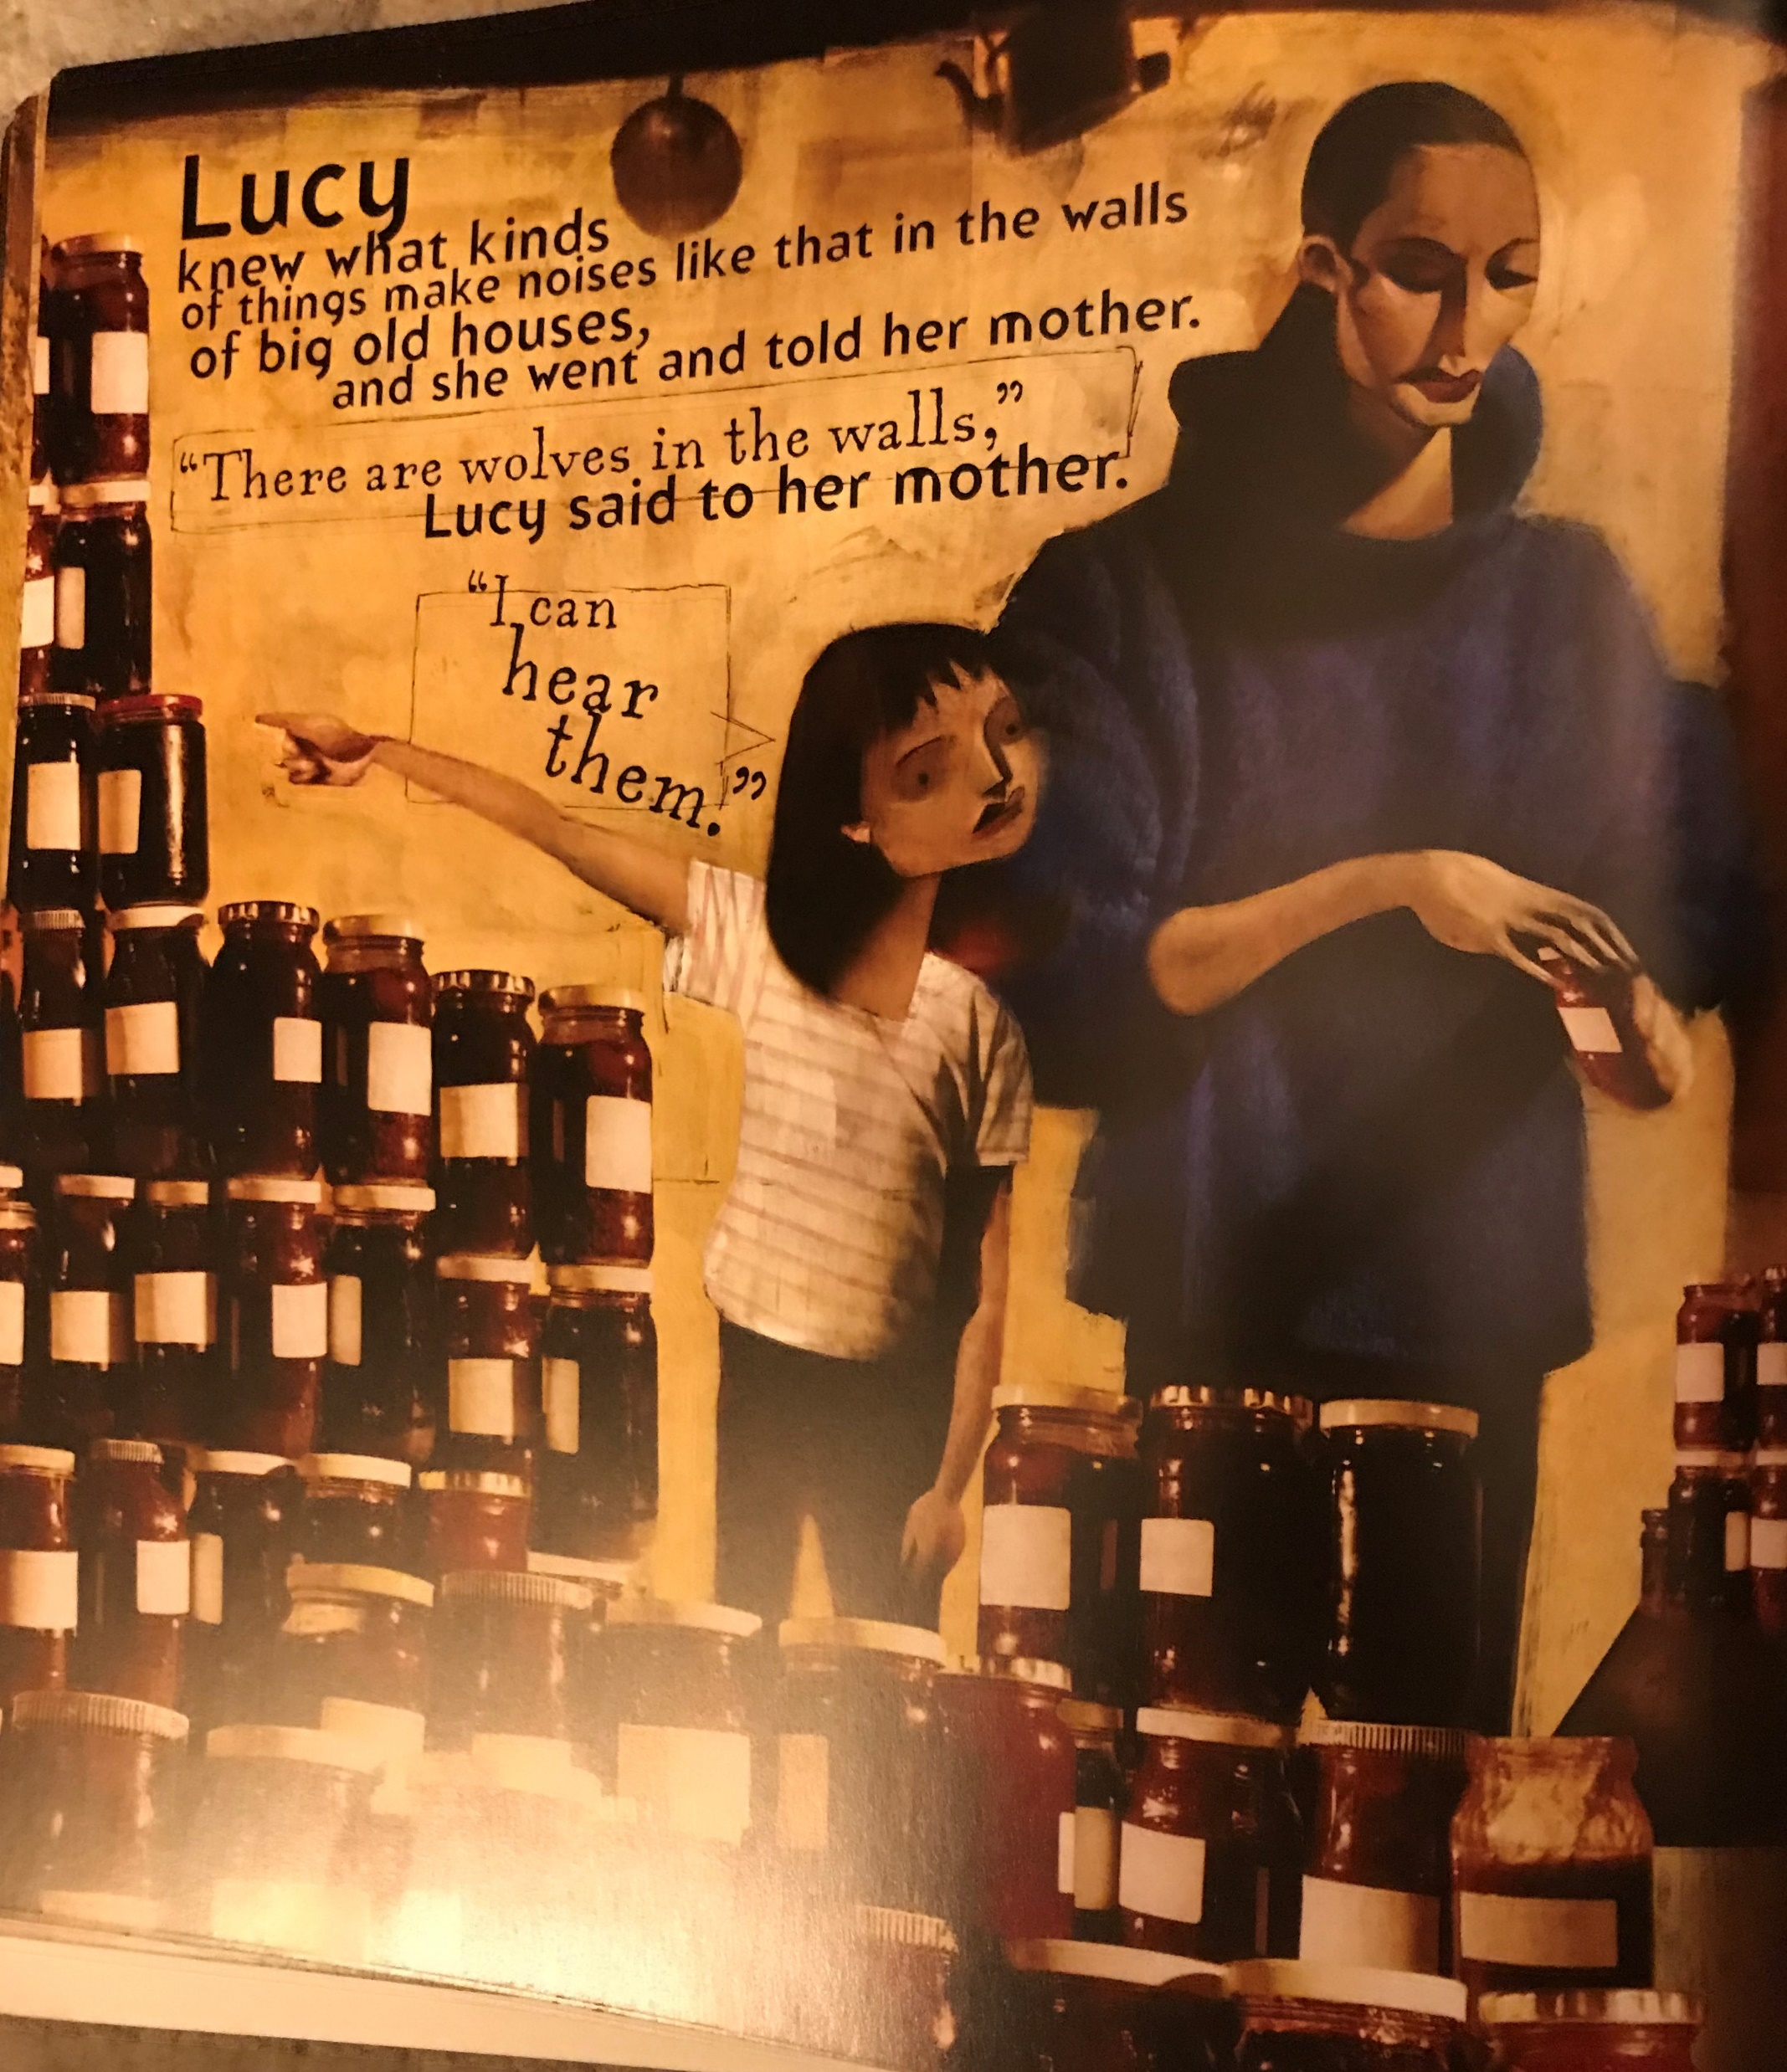
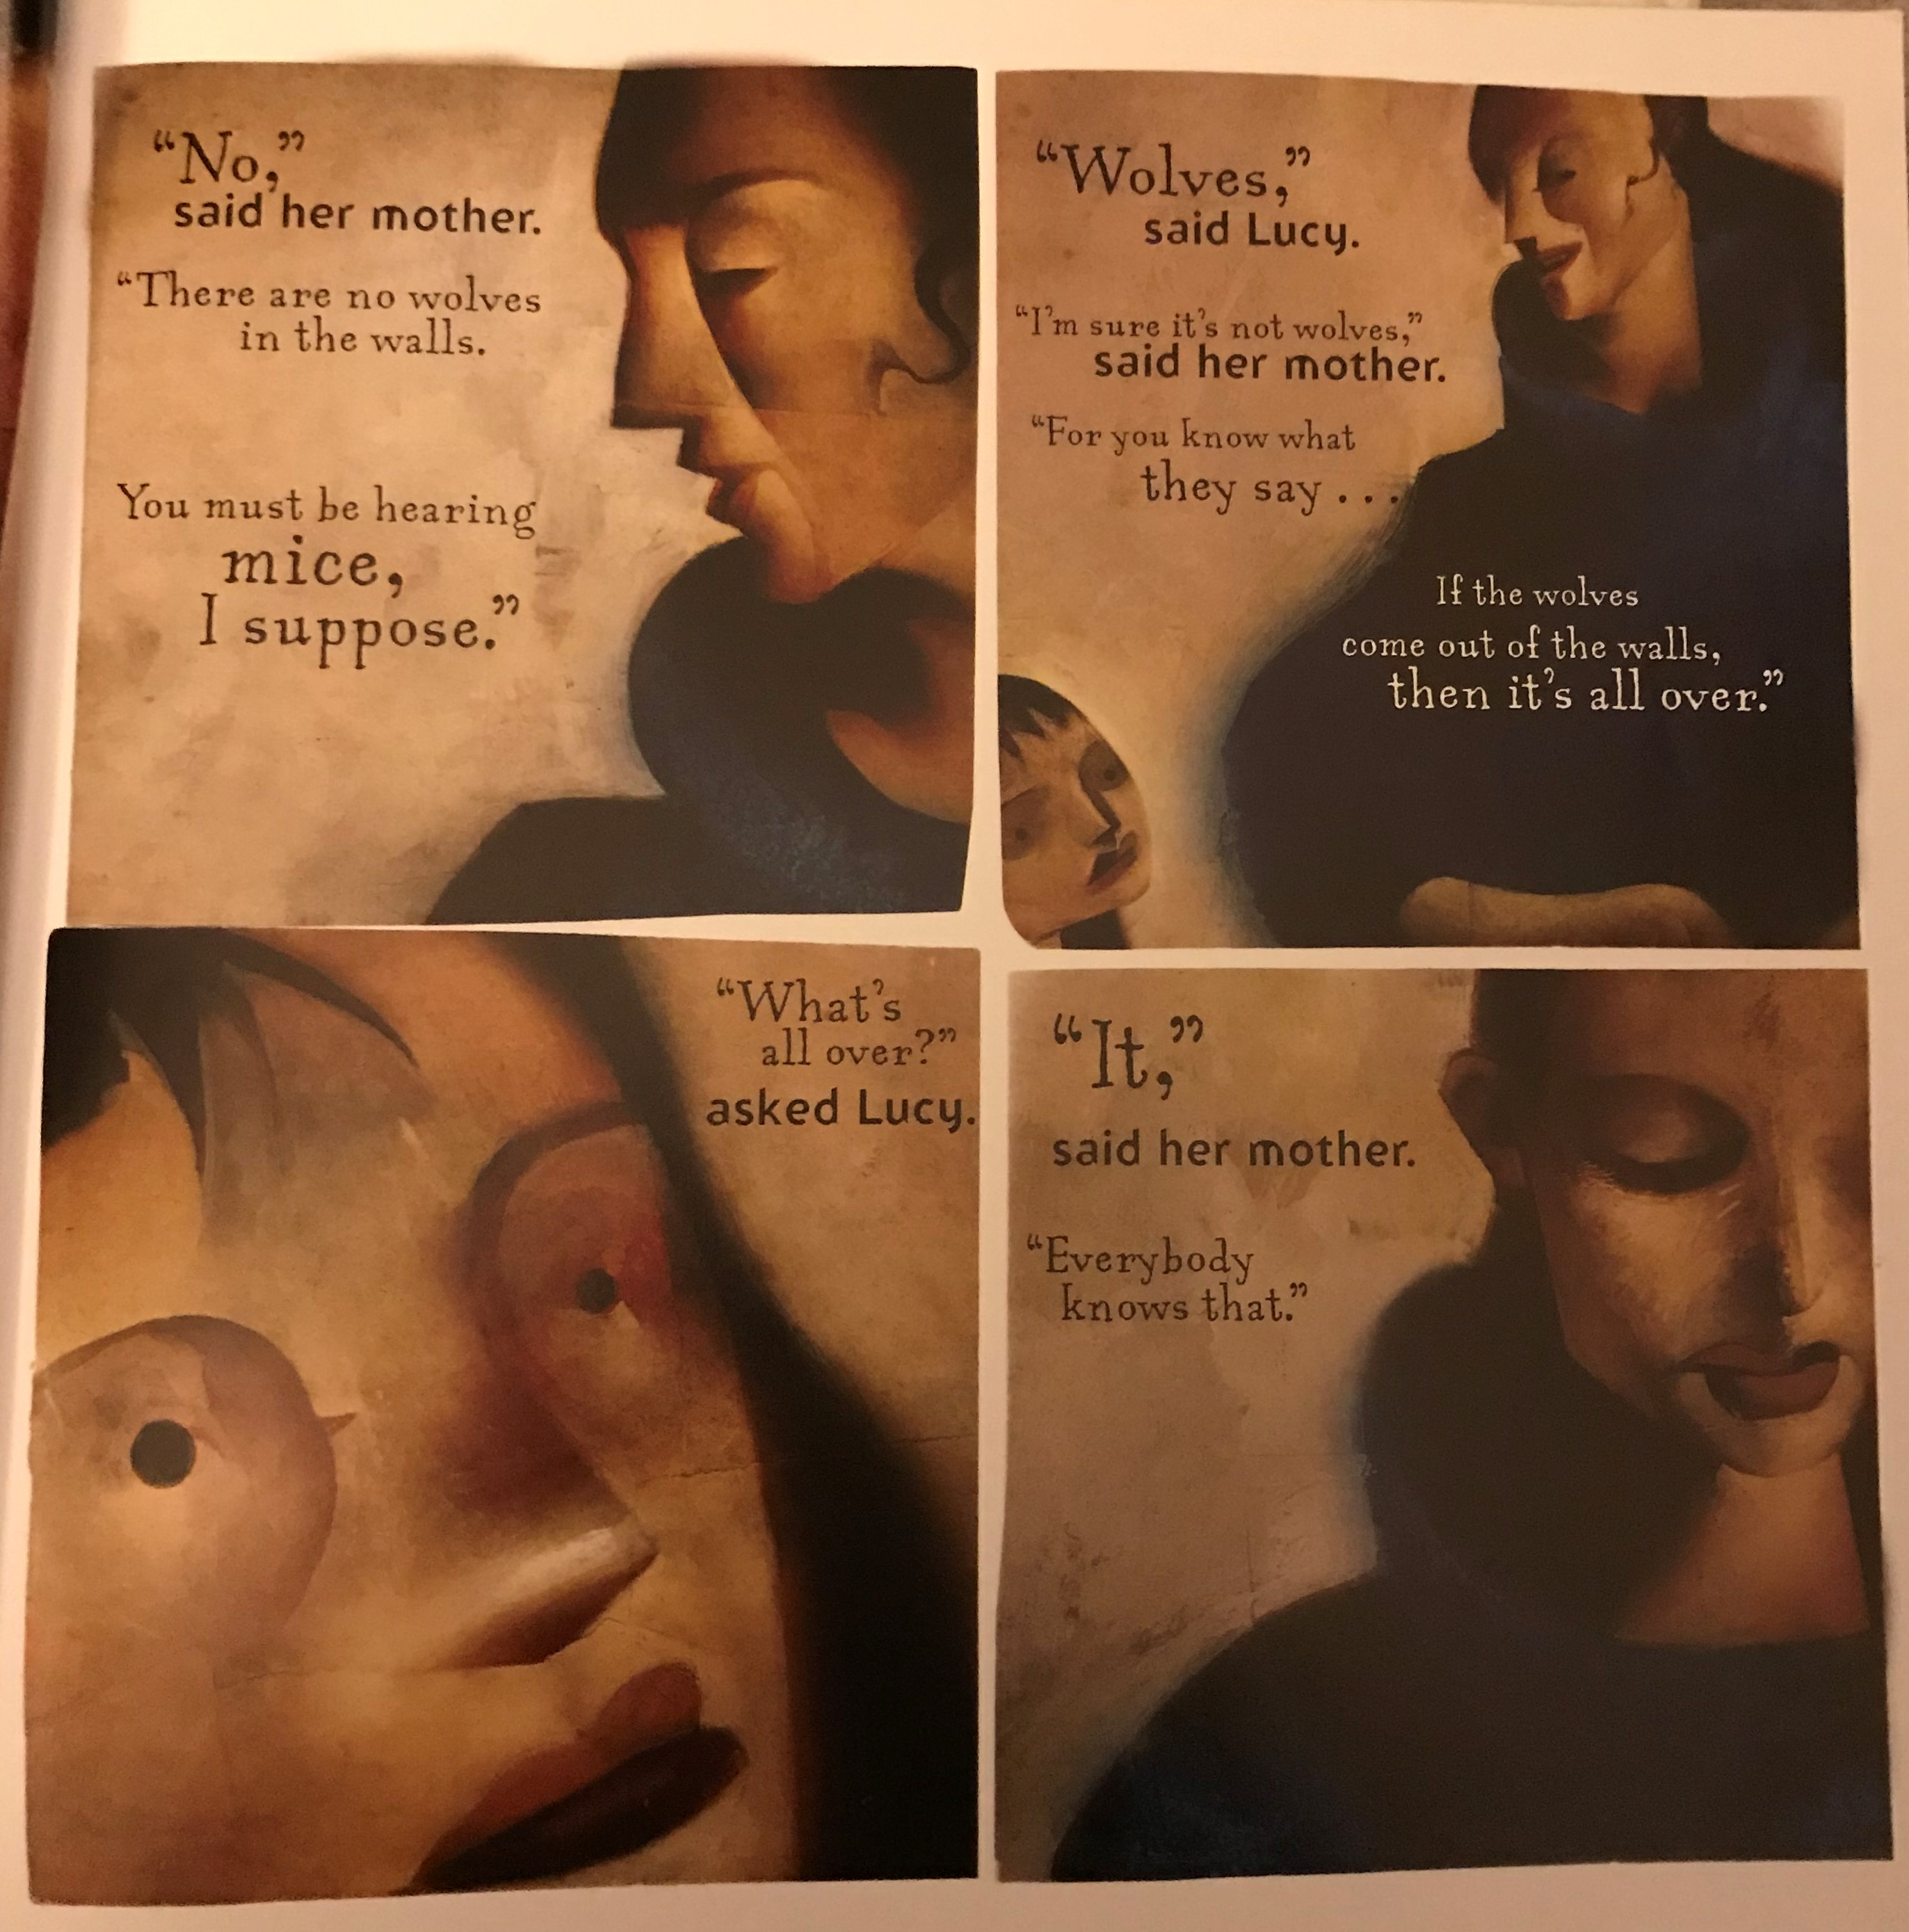

Slide 9
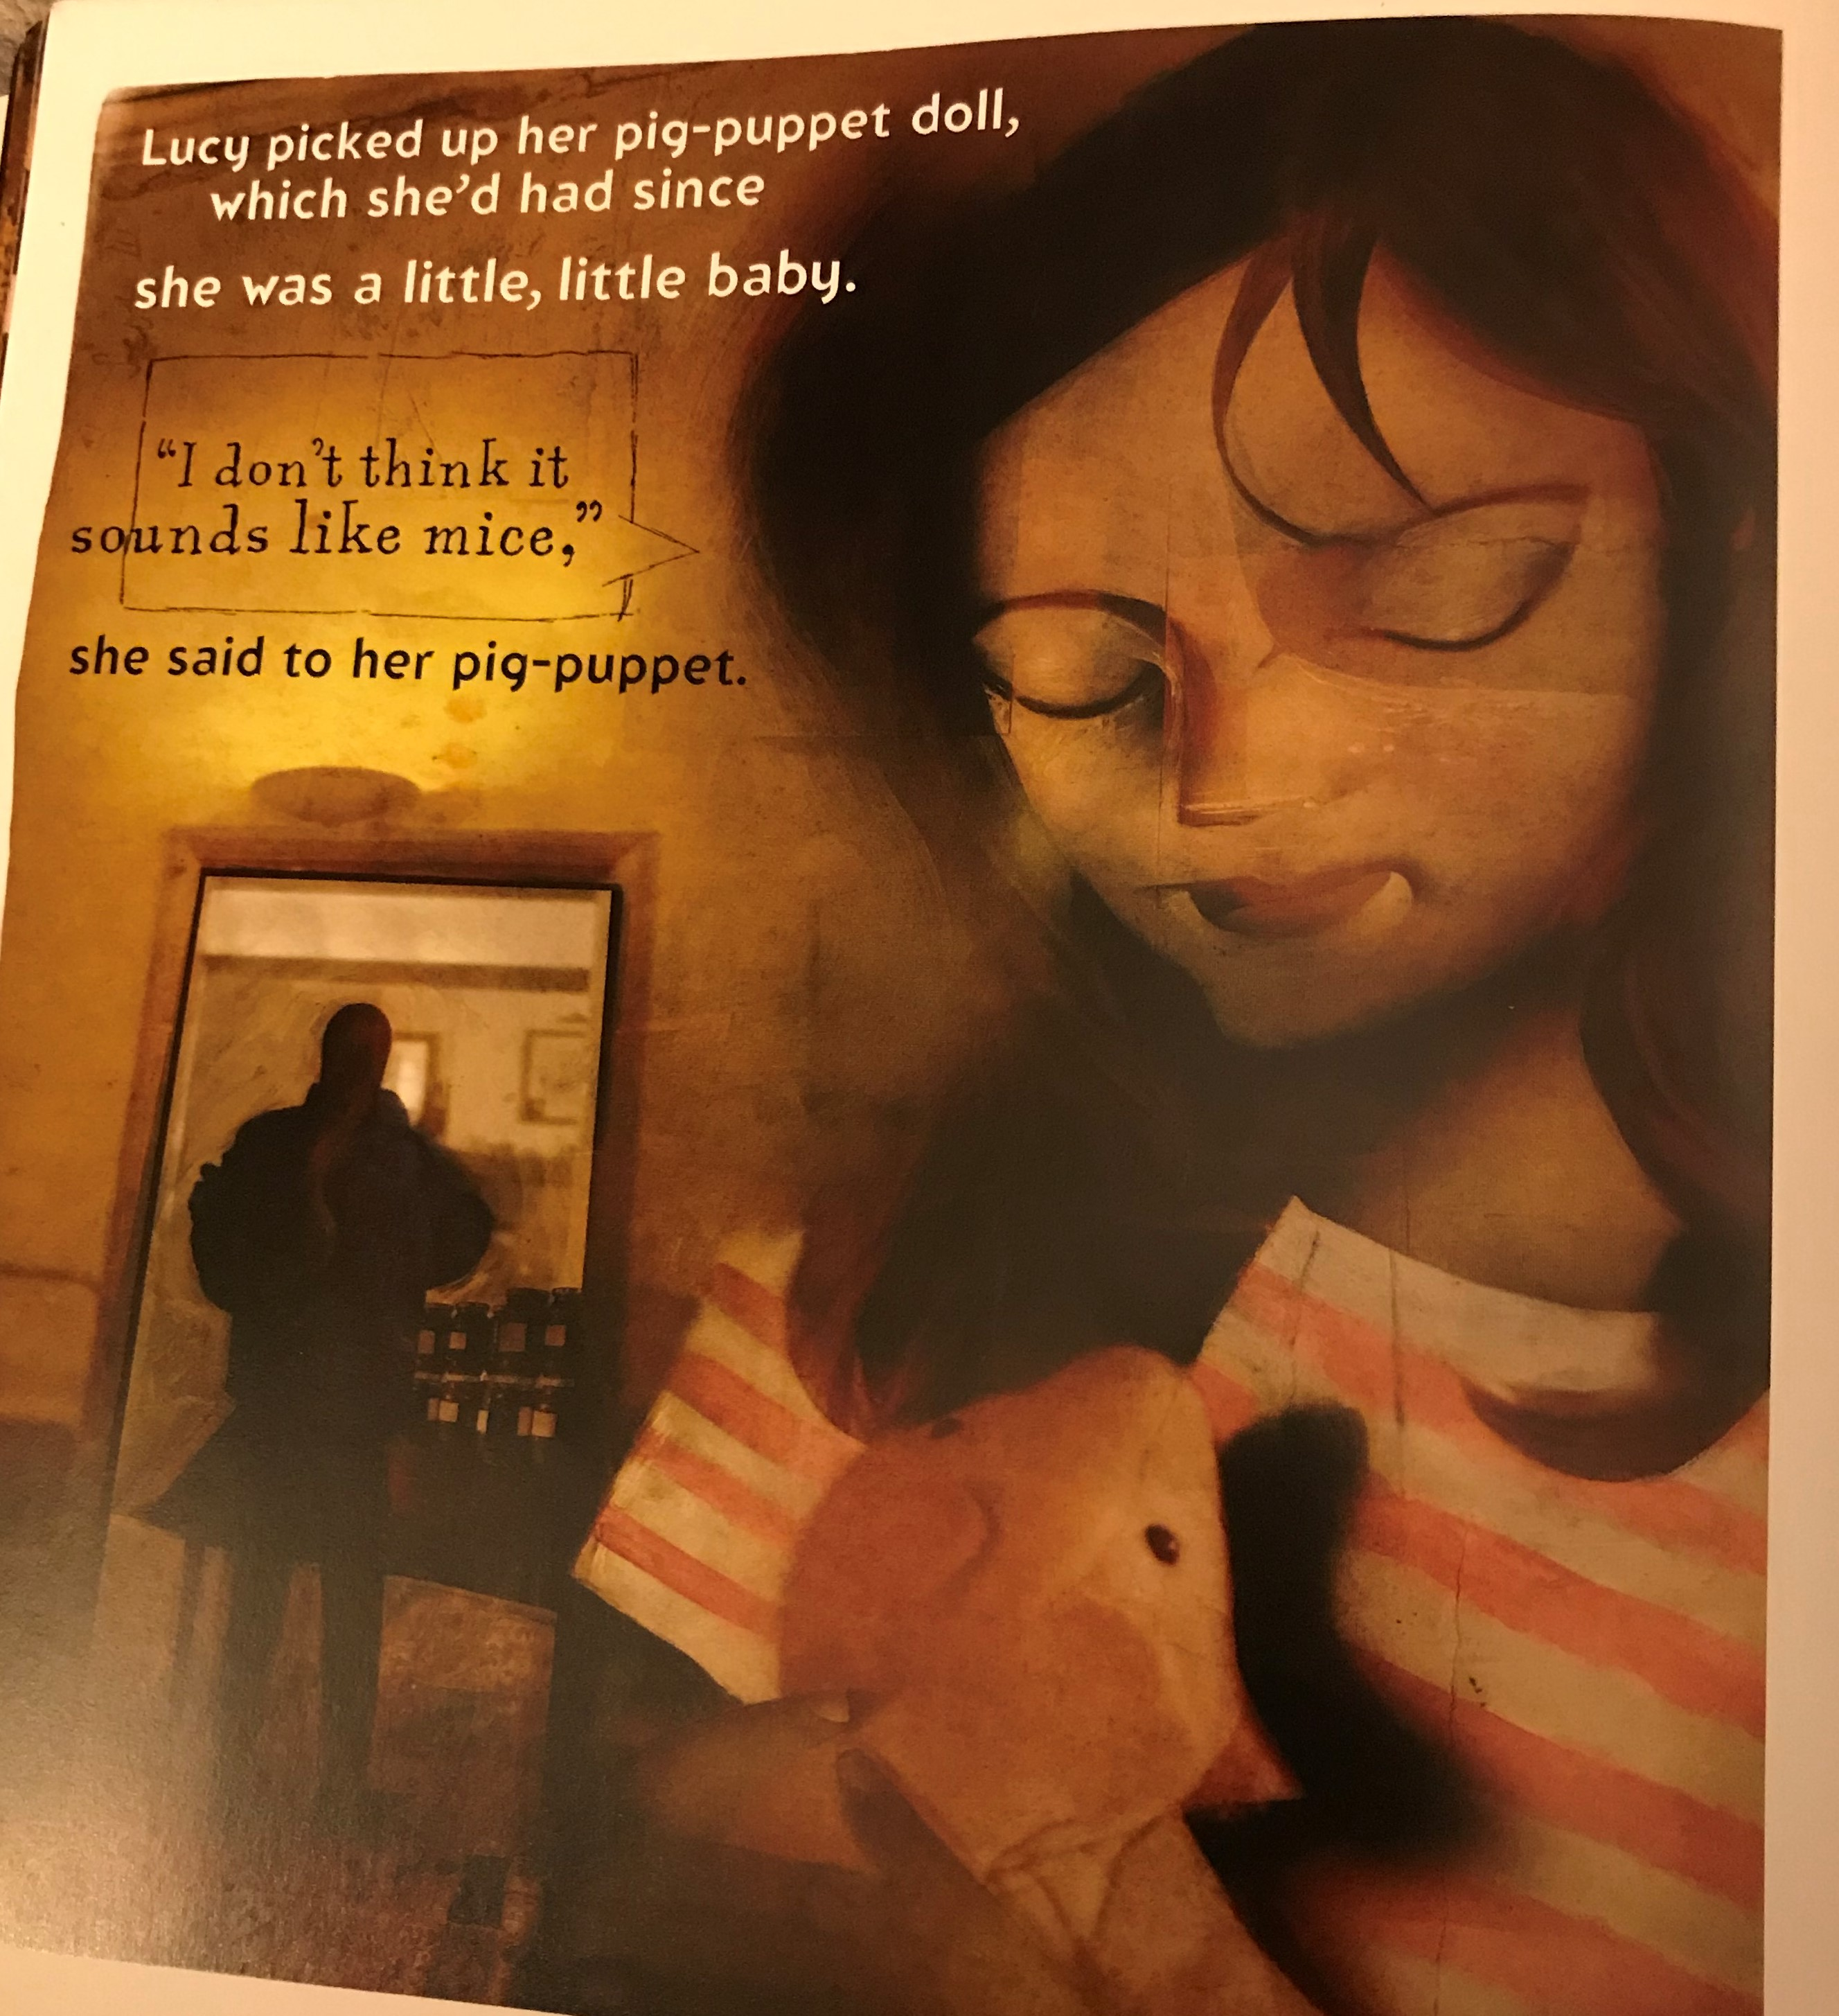
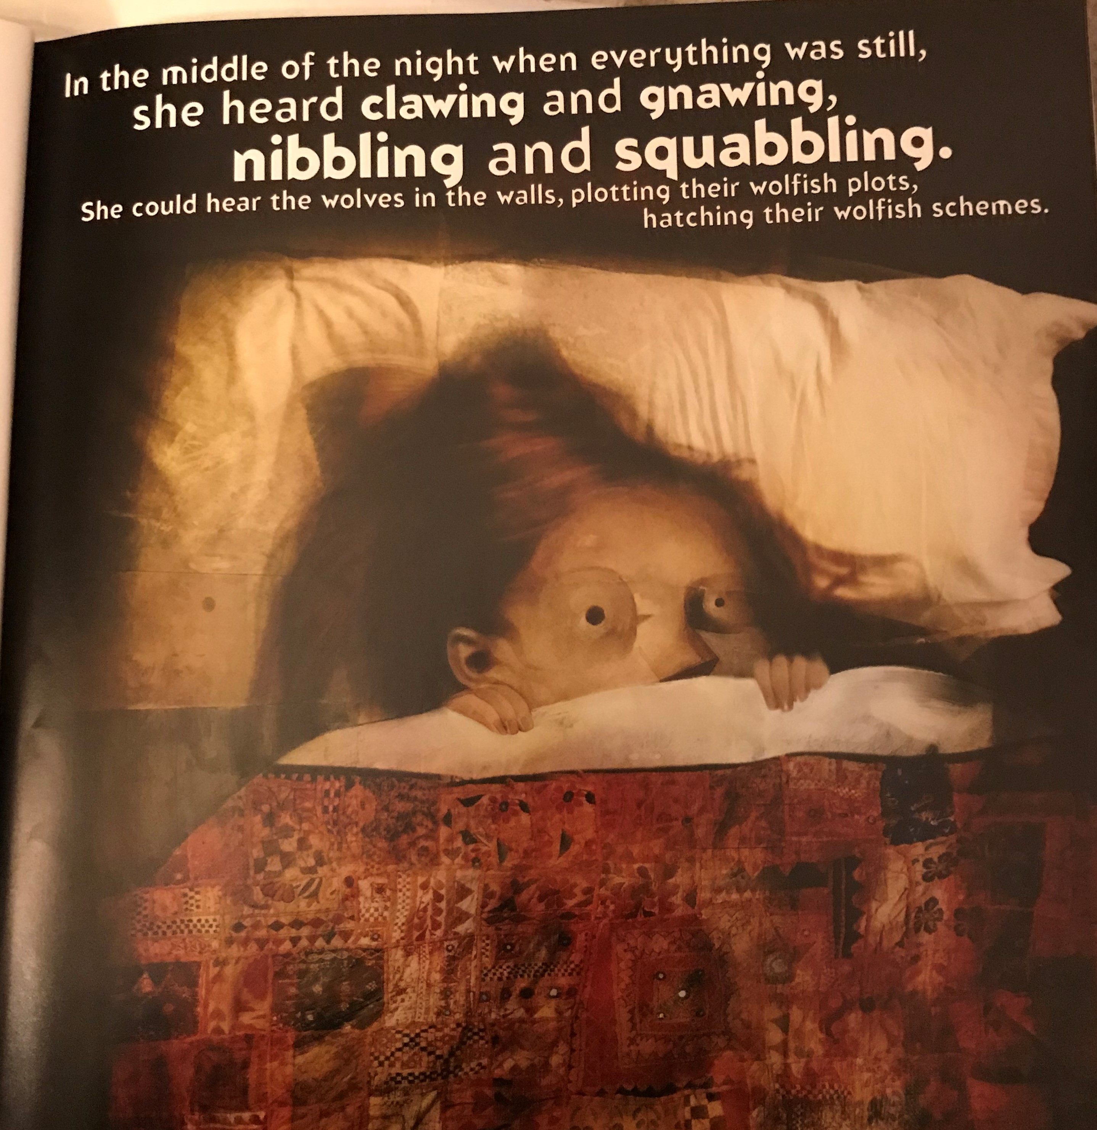

Slide 10
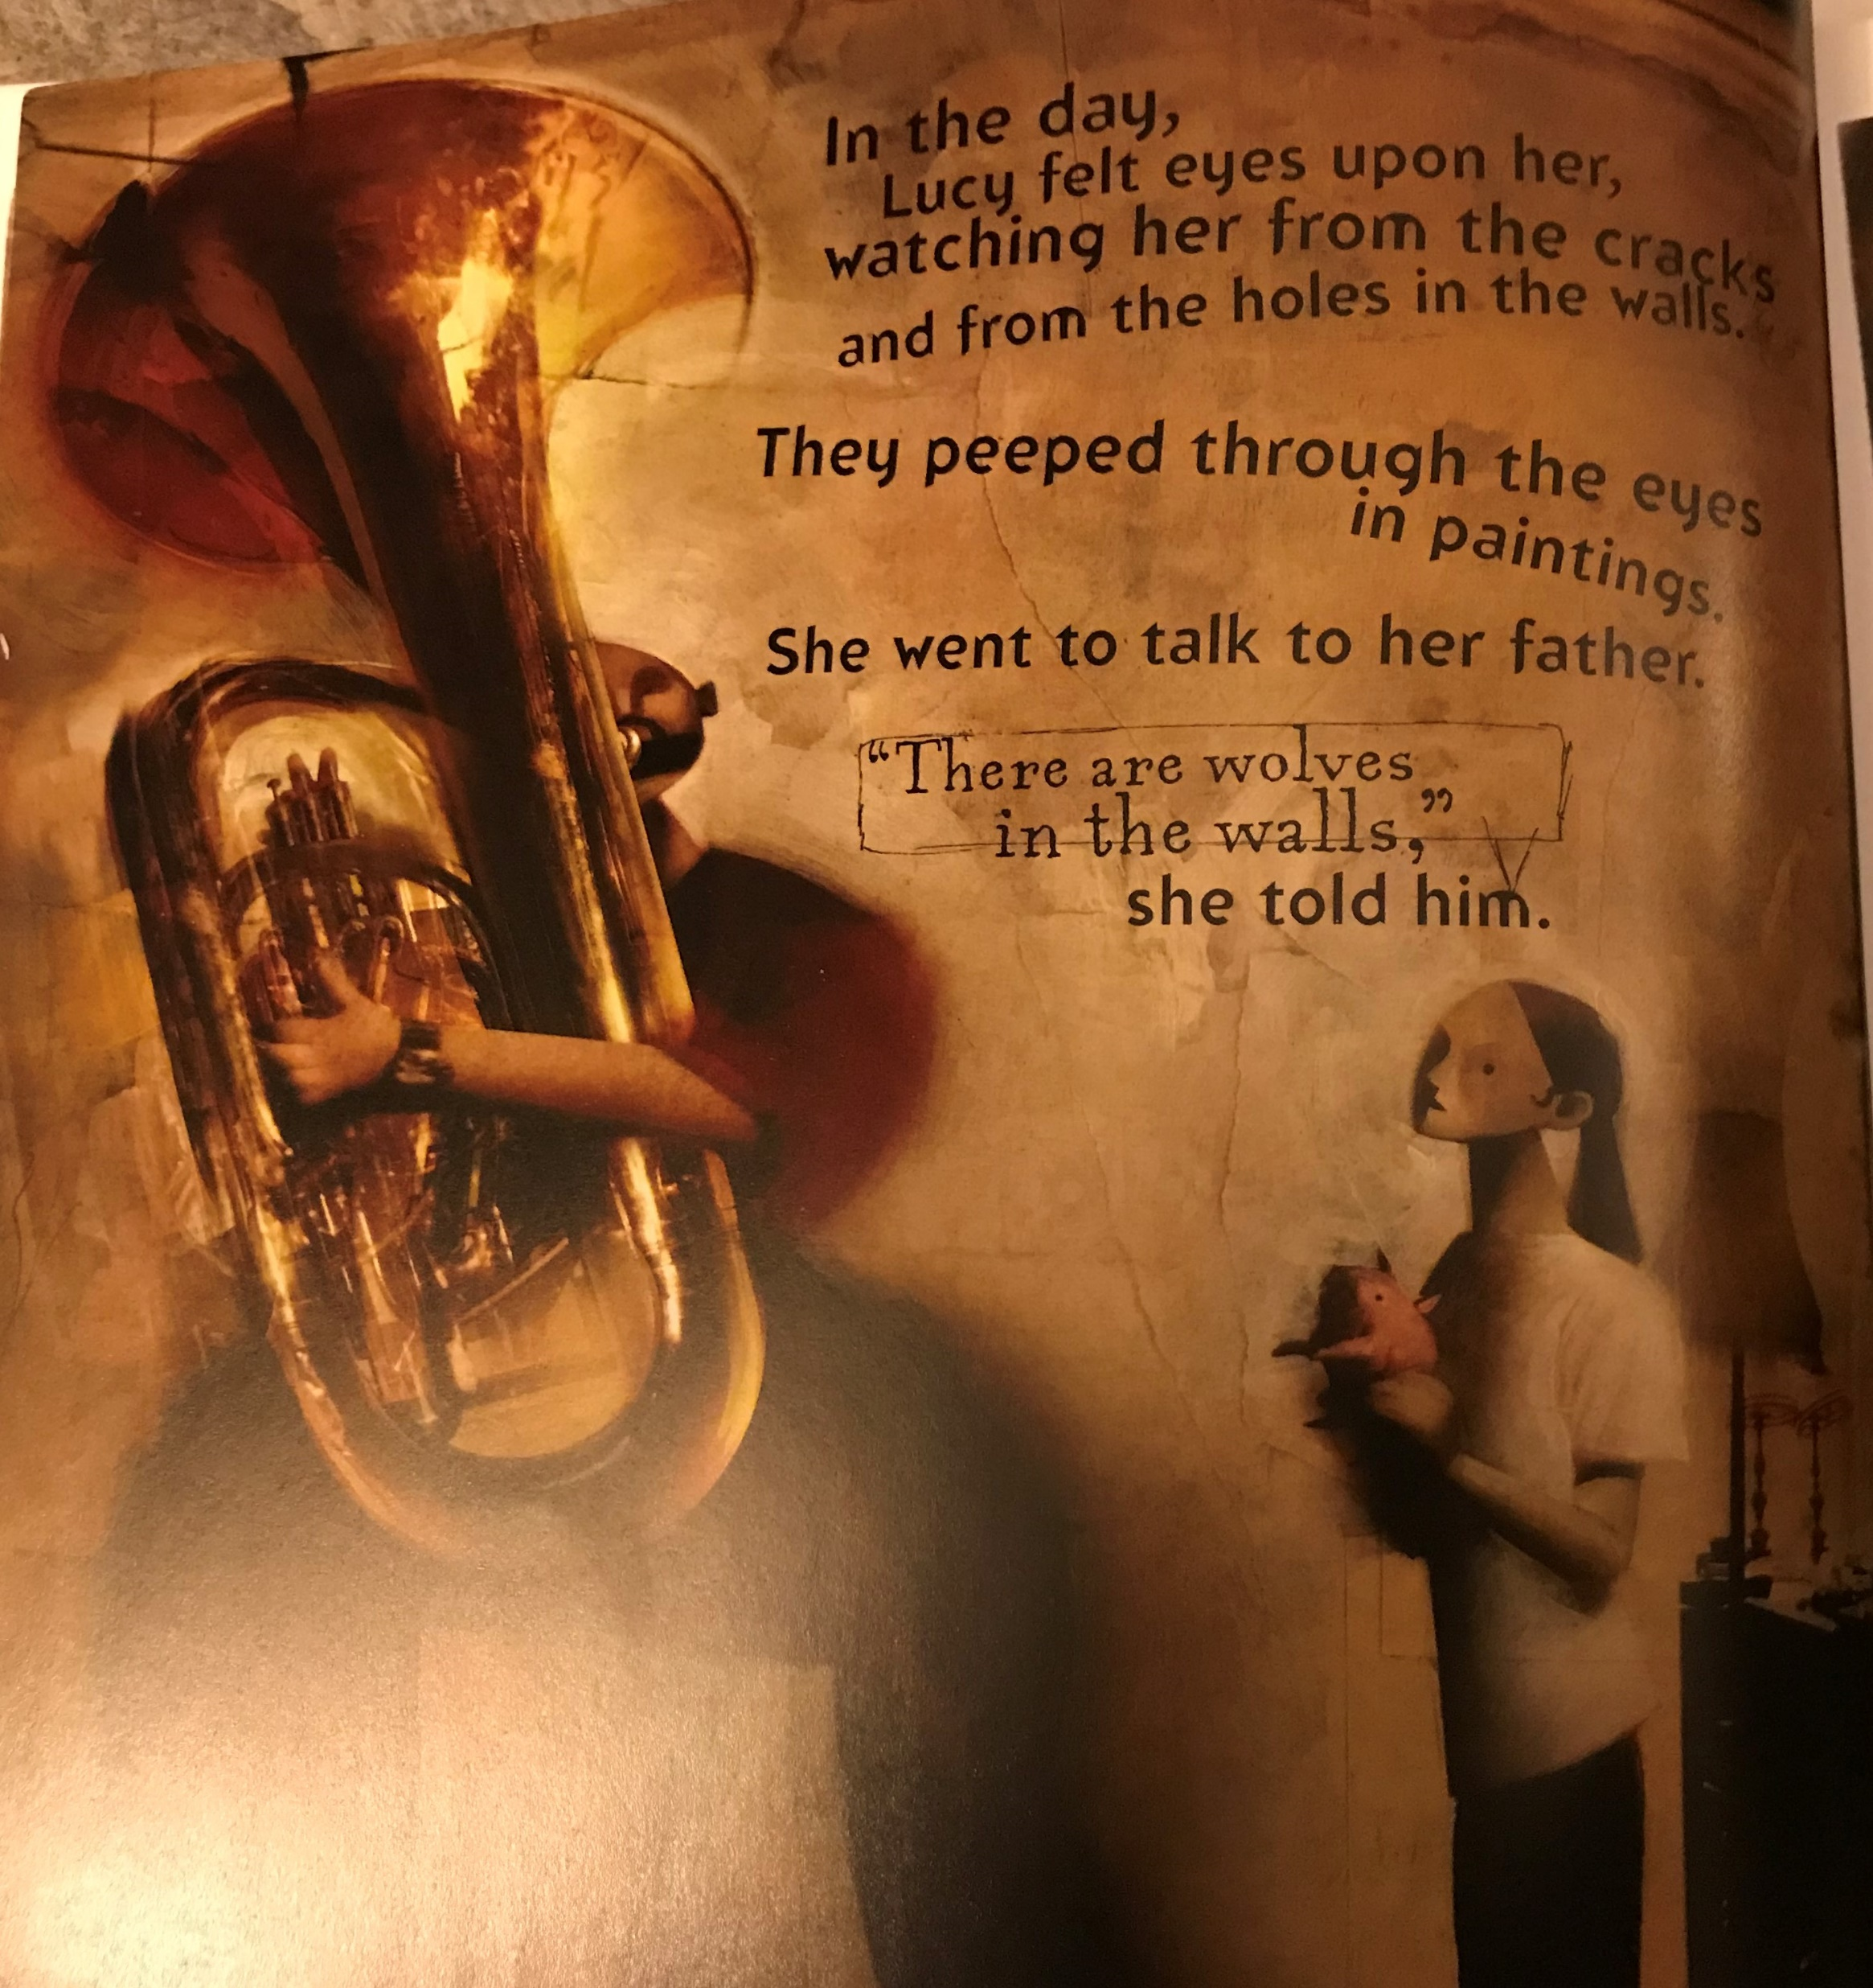

Slide 11
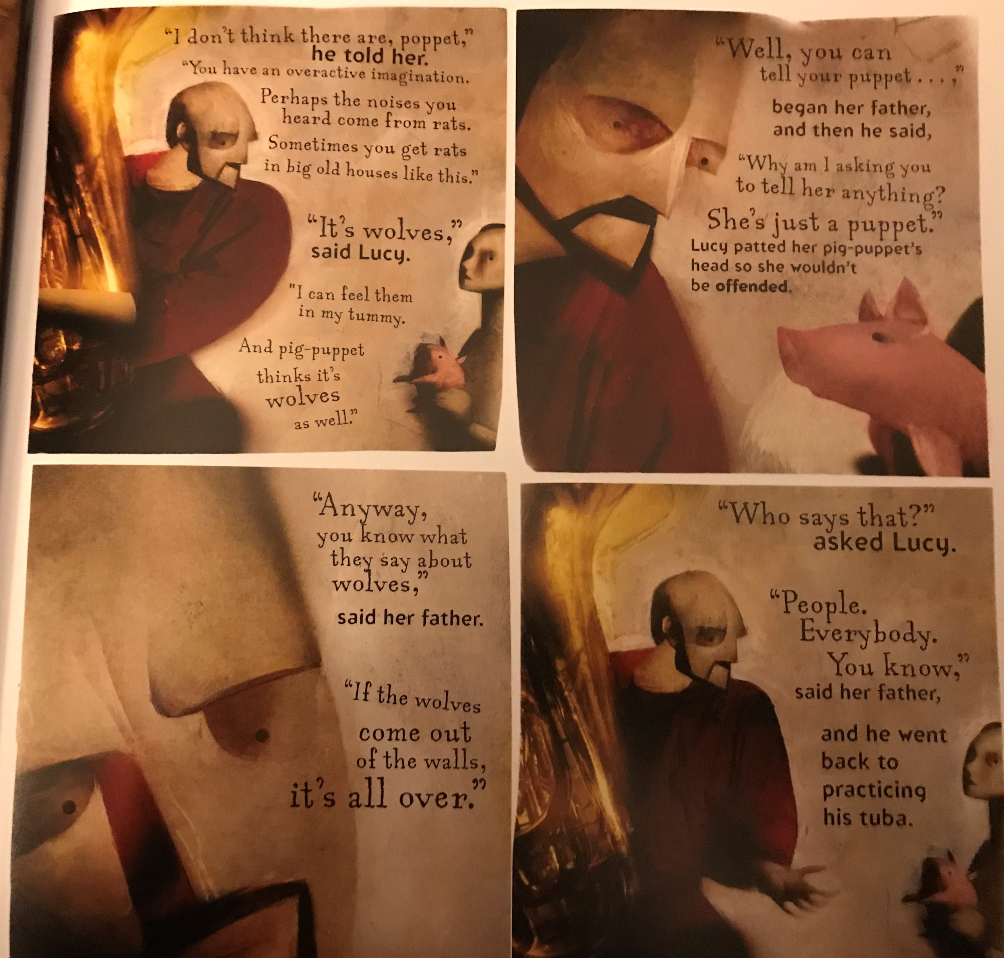

Slide 12
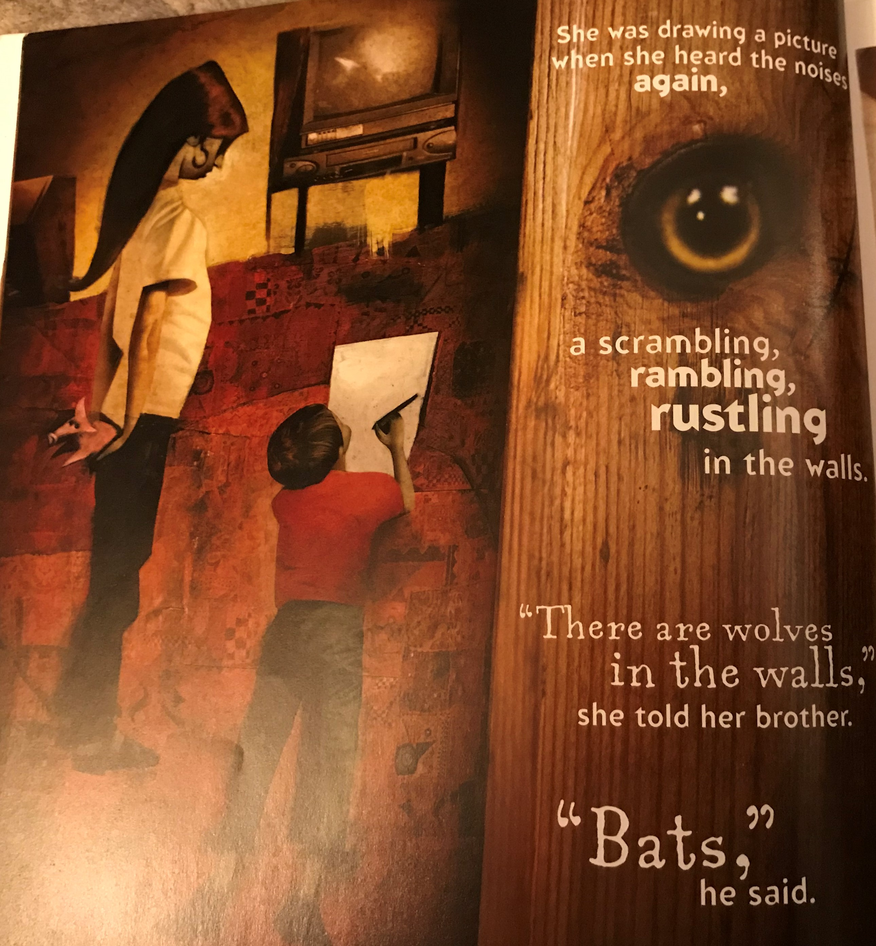

Slide 13
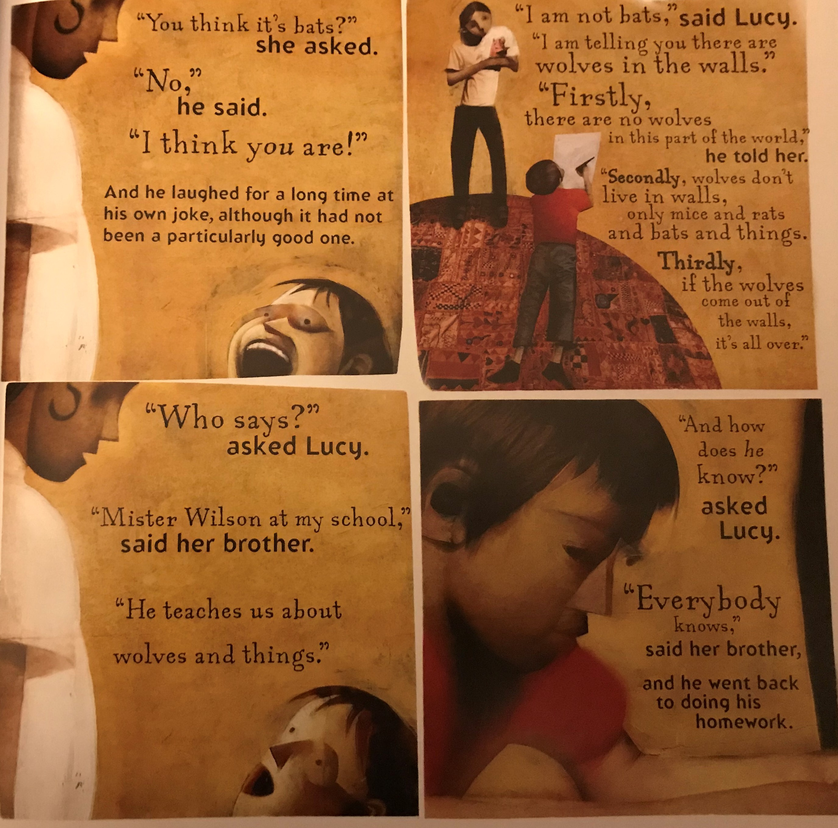

Slide 14
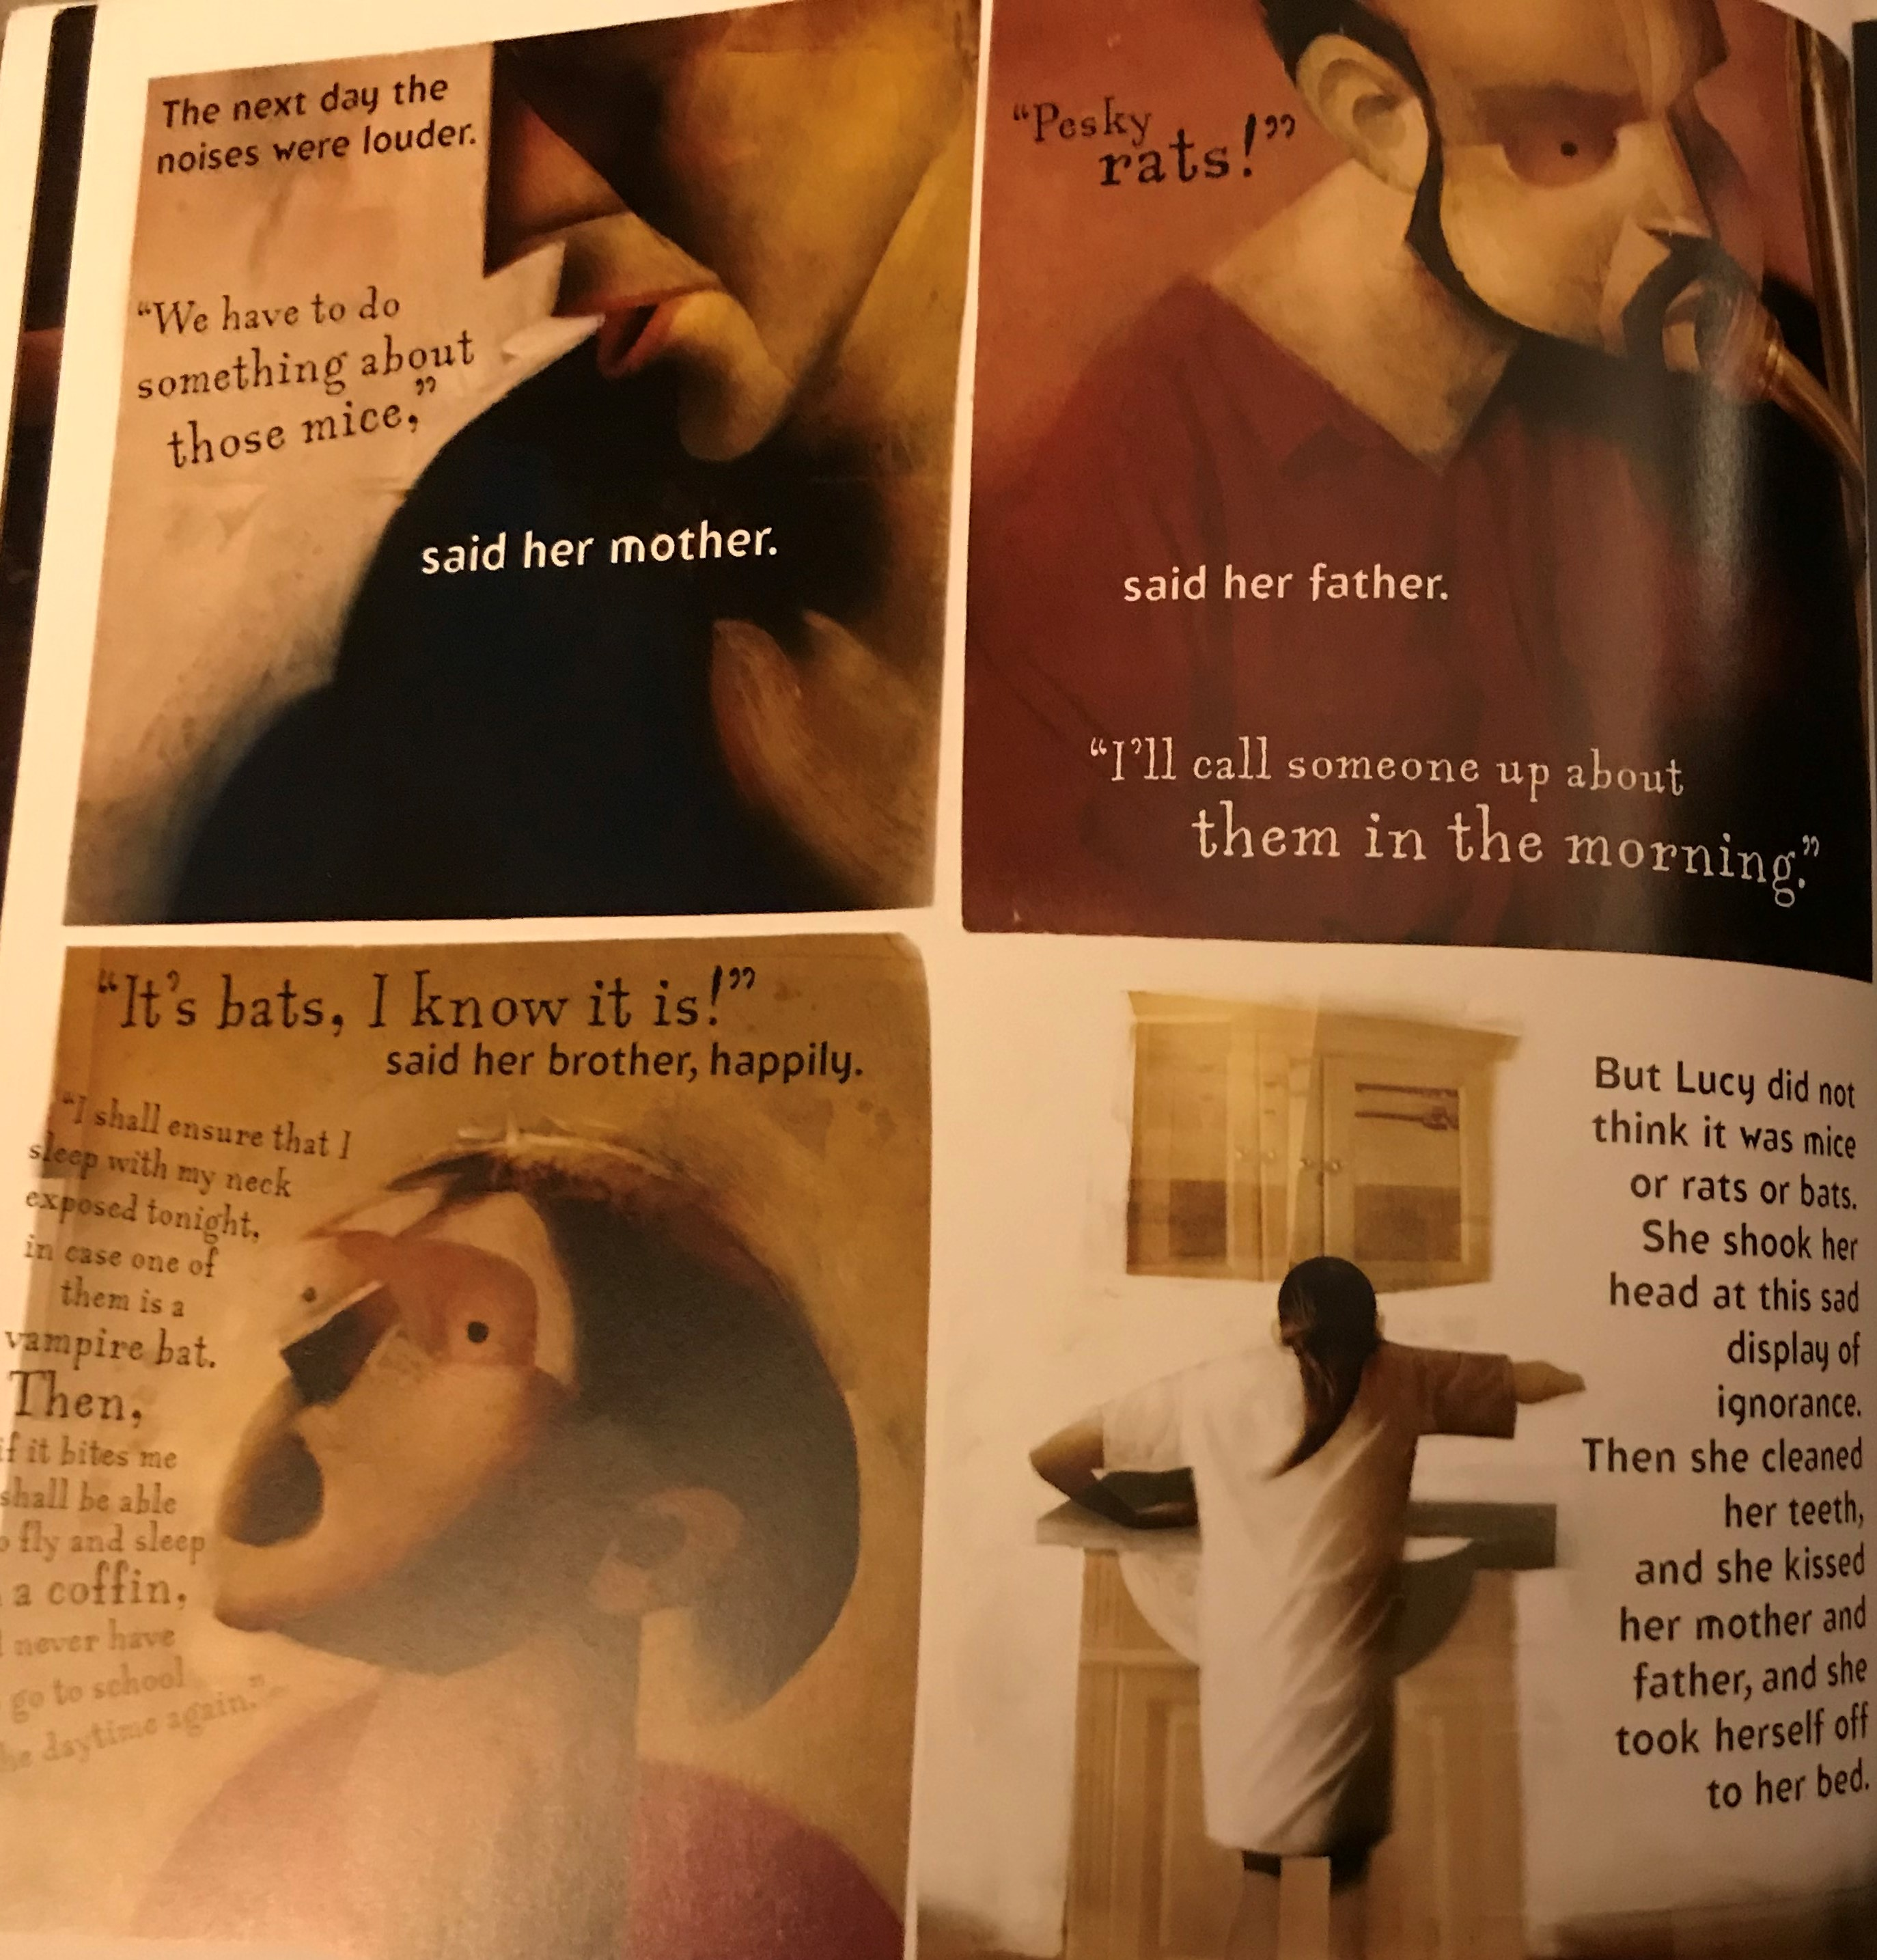

Slide 15
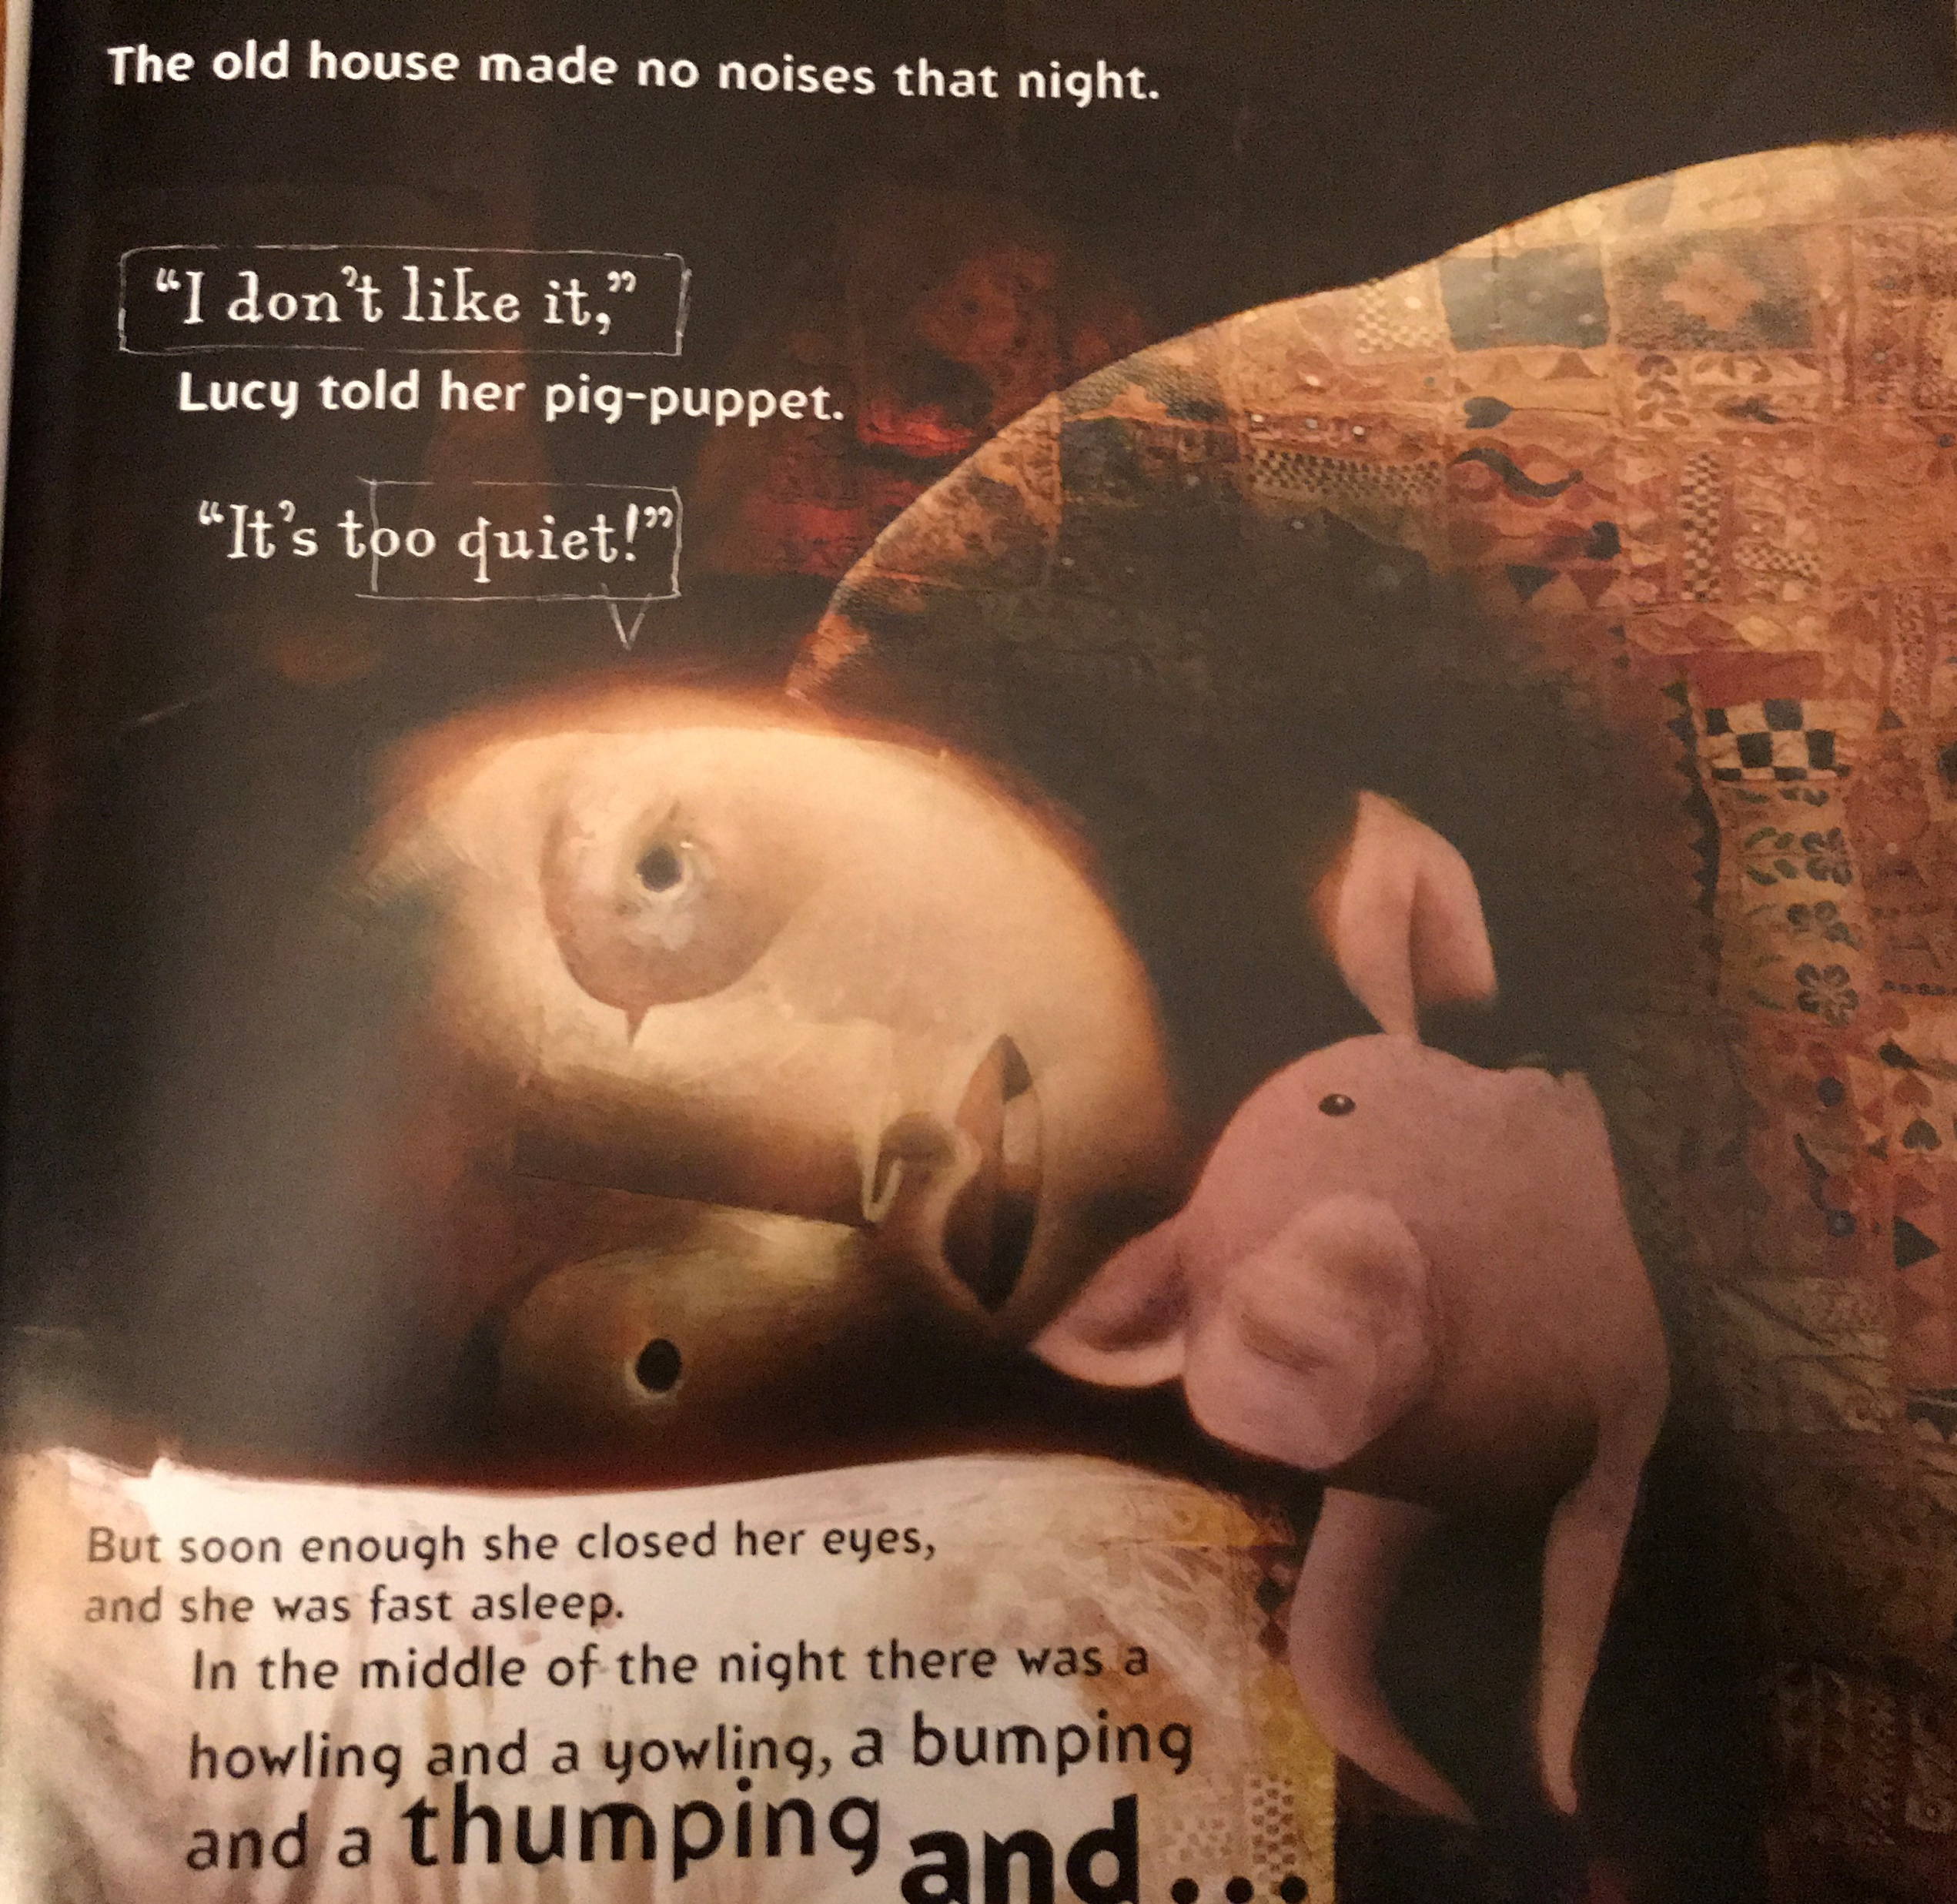

Slide 16
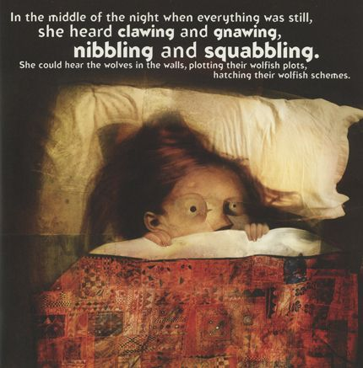
Now discuss with your talk partner about the story so far.
Ask each other questions…
What did they like?
Were there any parts that they disliked?
What patterns are there?
What puzzles are there?
Make notes of each other’s answers.

Slide 17
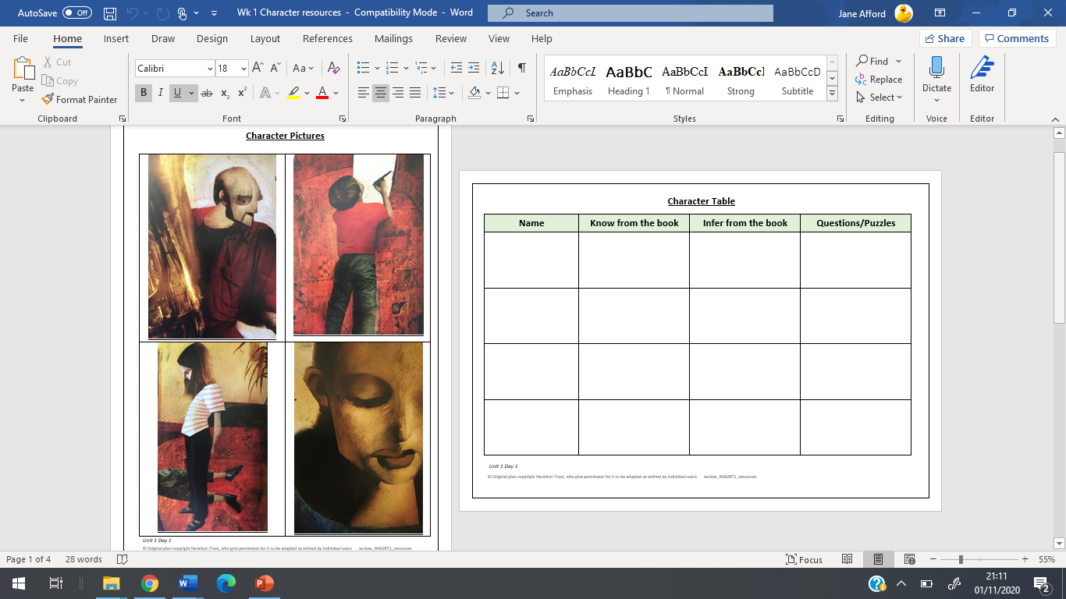
Activity Task: To identify and explore the characters in Wolves in the Walls
Work with your partner to talk about and note down ideas about each of the four characters on the Character Table. Then divide your ideas into;
those that are directly from the book,
those they have inferred
questions you want to ask about that character

Slide 18
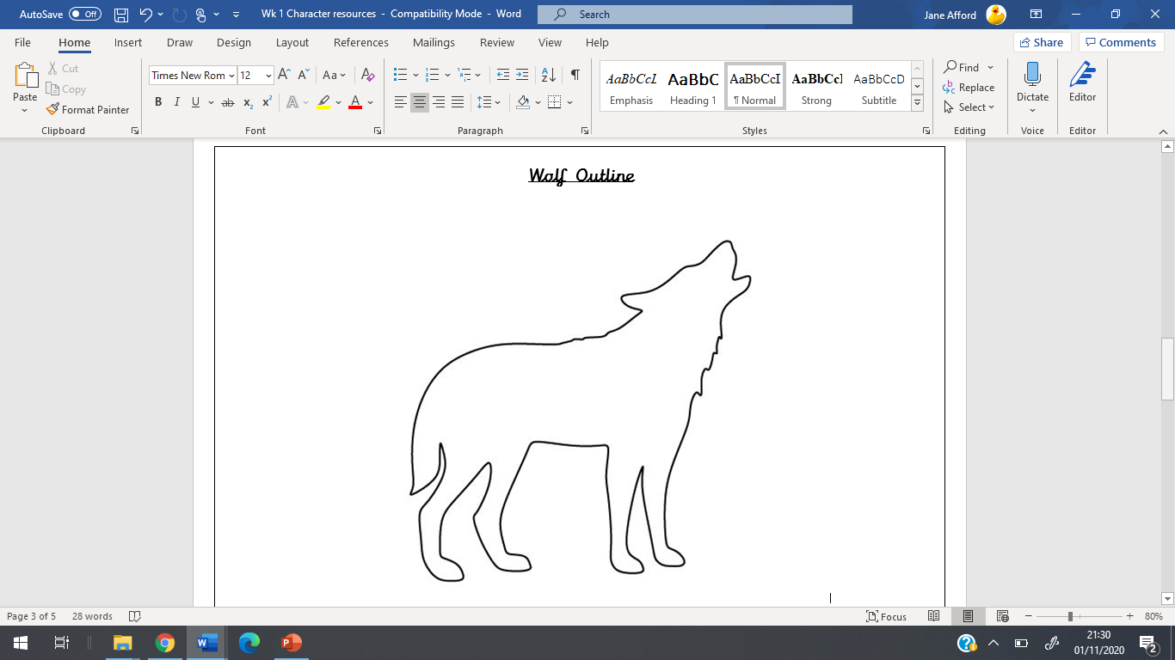

What do we think will happen next in this book?
Part of the effect of a good fiction book is that it is puzzling. It makes us wonder about things and what will happen.
Look at our Wolf Outline we’re going to add to this what the book has told us about wolves so far.
We‘ll see what else the book tells us in the next lesson.

