Slide 1
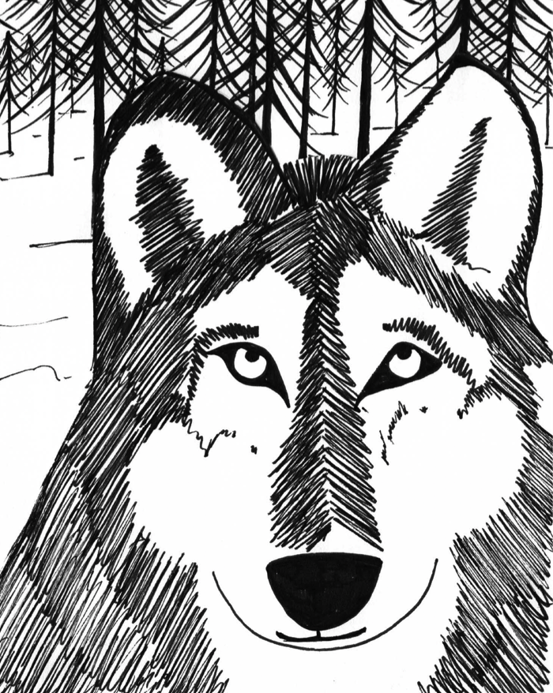
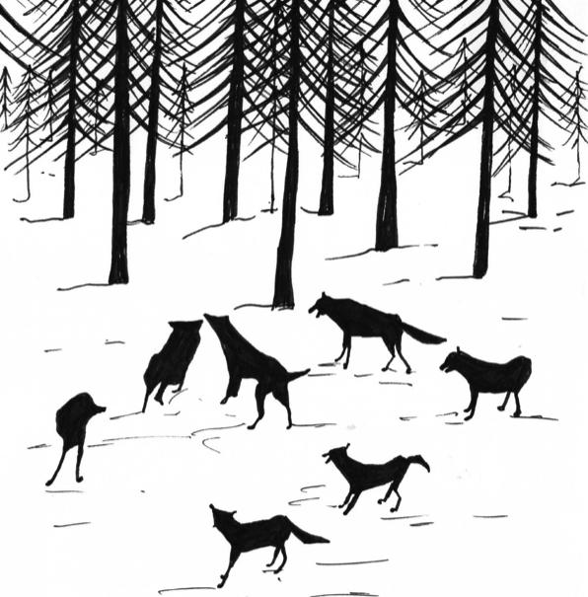
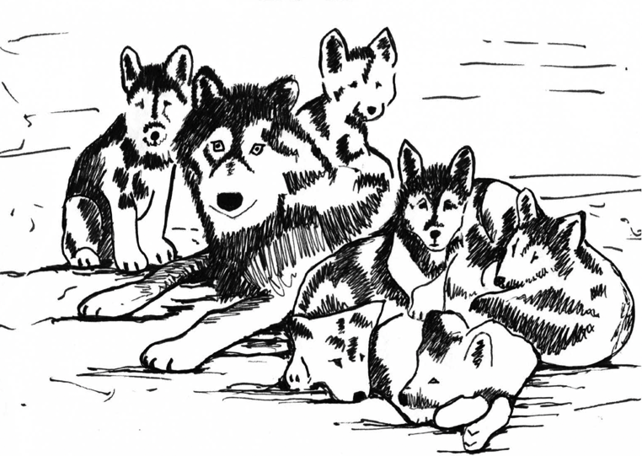
Wolves
Non-fiction information texts

Slide 2
Monday 9th November
LO: To Identify how language, structure, and presentation contribute to meaning.
LO: To Retrieve and record information from non-fiction

Slide 3
We are going to watch a video clip about wolves.
https//www.youtube.com/watch?v=wWEKBQRbFiM.
What facts and information did you learn from watching this clip?
Did anyone spot the fact about wolves’ teeth? What was it?
1:06 ‘Wolves have a bite twice as strong as a German Shepherd police-dog’
Can you think about any other questions that we might ask to find out about wolves’ teeth?

Slide 4
Let’s look at the information on Wolves’ teeth
A grey wolf's head is large and heavy, with a wide forehead, strong jaws and a long, blunt muzzle. The skull averages 230–280mm in length, and 130–150mm wide. The teeth are heavy and large, being better suited to crushing bone than those of other animals in the dog family, though not as specialised as those found in hyenas.
Its molars have a flat chewing surface, but not to the same extent as the coyote, whose diet contains more vegetable matter.
The grey wolf's jaws can exert a crushing pressure of perhaps 10,340 kPa compared to 5,200 kPa for a German shepherd. This force is sufficient to break open most bones.

Slide 5
These sentences give information about wolves’ teeth.
Do they answer any of our questions?
What sort of writing might they be from?
An information book or a report.
How can we tell?
General language: ‘A grey wolf’s head…Technical vocabulary: ‘muzzle, specialised’
Statistics:’10,430 kPa’ [kilopascals – a measure of pressure].

Slide 6
Let’s look at the information on Wolf Howl
Grey wolves howl to assemble the pack (usually before and after hunts), to pass on an alarm (particularly at a den site), to locate each other during a storm or unfamiliar territory and to communicate across great distances. Wolf howls can under certain conditions be heard over areas of up to 130 km2. The pitch usually remains constant or varies smoothly and may change direction as many as four or five times. The frequency of the pitch is between 150 and 760 Hz. Wolf howls are generally indistinguishable from those of large dogs.

Slide 7
This is information writing about one way that wolves communicate.
Does it include general language, technical vocabulary and statistics?
What sort of writing is it?
Yes
A non-fiction information text
Now answer these three questions n your w/b
1. What are two reasons that grey wolves howl?
2. How far can a grey wolf howl be heard?
3. What is the difference between a grey wolf howl and that of a large dog?

Slide 8
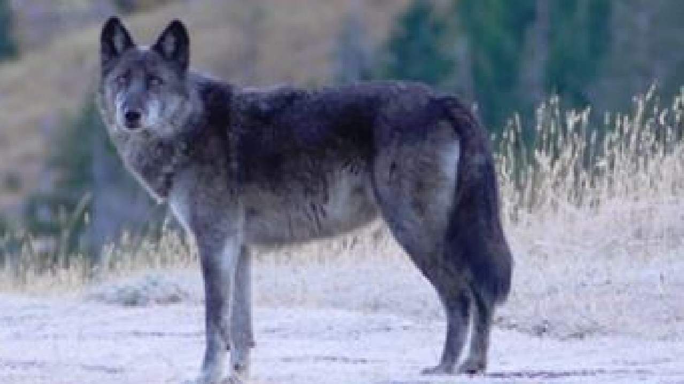
Monday 9th November
LO: To find information from non-fiction.
LO: To explain some features of reports.
Activity:
You are going to answer questions based on a non-fiction text about wolves.

