Slide 1

How to identify features of a newspaper.

Slide 2
Tuesday 24th November
LO: To work with a partner to write a sensational headline.
LO: To re-write direct speech as reported speech.

Slide 3
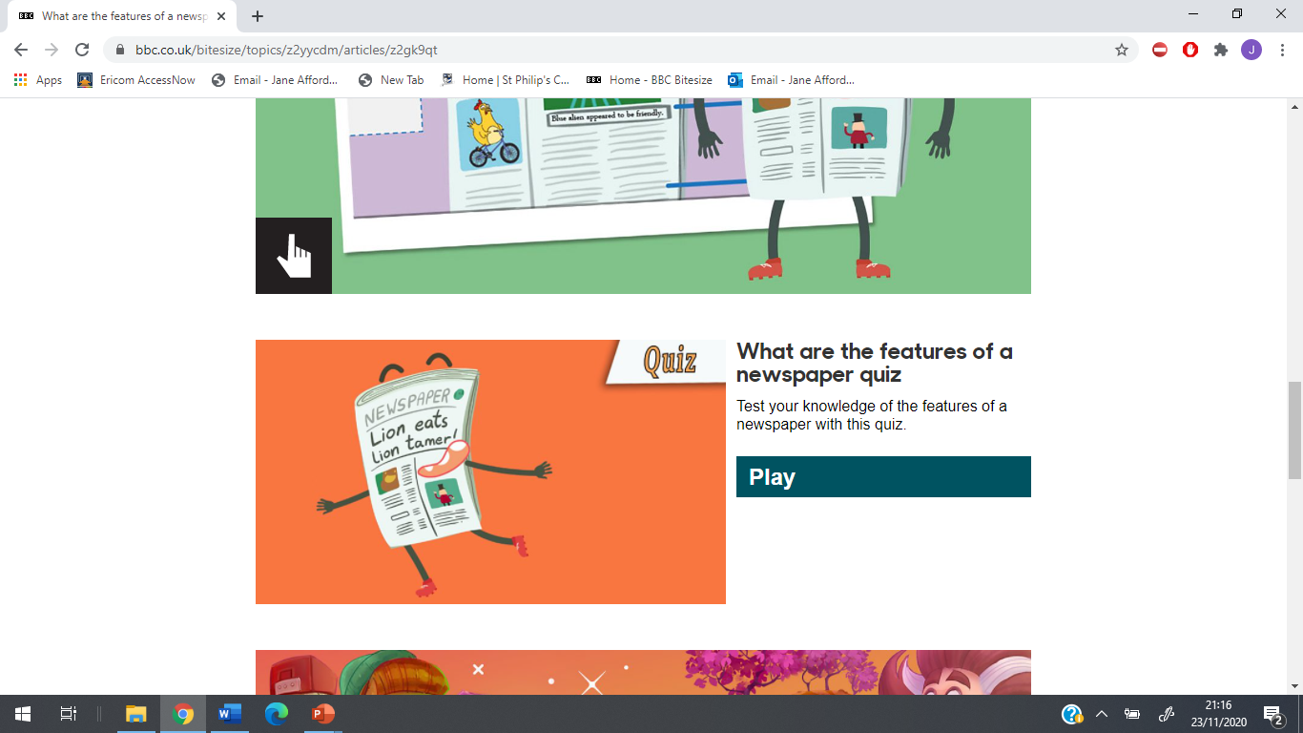
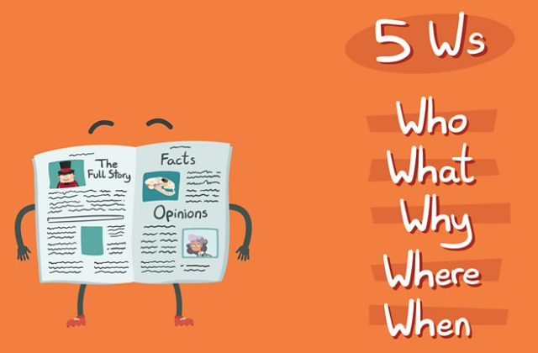
We are going to watch this clip about features of a newspaper.
https://www.bbc.co.uk/bitesize/topics/z2yycdm/articles/z2gk9qt

Slide 4
What did you learn about headlines?
Newspaper headlines are designed to attract the reader’s attention.
Use dramatic or emotional words, such as:
Crisis Drama Clash Fury Battle Row
Alliteration – ‘Pick up a Penguin’
Puns – ‘Kentucky Freed Chicken’ (Jokes)
Rhymes/half rhymes – ‘Beanz, Meanz, Heinz’
‘St Helen’s Glass has the class’

Slide 5
Working with your talk partner, try to think of headlines to make readers want to read these stories:
A huge storm over your town.
A footballer’s shorts fall down during an important game.
Try to use a range of techniques- such as alliteration, puns, full and half-rhyme.
Write your headlines on your whiteboard.

Slide 6
An important element of a newspaper article is the quotes. These are accurate written versions of the words actually spoken.
Direct Speech
He said, ‘I am on the point of leaving’.
‘You are as daft as my brother,’ Wendy said.
Emma declared, ‘I shall go shopping.’
‘I have your name and address,’ said the policeman.
These are the EXACT words spoken

Slide 7
Quotations in Newspaper Articles
Direct Speech
Mrs Jones, a local shopkeeper said, ‘I couldn’t believe it when Jon Bon Jovi turned up at my shop.’
These words came DIRECTLY from Mrs. Jones’ mouth

Slide 8

Quotations in Newspaper Articles
Reported Speech
It was a complete surprise for Mrs Jones
when Jon Bon Jovi turned up at her shop.
________________________________________________
These aren’t the actual words that Mrs. Jones said, although it does tell us how she felt.

Slide 9
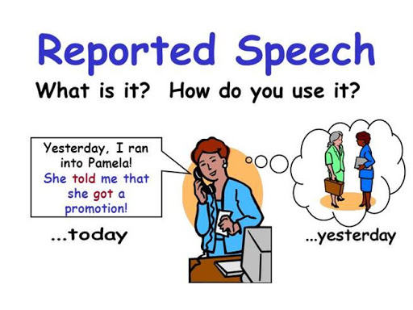
Indirect Speech
Independent task
Change these sentences into the
reported speech form.
Sally said, ‘We always drive to France.’
David said, ’I passed my driving test yesterday.’
‘When are you going shopping?’ asked Poppy.
‘That was an unexpected result,” cried Simon.

Slide 10

Now it’s your turn
Re-write the sentences on your activity sheet in your book.
Remember to start a new line for each new sentence.
Place the number in the margin.
Copy spellings carefully.
Remember your punctuation.

