Slide 1
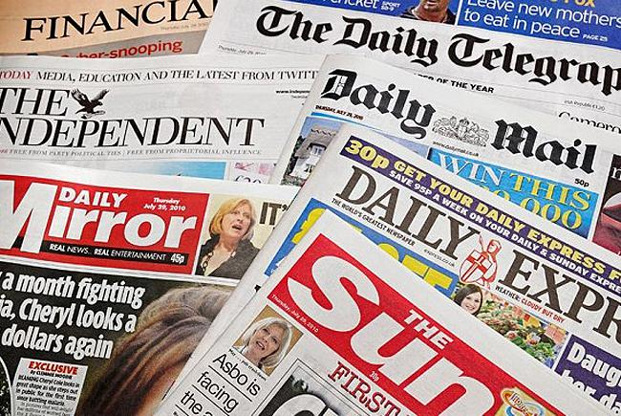
Features of a Newspaper article
Monday 30th November

Slide 2
LO: To recap the features of a newspaper article
LO: To write a caption for a picture in a newspaper article.
Monday 30th November 2020

Slide 3
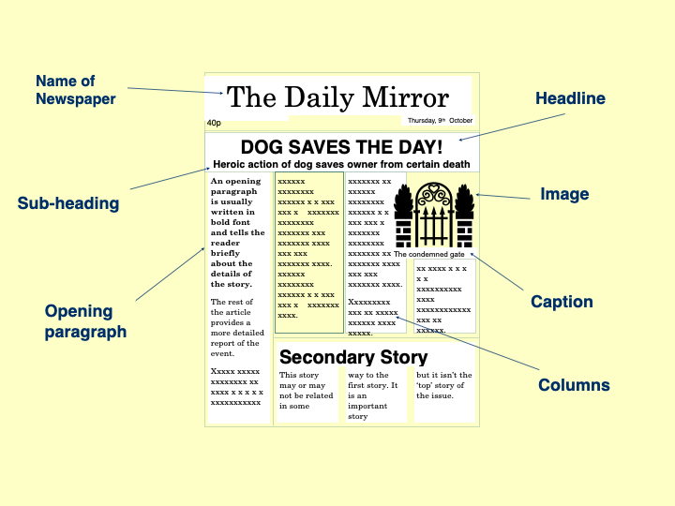
What can you remember?

Slide 4

Newspaper articles always include the 5 W’s...

Slide 5
What is a caption?
A brief description or explanation.
Describes an illustration, graph or picture.
The main purpose of a caption is to help the newspaper reader to understand what they see in the newspaper.
It should be brief, witty, and straight to the point.

Slide 6
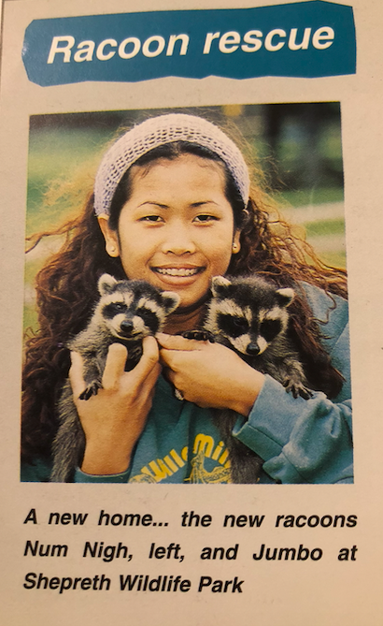
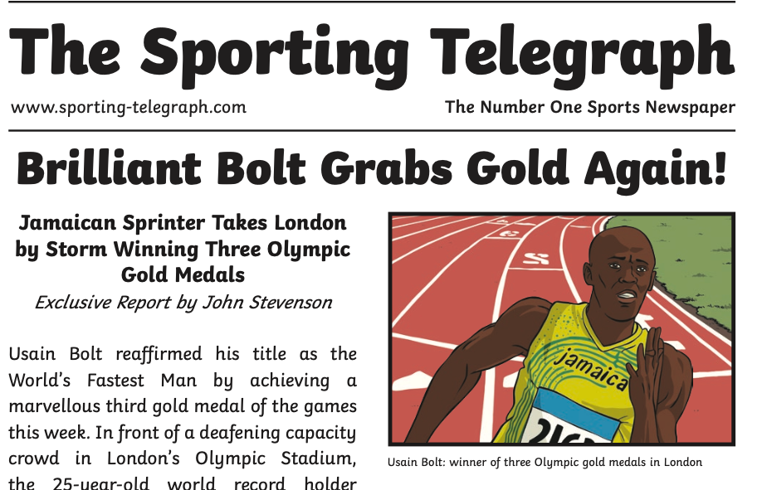
For example…

Slide 7
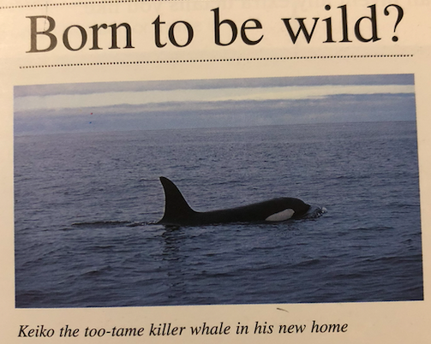
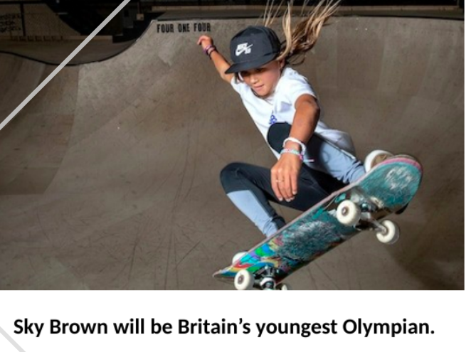
Let’s have a go together...
The killer whale is called Keiko
Sky Brown strikes again!

Slide 8
Your task:
Write a caption to match the picture on your sheet

