Slide 1
Newspaper Articles
Opening paragraph

Slide 2
Tuesday 1st December
LO: To write an opening paragraph for a newspaper article.

Slide 3
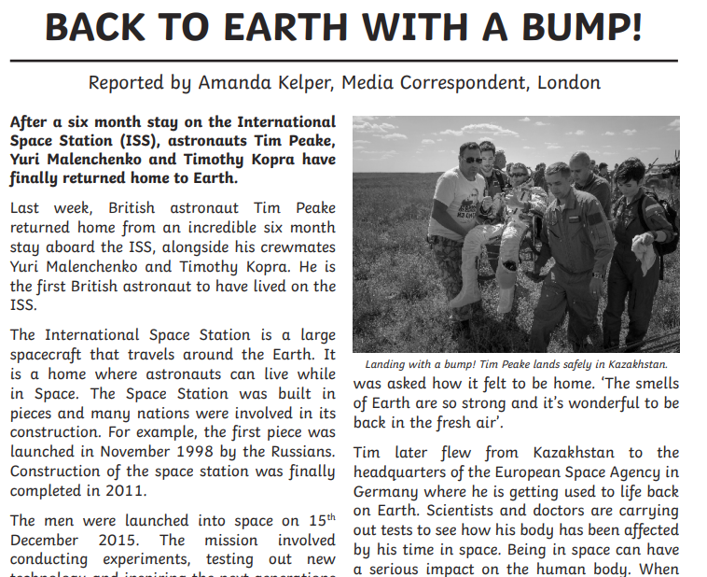
Here is an example of an opening paragraph in a newspaper article

Slide 4
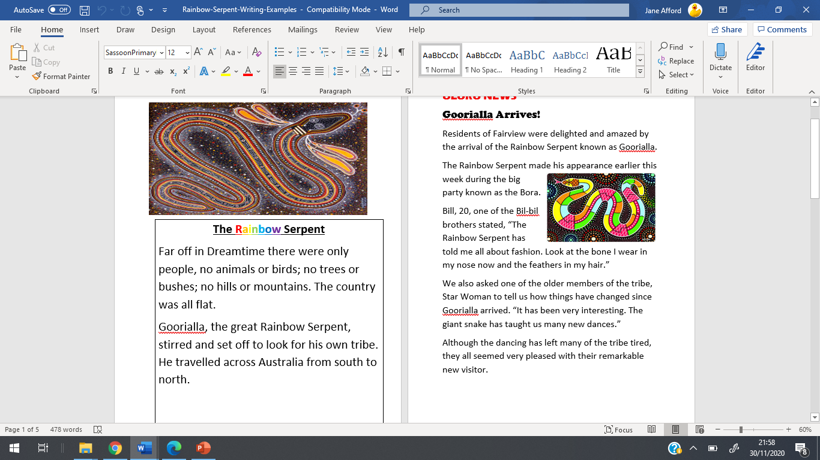

Slide 5
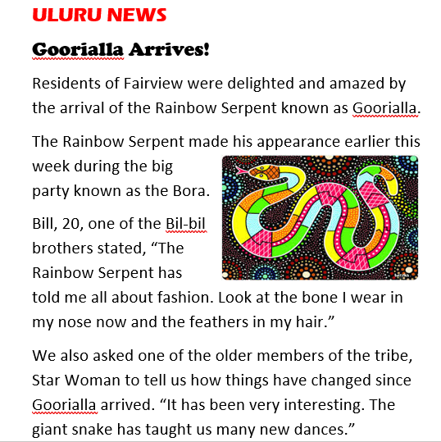
Now look at this opening paragraph about the Rainbow Serpent.

Slide 6
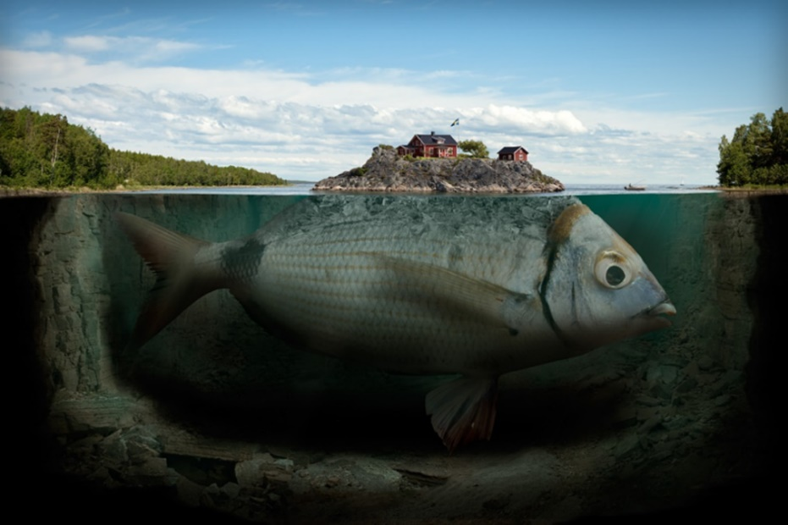
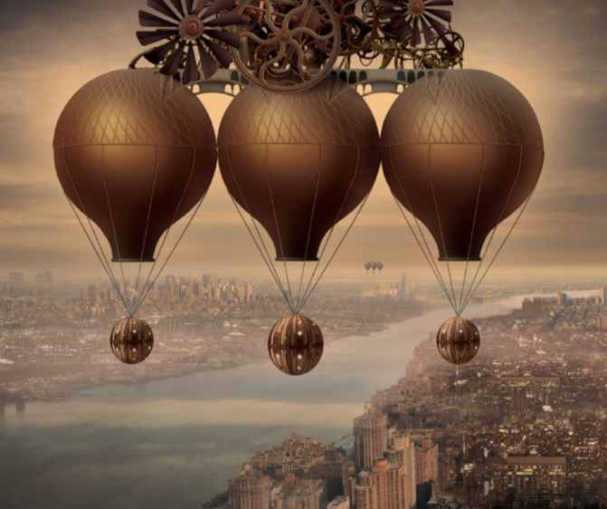
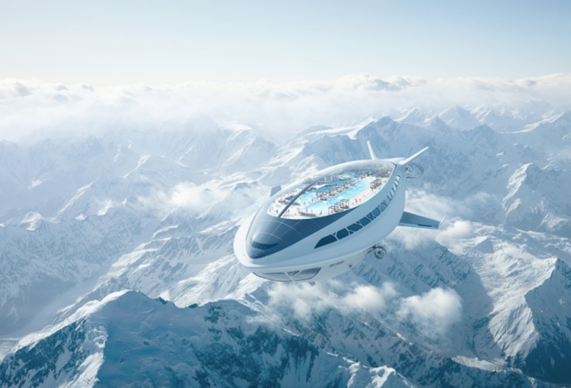
It’s your turn!
You are going to write an opening paragraph about the picture you have been given.
Remember, you have to grab the reader’s attention so they want to read the rest.

