Slide 1

KS1 SATS
KS1 SATS Guidance for Parents
SPRING 2020

Slide 2


KS1 SATs
May
2020
Things we will cover:-
What are SATs in Key Stage 1?
What do the SATs tests look like?
How do teachers assess/results?
Age related expectations
What can you do to help?
A parents guide for schools
applefortheteacher.co.uk

Slide 3
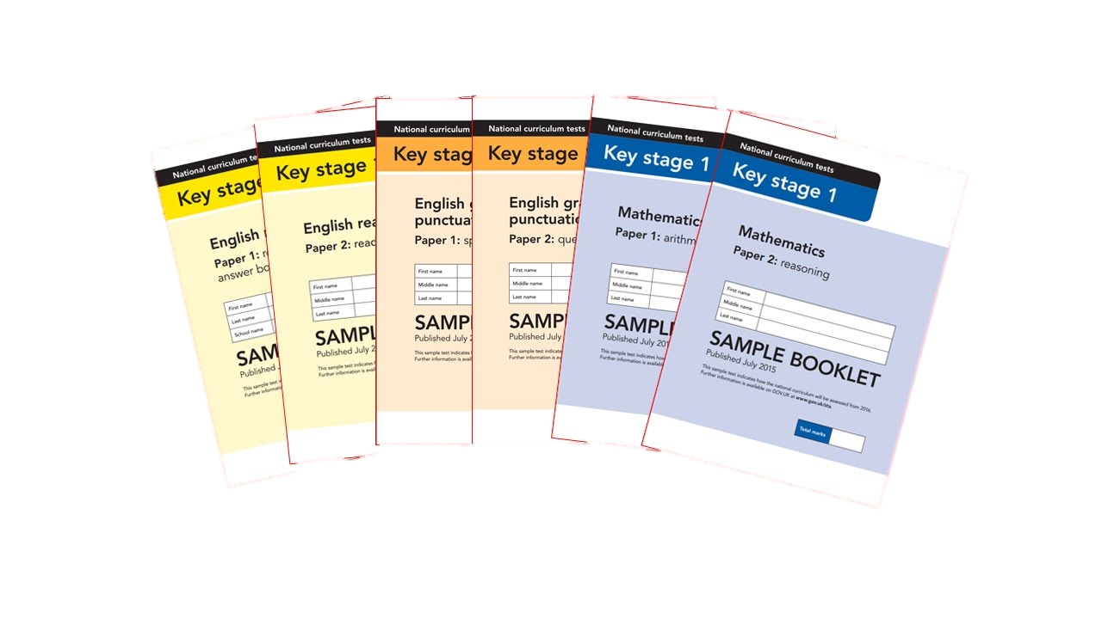
What are Sats?
At the end of Year 2, children in England sit national tests in the following subjects, the results are used to measure children’s attainment and the school’s performance:-
*English – Reading
*English – Grammar, Punctuation & Spelling
*Maths – Arithmetic & Reasoning
These tests reflect the updated national curriculum and are marked using the current grading system, which now replaces levels.
applefortheteacher.co.uk

Slide 4
WHAT WILL BE ASSESSED BY TESTS?
TESTS for YEAR 2 in 2020
READING
SPaG
Maths
TEST 1 – combined reading prompt and answer booklet
TEST 2 – more challenging separate reading booklet and reading answer booklet
All Children sit BOTH tests
TEST 1 - Spelling
TEST 2 – English, Punctuation, Spelling & Grammar
TEST 1 - Arithmetic
TEST 2 - Reasoning
In 2020 the tests will be marked internally by teachers and, in some cases, the results moderated by Local Authorities.

Slide 5
An outline of the tests
Paper 1
Paper 2
Reading booklet with
questions and answer spaces
combined.
Reading booklet with a separate booklet which has the questions and answer spaces.
English Reading
(Texts totalling 400 – 700 words)
(Texts totalling 800-1100 words)
Each paper for the KS1 Reading SATs is worth 50% of the available marks.
applefortheteacher.co.uk

Slide 6
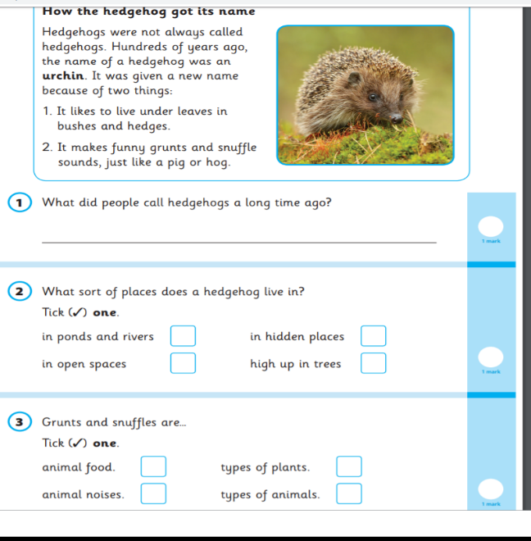
English – Reading
Paper 1 Example Page
applefortheteacher.co.uk

Slide 7
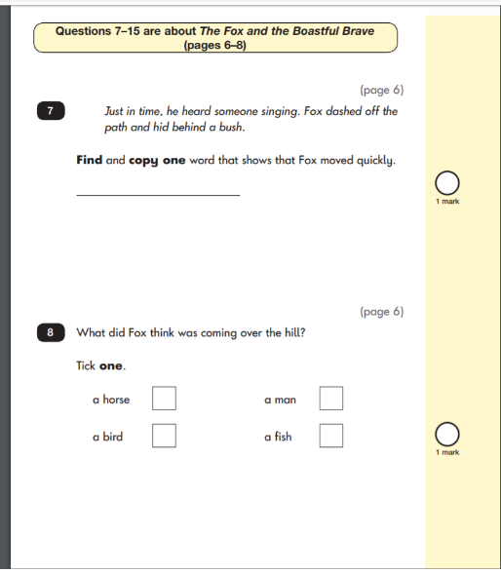


English – Reading
Paper 2 Example Pages
applefortheteacher.co.uk

Slide 8
English
English
Grammar, Punctuation & Spelling
Paper 1
Spelling test of 20 words
Paper 2
Question Paper to check grammar, punctuation and vocabulary
applefortheteacher.co.uk

Slide 9
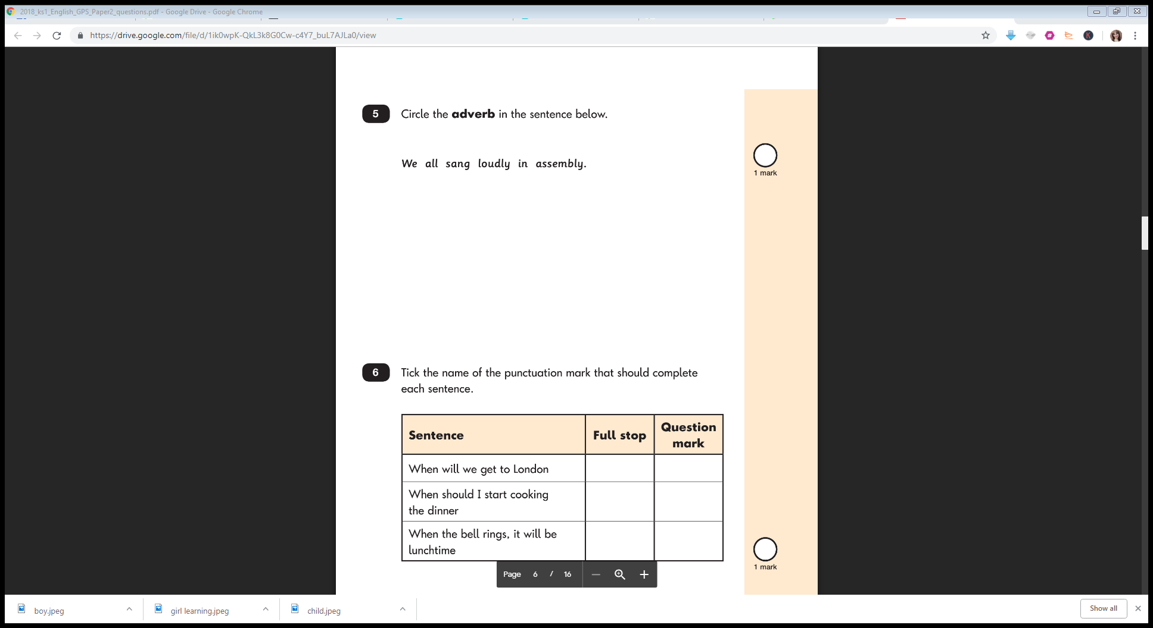
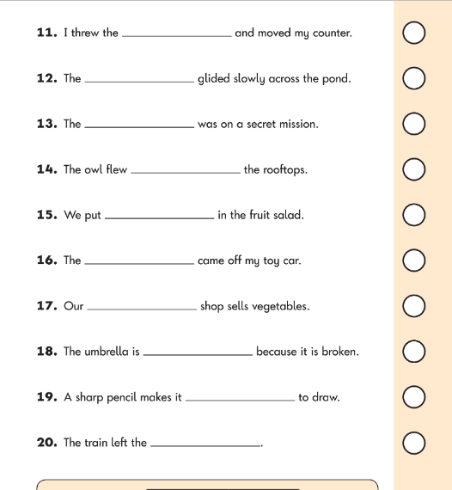
English – Spelling Example Page
English – Grammar Example Page
applefortheteacher.co.uk

Slide 10
Maths
Paper 1
Paper 2
Arithmetic
Reasoning, problem solving and mathematical fluency
Arithmetic
& Reasoning
(25 marks available)
(35 marks available)
applefortheteacher.co.uk

Slide 11
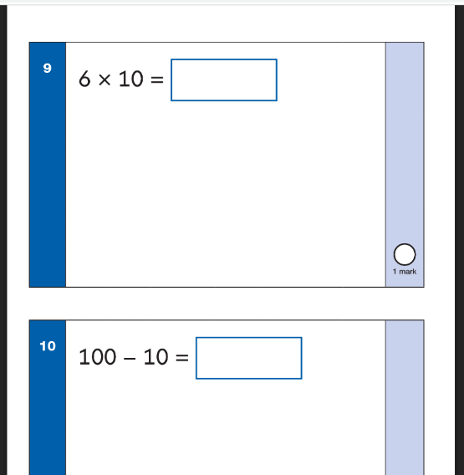
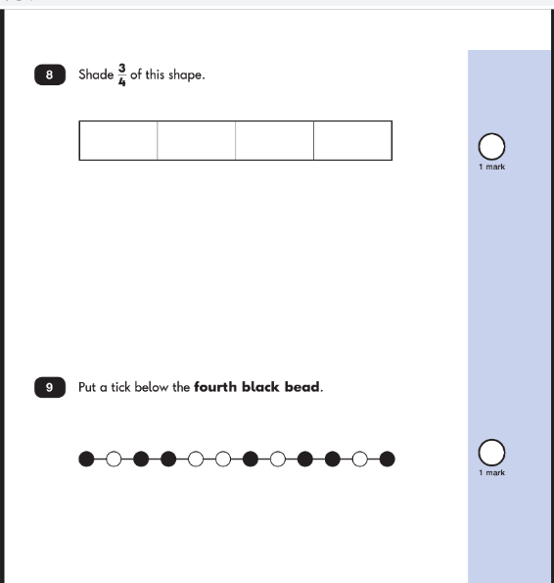
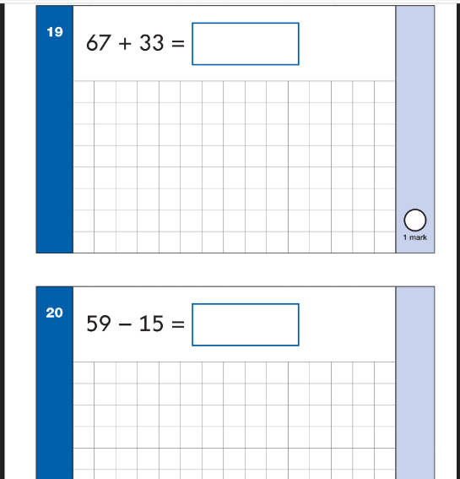
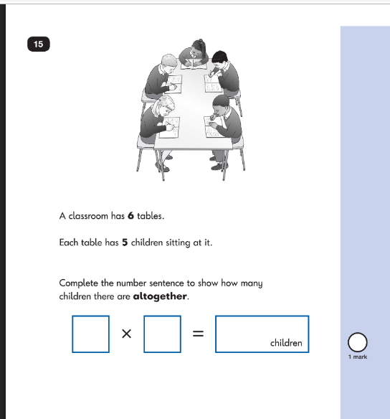
Maths Paper 1 Example Pages (Arithmetic)
Maths Paper 2 Example Pages (Reasoning)
applefortheteacher.co.uk

Slide 12

Teacher Assessment/results
KS1 SATs tests are one part of evidence towards the whole teacher assessment.
They are marked in school, and an overall grading based on the whole year’s work
will be made.
The results of the SATs tests are
reported to the Local Authority.
Moderation often takes place to ensure consistency across schools.
applefortheteacher.co.uk

Slide 13
WHAT WILL BE TEACHER ASSESSED?
TEACHER ASSESSMENT
READING
WRITING
MATHS
Teacher assessment
using
Interim Framework
Teacher assessment
using
Interim Framework
Teacher assessment
using
Interim Framework
Teacher assessment using
Interim Framework
SCIENCE
In 2020the tests will be marked internally by teachers and, in some cases, the results moderated by Local Authorities.

Slide 14
INTERIM FRAMEWORKS
To help with teacher assessment the DfE has produced ‘Interim Frameworks’. They set out the standards a pupil will be assessed against in reading, writing, maths and science.
The Interim Frameworks are only to be used as a guide, as they do not include full coverage of the content of the National Curriculum.
All of the criteria must be met for a child to attain the ‘Expected Standard’.

Slide 15
Age Related Expectations
Working below the expected standard (not working within the Year 2 Curriculum).
Working towards the expected standard (some of the learning is within the Year 2 Curriculum).
Working at the expected standard (All learning is within the Year 2 Curriculum).
Working at greater depth (very secure in Year 2 Curriculum, with elements of Year 3).
applefortheteacher.co.uk

Slide 16
How can you help your child prepare?
Help your child with reading, listen to them read and focus on bringing out a ‘love of reading’. Also reading stories to your child allows them to develop language, listening skills and comprehension. Encourage making predictions of what might happen next.
Help your child with writing, support with weekly spellings. Write together to make shopping lists and letter writing.
Help your child with maths, play times table games. Encourage them to help with cooking, weighing and measuring ingredients. Work out what time it is together. Provide opportunities for your child to pay for things in a shop, to work out how much things cost and how much change will be needed.
applefortheteacher.co.uk

Slide 17

Thank You!
Your time is appreciated.
Any Questions?
applefortheteacher.co.uk

