Slide 1
Welcome to year 2

Slide 2

What are our school’s core
Christian values?

Slide 3
What are our school’s core
Christian values?
Koinonia
Courage, Wisdom, Friendship, Forgiveness and Trust

Slide 4

Our Christian Vision…
Happiness, love and security abound
Everyone is special
Every achievement is celebrated
Relationships and teamwork matter
A beacon of light in the community
Christ in Everything we Do!

Slide 5
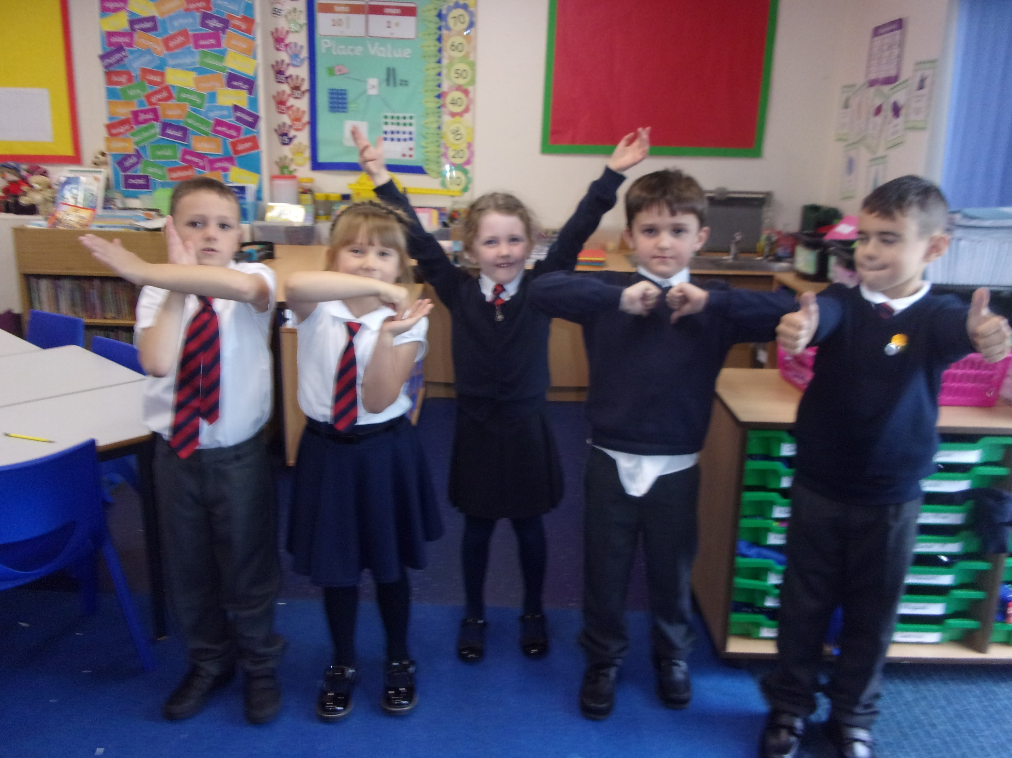




Slide 6
Year 2 staff
Mrs Bond
Mrs Halfpenny
Mrs klaassen (Tuesday pm and Thurs am)

Slide 7
Routines
Doors open at 8.45am.
Register at 8.55am.
Finish at 3.20pm.
If your child is absent from school please send a letter to the class teacher
It’s really important to be on time (whenever possible) as morning activities start as soon as we arrive at school.

Slide 8

Housekeeping!
Please name all uniform –
Boys’ winter uniform Girls’ winter uniform
Grey trousers Navy skirt or pinafore
White shirt White blouse
Navy long sleeved jumper Navy long sleeved cardigan
School tie School tie
Please make sure your child has a water bottle each day
Tuesdays and Thursdays are PE days. Please make sure kits are in school. PE kit – blue shorts and white t-shirt (eg on website) Children are allowed to wear navy blue tracksuit bottoms for outside PE during the winter.
We are struggling for space to store bags. Please could the children bring school book bags.

Slide 9
Class Timetable

Slide 10
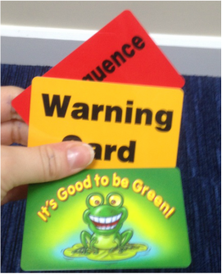
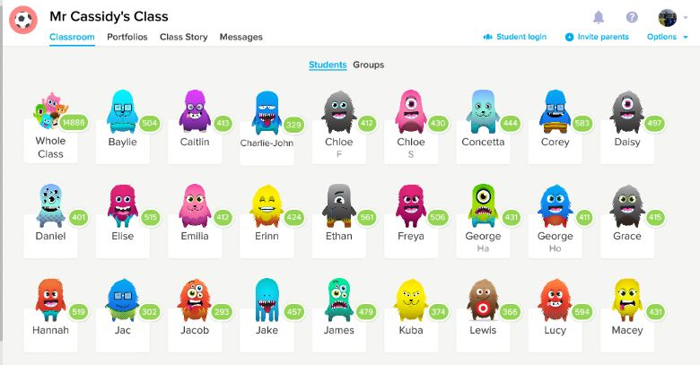

Behaviour!
Behaviour flow chart is on the web site
Children are awarded dojos for following the class rules – there is a prize at the end of the week for the child awarded the most dojos.
If children are not following the class rules a verbal warning is given before a card is issued.
If a red card is issued, the child will miss some of golden time and a letter will be sent home from Mrs Edward.
If we have had to issue yellow or red cards, we really appreciate your support in dealing with the issue. Thank you.

Slide 11
Badges
Spelling and times tables badges
Times tables badges
We work towards the bronze badge
2x, 5x and 10 x
Spelling badges
Ongoing throughout the year

Slide 12

Medical
Any medication updates – please let us know of any changes
Please feel free to check your child’s inhaler before leaving to make sure it’s still in date.
We have been advised that children should use a spacer when taking their inhaler - if possible please send one into school.
If your child needs any prescribed medication, a medical form needs to be filled in at the office before we are able to administer it.
Thank you

Slide 13
Homework
Homework will be given out on a Friday to be returned by Wednesday.
I would be really grateful if you could return homework on time so I have chance to mark it before Friday – Thank you.
Spellings will be tested each Friday.
Weekly spelling will be put on the website.
Please read with your child every day.
Please let us know if any homework is too difficult so we can give a little extra help at school.
Thank you

Slide 14
Reading
Your children will continue reading through the colour bands
Please try and read at home every night – your children benefit enormously from your support.
In school the children will be involved in
Shared reading.
Guided reading.
Reading across the curriculum.
Story time at the end of the day.

Slide 15

Curriculum
Curriculum map and autumn newsletter is on the website.
Website
Please keep checking the website dates and news.
We will try to keep the website updated with lots of photos of your children at work and play.
Trips
You will also find information about after school clubs on the website.

Slide 16
Assessment
Assessment takes place at the end of each half term.
We track progress using Target Tracker.
The children work to meet all the objectives on the ladders you’ve been given.
Your children are in Year 2 so we are in Band 2
Each band has been split into six sections
Beginning and Beginning Plus ( B and B+)
Working Within and Working within Plus – Up to 70% of the statements are confidently achieved (W and W+)
Secure and Secure Plus (S and S+)
We aim for most children to make 6 bands of progress each year
If you’d like more information, here is a full explanation of the assessment process on the website.
To support our Teacher assessment, at the end of KS1, we use the Teacher assessment framework.
Please make sure you have taken:
English and maths ladders
Writing assessment sheet
Spelling lists

Slide 17
Website and Twitter
Please remember the website holds lots of information and photos of your children.
Also twitter provides instant updates of what is going on in school.

Slide 18
Social media
Please be considerate of others when using social media and remain aware of how quickly and widely posts spread.
Remember to never post pictures of other people’s children.
Thank you

Slide 19

SATS
All Year 2 children sit SATS tests in Maths, Reading and SPAG (spelling, punctuation and grammar) in May.
There is no writing test but writing is teacher assessed.
More information will be given nearer the time but please be reassured that the testing process will be as stress free as possible.
We never mention the words SATs to the children and they are completed as part of a normal school day.

Slide 20
Thank you for coming.
We’re here most evenings if there is anything you’d like to talk about.
Also - parent’s evening this term is on Wednesday October 23rd.

