Slide 1
Year 2
Class worship

Slide 2

Welcome to our class worship
We will light our candle to show it’s time to worship
This Photo by Unknown Author is licensed under CC BY-SA

Slide 3
Our Christian value this half term is
compassion

Slide 4

Having compassion means

Slide 5
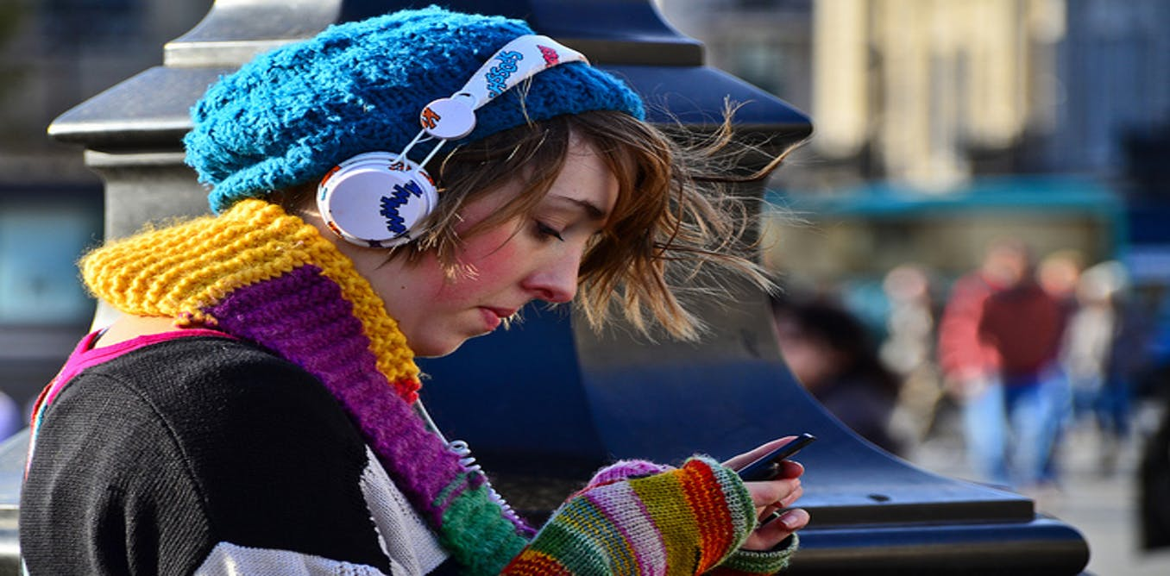
Being sensitive to the feelings of others
This Photo by Unknown Author is licensed under CC BY-ND

Slide 6
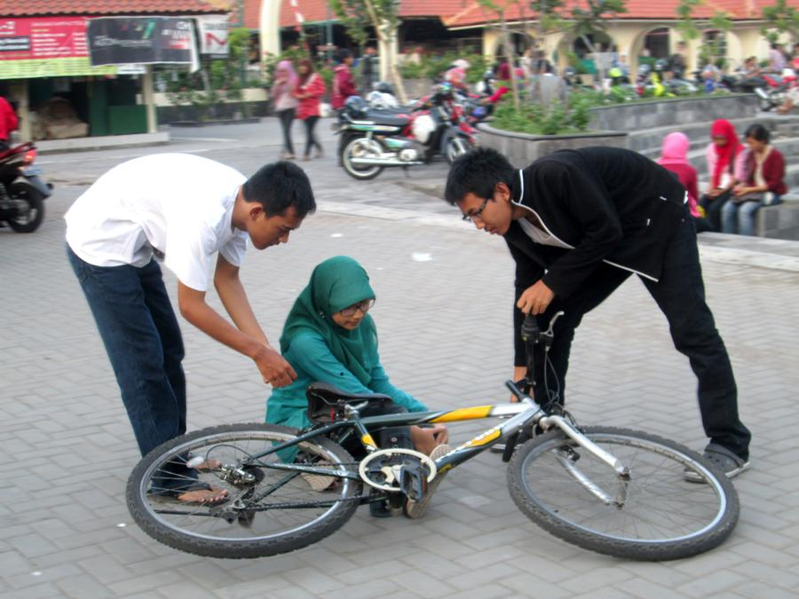
Being helpful to others

Slide 7
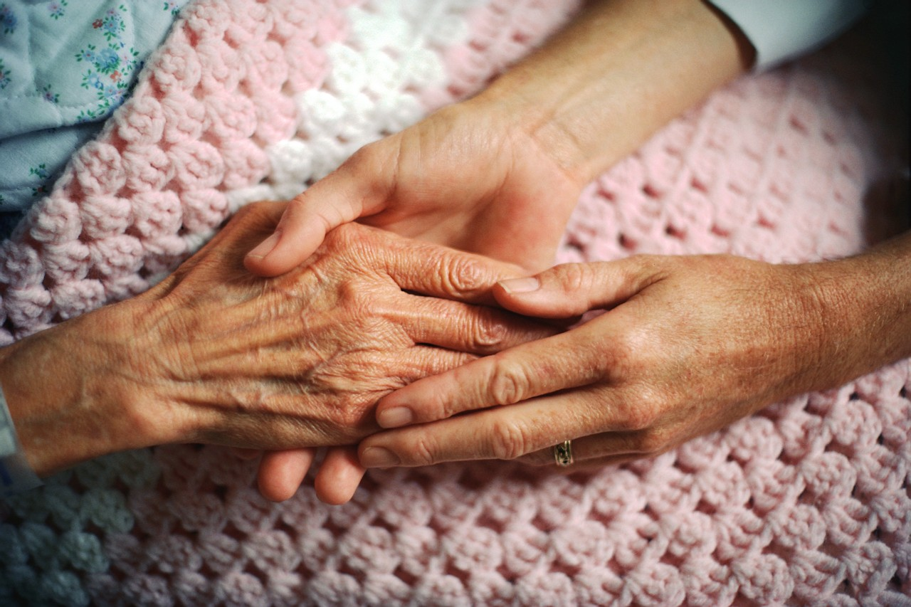
Caring for others
This Photo by Unknown Author is licensed under CC BY-NC

Slide 8
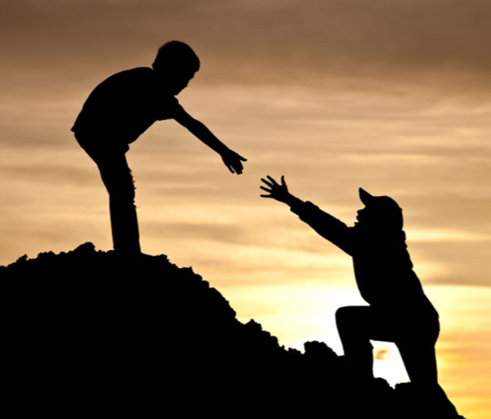
Being kind and fair

Slide 9
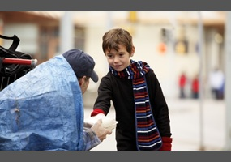

Wanting to prevent other people from suffering

Slide 10
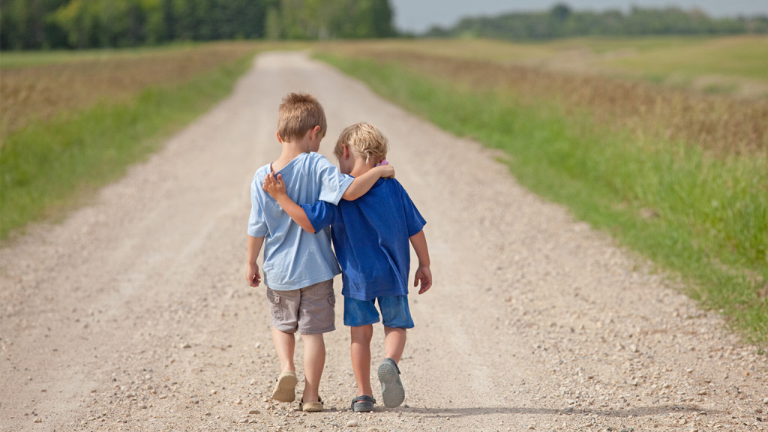
Showing warmth to others

Slide 11
Lot’s of people show compassion every day

Slide 12

Nurses

Slide 13
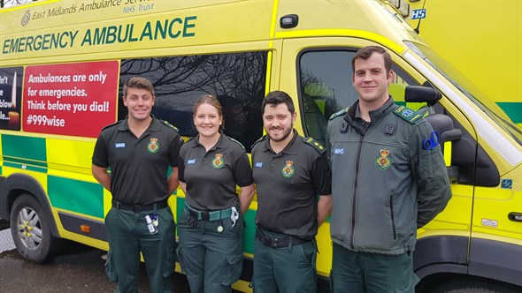
Paramedics

Slide 14
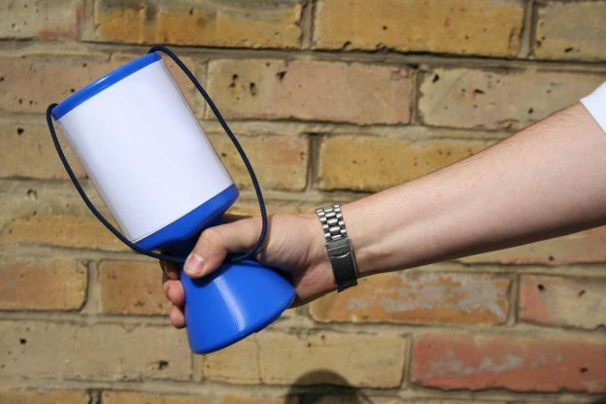
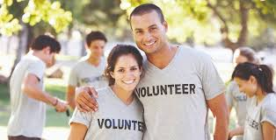
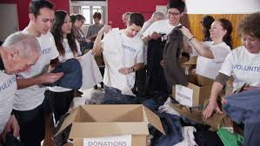
Charity workers

Slide 15
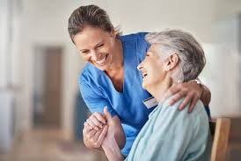
carers

Slide 16
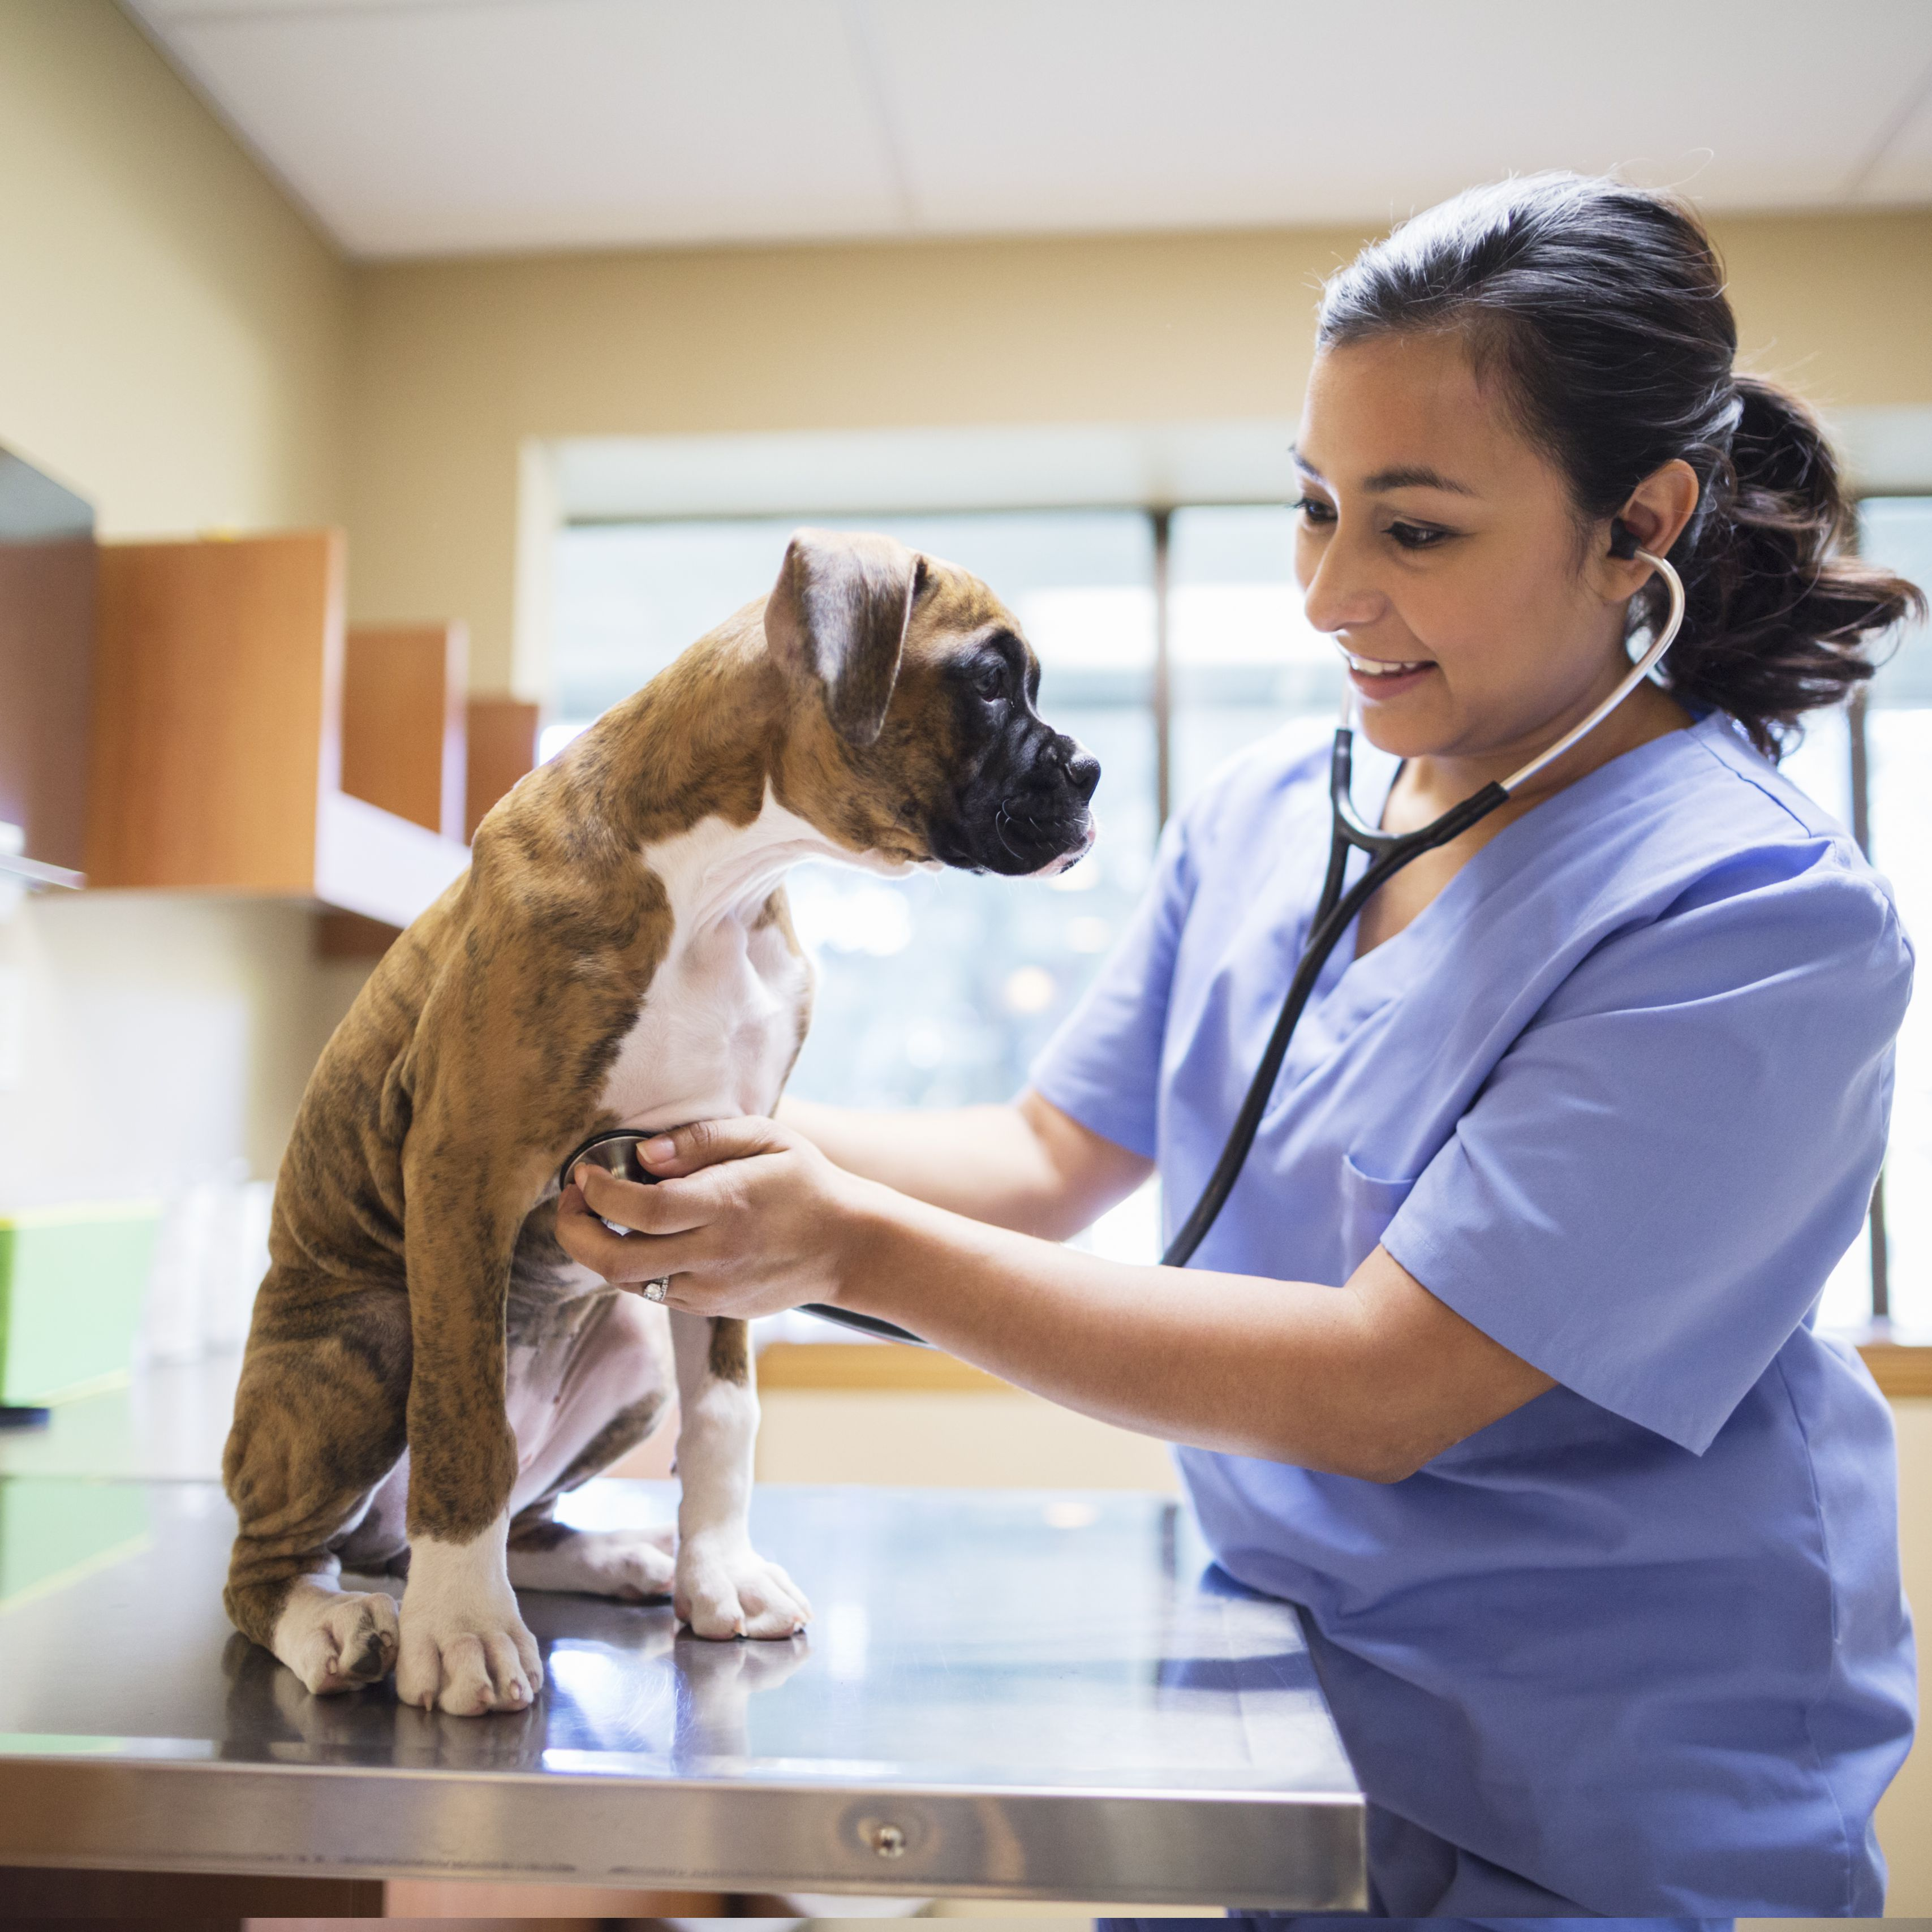

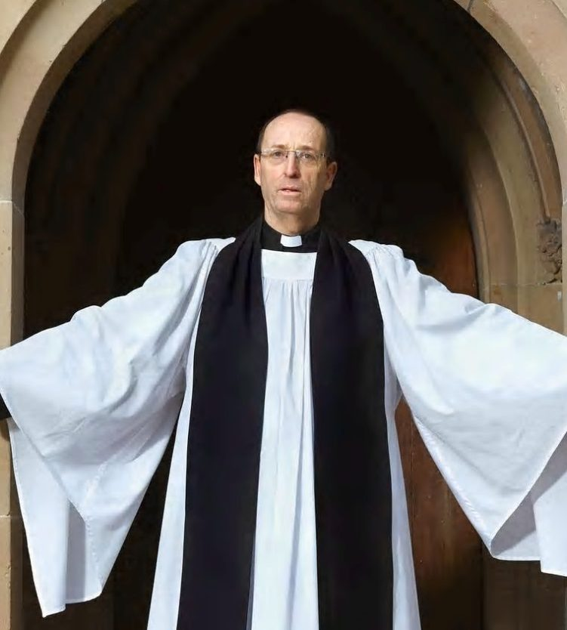
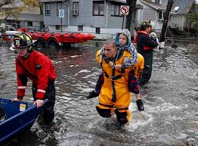
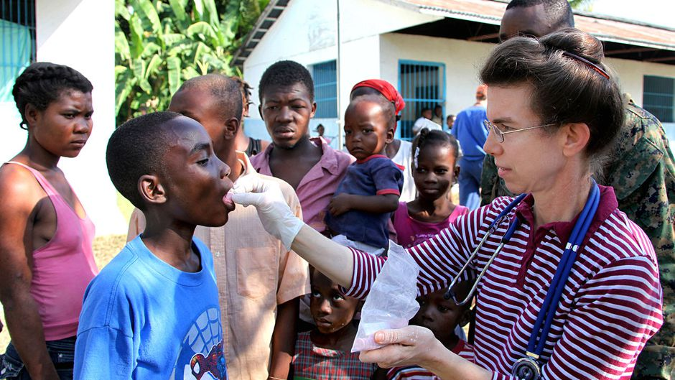
And many, many more

Slide 17
We have been talking about getting on and falling out in school
I like how …………..

Slide 18
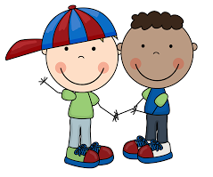
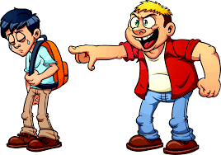

If we haven’t got something nice to say, we should say nothing at all.

Slide 19
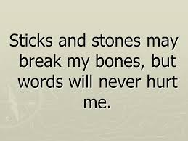
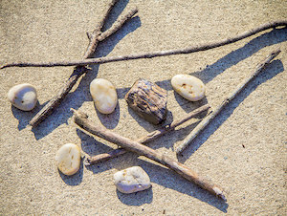
This is an old saying from when Mrs Bond was at school

Slide 20

We don’t think this is true
Calling people names huts their feelings

Slide 21
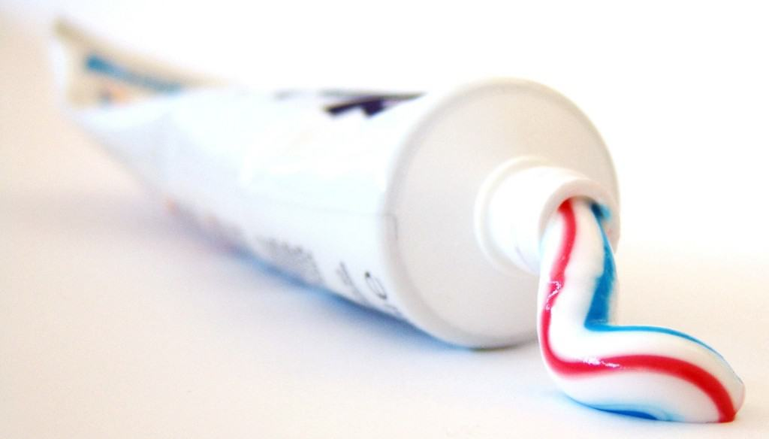
The tube of toothpaste is the person being unkind.
The toothpaste is the mean words being spoken

Slide 22
Does anyone think they could put the toothpaste back into the tube?

Slide 23
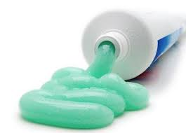
The toothpaste won’t go back into the tube.

Slide 24
Just like the toothpaste, once the mean words are out, they cannot be put back in.

Slide 25

When someone calls you names, your feelings are hurt.

Slide 26

Saying sorry helps but it cannot stop your heart from being damaged.

Slide 27
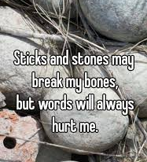


Slide 28
Let’s sing about being kind and compassionate to our friends

Slide 29
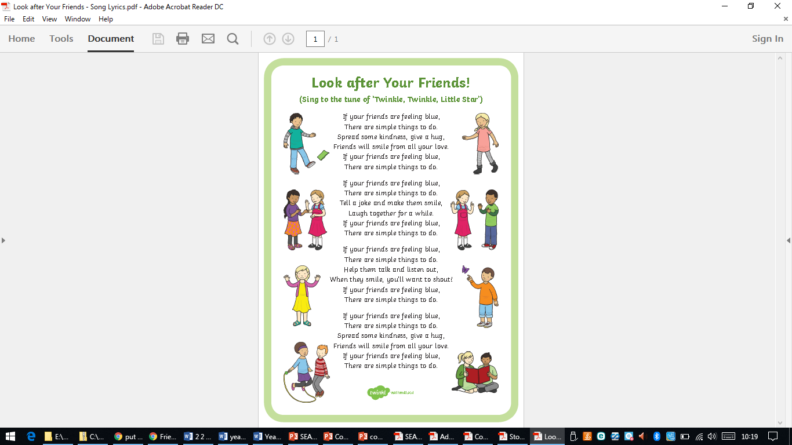

Slide 31
The Golden Rule
Luke 6:27-31
“Do unto others as you would have them do to you.”
Jesus says

Slide 32
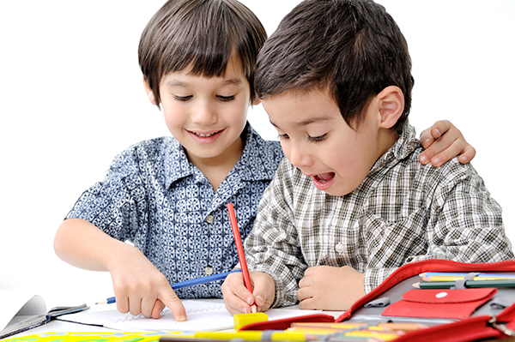
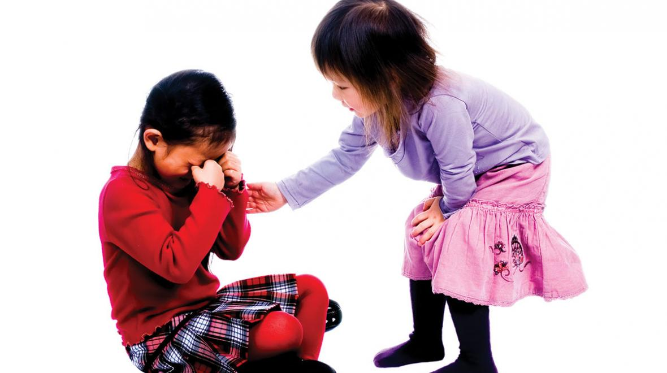
You cannot control what your friend does or says. You only have control over your words and actions. Choose kindness.

Slide 33

Let us pray

Slide 34

Thank you for joining us for our class worship.

