Slide 1



LIFE/work balance
We have started a #LIFEworkbalance campaign and we need your help to complete our LIFE/work balance survey.
We hope to publish the results soon, so please give 15 minutes of your time to help us get a true picture of school life.
Want to be a part of this campaign? Take the survey on our website and share it with your colleagues!
© Classroom Secrets Limited 2018

Slide 2
Year 2 – Summer Block 4 – Mass, Capacity and Temperature – Compare Mass
About This Resource:
This PowerPoint has been designed to support your teaching of this small step. It includes a starter activity and an example of each question from the Varied Fluency and Reasoning and Problem Solving resources also provided in this pack. You can choose to work through all examples provided or a selection of them depending on the needs of your class.
National Curriculum Objectives:
Mathematics Year 2: (2M1) Compare and order lengths, mass, volume/capacity and record the results using >, < and =
More Year 2 Mass Capacity and Temperature resources.
Did you like this resource? Don’t forget to review it on our website.
© Classroom Secrets Limited 2018

Slide 3
Year 2 – Summer Block 4 – Mass, Capacity and Temperature
Step 1: Compare Mass
© Classroom Secrets Limited 2018

Slide 4
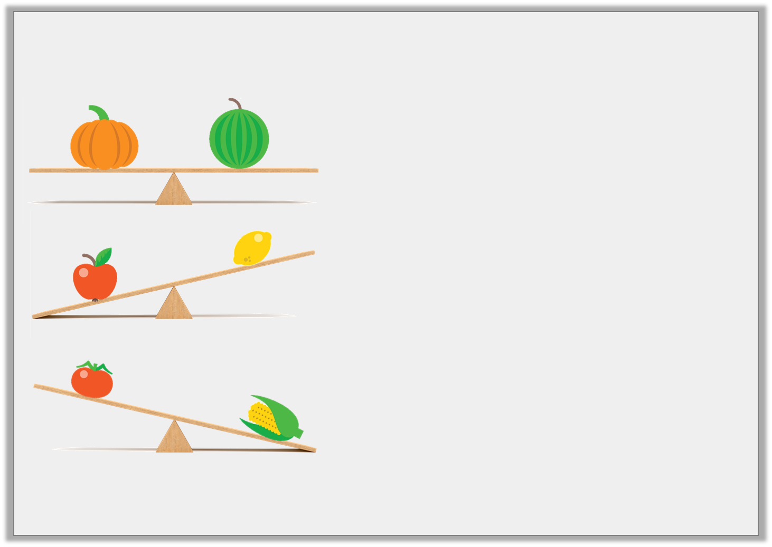
Introduction
Complete the sentences below:
Introduction
Complete the sentences below:
The pumpkin weighs the
as the melon.
The lemon weighs
than the apple.
The sweetcorn weighs
than the tomato.
Word bank: more less same
Word bank: more less same
© Classroom Secrets Limited 2018

Slide 5
Introduction
Complete the sentences below:
Introduction
Complete the sentences below:
The pumpkin weighs the
as the melon.
same
less
The lemon weighs
than the apple.
more
The sweetcorn weighs
than the tomato.
Word bank: more less same
Word bank: more less same
© Classroom Secrets Limited 2018

Slide 6
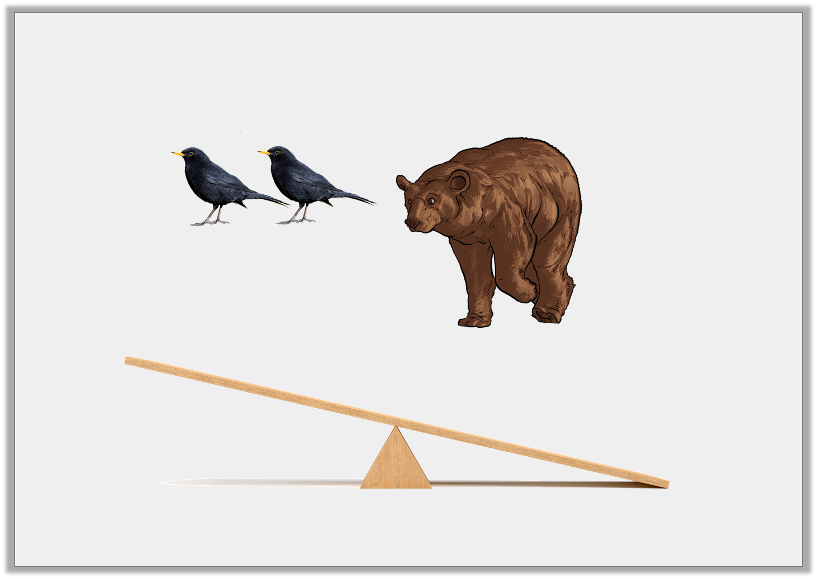
Varied Fluency 1
Draw lines to show which side of the
balance the objects belong.
© Classroom Secrets Limited 2018

Slide 7
Varied Fluency 1
Draw lines to show which side of the
balance the objects belong.
© Classroom Secrets Limited 2018

Slide 8
Varied Fluency 2
Use the words ‘more’ or ‘less’ to complete the sentence.
Two feathers weigh __________
than a pebble.
© Classroom Secrets Limited 2018

Slide 9
Varied Fluency 2
Use the words ‘more’ or ‘less’ to complete the sentence.
Two feathers weigh __________
than a pebble.
less
© Classroom Secrets Limited 2018

Slide 10
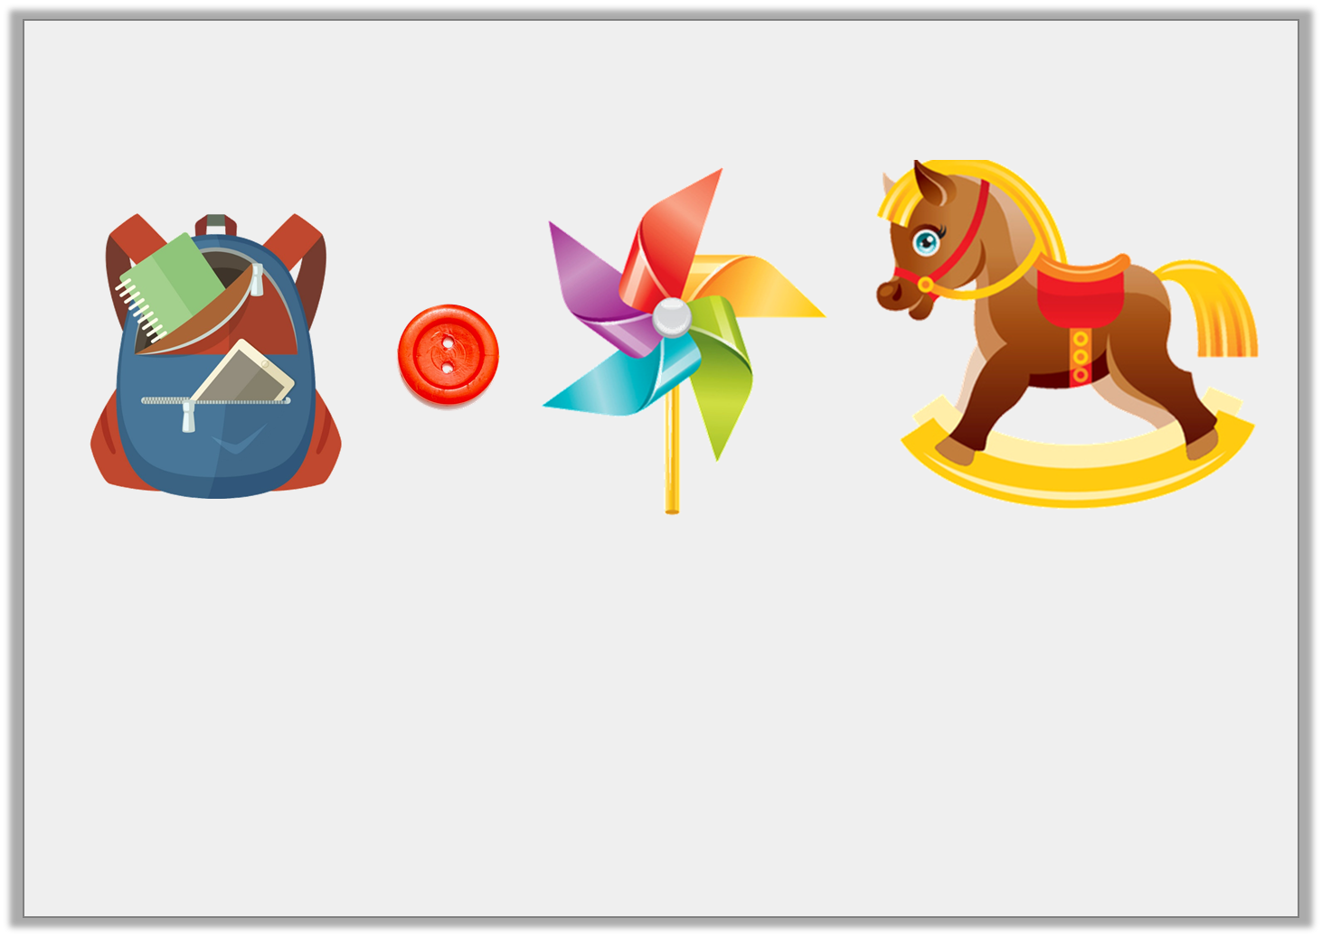
Varied Fluency 3
Order these objects from heaviest to lightest.
A | B | C | D
© Classroom Secrets Limited 2018

Slide 11
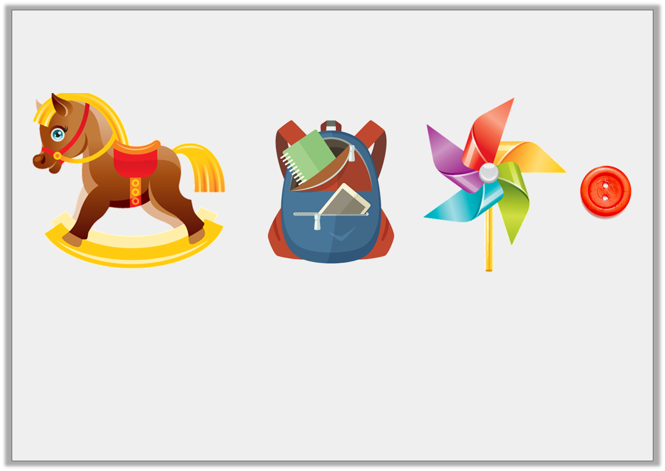
Varied Fluency 3
Order these objects from heaviest to lightest.
D | A | C | B
heaviest lightest
© Classroom Secrets Limited 2018

Slide 12
Varied Fluency 4
When comparing mass, which symbol could you swap for the underlined words?
A football is lighter than a bowling ball.
An elephant is heavier than a bat.
<
>
© Classroom Secrets Limited 2018

Slide 13
Varied Fluency 4
When comparing mass, which symbol could you swap for the underlined words?
A football _____________ a bowling ball.
An elephant _______________a bat.
<
>
<
>
© Classroom Secrets Limited 2018

Slide 14
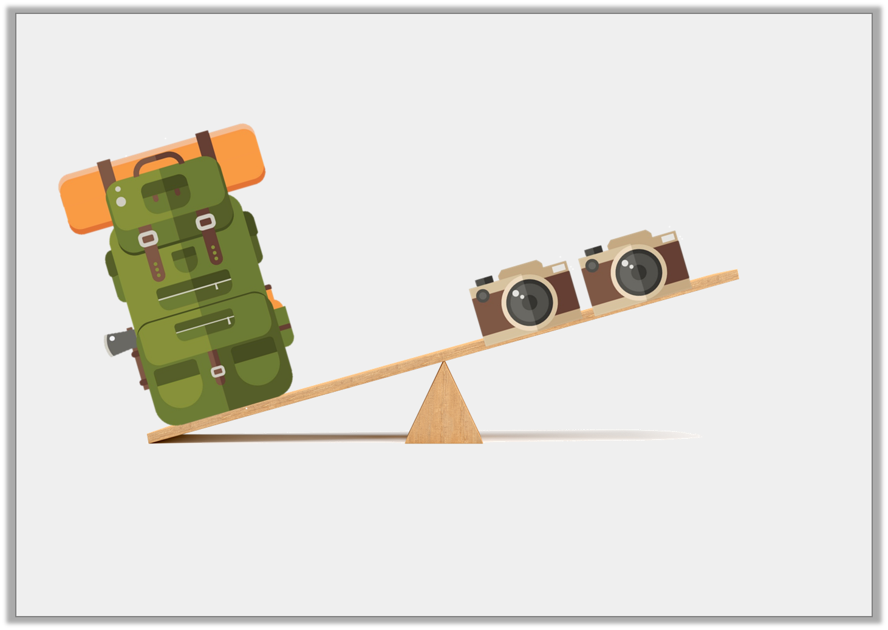
Reasoning 1
True or false?
Explain your answer.
© Classroom Secrets Limited 2018

Slide 15
Reasoning 1
True or false?
Explain your answer.
True because…
© Classroom Secrets Limited 2018

Slide 16
Reasoning 1
True or false?
Explain your answer.
True because the scale shows that the backpack is heavier than two cameras. A backpack full of equipment would be heavier than two small cameras.
© Classroom Secrets Limited 2018

Slide 17
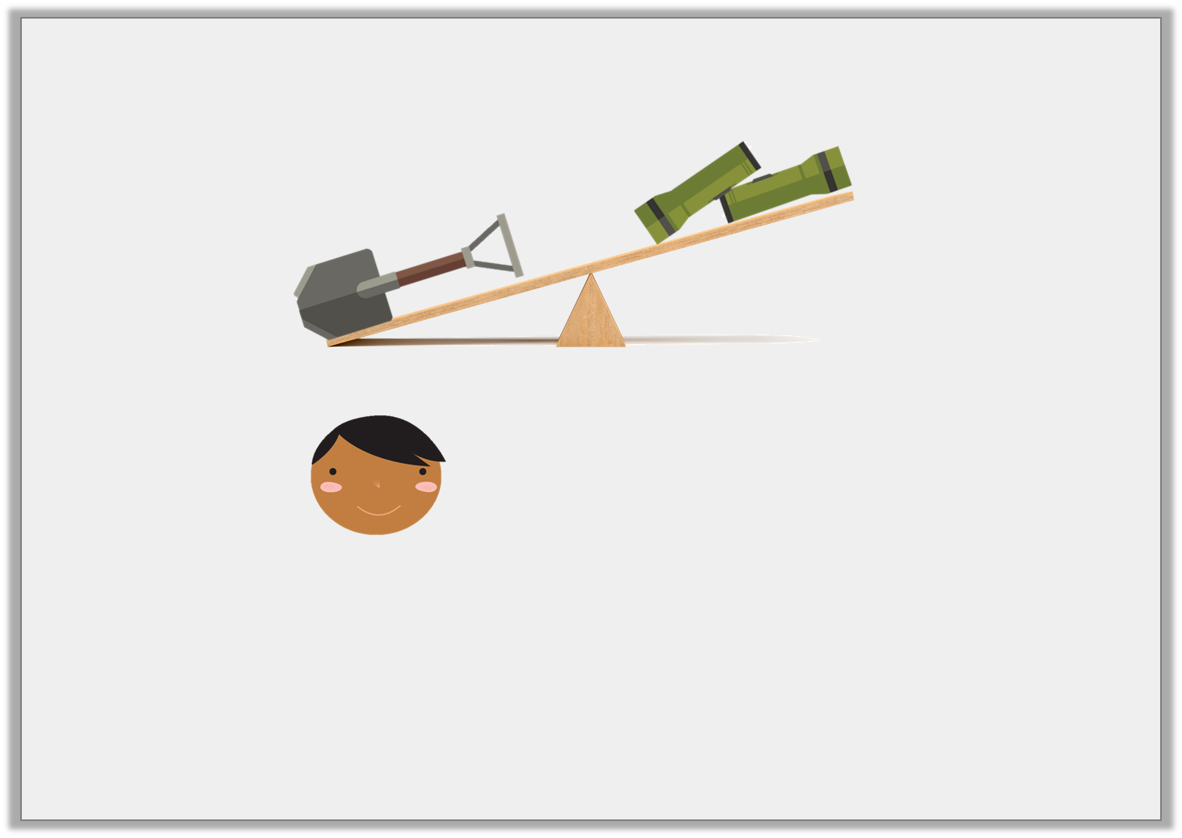
Reasoning 2
Ishmael looks at the items on the scales. He writes,
Is he correct? Explain your answer.
The mass of the shovel is < the mass of the torches.
© Classroom Secrets Limited 2018

Slide 18
Reasoning 2
Ishmael looks at the items on the scales. He writes,
Is he correct? Explain your answer.
Ishmael is incorrect because…
The mass of the shovel is < the mass of the torches.
© Classroom Secrets Limited 2018

Slide 19
Reasoning 2
Ishmael looks at the items on the scales. He writes,
Is he correct? Explain your answer.
Ishmael is incorrect because he has used the wrong symbol. He has written that the shovel is less than the torches. The shovel is actually heavier than the torches so he should have written the mass of the shovel > than the mass of the torches.
The mass of the shovel is < the mass of the torches.
© Classroom Secrets Limited 2018

Slide 20
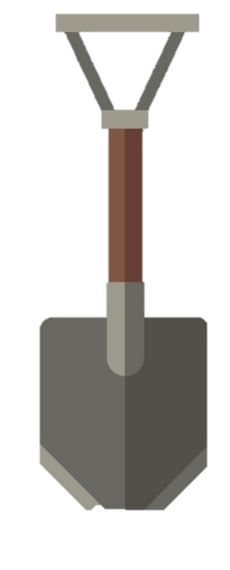

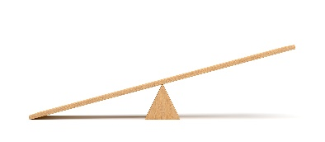
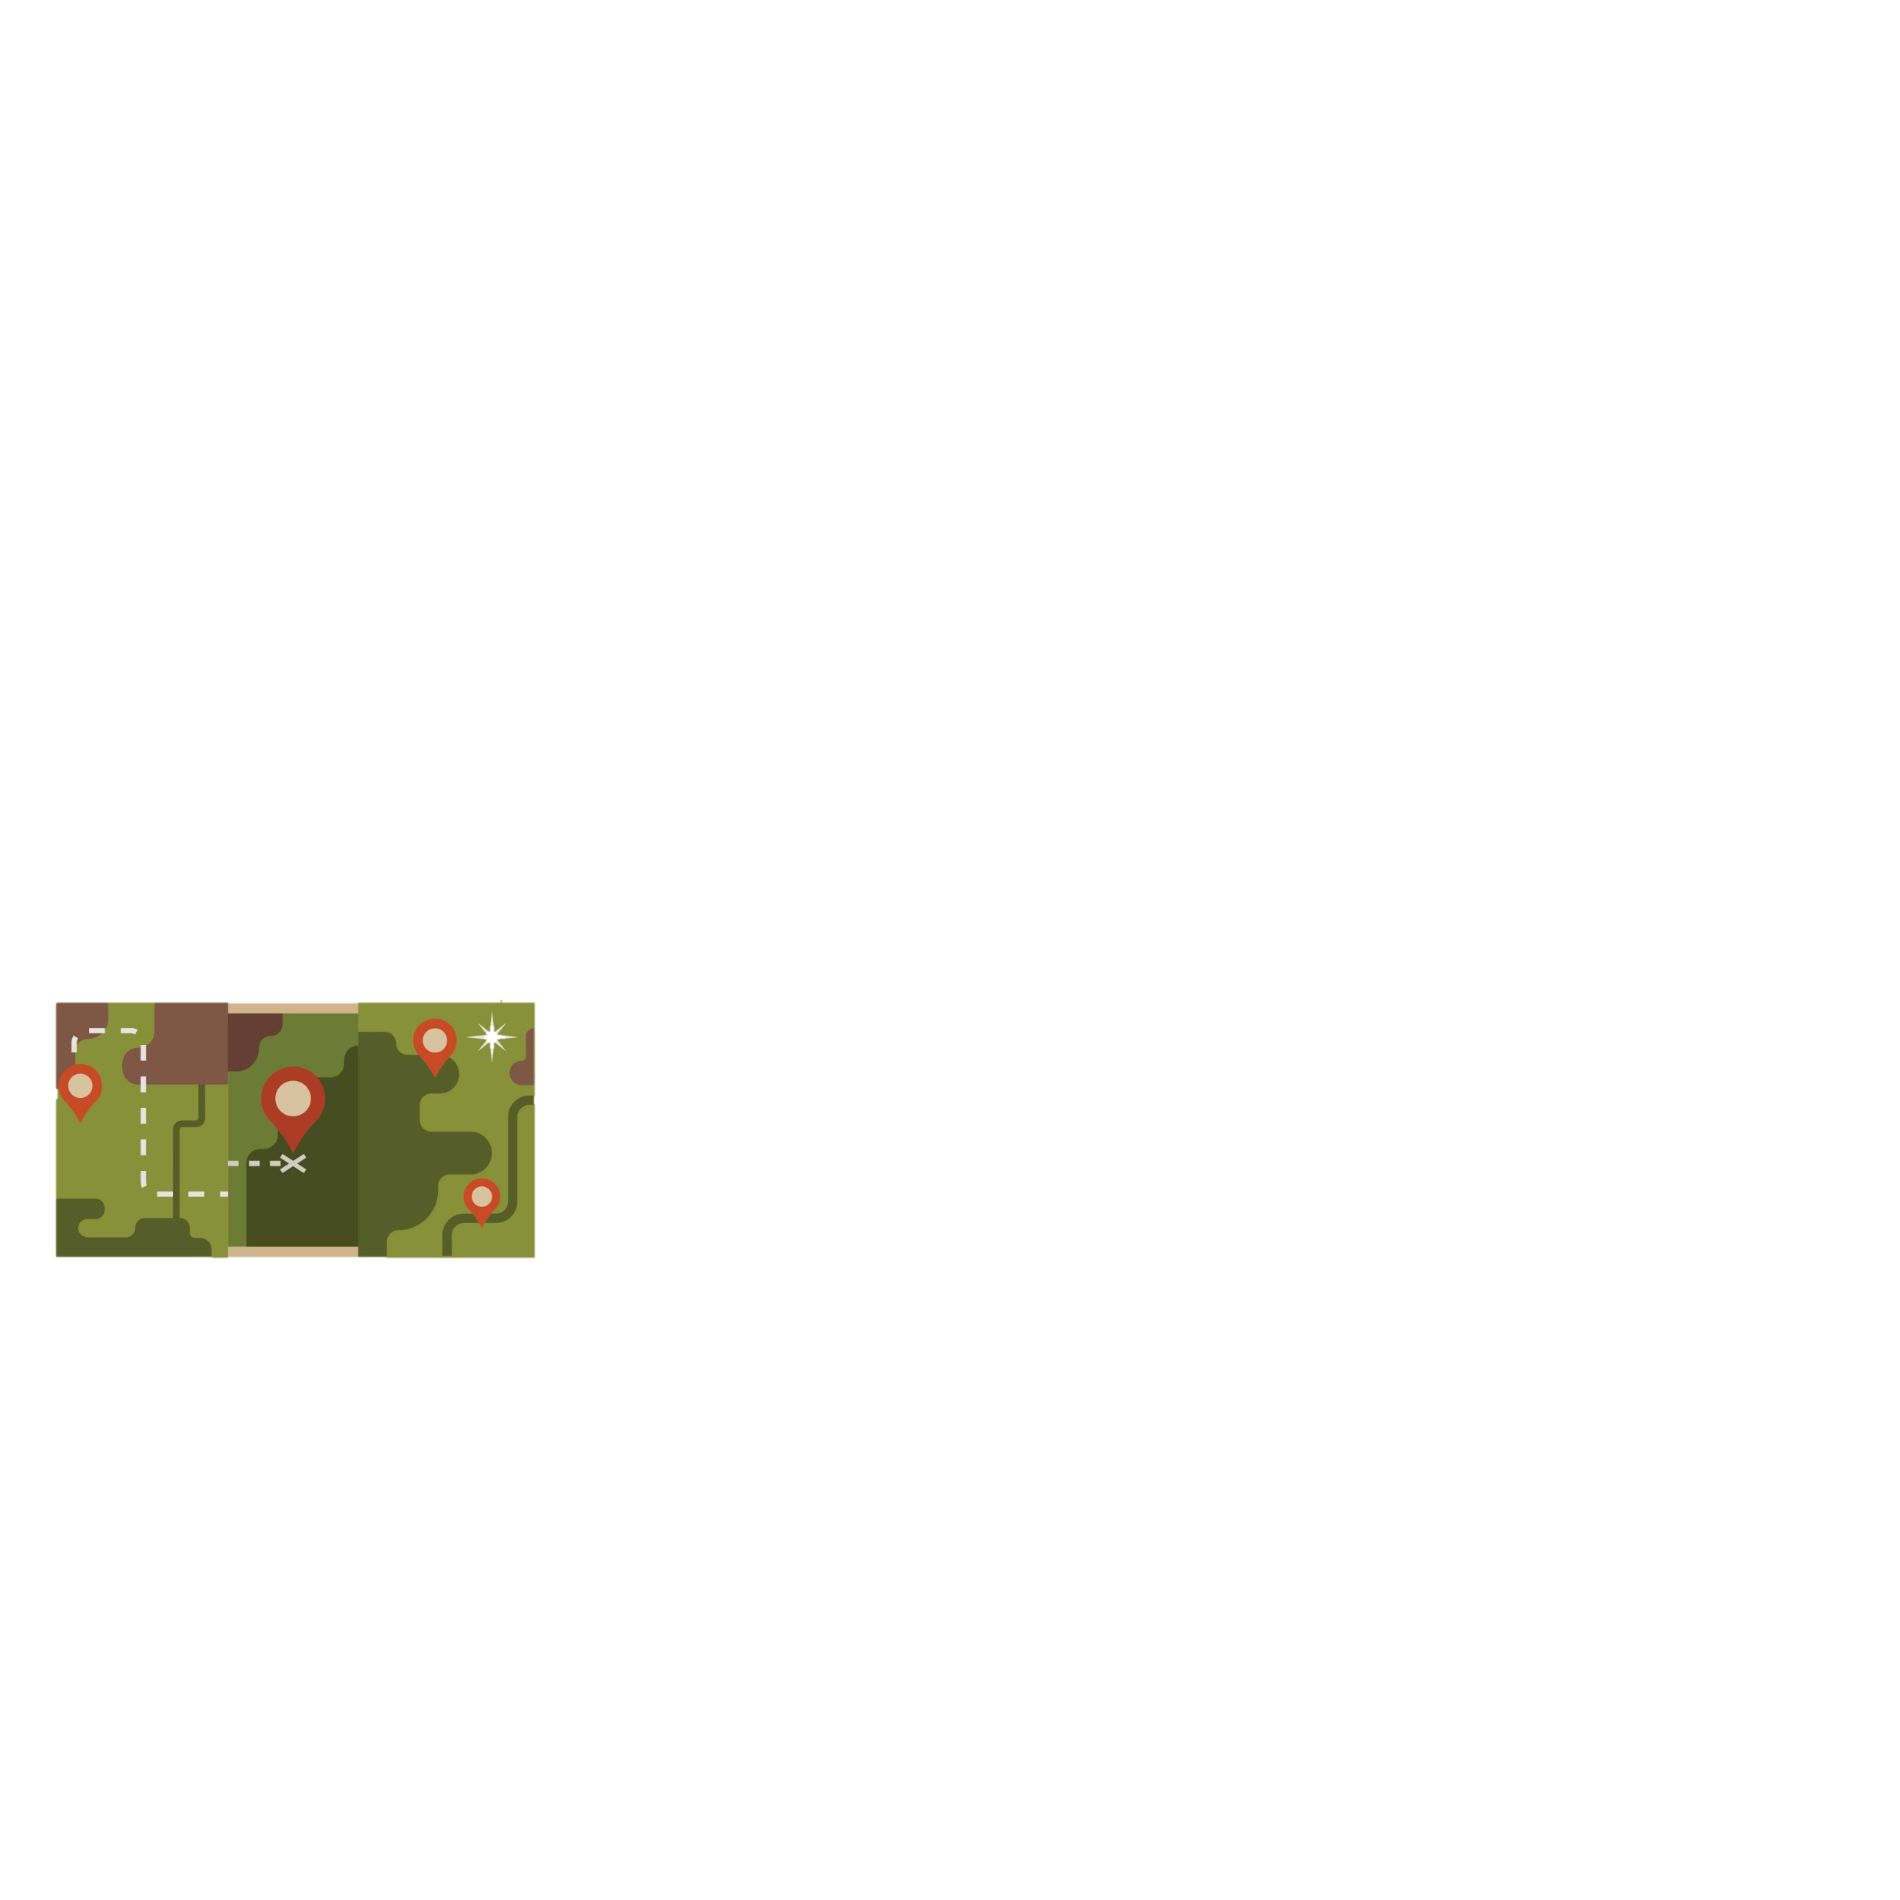

Problem Solving 1
Look at the scales below.
Use one item from each scale above to make the scale below correct. Which item can replace each letter?
B
A
© Classroom Secrets Limited 2018

Slide 21
Problem Solving 1
Look at the scales below.
Use one item from each scale above to make the scale below correct. Which item can replace each letter?
© Classroom Secrets Limited 2018

