Slide 1


Mass, Capacity and Temperature – Measure Mass in Grams
National Curriculum Objectives:
Year 2: (2M1)
Compare and order lengths, mass, volume/capacity and record the results using >, < and =
Mathematics Year 2: (2M2)
Choose and use appropriate standard units to estimate and measure length/height in any direction (m/cm); mass (kg/g); temperature (°C); capacity (litres/ml) to the nearest appropriate unit, using rulers, scales, thermometers and measuring vessels
© Classroom Secrets Limited 2019

Slide 2
Year 2 – Summer Block 4 – Mass, Capacity and Temperature
Step 2: Measure Mass in Grams
© Classroom Secrets Limited 2019

Slide 3
Introduction
What number is each arrow pointing to?
0 | 10 |  | 30 |  | 50 |  | 70 |  | 90 | 100
0 | 2 | 4 |  | 8 | 10 | 12 |  | 16 | 18 | 20
0 | 5 | 10 |  | 20 | 25 |  | 35 | 40 |  | 50
© Classroom Secrets Limited 2019

Slide 4
Introduction
What number is each arrow pointing to?
0 | 10 |  | 30 | 40 | 50 |  | 70 |  | 90 | 100
0 | 2 | 4 |  | 8 | 10 | 12 | 14 | 16 | 18 | 20
0 | 5 | 10 |  | 20 | 25 |  | 35 | 40 | 45 | 50
© Classroom Secrets Limited 2019

Slide 5
Varied Fluency 1
Complete the missing numbers on the scale:
0
2
30
28
4
26
6
8
g
22
10
20
12
18
16
© Classroom Secrets Limited 2019

Slide 6
Varied Fluency 1
Complete the missing numbers on the scale:
0
2
30
28
4
26
6
24
8
g
22
10
20
14
12
18
16
© Classroom Secrets Limited 2019

Slide 7
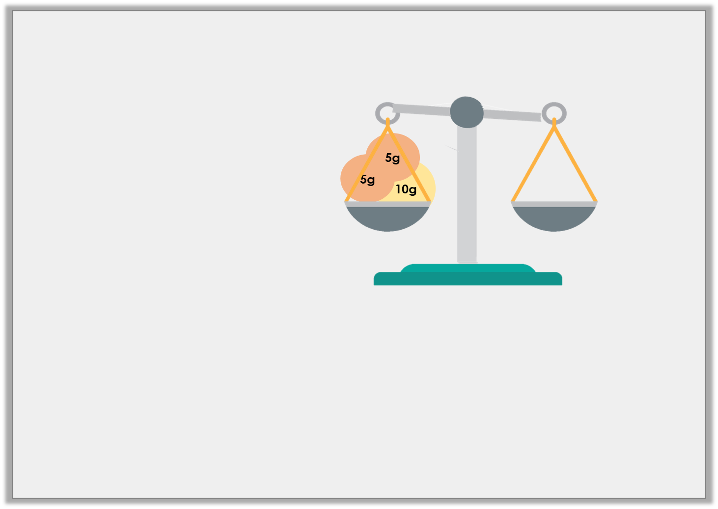
Varied Fluency 2
Join the matching pairs:
A
twenty-two grams
?
B
75
0
5
70
10
65
15
5g
60
g
20
2g
10g
55
25
5g
50
30
45
40
35
C
D
© Classroom Secrets Limited 2019

Slide 8
Varied Fluency 2
Join the matching pairs:
A
twenty-two grams
?
B
75
0
5
70
10
65
15
5g
60
g
20
2g
10g
55
25
5g
50
30
45
40
35
C
D
© Classroom Secrets Limited 2019

Slide 9
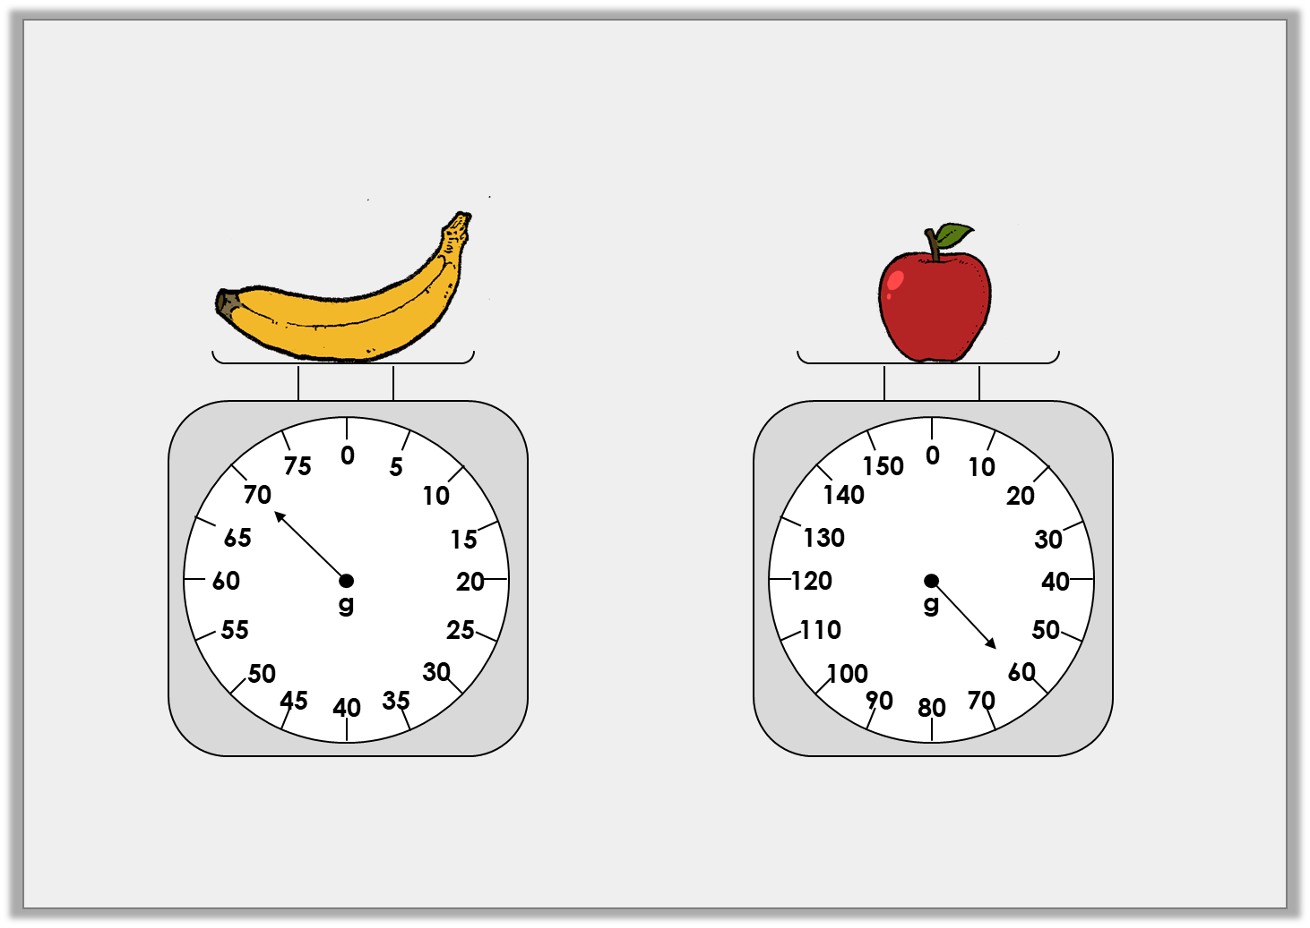
Varied Fluency 3
How much do these items weigh?
© Classroom Secrets Limited 2019

Slide 10
Varied Fluency 3
How much do these items weigh?
70g
60g
© Classroom Secrets Limited 2019

Slide 11
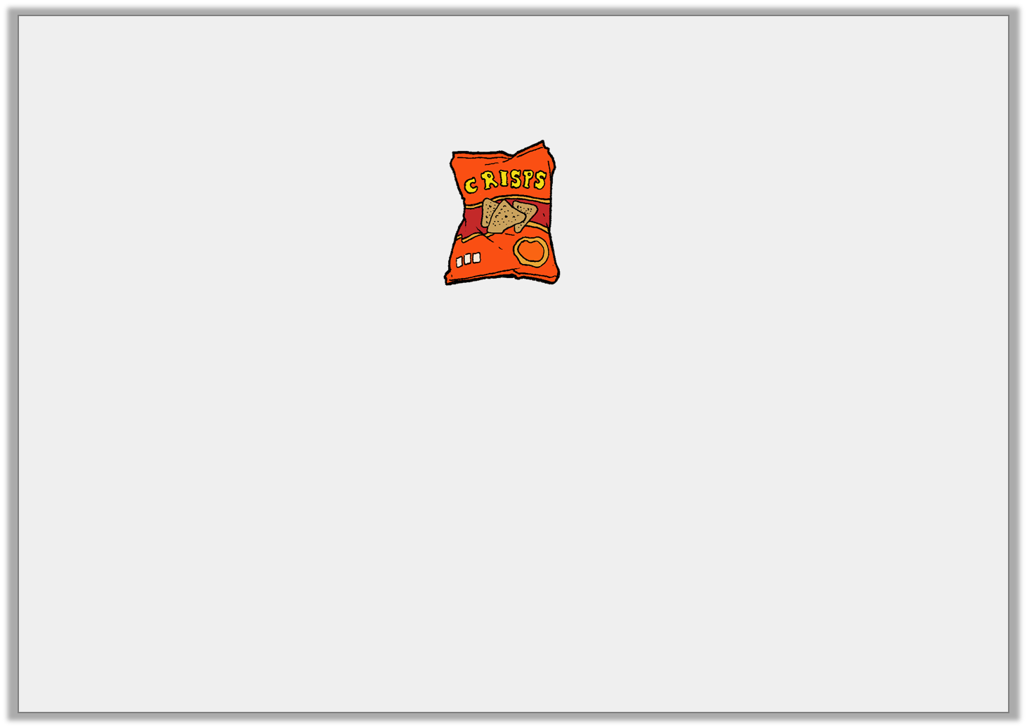
Problem Solving 1
A peach weighs 40g more than the crisps below.
How much does the peach weigh?
75
0
5
70
10
65
15
60
20
g
55
25
50
30
45
40
35
© Classroom Secrets Limited 2019

Slide 12
Problem Solving 1
A peach weighs 40g more than the crisps below.
How much does the peach weigh?
75g
75
0
5
70
10
65
15
60
20
g
55
25
50
30
45
40
35
© Classroom Secrets Limited 2019

Slide 13
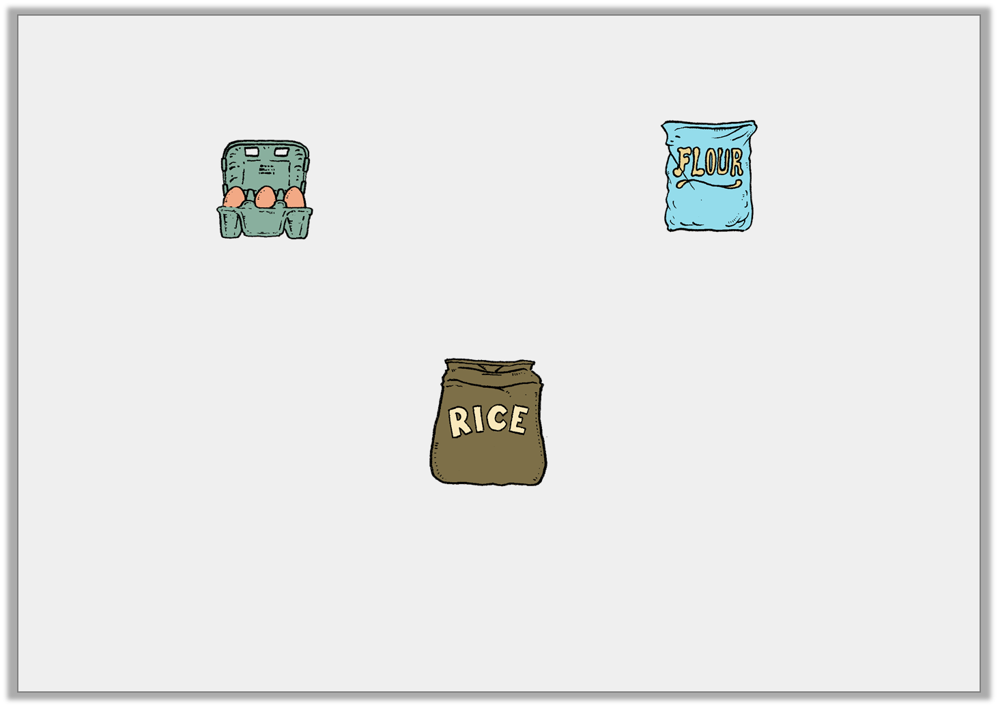
Problem Solving 2
The rice weigh less than the flour but more than the eggs.
How much could the rice weigh? Give 3 possible answers.
75
0
5
150
0
10
70
10
140
20
65
15
130
30
60
20
120
g
40
g
110
50
55
25
50
30
100
60
45
40
35
90
80
70
© Classroom Secrets Limited 2019

Slide 14
Problem Solving 2
The rice weigh less than the flour but more than the eggs.
How much could the rice weigh? Give 3 possible answers.
Various possible answers in the range 76g to 149g.
75
0
5
150
0
10
70
10
140
20
65
15
130
30
60
20
120
g
40
g
110
50
55
25
50
30
100
60
45
40
35
90
80
70
© Classroom Secrets Limited 2019

Slide 15
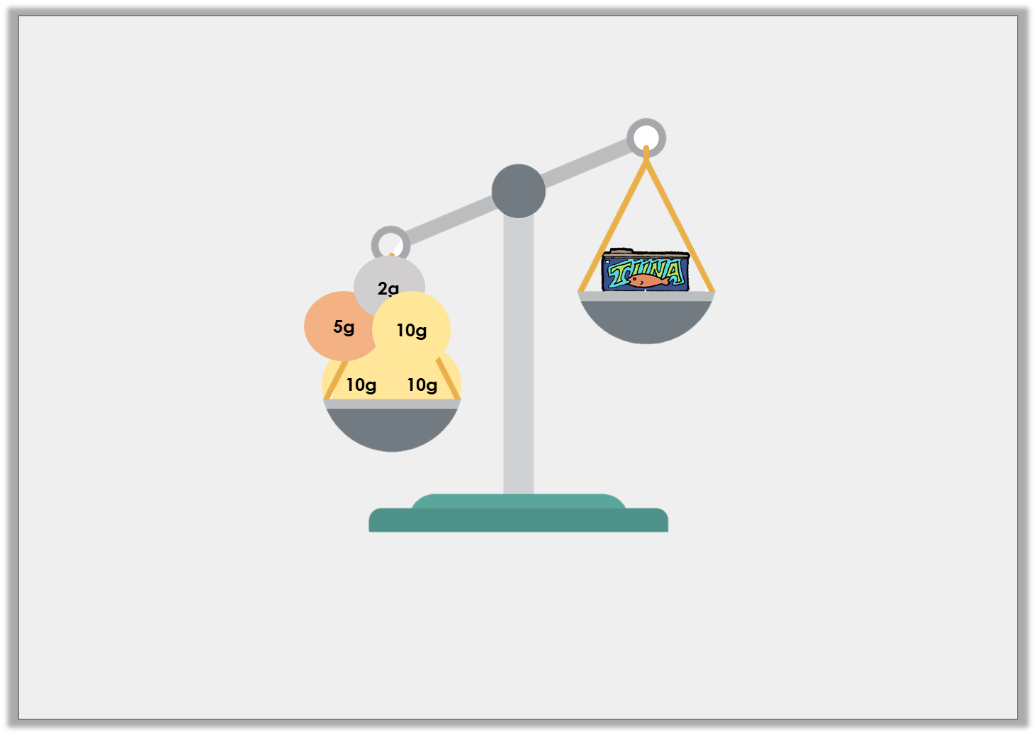
Reasoning 1
Daniel thinks the tuna could weigh 37g. Is he correct?
Explain your answer.
© Classroom Secrets Limited 2019

Slide 16
Reasoning 1
Daniel thinks the tuna could weigh 37g. Is he correct?
Explain your answer.
Daniel is not correct because…
© Classroom Secrets Limited 2019

Slide 17
Reasoning 1
Daniel thinks the tuna could weigh 37g. Is he correct?
Explain your answer.
Daniel is not correct because the balance scale shows that the tuna is lighter than 37g.
© Classroom Secrets Limited 2019

