Slide 1


Mass, Capacity & Temperature
Measure Mass (kg)
National Curriculum Objectives:
Mathematics Year 2: (2M1)
Compare and order lengths, mass, volume/capacity and record the results using >, < and =
Mathematics Year 2: (2M2)
Choose and use appropriate standard units to estimate and measure length/height in any direction (m/cm); mass (kg/g); temperature (°C); capacity (litres/ml) to the nearest appropriate unit, using rulers, scales, thermometers and measuring vessels
© Classroom Secrets Limited 2019

Slide 2
Year 2 – Summer Block 4 – Mass, Capacity & Temperature
Step 3: Measure Mass (kg)
© Classroom Secrets Limited 2019

Slide 3
Introduction
Identify which kilogram each arrow is pointing to on the scales.
20kg
30kg
10kg
20kg
30kg
10kg
35kg
60kg
© Classroom Secrets Limited 2019

Slide 4
Introduction
Identify which kilogram each arrow is pointing to on the scales.
20kg
25kg
30kg
10kg
20kg
26kg
30kg
10kg
20kg
35kg
60kg
© Classroom Secrets Limited 2019

Slide 5
Varied Fluency 1
What weight does the scale show?
0
14
2
12
4
kg
10
6
8
© Classroom Secrets Limited 2019

Slide 6
Varied Fluency 1
What weight does the scale show?
7kg
0
14
2
12
4
kg
10
6
8
© Classroom Secrets Limited 2019

Slide 7
Varied Fluency 2
Add an arrow to the scale so that it shows 25kg.
75
0
5
70
10
65
15
60
20
kg
55
25
50
30
45
35
40
© Classroom Secrets Limited 2019

Slide 8
Varied Fluency 2
Add an arrow to the scale so that it shows 25kg.
75
0
5
70
10
65
15
60
20
kg
55
25
50
30
45
35
40
© Classroom Secrets Limited 2019

Slide 9
Varied Fluency 3
Tick if the statement is true or false.
The scale reads less than 6kg
0
14
2
 | True
 | False
12
4
kg
10
6
8
© Classroom Secrets Limited 2019

Slide 10
Varied Fluency 3
Tick if the statement is true or false.
The scale reads less than 6kg
False. It reads 7kg which is more than 6kg.
0
14
2
 | True
✓ | False
12
4
kg
10
6
8
© Classroom Secrets Limited 2019

Slide 11
Varied Fluency 4
Circle the scale that shows 2kg less than 14kg.
A
B
0
0
14
2
14
2
12
4
12
4
kg
kg
10
6
10
6
8
8
© Classroom Secrets Limited 2019

Slide 12
Varied Fluency 4
Circle the scale that shows 2kg less than 14kg.
A
B
0
0
14
2
14
2
12
4
12
4
kg
kg
10
6
10
6
8
8
© Classroom Secrets Limited 2019

Slide 13
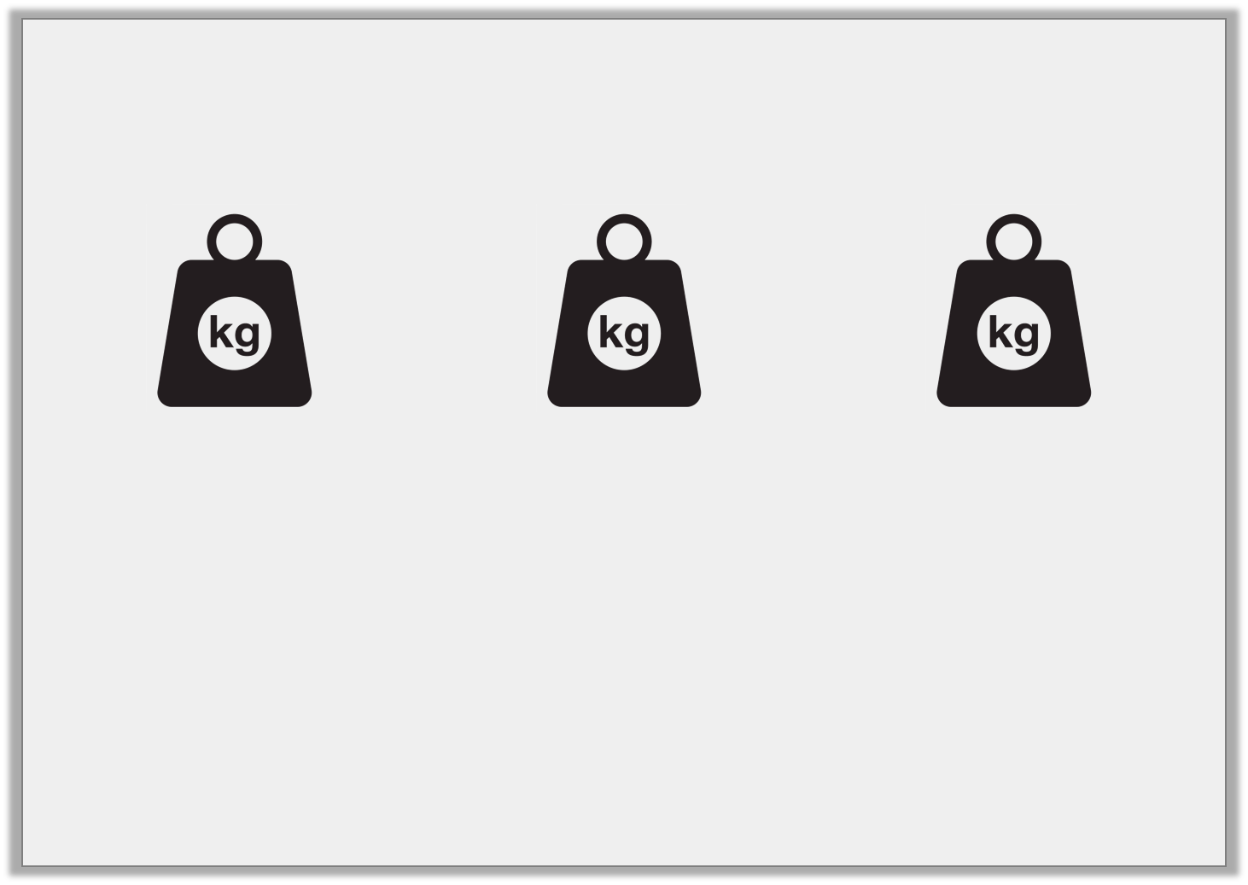
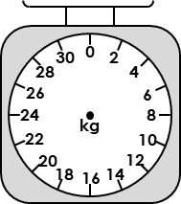
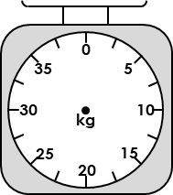
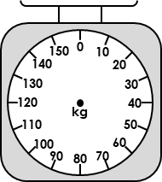
Problem Solving 1
Melissa has written down the measurements of these weights. Find and correct her mistakes.
A
B
C
1kg
5kg
4kg
© Classroom Secrets Limited 2019

Slide 14
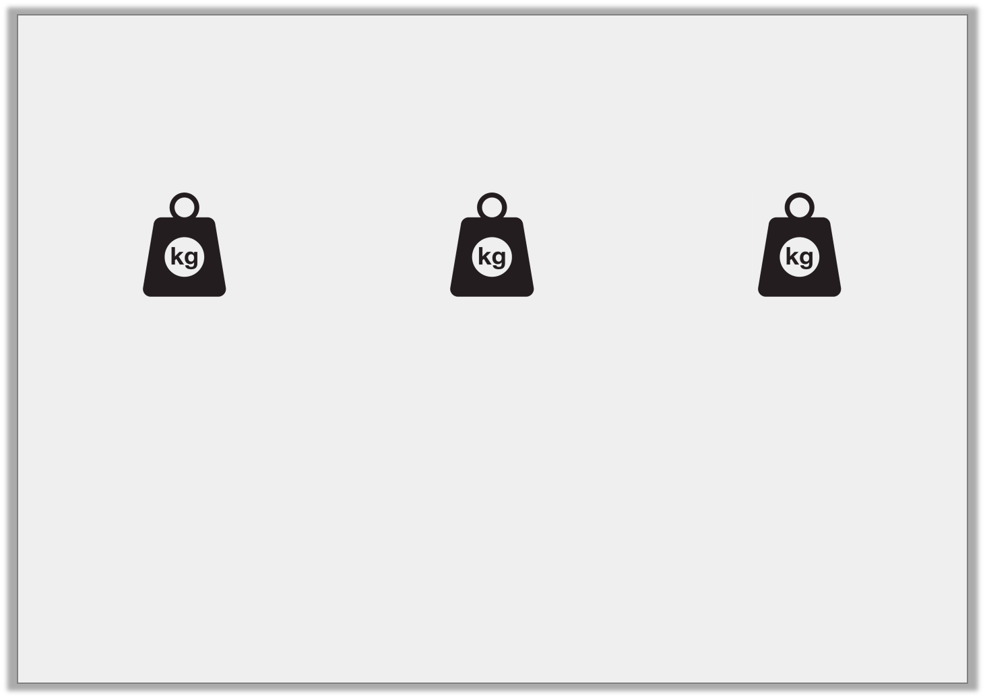
Problem Solving 1
Melissa has written down the measurements of these weights. Find and correct her mistakes.
A should be 10kg, C should be 40kg.
A
B
C
10kg
5kg
40kg
© Classroom Secrets Limited 2019

Slide 15
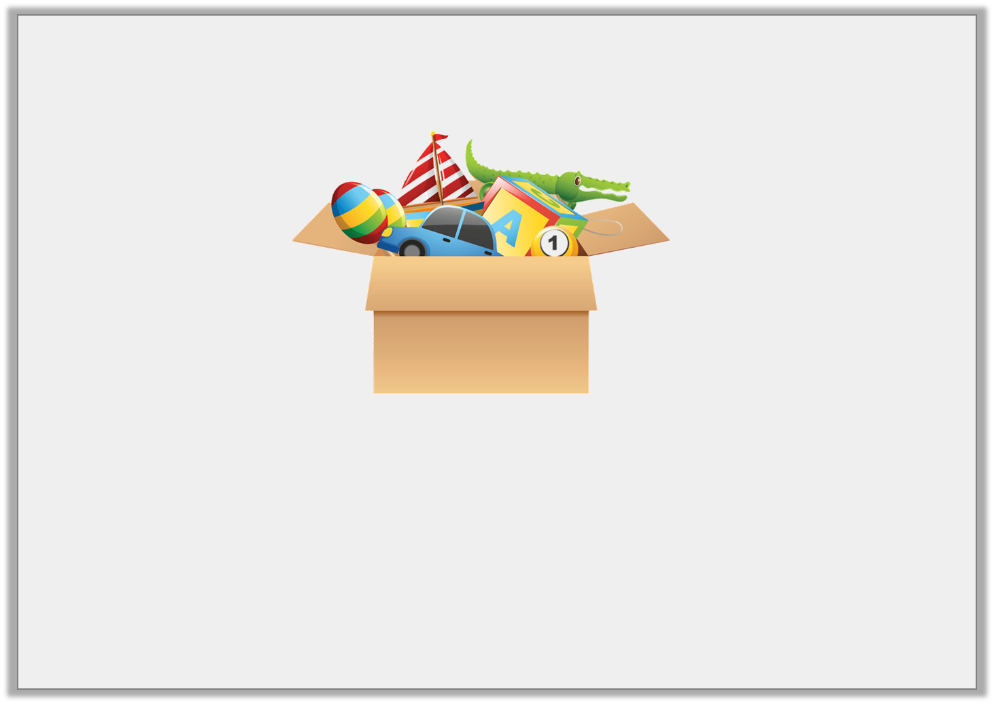
Problem Solving 2
The box of toys weighs more than 10kg but less than 35kg. What could the weight be?
© Classroom Secrets Limited 2019

Slide 16
Problem Solving 2
The box of toys weighs more than 10kg but less than 35kg. What could the weight be?
Various answers, including: 15kg, 20kg, 25kg, 30kg.
© Classroom Secrets Limited 2019

Slide 17
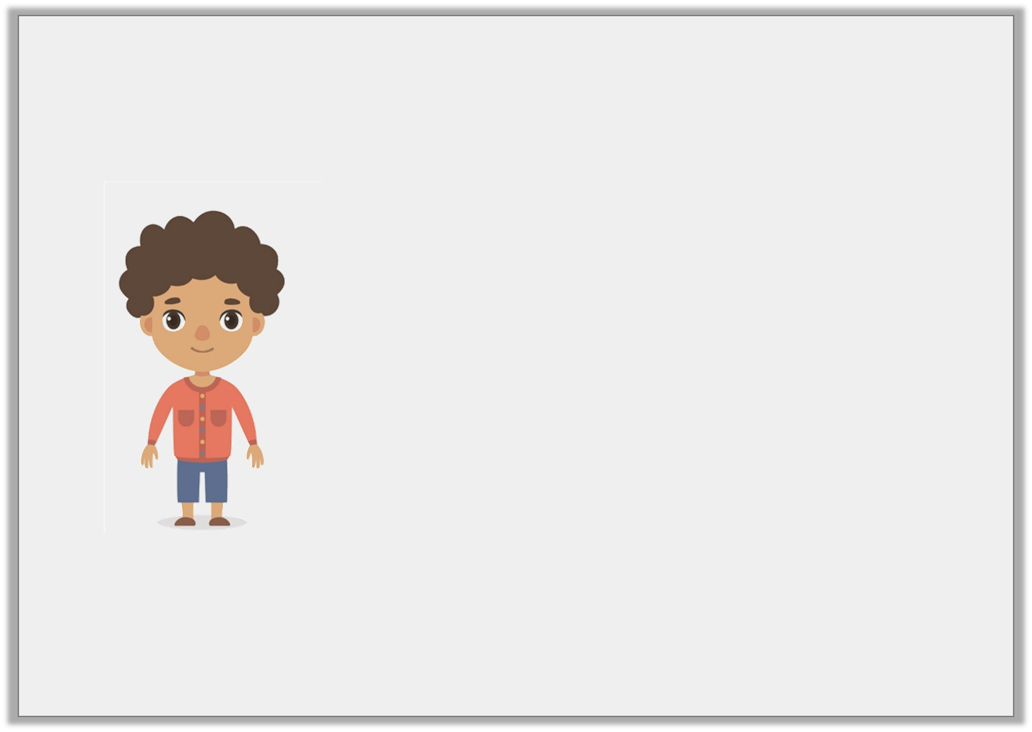
Reasoning 1
The scale shows how much a Year 2 child weighs.
Is Nick correct? How can you tell?
I weigh 41kg.
0
140
20
120
40
kg
100
60
80
© Classroom Secrets Limited 2019

Slide 18
Reasoning 1
The scale shows how much a Year 2 child weighs.
Is Nick correct? How can you tell?
He is incorrect because...
I weigh 41kg.
0
140
20
120
40
kg
100
60
80
© Classroom Secrets Limited 2019

Slide 19
Reasoning 1
The scale shows how much a Year 2 child weighs.
Is Nick correct? How can you tell?
He is incorrect because the scale shows 50kg.
I weigh 41kg.
0
140
20
120
40
kg
100
60
80
© Classroom Secrets Limited 2019

