Slide 1


Mass, Capacity and Temperature – Compare Capacity
National Curriculum Objectives:
Mathematics Year 2: (2M1)
Compare and order lengths, mass, volume/capacity and record the results using >, < and =
© Classroom Secrets Limited 2018

Slide 2
Year 2 – Summer Block 4 – Mass, Capacity & Temperature
Step 4: Compare Capacity
© Classroom Secrets Limited 2018

Slide 3
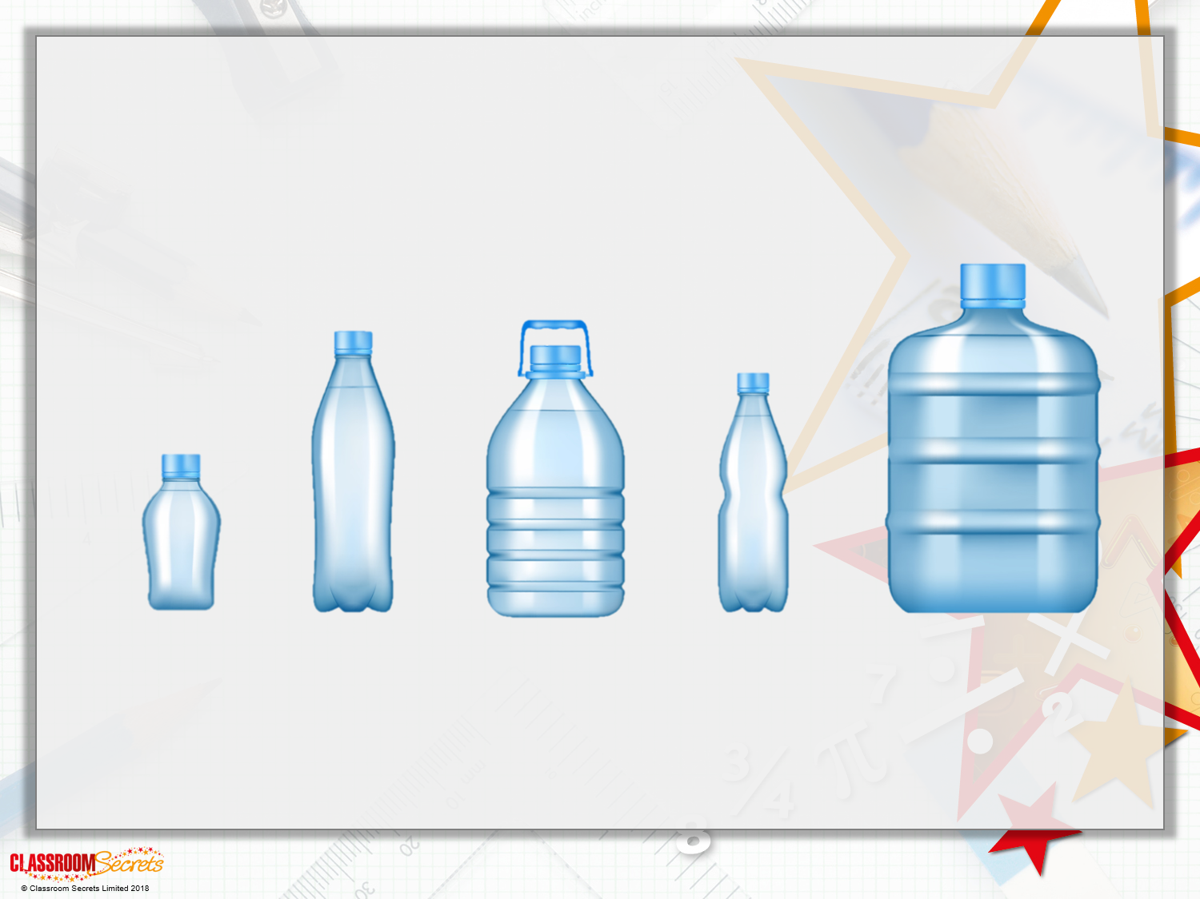
Introduction
Which container has the largest capacity?

Slide 4
Introduction
Which container has the largest capacity?

Slide 5
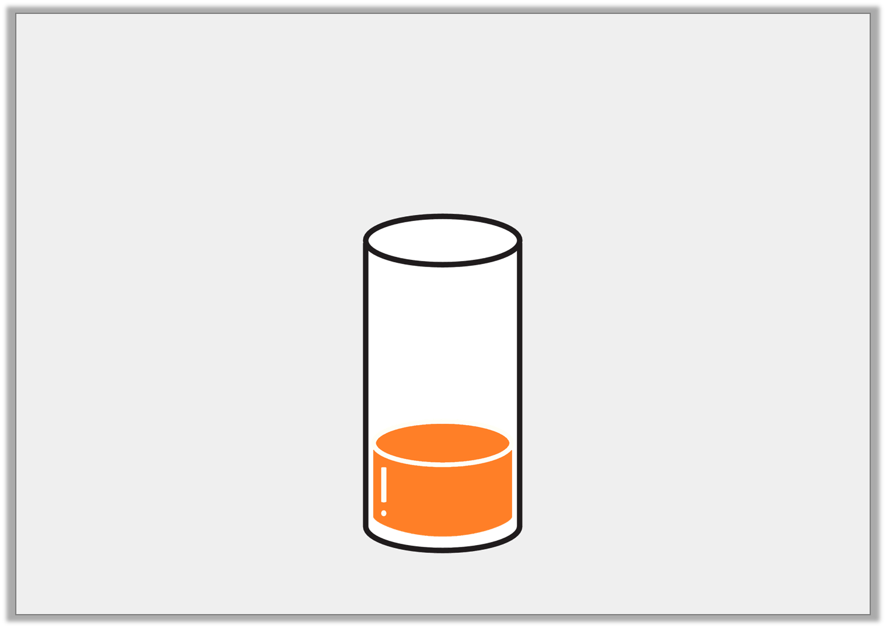
Varied Fluency 1
The volume of the container below is a quarter full.
True or false?
© Classroom Secrets Limited 2018

Slide 6
Varied Fluency 1
The volume of the container below is a quarter full.
True or false?
True
© Classroom Secrets Limited 2018

Slide 7
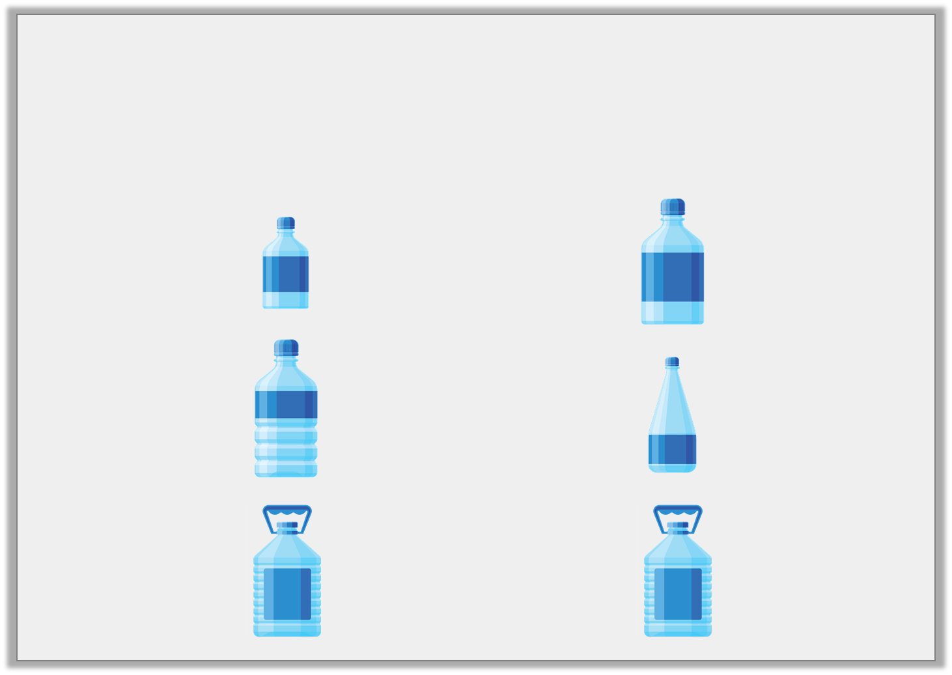
Varied Fluency 2
Use <, > and = symbols to compare the capacity
of container A with container B.
A
B
© Classroom Secrets Limited 2018

Slide 8
Varied Fluency 2
Use <, > and = symbols to compare the capacity
of container A with container B.
A
B
<
>
=
© Classroom Secrets Limited 2018

Slide 9
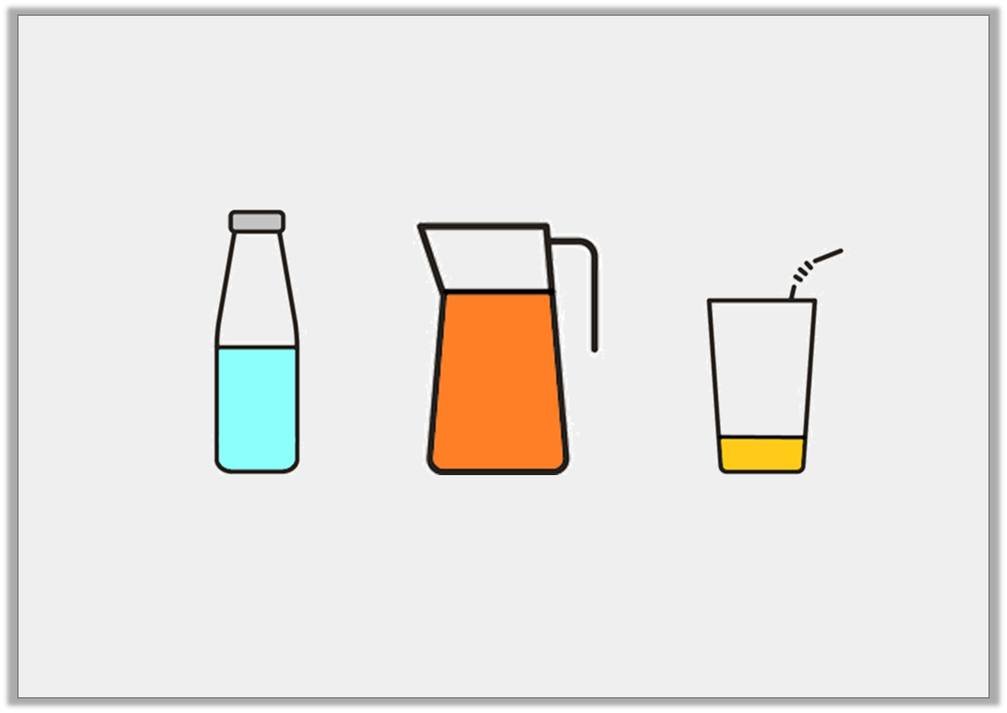
Varied Fluency 3
Draw a line to the word that best describes
the volume of each container.
full | quarter | half | three-quarters
© Classroom Secrets Limited 2018

Slide 10
Varied Fluency 3
Draw a line to the word that best describes
the volume of each container.
full | quarter | half | three-quarters
© Classroom Secrets Limited 2018

Slide 11
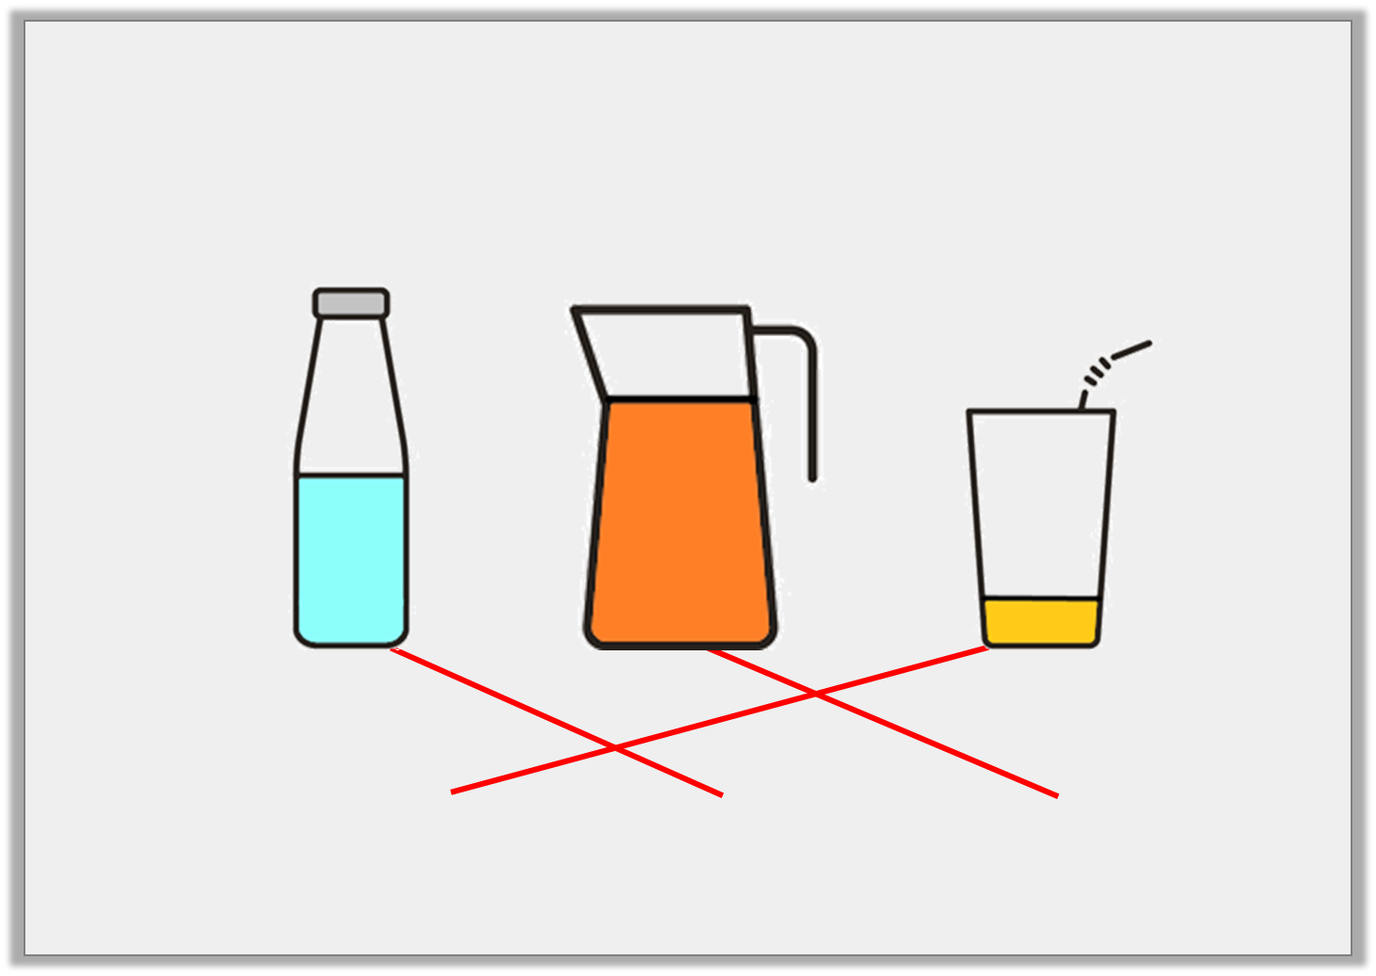
Varied Fluency 3
Draw a line to the word that best describes
the volume of each container.
full | quarter | half | three-quarters
© Classroom Secrets Limited 2018

Slide 12
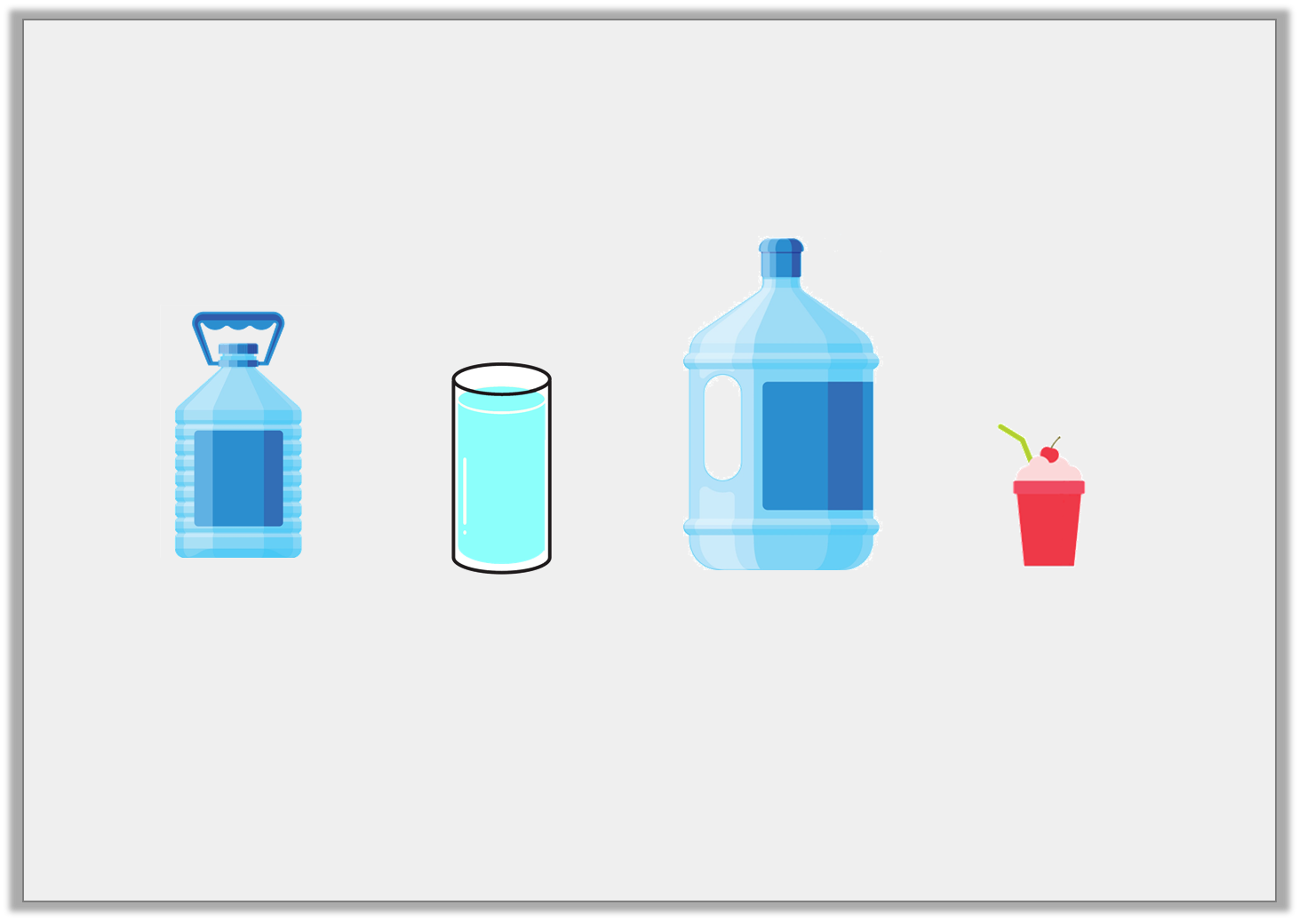
Varied Fluency 4
Order these items from the
largest capacity to the smallest capacity.
A | B | C | D
© Classroom Secrets Limited 2018

Slide 13
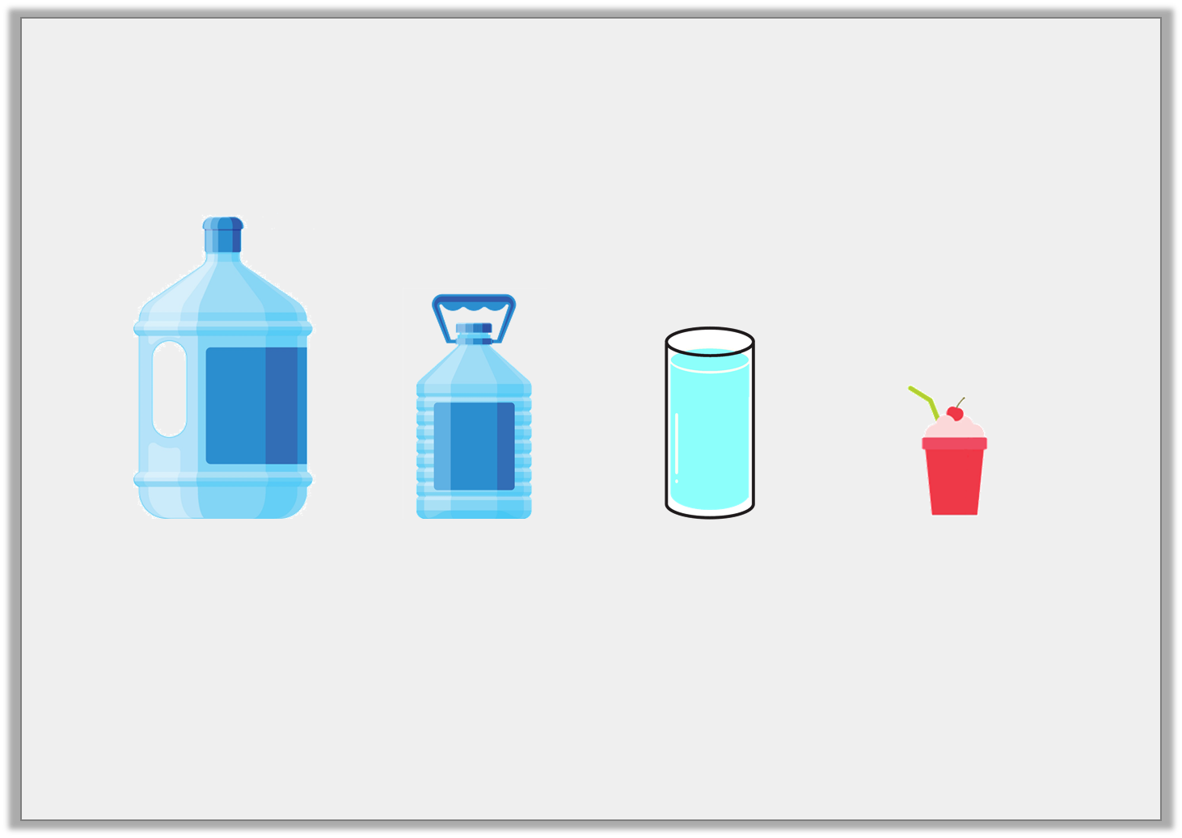
Varied Fluency 4
Order these items from the
largest capacity to the smallest capacity.
C | A | B | D
largest capacity
smallest capacity
© Classroom Secrets Limited 2018

Slide 14
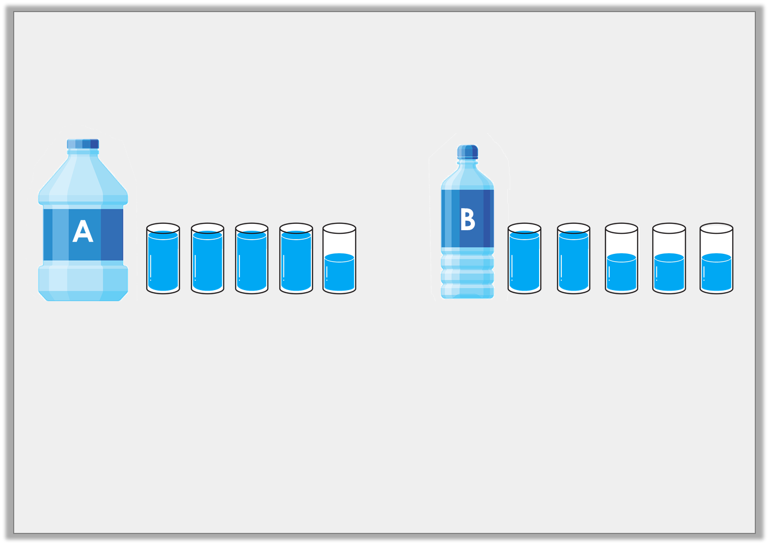
Reasoning 1
Which container has the largest capacity?
How do you know?
© Classroom Secrets Limited 2018

Slide 15
Reasoning 1
Which container has the largest capacity?
How do you know?
Container A because…
© Classroom Secrets Limited 2018

Slide 16
Reasoning 1
Which container has the largest capacity?
How do you know?
Container A because it can hold 4 full glasses and 1 half glass which is more than 2 full glasses and 3 half glasses.
© Classroom Secrets Limited 2018

Slide 17
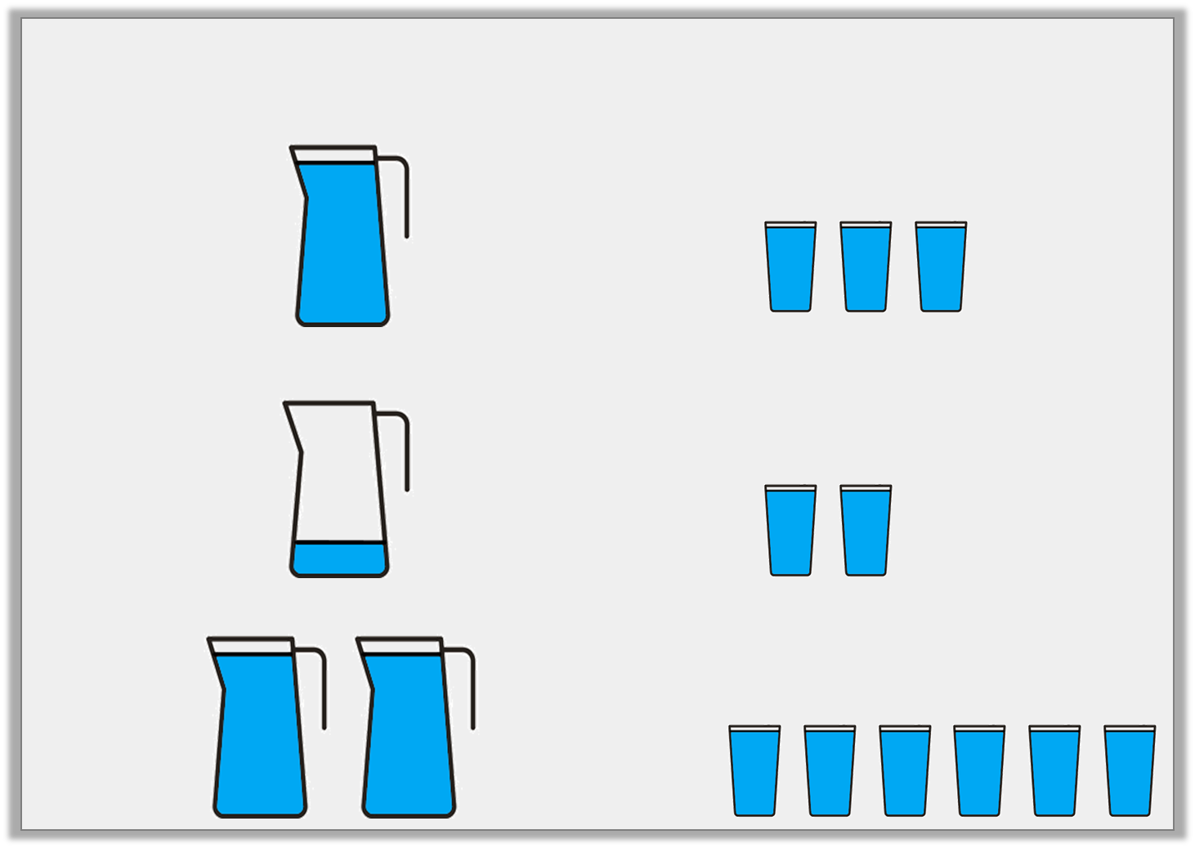
Problem Solving 1
Look at the comparison below:
Complete these statements using <, > and = symbols.
=
© Classroom Secrets Limited 2018

Slide 18
Problem Solving 1
Look at the comparison below:
Complete these statements using <, > and = symbols.
=
<
=
© Classroom Secrets Limited 2018

Slide 19
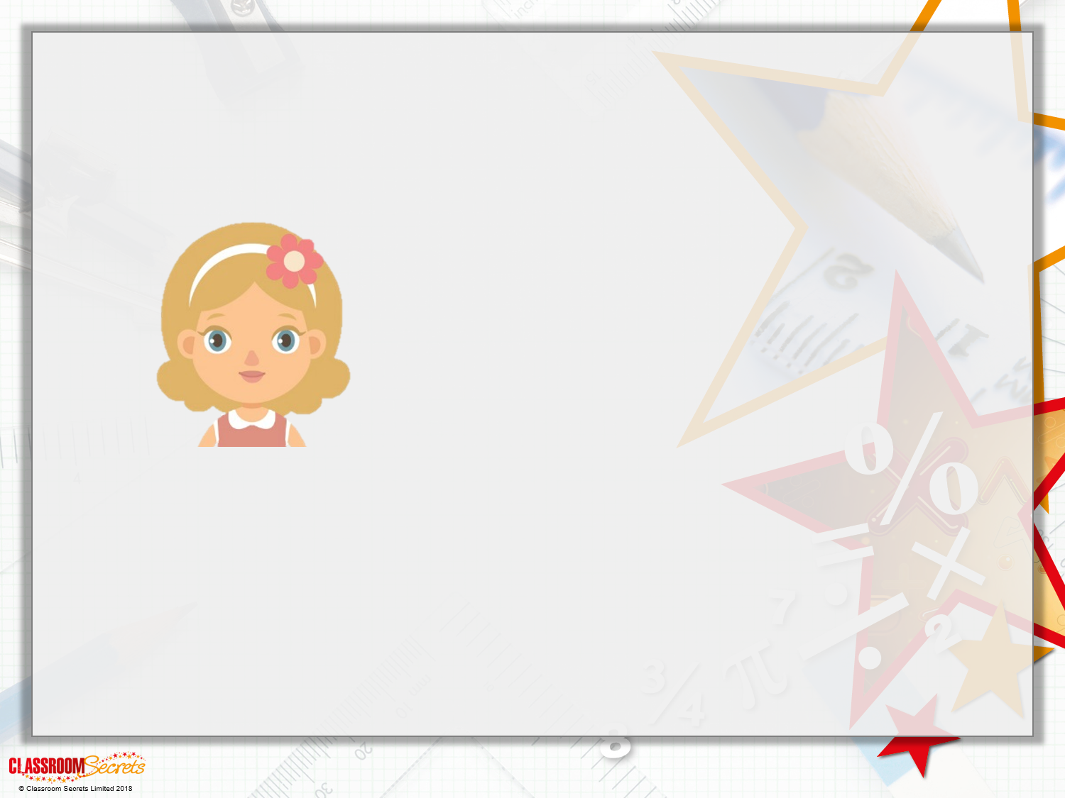
Reasoning 2
Daisy knows that 8 jugs of water will fill 5 buckets or 10 bowls.
Is she correct? Explain your answer.
I think that the capacity of a bowl is greater than the capacity of a jug.

Slide 20
Reasoning 2
Daisy knows that 8 jugs of water will fill 5 buckets or 10 bowls.
Is she correct? Explain your answer.
Daisy is incorrect because…
I think that the capacity of a bowl is greater than the capacity of a jug.

Slide 21
Reasoning 2
Daisy knows that 8 jugs of water will fill 5 buckets or 10 bowls.
Is she correct? Explain your answer.
Daisy is incorrect because with the same amount of water, you can fill more bowls than buckets so the bowls must have a smaller capacity.
I think that the capacity of a bowl is greater than the capacity of a jug.

