Slide 1


Mass, Capacity and Temperature – Litres
National Curriculum Objectives:
Mathematics Year 2: (2M1)
Compare and order lengths, mass, volume/capacity and record the results using >, < and =
Mathematics Year 2: (2M2)
Choose and use appropriate standard units to estimate and measure length/height in any direction (m/cm); mass (kg/g); temperature (°C); capacity (litres/ml) to the nearest appropriate unit, using rulers, scales, thermometers and measuring vessels
© Classroom Secrets Limited 2018

Slide 2
Mass, Capacity and Temperature
Step 6: Litres
© Classroom Secrets Limited 2018

Slide 3
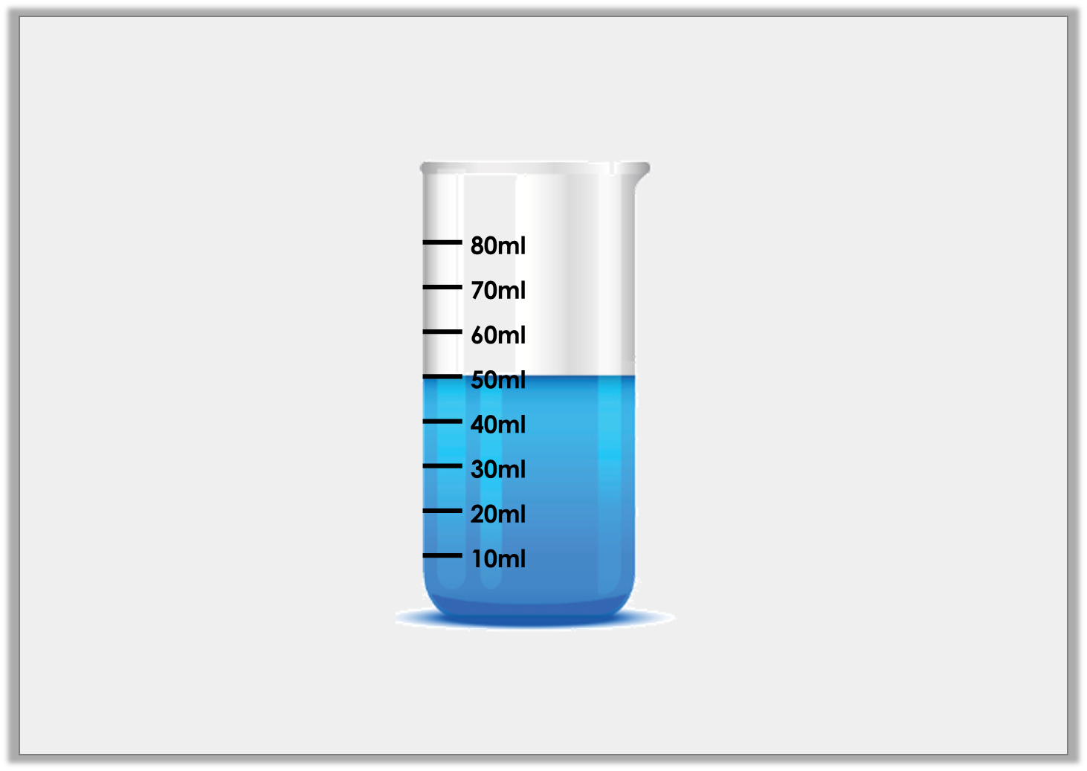
Introduction
How many millilitres of liquid are in this container?
What is the greatest volume of liquid that could be measured in this container?
© Classroom Secrets Limited 2018

Slide 4
Introduction
How many millilitres of liquid are in this container? 50ml
What is the greatest volume of liquid that could be measured in this container? 80ml
© Classroom Secrets Limited 2018

Slide 5
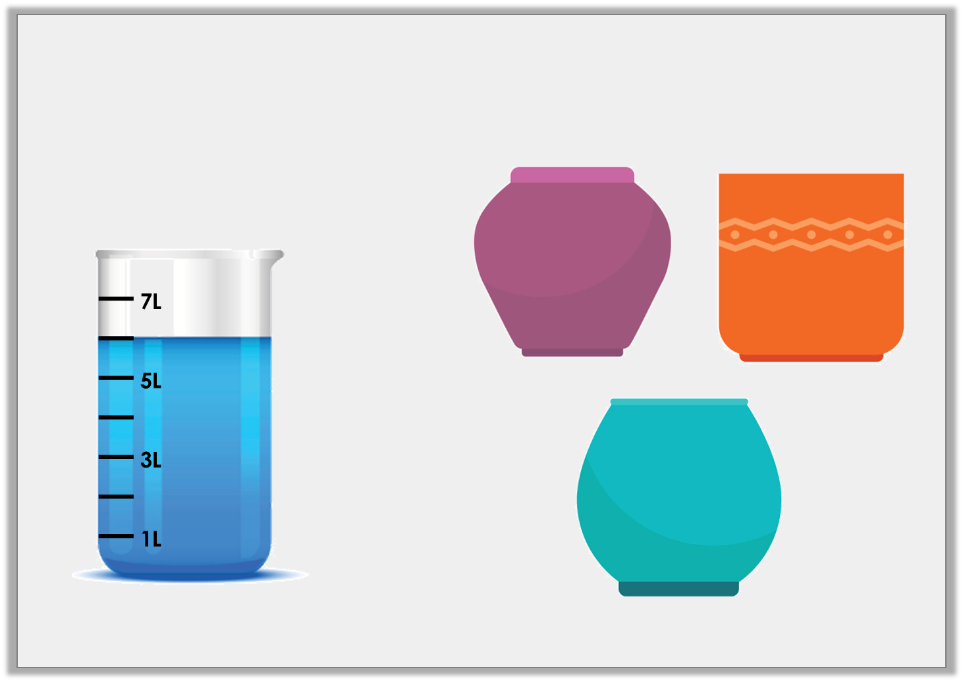
Varied Fluency 1
Which pot holds the same amount of liquid as the container?
A
B
5L
6L
C
7L
© Classroom Secrets Limited 2018

Slide 6
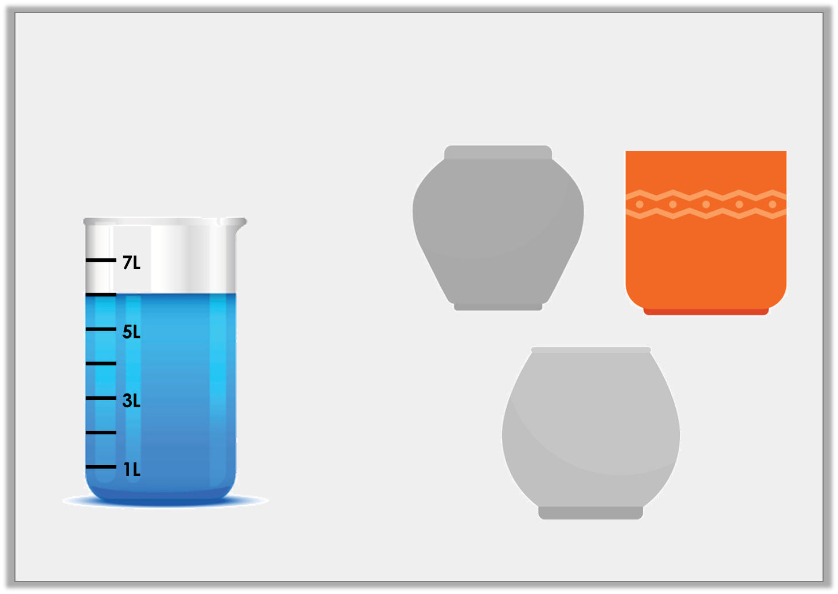
Varied Fluency 1
Which pot holds the same amount of liquid as the container?
A
B
5L
6L
C
7L
© Classroom Secrets Limited 2018

Slide 7
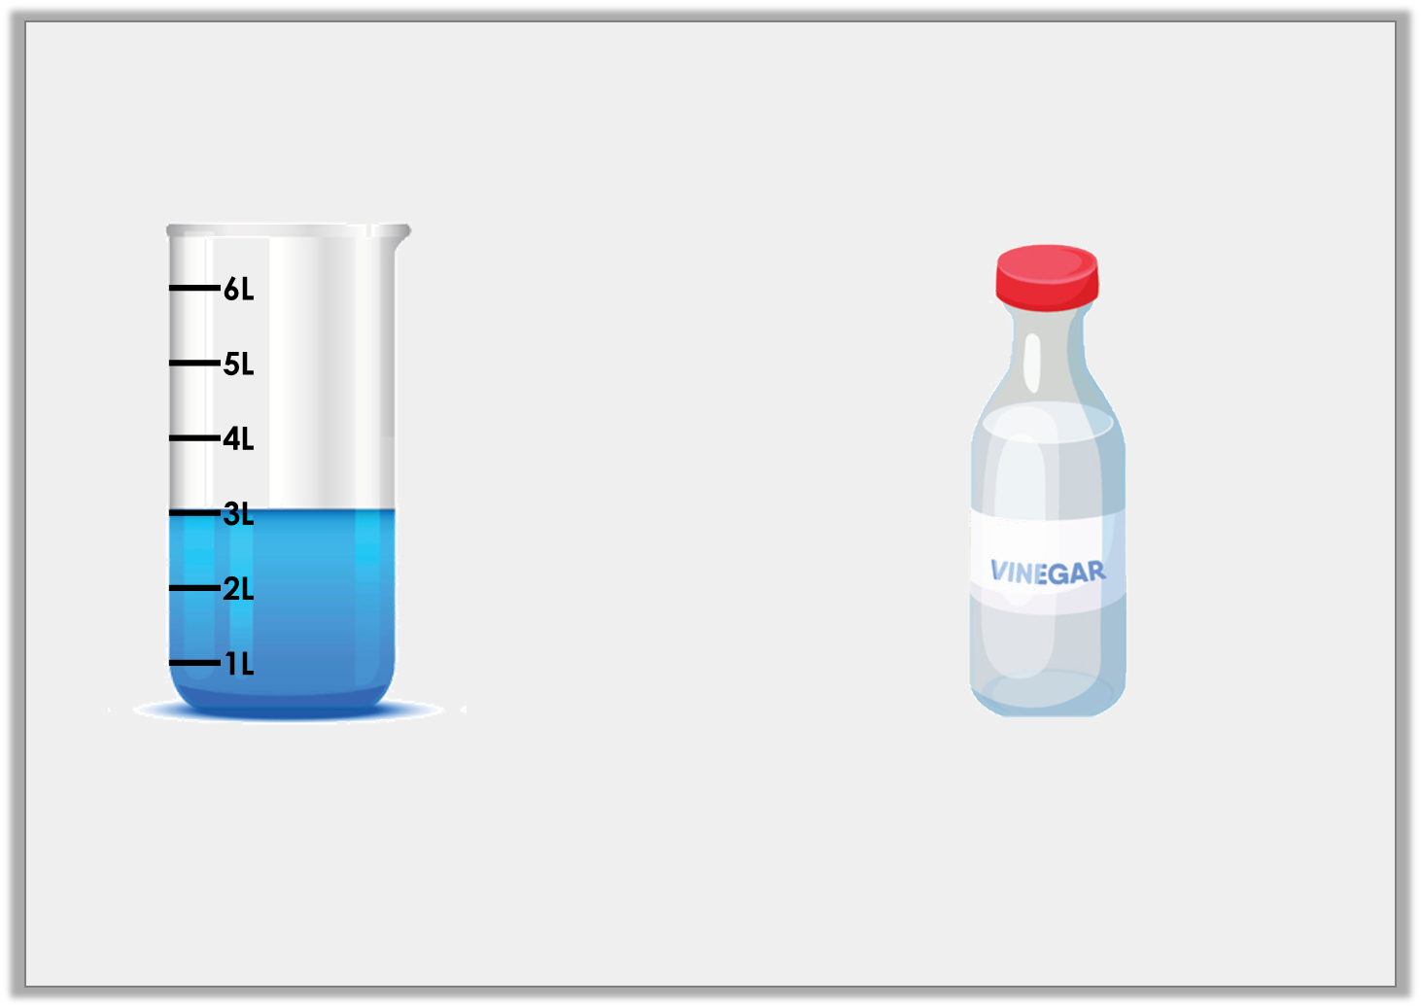
Varied Fluency 2
Complete the comparison by using the correct symbol from below.
2L
<
>
=
© Classroom Secrets Limited 2018

Slide 8
Varied Fluency 2
Complete the comparison by using the correct symbol from below.
>
2L
<
>
=
© Classroom Secrets Limited 2018

Slide 9
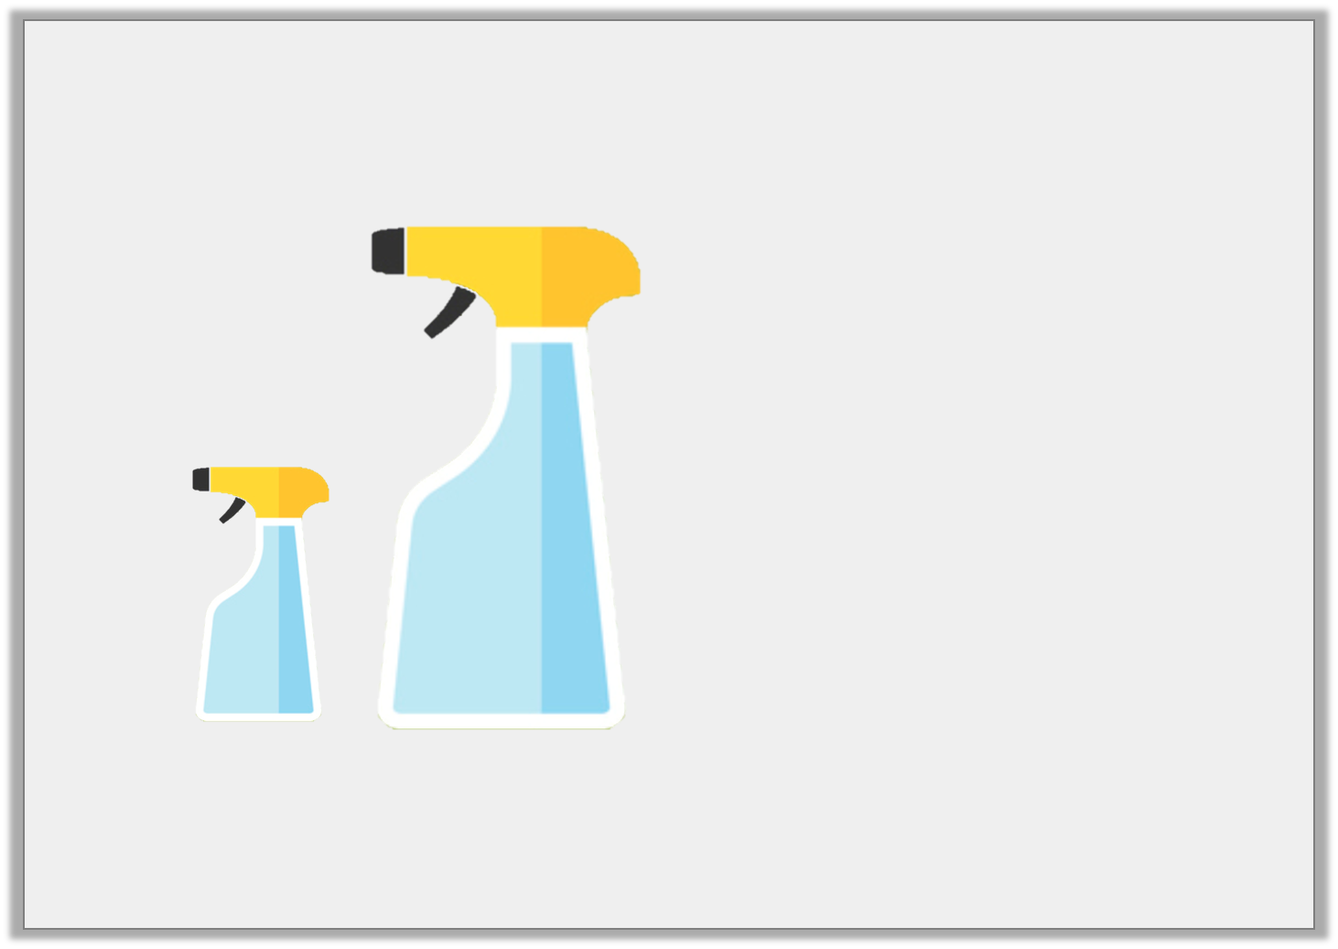
Varied Fluency 3
Estimate how much liquid is in container B.
1L
20L
2L
8L
A
B
© Classroom Secrets Limited 2018

Slide 10
Varied Fluency 3
Estimate how much liquid is in container B.
1L
20L
2L
8L
A
B
© Classroom Secrets Limited 2018

Slide 11
Varied Fluency 4
Colour the containers up to the correct level.
L
10L
8L
6L
4L
2L
L
10L
8L
6L
4L
2L
L
9L
7L
5L
3L
1L
9L
10L
4L
© Classroom Secrets Limited 2018

Slide 12
Varied Fluency 4
Colour the containers up to the correct level.
L
10L
8L
6L
4L
2L
L
10L
8L
6L
4L
2L
L
9L
7L
5L
3L
1L
9L
10L
4L
© Classroom Secrets Limited 2018

Slide 13
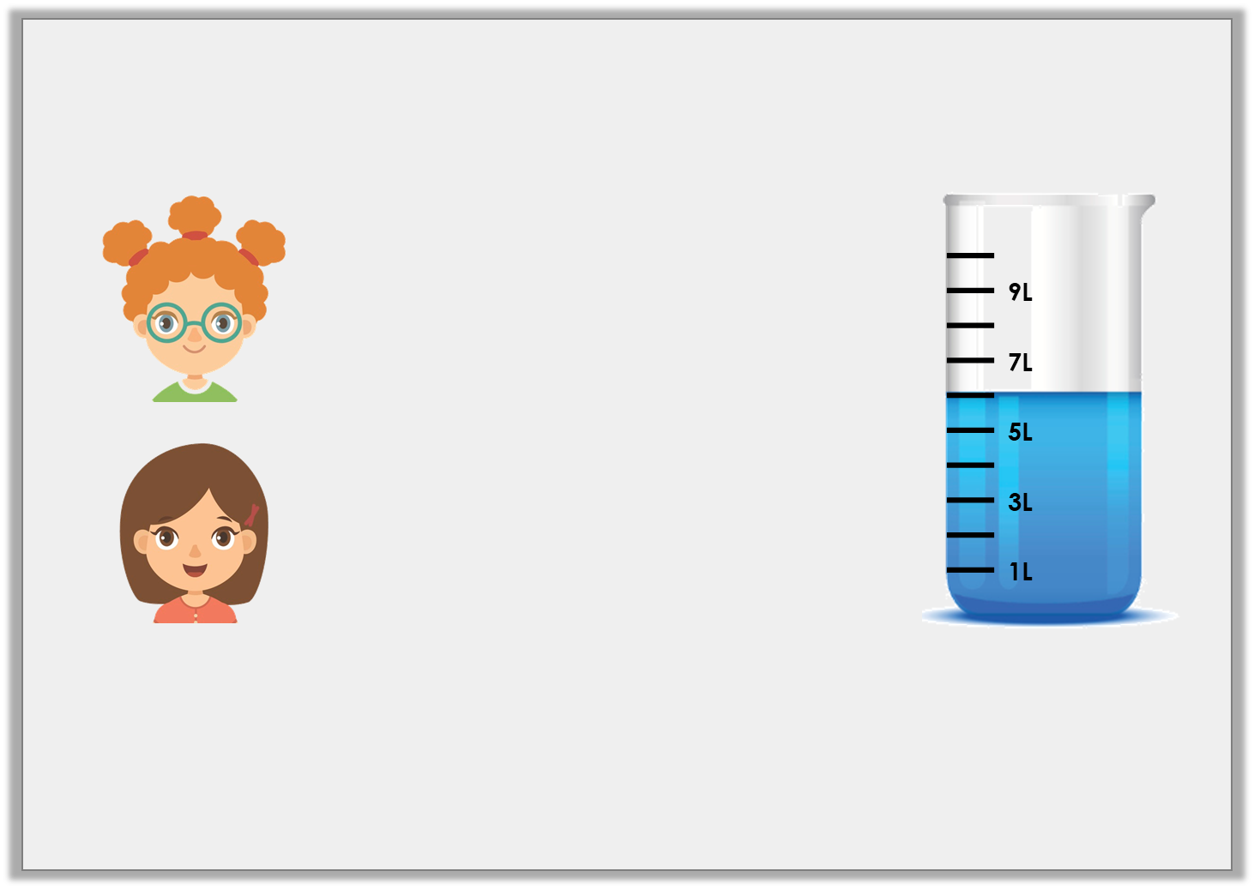
Reasoning 1
Kate and Freya are discussing capacity.
Who is correct? Explain your answer.
The volume of liquid in this container is 7L.
Kate
The volume of liquid in this container is 6L.
Freya
© Classroom Secrets Limited 2018

Slide 14
Reasoning 1
Kate and Freya are discussing capacity.
Who is correct? Explain your answer.
Freya is correct because…
The volume of liquid in this container is 7L.
Kate
The volume of liquid in this container is 6L.
Freya
© Classroom Secrets Limited 2018

Slide 15
Reasoning 1
Kate and Freya are discussing capacity.
Who is correct? Explain your answer.
Freya is correct because the liquid reaches the increment between 5L and 7L on the container so the volume of liquid is 6 litres.
The volume of liquid in this container is 7L.
Kate
The volume of liquid in this container is 6L.
Freya
© Classroom Secrets Limited 2018

Slide 16
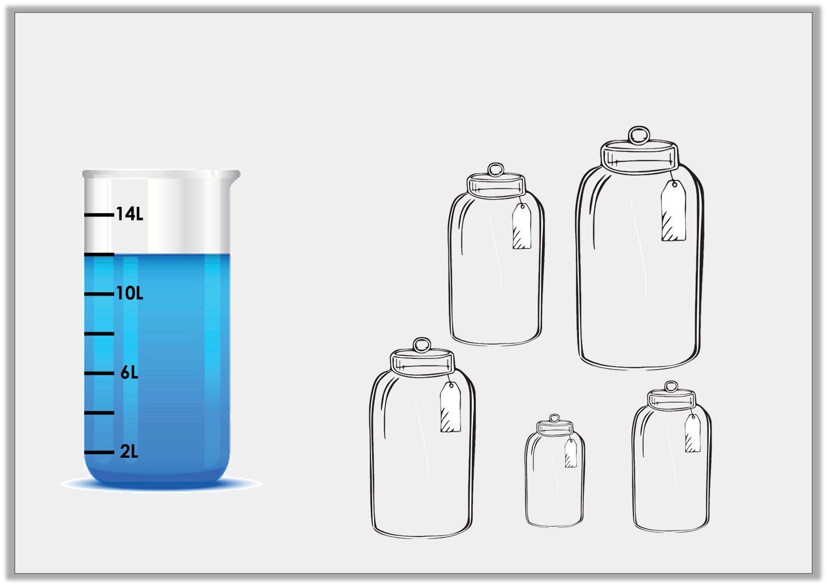
Problem Solving 1
Which combination of jars could be filled using the amount of liquid shown in the container below?
A
B
3L
5L
C
E
D
4L
1L
2L
© Classroom Secrets Limited 2018

Slide 17
Problem Solving 1
Which combination of jars could be filled using the amount of liquid shown in the container below?
A, B and C
A
B
3L
5L
C
E
D
4L
1L
2L
© Classroom Secrets Limited 2018

Slide 18
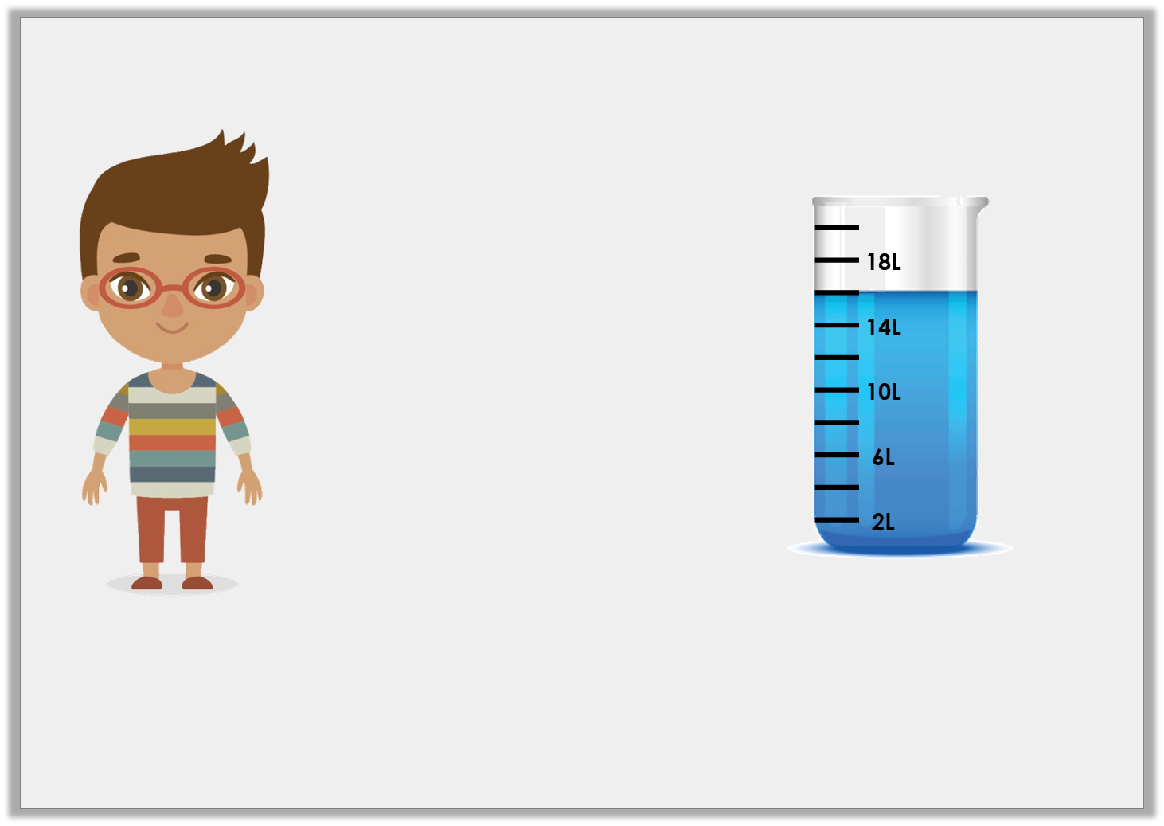
Reasoning 2
Tim wants to fill his paddling pool.
Does he have enough water? Explain your answer.
I need 18 litres of water to fill my paddling pool.
© Classroom Secrets Limited 2018

Slide 19
Reasoning 2
Tim wants to fill his paddling pool.
Does he have enough water? Explain your answer.
Tim does not have enough water because…
I need 18 litres of water to fill my paddling pool.
© Classroom Secrets Limited 2018

Slide 20
Reasoning 2
Tim wants to fill his paddling pool.
Does he have enough water? Explain your answer.
Tim does not have enough water because the liquid only reaches 16L on the container which is 2 litres less than what he needs.
I need 18 litres of water to fill my paddling pool.
© Classroom Secrets Limited 2018

