Slide 1


Mass and Capacity – Temperature
National Curriculum Objectives:
Mathematics Year 2: (2M2)
Choose and use appropriate standard units to estimate and measure length/height in any direction (m/cm); mass (kg/g); temperature (°C); capacity (litres/ml) to the nearest appropriate unit, using rulers, scales, thermometers and measuring vessels
© Classroom Secrets Limited 2018

Slide 2
Year 2 – Summer Block 4 – Mass and Capacity
Step 7: Temperature
© Classroom Secrets Limited 2018

Slide 3
Introduction
Use the word bank to complete the sentences.
We use a ________________ to measure temperature.
We measure temperature in degrees _____________.
If the temperature _______________ it gets warmer.
If the temperature _______________ it gets colder.
increases | Celsius | thermometer | decreases
© Classroom Secrets Limited 2018

Slide 4
Introduction
Use the word bank to complete the sentences.
We use a ________________ to measure temperature.
We measure temperature in degrees _____________.
If the temperature _______________ it gets warmer.
If the temperature _______________ it gets colder.
thermometer
Celsius
increases
decreases
increases | Celsius | thermometer | decreases
© Classroom Secrets Limited 2018

Slide 5
Varied Fluency 1
Complete the sentence.
The temperature is _________.
100ºC
80ºC
60ºC
50ºC
40ºC
30ºC
10ºC
0ºC
© Classroom Secrets Limited 2018

Slide 6
Varied Fluency 1
Complete the sentence.
The temperature is _________.
100ºC
80ºC
70ºC
60ºC
50ºC
40ºC
30ºC
10ºC
0ºC
70°C
© Classroom Secrets Limited 2018

Slide 7
Varied Fluency 2
Which is the highest temperature?
A
100ºC
80ºC
60ºC
40ºC
20ºC
0ºC
B
16ºC
14ºC
10ºC
6ºC
2ºC
© Classroom Secrets Limited 2018

Slide 8
Varied Fluency 2
Which is the highest temperature?
A
100ºC
80ºC
60ºC
40ºC
20ºC
0ºC
B
16ºC
14ºC
10ºC
6ºC
2ºC
© Classroom Secrets Limited 2018

Slide 9
Varied Fluency 3
True or false? The temperature is 31ºC.
50ºC
40ºC
30ºC
20ºC
10ºC
0ºC
© Classroom Secrets Limited 2018

Slide 10
Varied Fluency 3
True or false? The temperature is 31ºC.
False. The thermometer is going up in increments of 5ºC so the temperature is 35ºC.
50ºC
40ºC
30ºC
20ºC
10ºC
0ºC
© Classroom Secrets Limited 2018

Slide 11
Varied Fluency 4
Write the missing numbers on the scale and complete the temperature.
20ºC
14ºC
10ºC
8ºC
6ºC
2ºC
0ºC
© Classroom Secrets Limited 2018

Slide 12
Varied Fluency 4
Write the missing numbers on the scale and complete the temperature.
20ºC
18ºC
16ºC
14ºC
12ºC
10ºC
8ºC
6ºC
4ºC
2ºC
0ºC
12ºC
© Classroom Secrets Limited 2018

Slide 13
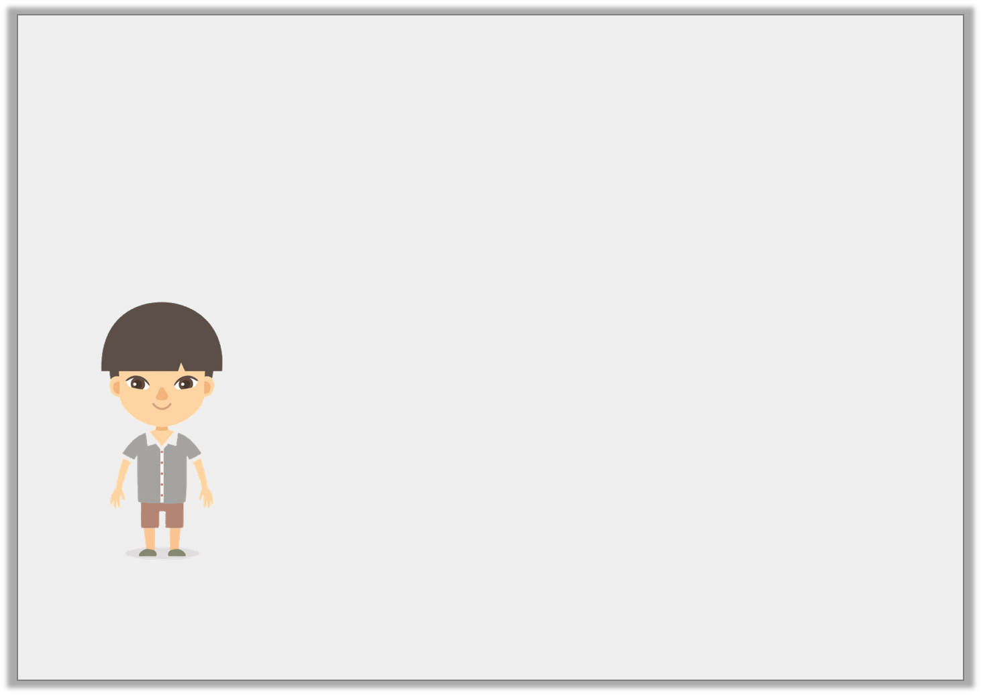
Problem Solving 1
Julian is describing a temperature. Draw on the thermometer one possibility of what the temperature could be.
18ºC
16ºC
12ºC
10ºC
8ºC
4ºC
0ºC
This temperature is greater than 9ºC but less than 18ºC.
© Classroom Secrets Limited 2018

Slide 14
Problem Solving 1
Julian is describing a temperature. Draw on the thermometer one possibility of what the temperature could be.
Various possible answers; for example: 10ºC, 11ºC, 12ºC, 13ºC, 14ºC, 15ºC, 16ºC and 17ºC.
18ºC
16ºC
12ºC
10ºC
8ºC
4ºC
0ºC
This temperature is greater than 9ºC but less than 18ºC.
© Classroom Secrets Limited 2018

Slide 15
Reasoning 1
Which is the odd one out? Explain why.
A
100ºC
80ºC
60ºC
40ºC
20ºC
0ºC
B
16ºC
14ºC
10ºC
6ºC
2ºC
C
16ºC
14ºC
10ºC
6ºC
2ºC
© Classroom Secrets Limited 2018

Slide 16
Reasoning 1
Which is the odd one out? Explain why.
Various possible answers, for example: B is the odd one out as it is the only one that does not read 10ºC
A
100ºC
80ºC
60ºC
40ºC
20ºC
0ºC
B
16ºC
14ºC
10ºC
6ºC
2ºC
C
16ºC
14ºC
10ºC
6ºC
2ºC
© Classroom Secrets Limited 2018

Slide 17
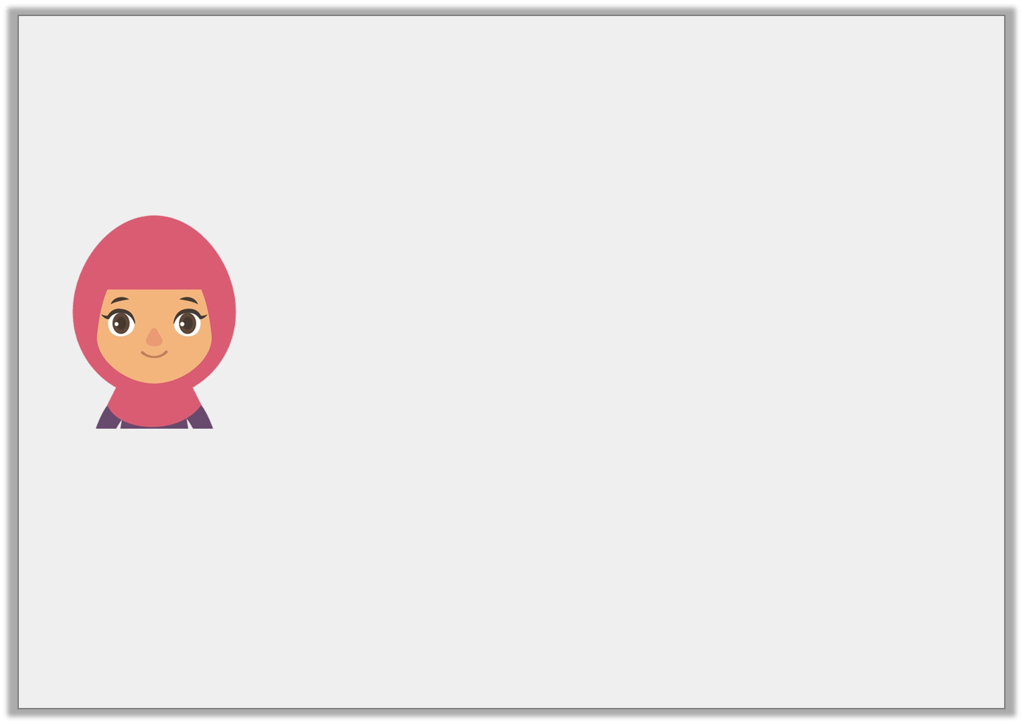
Reasoning 2
Ayesha is reading the temperature outside.
Is she correct? Explain why.
50ºC
45ºC
35ºC
35ºC
25ºC
15ºC
5ºC
0ºC
It is 10ºC.
© Classroom Secrets Limited 2018

Slide 18
Reasoning 2
Ayesha is reading the temperature outside.
Is she correct? Explain why.
Ayesha is correct because…
50ºC
45ºC
35ºC
35ºC
25ºC
15ºC
5ºC
0ºC
It is 10ºC.
© Classroom Secrets Limited 2018

Slide 19
Reasoning 2
Ayesha is reading the temperature outside.
Is she correct? Explain why.
Ayesha is correct because the thermometer is going up in increments of 5ºC. 5ºC + 5ºC = 10ºC.
50ºC
45ºC
35ºC
35ºC
25ºC
15ºC
5ºC
0ºC
It is 10ºC.
© Classroom Secrets Limited 2018

