Slide 1


Money – Find the Difference
National Curriculum Objectives:
Mathematics Year 2: (2C4)
Solve problems with addition and subtraction using concrete objects and pictorial representations, including those involving numbers, quantities and measures
Find the Difference
© Classroom Secrets Limited 2019

Slide 2
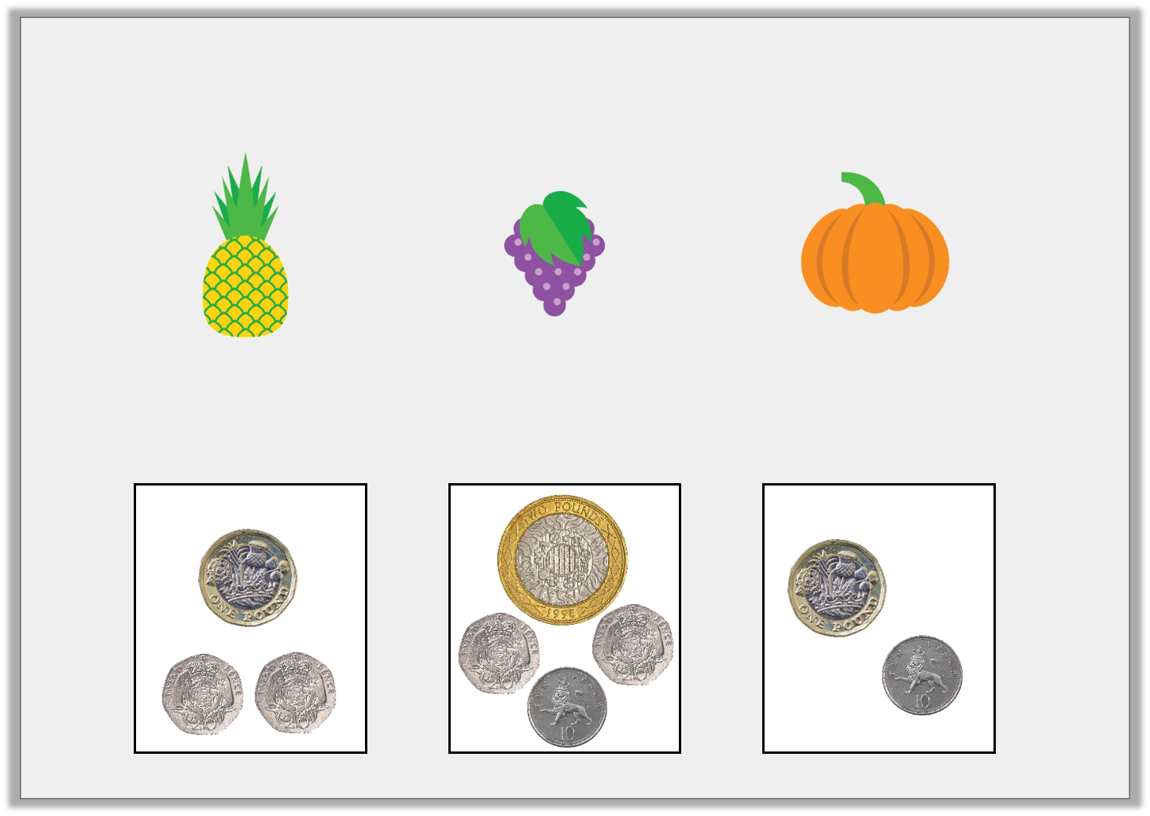
Introduction
Match the amounts to the coins.
£1 and 10p
£1 and 40p
£2 and 50p
© Classroom Secrets Limited 2019

Slide 3
Introduction
Match the amounts to the coins.
£1 and 10p
£1 and 40p
£2 and 50p
© Classroom Secrets Limited 2019

Slide 4
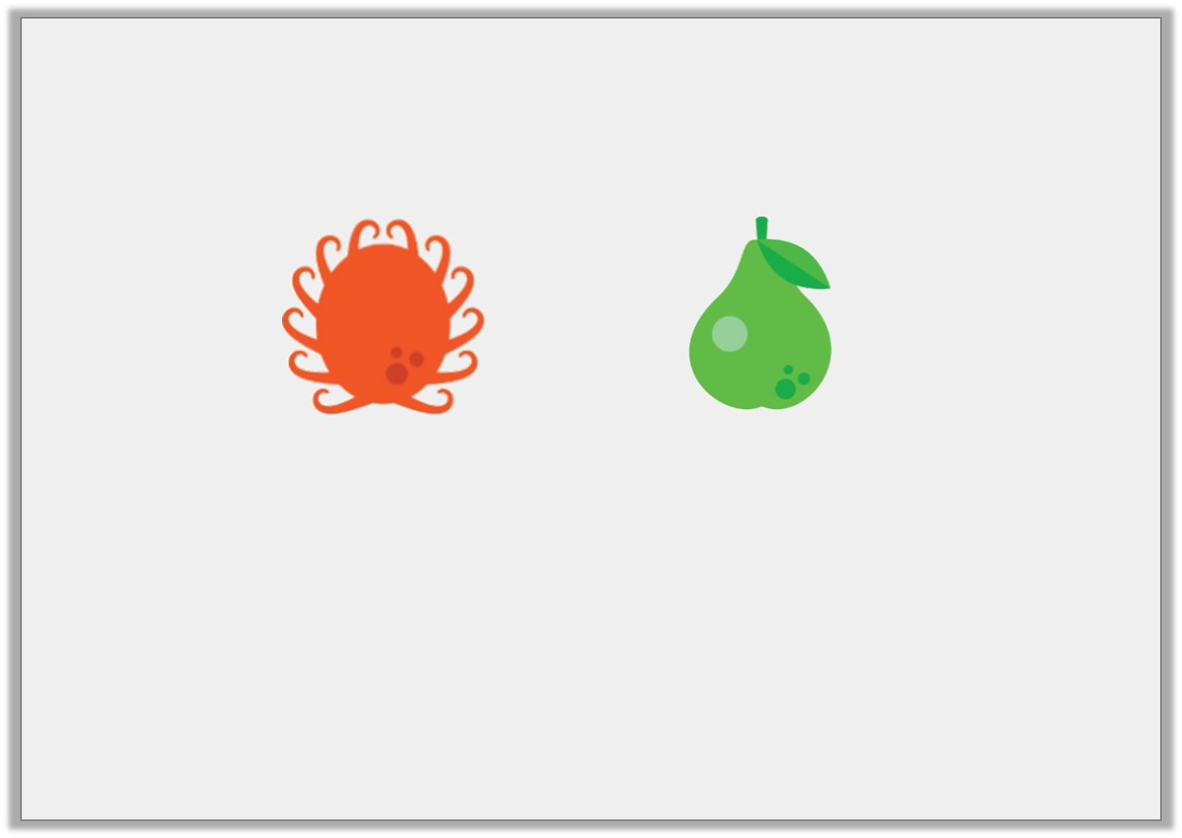
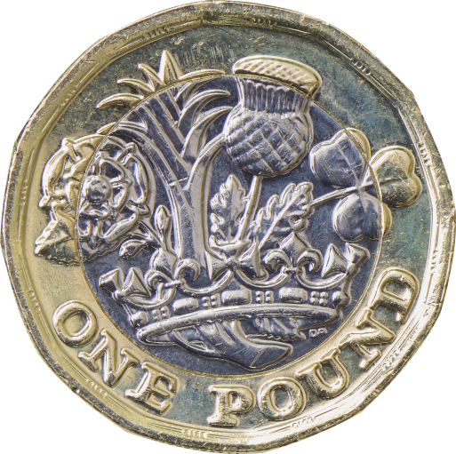
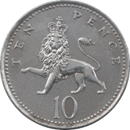
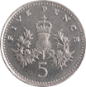
Varied Fluency 1
Circle the difference between the two amounts.
5p | 10p | 20p
© Classroom Secrets Limited 2019

Slide 5
Varied Fluency 1
Circle the difference between the two amounts.
5p | 10p | 20p
© Classroom Secrets Limited 2019

Slide 6
Varied Fluency 2
Complete the bar model.
£1 and 50p
£1 and 30p
© Classroom Secrets Limited 2019

Slide 7
Varied Fluency 2
Complete the bar model.
£1 and 50p
£1 and 30p | 20p
© Classroom Secrets Limited 2019

Slide 8
Varied Fluency 3
True or false?
The difference between the two amounts is £2.
£4 and 45p
£2 and 45p
© Classroom Secrets Limited 2019

Slide 9
Varied Fluency 3
True or false?
The difference between the two amounts is £2.
£4 and 45p
£2 and 45p
True
© Classroom Secrets Limited 2019

Slide 10
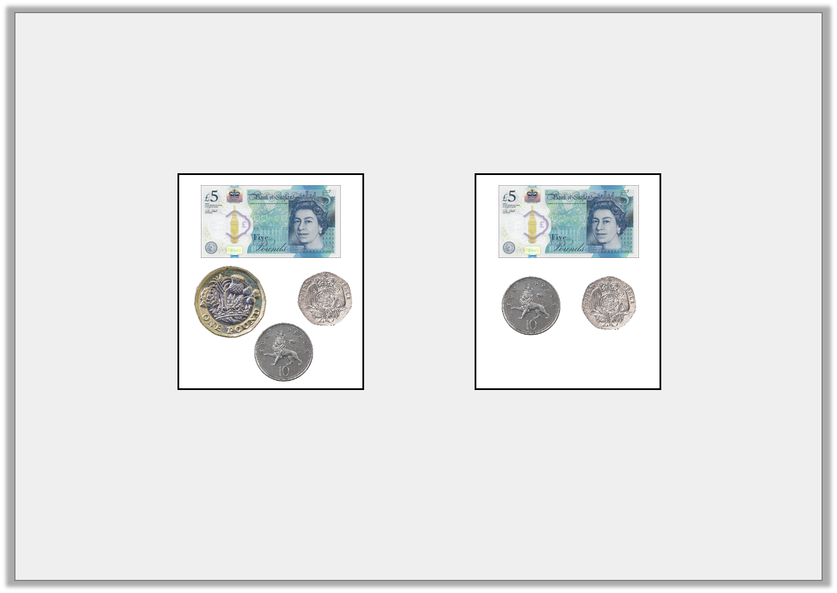
Varied Fluency 4
Find the difference between the two amounts.
© Classroom Secrets Limited 2019

Slide 11
Varied Fluency 4
Find the difference between the two amounts.
£1
© Classroom Secrets Limited 2019

Slide 12
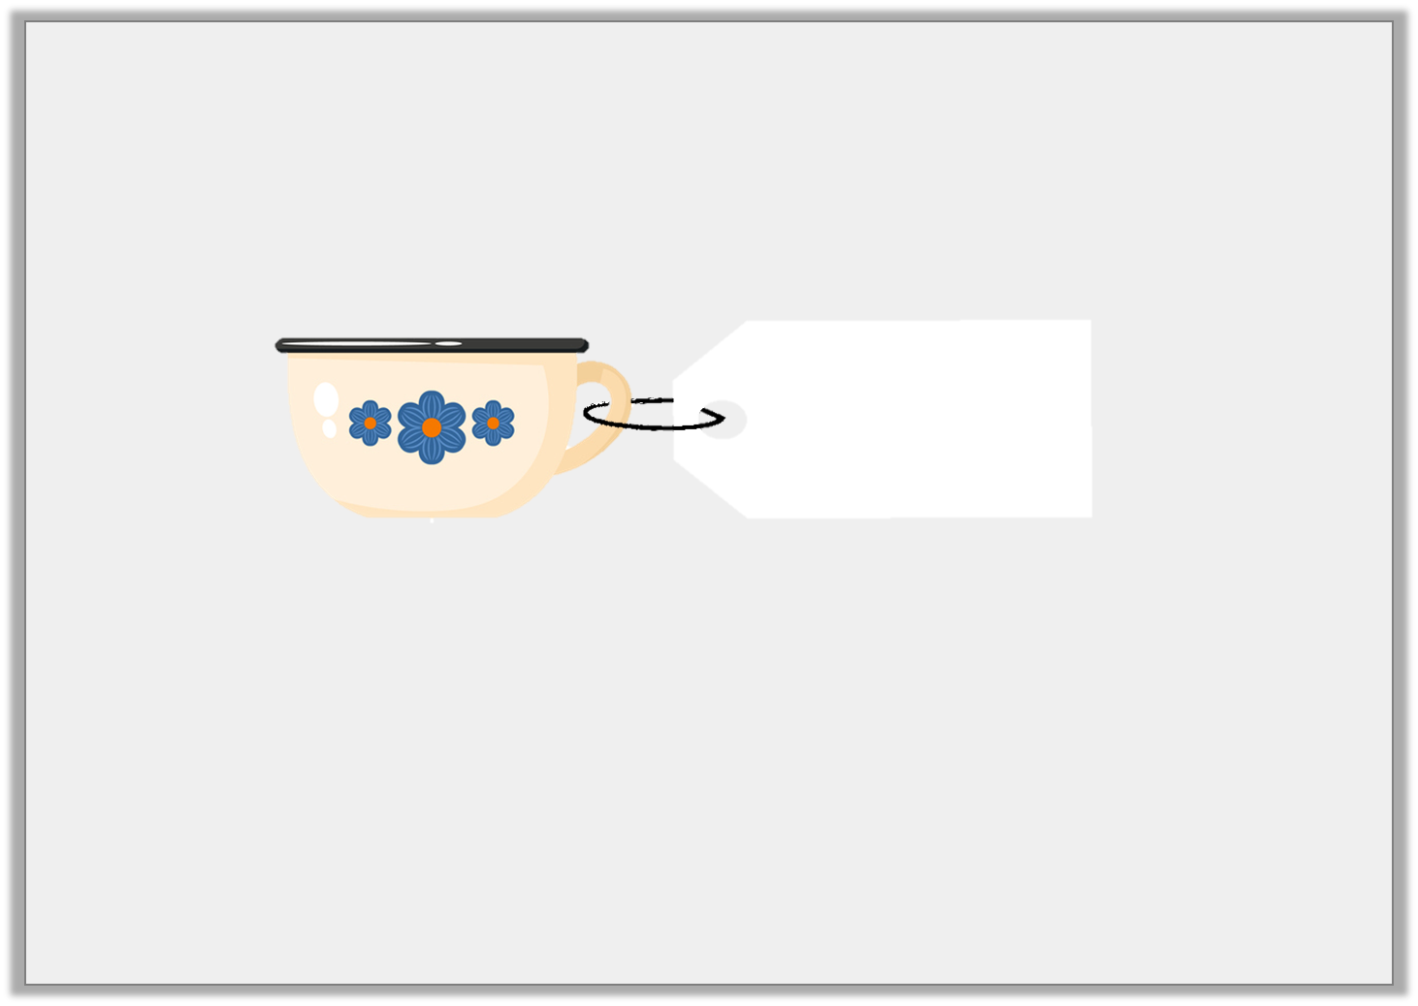
Reasoning 1
Zoe is shopping.
A cup costs £4.
The difference between the price of the cup and a vase is £2 and 20p.
How much is the vase? Prove it.
£4
© Classroom Secrets Limited 2019

Slide 13
Reasoning 1
Zoe is shopping.
A cup costs £4.
The difference between the price of the cup and a vase is £2 and 20p.
How much is the vase? Prove it.
The vase could be…
£4
© Classroom Secrets Limited 2019

Slide 14
Reasoning 1
Zoe is shopping.
A cup costs £4.
The difference between the price of the cup and a vase is £2 and 20p.
How much is the vase? Prove it.
The vase could be £6 and 20p (£4 + £2 and 20p) or £1 and 80p (£4 – £2 and 20p)
£4
© Classroom Secrets Limited 2019

Slide 15
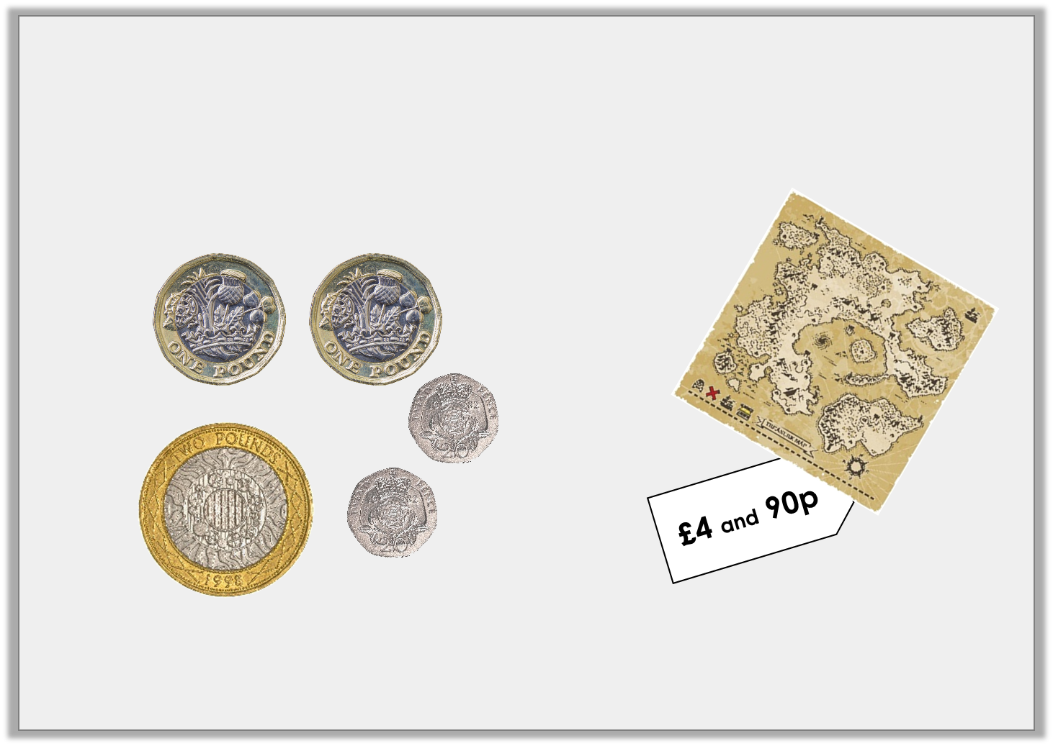
Reasoning 2
Will is saving up to buy a treasure map.
He thinks he needs another 50p.
Is he correct? Prove it.
© Classroom Secrets Limited 2019

Slide 16
Reasoning 2
Will is saving up to buy a treasure map.
He thinks he needs another 50p.
Is he correct? Prove it.
Will is correct because…
© Classroom Secrets Limited 2019

Slide 17
Reasoning 2
Will is saving up to buy a treasure map.
He thinks he needs another 50p.
Is he correct? Prove it.
Will is correct because the map is £4 and 90p but Will only has £4 and 40p – he needs 50p.
© Classroom Secrets Limited 2019

Slide 18
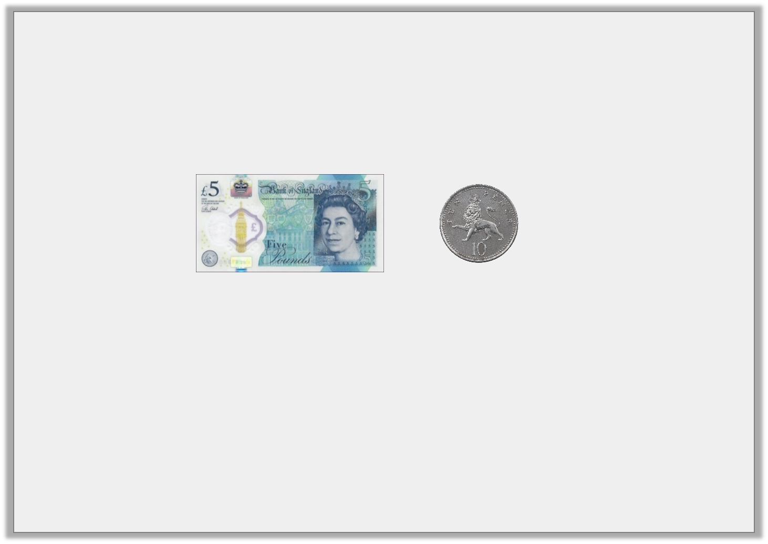
Problem Solving 1
Dee has £8 and 10p.
Some money has fallen out of her pocket.
This is the money she has left. What coin(s) has she dropped?
Give two possibilities.
© Classroom Secrets Limited 2019

Slide 19
Problem Solving 1
Dee has £8 and 10p.
Some money has fallen out of her pocket.
This is the money she has left. What coin(s) has she dropped?
Give two possibilities.
Various answers, for example:
£2 and £1; 3 x £1; 6 x 50p. (£3)
© Classroom Secrets Limited 2019

