Slide 1
Writing a postcard

Slide 2
What do you think needs to be included in a postcard?
Space for a picture (on the front)
Blank lines for an address.
Space to write about your holiday.
postcard
The name and address of who you’re sending it to.
Some writing to say what you’ve been doing on your holiday.
Space in the top right corner for a stamp.

Slide 3
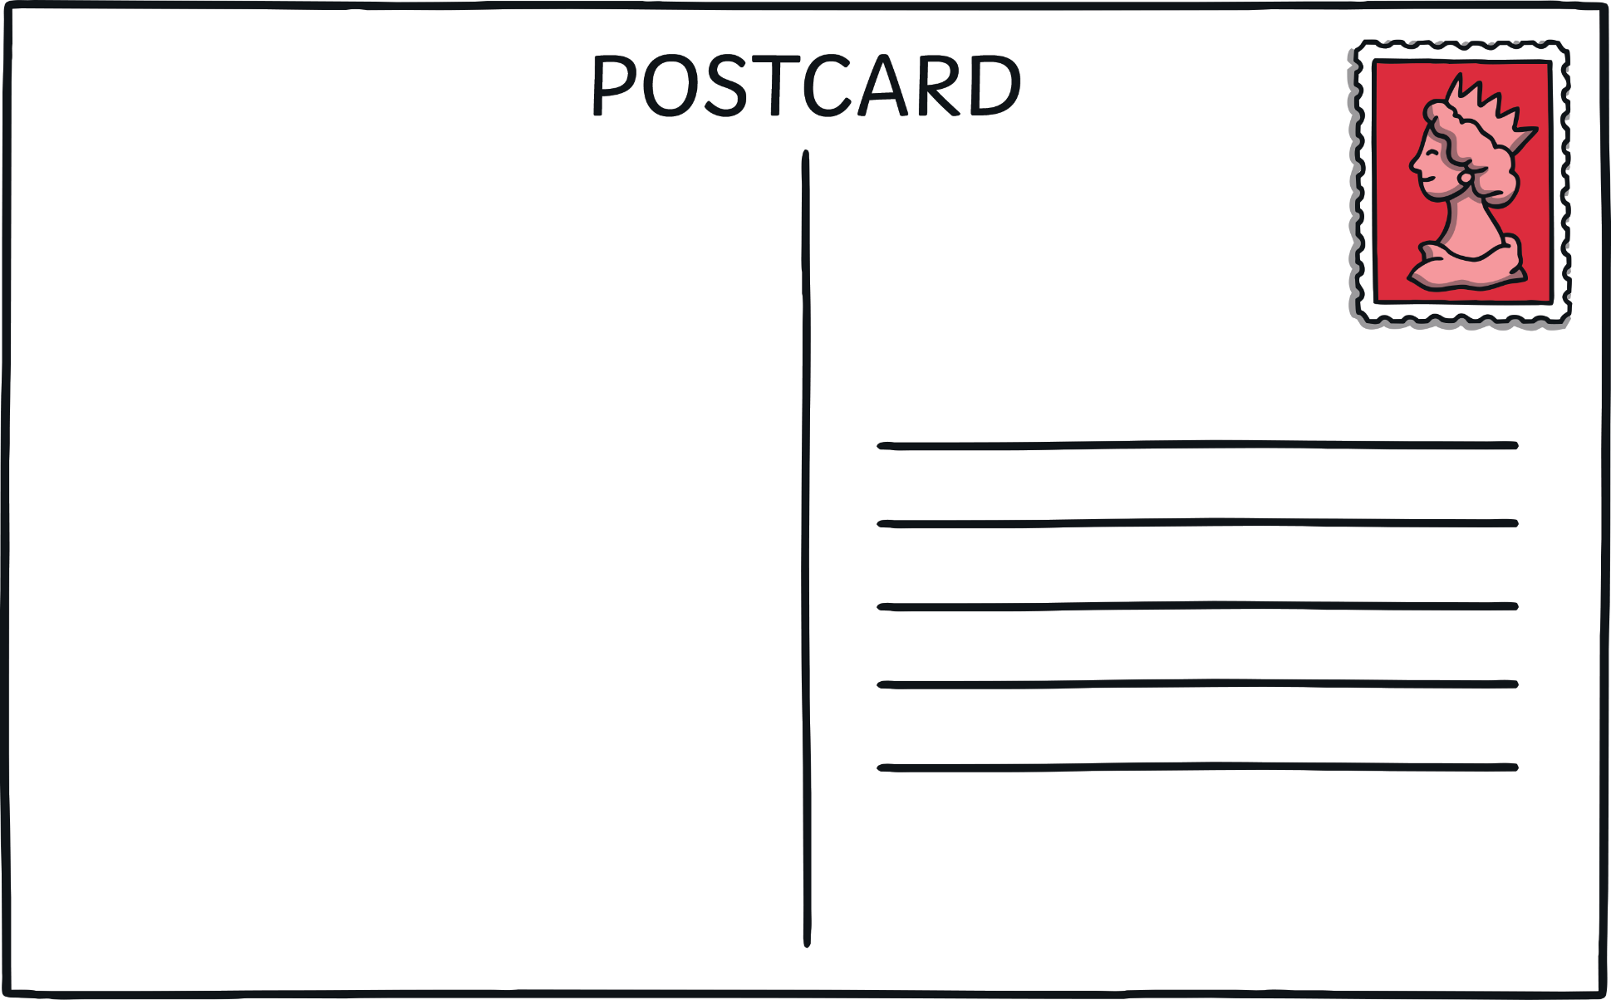

Slide 4
What might you write about in your postcard?
Maybe:
What you can see down below
What the castle looks like
What did you find inside the castle?
What are you going to do?

Slide 5
A stamp in the top right corner.
Dear Mum,
From Jack x
Lines for writing the address.
Space to write.
The name and address for who you are sending the postcard to.

Slide 6

Plenary
What are the six things that need to go on a postcard?
Give two suggestions of what you might write about in a post card.

