Slide 1
Under the Sea Creatures

Slide 2
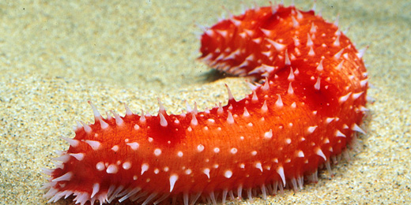
Sea Cucumbers
Sea cucumbers do not have a brain.
They breathe out of their bottoms.

Slide 3
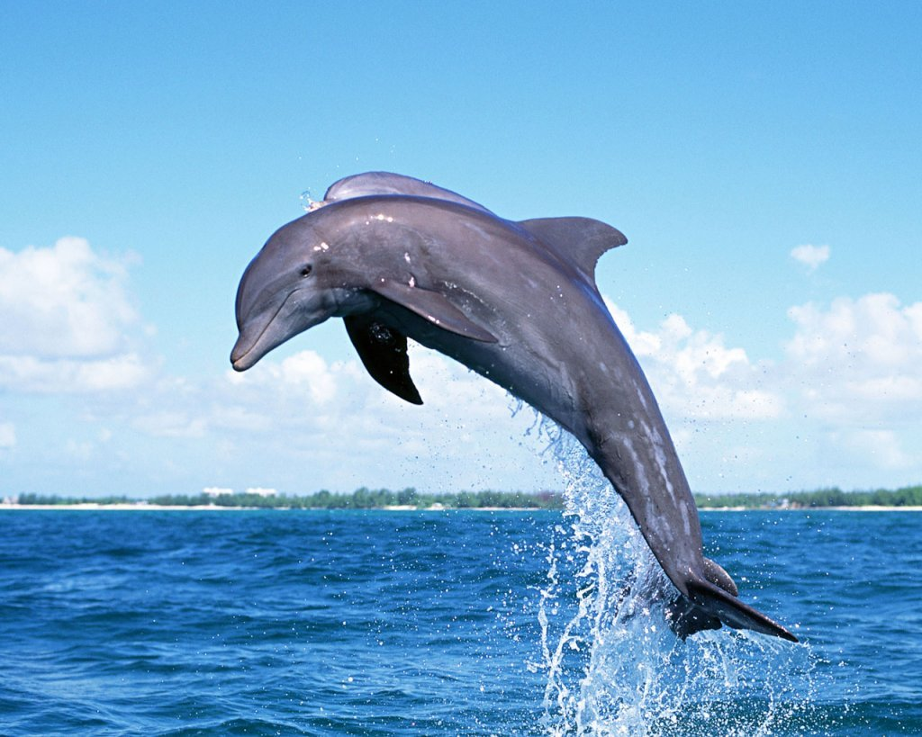
Dolphins
Dolphins can jump out of water.
They breathe through their blowholes.

Slide 4
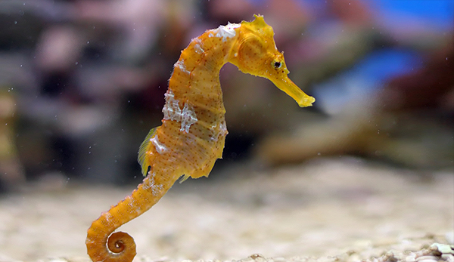
Seahorse
A seahorse has only one mate for life.
Seahorses are actually a type of fish.

Slide 5

Starfish
Starfish are not a type of fish.
They have five legs and come in lots of different colours.

Slide 6
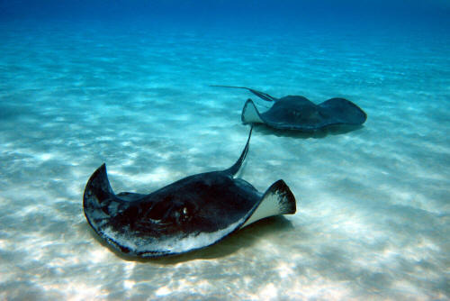
Stingray
A stingray has a sting at the end of its tail to protect it from other predators.
They have a smooth body on the bottom.

Slide 7
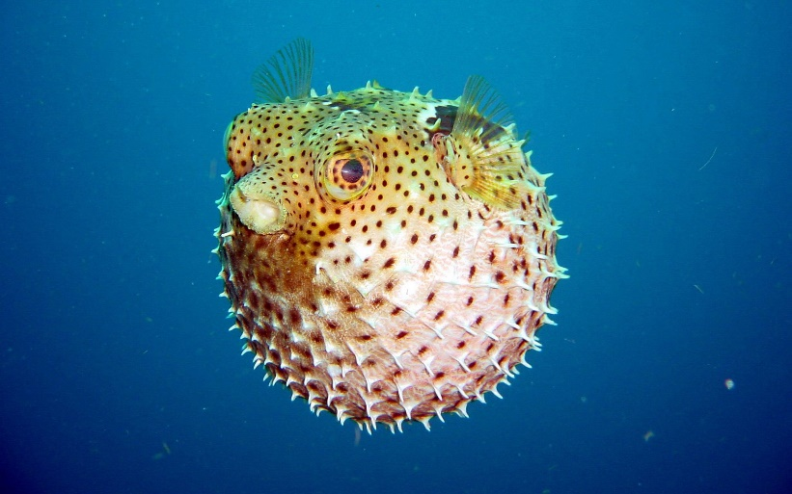
Pufferfish
A pufferfish stretches its skin when it is in danger. This makes it bigger and the spikes stand out to protect it.

Slide 8
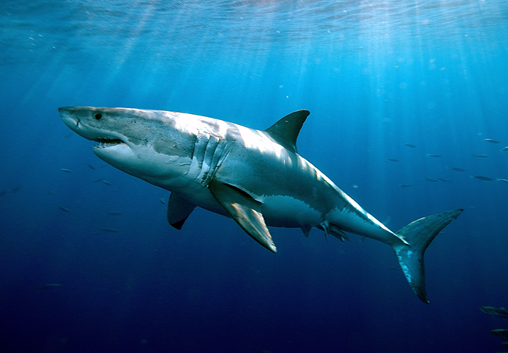
Shark
There are 50 different types of sharks.
Sharks have sharp teeth and eat other sea animals.

Slide 9
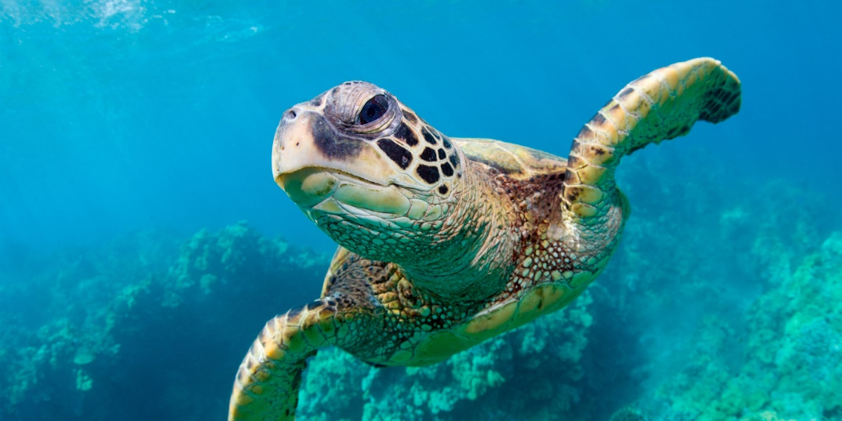
Turtle
A turtle has a hard shell to protect it from other sea creatures.
They lay eggs in the sand.

Slide 10
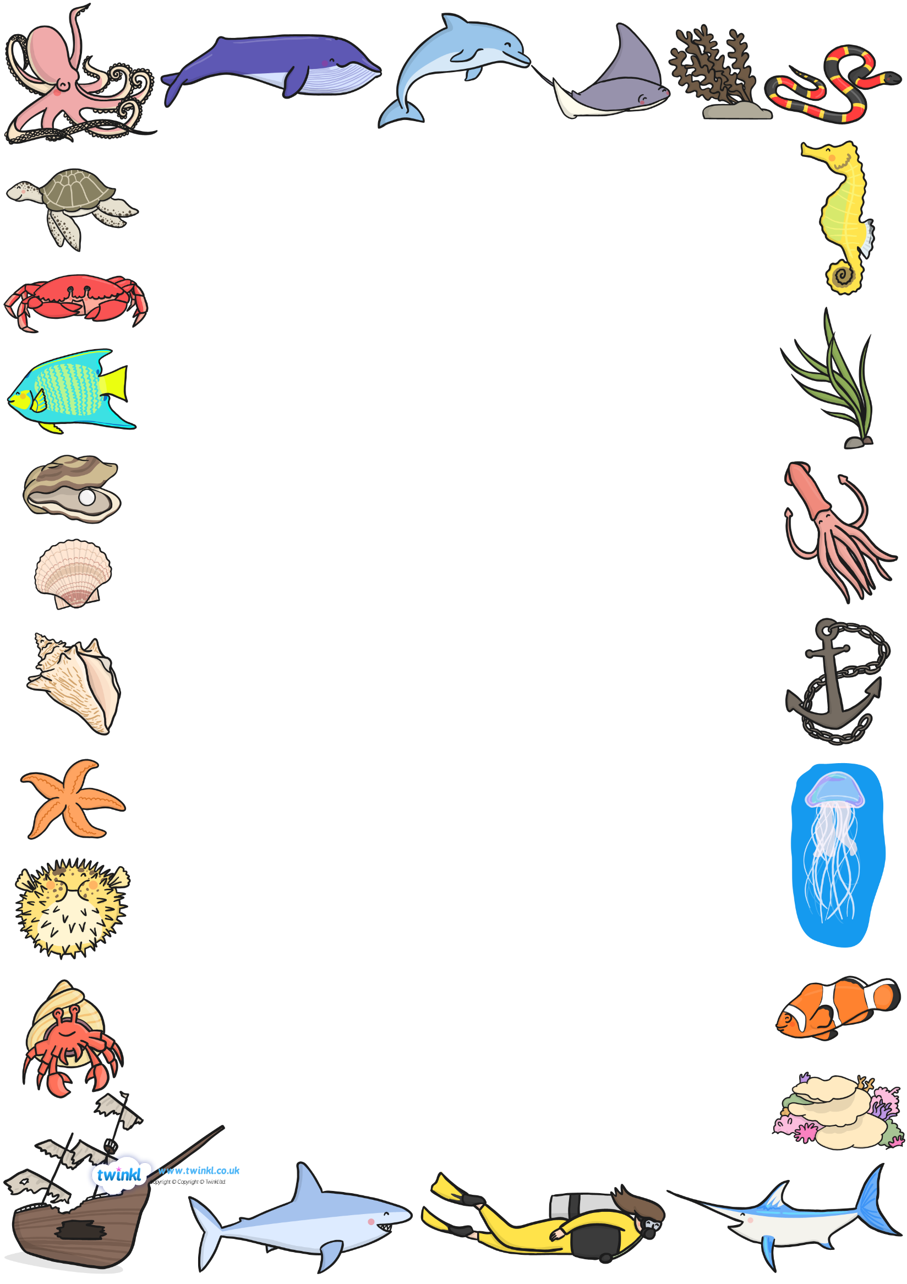
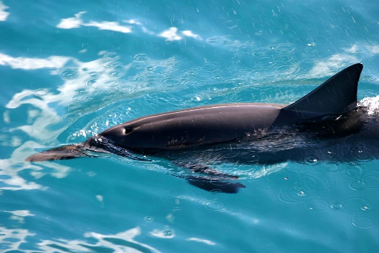
A dolphin can breathe out of its blowhole.

