Slide 1
Ascension

Slide 2

Big questions! Why are Ascension and Pentecost special celebrations in the
Church year?

Slide 3
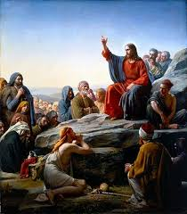
What can you remember about the story of the ascension?
Where?
Who?
What?

Slide 4
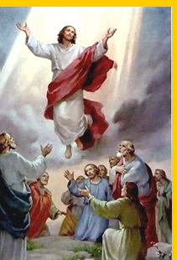
What can you remember about the story of the ascension?
Where?
Who?
What?

Slide 5
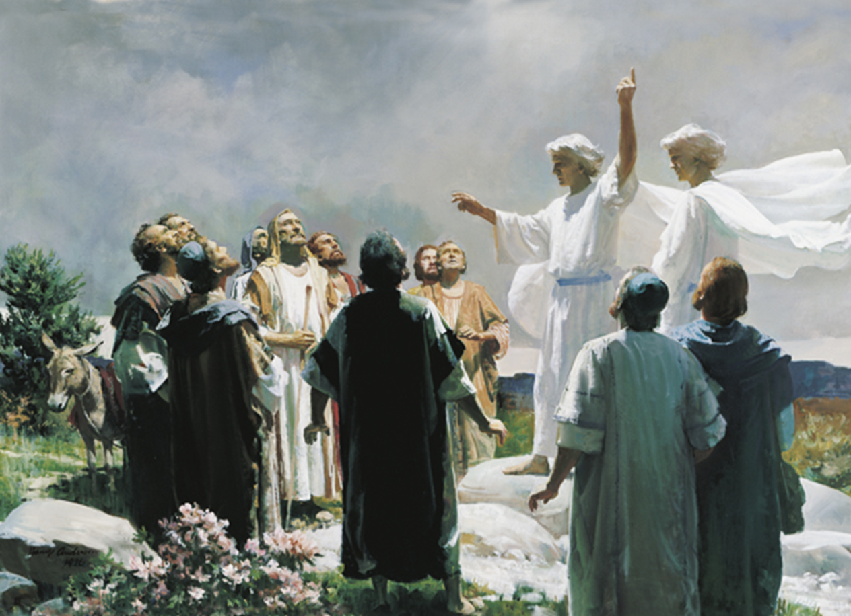
What can you remember about the story of the ascension?
Where?
Who?
What?

Slide 6
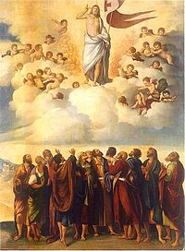

Slide 7
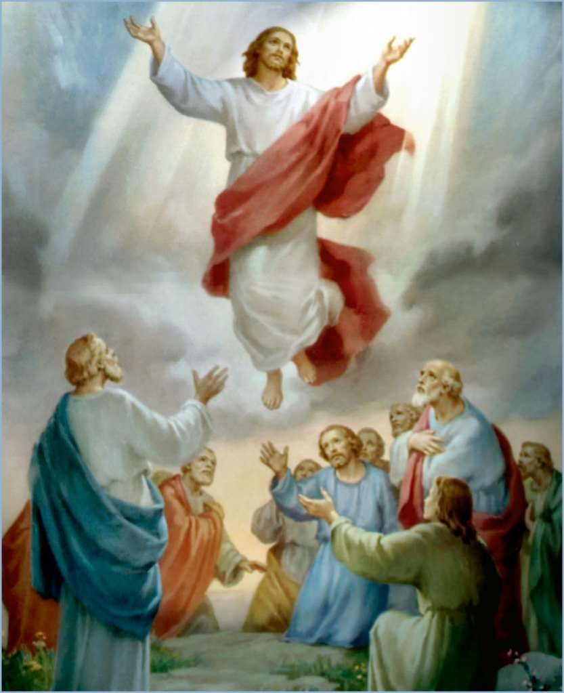

Slide 8
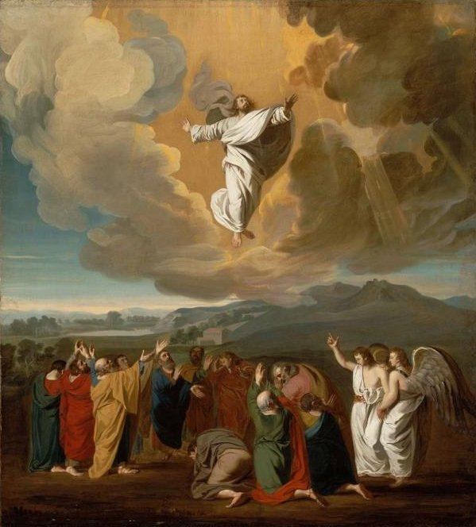

Slide 9
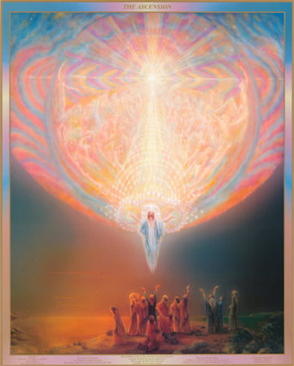

Slide 10
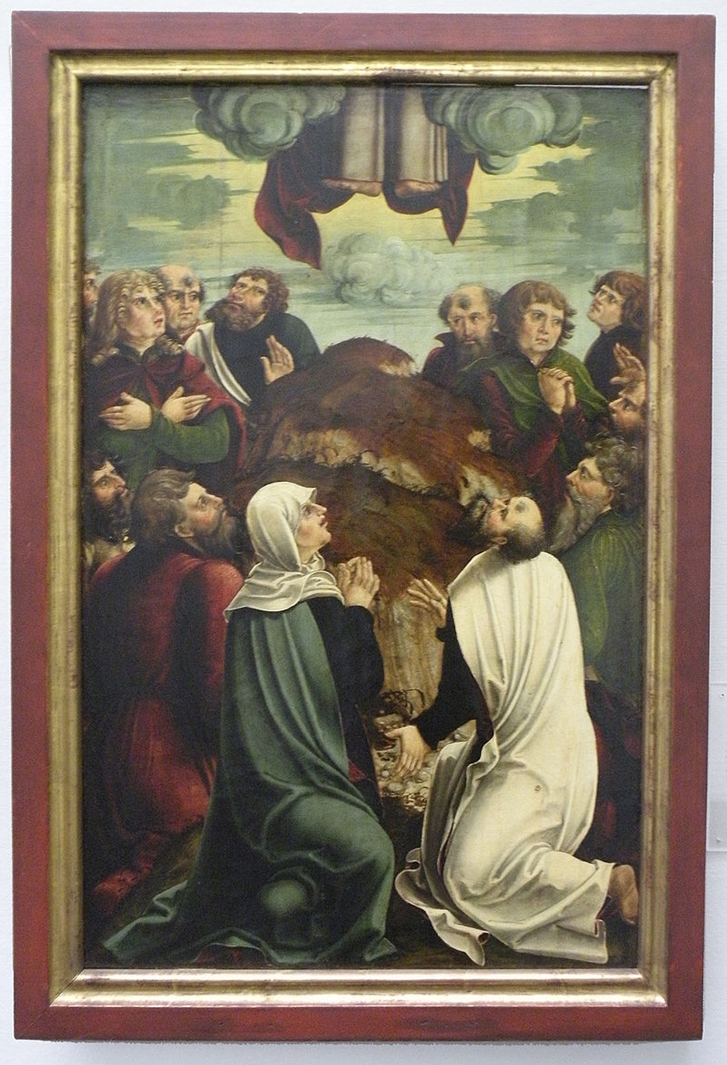

Slide 11
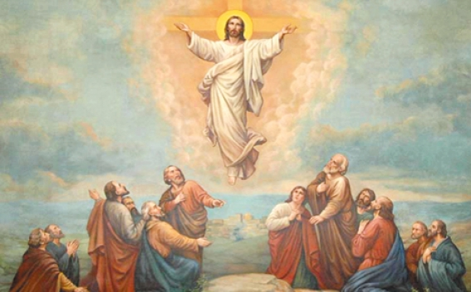

Slide 12
Big questions! Why are Ascension and Pentecost special celebrations in the
Church year?

