Slide 1
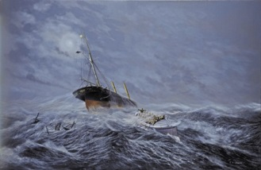
The Great Lifeboat Disaster of 1886

Slide 2
How an act of bravery changed history
This is the story of how 27 men gave their lives to save 12 total strangers.
The Southport lifeboat alone left 13 widows and 50 orphans.
As a result, the first ever street collection was created; raising an amazing £5,500 (£600.00 in coppers) in one day.
Southport was to become famous across England.

Slide 3
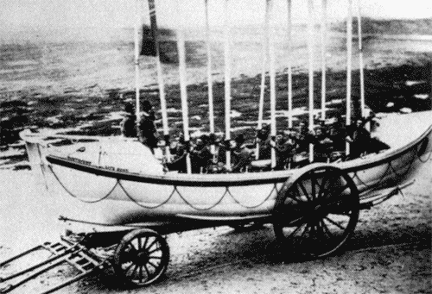
The hazardous sandbanks at the mouth of the River Ribble, created such a risk to shipping that three lifeboats once patrolled the area.
They were from Lytham, St. Anne’s and Southport.
The brave lifeboat crews matched their strength against the sea, time and again – with constant risk to themselves.

Slide 4
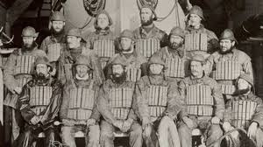
The crew of the Eliza Fernley, Southport’s lifeboat.
Most of the crew were local fishermen from Southport and all manned the lifeboat voluntarily.

Slide 5
The Mexico Disaster
On December 9th 1886, The Eliza Fernley answered the call for help from the German vessel, The Mexico. It set sail from Liverpool, but ran aground on the Horse Bank near Southport during a tremendous gale.
Two other boats joined the Eliza Fernley in the rescue, the Laura Janet from St. Anne’s and the Charles Biggs from Lytham.

Slide 6
The Mexico Disaster
Only The Lytham boat, The Charles Biggs,
reached the ship in trouble.
Both other lifeboats capsized due to the stormy weather.
Twenty seven men died in their quest to save others.
There were two survivors – Henry Robinson and Jack Johnson.
These survivors raised the alarm after clinging to the keel of a boat, swimming to shore and then walking miles to their homes.

Slide 7
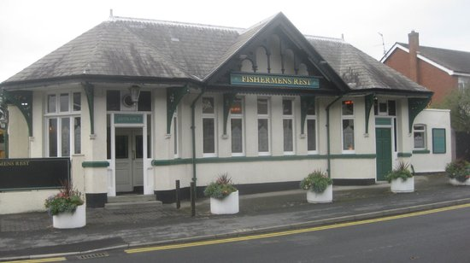
The Mexico Disaster
Sadly, 27 men lost their lives.
Their bodies were taken to The Birkdale Palace Hotel which is now known as
The Fisherman’s Rest

