Slide 1


Geography
Beside the Seaside
Year One
Geography | KS1 | Beside the Seaside | Where are Our Seasides? | Lesson 1

Slide 2
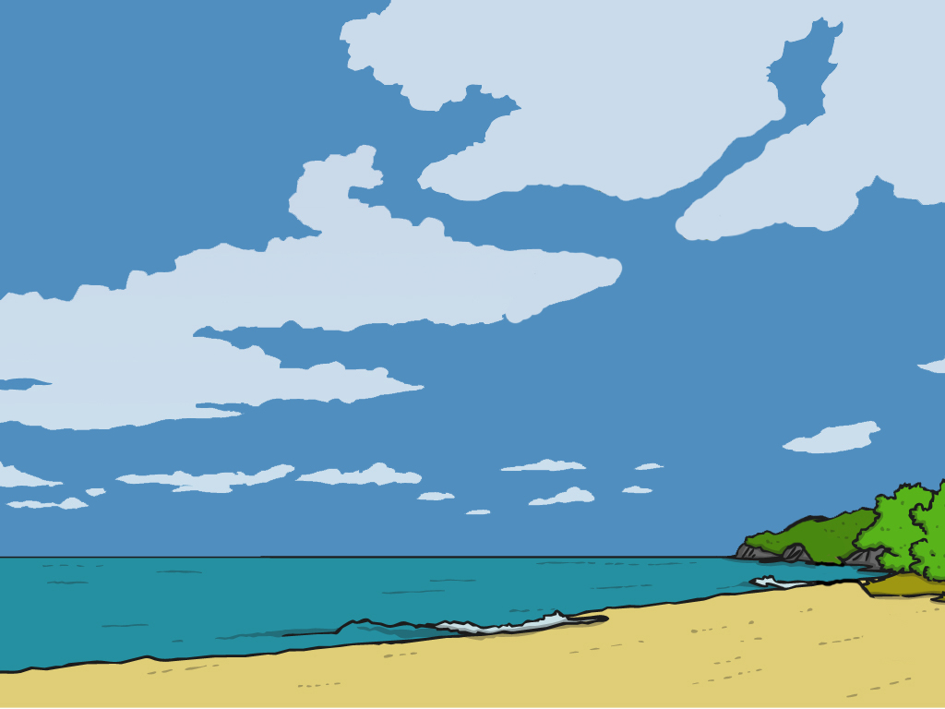

Where are
Our Seasides?

Slide 3
Aim
I can use key words to describe different places and environments.
I can use a map to find seaside locations.
Success Criteria
I can use key words to describe different places I have visited.
I can talk about the different types of environments that people can visit and describe what they are like (town, village, city, countryside, seaside).
I can use key words to describe what seaside locations are like.
I can locate (find) our nearest seaside resort on a map.
I can find out three facts about our nearest seaside resort.

Slide 4


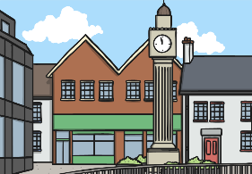
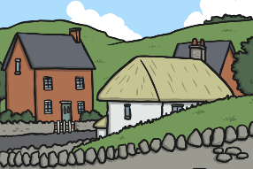
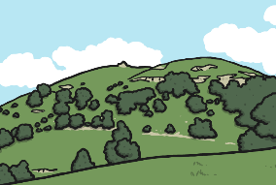
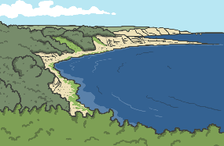
Key Words
city
town
village
countryside
coast
visit
locate
resort
holiday
national
international
international
near
far
urban
rural
human
physical
tourists
local area

Slide 5
What do I Know Already?
Quick Quiz
1. Write 5 words that describe the seaside.
2. Why do people visit the seaside?
3. Can you name any seaside places in the __UK (resorts)?
4 What is an Island?
5. How might the seaside be different from a town away from the coast? __

Slide 6

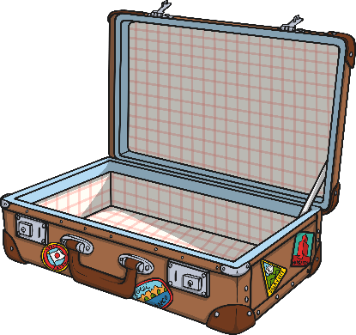
Where Have We Visited?
What different places have you visited?
Are these places nearby or far away?

Slide 7

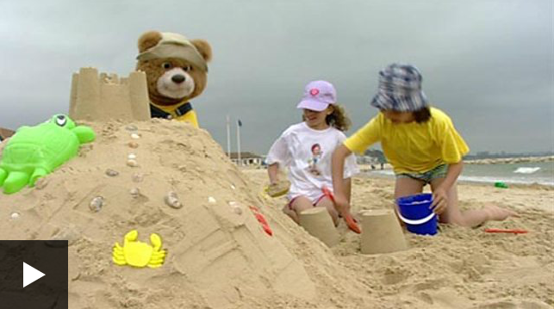
Sun, Sand and Seasides
What do we know about the seaside and what is it like?
What things can you do at a seaside resort and why do people visit them?
Click to watch the video

Slide 8
Sun, Sand and Seasides
What are the main features of the seaside?
The Seaside
The…
Notes:
Write in the text box to add children’s rersponses.

Slide 9

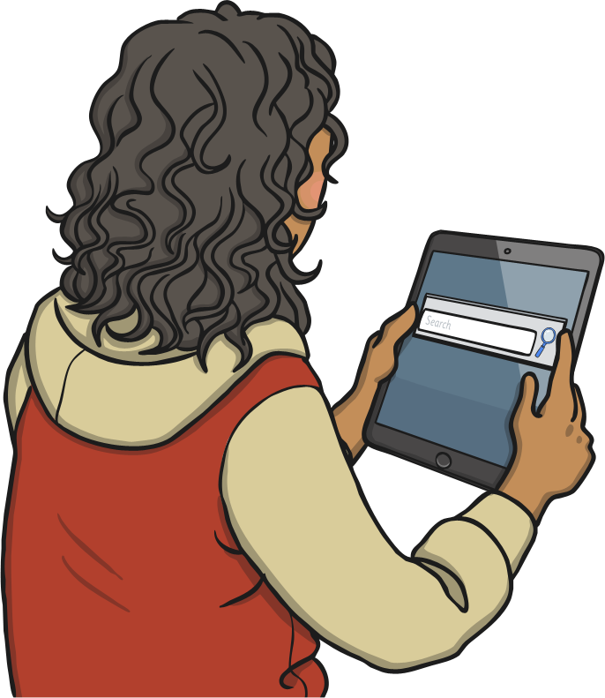

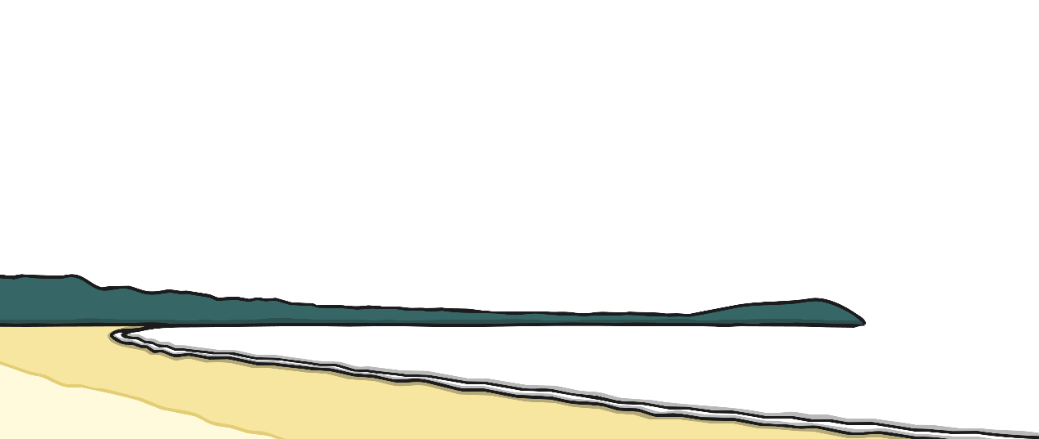
Where Is Our
Nearest Seaside?
Work together to locate (find) our local area and then our nearest seaside resort.
Where do we live?
Can you think of another seaside resort near to us?
Has you visited this resort?
Notes:
Write in the text box to add children’s rersponses.

Slide 10
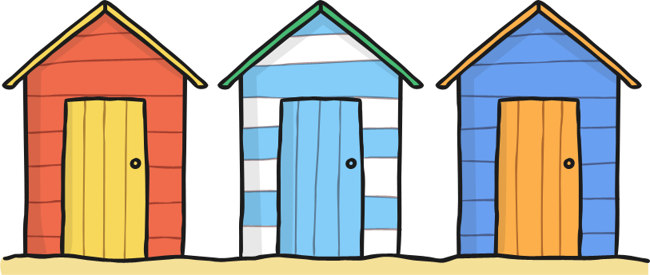
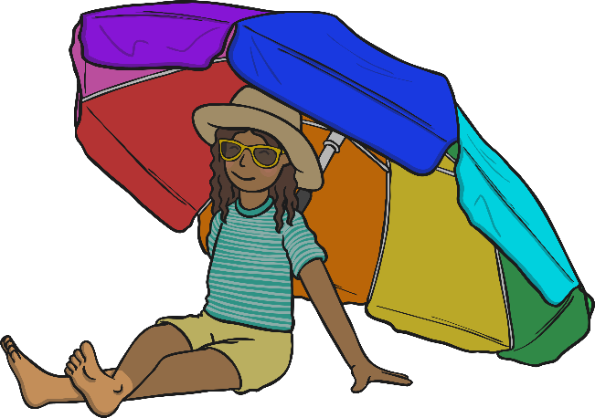

Spot the Difference
Ready, Steady, Catch!
Look at the next four pictures.
In what ways are they same and different?
Notes:
Write in the text box to add children’s rersponses.

Slide 11
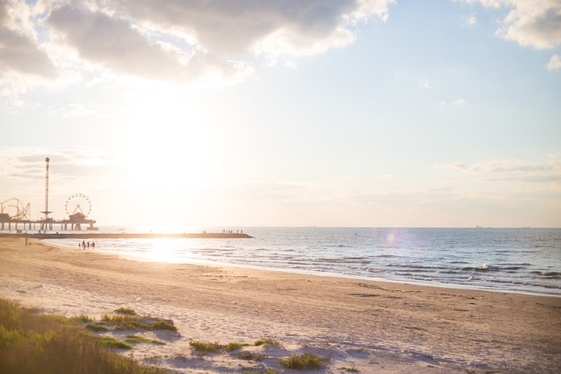
Spot the Difference
Notes:
Write in the text box to add children’s rersponses.

Slide 12
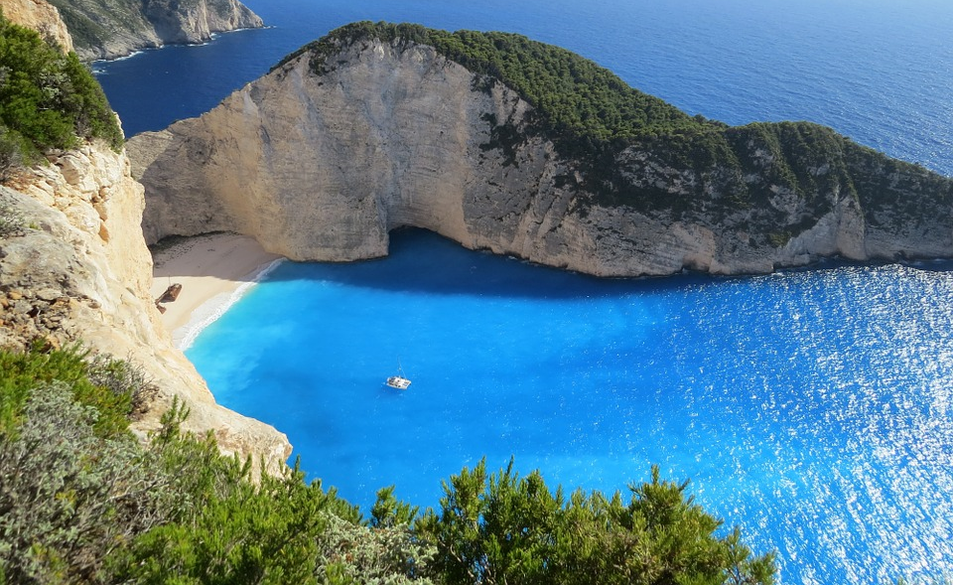
Spot the Difference
Notes:
Write in the text box to add children’s rersponses.

Slide 13
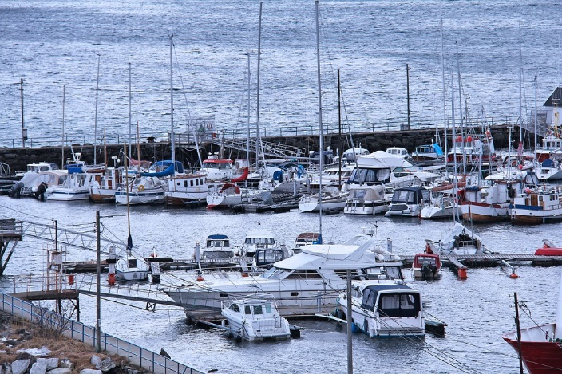
Spot the Difference
Notes:
Write in the text box to add children’s rersponses.

Slide 14

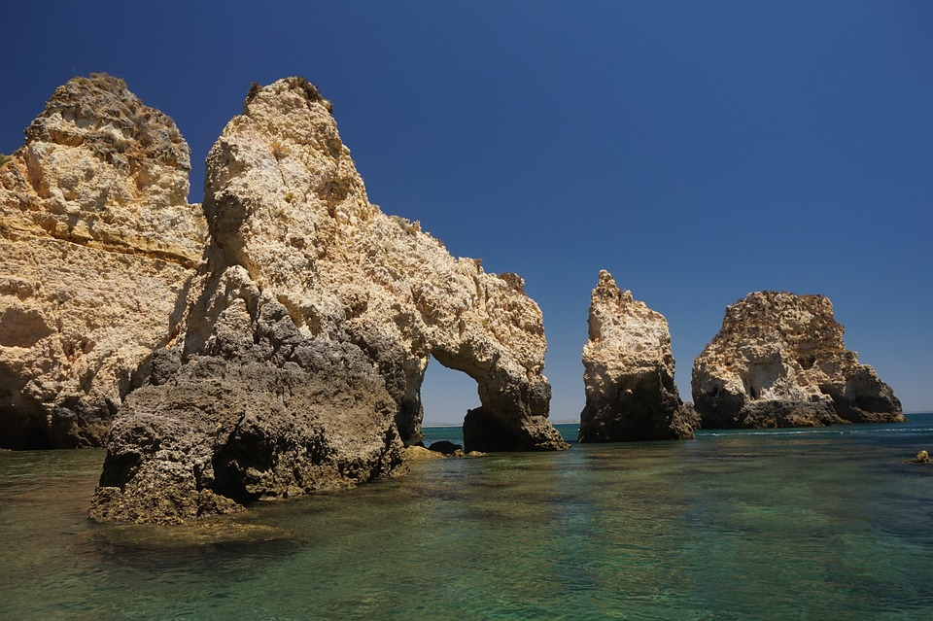
Spot the Difference
Notes:
Write in the text box to add children’s responses.

Slide 15
Aim
I can use key words to describe different places and environments.
I can use a map to find seaside locations.
Success Criteria
I can use key words to describe different places I have visited.
I can talk about the different types of environments that people can visit and describe what they are like (town, village, city, countryside, seaside).
I can use key words to describe what seaside locations are like.
I can locate (find) our nearest seaside resort on a map.
I can find out three facts about our nearest seaside resort.

