Slide 1
Welcome to year 3

Slide 2
Year 3 staff
Mrs Lamb
Mrs Parsons
Mrs Owen

Slide 3

What are our school’s core
Christian values?

Slide 4
What are our school’s core
Christian values?
Koinonia
Courage, Wisdom, Friendship, Forgiveness and Trust

Slide 5

Our Christian Vision…
Happiness, love and security abound
Everyone is special
Every achievement is celebrated
Relationships and teamwork matter
A beacon of light in the community
Christ in Everything we Do!

Slide 6




Slide 7
Routines
Doors open at 8.45am.
Register at 8.55am.
Finish at 3.20pm. Children are not permitted to use playground equipment.
Thank you so much to everyone for being so punctual - we start times tables/phonics/grammar at 8.45 so it’s really important to be on time so everyone is ready to get started.

Slide 8
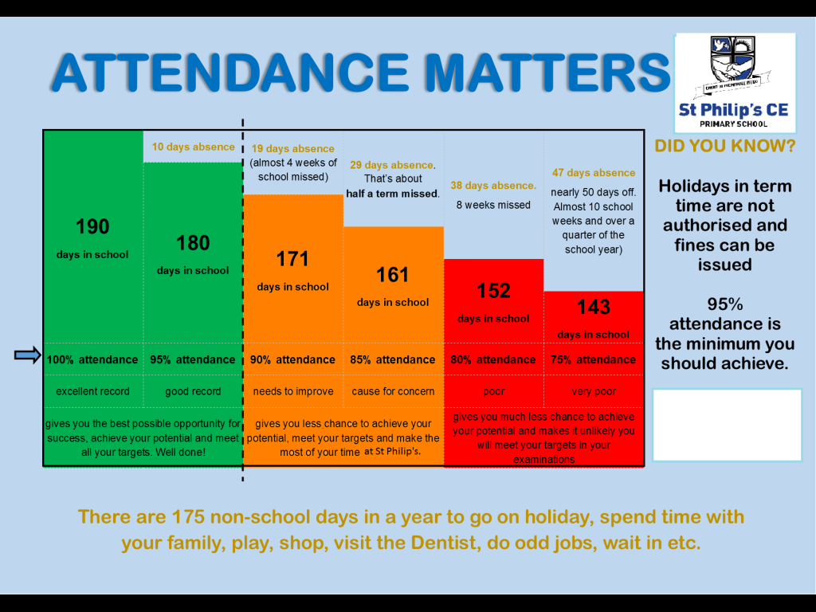

Slide 9
Behaviour
Dojos are awarded frequently.
Reward at the end of the week.
Good to be green
All children start each day on green.
Green all week means children are rewarded with their full Golden Time on Friday.
Children only lose Golden Time if they have been given red cards or several yellow cards during the week.

Slide 10
Every child begins each new day on Green.
Stickers will be awarded to children who remain Green all week
Privilege cards can also be awarded at the discretion of the Teacher.
Ten Green Weeks will result in a gold sticker and a letter home.
.
Step 1
Verbal Warning
Step 2
Second verbal warning leads to an yellow warning card
3 yellow cards = 5 minutes lost from Golden Time
Blue Frozen card for behaviour deemed as unacceptable in the behaviour policy.
Golden time is automatically lost and Parents are informed.
Step 3
Second Warning card within one lesson leads to a red card
Red card leads to 10 minutes off Golden time.
Red card goes behind name card until Friday
yellow card is kept behind name card until Friday

Slide 11

Housekeeping!
Please name all uniform –
Boys’ winter uniform Girls’ winter uniform
Grey trousers Navy skirt or pinafore
White shirt White blouse
Navy long sleeved jumper Navy long sleeved cardigan
School tie School tie
Please make sure your child has a water bottle each day
Tuesdays and Thursdays are PE days. Please make sure kits are in school.
Children are allowed to wear navy blue tracksuit bottoms for outside PE during the winter. Please make sure kits have pumps and trainers.
No term time holidays will be authorised and fines are now in place.

Slide 12
Class Timetable
ENTER SCHOOL 8.45-8.55 | MRS LAMB/MRS PARSONS (Teacher) MRS Owen (TA) Year Group Y3
 | Monday | Tuesday Times Tables Check | Wednesday Times Tables Check | Thursday Times Tables Check | Friday Times Tables Check
8:55-9.00 | Registration | Registration | Registration | Registration | Registration
9.00-9.20 Phonics/SPAG | SPAG | SPAG | SPAG | Based on key skills gaps. Hand out HW | Spellings
9.20 – 10.20 | Maths | Maths | English | Maths | Maths including active maths
10.20-10.35 | Breaktime
10.35-10.55am Maths Meeting | Key skills test | Based on key skills gaps. | Based on key skills gaps. | Handwriting | Key skills test
10.55 – 11.55 | English | English | Maths | English | English – Comprehension/x-curricular
11:55 – 12.55 | Lunchtime
12.55-2.10 | Active Mile Computing JO | Active mile PE | Active Mile Science | Active Mile PE | Art/French Story/Finishing off Active mile
2.10-2.25 | Worship
2.25-3.20 | Music Story | 2.10 – 3.20pm Geography/History | RE | PSCHE | Golden Time Celebration

Slide 13

Medical
Any medication updates – please let us know of any changes, especially if no longer need inhaler.
Please check your child’s inhaler before leaving to make sure it’s still in date.
We have been advised that children should use a spacer when taking their inhaler - if possible please send one into school.
If your child needs any prescribed medication, a medical form needs to be filled in at the office before we are able to administer it.
Thank you

Slide 14
Homework
Homework will be given out on a Thursday to be returned by Wednesday.
Spellings will be tested each Friday and then a new list given out.
Please try to read with your child every day and help them to learn their spellings. We expect your child to change their banded reading book at least once a week plus we will let the children choose a library book each Monday.
Sometimes there may be computer based homework where children will need to log in to Purple Mash. We are mindful though that it is important to limit children’s time online and ask everyone be vigilant regarding e-safety and safeguarding.
Please let us know if homework is too difficult so we can give a little extra help at school plus come and see us if you have any worries or concerns.
Thank you

Slide 15
Curriculum
Curriculum map is on the website.
Website
Please keep checking the website for dates and news. We will be holding a class worship each half term which we would love you to attend for your child. Letters will be given out nearer the time.
We will try to keep the website updated with lots of photos of your children at work and play.
You will also find information about after school clubs on the website and please follow us on Twitter.
We have made huge changes to our website and hope that all the information you need will be available for you online to save you a phone call to the school.

Slide 16
Assessment
Assessment takes place at the end of each half term.
We track progress using Target Tracker.
The children work to meet all the objectives on the ladders you’ve been given.
Your children are in Year 3 so we are in Band 3
Each band has been split into six sections
Beginning and Beginning Plus ( B and B+)
Working just below (W) and Working within – Up to 70% of the statements are confidently achieved ( W+)
Secure and Secure Plus (S and S+)
If you’d like more information, there is a full explanation of the assessment process on the website.
To support our Teacher assessment, at the end of Year 3, we use the NFER tests.
Please make sure you have taken:
English and maths ladders
Reading ladders
We will also put these ladders on the website

Slide 17
Thank you for coming.
We’re here most evenings if there is anything you’d like to talk about or if you’d like to volunteer to help please come and see us.
Also - parent’s evening
October 23rd from 2pm.

