Slide 1
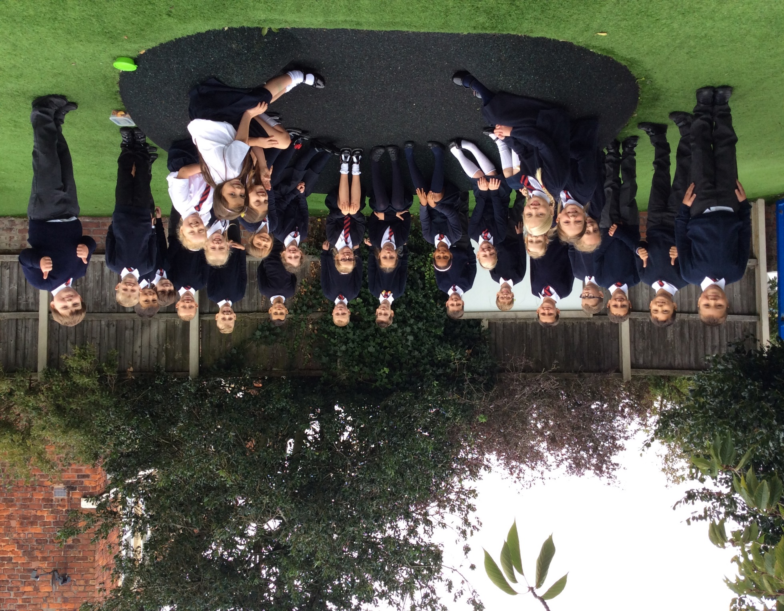
Welcome to year 3

Slide 2
Welcome
I am delighted to be teaching your children again.
It’s wonderful to see their journey from Reception to Year 3 and I look forward to sharing in their adventures once again.
Our classroom will be one in which each of the children are unique and all contributions are valued.
We will have lots of fun, outdoor adventures and work hard.
We will aim to cement solid values of friendship and teamwork.

Slide 3

What are our school’s core
Christian values?

Slide 4
What are our school’s core
Christian values?
Koinonia
Courage, Wisdom, Friendship, Forgiveness and Trust

Slide 5

Our Christian Vision…
Happiness, love and security abound
Everyone is special
Every achievement is celebrated
Relationships and teamwork matter
A beacon of light in the community
Christ in Everything we Do!

Slide 6


Slide 7
Year 3 staff
Teachers
Mrs Maguire
Mrs Klaassen – Friday afternoon
Support staff – Mrs Westby, Mrs Edwards & Mrs Piper

Slide 8
Routines
Children start each day according to the first letter of their surname.
Start (KS2)
8.45: A -F 8.50: G - M 8.55: N - Z All Finish 3.15 pm
Finish at 3.15pm.
If your child is absent from school please telephone the school as soon as possible and send a letter to the class teacher
It’s really important to be on time (whenever possible) as morning activities start as soon as we arrive at school.

Slide 9

Housekeeping!
Please name all uniform –
Boys’ winter uniform Girls’ winter uniform
Grey trousers Navy skirt or pinafore
White shirt White blouse
Navy long sleeved jumper Navy long sleeved cardigan
School tie School tie
PE will be on Tuesdays and Fridays so please come to school in your PE kit on those days (including blue jogging bottoms and blue jumpers/hoodies when it’s cold). White or black trainers suitable for sport NOT fashion may be worn. You are not allowed to wear jewellery for PE (including earrings) so please make sure you have removed these before you come to school.
Please make sure your child has a water bottle each day
We are struggling for space to store bags. Please could the children bring school book bags.

Slide 10
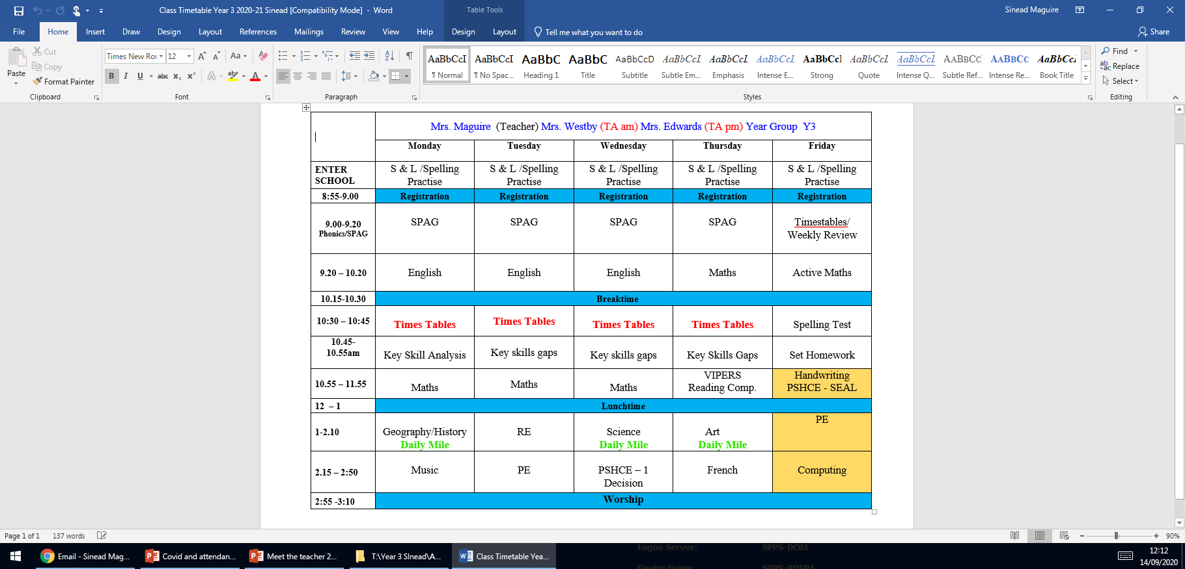
Class Timetable

Slide 11
Our Expectations
St Philip’s Standards
Be Ready
Be Respectful
Be Responsible
Fantastic Walking

Slide 12
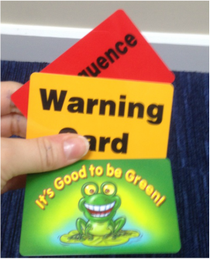

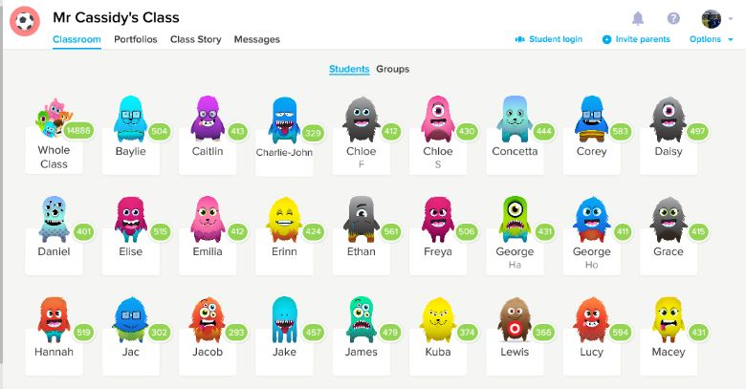
Behaviour!
Behaviour flow chart is on the web site
Children are awarded dojos for following the class rules – there is a prize at the end of the week
If children are not following the class rules a verbal warning is given before a card is issued

Slide 13

Warm Fuzzies
Unique to Year 3 - Warm fuzzies can be earned by the children to “save” up as a class to spend on various fun activities eg. Cake decorating, extra play on the adventure playground, wear slippers and bring a book or popcorn and movies session.

Slide 14
Badges
Spelling and times tables badges
Times tables badges
We work towards the bronze badge
3x, 4x and 8x
Spelling badges
Ongoing throughout the year

Slide 15

Medical
Any medication updates – please let us know of any changes
Please check that your child’s inhaler is in date.
We have been advised that children should use a spacer when taking their inhaler - if possible please send one into school.
If your child needs any prescribed medication, a medical form needs to be filled in at the office before we are able to administer it.
Thank you

Slide 16
Homework
Homework will be given out on a Friday to be returned on Monday ideally but no later than Wednesday.
We would be really grateful if you could return homework on time so we have chance to mark it before Friday – Thank you.
Spellings will be tested each Friday.
Weekly spelling will be put on the website.
Please try to read with your child every day.
Please let us know if any homework is too difficult so we can give a little extra help at school.
Thank you

Slide 17
Reading
Your children will continue reading through the colour bands
Please try and read at home every night.
In school the children will be involved in
Shared reading.
Reading across the curriculum.
Story time at the end of the day.

Slide 18

Curriculum
Curriculum map and autumn newsletter is on the website.
Website
Please keep checking the website dates and news.
We will try to keep the website updated with lots of photos of your children at work and play.
Trips
You will also find information about after school clubs on the website.

Slide 19
Covid and attendance…
Attendance at school is mandatory for all children unless they are sick or have and appointment.
The usual rules on absence continue to apply. Well children are expected to attend daily, arrive on time and have the things that they need. Reading books should be brought to school daily Limit the amount of things brought into school please.
Parents have a vital role to play in deciding when to keep a child off school but we appreciate that this is now complicated by the current situation. Children have already missed so much time in school so I would urge you to send them to school wherever possible.
It’s a difficult judgement call but if in the past you would have sent your child to school with a runny nose, slight tummy pain, minor headache or just a bit under the weather it is still probably ok, if you feel they can manage the day to send them in. We will always contact you if we have concerns about your child. Each case is different so feel free to speak to Mrs Edward.
First Response
If your child is absent you must contact the school office by telephone or email to report your child's absence giving clear details of the reason for absence. Failure to do so means that our First Response kicks in and if we cannot get hold of you and we are unable to make contact with you via your emergency contact details, it might be necessary for a senior leader to come to your house!!!!! This is part of our safeguarding response to ensure everyone is safe and well. As you can imagine, a home visit takes up a lot of time and it is usually the case that families have forgotten to call us. I’m sure you don’t want us on your doorstep so please remember to give us a call. Thank you
Some Covid reminders
Symptoms are Fever above 37.8, persistent cough, shortness of breath, loss of taste or smell
To Book at test call 119. If you or your child are awaiting a test result do not come to school and do not come to the playground even if you are symptom free.
See our Covid Pages of the website for additional guidance.

Slide 20
Latest guidance from Sefton Council

Slide 21
Assessment
Assessment takes place at the end of each half term.
We track progress using Target Tracker.
The children work to meet all the objectives on the ladders you’ve been given.
Your children are in Year 3 so we are in Band 3
Each band has been split into six sections
Beginning and Beginning Plus ( B and B+)
Working Within and Working within Plus – Up to 70% of the statements are confidently achieved (W and W+)
Secure and Secure Plus (S and S+)
We aim for most children to make 6 bands of progress each year
If you’d like more information, there is a full explanation of the assessment process on the website.

Slide 22
ST PHILIP’S CE PRIMARY SUPPORT TRIANGLE
SENDCO - Mrs Klaassen
SEN Support
Targeted Support
Enhanced Quality First,
Quality First – Universal Offer for all
High Needs Funding
EHCP’s
Specialist

Slide 23
Website and Twitter
Please remember the website holds lots of information and photos of your children.
Also twitter gives instant updates of what is going on in school.
Please take care when posting on Social Media – remember not to include names and always ask children’s parents/carers to obtain permission to post.

Slide 24
Partnership
I look forward to working with you all in partnership for the good of your child’s education.
If you have any questions of if you need further support, please do not hesitate to contact me between school hours via email.
I endeavour to reply within 24 hours.

