Slide 1
Tuesday 5th January
LO: To research an Ancient Civilisation.

Slide 2

Civilisation?
Ancient?

Slide 3
Have a look at the timelines to see where ‘Ancient’ times were compared to other history we have learned about.

Slide 4
How many ancient civilisations were there?
What do we know already?
What questions do you have?

Slide 5
Over to you…

Slide 6
Your task is to research at least two Ancient Civilisations to see how they compare to each other.

Slide 7
Think about:
Where was it?
How long was it a civilisation for?
Food? Farming?
Jobs?
Inventions?
Buildings?
Religious beliefs?
Famous for…?

Slide 8
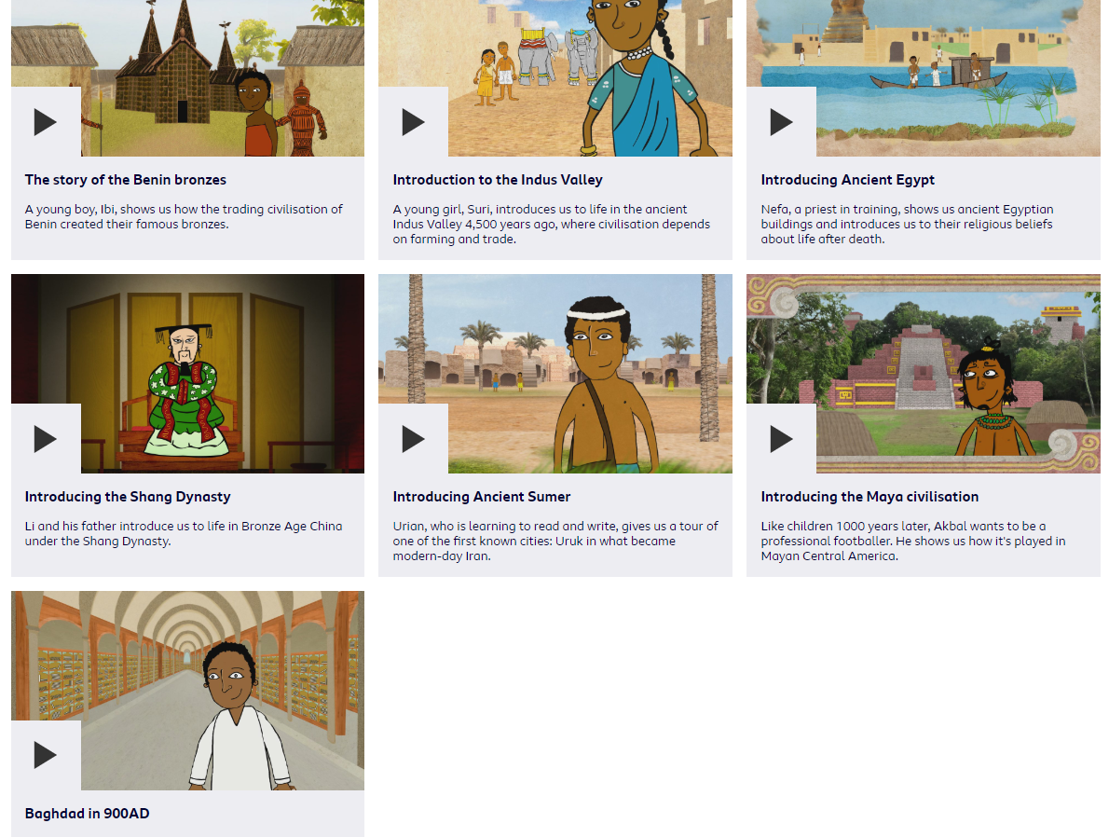
There is extra information for lots of these civilisations on Purple Mash and BBC bitesize too!

