Slide 1
2 1. 1 0.2 0
LO:
To find multiples and factors of numbers.
Red to respond

Slide 2
Key Skills

Slide 3
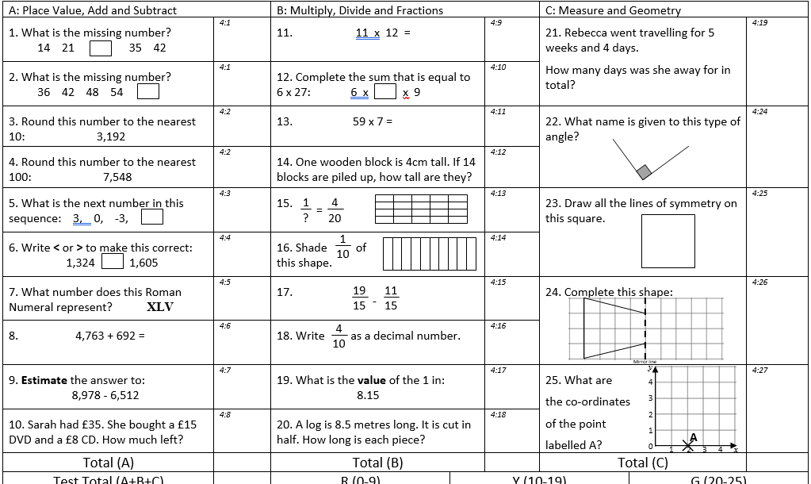

Slide 4
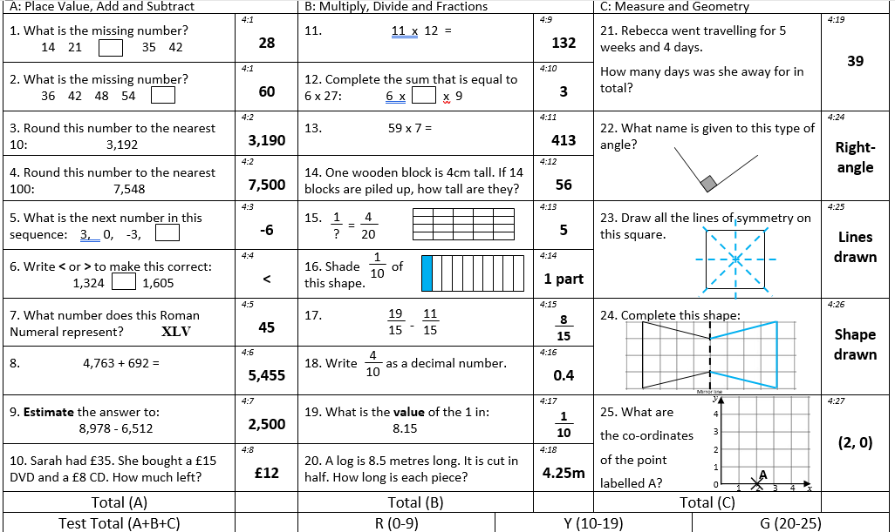

Slide 5


Introduction
Place the multiples in to the correct table.
Multiple of 4
Multiple of 6
Multiple of 7
30
20
18
44
49
40
35
© Classroom Secrets Limited 2018

Slide 6
Introduction
Place the multiples in to the correct table.
Multiple of 4
Multiple of 6
Multiple of 7
20
44
30
18
49
35
40
© Classroom Secrets Limited 2018

Slide 7
Varied Fluency 1
Match the number to its multiple.
Number |  | Multiple
6 |  | 32
4 |  | 35
7 |  | 54
© Classroom Secrets Limited 2018

Slide 8
Varied Fluency 1
Match the number to its multiple.
Number |  | Multiple
6 |  | 32
4 |  | 35
7 |  | 54
© Classroom Secrets Limited 2018

Slide 9
Varied Fluency 2
True or false?
54 is a multiple of 7.
© Classroom Secrets Limited 2018

Slide 10
Varied Fluency 2
True or false?
False
54 is a multiple of 7.
© Classroom Secrets Limited 2018

Slide 11
Varied Fluency 3
Complete the sequence of multiples.
24 |  |  |  | 36 |  | 42
© Classroom Secrets Limited 2018

Slide 12
Varied Fluency 3
Complete the sequence of multiples.
24 |  | 30 |  | 36 |  | 42 |  | 48 |  | 54 |  | 60
© Classroom Secrets Limited 2018

Slide 13
Varied Fluency 4
Fill in the table below with two possible multiples for each number.
Number | Multiple
4
8
7
6
© Classroom Secrets Limited 2018

Slide 14
Varied Fluency 4
Fill in the table below with two possible multiples for each number.
Various answers, for example:
Number | Multiple
4 | 8 | 24
8 | 24 | 64
7 | 14 | 56
6 | 6 | 36
© Classroom Secrets Limited 2018

Slide 15

Problem Solving 1
Kara is thinking of a number.
What could her number be?
Is there only one answer?
My number is a multiple of 6 and 7. It is even and below 50.
© Classroom Secrets Limited 2018

Slide 16
Problem Solving 1
Kara is thinking of a number.
What could her number be?
42
Is there only one answer?
Yes, there is only one answer.
My number is a multiple of 6 and 7. It is even and below 50.
© Classroom Secrets Limited 2018

Slide 17
Reasoning 1
Below is a section of a hundred square.
Why are some of the numbers shaded?
Why do some of the numbers have circles around them?
32 | 33 | 34
42 | 43 | 44
52 | 53 | 54
© Classroom Secrets Limited 2018

Slide 18
Reasoning 1
Below is a section of a hundred square.
Why are some of the numbers shaded?
Why do some of the numbers have circles around them?
Shaded numbers are multiples of…
Circled numbers are multiples of…
32 | 33 | 34
42 | 43 | 44
52 | 53 | 54
© Classroom Secrets Limited 2018

Slide 19
Reasoning 1
Below is a section of a hundred square.
Why are some of the numbers shaded?
Why do some of the numbers have circles around them?
Shaded numbers are multiples of 4.
Circled numbers are multiples of 6.
32 | 33 | 34
42 | 43 | 44
52 | 53 | 54
© Classroom Secrets Limited 2018

Slide 20
Reasoning
Which is the odd one out?
How do you know?
16
36
32
24
40
80
8
© Classroom Secrets Limited 2018

Slide 21
Reasoning
Which is the odd one out?
How do you know?
36 is the odd one out because…
16
36
32
24
40
80
8
© Classroom Secrets Limited 2018

Slide 22
Reasoning
Which is the odd one out?
How do you know?
36 is the odd one out because it is not a multiple of 8.
16
36
32
24
40
80
8
© Classroom Secrets Limited 2018

Slide 23
18 × 1
9 × 2
Factor pair
18
3 × 6
6 × 3
The factors of 18 are: 1, 2, 3, 6, 9 and 18

Slide 24

Have a think
__ × 1
10 × 2
20
20
5 × 4
1, 2, 4, 5, 10 and 20
The factors of 20 are: _________________

Slide 25
Have a think
25 × 1
25
5 × 5
1, 5, 5 and 25
1, 5 and 25
The factors of 25 are: _________________

Slide 26
1, 3 and 7 are all factors of a number between 40 and 50
Have a think
What is the number?
42
The number must be a multiple of 3 and 7
3
6
9
12
15
18
21
24
27
30
33
36
7
14
21
28
35
42
49
56
63
70
77
84

Slide 27
Varied Fluency 1
Draw lines to match the factor pairs of 30.
Which pair is the odd one out?
4 |  | 10
5 |  | 9
3 |  | 6
© Classroom Secrets Limited 2018

Slide 28
Varied Fluency 1
Draw lines to match the factor pairs of 30.
Which pair is the odd one out?
4 and 9 are not factor pairs of 30.
4 |  | 10
5 |  | 9
3 |  | 6
© Classroom Secrets Limited 2018

Slide 29
Varied Fluency 2
True or false? All of these numbers are factors of 18.
3 |  | 1 |  | 9
2 |  | 6 |  | 18
© Classroom Secrets Limited 2018

Slide 30
Varied Fluency 2
True or false? All of these numbers are factors of 18.
True
3 |  | 1 |  | 9
2 |  | 6 |  | 18
© Classroom Secrets Limited 2018

Slide 31
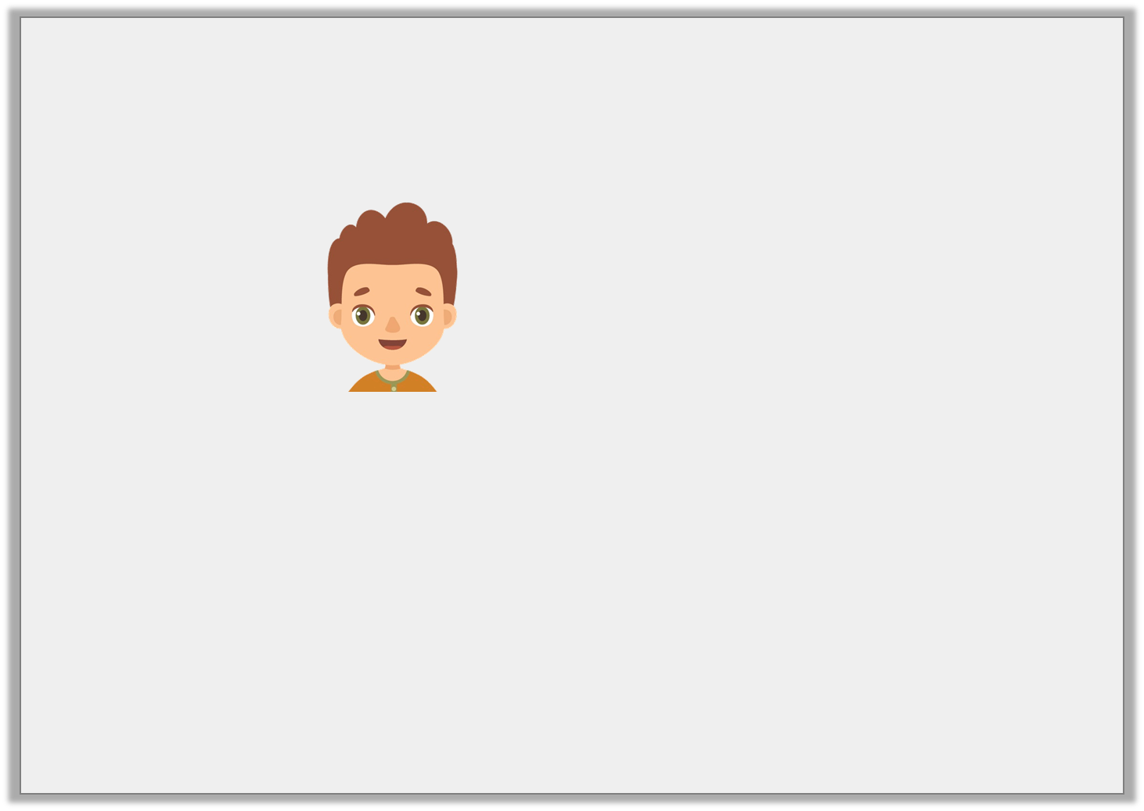
Reasoning 1
Class 5 have been finding factors. Abraham says,
Is he correct? Prove it.
The number 33 has got six different factors.
© Classroom Secrets Limited 2018

Slide 32
Reasoning 1
Class 5 have been finding factors. Abraham says,
Is he correct? Prove it.
He is incorrect because...
The number 33 has got six different factors.
© Classroom Secrets Limited 2018

Slide 33
Reasoning 1
Class 5 have been finding factors. Abraham says,
Is he correct? Prove it.
He is incorrect because 33 has got four different factors: 1, 3, 11 and 33.
The number 33 has got six different factors.
© Classroom Secrets Limited 2018

Slide 34
Problem Solving 2
Three factors are put into the machine below. Use the clues to work out what the missing factors and products could be.
D is half of C.
B is an even number.
E is bigger than 64 but smaller than 96.
4
x 8
C
A
D
B
E
© Classroom Secrets Limited 2018

Slide 35
Problem Solving 2
Three factors are put into the machine below. Use the clues to work out what the missing factors and products could be.
D is half of C.
B is an even number.
E is bigger than 64 but smaller than 96.
4
x 8
32
2
16
10
80
© Classroom Secrets Limited 2018

Slide 36
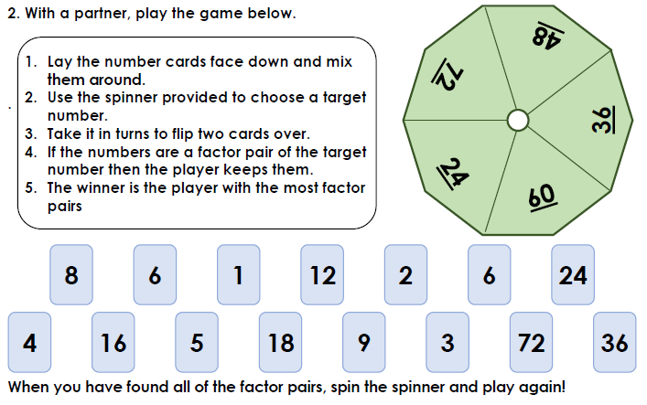

Slide 37
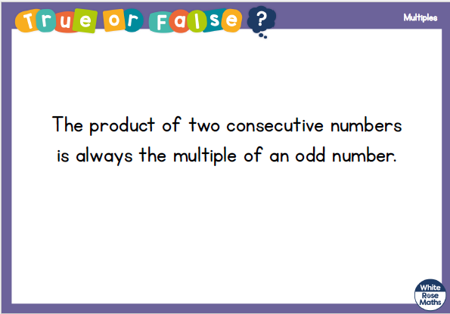

Slide 38
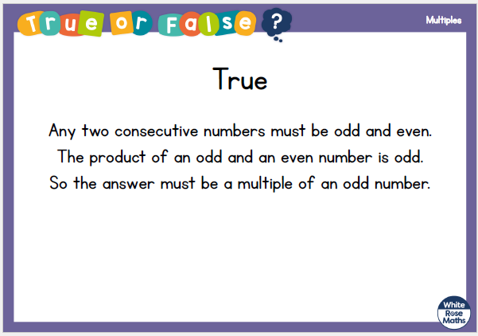

Slide 39
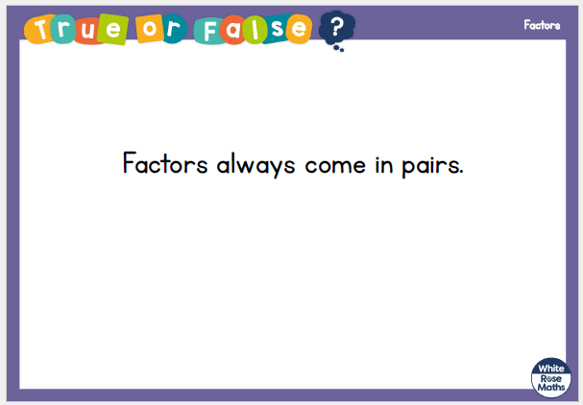

Slide 40
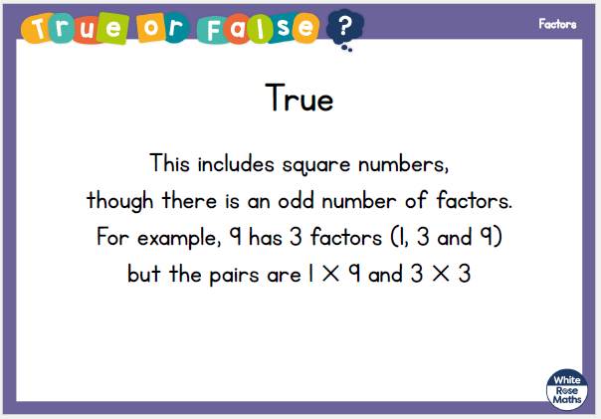

Slide 42
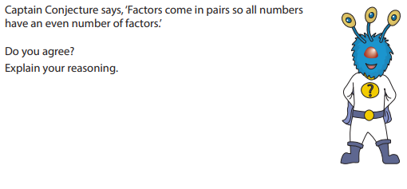

Slide 43
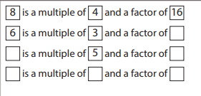

Slide 44
2 2. 1 0.2 0
LO:
To find common factors.
Red to respond

Slide 45
Maths Meeting

Slide 46
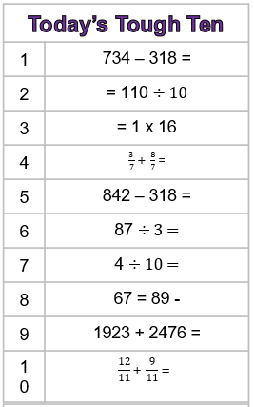

Slide 47
List the factors of 36
Which number is not a factor of 14?
1 4 7 14
What fraction of the multiples of 7 are odd?
Less than half Half More than half
64 ____ 48 ____ 32

Slide 48
List the factors of 36
Which number is not a factor of 14?
1 4 7 14
What fraction of the multiples of 7 are odd?
Less than half Half More than half
64 ____ 48 ____ 32
1, 2, 3, 4, 6, 9, 12, 18, 36
56
40

Slide 49


Have a think
1, 2, 3, 4, 6 and 12
The factors of 12 are: ________________
The factors of 8 are: 1, 2, 4 and 8
1, 2 and 4 are factors of 12 and 8
1, 2 and 4 are common factors of 12 and 8
Whitney and Dexter both have dark hair.
They have dark hair in common.

Slide 50
Factors of 15
Factors of 25
1, 5, 25
1, 3, 5, 15
Common factors of 15 and 25
Have a think
1
2
3
5
15
25

Slide 51
Reasoning 2
Kasim has sorted some factors into a Venn diagram by systematically checking each times table.
Explain the mistake he has made.
Factors
of 24
Factors
of 30
2
3
8
6
10
1
4
© Classroom Secrets Limited 2018

Slide 52
Reasoning 2
Kasim has sorted some factors into a Venn diagram by systematically checking each times table.
Explain the mistake he has made.
Kasim’s mistake is…
Factors
of 24
Factors
of 30
2
3
8
6
10
1
4
© Classroom Secrets Limited 2018

Slide 53
Reasoning 2
Kasim has sorted some factors into a Venn diagram by systematically checking each times table.
Explain the mistake he has made.
Kasim’s mistake is that 4 is not a factor of 30 so it should not be in the middle of the Venn diagram. It should only be listed as a factor of 24.
Factors
of 24
Factors
of 30
2
3
8
6
10
1
4
© Classroom Secrets Limited 2018

Slide 54
Varied Fluency 3
Match the pairs of numbers to their common factor. You may want to draw arrays to help you.
36 and 90 |  | 4
32 and 44 |  | 7
21 and 63 |  | 9
© Classroom Secrets Limited 2018

Slide 55
Varied Fluency 3
Match the pairs of numbers to their common factor. You may want to draw arrays to help you.
36 and 90 |  | 4
32 and 44 |  | 7
21 and 63 |  | 9
© Classroom Secrets Limited 2018

Slide 56
Varied Fluency 4
Write all the common factors for the numbers below.
18
27
© Classroom Secrets Limited 2018

Slide 57
Varied Fluency 4
Write all the common factors for the numbers below.
18
27
1, 3 and 9
© Classroom Secrets Limited 2018

Slide 58
What is the highest common factor of 27 and 90?
9
The factors of 27 are 1, 3, 9 and 27
Have a think
The factors of 90 are ________________________________
1, 2, 3, 5, 6, 9, 10, 15, 18, 30, 45 and 90
3 and 30
1 and 90
5 and 18
90
2 and 45
6 and 15
9 and 10

Slide 59
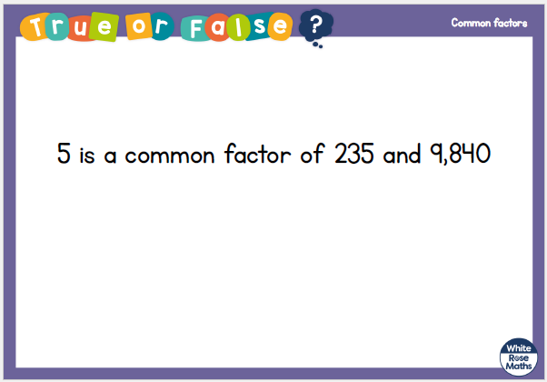

Slide 60
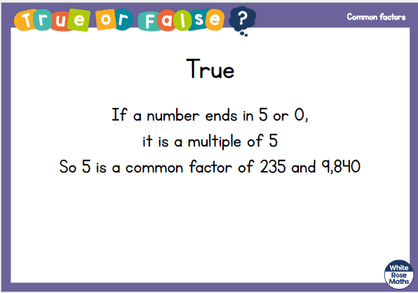

Slide 61

Reasoning 1
Lily says,
Is Lily correct? Prove it by working systematically through the times tables.
The number 2 is the largest common factor of 36 and 40.
© Classroom Secrets Limited 2018

Slide 62
Reasoning 1
Lily says,
Is Lily correct? Prove it by working systematically through the times tables.
Lily is not correct because…
The number 2 is the largest common factor of 36 and 40.
© Classroom Secrets Limited 2018

Slide 63
Reasoning 1
Lily says,
Is Lily correct? Prove it by working systematically through the times tables.
Lily is not correct because the number 4 is the largest common factor of 36 and 40.
The number 2 is the largest common factor of 36 and 40.
© Classroom Secrets Limited 2018

Slide 64
2 3. 1 0.2 0
LO:
To understand prime numbers.

Slide 65
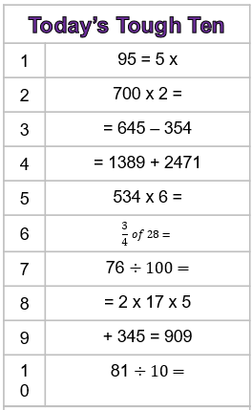

Slide 66
Have a think
1 row of 5
The only factors of 5 are 1 and 5
5 is a prime number

Slide 67
1 row of 6
Have a think
2 rows of 3

Slide 68
With which of these numbers can you only make one rectangular array?
Have a think
4
11
13
Which of these numbers is prime?

Slide 69

Teddy is thinking of a prime number.
Have a think
It has 2 digits.
It is between 10 and 39
It is 1 more than a multiple of 6
It is 3 less than a multiple of 10
What is Teddy’s number?
37
6
12
18
24
30
36
7
13
19
25
31
37

Slide 70
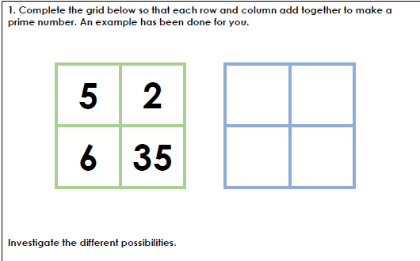

Slide 71
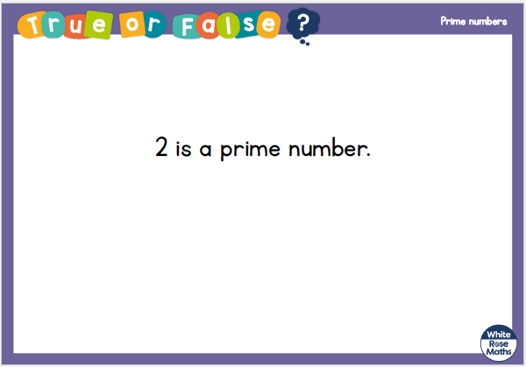

Slide 72
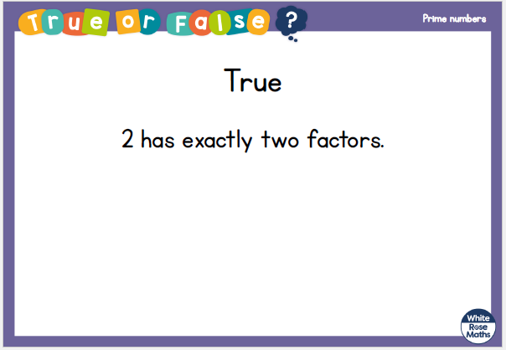

Slide 73
2 4. 1 0.2 0
LO:
To understand square numbers.

Slide 74
Maths Meeting https://uk.ixl.com/math/year-5/interpret-line-graphs

Slide 75
1 row of 9 is equal to 9
1 and 9 are factors of 9
3
3 rows of 3 are equal to 9
3 is a factor of 9
3
Using 9 counters it is possible to make a square.
9 is a square number.

Slide 76
Is 10 a square number?
No

Slide 77
1) Is 4 a square number?
Yes
Have a think
2) Is 6 a square number?
No

Slide 78
Have a think
Does this show that 8 is a square number?
No

Slide 79
3
3
3 rows of 3 counters is equal to 9
3 × 3 = 9
The product of an integer multiplied by itself is a square number.

Slide 80


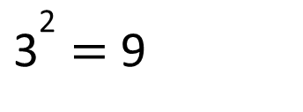

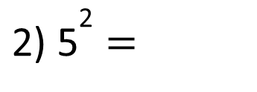
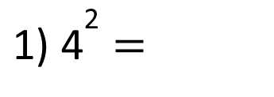
The product of an integer multiplied by itself is a square number.
3 × 3 = 9
${\text{3}}^{\text{2}}$ = 9
$$\text{"3 }\text{squared} \text{is} \text{equal} \text{to}\text{ 9"}$$
${\text{1) 4}}^{\text{2}}$ =
16
4 multiplied by itself
4 × 2 =
4 × 4 =
Have a think
$$\text{2}$$
25
3) 49 =
${\text{2) 5}}^{\text{2}}$ =
7
5 × 5 =
7
7
__ × __ = 49

Slide 81
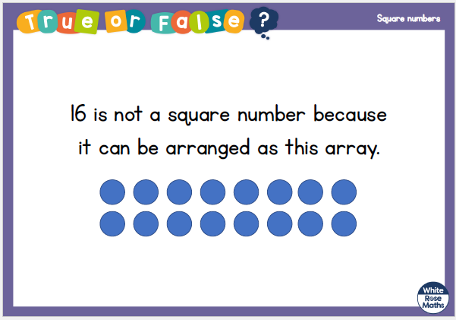

Slide 82
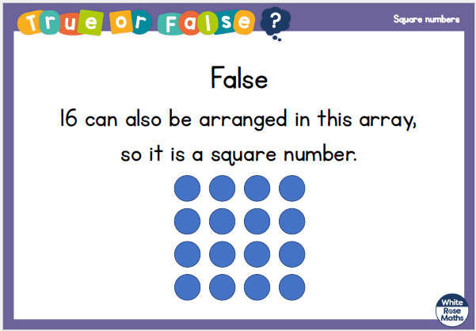

Slide 83

Reasoning 1
Josh says,
Is Josh right? Convince me.
All square numbers are odd.
© Classroom Secrets Limited 2018

Slide 84
Reasoning 1
Josh says,
Is Josh right? Convince me.
Josh is incorrect because…
All square numbers are odd.
© Classroom Secrets Limited 2018

Slide 85
Reasoning 1
Josh says,
Is Josh right? Convince me.
Josh is incorrect because there are square numbers that are even. For example, 4² = 16.
All square numbers are odd.
© Classroom Secrets Limited 2018

Slide 86
Problem Solving 1
25 is the sum of two square numbers.
Using the example above, complete the following:
34 is the sum of two squared numbers. What could they be?
45 is the sum of two squared numbers. What could they be?
25 = 4² + 3²
© Classroom Secrets Limited 2018

Slide 87
Problem Solving 1
25 is the sum of two square numbers.
Using the example above, complete the following:
34 is the sum of two squared numbers. What could they be?
5² and 3²
45 is the sum of two squared numbers. What could they be?
6² and 3²
25 = 4² + 3²
© Classroom Secrets Limited 2018

Slide 88
Problem Solving 2
Solve the following problems.
I think of a number. I square it and subtract 10. The answer is 54. What was my number?
I think of another number. I square it and add 15. The answer is 115. What was my number?
© Classroom Secrets Limited 2018

Slide 89
Problem Solving 2
Solve the following problems.
I think of a number. I square it and subtract 10. The answer is 54. What was my number?
8
I think of another number. I square it and add 15. The answer is 115. What was my number?
10
© Classroom Secrets Limited 2018

Slide 90


Dora is thinking of a square number.
It is odd.
Its digits sum to 7
It is one more than a multiple of 8
25
What number is Dora thinking of?
Have a think
41
4 + 1 = 5
41’s digits sum to 5
1
4
9
16
25
2 + 5 = 7
1 + 6 = 7
24

Slide 91
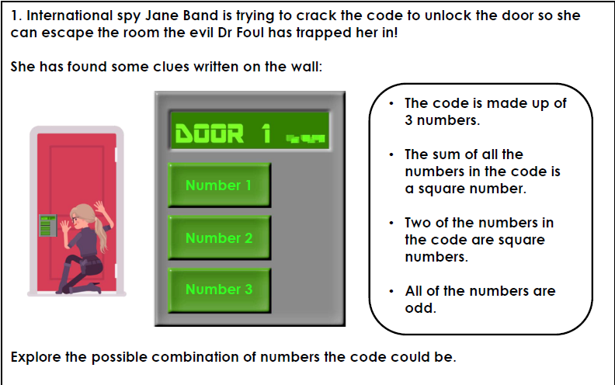

Slide 93


Slide 94
2 5. 1 0.2 0
LO:
To understand cubed numbers.

Slide 95
Key Skills

Slide 98
Here are 6 cubes
Have a think
Is it possible to make a cube?

Slide 99
Here are 8 cubes
Is it possible to make a cube?
2
2
2
2 × 2
= 8
× 2
8 is a cube number.

Slide 100
4
4
4
4 × 4
× 4
= 64
16
64 is a cube number.

Slide 101
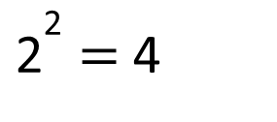
Cube numbers
Square numbers
2 × 2 × 2 = 8
2 × 2 = 4
3
${\text{2}}^{\text{2}}$ = 4
2 = 8
Have a think
4 × 4 × 4 = 64
3
4 = 64
“4 cubed is equal to 64”

Slide 102


Have a think
5 cubed is equal to 15 because 5 multiplied by 3 is equal to 15
5 × 5 × 5
= 125
25
$${\text{5}}^{\text{3}}$$
= 125

Slide 103
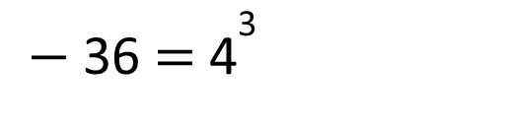


Have a think
Calculate:
$${\text{8}}^{\text{3}} \text{=}$$
512
8 × 8 × 8 =
64 × 8 =
$${\text{3}}^{\text{3}}$$
= 25 +
2
100
$−$ 36 = ${\text{4}}^{\text{3}}$

Slide 104

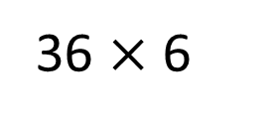


$${\text{1}}^{\text{3}}$$
3
Have a think
$${\text{3}}^{\text{3}}$$
36 $×$ 6
Match the calculation to the number.
3 × 3
27
$${\text{6}}^{\text{3}}$$
1
5 × 2
9
1 + 1 + 1
10

Slide 105
Varied Fluency 1
Match the numbers to their cube numbers.
7³ |  | 1,331
11³ |  | 64
4³ |  | 343
© Classroom Secrets Limited 2018

Slide 106
Varied Fluency 1
Match the numbers to their cube numbers.
7³ |  | 1,331
11³ |  | 64
4³ |  | 343
© Classroom Secrets Limited 2018

Slide 107
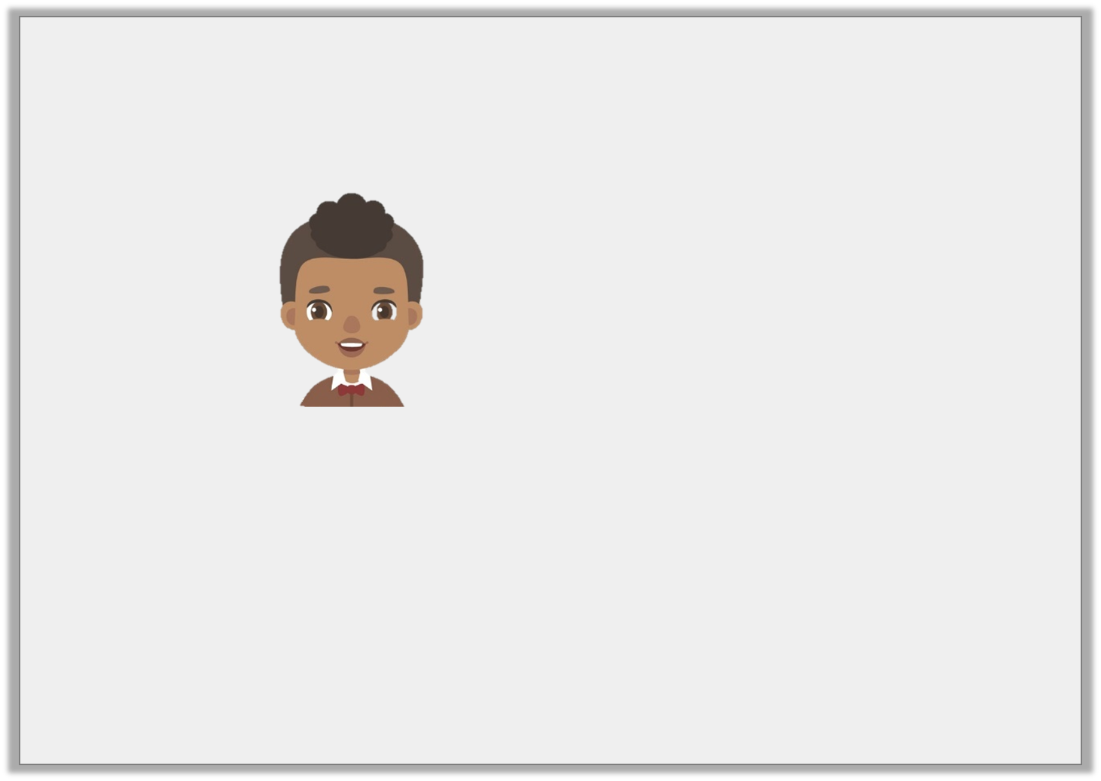
Reasoning 2
Jamal says,
Is he correct? Prove it.
The number 343 is a cube number.
© Classroom Secrets Limited 2018

Slide 108
Reasoning 2
Jamal says,
Is he correct? Prove it.
Jamal is correct because…
The number 343 is a cube number.
© Classroom Secrets Limited 2018

Slide 109
Reasoning 2
Jamal says,
Is he correct? Prove it.
Jamal is correct because when the number 7 is multiplied by itself and then by itself again, the product is 343.
The number 343 is a cube number.
© Classroom Secrets Limited 2018

Slide 110


