Slide 1
2 3. 1 1.2 0
LO:
To understand square numbers.
Red to respond

Slide 2
Key Skills

Slide 3
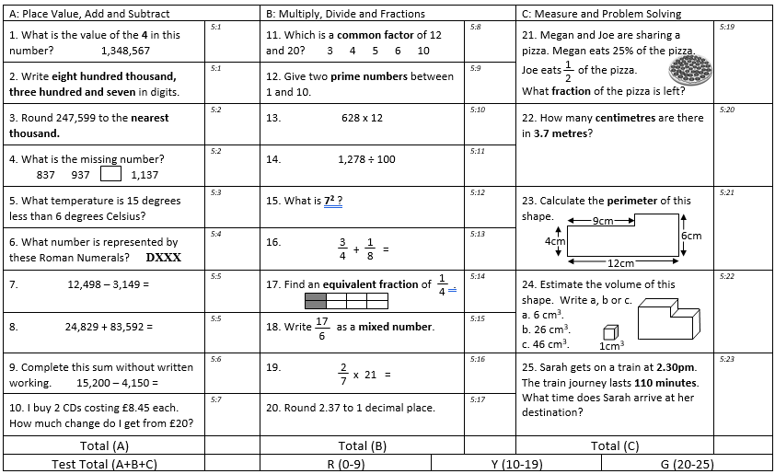

Slide 4
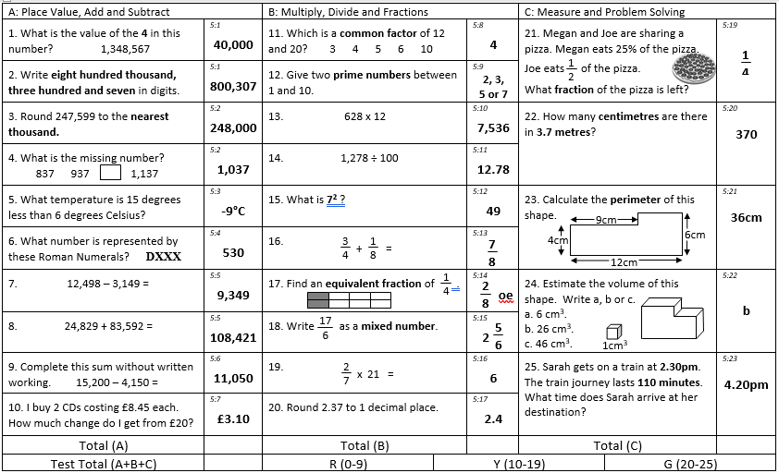

Slide 5
1 row of 9 is equal to 9
1 and 9 are factors of 9
3
3 rows of 3 are equal to 9
3 is a factor of 9
3
Using 9 counters it is possible to make a square.
9 is a square number.

Slide 6
Is 10 a square number?
No

Slide 7

1) Is 4 a square number?
Yes
Have a think
2) Is 6 a square number?
No

Slide 8
Have a think
Does this show that 8 is a square number?
No

Slide 9
3
3
3 rows of 3 counters is equal to 9
3 × 3 = 9
The product of an integer multiplied by itself is a square number.

Slide 10


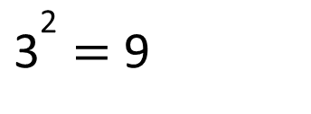

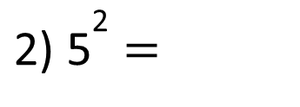
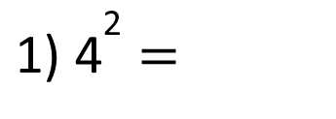
The product of an integer multiplied by itself is a square number.
3 × 3 = 9
${\text{3}}^{\text{2}}$ = 9
$$\text{"3 }\text{squared} \text{is} \text{equal} \text{to}\text{ 9"}$$
${\text{1) 4}}^{\text{2}}$ =
16
4 multiplied by itself
4 × 2 =
4 × 4 =
Have a think
$$\text{2}$$
25
3) 49 =
${\text{2) 5}}^{\text{2}}$ =
7
5 × 5 =
7
7
__ × __ = 49

Slide 11
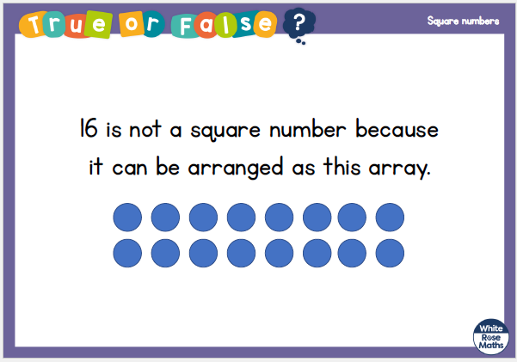

Slide 12
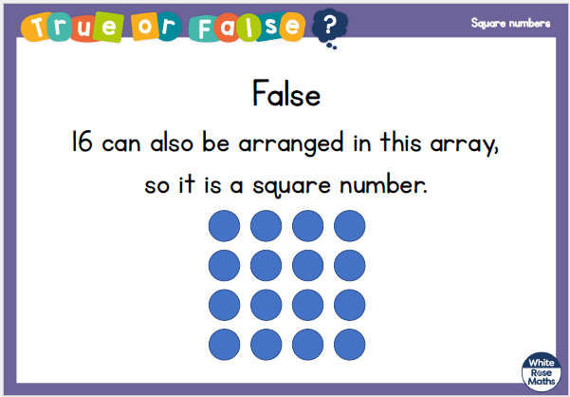

Slide 13



Reasoning 1
Josh says,
Is Josh right? Convince me.
All square numbers are odd.
© Classroom Secrets Limited 2018

Slide 14
Reasoning 1
Josh says,
Is Josh right? Convince me.
Josh is incorrect because…
All square numbers are odd.
© Classroom Secrets Limited 2018

Slide 15
Reasoning 1
Josh says,
Is Josh right? Convince me.
Josh is incorrect because there are square numbers that are even. For example, 4² = 16.
All square numbers are odd.
© Classroom Secrets Limited 2018

Slide 16
Problem Solving 1
25 is the sum of two square numbers.
Using the example above, complete the following:
34 is the sum of two squared numbers. What could they be?
45 is the sum of two squared numbers. What could they be?
25 = 4² + 3²
© Classroom Secrets Limited 2018

Slide 17
Problem Solving 1
25 is the sum of two square numbers.
Using the example above, complete the following:
34 is the sum of two squared numbers. What could they be?
5² and 3²
45 is the sum of two squared numbers. What could they be?
6² and 3²
25 = 4² + 3²
© Classroom Secrets Limited 2018

Slide 18
Problem Solving 2
Solve the following problems.
I think of a number. I square it and subtract 10. The answer is 54. What was my number?
I think of another number. I square it and add 15. The answer is 115. What was my number?
© Classroom Secrets Limited 2018

Slide 19
Problem Solving 2
Solve the following problems.
I think of a number. I square it and subtract 10. The answer is 54. What was my number?
8
I think of another number. I square it and add 15. The answer is 115. What was my number?
10
© Classroom Secrets Limited 2018

Slide 20


Dora is thinking of a square number.
It is odd.
Its digits sum to 7
It is one more than a multiple of 8
25
What number is Dora thinking of?
Have a think
41
4 + 1 = 5
41’s digits sum to 5
1
4
9
16
25
2 + 5 = 7
1 + 6 = 7
24

Slide 21
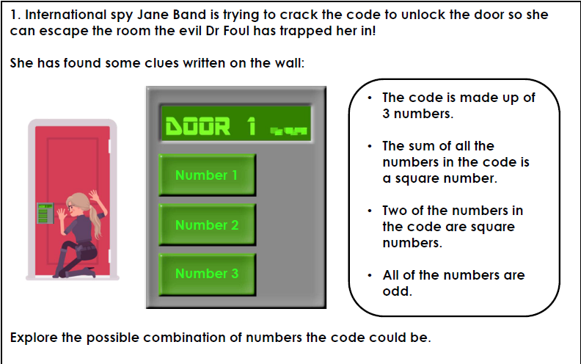

Slide 23


Slide 24
2 4. 1 1.2 0
LO:
To understand cubed numbers.
Red to respond

Slide 25
Maths Meeting https://uk.ixl.com/math/year-5/interpret-line-graphs

Slide 26
Here are 6 cubes
Have a think
Is it possible to make a cube?

Slide 27
Here are 8 cubes
Is it possible to make a cube?
2
2
2
2 × 2
= 8
× 2
8 is a cube number.

Slide 28
4
4
4
4 × 4
× 4
= 64
16
64 is a cube number.

Slide 29
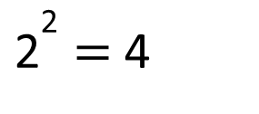
Cube numbers
Square numbers
2 × 2 × 2 = 8
2 × 2 = 4
3
${\text{2}}^{\text{2}}$ = 4
2 = 8
Have a think
4 × 4 × 4 = 64
3
4 = 64
“4 cubed is equal to 64”

Slide 30


Have a think
5 cubed is equal to 15 because 5 multiplied by 3 is equal to 15
5 × 5 × 5
= 125
25
$${\text{5}}^{\text{3}}$$
= 125

Slide 31
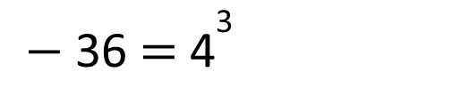


Have a think
Calculate:
$${\text{8}}^{\text{3}} \text{=}$$
512
8 × 8 × 8 =
64 × 8 =
$${\text{3}}^{\text{3}}$$
= 25 +
2
100
$−$ 36 = ${\text{4}}^{\text{3}}$

Slide 32

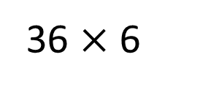


$${\text{1}}^{\text{3}}$$
3
Have a think
$${\text{3}}^{\text{3}}$$
36 $×$ 6
Match the calculation to the number.
3 × 3
27
$${\text{6}}^{\text{3}}$$
1
5 × 2
9
1 + 1 + 1
10

Slide 33
Varied Fluency 1
Match the numbers to their cube numbers.
7³ |  | 1,331
11³ |  | 64
4³ |  | 343
© Classroom Secrets Limited 2018

Slide 34
Varied Fluency 1
Match the numbers to their cube numbers.
7³ |  | 1,331
11³ |  | 64
4³ |  | 343
© Classroom Secrets Limited 2018

Slide 35
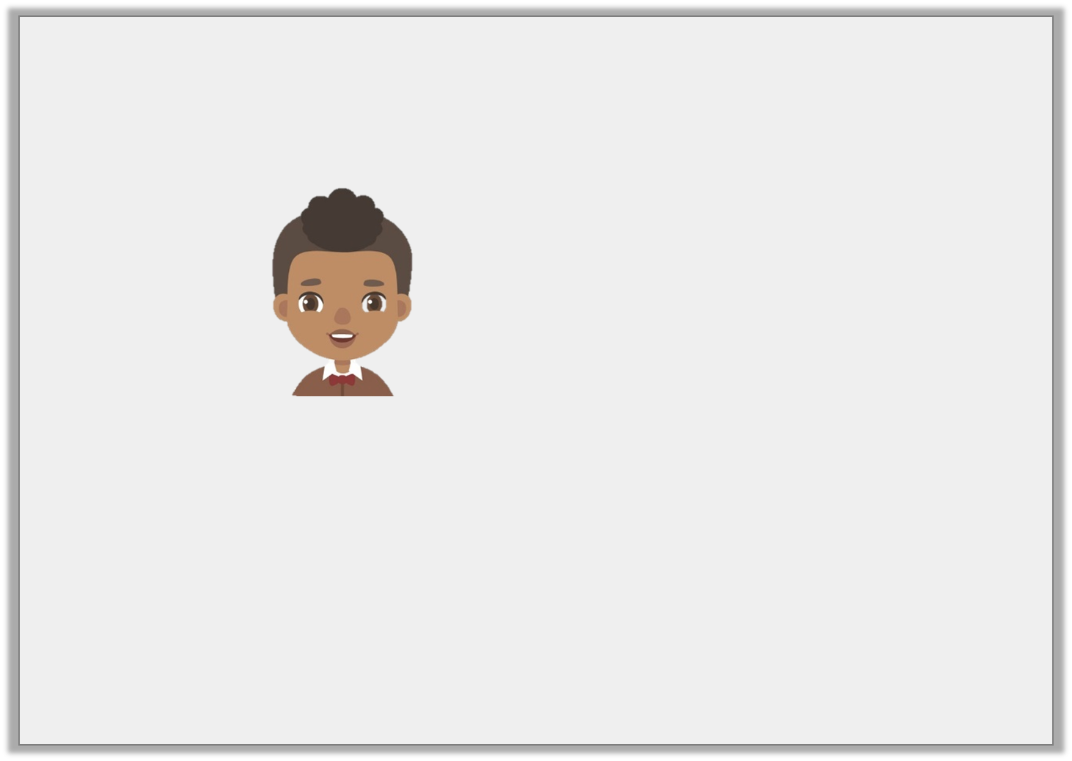
Reasoning 2
Jamal says,
Is he correct? Prove it.
The number 343 is a cube number.
© Classroom Secrets Limited 2018

Slide 36
Reasoning 2
Jamal says,
Is he correct? Prove it.
Jamal is correct because…
The number 343 is a cube number.
© Classroom Secrets Limited 2018

Slide 37
Reasoning 2
Jamal says,
Is he correct? Prove it.
Jamal is correct because when the number 7 is multiplied by itself and then by itself again, the product is 343.
The number 343 is a cube number.
© Classroom Secrets Limited 2018

Slide 38
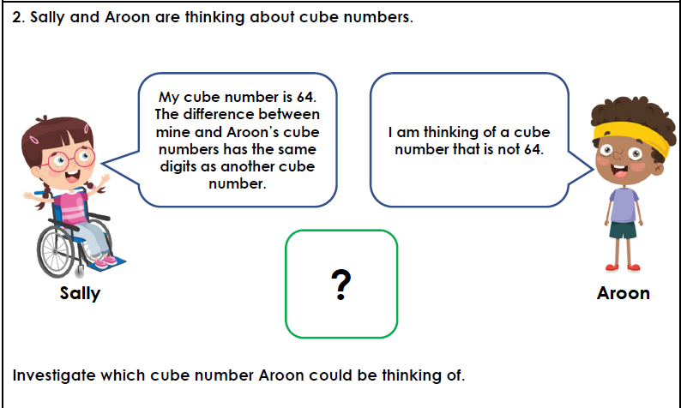

Slide 39
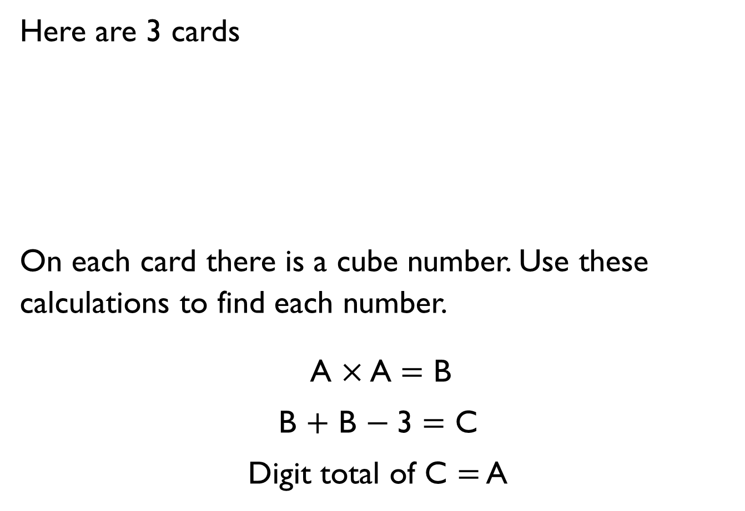
Here are 3 cards
On each card there is a cube number. Use these calculations to find each number.
A $×$ A $=$ B
B $+$ B $−$3 $=$ C
Digit total of C $=$ A
A
B
C

Slide 40
Teddy’s age is a cube number.
Next year his age will be a square number.
How old is he now?

Slide 41
2 5. 1 1.2 0
LO:
To multiply by 10 and 100.
Red to respond

Slide 42
Maths Meeting https://uk.ixl.com/math/year-5/interpret-line-graphs

Slide 43
Introduction
Complete the table below.
 | x 10 | x 100
5
12 |  | 1,200
345 | 3,450
© Classroom Secrets Limited 2018

Slide 44
Introduction
Complete the table below.
 | x 10 | x 100
5 | 50 | 500
12 | 120 | 1,200
345 | 3,450 | 34,500
© Classroom Secrets Limited 2018

Slide 45
Varied Fluency 1
Look at the number shown below.
4,704
Multiply the number by 100. Record your answer in the place value chart below.
M | HTh | TTh | Th | H | T | O
© Classroom Secrets Limited 2018

Slide 46
Varied Fluency 1
Look at the number shown below.
4,704
Multiply the number by 100. Record your answer in the place value chart below.
470,400
M | HTh | TTh | Th | H | T | O
 | ●    | ●       |  | ●   
© Classroom Secrets Limited 2018

Slide 47
Varied Fluency 2
Circle the correct answer to the following calculation.
4,912 x 1,000 =
M | HTh | TTh | Th | H | T | O
491,200 |  | 4,921,000 |  | 4,912,000
© Classroom Secrets Limited 2018

Slide 48
Varied Fluency 2
Circle the correct answer to the following calculation.
4,912 x 1,000 =
M | HTh | TTh | Th | H | T | O
4 | 9 | 1 | 2 | 0 | 0 | 0
491,200 |  | 4,921,000 |  | 4,912,000
© Classroom Secrets Limited 2018

Slide 49
Varied Fluency 3
Complete the calculations.
A.
 | = | 7,508 | x | 100
10 | x | 42,610 | =
B.
C.
 | = | 9,172 | x | 1,000
© Classroom Secrets Limited 2018

Slide 50
Varied Fluency 3
Complete the calculations.
A.
750,800 | = | 7,508 | x | 100
10 | x | 42,610 | = | 426,100
B.
C.
9,172,000 | = | 9,172 | x | 1,000
© Classroom Secrets Limited 2018

Slide 51
Reasoning 2
Esther is matching calculations where numbers have been multiplied by either 10, 100 or 1,000 but she’s jumbled up her cards. Find the matching pairs.
Which number does not belong?
Convince me.
A. 45,260
B. 4,562
C. 5,454,000
D. 4,526
E. 5,454
© Classroom Secrets Limited 2018

Slide 52
Reasoning 2
Esther is making calculations where numbers have been multiplied by either 10, 100 or 1,000 but she’s jumbled up her cards. Find the matching pairs.
Which number does not belong?
Convince me.
B is the odd one out because…
A. 45,260
B. 4,562
C. 5,454,000
D. 4,526
E. 5,454
© Classroom Secrets Limited 2018

Slide 53
Reasoning 2
Esther is making calculations where numbers have been multiplied by either 10, 100 or 1,000 but she’s jumbled up her cards. Find the matching pairs.
Which number does not belong?
Convince me.
B is the odd one out because 4,526 x 10 = 45,260 and 5,454 x 1,000 = 5,454,000
A. 45,260
B. 4,562
C. 5,454,000
D. 4,526
E. 5,454
© Classroom Secrets Limited 2018

Slide 54
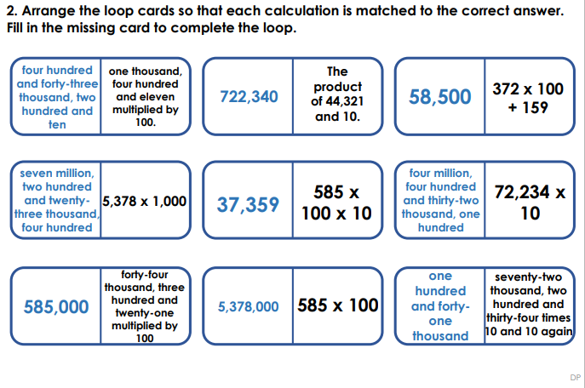

Slide 55
Jack is thinking of a 3-digit number.
When he multiplies his number by 100, the ten thousands and hundreds digit are the same.
The sum of the digits is 10
What number could Jack be thinking of?

Slide 56
2 6. 1 1.2 0
LO:
To multiply by 10, 100 and 1000.
Red to respond

Slide 57
10 × 18 × 10 =
95 × × 10 = 950
What is 10 times greater than 34?
4) 570 is 10 times greater than what number?

Slide 58
10 × 18 × 10 =
95 × × 10 = 950
What is 10 times greater than 34?
4) 570 is 10 times greater than what number?
1,800
1
340
57

Slide 59
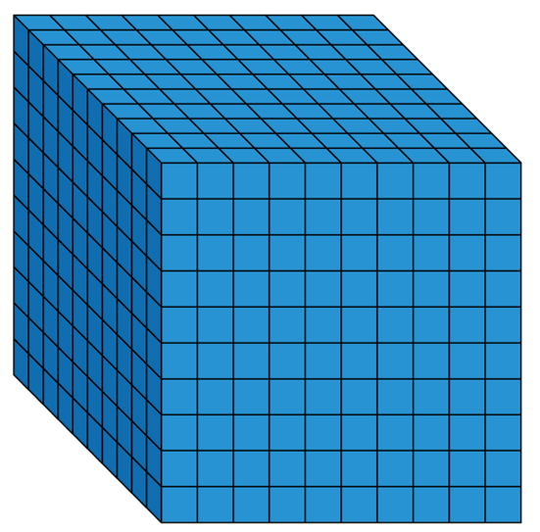
1 thousand
6 times
6 × 1 thousand =
6 thousands
6 × 1,000 =
6,000
1,000 × 6 =
6,000

Slide 60
Have a think
Th | H | T | O
7
8
Th | H | T | O
78 × 10 =
780
7
8
0
Th | H | T | O
78 × 100 =
7,800
7
8
0
0
TTh | Th | H | T | O
78 × 1,000 =
78,000
7
8
0
0
0
What stays the same? What changes?

Slide 61
Have a think
1) To multiply a number by 10 each digit moves
to the left on a place value grid.
1
2) To multiply a number by 100 each digit moves
to the left on a place value grid.
2
3) To multiply a number by 1,000 each digit moves
to the left on a place value grid.
3

Slide 62
× 1,000 = 52,000
52
What number, when it is made 1,000 times greater, is equal to 52,000?
TTh | Th | H | T | O
5
2
0
0
0
171
Have a think
1) 1,000 × = 171,000
41 × 10 × 10 × 10 =
2) 792 × 1,000 =
792,000
41 × 1,000 =
41,000
3) 10 × 41 × 10 × 10 =

Slide 63
Mo has £357,000 in his bank.
He divides the amount by 1,000 and takes that much money out of the bank.
Using the money he has taken out, he buys some furniture costing two hundred and sixty-nine pounds.
How much money does Mo have left from the money he took out?
Show your working out.

Slide 64
Here are the answers to some problems:
5,700 405 397 6,203
Can you write at least two questions for each answer involving dividing by 10, 100 or 1,000?

