Slide 1
30. 1 1.2 0
LO:
To divide by 10, 100 and 1000.
Red to respond

Slide 2
Key Skills

Slide 3
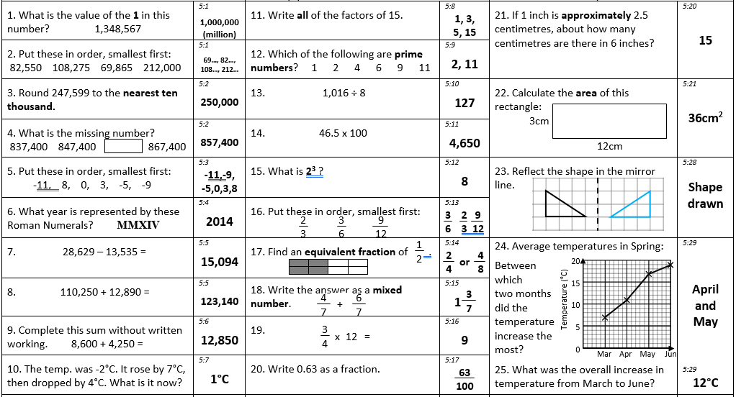

Slide 4
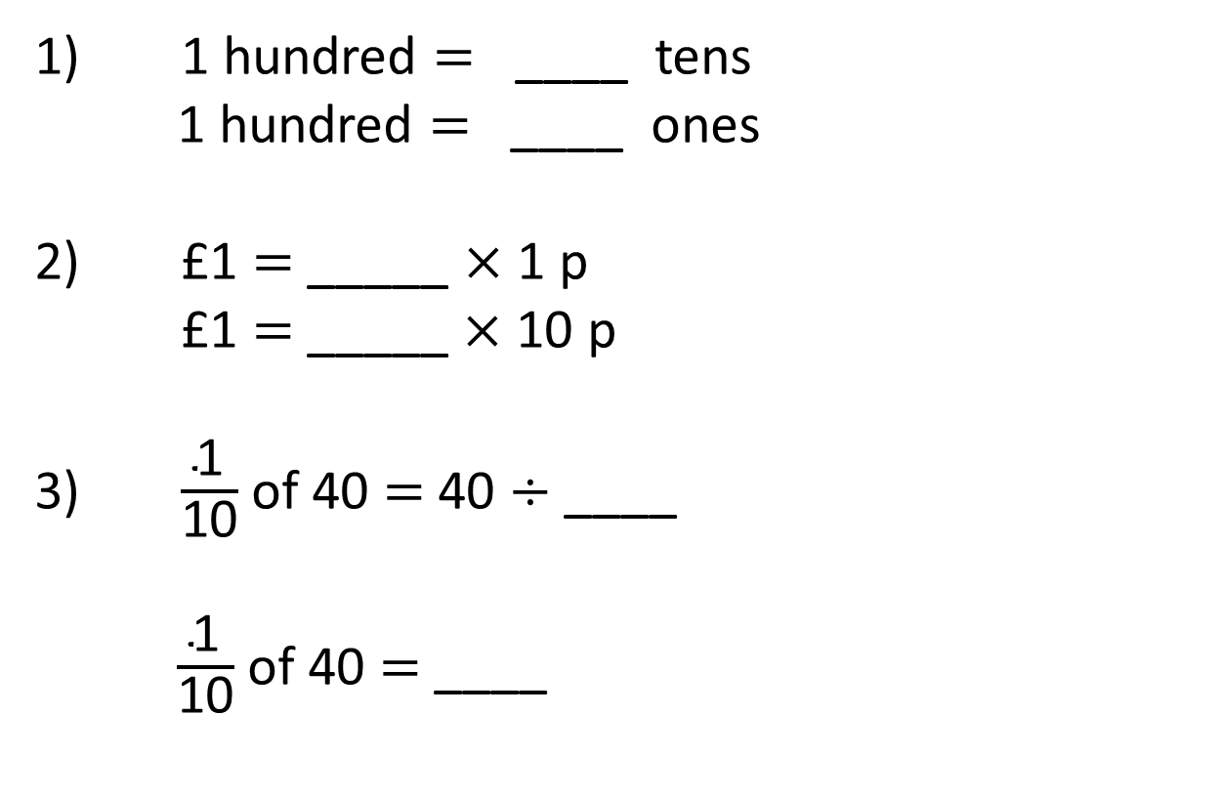
1) 1 hundred = ____ tens
1 hundred $=$ ____ ones
2) £1 = _____ $×$ 1 p
£1 $=$ _____ $×$ 10 p
3) $\frac{\text{1}}{\text{10}}$ of 40 $=$ 40 $÷$ ____
$\frac{\text{1}}{\text{10}}$ of 40 $=$ ____

Slide 5
10
1) 1 hundred = ____ tens
1 hundred $=$ ____ ones
2) £1 = _____ $×$ 1 p
£1 $=$ _____ $×$ 10 p
3) $\frac{\text{1}}{\text{10}}$ of 40 $=$ 40 $÷$ ____
$\frac{\text{1}}{\text{10}}$ of 40 $=$ ____
100
100
10
10
4

Slide 6






$×$ 10
$×$ 10
$×$ 10
Th | H | T | O
$÷$ 10
$÷$ 10
$÷$ 10

Slide 7

TTh | Th | H | T | O
4
7
0
0
0
47,000 ÷ 10 =
4,700
TTh | Th | H | T | O
4
7
0
0
47,000 ÷ 100 =
470
TTh | Th | H | T | O
4
7
0
47,000 ÷ 1,000 =
47
TTh | Th | H | T | O
Have a think
4
7
What stays the same? What changes?

Slide 8
Have a think
1) To divide a number by 10 each digit moves
to the right on a place value grid.
1
2) To divide a number by 100 each digit moves
to the right on a place value grid.
2
3) To divide a number by 1,000 each digit moves
to the right on a place value grid.
3

Slide 9
Number | Divided by 10 | Divided by 100 | Divided by 1,000
35,000
 |  |  | 27
3,500
350
35
27,000
2,700
270
27,000
_____ ÷ 1,000 = 27
27 is one thousandth of what number?
Have a think
TTh | Th | H | T | O
2
7
0
0
0

Slide 10


Introduction
What numbers are shown on the place value charts below?
T Th | Th | H | T | O
 |  | 
T Th | Th | H | T | O
 |  |  |   | 
© Classroom Secrets Limited 2018

Slide 11
Introduction
What numbers are shown on the place value charts below?
33,500
2,363
T Th | Th | H | T | O
 |  | 
T Th | Th | H | T | O
 |  |  |   | 
© Classroom Secrets Limited 2018

Slide 12
Varied Fluency 1
Match each statement below to the correct answer.
T Th | Th | H | T | O
 |  |   |  
34,000 ÷ 10 =
34,000 ÷ 100 =
3,400
T Th | Th | H | T | O
 |  |  |   |  
34,000 ÷ 1,000 =
© Classroom Secrets Limited 2018

Slide 13
Varied Fluency 1
Match each statement below to the correct answer.
T Th | Th | H | T | O
 |  |   |  
34,000 ÷ 10 =
34,000 ÷ 100 =
3,400
T Th | Th | H | T | O
 |  |  |   |  
34,000 ÷ 1,000 =
© Classroom Secrets Limited 2018

Slide 14
Varied Fluency 2
Calculate:
93,400 ÷ 100 =
93,400 ÷ 10 =
T Th | Th | H | T | O
© Classroom Secrets Limited 2018

Slide 15
Varied Fluency 2
Calculate:
93,400 ÷ 100 = 934
93,400 ÷ 10 = 9,340
T Th | Th | H | T | O
   |  |  
© Classroom Secrets Limited 2018

Slide 16
Varied Fluency 3
Use two of the numbers below to make this statement correct.
 | ÷ | 100 | < |  | ÷ | 10
a.
32,600
b.
4,050
c.
T Th | Th | H | T | O
 |  | 
© Classroom Secrets Limited 2018

Slide 17
Varied Fluency 3
Use two of the numbers below to make this statement correct.
Various answers, for example: (c) 62,400 ÷ 100 < 32,600 ÷ 10;
32,600 ÷ 100 < (c) 62,400 ÷ 10
32,600 | ÷ | 100 | < | 4,050 | ÷ | 10
a.
32,600
b.
4,050
c.
T Th | Th | H | T | O
 |  | 
© Classroom Secrets Limited 2018

Slide 18
Varied Fluency 4
True or false? The following calculations both give an answer of 375.
37,500 ÷ 10 ÷ 10
37,500 ÷ 100
T Th | Th | H | T | O
 |  | 
© Classroom Secrets Limited 2018

Slide 19
Varied Fluency 4
True or false? The following calculations both give an answer of 375.
True
37,500 ÷ 10 ÷ 10
37,500 ÷ 100
T Th | Th | H | T | O
 |  |  |  | 
© Classroom Secrets Limited 2018

Slide 20
Reasoning 1
A number divided by 100 equals this:
Alfred says the calculation must have been 66,300 ÷ 100.
Is he correct?
Convince me.
100
10
1
100
10
100
10
10
100
1
100
10
1
100
© Classroom Secrets Limited 2018

Slide 21
Reasoning 1
A number divided by 100 equals this:
Alfred says the calculation must have been 66,300 ÷ 100.
Is he correct?
Convince me.
Alfred is incorrect because…
100
10
1
100
10
100
10
10
100
1
100
10
1
100
© Classroom Secrets Limited 2018

Slide 22
Reasoning 1
A number divided by 100 equals this:
Alfred says the calculation must have been 66,300 ÷ 100.
Is he correct?
Convince me.
Alfred is incorrect because the place value counters show the number 653 so the calculation must have been 65,300 ÷ 100.
100
10
1
100
10
100
10
10
100
1
100
10
1
100
© Classroom Secrets Limited 2018

Slide 23
Reasoning 2
Sandra is completing the calculation below.
She has shown her answer on the place value chart below.
Explain the mistake that Sandra has made.
78,060 ÷ 10 =
T Th | Th | H | T | O
 | 7 | 8 | 6
© Classroom Secrets Limited 2018

Slide 24
Reasoning 2
Sandra is completing the calculation below.
She has shown her answer on the place value chart below.
Explain the mistake that Sandra has made.
The mistake Sandra has made is in the tens column because…
78,060 ÷ 10 =
T Th | Th | H | T | O
 | 7 | 8 | 6
© Classroom Secrets Limited 2018

Slide 25
Reasoning 2
Sandra is completing the calculation below.
She has shown her answer on the place value chart below.
Explain the mistake that Sandra has made.
The mistake Sandra has made is in the tens column because she hasn’t moved that number into the ones column. The correct answer should be 7,806 not 7,860.
78,060 ÷ 10 =
T Th | Th | H | T | O
 | 7 | 8 | 6
© Classroom Secrets Limited 2018

Slide 26
5,700 ÷ 10
÷ 10 =
57
570
5,700
÷ 10 ÷ 10
=
57
÷ 100
Have a think
671,000 ÷ 100 ÷ 10 =
671
÷ 1,000

Slide 27
The population of Bradford is 530,000
The population of a village close to Bradford is
one hundredth the size of Bradford’s.
What is the population of the village?
530,000
5,300
÷ 100 =
Have a think
A supermarket sells £750,000 of goods in a week.
The manager of the supermarket earns one thousandth of what the shop sells.
How much does the manager earn per week?
750,000
÷ 1,000 =
£750

Slide 28
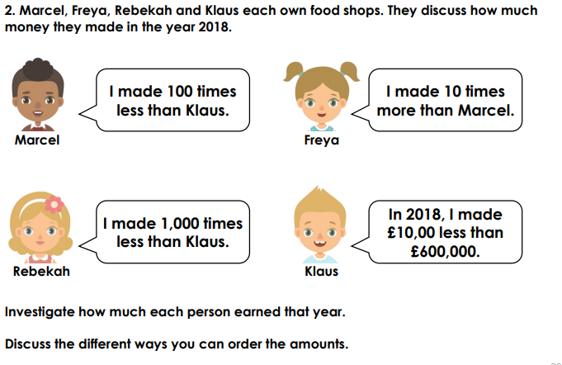

Slide 29
1. 1 2.2 0
LO:
To calculate with multiples of 10, 100 and 1000.
Red to respond

Slide 30
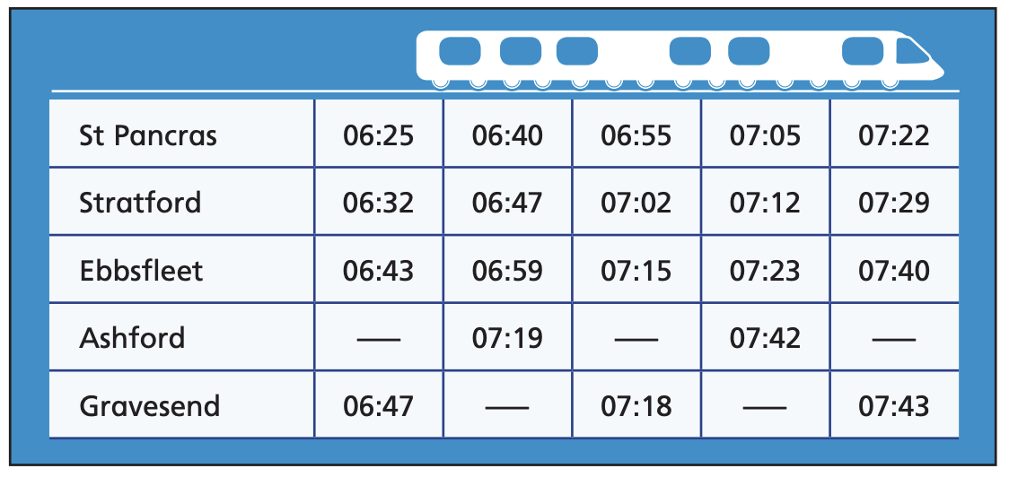
Year 5 | Week 8 | Day 5

Slide 31
Year 5 | Week 9 | Day 1

Slide 32
Year 5 | Week 9 | Day 2

Slide 33
13 × 300 =
3,900
Have a think
How can we multiply by 300?
100 × 3 =
300
13 × 300 =
13 × 100 × 3 =
1,300
× 3 =
3,900

Slide 34
1) 3,000 × 4 =
12,000
Have a think
2) 700 × 51 =
35,700
51 × 100 =
5,100
5,100
5,100 × 7 =
35,700
3) 12 × 600 =
7,200
5,000
100
12 × 100 =
1,200
35,000
700
7,200
1,200 × 6 =

Slide 35
4,200 ÷ 70 =
60
Have a think
What factors of 70 will be able to help us?
Factors pairs of 70: 1 and 70
2 and 35
5 and 14
7 and 10
10
7
4,200 ÷ ___ ÷ ___ =
420
420 ÷ 7 =
60
42 ÷ 7 = 6

Slide 36
7
56,000 ÷ 8,000 =
1,000
56,000 ÷ _____ ÷ _____ =
8
56 ÷ 8 =
7
32
1) 6,400 ÷ 200 =
Have a think
6,400 ÷ 100 ÷ 2 =
64 ÷ 2 =
32
2) 15,000 ÷ 5,000 =
3
15,000 ÷ 1,000 ÷ 5 =
3
15 ÷ 5 =

Slide 37
Introduction
Complete the calculations below using the knowledge of 7 x 5 = 35.
70 x 5 =
70 x 50 =
700 x 5 =
700 x 50 =
© Classroom Secrets Limited 2018

Slide 38
Introduction
Complete the calculations below using the knowledge of 7 x 5 = 35.
70 x 5 = | 350
70 x 50 = | 3,500
700 x 5 = | 3,500
700 x 50 = | 35,000
© Classroom Secrets Limited 2018

Slide 39
Varied Fluency 1
Use this multiplication fact to complete the calculations and find the odd one out.
15 x 4 = 60
A. | 1,500 | x | 40 | =
B. | 150 | x | 40 | =
C. | 150 | x | 400 | =
© Classroom Secrets Limited 2018

Slide 40
Varied Fluency 1
Use this multiplication fact to complete the calculations and find the odd one out.
B is the odd one out.
15 x 4 = 60
A. | 1,500 | x | 40 | = | 60,000
B. | 150 | x | 40 | = | 6,000
C. | 150 | x | 400 | = | 60,000
© Classroom Secrets Limited 2018

Slide 41
Varied Fluency 2
Complete this statement to make it true.
If 90 x 11 = ______ then 900 x 11 = ______
© Classroom Secrets Limited 2018

Slide 42
Varied Fluency 2
Complete this statement to make it true.
If 90 x 11 = 990 then 900 x 11 = 9,900
© Classroom Secrets Limited 2018

Slide 43
Varied Fluency 3
Use this division fact to check the answers to the calculations below. Tick the correct calculations.
4,000 ÷ 80 = 50
A. | 50 | x | 80 | = | 400
B. | 4,000 | ÷ | 8 | = | 500
C. | 400 | ÷ | 8 | = | 50
© Classroom Secrets Limited 2018

Slide 44
Varied Fluency 3
Use this division fact to check the answers to the calculations below. Tick the correct calculations.
4,000 ÷ 80 = 50
A. | 50 | x | 80 | = | 400
B. | 4,000 | ÷ | 8 | = | 500
C. | 400 | ÷ | 8 | = | 50
✓
✓
© Classroom Secrets Limited 2018

Slide 45
Varied Fluency 4
Match the calculations to the correct answer.
A
3 x 140
4,200
B
30 x 140
420
C
3 x 14
42
© Classroom Secrets Limited 2018

Slide 46
Varied Fluency 4
Match the calculations to the correct answer.
A
3 x 140
4,200
B
30 x 140
420
C
3,000 x 14
42,000
© Classroom Secrets Limited 2018

Slide 47

Reasoning 1
Lila is using 34 x 5 = 170 to solve other calculations.
Is she correct? Explain how you know.
I think that 340 x 5 will give the same as 500 x 34. They both equal 1,700.
Lila
© Classroom Secrets Limited 2018

Slide 48
Reasoning 1
Lila is using 34 x 5 = 170 to solve other calculations.
Is she correct? Explain how you know.
Lila is incorrect because…
I think that 340 x 5 will give the same as 500 x 34. They both equal 1,700.
Lila
© Classroom Secrets Limited 2018

Slide 49
Reasoning 1
Lila is using 34 x 5 = 170 to solve other calculations.
Is she correct? Explain how you know.
Lila is incorrect because 340 x 5 = 1,700 but 500 x 34 = 17,000.
I think that 340 x 5 will give the same as 500 x 34. They both equal 1,700.
Lila
© Classroom Secrets Limited 2018

Slide 50
Problem Solving 1
The target number is below.
Use all the digit cards and symbols to create related number sentences that equal the target number.
720
x
÷
72,000
72
36
3,600
5
20
100
10
© Classroom Secrets Limited 2018

Slide 51
Problem Solving 1
The target number is below.
Use all the digit cards and symbols to create related number sentences that equal the target number.
36 x 20 = 720
72 x 10 = 720
3,600 ÷ 5 = 720
72,000 ÷ 100 = 720
720
x
÷
72,000
72
36
3,600
5
20
100
10
© Classroom Secrets Limited 2018

Slide 52
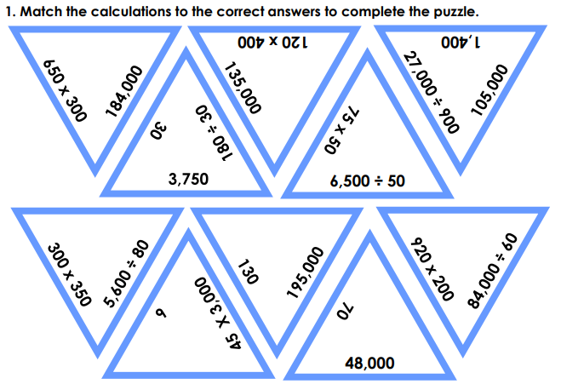

Slide 53
2. 1 2.2 0
LO:
To measure perimeter.
Red to respond

Slide 54
Year 5 | Week 9 | Day 3
$$×$$

Slide 55
Year 5 | Week 9 | Day 4

Slide 56
Year 5 | Week 9 | Day 5

Slide 57
1) 1 cm = _____ mm
2) 75 mm = _____ cm
3) How many sides does a quadrilateral have?
4) How many pairs of equal sides does a rectangle have?

Slide 58
10
1) 1 cm = _____ mm
2) 75 mm = _____ cm
3) How many sides does a quadrilateral have?
4) How many pairs of equal sides does a rectangle have?
7.5
4
2 pairs

Slide 59

32 mm
or 3.2 cm
3 cm
2 mm
30 mm
1 cm = 10 mm

Slide 60
Have a think
Is this line 6 cm long?
How long is the line? Give your answer in millimetres.
45 mm

Slide 61
Have a think
6 cm or 60 mm
Is the line equal to, greater than or less than 30 mm?
Greater than

Slide 62
Introduction
Match the shape to its perimeter.
12cm |  | 10cm |  | 14cm
© Classroom Secrets Limited 2018

Slide 63
Introduction
Match the shape to its perimeter.
12cm |  | 10cm |  | 14cm
© Classroom Secrets Limited 2018

Slide 64
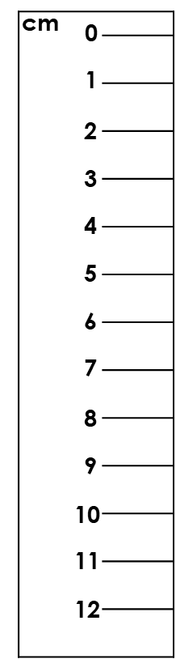
Varied Fluency 1
Find the perimeter of this shape.
© Classroom Secrets Limited 2018

Slide 65
Varied Fluency 1
Find the perimeter of this shape.
Measure each side with a ruler.
© Classroom Secrets Limited 2018

Slide 66
Varied Fluency 1
Find the perimeter of this shape.
The side measured was 8cm.
Now measure any other sides needed
using the same method.
8cm
© Classroom Secrets Limited 2018

Slide 67
Varied Fluency 1
Find the perimeter of this shape.
8cm + 4cm + 8cm + 4cm = 24cm
8cm
4cm
4cm
8cm
© Classroom Secrets Limited 2018

Slide 68
Varied Fluency 2
Match the shape to its perimeter.
B
A
20cm
22cm
18cm
© Classroom Secrets Limited 2018

Slide 69
Varied Fluency 2
Measure each side with a ruler.
A
© Classroom Secrets Limited 2018

Slide 70
Varied Fluency 2
Measure each side with a ruler.
B
© Classroom Secrets Limited 2018

Slide 71
Varied Fluency 2
Match the shape to its perimeter.
The sides measured were 5cm on shape A
and 4cm on shape B.
Now measure any other sides needed
using the same method.
4cm
B
A
5cm
20cm
22cm
18cm
© Classroom Secrets Limited 2018

Slide 72
Varied Fluency 2
Match the shape to its perimeter.
Shape A: 5cm + 2cm + 1cm + 2cm +
3cm + 2cm + 1 cm = 2cm = 18cm
Shape B: 4cm + 4cm + 4cm + 4 cm + 4cm = 20cm
B
A
20cm
22cm
18cm
© Classroom Secrets Limited 2018

Slide 73

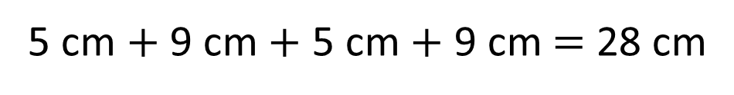
Perimeter $=$ the length around a closed 2D shape
5 cm
9 cm
9 cm
5 cm
5 cm $+$ 9 cm $+$ 5 cm $+$ 9 cm $=$ 28 cm
9 cm + 5 cm =
14 cm
14 cm × 2 =
28 cm

Slide 74
Perimeter $=$ the length around a closed 2D shape
Have a think
Do we need to measure all the sides to find the perimeter?

Slide 75
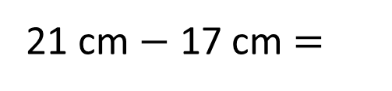
Perimeter $=$ the length around a closed 2D shape
4.5 cm
5 cm
Complete the shape so its perimeter is 21 cm
3 cm
3.9 cm
0.6 cm
Have a think
What would you do first to complete the task?
5 cm + 4.5 cm + 3.9 cm + 3 cm + 0.6 cm =
5 cm + 4.5 cm + 3.9 cm + 0.6 cm + 3 cm =
17 cm
21 cm $−$ 17 cm =
4 cm
4.5 cm

Slide 76
Varied Fluency 3
Which shape has the longest perimeter?
A
B
© Classroom Secrets Limited 2018

Slide 77
Varied Fluency 3
Which shape has the longest perimeter?
Measure each side with a ruler.
A
© Classroom Secrets Limited 2018

Slide 78
Varied Fluency 3
Which shape has the longest perimeter?
B
© Classroom Secrets Limited 2018

Slide 79
Varied Fluency 3
Which shape has the longest perimeter?
The sides measured were 7cm on shape A
and 1cm on shape B.
Now measure any other sides needed
using the same method.
1cm
A
B
7cm
© Classroom Secrets Limited 2018

Slide 80
Varied Fluency 3
Which shape has the longest perimeter?
Shape B
Shape A: 7cm + 6cm + 4cm + 4cm +
3cm + 2cm = 26cm
Shape B: 7cm + 2cm + 2cm + 3cm + 2cm +
1cm + 5cm + 4cm + 2cm + 2cm = 30cm
A
B
26cm
30cm
© Classroom Secrets Limited 2018

Slide 81
Varied Fluency 4
True or false?
The perimeter of this shape is 26cm.
© Classroom Secrets Limited 2018

Slide 82
Varied Fluency 4
True or false?
The perimeter of this shape is 26cm.
© Classroom Secrets Limited 2018

Slide 83
Varied Fluency 4
True or false?
The perimeter of this shape is 26cm.
The side measured was 4cm. Now measure any
other sides needed using the same method.
4cm
© Classroom Secrets Limited 2018

Slide 84
Varied Fluency 4
True or false?
The perimeter of this shape is 26cm.
False. The perimeter of this shape is 24cm.
4cm + 4cm + 4cm + 4cm + 4cm + 4cm = 24cm
4cm
4cm
4cm
4cm
4cm
4cm
© Classroom Secrets Limited 2018

Slide 85
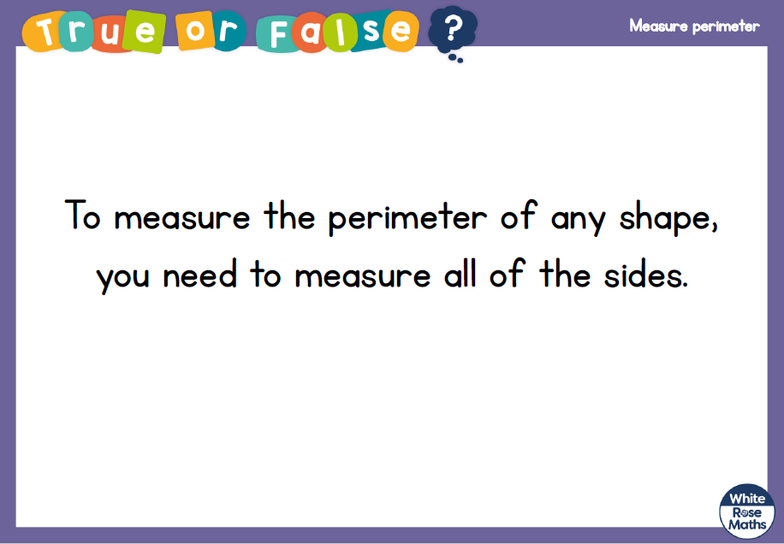

Slide 86
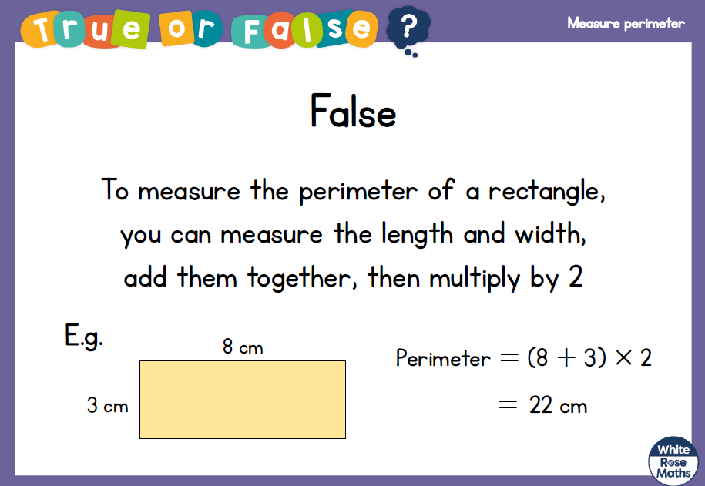

Slide 87
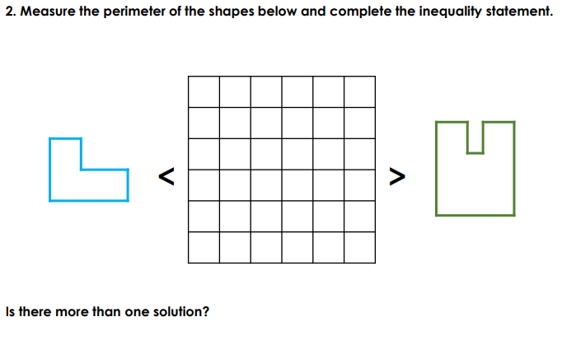

Slide 88

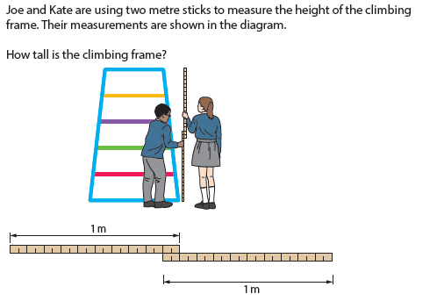

Slide 89
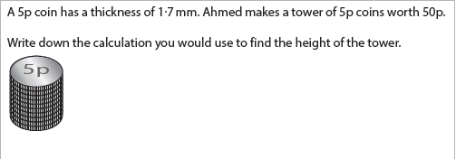

Slide 90
3. 1 2.2 0
LO:
To work out perimeter, including rectangles.
Red to respond

Slide 91

Perimeter $=$ the length around a closed 2D shape
1 cm
1 cm
5 cm
4 cm
4 cm
5 cm
5 cm
+ 4 cm
+ 5 cm
+ 4 cm
= 18 cm

Slide 92
Have a think
Note down the features of a rectangle.
2 cm
2 cm
2D shape
4 sides
All sides are straight
6 cm
6 cm
2 pairs of equal sides
Perimeter =
16 cm
8 cm ?
6 cm
+ 2 cm
+ 6 cm
+ 2 cm
= 16 cm

Slide 93
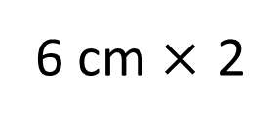
2 cm
6 cm
6 cm
+ 2 cm
+ 6 cm
+ 2 cm
= 16 cm
6 cm $×$ 2
+
2 cm × 2
= 16 cm
= 16 cm
8 cm
× 2

Slide 94
2)
1)
Have a think
6 cm
14 cm
9 cm
22 cm
2 cm
40 cm
7 cm
3)
4)
18 cm
Square
3 cm
6 cm
28 cm

Slide 95
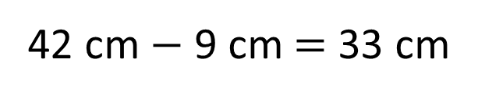
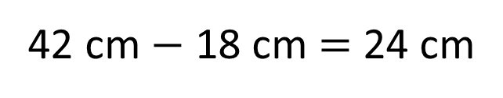
Perimeter of the rectangle = 42 cm
9 cm
12 cm
33 cm
33
12
24
cm
9 cm
9 cm
42 cm $−$ 9 cm = 33 cm
42 cm $−$ 18 cm = 24 cm
24 cm ÷ 2 = 12 cm
33 + 9 + 33 + 9 = 84 cm

Slide 97

1 cm
6 cm
3 cm
3 cm
6 cm
Perimeter $=$ the length around a closed 2D shape
6 + 3 + 6 + 3 = 18 cm
6 + 3 =
9
6 × 2 + 3 × 2 = 18 cm
9 × 2 =
18 cm

Slide 98
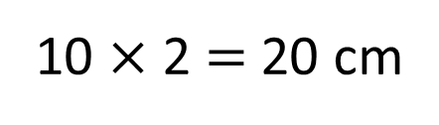
What is the perimeter of this rectilinear shape?
1 cm
2 cm
2 cm
4 cm
4 cm
2 cm
6 cm
Do I need to count all the squares?
Have a think
2 + 2 + 4 + 2 + 6 + 4 = 20 cm
20 cm
6 + 4 = 10
10 $×$ 2 = 20 cm

Slide 99
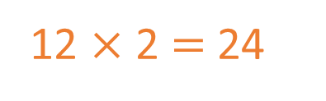
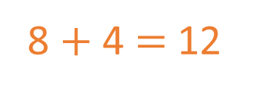
1 cm
2
2 cm
1
3
A
8 $+$ 4 $=$ 12
3
1
22 cm
12 $×$ 2 $=$ 24
1
3
1
1
2
1
1
8
1
1
B
4
24 cm
Have a think
Which shape has the greater perimeter?
Shape B

Slide 100
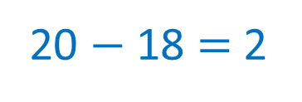
Have a think
Draw a rectangle with a perimeter of 20 cm
Two pairs of equal sides
1
1
× 2 + × 2 = 20
10
0
9
18
20 $−$ 18 $=$ 2
10
9
10
9
Have a think
8 and 2
7 and 3
6 and 4
5 and 5
1

Slide 101

1 cm
4 cm
1 cm
5 cm
3 cm
Have a think
9 cm
Is this closed shape’s perimeter greater than 22 cm?
9 + 3 + 1 + 4 + 5 =
Yes
9 + 1 + 3 + 4 + 5 =
22 cm

