Slide 1
7. 1 2.2 0
LO:
To measure perimeter.
Red to respond

Slide 2
Key Skills

Slide 3
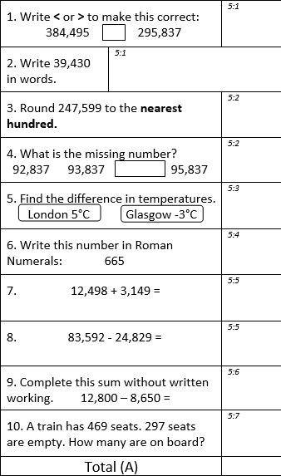

Slide 4
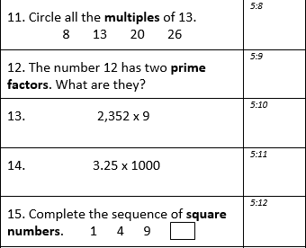
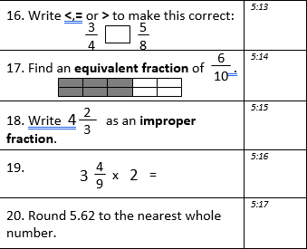

Slide 5
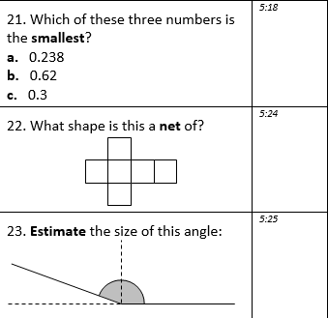
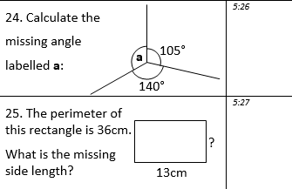

Slide 6
1) 1 cm = _____ mm
2) 75 mm = _____ cm
3) How many sides does a quadrilateral have?
4) How many pairs of equal sides does a rectangle have?

Slide 7
10
1) 1 cm = _____ mm
2) 75 mm = _____ cm
3) How many sides does a quadrilateral have?
4) How many pairs of equal sides does a rectangle have?
7.5
4
2 pairs

Slide 8

32 mm
or 3.2 cm
3 cm
2 mm
30 mm
1 cm = 10 mm

Slide 9

Have a think
Is this line 6 cm long?
How long is the line? Give your answer in millimetres.
45 mm

Slide 10
Have a think
6 cm or 60 mm
Is the line equal to, greater than or less than 30 mm?
Greater than

Slide 11


Introduction
Match the shape to its perimeter.
12cm |  | 10cm |  | 14cm
© Classroom Secrets Limited 2018

Slide 12
Introduction
Match the shape to its perimeter.
12cm |  | 10cm |  | 14cm
© Classroom Secrets Limited 2018

Slide 13
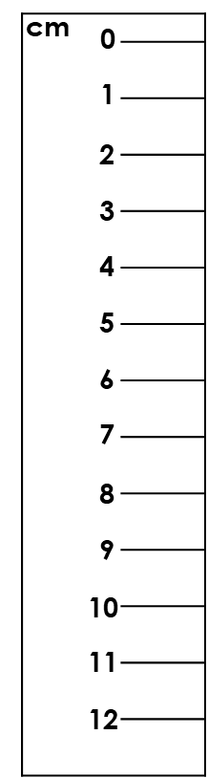
Varied Fluency 1
Find the perimeter of this shape.
© Classroom Secrets Limited 2018

Slide 14
Varied Fluency 1
Find the perimeter of this shape.
Measure each side with a ruler.
© Classroom Secrets Limited 2018

Slide 15
Varied Fluency 1
Find the perimeter of this shape.
The side measured was 8cm.
Now measure any other sides needed
using the same method.
8cm
© Classroom Secrets Limited 2018

Slide 16
Varied Fluency 1
Find the perimeter of this shape.
8cm + 4cm + 8cm + 4cm = 24cm
8cm
4cm
4cm
8cm
© Classroom Secrets Limited 2018

Slide 17
Varied Fluency 2
Match the shape to its perimeter.
B
A
20cm
22cm
18cm
© Classroom Secrets Limited 2018

Slide 18
Varied Fluency 2
Measure each side with a ruler.
A
© Classroom Secrets Limited 2018

Slide 19
Varied Fluency 2
Measure each side with a ruler.
B
© Classroom Secrets Limited 2018

Slide 20
Varied Fluency 2
Match the shape to its perimeter.
The sides measured were 5cm on shape A
and 4cm on shape B.
Now measure any other sides needed
using the same method.
4cm
B
A
5cm
20cm
22cm
18cm
© Classroom Secrets Limited 2018

Slide 21
Varied Fluency 2
Match the shape to its perimeter.
Shape A: 5cm + 2cm + 1cm + 2cm +
3cm + 2cm + 1 cm = 2cm = 18cm
Shape B: 4cm + 4cm + 4cm + 4 cm + 4cm = 20cm
B
A
20cm
22cm
18cm
© Classroom Secrets Limited 2018

Slide 22
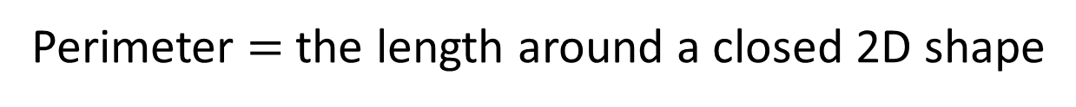
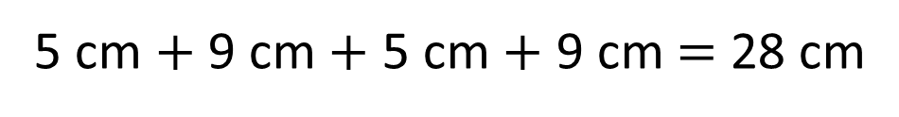
Perimeter $=$ the length around a closed 2D shape
5 cm
9 cm
9 cm
5 cm
5 cm $+$ 9 cm $+$ 5 cm $+$ 9 cm $=$ 28 cm
9 cm + 5 cm =
14 cm
14 cm × 2 =
28 cm

Slide 23
Perimeter $=$ the length around a closed 2D shape
Have a think
Do we need to measure all the sides to find the perimeter?

Slide 24
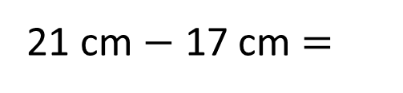
Perimeter $=$ the length around a closed 2D shape
4.5 cm
5 cm
Complete the shape so its perimeter is 21 cm
3 cm
3.9 cm
0.6 cm
Have a think
What would you do first to complete the task?
5 cm + 4.5 cm + 3.9 cm + 3 cm + 0.6 cm =
5 cm + 4.5 cm + 3.9 cm + 0.6 cm + 3 cm =
17 cm
21 cm $−$ 17 cm =
4 cm
4.5 cm

Slide 25
Varied Fluency 3
Which shape has the longest perimeter?
A
B
© Classroom Secrets Limited 2018

Slide 26
Varied Fluency 3
Which shape has the longest perimeter?
Measure each side with a ruler.
A
© Classroom Secrets Limited 2018

Slide 27
Varied Fluency 3
Which shape has the longest perimeter?
B
© Classroom Secrets Limited 2018

Slide 28
Varied Fluency 3
Which shape has the longest perimeter?
The sides measured were 7cm on shape A
and 1cm on shape B.
Now measure any other sides needed
using the same method.
1cm
A
B
7cm
© Classroom Secrets Limited 2018

Slide 29
Varied Fluency 3
Which shape has the longest perimeter?
Shape B
Shape A: 7cm + 6cm + 4cm + 4cm +
3cm + 2cm = 26cm
Shape B: 7cm + 2cm + 2cm + 3cm + 2cm +
1cm + 5cm + 4cm + 2cm + 2cm = 30cm
A
B
26cm
30cm
© Classroom Secrets Limited 2018

Slide 30
Varied Fluency 4
True or false?
The perimeter of this shape is 26cm.
© Classroom Secrets Limited 2018

Slide 31
Varied Fluency 4
True or false?
The perimeter of this shape is 26cm.
© Classroom Secrets Limited 2018

Slide 32
Varied Fluency 4
True or false?
The perimeter of this shape is 26cm.
The side measured was 4cm. Now measure any
other sides needed using the same method.
4cm
© Classroom Secrets Limited 2018

Slide 33
Varied Fluency 4
True or false?
The perimeter of this shape is 26cm.
False. The perimeter of this shape is 24cm.
4cm + 4cm + 4cm + 4cm + 4cm + 4cm = 24cm
4cm
4cm
4cm
4cm
4cm
4cm
© Classroom Secrets Limited 2018

Slide 34
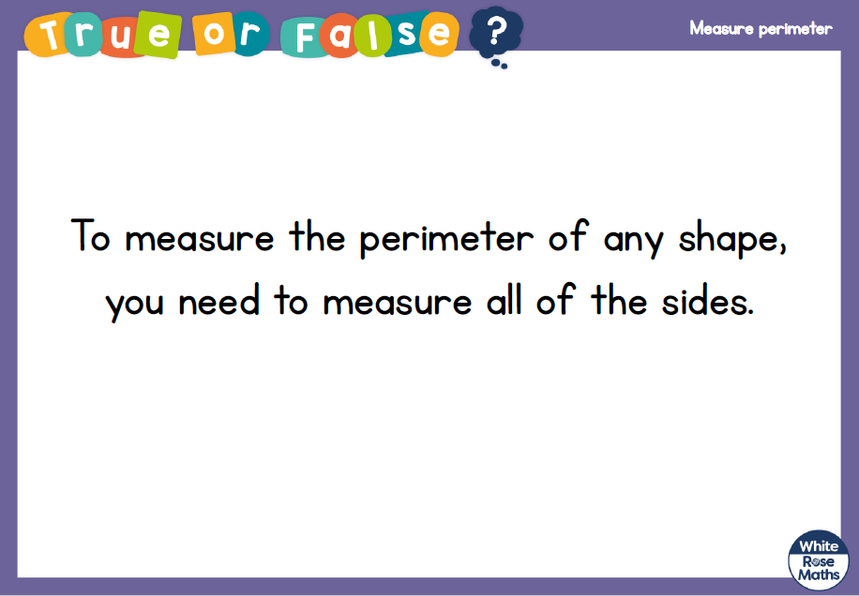

Slide 35
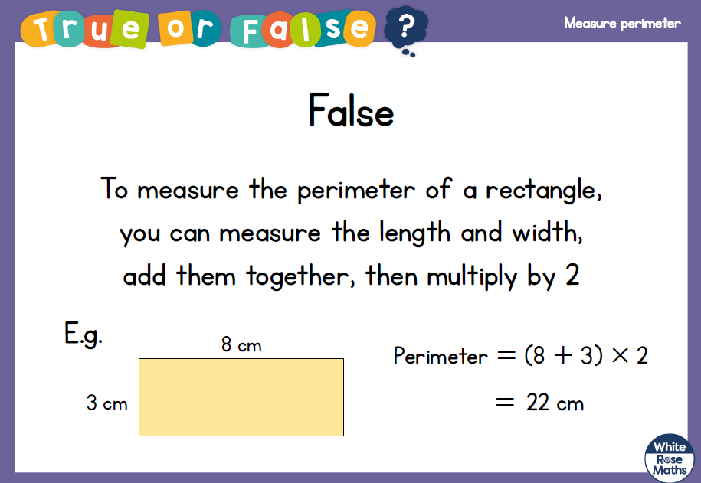

Slide 36
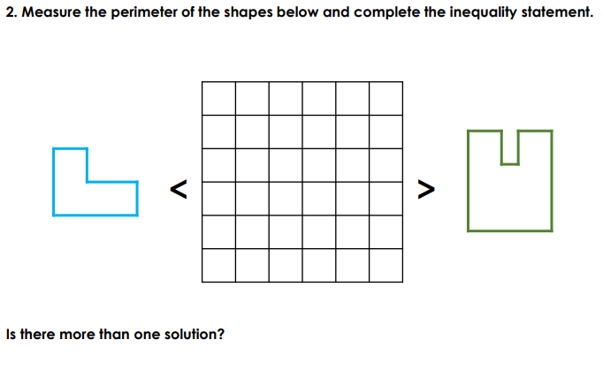

Slide 37

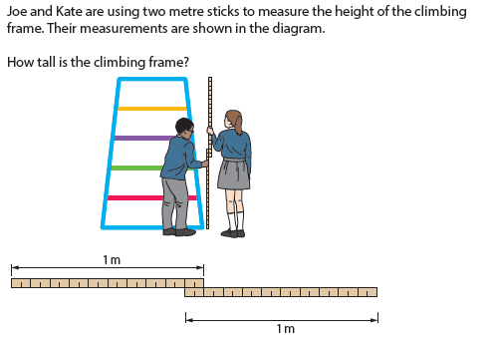

Slide 38
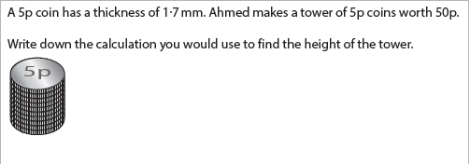

Slide 39
8. 1 2.2 0
LO:
To work out perimeter, including rectangles.
Red to respond

Slide 40
Year 5 | Week 9 | Day 3
$$×$$

Slide 41
Year 5 | Week 9 | Day 4

Slide 42
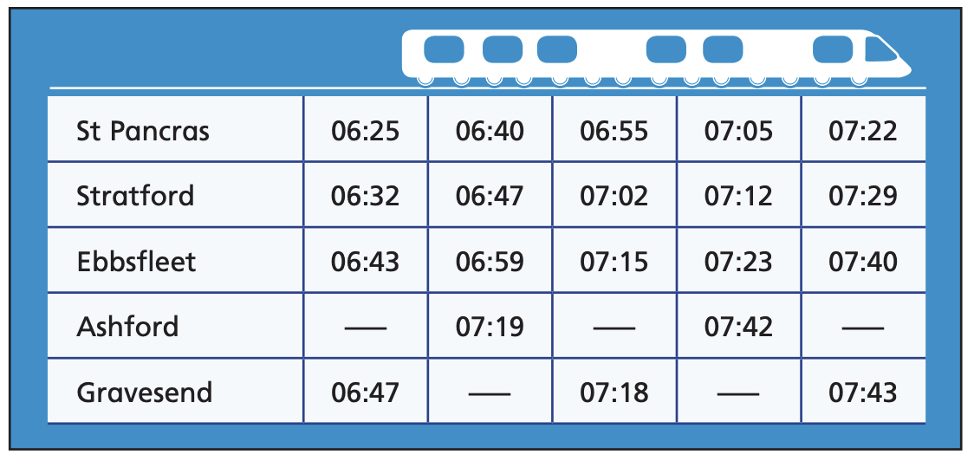
Year 5 | Week 9 | Day 5

Slide 43

Perimeter $=$ the length around a closed 2D shape
1 cm
1 cm
5 cm
4 cm
4 cm
5 cm
5 cm
+ 4 cm
+ 5 cm
+ 4 cm
= 18 cm

Slide 44
Have a think
Note down the features of a rectangle.
2 cm
2 cm
2D shape
4 sides
All sides are straight
6 cm
6 cm
2 pairs of equal sides
Perimeter =
16 cm
8 cm ?
6 cm
+ 2 cm
+ 6 cm
+ 2 cm
= 16 cm

Slide 45
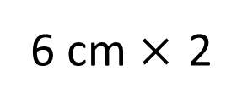
2 cm
6 cm
6 cm
+ 2 cm
+ 6 cm
+ 2 cm
= 16 cm
6 cm $×$ 2
+
2 cm × 2
= 16 cm
= 16 cm
8 cm
× 2

Slide 46
2)
1)
Have a think
6 cm
14 cm
9 cm
22 cm
2 cm
40 cm
7 cm
3)
4)
18 cm
Square
3 cm
6 cm
28 cm

Slide 47
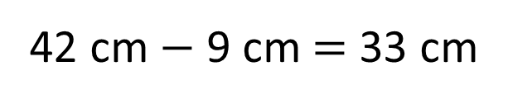
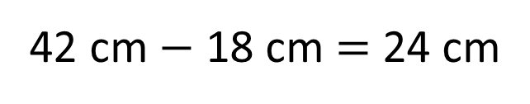
Perimeter of the rectangle = 42 cm
9 cm
12 cm
33 cm
33
12
24
cm
9 cm
9 cm
42 cm $−$ 9 cm = 33 cm
42 cm $−$ 18 cm = 24 cm
24 cm ÷ 2 = 12 cm
33 + 9 + 33 + 9 = 84 cm

Slide 49
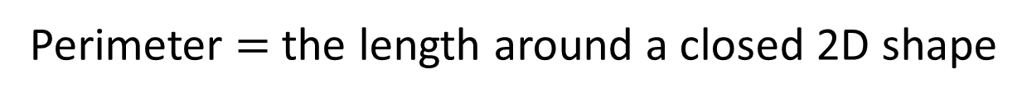
1 cm
6 cm
3 cm
3 cm
6 cm
Perimeter $=$ the length around a closed 2D shape
6 + 3 + 6 + 3 = 18 cm
6 + 3 =
9
6 × 2 + 3 × 2 = 18 cm
9 × 2 =
18 cm

Slide 50
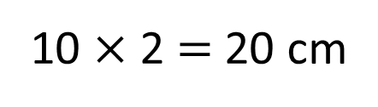
What is the perimeter of this rectilinear shape?
1 cm
2 cm
2 cm
4 cm
4 cm
2 cm
6 cm
Do I need to count all the squares?
Have a think
2 + 2 + 4 + 2 + 6 + 4 = 20 cm
20 cm
6 + 4 = 10
10 $×$ 2 = 20 cm

Slide 51
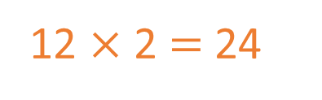
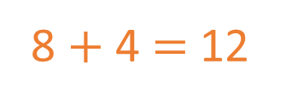
1 cm
2
2 cm
1
3
A
8 $+$ 4 $=$ 12
3
1
22 cm
12 $×$ 2 $=$ 24
1
3
1
1
2
1
1
8
1
1
B
4
24 cm
Have a think
Which shape has the greater perimeter?
Shape B

Slide 52
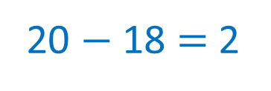
Have a think
Draw a rectangle with a perimeter of 20 cm
Two pairs of equal sides
1
1
× 2 + × 2 = 20
10
0
9
18
20 $−$ 18 $=$ 2
10
9
10
9
Have a think
8 and 2
7 and 3
6 and 4
5 and 5
1

Slide 53

1 cm
4 cm
1 cm
5 cm
3 cm
Have a think
9 cm
Is this closed shape’s perimeter greater than 22 cm?
9 + 3 + 1 + 4 + 5 =
Yes
9 + 1 + 3 + 4 + 5 =
22 cm

Slide 54
9. 1 2.2 0
Arithmetic assessment.

Slide 55
10. 1 2.2 0
Reasoning 1 assessment.

Slide 56
11. 1 2.2 0
Reasoning 2 assessment.

