Slide 1
5. 1 .2 1
LO:
To calculate the perimeter of rectilinear shapes.
Red to respond

Slide 2
Year 5 | Week 10 | Day 1

Slide 3

Year 5 | Week 10 | Day 2
cm

Slide 4
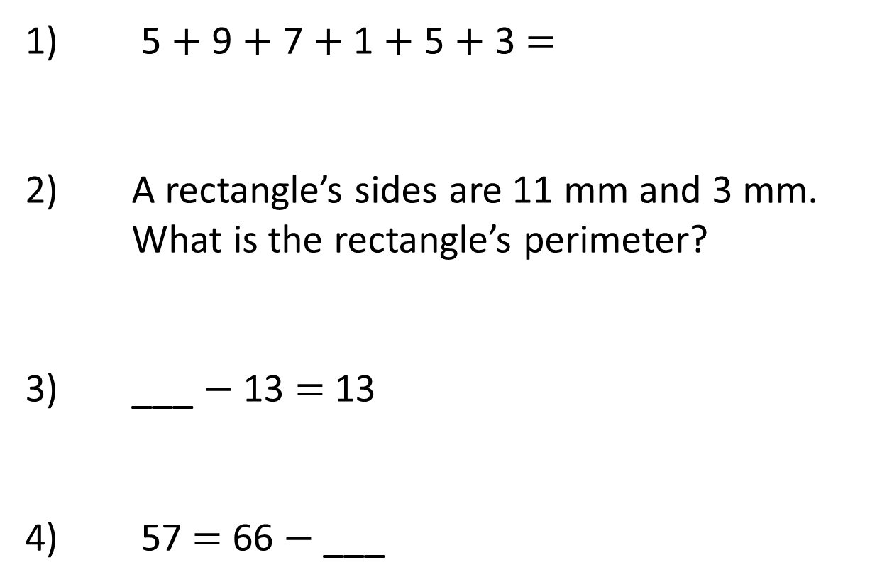
1) 5 + 9 + 7 + 1 + 5 + 3 =
2) A rectangle’s sides are 11 mm and 3 mm.
What is the rectangle’s perimeter?
3) ___ $−$ 13 = 13
4) 57 = 66 $−$ ___

Slide 5
1) 5 + 9 + 7 + 1 + 5 + 3 =
2) A rectangle’s sides are 11 mm and 3 mm.
What is the rectangle’s perimeter?
3) ___ $−$ 13 = 13
4) 57 = 66 $−$ ___
5 + 5 + 9 + 1 + 7 + 3 =
30
28 mm
26
9

Slide 6
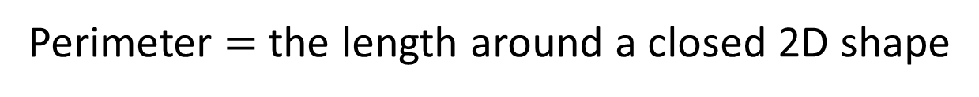
Perimeter $=$ the length around a closed 2D shape
1 cm
1 cm
2 cm
3 cm
5 cm
3 cm
2 cm
5 cm
2 cm
+ 3 cm
+ 3 cm
+ 2 cm
+ 5 cm
+ 5 cm
= 20 cm

Slide 7
6 cm
4 cm
4 cm
? cm
7 cm
5 cm
3 cm
3 cm
1 cm
= 26 cm
7 cm + 6 cm + 4 cm + 5 cm + 3 cm + 1 cm

Slide 8
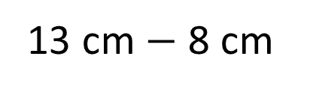
13 cm
13 cm
3 cm
8 cm
8 cm
9 cm
6 cm
13 cm $−$ 8 cm
= 5 cm
5 cm
3 cm + 13 cm + 9 cm + 5 cm + 6 cm + 8 cm
= 44 cm

Slide 9


2 m
1)
30 m
3 m
Have a think
5 m
8 m
2)
46 cm
5 m
14 cm
6 cm
7 m
9 cm
2 cm
10 cm
3)
3 cm
10 cm
10 cm
4 cm
7 cm
14 cm
4 cm
23 cm $=$ 7 cm $+$ cm $+$ 14 cm
4 cm
2
?
23 cm
74 cm

Slide 10
Here is a square inside another square.
The perimeter of the inner square is 16 cm
The outer square’s perimeter is four times the size of
the inner square.
What is the length of one side of the outer square?
How do you know? What do you notice?

Slide 11
6. 1 .2 1
LO:
To measure area by counting squares.
Red to respond

Slide 12
Year 5 | Week 10 | Day 3

Slide 13
Year 5 | Week 10 | Day 4

Slide 14
1) Complete the missing numbers to describe the array
___ + ___ + ___ = ____
3 × ___ = ___
2) 8 + 8 + 8 + 8 = ___ × 8
3) What fraction of the shape is shaded?

Slide 15

1) Complete the missing numbers to describe the array
___ + ___ + ___ = ____
3 × ___ = ___
2) 8 + 8 + 8 + 8 = ___ × 8
3) What fraction of the shape is shaded?
5
5
5
15
5
15
4
$$\frac{\text{1}}{\text{2}}$$

Slide 16
Area is the space inside a 2D shape.

Slide 17
Have a think
Can you visualise the areas of these shapes?
Area is the space inside a 2D shape.
Area is the space inside a closed 2D shape.

Slide 18
Have a think
Which shape would be the best to fill the rectangle?
Why?

Slide 19
Gaps
Which shape would be the best to fill the rectangle?
Why?
The area is 20 circles

Slide 20
Which shape would be the best to fill the rectangle?
Why?

Slide 21
The area of the rectangle is:
20 squares

Slide 22
1
2
3
4
5
6
7
7
The area is ___ squares.

Slide 23
1)
Have a think
9
The area is __ squares.
3)
2)
4
The area is __ squares.
4
The area is __ squares.

Slide 24
Have a think
The green area is __ squares.
2
4
The yellow area is __ squares.
The grey area is __ squares.
2
The white area is __ squares.
4
12
The total area is __ squares.

Slide 25


To find the area, I’m going to count the squares.
3
6
9
12
I’m going to use multiples to be more efficient.
4
1
2
3
4
8
5
6
7
8
12
9
10
11
12
4 + 4 + 4 =
12
3 + 3 + 3 + 3 =
12
4 × 3 =
12
3 × 4 =
12
The total area is 12 squares.

Slide 26
Have a think
1)
5 × 2 =
10 squares
2)
1 × 6 =
6 squares
3)
4 × 4 =
16 squares

Slide 27


$$\frac{\text{1}}{\text{2}}$$
1
2
3
$$\frac{\text{1}}{\text{2}}$$
3
The area is ____ squares.

Slide 28

1)
Have a think
2)
3
2
$$\frac{\text{1}}{\text{2}}$$
3)
3

Slide 29
      Each orange square has an area of 24 cm².
      Calculate the total orange area.
      Calculate the blue area.
      Calculate the green area.
      What is the total area of the whole shape?

Slide 30
7. 1 .2 1
LO:
To find the area of rectangles.
Red to respond

Slide 31
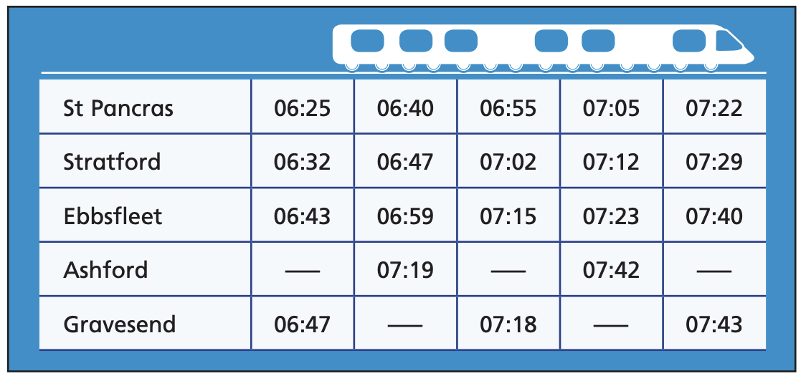

Year 5 | Week 10 | Day 5

Slide 32
Year 5 | Week 11 | Day 1
cm

Slide 33
1) ___ cm = 90 mm
2) 30 = 6 × ___
3) 5 =
4) 100 = ____
2
2

Slide 34
1) ___ cm = 90 mm
2) 30 = 6 × ___
3) 5 =
4) 100 = ____
9
5
2
25
2
10

Slide 35
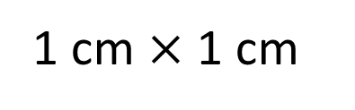
1 cm
1 cm
1 cm $×$ 1 cm
1 cm squared
2
1 cm

Slide 36
1 cm
6 squares
1 cm
2 rows
There are 2 rows.
There are 6 squares in each row.
There are 12 squares altogether.
2 × 6 =
12
The area of the rectangle is 12 cm squared.
12 cm
2

Slide 37
1 square
1 cm
1 cm
3 rows
Have a think
3
There are ___ rows.
1
There is ___ square in each row.
There are ___ squares altogether.
3
3
1
___ × ___ =
3
___
3
The area of the rectangle is ___ cm squared.
3
2
___ cm

Slide 38
Have a think
3 cm
4 cm
2 cm
20 mm
7 cm
4 × 2 =
8 cm
2
3 × 7 =
21 cm
2

Slide 39

9 mm
2 m
2 m
Square
9 mm
9 × 9 =
2
The area of this rectangle is 4 m
81 mm
2
2
2
9 =
81 mm
Have a think
Explain why Tiny is incorrect.

Slide 40
Area = 72 m
2
?
12
12 m
6 m
6 × ___ = 72
?
Have a think
17 cm
2
Area = 17 cm
1 cm
17
1 × ___ = 17

Slide 41
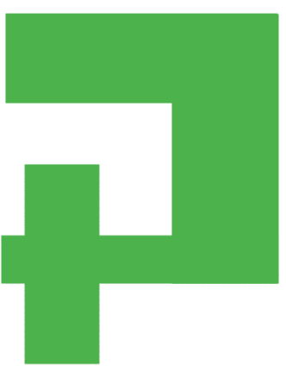
How many different ways can you split this shape to find the area?
Add more values and work out the area.
2 m
6 m

Slide 42
Can you construct a ‘Pirate Island’ to be used as part of a treasure map for a new game? Each square represents 4 m².
The island must include the following features and be of the given approximate measure:
Circular Island 180 m²
Oval Lake 58 m²
Forests with a total area of 63 m² (can be split over more than one space)
Beaches with a total area of 92 m² (can be split over more than one space)
Mountains with a total area of 57 m²
Rocky coastline with total area of 25 m²

