Slide 1
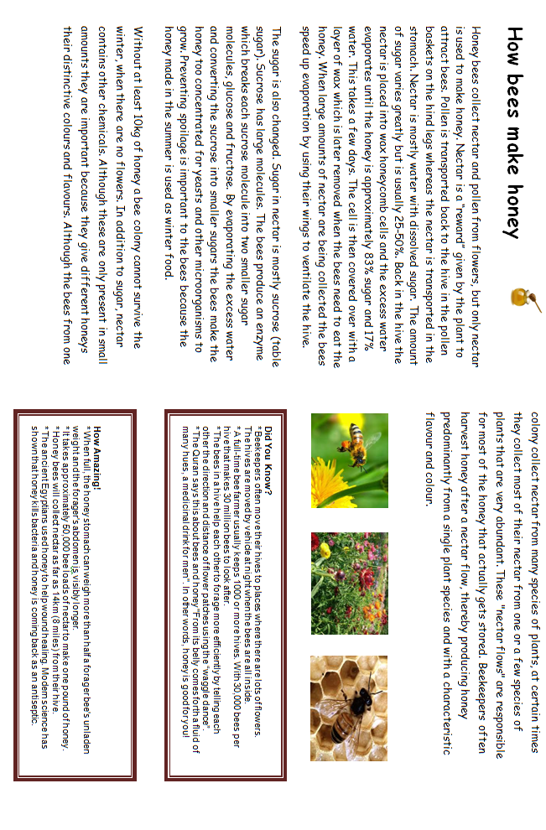

Slide 2
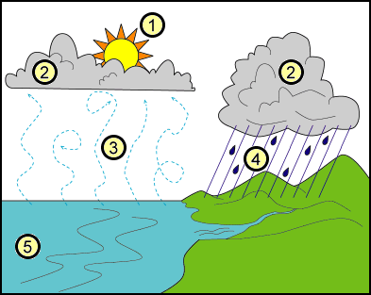
The water cycle
The water cycle (also known as the hydrological cycle) happens all over the world. There is the same amount of water on the Earth now as there was when the Earth began. The water cycle is how the earth's water recycles itself.
The cycle includes precipitation, evaporation, condensation, and transpiration. Earth's water keeps changing from liquid water to vapour and then back again. This cycle happens because of the sun's heat and gravity.
How does the Water Cycle work?
1. First of all, water molecules from lakes, rivers, streams, reservoirs, and the sea get heated up by the sun and then turn into vapour that rises into the air.
2. Next, these water molecules form into clouds, this is because a process called condensation occurs.
3. When the air and the water cool, they form drops of water which then fall to the earth as rain. If they are frozen, they become snow or sleet.
4. Once the water reaches the ground, it can flow across the land until it reaches rivers, lakes, streams, or the sea.
It can also sink into the ground and flow because of gravity through gaps in rock, gravel and sand. Because of this, it reaches these bodies of water too.
5. Now the cycle begins again, when water is evaporated once more.
Why is water important?
Many of us think water will always be there for us when we want it. Without water, living things would die (including humans). You will die if you go without water for more than a week. Plants will die without water and that would kill all of the animals that eat the plants.

Slide 3

How to Fly a Hot Air Balloon
A hot air balloon consists of a basket, four big gas tanks, a burner and the balloon or ‘envelope’.
First, the pilot puts four nylon poles into sockets on top of the basket. Then she puts the burner on top of the poles. Next, she connects the cables to the burner frame. The cables also go under the basket in order to hold everything together.
After this, she connects the hoses from the full gas tanks to the burner so that she can test it.
Next, two people hold the mouth of the balloon open while it is filled with cold air from the fan until it is quite fat and tight.
Now for the difficult bit. The pilot lies on the ground, half in the basket. She turns on the gas burner and points the flame into the ‘mouth’ of the balloon. This is so that the balloon slowly stands up.
When the pilot is ready to go, she heats up the air in the balloon a bit more. This results in the air in the balloon to be hot enough to get the balloon to rise off the ground.

