Slide 1
Monday 23rd November
LO: Spelling practice.

Slide 2
Monday 23rd November
LO: Spelling practice.
Green Group | Yellow Group | Red Group
through | through | threw
threw | threw | through
herd | herd | heard
heard | heard | night
weather | though | again
whether | thought
reign
remember
business
different

Slide 3
Monday 23rd November
LO: To publish my narrative opening.

Slide 4

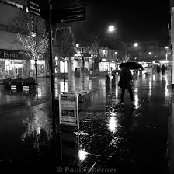

Publishing
Your very best, joined handwriting.
Double page spread in your book, picture of Southport in the middle of your page.
Lockdown Lord Street

Slide 5
Tuesday 24th November
LO: To learn about causal conjunctions.

Slide 6

Using Causal Conjunctions

Slide 7

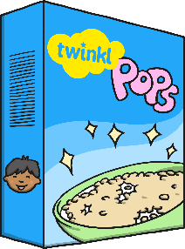

Causal conjunctions are used to explain how things work or why things happen.
I got soaking wet in the rain because I didn’t have my umbrella with me.
I didn’t have breakfast today, so I am really hungry now!
I am about to walk the dog hence my casual clothes and wellingtons.

Slide 8
Causal conjunctions can be:
Subordinating conjunctions
because
since
even though
as
now that
Coordinating conjunctions
so
yet
Adverbs/
Adverbials
accordingly
consequently
therefore
hence
as a result

Slide 9
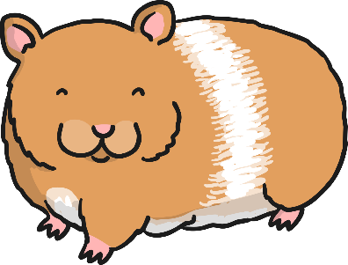
Top tip:
Use a comma before a coordinating conjunction if it links two independent, complete ‘thoughts’, i.e. clauses with a subject and verb in each.
For example:
My hamster loved to play, so I gave him a spinning wheel.
Here ‘so’ links two independent clauses.

Slide 10


Causal conjunctions link clauses and can be used in the middle of a sentence.
My watch is not broken even though I dropped it onto the floor.
I don’t enjoy TV, so I have chosen to read tonight.

Slide 11
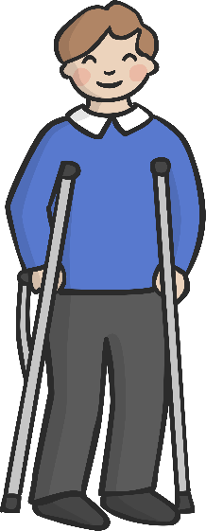
Causal conjunctions can also be used at the beginning
of a sentence to refer to the sentence before.
I dropped my watch on the floor. Consequently, it is broken.
Andy broke his leg recently. Accordingly, he is unable to ski at the moment.
The school heating is not working. As a result of this, the building is closed today.

Slide 12

Causal conjunctions which are also conjunctions can be used to link clauses in the middle or at the beginning of a sentence.
For example:
She is going to bed, so she won’t be tired tomorrow.
So she won’t be tired tomorrow, she is going to bed now.
Dad was late for work because he missed the train.
Because he missed the train, Dad was late for work.
Tom didn’t eat his sandwich as he wasn’t very hungry.
As he wasn’t very hungry, Tom didn’t eat his sandwich.

Slide 13

Using Causal Conjunctions Quiz

Slide 14
Causal Conjunctions can be:
Subordinating conjunctions
Coordinating conjunctions
all three
adverbs/adverbials
all three

Slide 15
Which sentence uses a
conjunction accurately?
We are going for a picnic the weather is so nice.
Since the weather is so nice, we are going for a picnic.
Since the weather is so nice, we are going for a picnic.
The weather is so nice since we are going for a picnic.

Slide 16
Which sentence uses a
conjunction accurately?
I visited the British Museum. I am interested in History.
I visited the British Museum I am interested in History because.
I visited the British Museum because I am interested in History.
I visited the British Museum because I am interested in History.

Slide 17
Which causal conjunction is missing?
As a result of
because
Therefore
as
Consequently
her injury, Sandy had to withdraw from the swimming competition.
The brakes do not work. the car is unsafe to drive.
I am wearing sunscreen today it is very hot.
Our teacher is not in school today he is ill.
Sal revised carefully. , she did well in her exams.
As a result of
Therefore
as
because
Consequently

Slide 18
Tuesday 24th November
LO: To identify features of and summarise explanation texts.

Slide 19
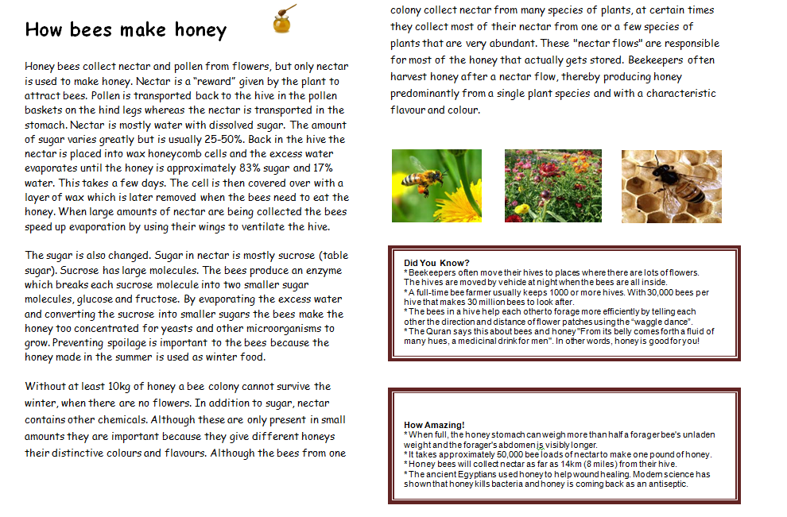

Slide 20
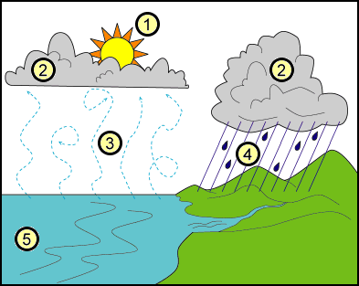
The water cycle
The water cycle (also known as the hydrological cycle) happens all over the world. There is the same amount of water on the Earth now as there was when the Earth began. The water cycle is how the earth's water recycles itself.
The cycle includes precipitation, evaporation, condensation, and transpiration. Earth's water keeps changing from liquid water to vapour and then back again. This cycle happens because of the sun's heat and gravity.
WAGOLL

Slide 21
How does the Water Cycle work?
1. First of all, water molecules from lakes, rivers, streams, reservoirs, and the sea get heated up by the sun and then turn into vapour that rises into the air.
2. Next, these water molecules form into clouds, this is because a process called condensation occurs.
3. When the air and the water cool, they form drops of water which then fall to the earth as rain. If they are frozen, they become snow or sleet.
4. Once the water reaches the ground, it can flow across the land until it reaches rivers, lakes, streams, or the sea.
It can also sink into the ground and flow because of gravity through gaps in rock, gravel and sand. Because of this, it reaches these bodies of water too.
5. Now the cycle begins again, when water is evaporated once more.
Why is water important?
Many of us think water will always be there for us when we want it. Without water, living things would die (including humans). You will die if you go without water for more than a week. Plants will die without water and that would kill all of the animals that eat the plants.

Slide 22
Explanation text
needs
Purpose
a title telling what’s to be explained
introduction, providing any necessary background
to explain a process
to help the reader understand how or why something happens (or why something is as it is)
clear layout (e.g. sections, paragraphs) which helps show the stages in the process
each paragraph starts with a topic sentence
A topic sentence sums up what the paragraph is about.
maybe labelled picture(s) or diagram(s)
to engage the reader’s attention.
organisational devices to aid clarity (e.g. bullet points, subheadings)
The genre of
text can also affect
the purpose.
closing sentence, to round off the report.

Slide 23
Explanation writing
Audience
Use what you know about your audience to decide
think about the audience for the explanation
how much background detail is needed
how much do you know about them
(age, interests, prior knowledge)
appropriate level of formality.
Think about your audience when you plan the layout. How can you make it easy for them to read?
Where should the text sit along these continua?
informal
formal
personal
impersonal
The position on each continuum may be different. Impersonal texts are sometimes written informally, and personal texts may be formal.

Slide 24

Explanation language features
present tense verbs
(unless historical explanations)
because
time connectives to show sequence of events
if... then...
the reason that...
causal language
when
so
impersonal language
this results in...
technical vocabulary, with definitions if necessary.
this causes...
therefore

Slide 25

Impersonal writing
third person
The stick was placed in...
passive voice
formal connectives, e.g. However, Therefore, Furthermore, Consequently
This is known as...
The motor is operated by...
usually formal vocabulary e.g.
placed rather than put
known as rather than called.
The sides are covered in...

Slide 26
Features
Present tense, e.g. many birds fly south
Connectives that signal time, e.g. then, next, several months later
Causal connectives, e.g. because, so, this causes
Decide whether diagrams, charts, illustrations or a flow chart would help to explain.
Use a title that indicates what you are writing about.
Using how or why in the title helps. Try to make the title intrigue (interest) the reader, e.g. Why do sloths hang about?.

Slide 27
Use the first paragraph to introduce your subject to the reader.
Add in extra, interesting information.
Try to end by relating the subject to the reader.
If you use specialised terminology a glossary may be needed.
Interest the reader with exclamation, eg Beware - whirlwinds can kill!
Or use questions, e.g. Did you know that…?
Draw the reader in, e.g. strange as it may seem…, not many people know that…
Finally ...re-read your explanation, pretending you know nothing about the subject - is it clear?

Slide 28
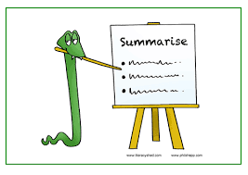
Summarise the texts!

Slide 29
Wednesday 25th November
LO: To use causal conjunctions.

Slide 30
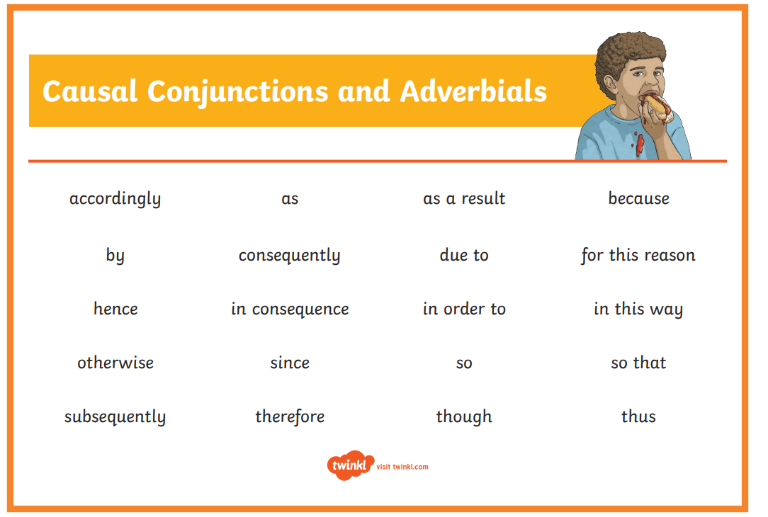

Slide 31
CAUSE AND EFFECT CONNECTIVES
These connectives help to explain why something happens.
e.g. The boy missed his bus and consequently was late for school.
Try to explain why something happened using one of these connectives.
so
because
thus
consequently
therefore

Slide 32
CAUSE AND EFFECT CONNECTIVES
this results in, this causes, this means that, as a result
even though
yet so
because
thus
consequently
therefore
however
despite
as a result of
this causes…
this results in…
this means that..
These connectives help to explain why something happens.
e.g. The boy missed his bus and consequently was late for school.
Try to explain why something happened using one of these connectives.

Slide 33
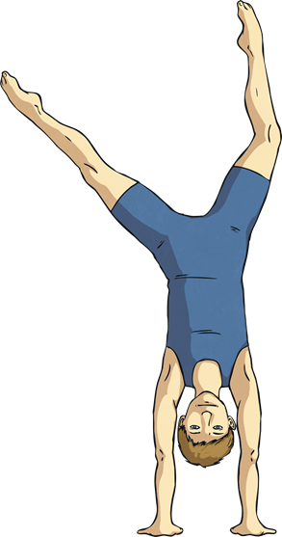
What Do You Notice about the Highlighted Words?
I am usually late because I often forget to set my alarm.
My sister loves animals, so we went on a trip to the zoo for her birthday.
As a result of practising hard, I came first in the gymnastics competition.

Slide 34

What Do You Notice about the Highlighted Words?
They are all causal conjunctions, which are used to explain how things work or why something happens.
They can be:
subordinating conjunctions, e.g. because;
co-ordinating conjunctions, e.g. so;
causal adverbials, e.g. as a result.

Slide 35
Sort the Causal Conjunctions
Sort the causal conjunctions into the correct category below:
Subordinating conjunctions
Coordinating conjunctions
Adverbials
as a result
therefore
yet
as
accordingly
consequently
hence
because
so
even though
since
now that

Slide 36
When Are Causal Conjunctions Used?
Causal conjunctions are used:
to link independent clauses in the middle of sentences
e.g. I dislike dogs, so I don’t enjoy visiting my uncle who has four huskies.
to link independent clauses at the beginning of a sentence
e.g. Because I had forgotten my lunch, the school cook let me have a hot dinner.
at the beginning of a sentence to refer to the sentence before
e.g. I lost my homework on the way to school. Consequently, I will have to stay in to complete it at lunchtime.
to add cohesion within paragraphs
e.g. Many schools have a rule that children wear uniform, which most parents and children are happy with. Wearing a school uniform means that pupils all look the same and nobody feels different. Accordingly, most pupils attend school looking smart and feeling proud to be part of their school.

Slide 37
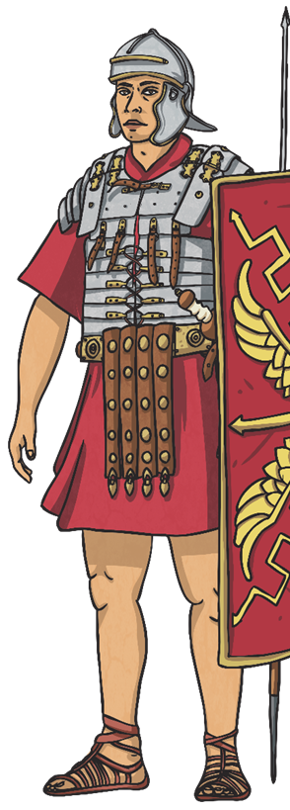


Is It a Causal Conjunction?
Read each sentence to decide whether the highlighted words are causal conjunctions or not.
1. Even though it was a warm, sunny day, my mum said we could not fill the paddling pool.
2. My little sister always follows me around, which really annoys me.
3. Since we visited the Roman ruins, I have been reading history books to find out more information.
Reveal

Slide 38
Connectives game!
Why don’t rainbows wobble in the wind?
They don’t wobble because the ends of the rainbow are stuck in pots of gold.
Why do boys wear hair gel?
Why does rain fall down?

Slide 39
Connectives game!
even though
yet so
because
thus
consequently
therefore
however
despite
as a result of
this causes…
this results in…
this means that..
Why do boys wear hair gel?
Why does rain fall down?

Slide 40
Choose a question below, create an causal conjunction sentence with your partner to answer the question!
Why are aliens always green?
Why don’t rainbows wobble in the wind?
Why do boys wear hair gel?
Why is a banana curly?
Where do teachers go at night?
Why does it get dark at night?

Slide 41
Wednesday 25th November
LO: To use causal conjunctions correctly.

Slide 42
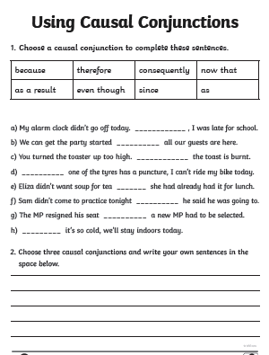
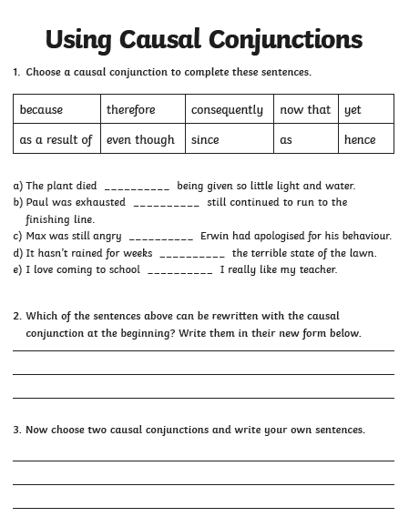
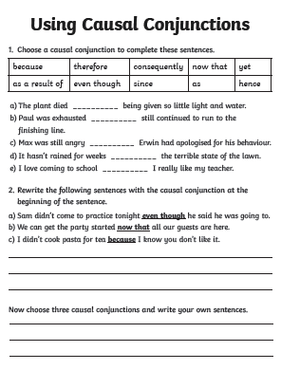

Slide 43
Thursday 26th November
LO: To revise determiners.

Slide 44
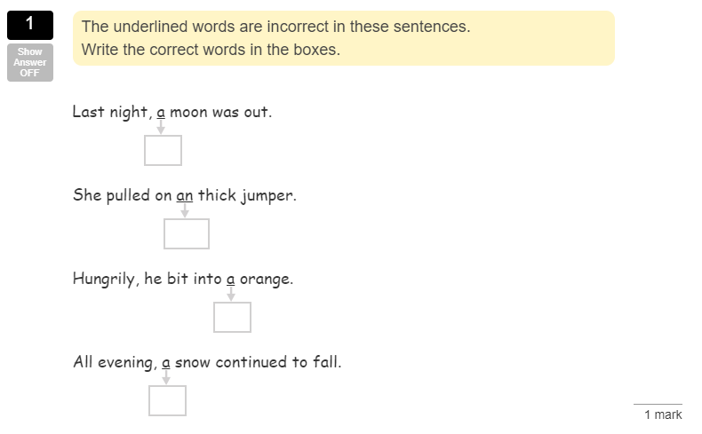

Slide 45
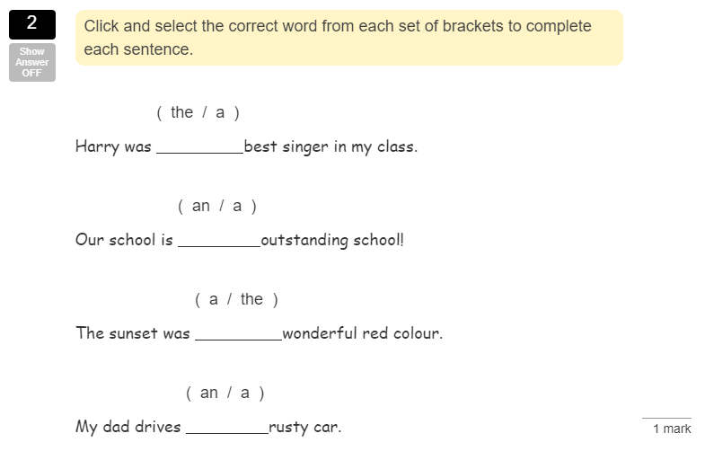

Slide 46
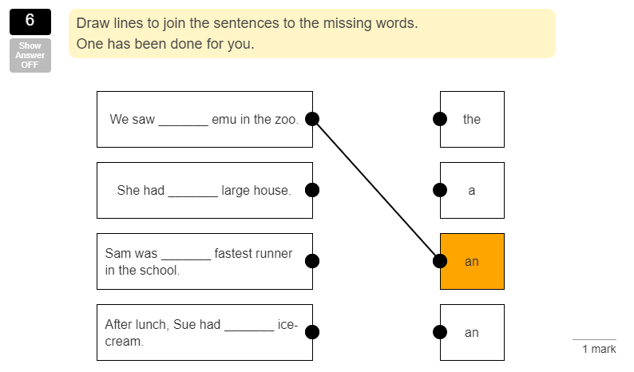

Slide 47
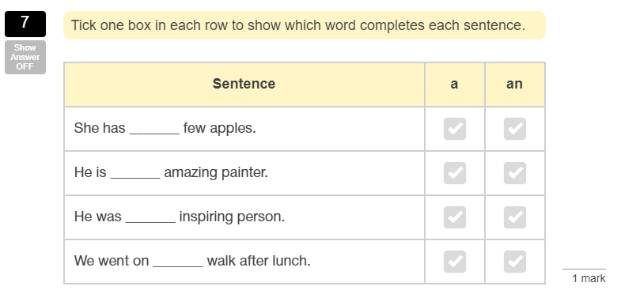

Slide 48
Thursday 26th November
LO: To structure an explanation text.

Slide 49
Explanation text
tells how or why a process
happens (or how something works).
This is sequential and deals
with cause and effect.

Slide 50
These texts are often ‘explanation texts’…
“question & answer” articles and leaflets
write-up of science equipment
encyclopaedia
entry
explanation
parts of a non-fiction book
(e.g. geography, biology)
science text book
technical manual
(e.g. for car or washing machine)

Slide 51
Planning and organising explanations
Simple explanation:
More complex explanations
e.g.
a series of logical steps
Reversible effects
This happens
this
this
this
leading to
leading to
leading to
possibly other causes and effects at each stage.
More than one cause
Probably...
labelled
diagram(s)
Cycle

Slide 52
Organising explanation text
Intro
defines the process
Intro
End
When you have made your
flowchart skeleton, each
blob gives you one paragraph (or section) in your writing.
the process in logically sequenced steps
neat last line
Explanations can be complicated. You may have to draft your flow chart several times. But making the flow chart – and other diagrams – can help you understand the process better.
End

Slide 53





Slide 54
Your text is cut up and in the wrong order!
Put the text in the correct order. How do you know you are right?
What features of explanation texts can you spot?
What would this text look like in a planning bubble template?

Slide 55
Which parts of explanation texts are most interesting for the reader?
Why?
How do diagrams and pictures help?

Slide 56
Friday 27th November
LO: To plan a futuristic invention.

Slide 57
https://youtu.be/2igRcGxlshA https://www.youtube.com/watch?v=Xc5eqwzEgUo

Slide 58
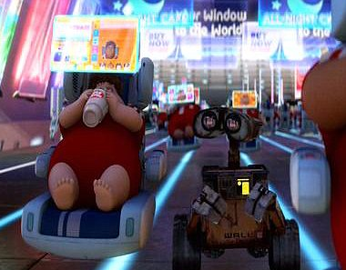
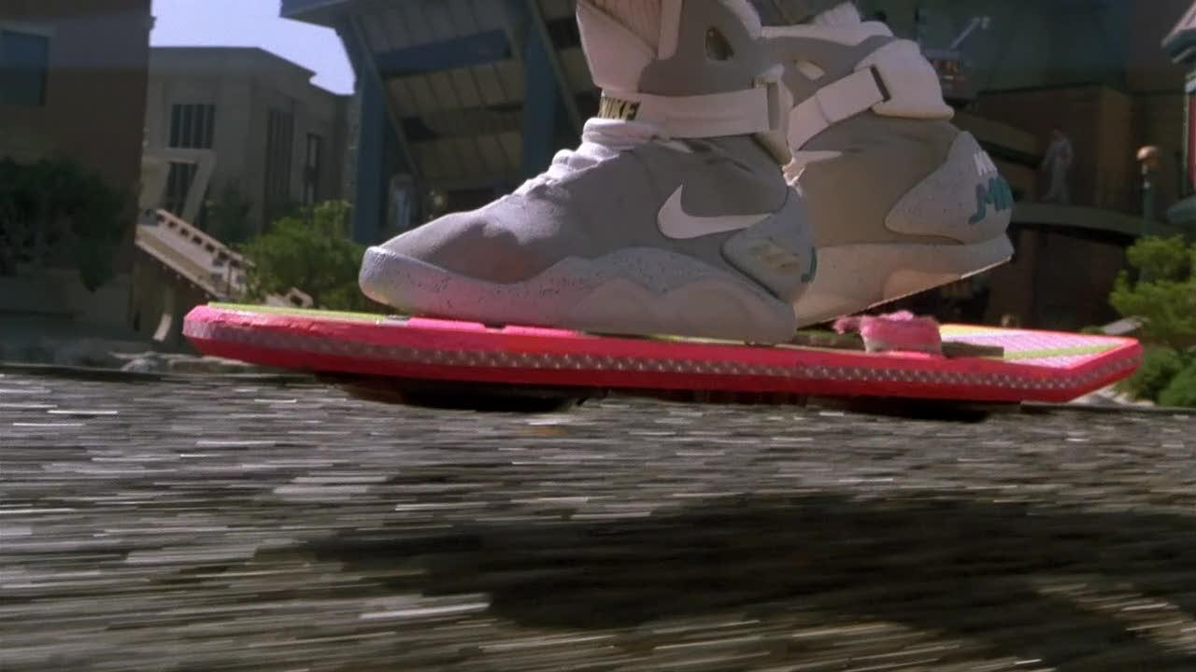
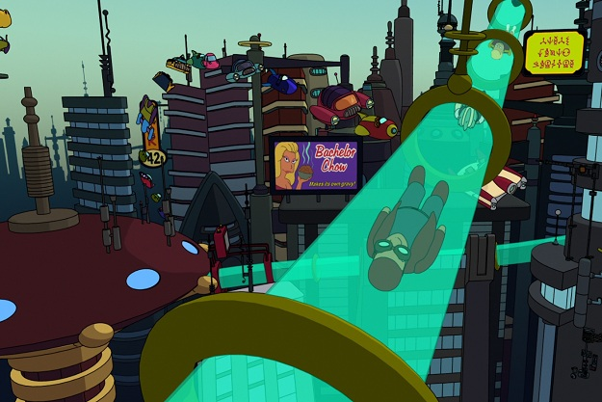
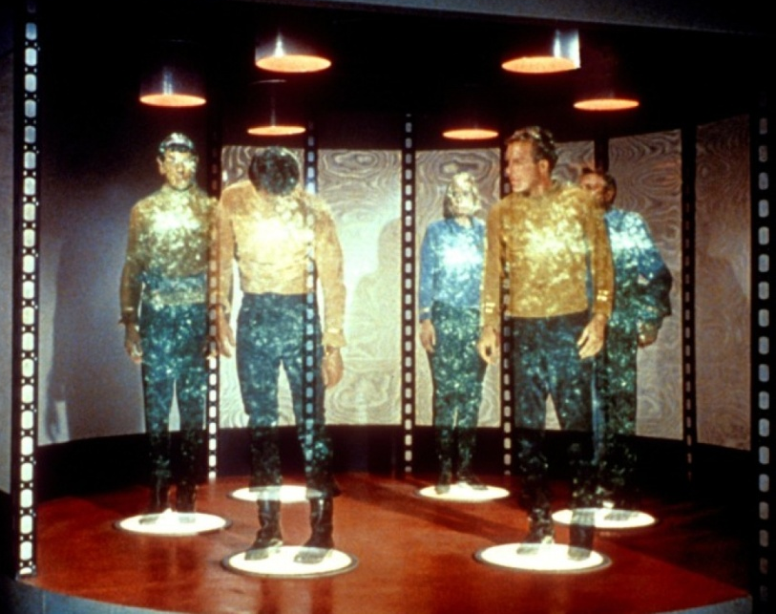
Invention pictures

