Slide 1
Monday 30th November
LO: Spelling practice.
Green Group | Yellow Group | Red Group
past | past | passed
passed | passed | which
steel | which | witch
steal | witch | who
which | although | never
witch | appear
occasion
mention
possess
possession

Slide 2
Monday 30th November
LO: To participate in a guided write of an explanation text.

Slide 3
https://youtu.be/2igRcGxlshA https://www.youtube.com/watch?v=Xc5eqwzEgUo https://www.youtube.com/watch?v=vGxRUglFFME&t=3s

Slide 4
What features do we need?

Slide 5
What features do we need?
Title / Heading
Subtitles / subheadings
Formal language
Variety of punctuation
Fact box
Images (photo, diagram, illustration)
Introduction
Conclusion

Slide 6
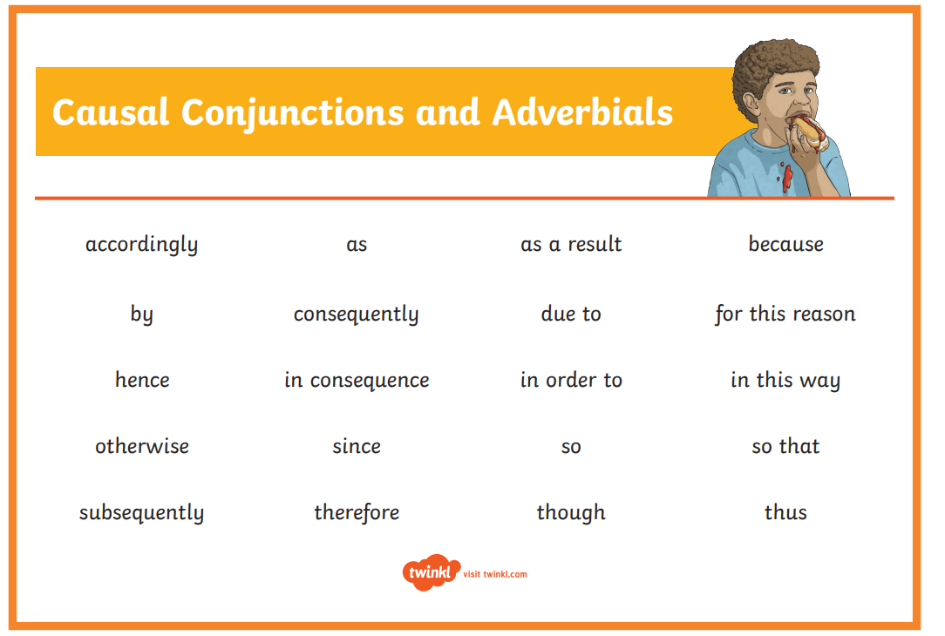

Slide 7
Explanation text
tells how or why a process
happens (or how something works).
This is sequential and deals
with cause and effect.

Slide 8
Planning and organising explanations
Simple explanation:
More complex explanations
e.g.
a series of logical steps
Reversible effects
This happens
this
this
this
leading to
leading to
leading to
possibly other causes and effects at each stage.
More than one cause
Probably...
labelled
diagram(s)
Cycle

Slide 9
Organising explanation text
Intro
defines the process
Intro
End
When you have made your
flowchart skeleton, each
blob gives you one paragraph (or section) in your writing.
the process in logically sequenced steps
neat last line
Explanations can be complicated. You may have to draft your flow chart several times. But making the flow chart – and other diagrams – can help you understand the process better.
End

Slide 10
Features
Present tense, e.g. many birds fly south
Connectives that signal time, e.g. then, next, several months later
Causal connectives, e.g. because, so, this causes
Decide whether diagrams, charts, illustrations or a flow chart would help to explain.
Use a title that indicates what you are writing about.
Using how or why in the title helps. Try to make the title intrigue (interest) the reader, e.g. Why do sloths hang about?.

Slide 11
Use the first paragraph to introduce your subject to the reader.
Add in extra, interesting information.
Try to end by relating the subject to the reader.
If you use specialised terminology a glossary may be needed.
Interest the reader with exclamation, eg Beware - whirlwinds can kill!
Or use questions, e.g. Did you know that…?
Draw the reader in, e.g. strange as it may seem…, not many people know that…
Finally ...re-read your explanation, pretending you know nothing about the subject - is it clear?

Slide 12
Tuesday 1st December
LO: To plan an explanation text.

Slide 13
What Is Parenthesis?
Parenthesis is the addition of extra information or an afterthought in our writing.
It can be a word, phrase or clause marked with brackets, dashes or commas.
When a parenthesis is removed, the sentence still makes grammatical sense.
e.g. I moved to Sheffield in 2011 (when I was six years old).
still makes sense as:
I moved to Sheffield in 2011.

Slide 14
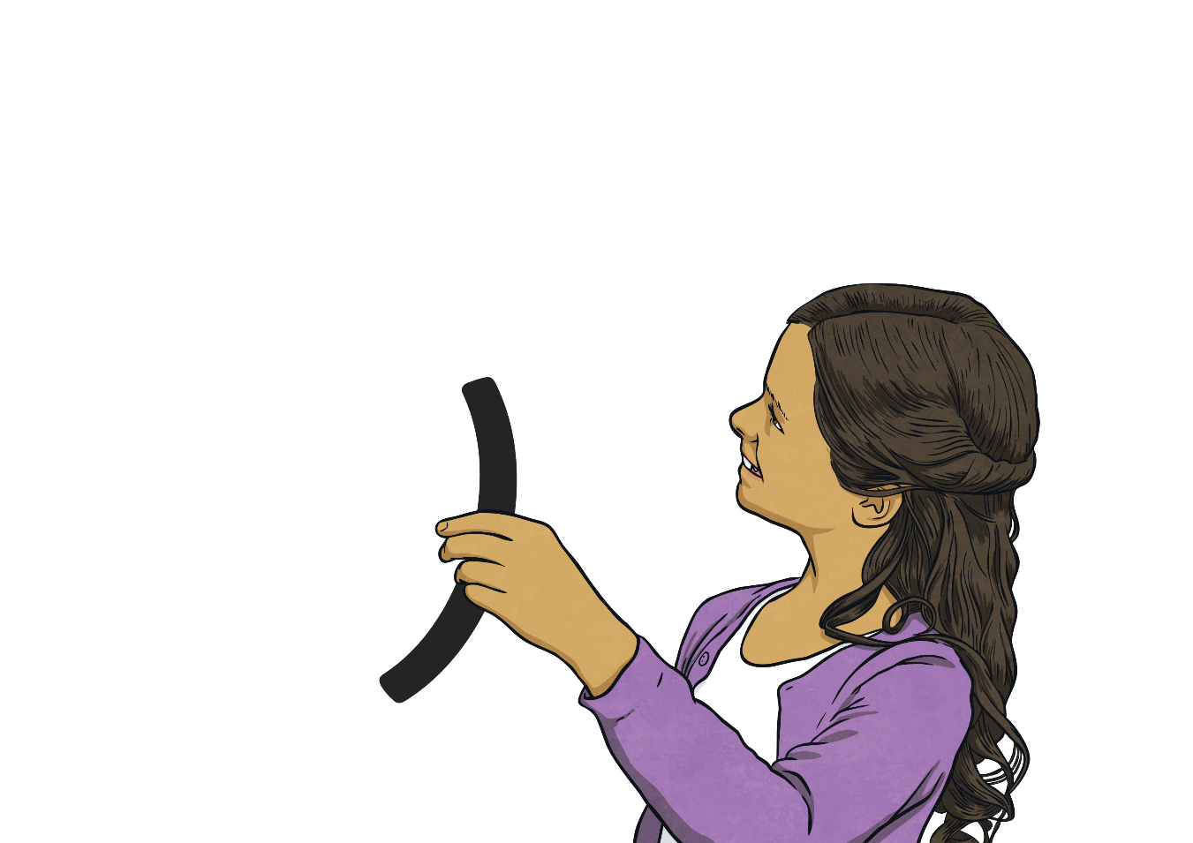
Parenthesis Punctuation
There are three possible ways to punctuate parenthesis.
Can you tell your partner the three possible ways to punctuate parenthesis?
Commas
Brackets
dashes
,
( )
-

Slide 15
Spot the Parenthesis
Can you identify the parenthesis in the following sentences?
The narcissus, daffodil, is a spring plant with yellow petals.
My brother - the one who lives in Australia- is coming over for Christmas.
Ramchester won the league today (for the fifth season running).
Remember to only put brackets, dashes or commas around the parenthesis itself.
Check that your sentence still makes sense if you didn’t read the part you have added the extra punctuation to.
,
,
-
-
(
)

Slide 16
Quick Quiz 1
Decide where the punctuation for parenthesis should be in these sentences:
The newspaper which is normally delivered at 9:30 did not come today.
Today we went on a trip to York where I had never been before.
Some people don’t like the rain especially in England but I do.
Many cats but not all of them sleep for 15 hours a day.
Ricki plays the guitar I am sure he will be a rock star one day in our school band.
Did you and your partner agree? If not, can you explain why?
,
,
(
)
(
)
(
)
-
-

Slide 17


Quick Quiz 2
Identify whether the following sentences correctly use the punctuation for parenthesis:
Her father a spy drove his daughter – to the cinema – to meet friends.
Her father – a spy – drove his daughter to the cinema to meet friends.
I don’t believe in UFOs (unidentified flying objects).
Shelly the captain, of the team, was a very skilful player.
Shelly, the captain of the team, was a very skilful player.
St. George, the patron saint of England, was a Roman soldier.

Slide 18
Which sentence correctly uses dashes for parenthesis?
Many cats but not all of them – sleep for 15 hours 1 a day.
Many cars but not – all of them – sleep for 15 hours of day.
Many cats – but not all of them – sleep for 15 hours a day.

Slide 19
Which sentence correctly uses dashes for parenthesis?
Her mother – a great athlete in her teens – showed her daughter all of her medals.
Her mother a great athlete in her teens – showed her daughter all of her medals-.
Her mother – a great – athlete in her teens showed her daughter all of her medals.

Slide 20
Which sentence correctly uses dashes for parenthesis?
I know he’s – made his decision – and I don’t like to interfere but I feel like he’s making the wrong choice.
I know he’s made his decision – and I don’t like to interfere – but I feel like he’s making the wrong choice.
I know he’s made his decision and I don’t like to interfere – but I feel like he’s making the – wrong choice.

Slide 21
Which sentence correctly uses dashes for parenthesis?
This year I am going to New York – I have never been out of Europe before – and I am very excited.
This year – I am going to New York – I have never been out of Europe before and I am very excited.
This year I am going to New York I have never been out of Europe before and I am – very – excited.

Slide 22
Which sentence correctly uses dashes for parenthesis?
The vast desert lush with flowers – after the rain storm – contained lots of interesting plant life.
The vast desert – lush with flowers after the rain storm – contained lots of interesting plant life.
The vast desert lush with flowers after the rain storm contained – lots – of interesting plant life.

Slide 23
Which sentence correctly uses dashes for parenthesis?
One day – last month – I’m sure it was on a Tuesday I fell down and grazed my knee.
One day last month I’m sure it was on a Tuesday – I fell down – and grazed my knee.
One day last month – I’m sure it was on a Tuesday – I fell down and grazed my knee.

Slide 24
Which sentence correctly uses dashes for parenthesis?
I have given the letter – which you sent me two days ago – to my dad.
I have – given the letter – which you sent me two days ago to my dad.
I have given the letter which you sent me – two days ago – to my dad.

Slide 25
Which sentence shows the brackets put into the correct place to indicate parenthesis?
She knows (although she daren’t come forward) that it was all her fault.
She knows although she daren’t come forward (that it was all her fault).
She knows although (she daren’t come forward) that it was all her fault.

Slide 26
Which sentence shows the brackets put into the correct place to indicate parenthesis?
Isobel (Isobel White), not Isobel Greene, injured her knee in P.E today.
Isobel (Isobel White, not Isobel Greene), injured her knee in P.E today.
Isobel White, (not Isobel Greene), injured her knee in P.E today.

Slide 27
Which sentence shows the brackets put into the correct place to indicate parenthesis?
Although she says she’s not a bully and we all know she is (she tripped up another girl on the playground).
Although she says she’s not a bully (and we all know she is) she tripped up another girl on the playground.
Although she says she’s not a bully and (we all know she is) she tripped up another girl on the playground.

Slide 28
Which sentence shows the brackets put into the correct place to indicate parenthesis?
The smallest of the puppies the one (they called Toby) bounded over to fetch his ball.
The smallest of the puppies the one they called Toby bounded over (to fetch his ball.)
The smallest of the puppies (the one they called Toby) bounded over to fetch his ball.

Slide 29
Which sentence shows the brackets put into the correct place to indicate parenthesis?
They I mean the ogres were fed up (of their damp, mossy cave.)
They I mean (the ogres) were fed up of their damp, mossy cave.
They (I mean the ogres) were fed up of their damp, mossy cave.

Slide 30
Which sentence shows the brackets put into the correct place to indicate parenthesis?
She brought her sister who (she doesn’t normally like) some fudge back from the seaside.
She brought her sister (who she doesn’t normally like) some fudge back from the seaside.
She brought her sister who she doesn’t normally like some fudge (back from the seaside).

Slide 31
Explanation text
tells how or why a process
happens (or how something works).
This is sequential and deals
with cause and effect.

Slide 32
Planning and organising explanations
Simple explanation:
More complex explanations
e.g.
a series of logical steps
Reversible effects
This happens
this
this
this
leading to
leading to
leading to
possibly other causes and effects at each stage.
More than one cause
Probably...
labelled
diagram(s)
Cycle

Slide 33
Organising explanation text
Intro
defines the process
Intro
End
When you have made your
flowchart skeleton, each
blob gives you one paragraph (or section) in your writing.
the process in logically sequenced steps
neat last line
Explanations can be complicated. You may have to draft your flow chart several times. But making the flow chart – and other diagrams – can help you understand the process better.
End

Slide 34
Explanation
Purpose
Tells us how something works or gives us information about something.

Slide 35

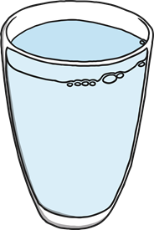
Structure
A general statement is used to introduce the topic of explanation.
There are lots of things we can do to stay healthy and to keep illnesses away.
A series of logical steps explaining how or why something occurs.
The best drinks for staying healthy are water and milk. Fruit juices can be good for us but they can have a lot of sugar in them. Fizzy drinks are not good for us at all.
Steps continue until the final state is produced or the explanation is complete.

Slide 36

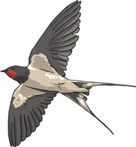
Features
Explanations are written in the present tense.
Many birds fly south
Conjunctions that signal time are used in explanations.
then next several months later
Explanations are written using causal connectives.
because so this causes

Slide 37
Features
Title – explains what the text is for
Opening Statement – about the subject
Clear, simple points about why or how something occurs
Technical words – where appropriate
Conjunctions – e.g. because, resulting in
Present tense
Summary Paragraph

Slide 38
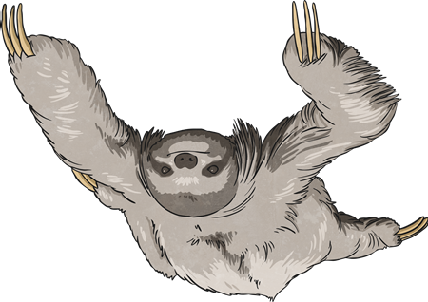
Use a clear title that indicates what you are writing about.
Decide whether to use diagrams, charts, illustrations or flow charts to help explain.
Title and Introduction
Use the first paragraph to introduce the subject to the reader.
Try to make the title intrigue the reader.
Why do sloths hang about?
Using how or why in a title helps.

Slide 39
Organise the writing and illustrations to explain:
What you need.
How it works.
Why it works.
When and where it works.
What it is used for.
Add in extra, interesting information.

Slide 40
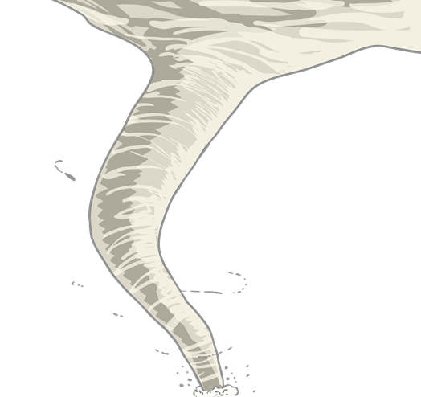
Interest the reader with an exclamation or question.
Beware – whirlwinds can kill!
Did you know...?
Interest the reader.
Strange as it may seem…,
Not many people know that…

Slide 41
Reread the explanation pretending that you know nothing about the subject. Does it make sense?
Finish by drawing all ideas together in a concluding paragraph.
Ending
If specialised terminology is used, a glossary may be needed.
Relate the ending to the reader.

Slide 42
Features
Present tense, e.g. many birds fly south
Connectives that signal time, e.g. then, next, several months later
Causal connectives, e.g. because, so, this causes
Decide whether diagrams, charts, illustrations or a flow chart would help to explain.
Use a title that indicates what you are writing about.
Using how or why in the title helps. Try to make the title intrigue (interest) the reader, e.g. Why do sloths hang about?.

Slide 43
Use the first paragraph to introduce your subject to the reader.
Add in extra, interesting information.
Try to end by relating the subject to the reader.
If you use specialised terminology a glossary may be needed.
Interest the reader with exclamation, eg Beware - whirlwinds can kill!
Or use questions, e.g. Did you know that…?
Draw the reader in, e.g. strange as it may seem…, not many people know that…
Finally ...re-read your explanation, pretending you know nothing about the subject - is it clear?

Slide 44
Wednesday 2nd December
LO: To use formal language and technical vocabulary in an explanation.

Slide 46
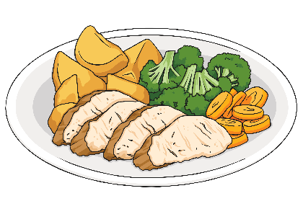
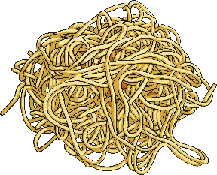
Creating Relative Clause Sentences
We can add extra additional detail about a noun by adding a relative clause
to a sentence.
Instead of using two single-clause (simple sentences) to
describe something,
e.g. Sarah is eating roast chicken. It is her favourite meal.
We can combine the two sentences to make one multi-clause
(complex) sentence using subordination with a relative clause.
e.g. Sarah is eating spaghetti, which is her favourite meal.
A relative clause is connected to the main clause by a relative pronoun. We’ve replaced the pronoun ‘It’ in the second sentence with the
relative pronoun ‘which’.

Slide 47
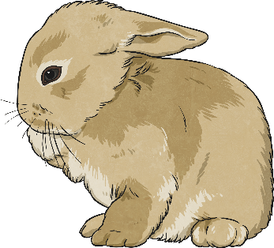
Relative Pronouns
A relative clause always starts with a relative pronoun.
Examples of relative pronouns are:
Can you identify the relative pronouns in these sentences?
We went to the new swimming pool, which has three fantastic slides.
Josie, who loves to play football, was picked for the county team.
Sadiq, whose pen had run out, put his hand up to ask for another one.
The boy whom you met last week is coming to visit later.
My Grandad caught the rabbit that had escaped.
whose
which
who
that
whom

Slide 48
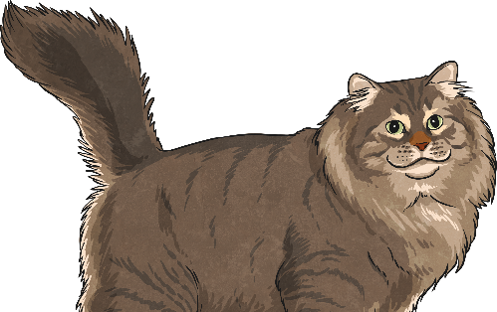
Where Can a Relative Clause Be Placed?
Where in these sentences are the relative clauses placed? How do you know?
The class were well-behaved on the school trip, which made their teacher proud.
William, who was wearing his favourite shirt, was going to the school disco.
I go to a swimming club early in the morning, which means that I’m tired by the afternoon.
Have you seen the people whom we met yesterday at the park?
Amir found the missing cat that his neighbour had lost.
Relative clauses can be in the middle of a
sentence (embedded) or at the end of a sentence.

Slide 49
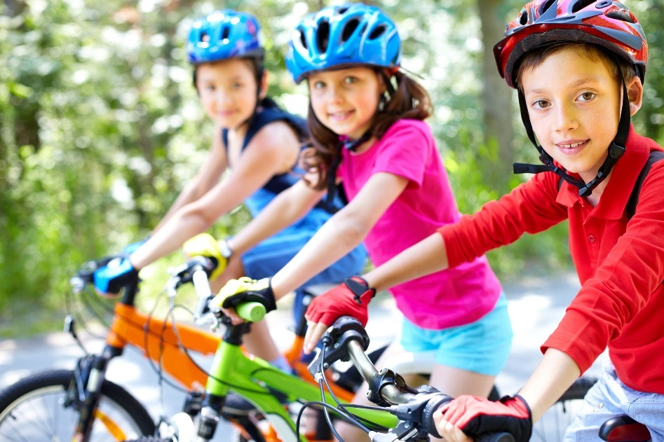
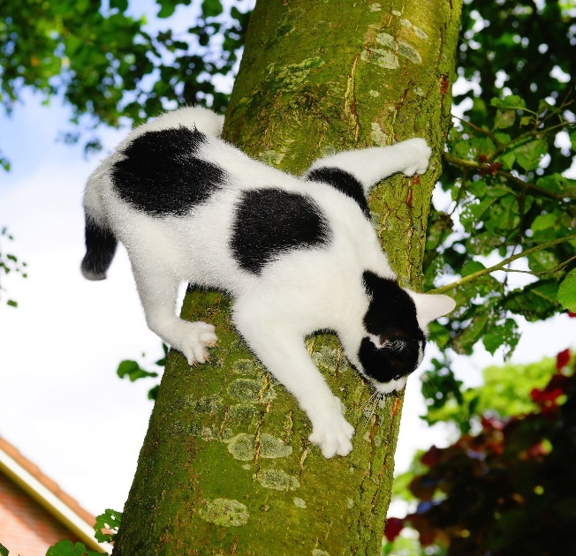
Creating Relative Clauses
Write sentences about the following pictures and include an embedded relative clause:
My cat, which was black and white, got stuck
up a tree.
The children, who all wore helmets, were excited about their cycling trip.

Slide 50
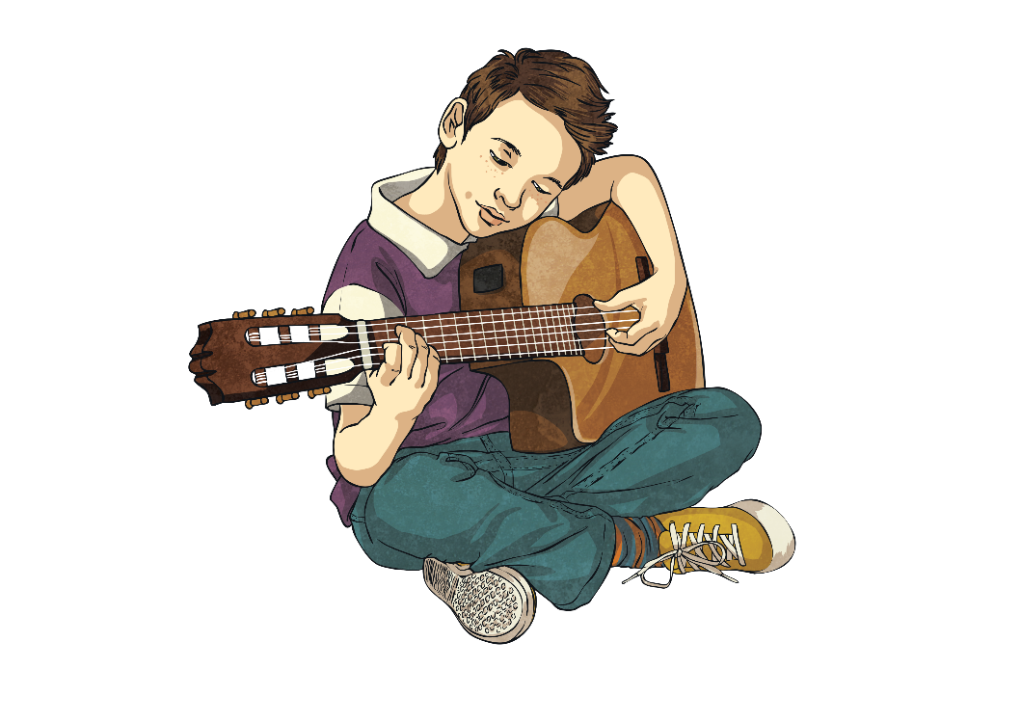
Quick Quiz 1
For each sentence, identify the relative pronoun:
I can’t eat that chocolate bar because it has nuts in, which I’m allergic to.
Mangoes, which are grown in tropical countries, are one of my favourite foods.
The cats that were caterwauling last night kept me awake.
Jamal, who is a fantastic guitarist, has joined the school band.

Slide 51
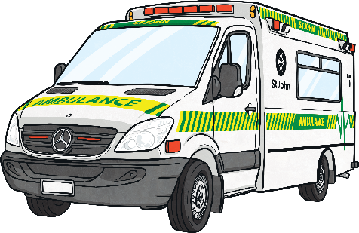
Quick Quiz 2
Can you match the main clause to the appropriate relative clause?
The cat scratched my arm,
The paddling pool is full of cool water,
I have a sister,
The ambulance rushed to help the child,
who is three years younger than me.
who had fallen from the tall slide.
which made it sore.
which is fabulous on this hot day.

Slide 52
Quick Quiz 3
Can you break each relative clause sentence back down into two single-clause (simple) sentences?
I look just like my dad, whose hair is black too.
I look just like my dad. His hair is black too.
My rabbit, who loves carrots, always runs up to me when I go to its hutch.
My rabbit always runs up to me when I go to its hutch. It loves carrots.
Micah, whose legs were aching, finally completed the race.
Micah finally completed the race. His legs were aching.

Slide 53
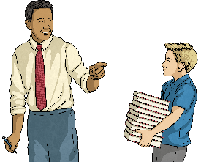
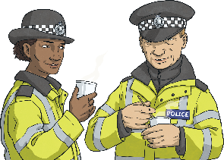
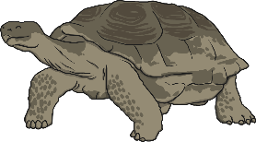
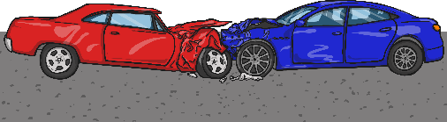
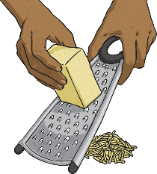
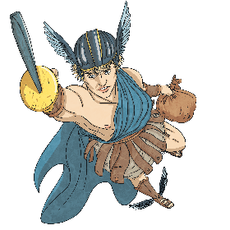

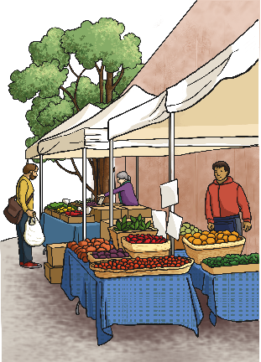
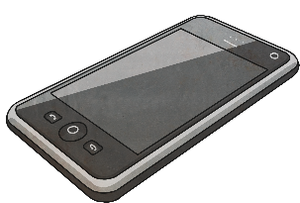
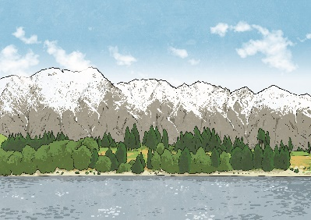
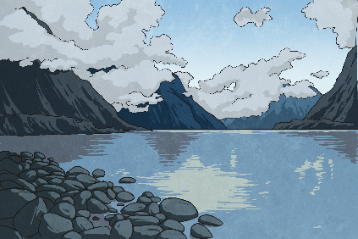
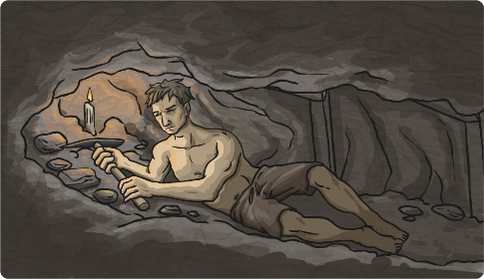
Writing Relative Clause Sentences
Choose a square to reveal a hidden picture. Write a relative clause sentence about the picture on your whiteboard. Underline your relative pronoun.
?
?
?
?
?
?
?
?
?
?
?
?
next

Slide 55
Features
Present tense, e.g. many birds fly south
Connectives that signal time, e.g. then, next, several months later
Causal connectives, e.g. because, so, this causes
Decide whether diagrams, charts, illustrations or a flow chart would help to explain.
Use a title that indicates what you are writing about.
Using how or why in the title helps. Try to make the title intrigue (interest) the reader, e.g. Why do sloths hang about?.

Slide 56
Use the first paragraph to introduce your subject to the reader.
Add in extra, interesting information.
Try to end by relating the subject to the reader.
If you use specialised terminology a glossary may be needed.
Interest the reader with exclamation, eg Beware - whirlwinds can kill!
Or use questions, e.g. Did you know that…?
Draw the reader in, e.g. strange as it may seem…, not many people know that…
Finally ...re-read your explanation, pretending you know nothing about the subject - is it clear?

Slide 57
Thursday 3rd December
LO: To use parenthesis and relative clauses in an explanation text.

Slide 58

Let’s start with a simple sentence.
Matthew was playing the guitar.
Not very interesting, is it?
Why don’t we add some extra information?
Matthew was playing the guitar. He was in his bedroom.
Ok, but still rather simple. How could we improve this?

Slide 59
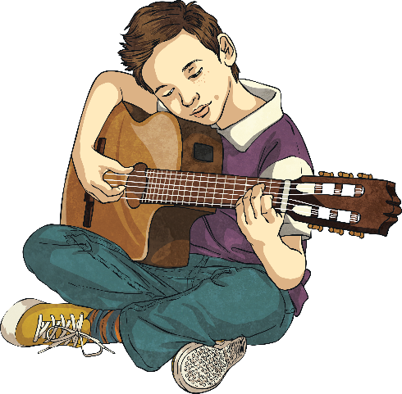
Let’s make it a complex sentence.
Matthew was playing the guitar. He was in his bedroom.
The second sentence adds a bit of non-vital information to the first one, so we can drop it in as a relative clause, like this…
Matthew, was playing the guitar.
who was in his bedroom,

Slide 60
We’ve dropped in a relative clause!
Matthew, who was in his bedroom, was playing the guitar.
main clause
subordinate clause
The main clause could be a sentence by itself and still make sense:
Matthew was playing the guitar.
However, the second sentence is now a subordinate clause, which doesn’t make any sense by itself: Who was in his bedroom.
The subordinate clause has to be stapled into the sentence with commas.

Slide 61
So it’s all relative, then?
We’ve replaced the pronoun in the second sentence with a relative pronoun. Can you spot it?
Matthew was playing the guitar. He was in his bedroom.
Matthew, who was in his bedroom, was playing the guitar.
Who is the relative pronoun we use to replace ‘people’ nouns/pronouns.

Slide 62
Other Relative Pronouns
Which is the relative pronoun we use to replace ‘objects’ nouns/pronouns.
Apples grow on trees. They are very healthy.
Apples, which are very healthy, grow on trees.

Slide 63
Other Relative Pronouns
Whose is the relative pronoun we use to replace possessive pronouns.
Victoria became Queen in 1837. Before Elizabeth II, her reign was the longest in British history.
My dog is called Frizz. His fur is very curly.
My dog, whose fur is very curly, is called Frizz.
Victoria, whose reign was the longest in British history before Elizabeth II, became Queen in 1837.

Slide 64
Other Relative Pronouns
Where is the relative pronoun we use to replace ‘place’ nouns/pronouns.
Mallorca is a Spanish island. We go there on holiday.
Mallorca, where we go on holiday, is a Spanish island.
The relative pronoun always goes straight after the main noun, so sometimes we have to re-order the clause slightly.

Slide 65
Other Relative Pronouns
When is the relative pronoun we use to replace ‘time’ noun phrases/pronouns.
In 2008, I was two years old. My brother was born in 2008.
In 2008, when my brother was born, I was two years old.
The relative pronoun 'that' is used for relative clauses where the added information is vital to the meaning of a sentence. When using 'that', we tend not to use commas around the relative clause. For example:
The old house that is next to our school is up for sale.

Slide 66
Instead of, not as well as…
Relative pronouns are used in relative clauses. Can you spot what’s wrong with these new sentences?
My mum is a doctor. Her name is Safira.
My mum, whose her name is Safira, is a doctor.
The writer has left the pronoun in the new subordinate clause, as well as adding a relative pronoun.

Slide 67
Punctuation
Relative clauses containing non-vital information have to be separated from the main clause. Typically, we use commas to mark the relative clauses, although dashes or brackets can also be used.
George was passed by a fire engine, which had its blue lights on.
Hospitals (where doctors and nurses work) are very busy places.
Grandma – whose eyes are sensitive – has to wear dark glasses.

Slide 68
Plenary
What have we learned?
We can combine two simple sentences into a complex sentence using a relative pronoun.
Relative pronouns look like question words, but they’re actually replacing a noun.
One of the sentences becomes a subordinate clause which we place after the noun.

Slide 69
Friday 4th December
LO: To self and peer assess our explanation texts.

Slide 70
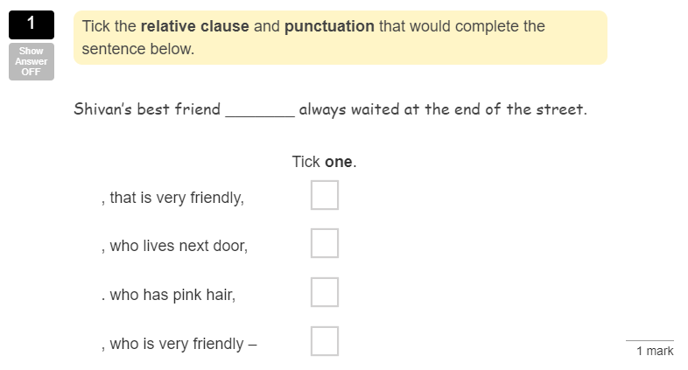

Slide 71
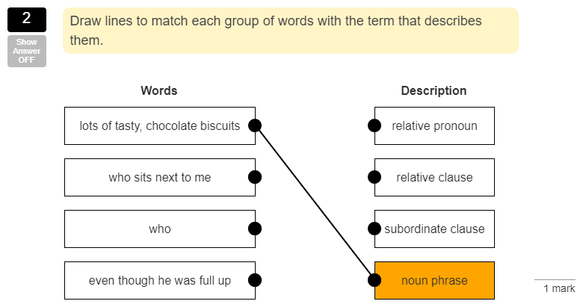

Slide 72
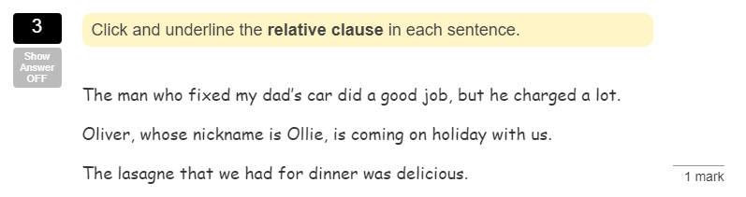

Slide 73
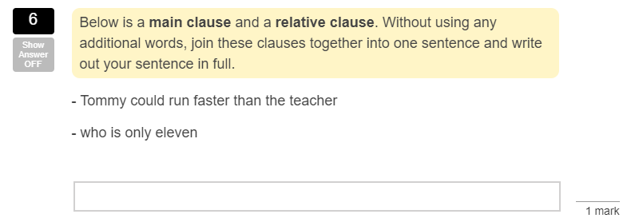

Slide 74
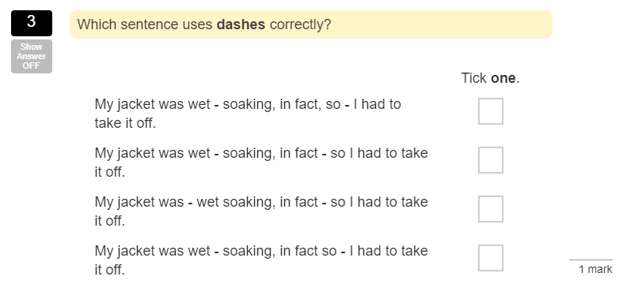

Slide 75
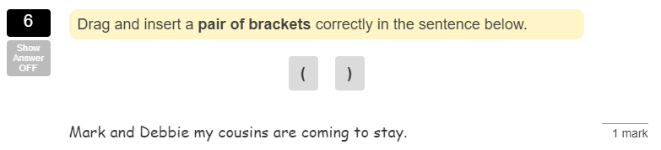

Slide 76
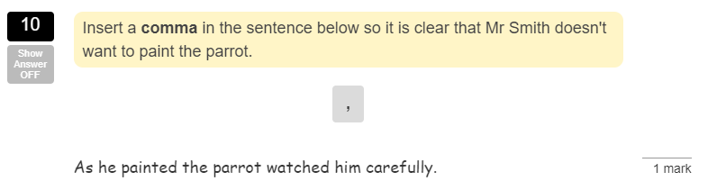

Slide 77
Features
Present tense, e.g. many birds fly south
Connectives that signal time, e.g. then, next, several months later
Causal connectives, e.g. because, so, this causes
Decide whether diagrams, charts, illustrations or a flow chart would help to explain.
Use a title that indicates what you are writing about.
Using how or why in the title helps. Try to make the title intrigue (interest) the reader, e.g. Why do sloths hang about?.

Slide 78
Use the first paragraph to introduce your subject to the reader.
Add in extra, interesting information.
Try to end by relating the subject to the reader.
If you use specialised terminology a glossary may be needed.
Interest the reader with exclamation, eg Beware - whirlwinds can kill!
Or use questions, e.g. Did you know that…?
Draw the reader in, e.g. strange as it may seem…, not many people know that…
Finally ...re-read your explanation, pretending you know nothing about the subject - is it clear?

