Slide 1
Monday 7th December
LO: Spelling practice.
Green Group | Yellow Group | Red Group
vicious | vicious | there
delicious | delicious | their
ambitious | cautious | they’re
cautious | spacious | here
gracious | actually | hear
experience | different
peculiar
answer
surprise
enough

Slide 2
Monday 7th December
LO: To design a ‘Cracking Contraption’ and explain how it works.

Slide 3
https://youtu.be/2igRcGxlshA https://www.youtube.com/watch?v=Xc5eqwzEgUo https://www.youtube.com/watch?v=vGxRUglFFME&t=3s

Slide 4
What features do we need?

Slide 5
What features do we need?
Title / Heading
Subtitles / subheadings
Formal language
Variety of punctuation
Fact box
Images (photo, diagram, illustration)
Introduction
Conclusion

Slide 6
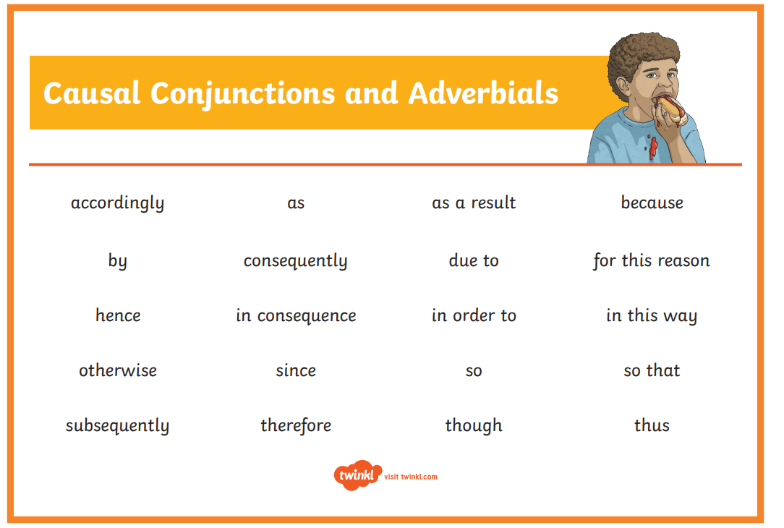

Slide 7
Explanation text
tells how or why a process
happens (or how something works).
This is sequential and deals
with cause and effect.

Slide 8
Features
Present tense, e.g. many birds fly south
Connectives that signal time, e.g. then, next, several months later
Causal connectives, e.g. because, so, this causes
Decide whether diagrams, charts, illustrations or a flow chart would help to explain.
Use a title that indicates what you are writing about.
Using how or why in the title helps. Try to make the title intrigue (interest) the reader, e.g. Why do sloths hang about?.

Slide 9
Use the first paragraph to introduce your subject to the reader.
Add in extra, interesting information.
Try to end by relating the subject to the reader.
If you use specialised terminology a glossary may be needed.
Interest the reader with exclamation, eg Beware - whirlwinds can kill!
Or use questions, e.g. Did you know that…?
Draw the reader in, e.g. strange as it may seem…, not many people know that…
Finally ...re-read your explanation, pretending you know nothing about the subject - is it clear?

Slide 11
Tuesday 8th December
LO: To write more sections of my explanation text.

Slide 12
Features
Title – explains what the text is for
Opening Statement – about the subject
Clear, simple points about why or how something occurs
Technical words – where appropriate
Conjunctions – e.g. because, resulting in
Present tense
Summary Paragraph

Slide 13

Use a clear title that indicates what you are writing about.
Decide whether to use diagrams, charts, illustrations or flow charts to help explain.
Title and Introduction
Use the first paragraph to introduce the subject to the reader.
Try to make the title intrigue the reader.
Why do sloths hang about?
Using how or why in a title helps.

Slide 14
Organise the writing and illustrations to explain:
What you need.
How it works.
Why it works.
When and where it works.
What it is used for.
Add in extra, interesting information.

Slide 15
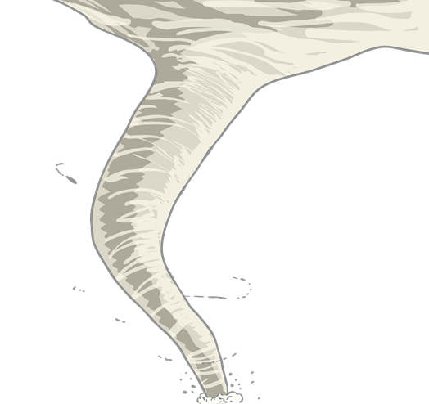
Interest the reader with an exclamation or question.
Beware – whirlwinds can kill!
Did you know...?
Interest the reader.
Strange as it may seem…,
Not many people know that…

Slide 16
Reread the explanation pretending that you know nothing about the subject. Does it make sense?
Finish by drawing all ideas together in a concluding paragraph.
Ending
If specialised terminology is used, a glossary may be needed.
Relate the ending to the reader.

Slide 17
Features
Present tense, e.g. many birds fly south
Connectives that signal time, e.g. then, next, several months later
Causal connectives, e.g. because, so, this causes
Decide whether diagrams, charts, illustrations or a flow chart would help to explain.
Use a title that indicates what you are writing about.
Using how or why in the title helps. Try to make the title intrigue (interest) the reader, e.g. Why do sloths hang about?.

Slide 18
Use the first paragraph to introduce your subject to the reader.
Add in extra, interesting information.
Try to end by relating the subject to the reader.
If you use specialised terminology a glossary may be needed.
Interest the reader with exclamation, eg Beware - whirlwinds can kill!
Or use questions, e.g. Did you know that…?
Draw the reader in, e.g. strange as it may seem…, not many people know that…
Finally ...re-read your explanation, pretending you know nothing about the subject - is it clear?

Slide 21
Wednesday 9th December
Reading and spelling assessments.

Slide 22
Thursday 10th December
Grammar assessment.

Slide 23
Friday 11th December
LO: To publish my explanation text.

