Slide 1
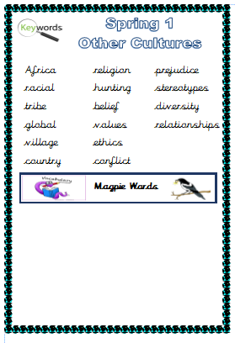
What do these words mean?

Slide 2
Tuesday 5th January
LO: To know personal and possessive pronouns.

Slide 3
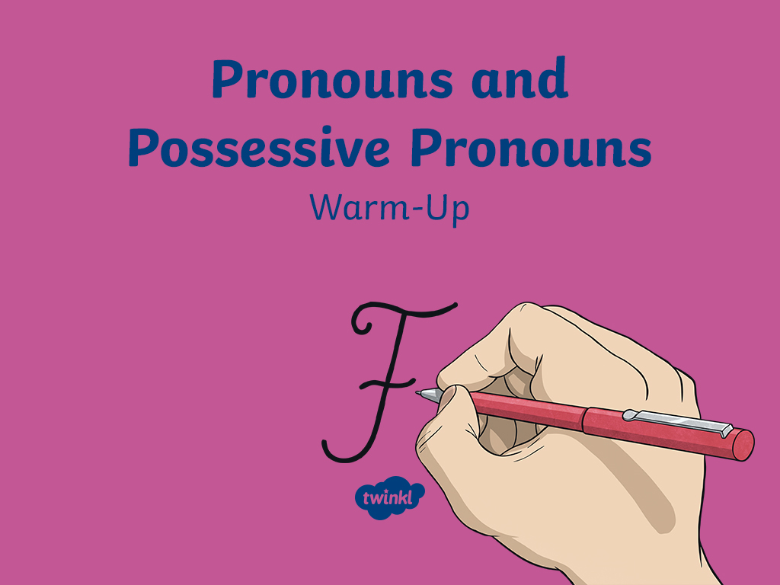

Slide 4
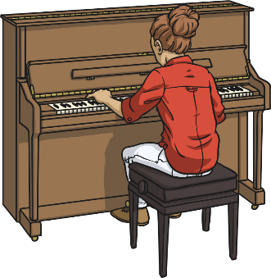
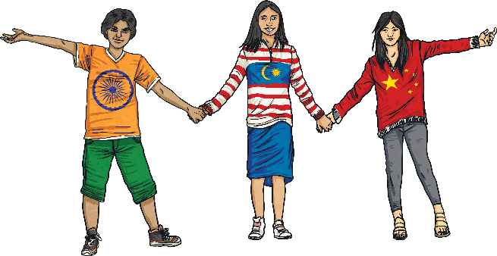
What Are Personal and
Possessive Pronouns?
Personal pronouns represent people, places and things, such as:
She gave him a piano lesson.
I had lots of fun with you today.
Possessive pronouns show ownership and replace
possessive noun phrases, such as:
The guitar is hers.
“The parking space is ours!” screamed Gina.

Slide 5
Pronouns
How many different personal and possessive pronouns can you think of?
you
Pronouns
his
I
we
hers
he
them
its
she
us
ours
it
mine
theirs
they
yours

Slide 6
Personal or Possessive?
Keeping in mind that personal pronouns represent people, places and things, and possessive pronouns show ownership, sort the following words into the
correct circles:
I
yours
his
him
he
you
theirs
she
its
ours
her
it
them
they
we
Personal
Possessive

Slide 7
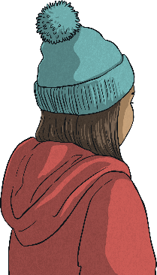
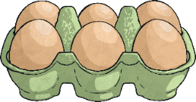

Spot the Pronouns
Read the sentences below and spot the pronouns.
Try to decide if they are personal or possessive pronouns.
“Those eggs are ours. You need to collect them,” said Anita.
“Is the bobble hat mine or yours?” asked Charlotte.
First he signed the paper and then he walked inside.
The responsibility is yours to make sure that you are lining up correctly.

Slide 8
Spot the Pronouns Answers
Were you able to spot the pronouns?
Could you decide if they were personal or possessive pronouns?
“Those eggs are ours. You need to collect them,” said Anita.
“Is the bobble hat mine or yours?” asked Charlotte.
First he signed the paper and then he walked inside.
The responsibility is yours to make sure that you are lining up correctly.

Slide 9

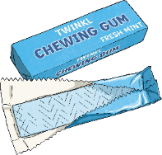
Which Pronoun Fits?
Read the sentences below and add in the missing pronouns. Will they be personal or possessive pronouns? Will more than one option fit?
“ snapped my pencil!” screamed Sandra.
“ don’t know who did it, ask ,” retorted Bradley.
"The chewing gum is , not ," lied Sayid.
“This group is . is over there,”
snapped Keisha.

Slide 10

Which Pronoun Fits?
Read the sentences below and add in the missing pronouns. Will they be personal or possessive pronouns? Will more than one option fit?
“She snapped my pencil!” screamed Sandra.
“I don’t know who did it, ask them,” retorted Bradley.
“The chewing gum is theirs, not mine,” lied Sayid.
“This group is ours. Yours is over there,” snapped Keisha.

Slide 11
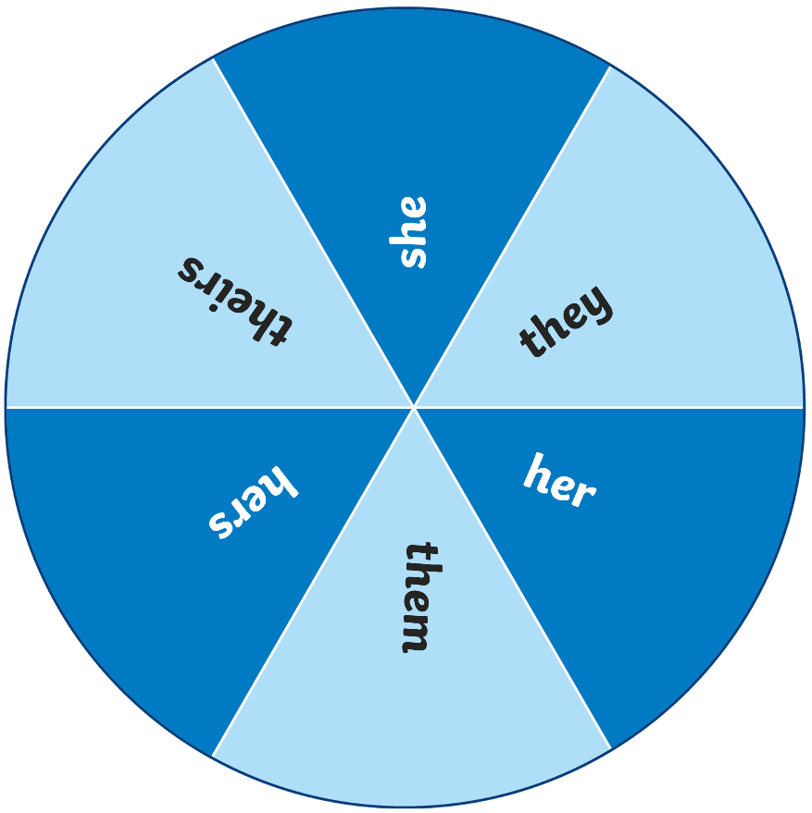
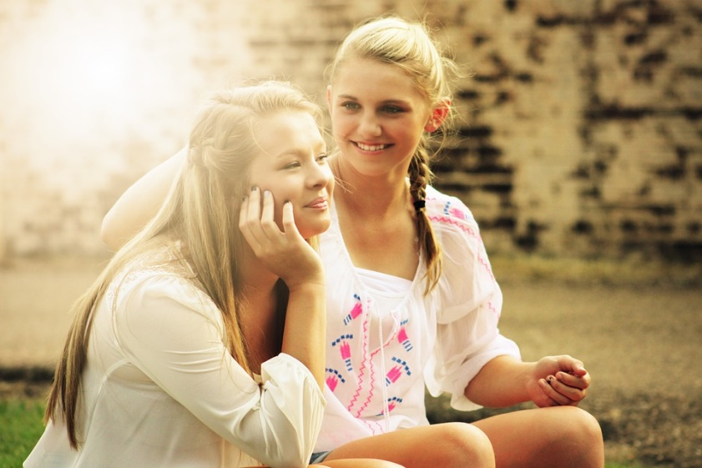
Spin the Wheel!
Spin the wheel to select a pronoun.
Spin
Next Slide
Spin the spinner to choose a pronoun. On your whiteboards, write your own sentence about this picture which includes that pronoun.

Slide 12
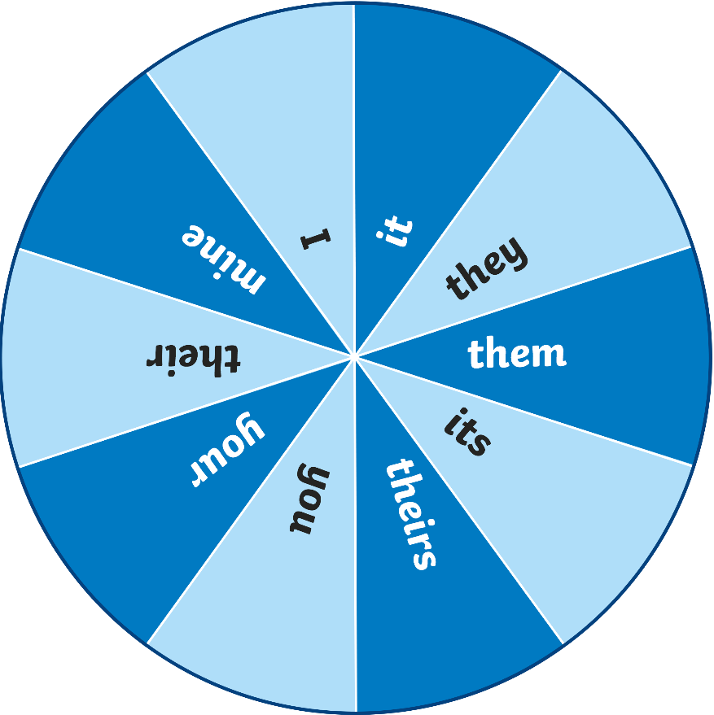
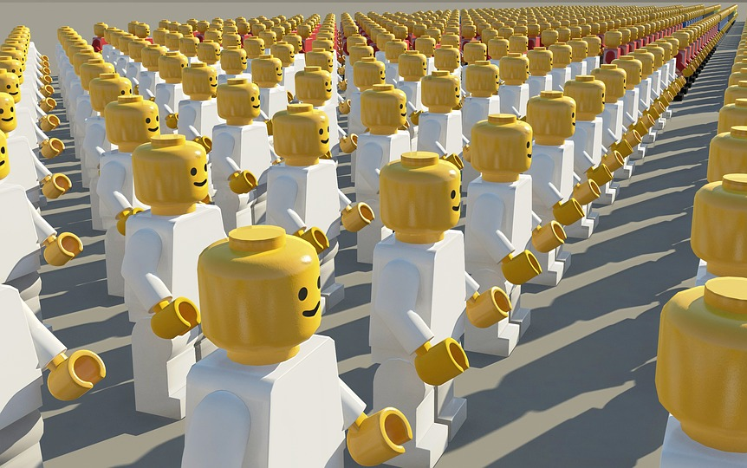
Spin the Wheel!
Spin the wheel to select a pronoun.
Spin
Next Slide
Spin the spinner to choose a pronoun. On your whiteboards, write your own sentence about this picture which includes that pronoun.

Slide 13
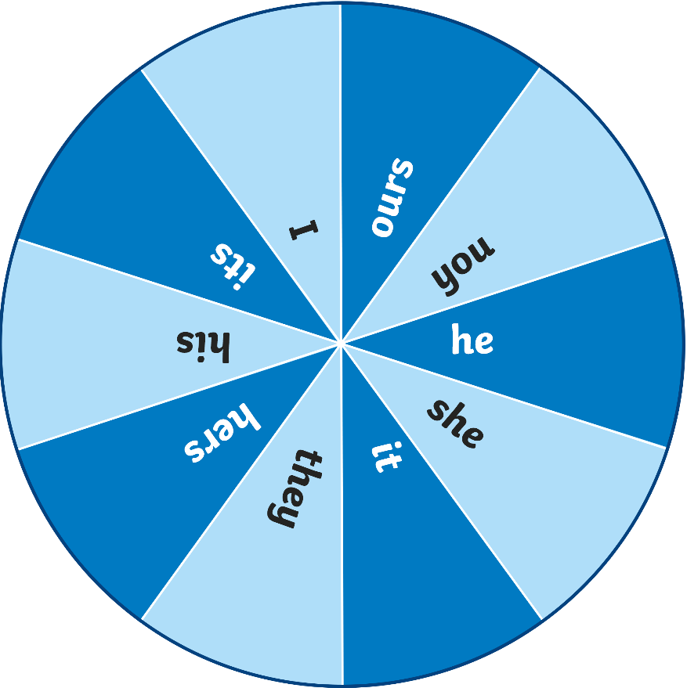
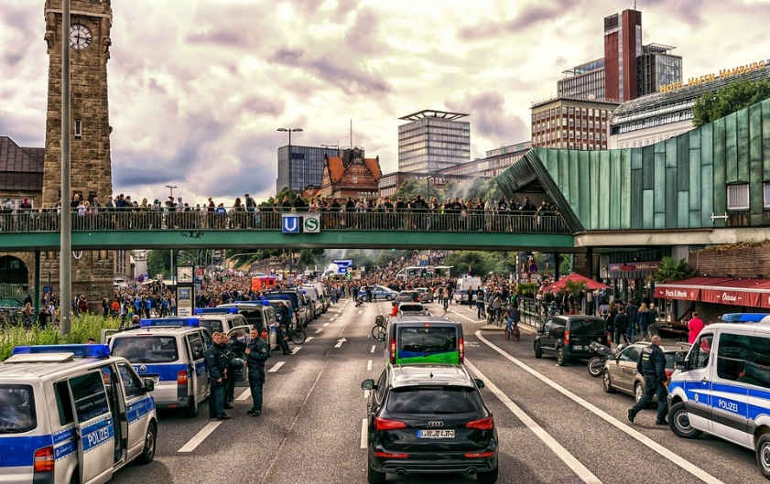
Spin the Wheel!
Spin the wheel to select a pronoun.
Spin
Next Slide
Spin the spinner to choose a pronoun. On your whiteboards, write your own sentence about this picture which includes that pronoun.

Slide 14
Pronouns Quick Quiz
Take a quiz to see if you are an expert!
Is the pronoun underlined in this sentence a
personal pronoun or a possessive pronoun?
You must stop lying to me.
personal
possessive
You’re correct.

Slide 15
Pronouns Quick Quiz
Is the pronoun underlined in this sentence a
personal pronoun or a possessive pronoun?
We would love to come to the party.
personal
possessive
You’re correct!

Slide 16
Pronouns Quick Quiz
Is the pronoun underlined in this sentence a
personal pronoun or a possessive pronoun?
Sorry, that cat is mine.
personal
possessive
You’re correct!

Slide 17
Pronouns Quick Quiz
Is the pronoun underlined in this sentence a
personal pronoun or a possessive pronoun?
Please stop talking to me whilst I work.
personal
possessive
You’re correct!

Slide 18
Pronouns Quick Quiz
Is the pronoun underlined in this sentence a
personal pronoun or a possessive pronoun?
They went on and on about it for hours.
personal
possessive
You’re correct!

Slide 19
Pronouns Quick Quiz
Is the pronoun underlined in this sentence a
personal pronoun or a possessive pronoun?
If the pots are yours, you need to wash them.
personal
possessive
You’re correct!

Slide 20
LO: To infer what life could be like for a character in another culture.

Slide 21
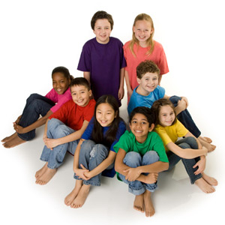
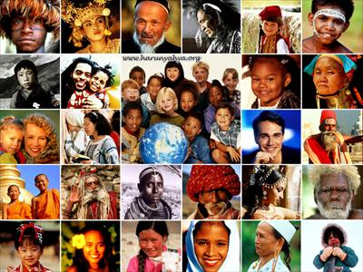
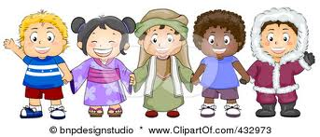
Stories from other cultures

Slide 22
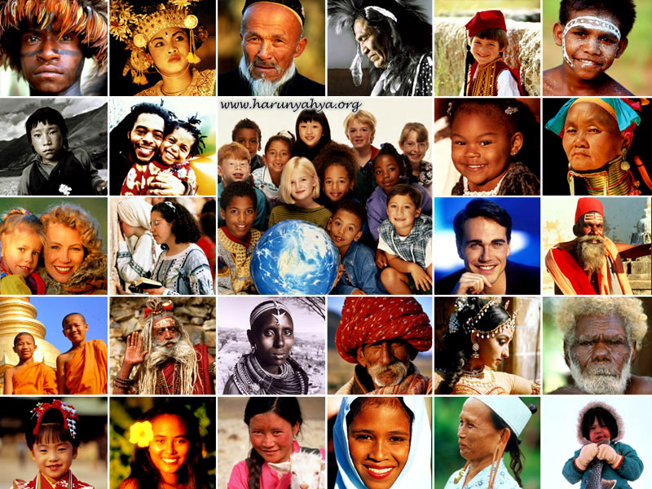
What does ‘culture’ mean ?

Slide 23
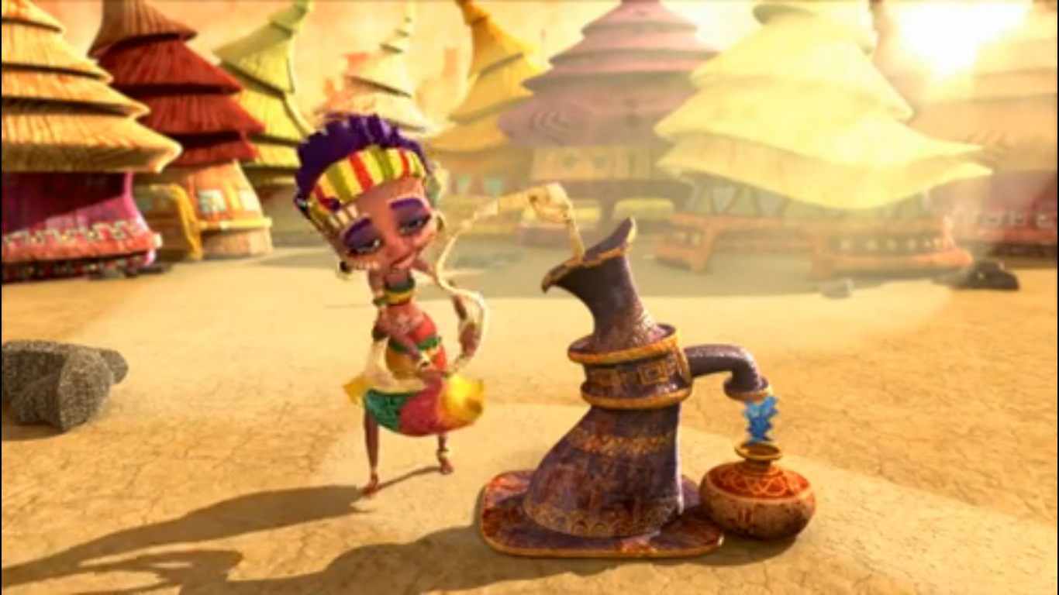
Think about what life could be like for a character in a different culture

Slide 24
https://vimeo.com/23455377

Slide 25
What do we know about Zahra?
Why is she travelling back and forwards to the pump?
Why do trees and flowers suddenly appear at the end of the film?
What does this film teach us about the culture/place where she lives?

Slide 26
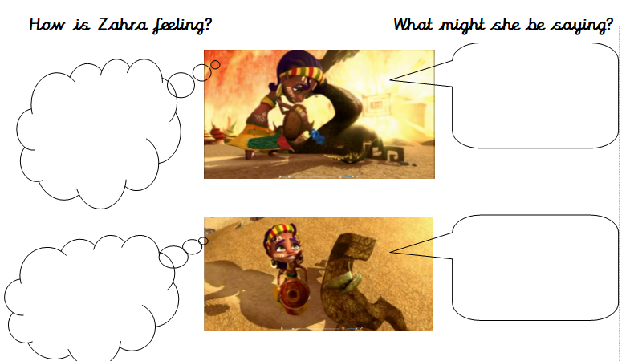

Slide 27
How does this culture compare to ours?
Similarities?
Differences?

Slide 28
Wednesday 6th January
LO: To use different types of pronouns in sentences.

Slide 29
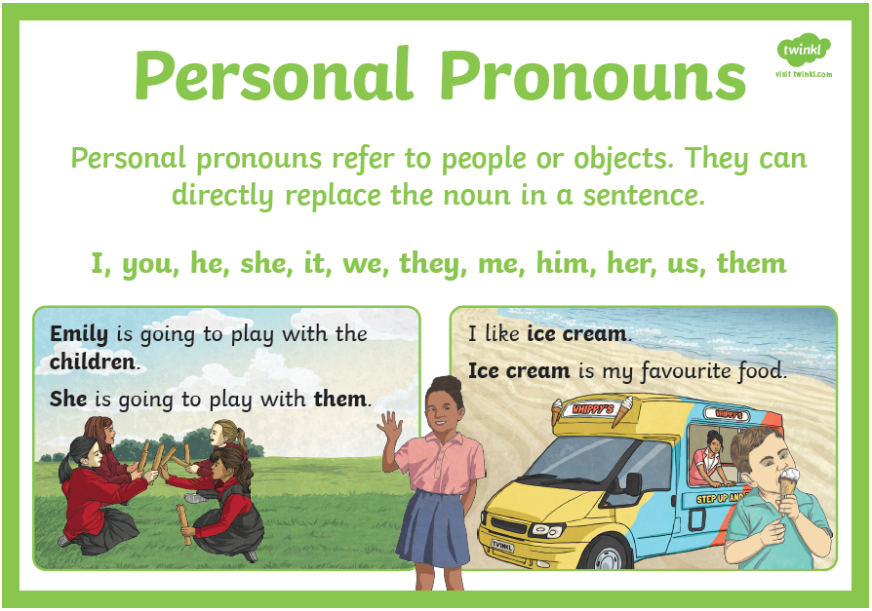

Slide 30
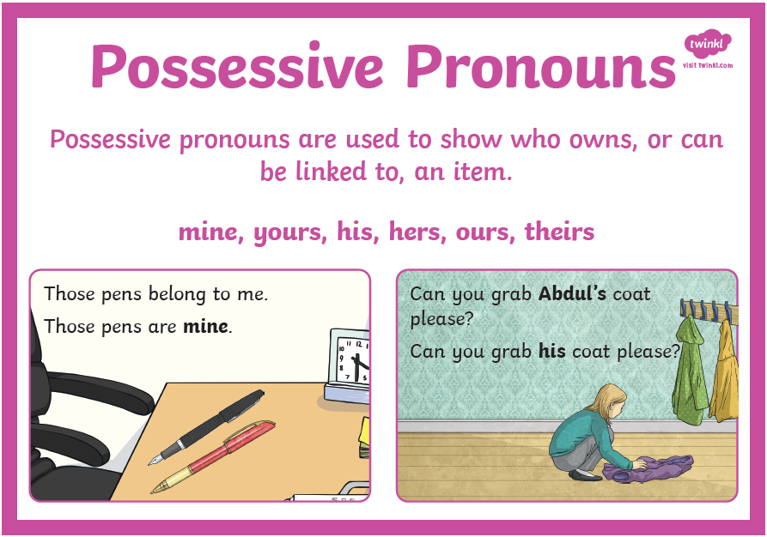

Slide 31
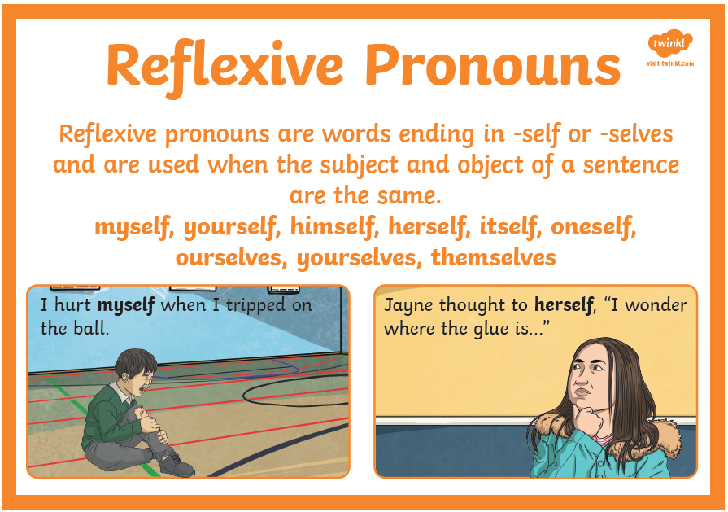

Slide 32
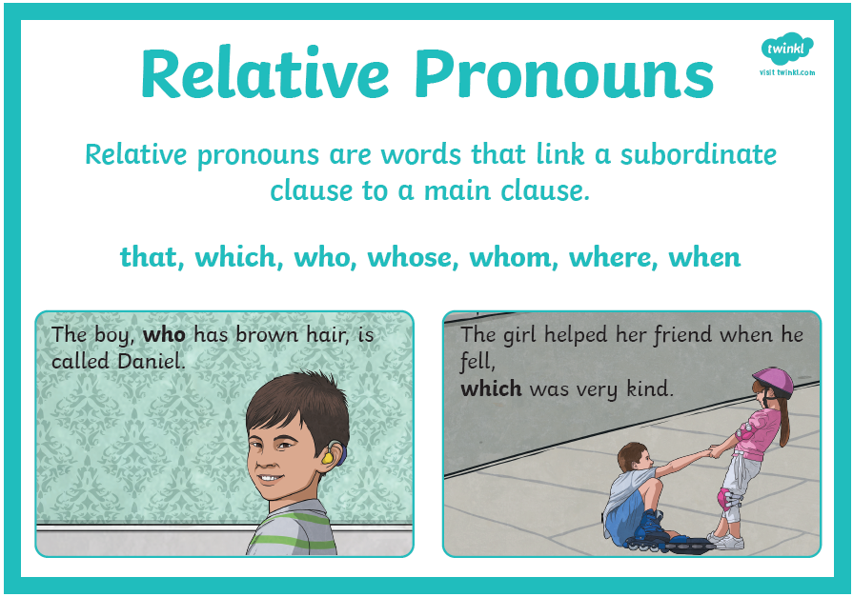

Slide 33
LO: To take part in a discussion about books.

Slide 34
Zahra was from Africa.
Is all of Africa like this?
No!

Slide 35
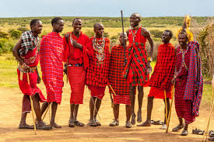
Africa or not?

Slide 36
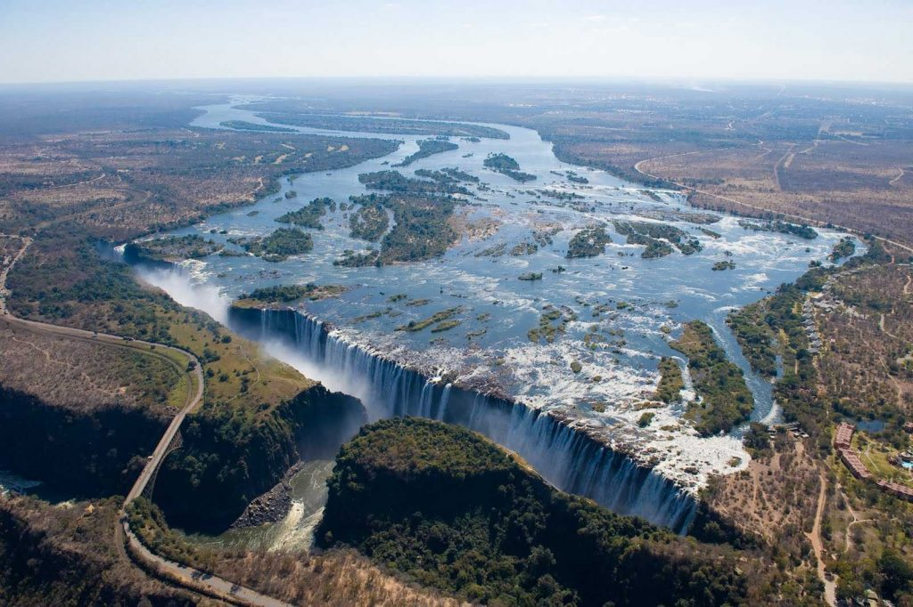
Africa or not?

Slide 37
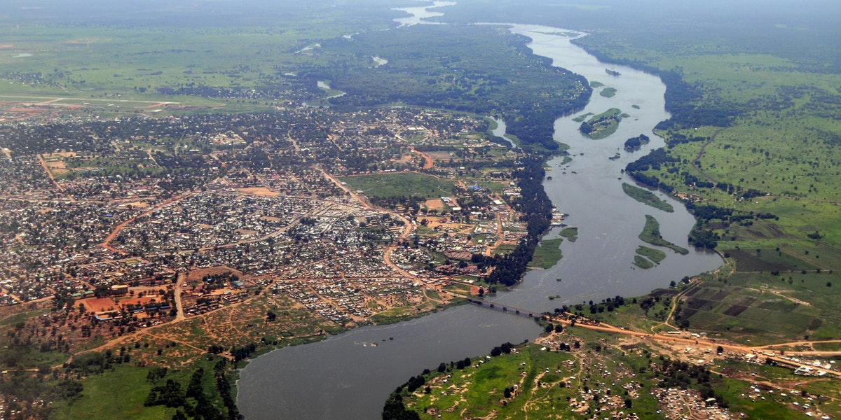
Africa or not?

Slide 38
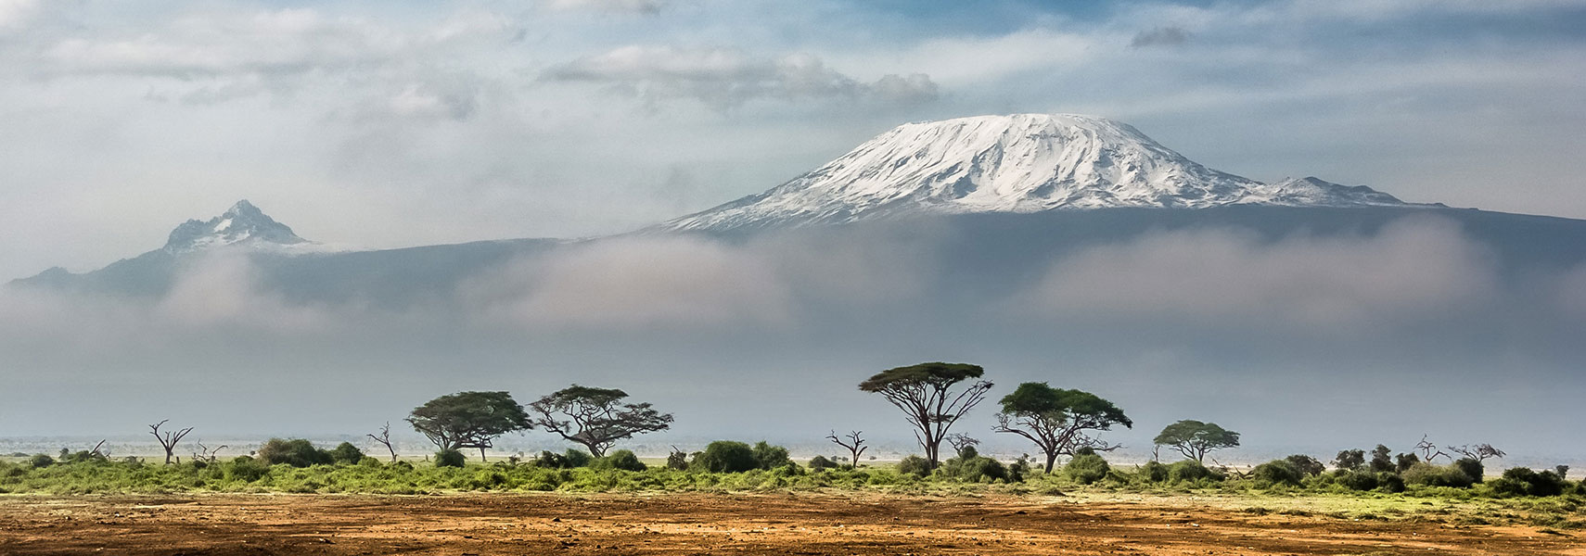
Africa or not?

Slide 39
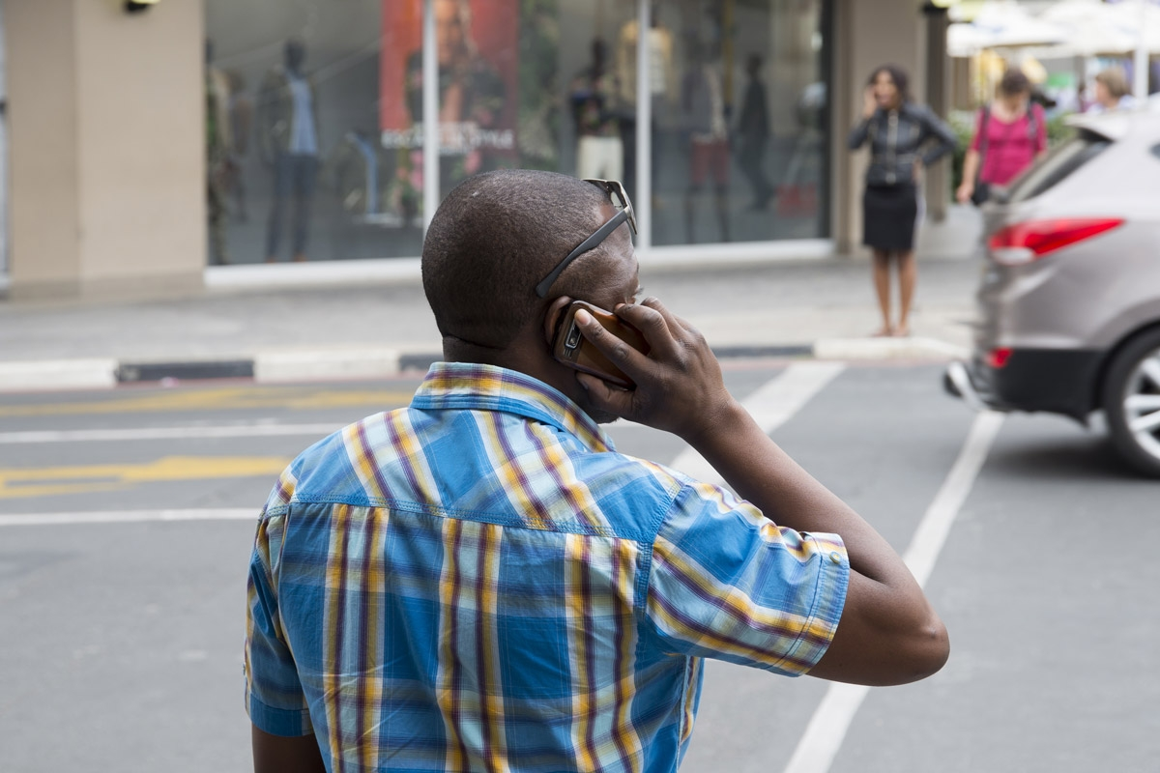
Africa or not?

Slide 40
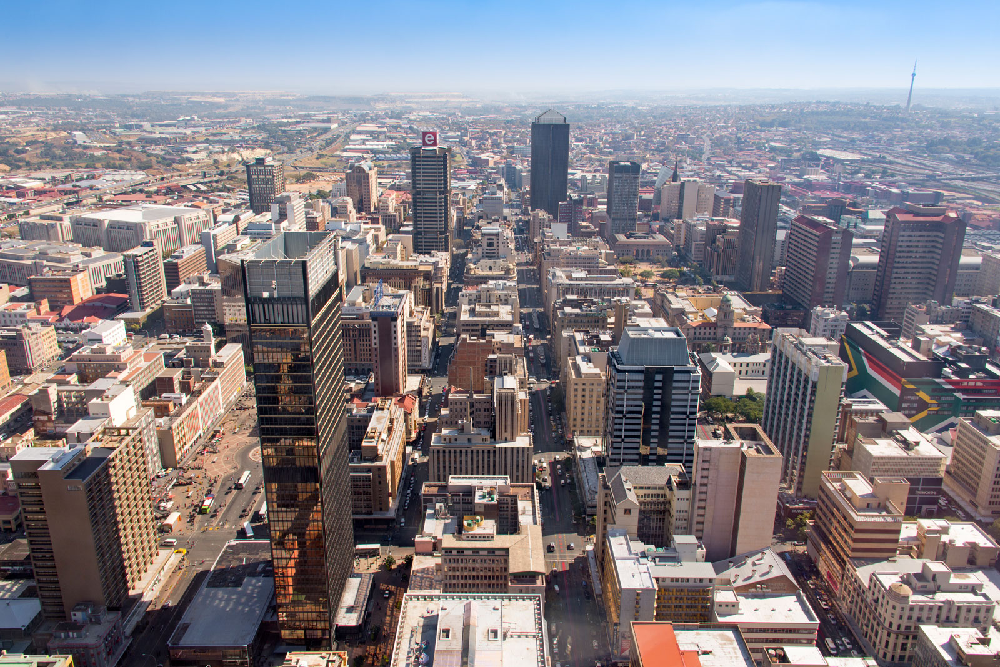
Africa or not?

Slide 41
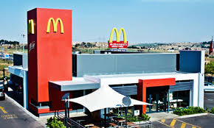
Africa or not?

Slide 42
Africa is a very diverse continent.

Slide 43
https://www.youtube.com/watch?v=gh3erSSTQnk

Slide 44
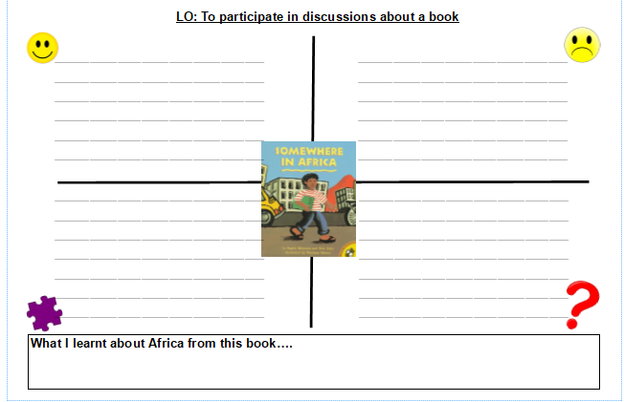

Slide 45
What have you learnt about Africa this lesson?
TPS

Slide 46
Thursday 7th January
LO: To recognise relative pronouns and clauses.

Slide 47
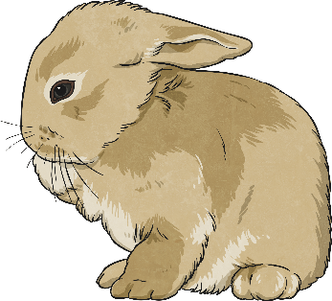
Relative Pronouns
A relative clause always starts with a relative pronoun.
Examples of relative pronouns are:
Can you identify the relative pronouns in these sentences?
We went to the new swimming pool, which has three fantastic slides.
Josie, who loves to play football, was picked for the county team.
Sadiq, whose pen had run out, put his hand up to ask for another one.
The boy whom you met last week is coming to visit later.
My Grandad caught the rabbit that had escaped.
whose
which
who
that
whom

Slide 48
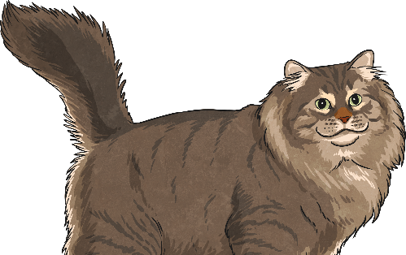
Where Can a Relative Clause Be Placed?
Where in these sentences are the relative clauses placed? How do you know?
The class were well-behaved on the school trip, which made their teacher proud.
William, who was wearing his favourite shirt, was going to the school disco.
I go to a swimming club early in the morning, which means that I’m tired by the afternoon.
Have you seen the people whom we met yesterday at the park?
Amir found the missing cat that his neighbour had lost.
Relative clauses can be in the middle of a
sentence (embedded) or at the end of a sentence.

Slide 49

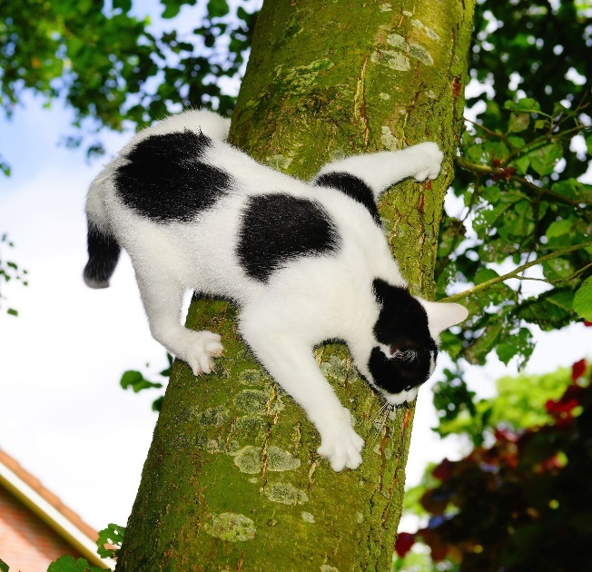
Creating Relative Clauses
Write sentences about the following pictures and include an embedded relative clause:
My cat, which was black and white, got stuck
up a tree.
The children, who all wore helmets, were excited about their cycling trip.

Slide 50
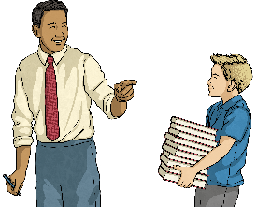
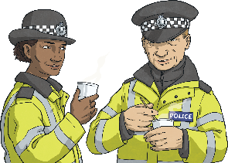
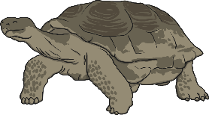
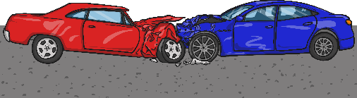
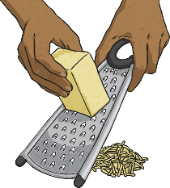
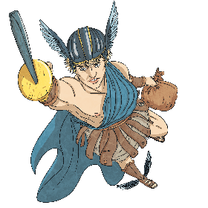
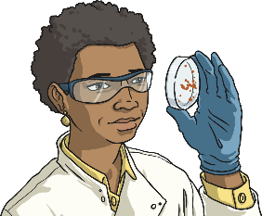
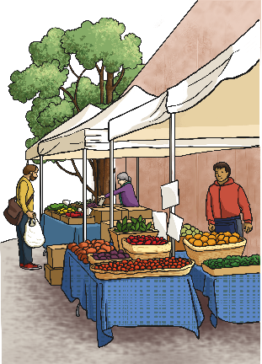
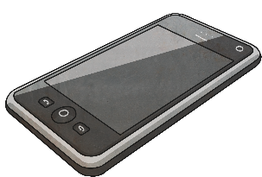
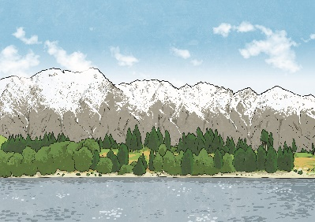
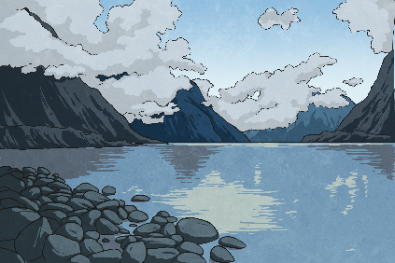
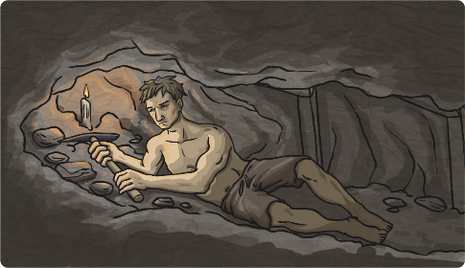
Writing Relative Clause Sentences
Choose a square to reveal a hidden picture. Write a relative clause sentence about the picture on your whiteboard. Underline your relative pronoun.
?
?
?
?
?
?
?
?
?
?
?
?
next

Slide 51
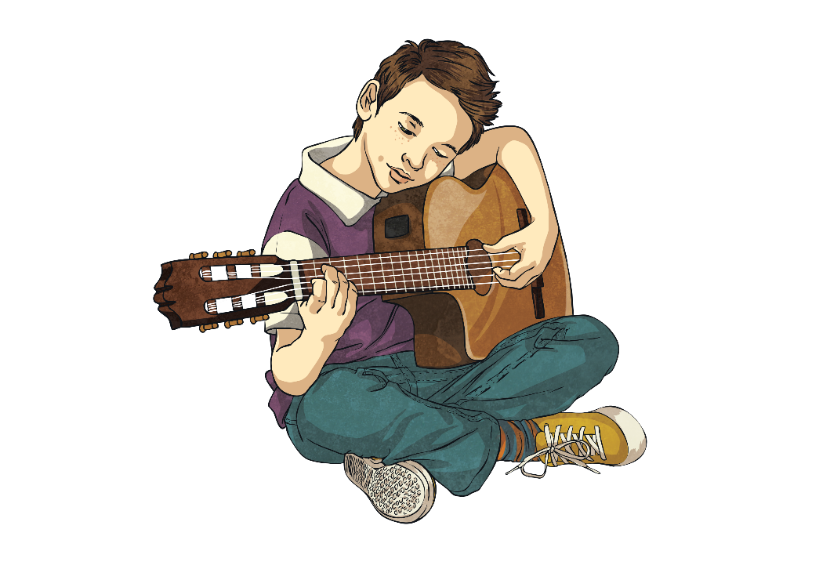
Quick Quiz 1
For each sentence, identify the relative pronoun:
I can’t eat that chocolate bar because it has nuts in, which I’m allergic to.
Mangoes, which are grown in tropical countries, are one of my favourite foods.
The cats that were caterwauling last night kept me awake.
Jamal, who is a fantastic guitarist, has joined the school band.

Slide 52
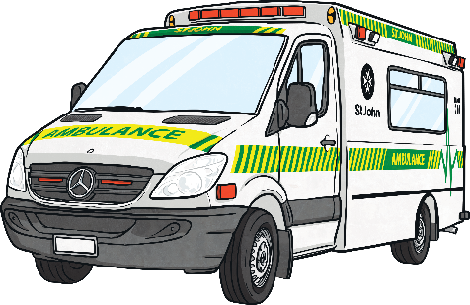
Quick Quiz 2
Can you match the main clause to the appropriate relative clause?
The cat scratched my arm,
The paddling pool is full of cool water,
I have a sister,
The ambulance rushed to help the child,
who is three years younger than me.
who had fallen from the tall slide.
which made it sore.
which is fabulous on this hot day.

Slide 53
Quick Quiz 3
Can you break each relative clause sentence back down into two single-clause (simple) sentences?
I look just like my dad, whose hair is black too.
I look just like my dad. His hair is black too.
My rabbit, who loves carrots, always runs up to me when I go to its hutch.
My rabbit always runs up to me when I go to its hutch. It loves carrots.
Micah, whose legs were aching, finally completed the race.
Micah finally completed the race. His legs were aching.

Slide 54
LO: To explore relationships of characters in another culture.

Slide 55
Today’s story is from Zimbabwe.
Do you know where Zimbabwe is?

Slide 56
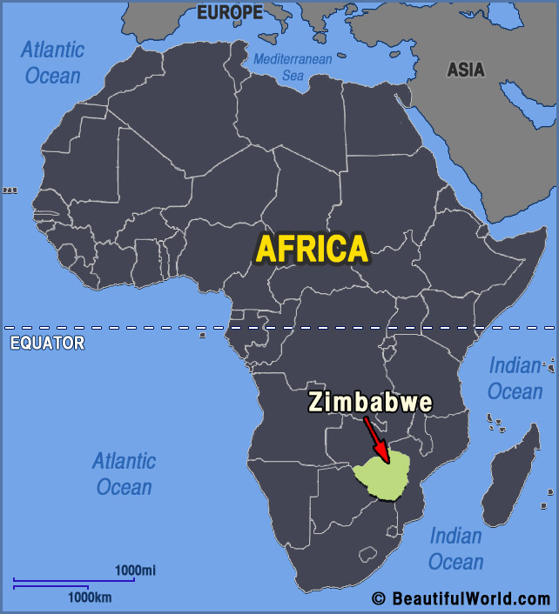

Slide 57
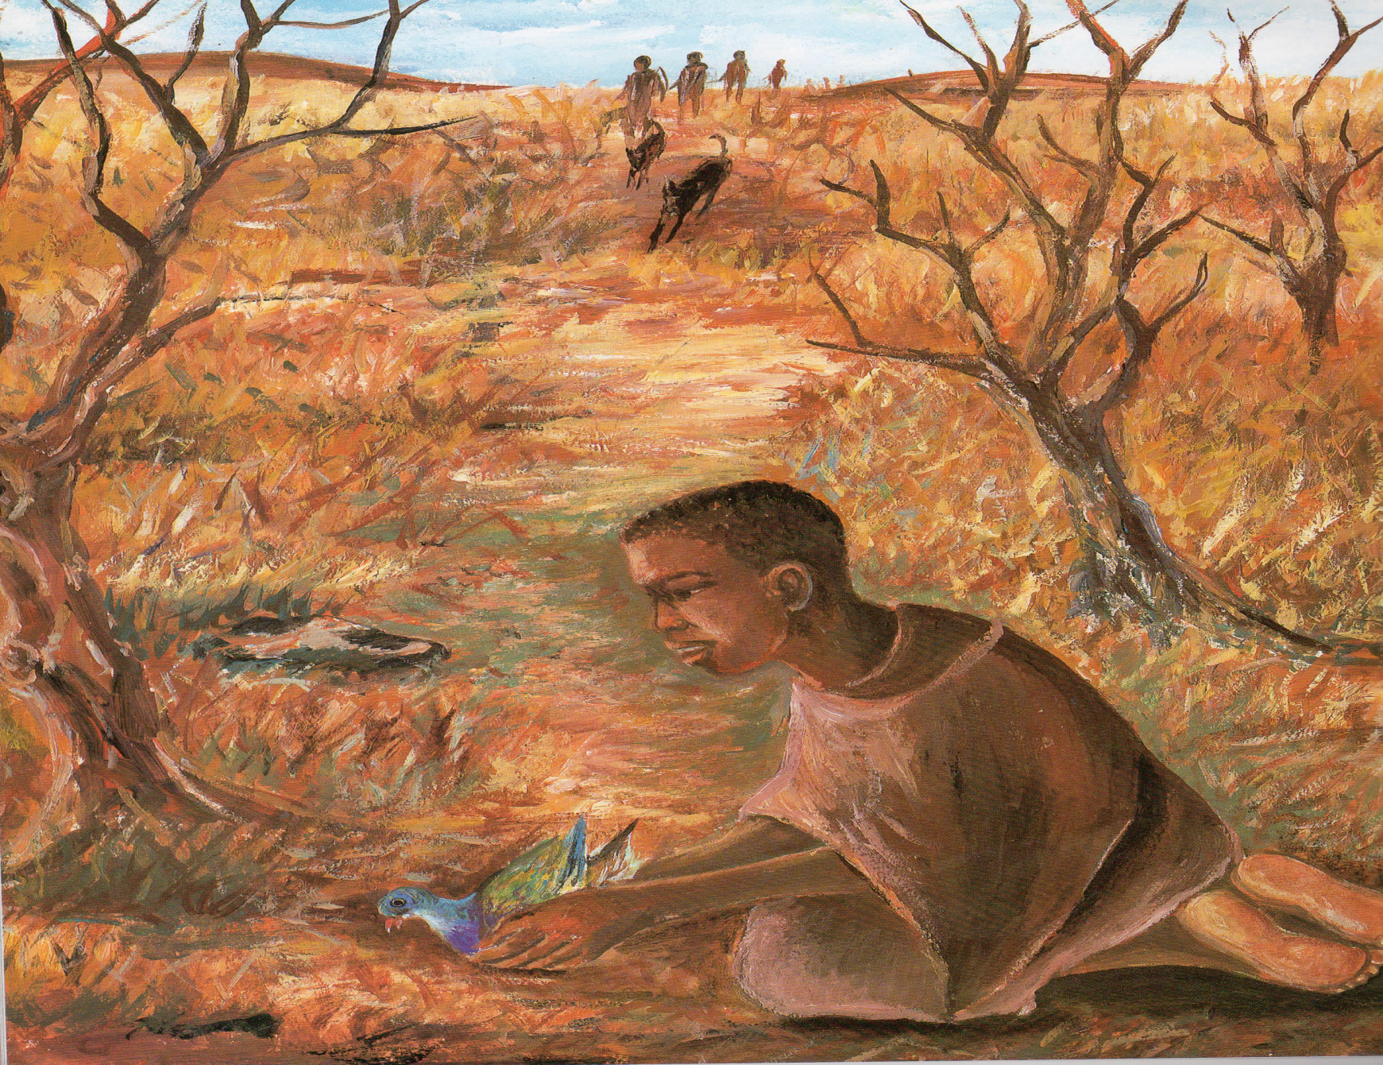

Slide 58


Slide 59


Slide 60


Slide 61

What is this story about?
What clues in the pictures tell us this story is not set in the UK?
How might their culture be different than ours?

Slide 62
We have 4 characters in this story:
Gano, Muto, Kondo, old Marumba
You have two characters to listen for... make notes about what each character is like and the things they do which are different to our lives.
BONUS: Whose point of view is this story told from?

Slide 63


Slide 64


Slide 65


Slide 66
Which character do you feel the most sorry for?
Why?

Slide 67
What traditions are in this story?

Slide 68

What traditions are in this story?

