Slide 2
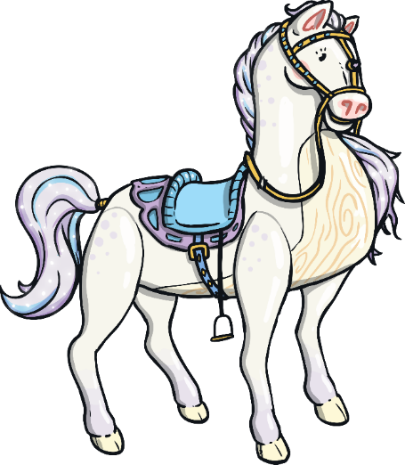
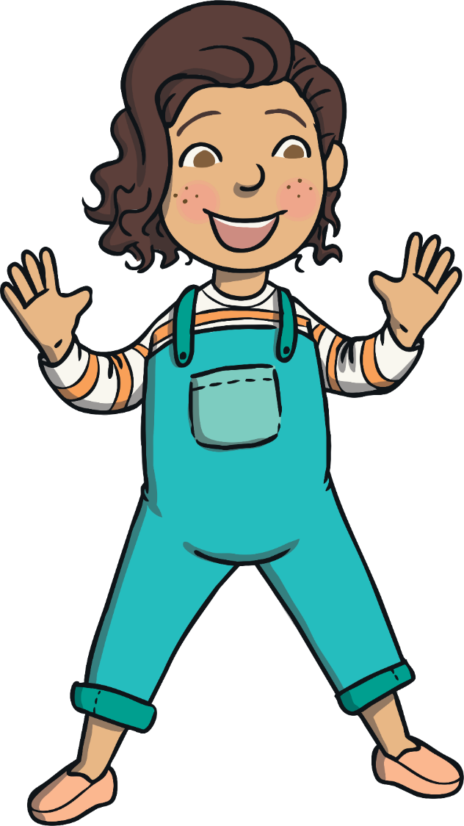
The Old Toy Room
Read the book ‘The Old Toy Room’ and look at the illustrations.
To see a question about the story, click this button:
?

Slide 3
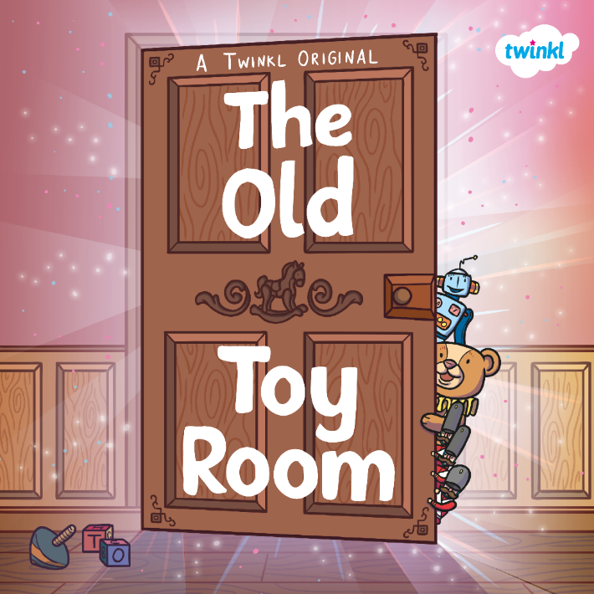

?
What do you think this book is going to be about?
?
Do you think it is fiction or non-fiction?
?
What do you think might be behind the door?

Slide 4
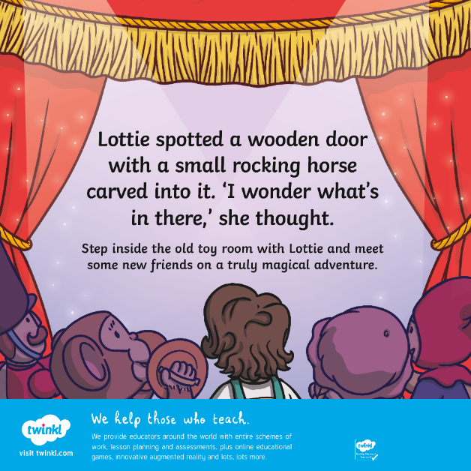
The story is described as a ‘magical adventure’. What do you think might be magical in this story?
Who do you think might be the ‘new friends’ that Lottie meets?
?
?

Slide 5
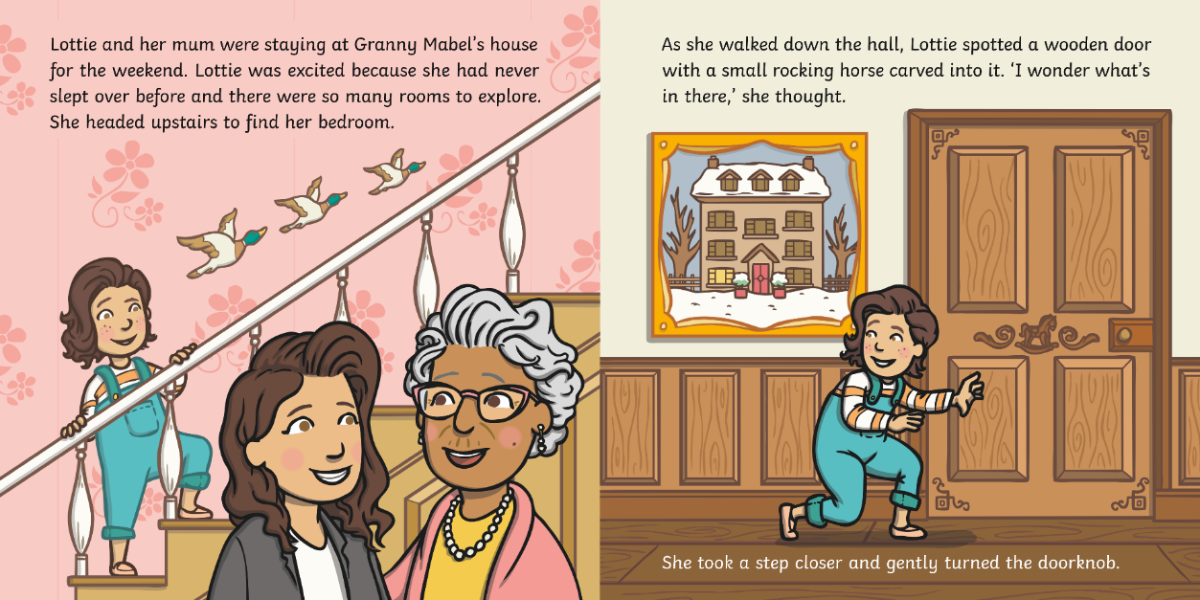
?
What do you think happens next?

Slide 6
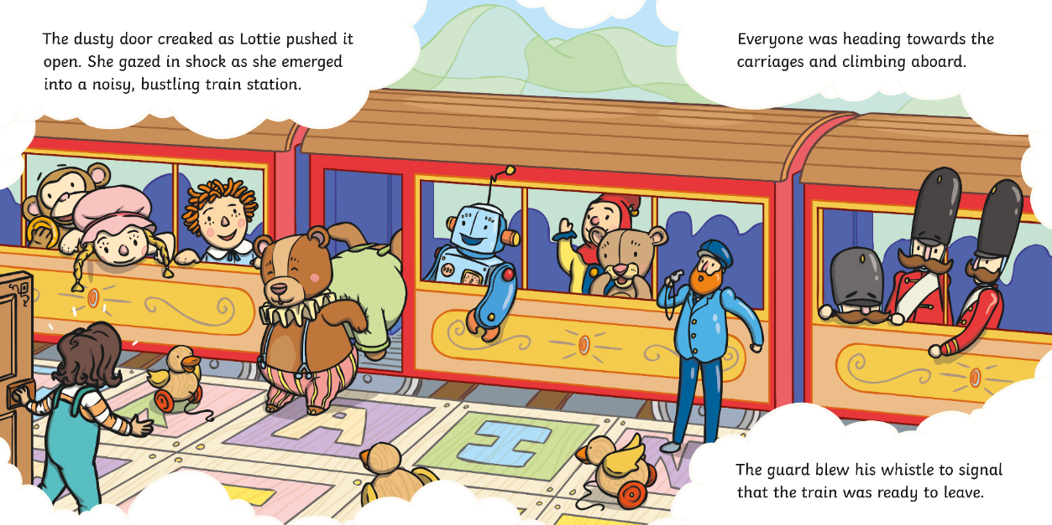
?
Where is Lottie now?

Slide 7
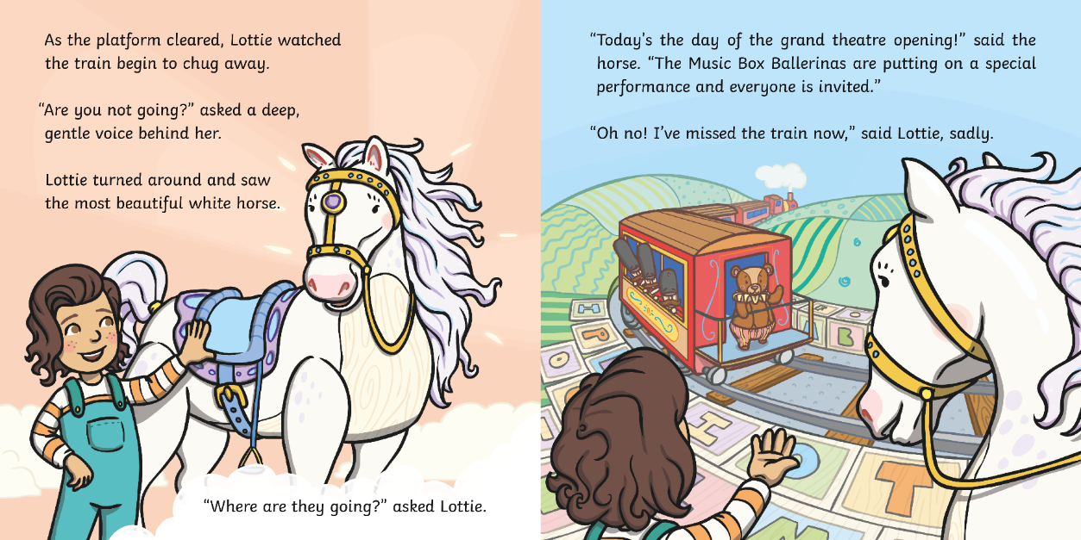
?
There are lots of adjectives here. Can you spot them?

Slide 8
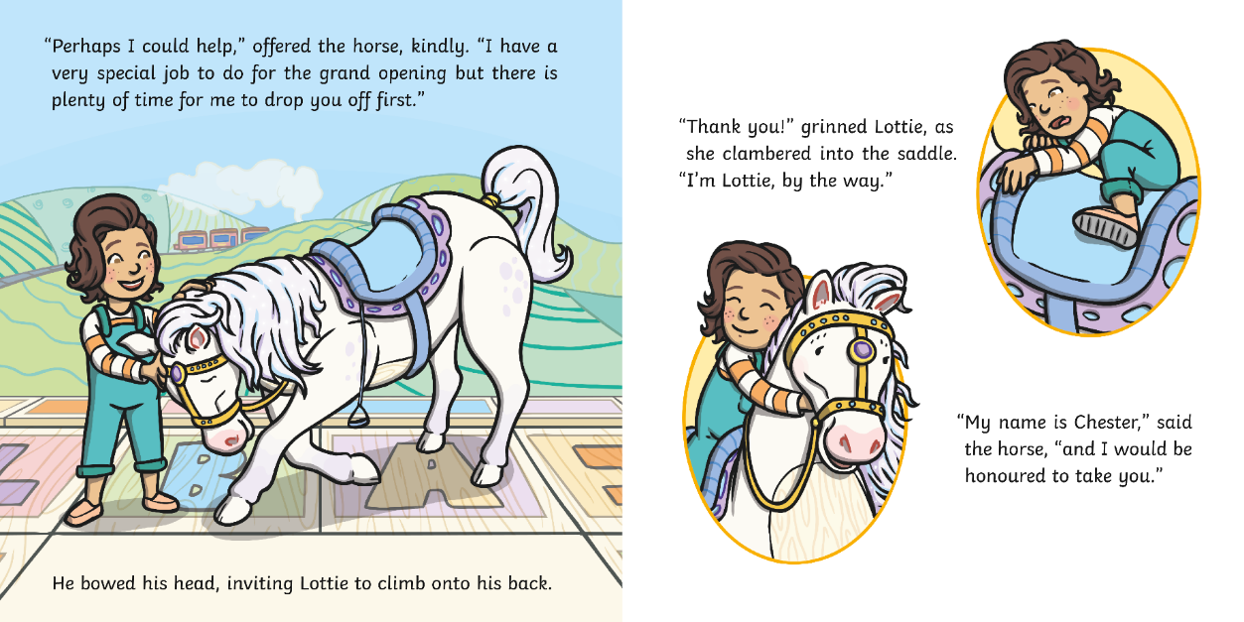
?
What does the verb ‘clambered’ mean?

Slide 9
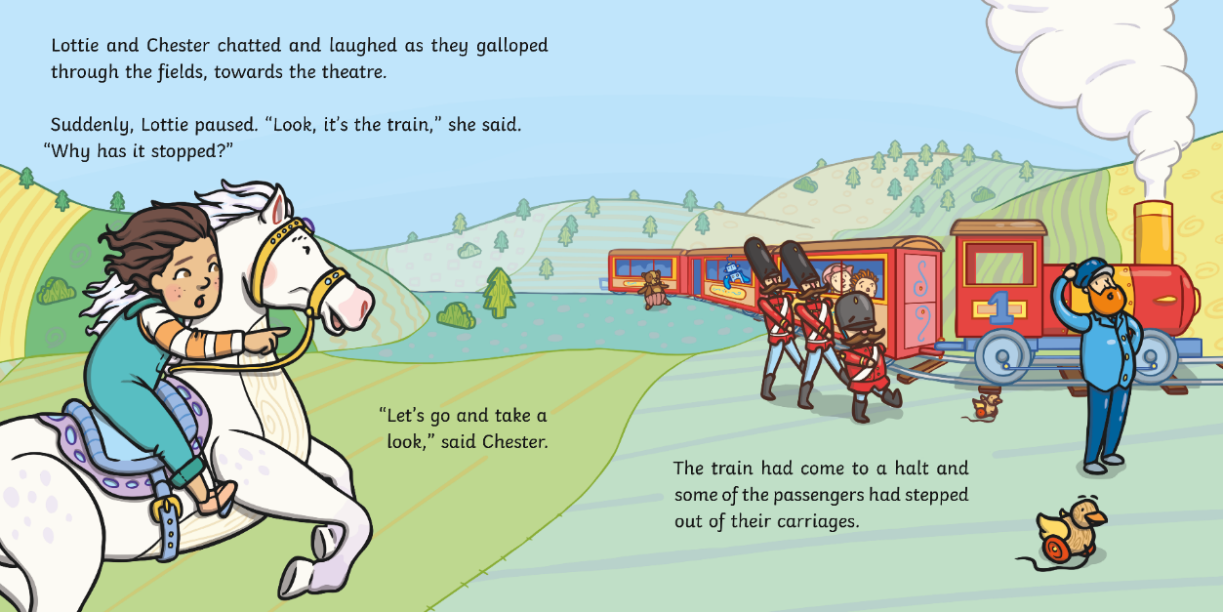
?
What do you think the problem is?

