Slide 1
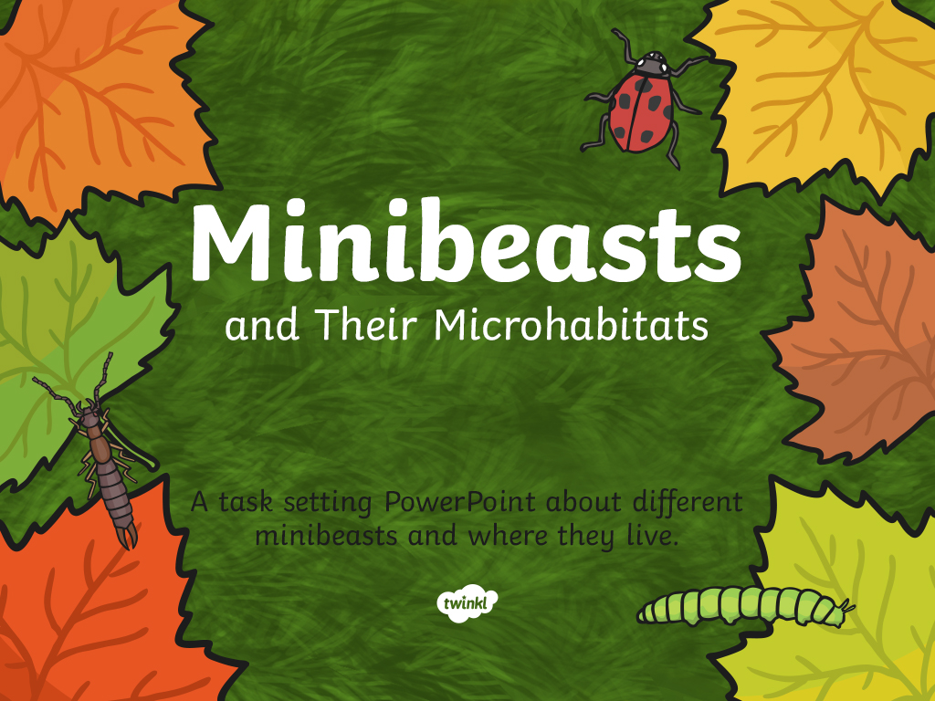

Slide 2

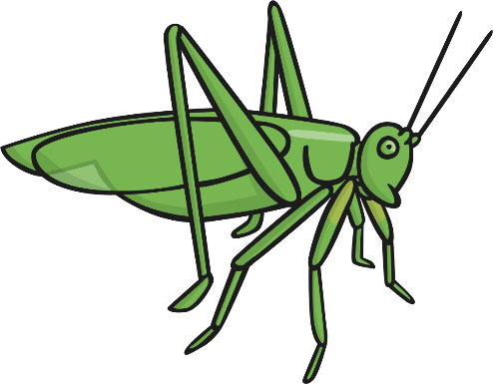
Many different minibeasts live in many different microhabitats.
They are suited to live in that microhabitat because they can find the food, water and shelter they need.
Minibeasts help to keep the microhabitat healthy.

Slide 3
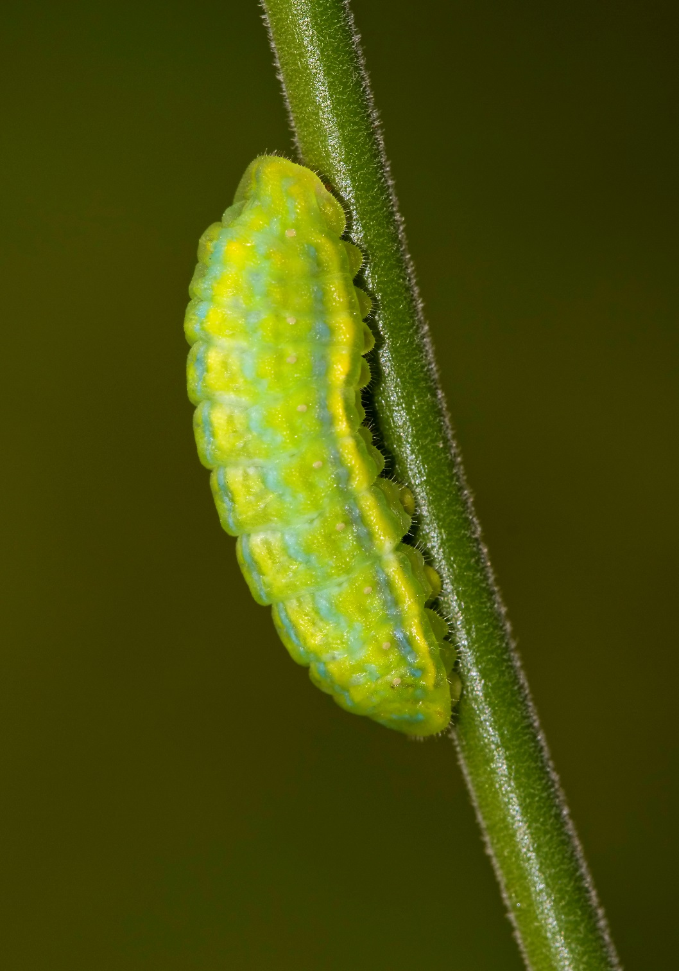
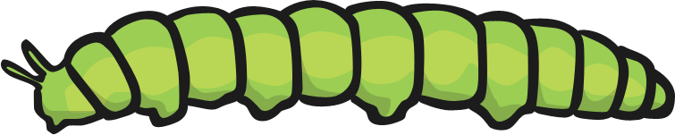
Caterpillar
Caterpillars like to live on top and underneath leaves.
This is so they can use their camouflage and blend into the leaf.
This helps protect them so they cannot be seen by predators.
The caterpillars can then also catch what they want to eat.
Photo courtesy of forbesimages (@flickr.com) –
granted under creative commons licence - attribution

Slide 4
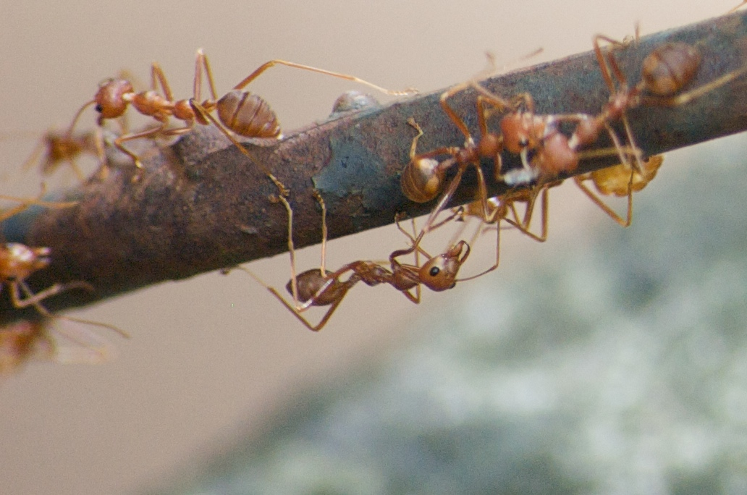
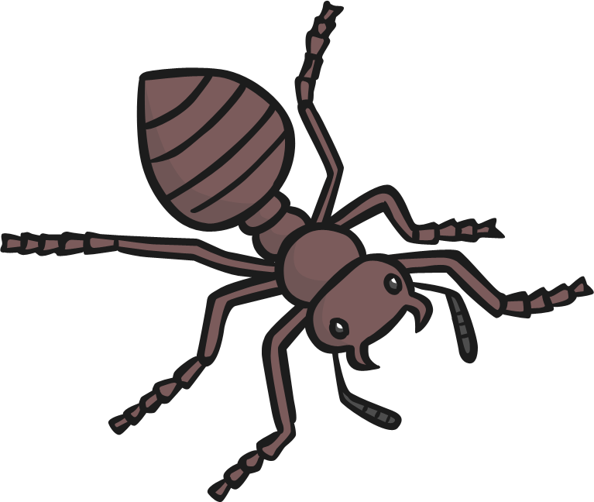
Ant
Ants mostly live underground.
They live in big families.
There are lots of insects to eat underground.
Ants don’t have ears. Ants “hear” by feeling vibrations in the ground through their feet.
Photo courtesy of Al Abbasi (@flickr.com) – granted under creative commons licence - attribution

Slide 5
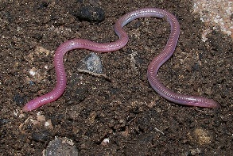
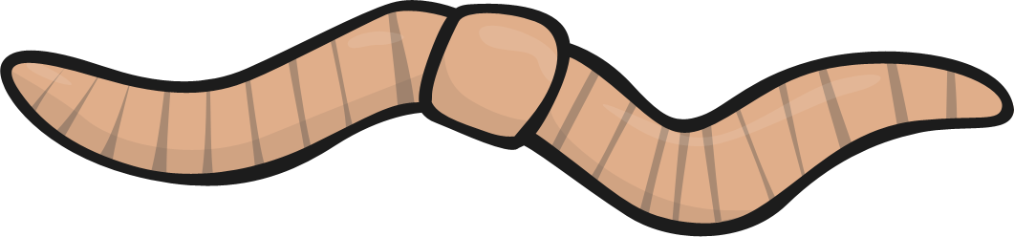
Worm
Worms like to live anywhere there is soil.
They like to eat dead leaf matter and need the soil to be moist.
Worms help keep soil healthy as they dig tunnels that let air and water into soil and to the roots of plants.
Photo courtesy of houseoftherisingcake(@flickr.com) – granted under creative commons licence - attribution

Slide 6
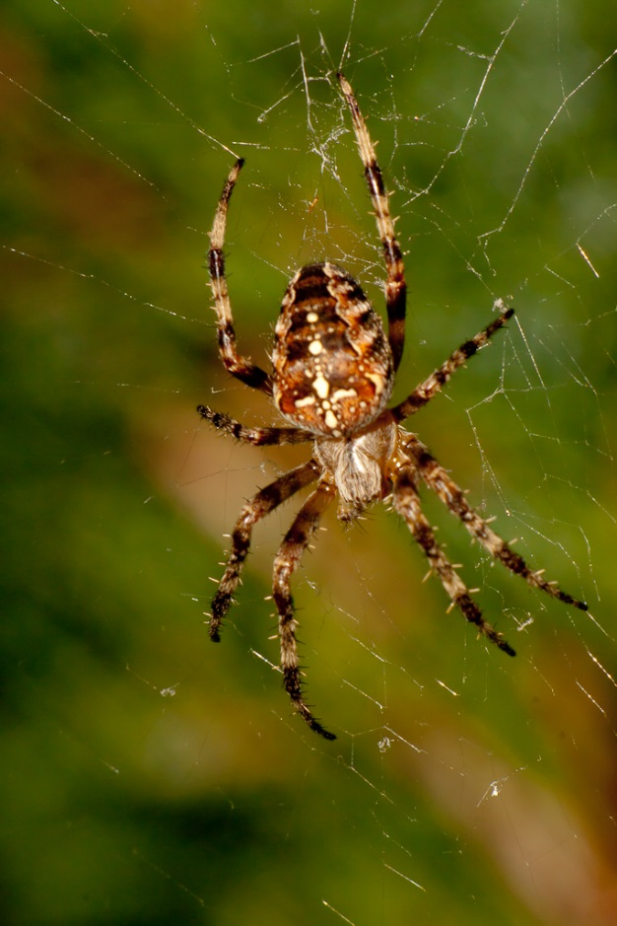
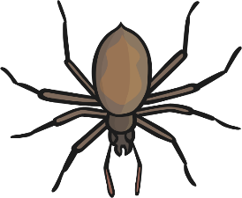
Spider
Spiders are able to live just about anywhere.
They do well in all types of habitats but they do have to find shelter when the weather gets colder.
Their body colours help them blend in well to their surroundings.
Spiders build webs to catch small insects to eat.
Photo courtesy of Leszeck.leszynski(@flickr.com) – granted under creative commons licence - attribution

Slide 7
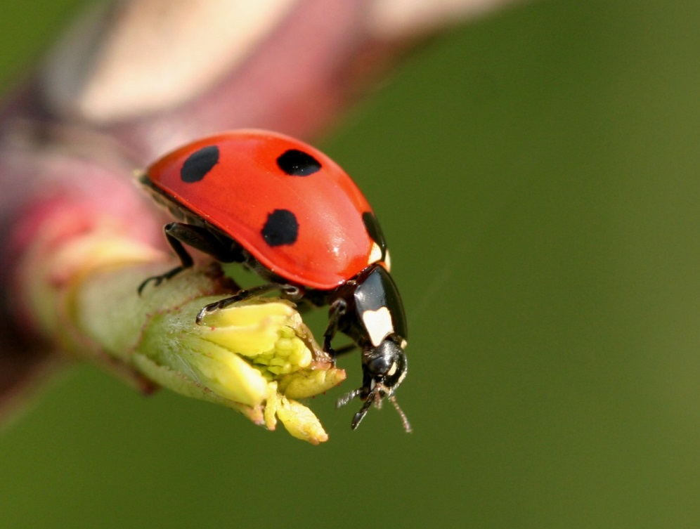
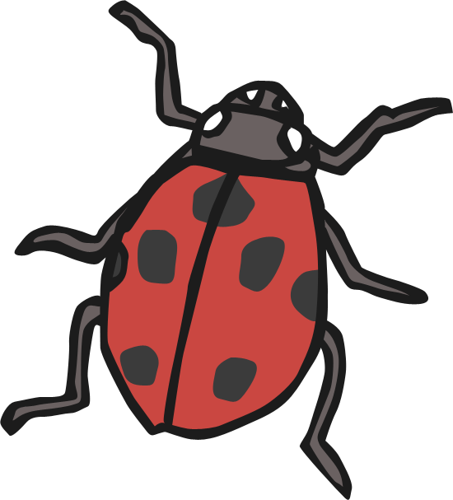

Ladybird
During the summer, ladybirds live in shrubs, branches, and flowers.
When the weather gets colder they find protective hiding places, such as tree stumps or cracks in wood. This then becomes a place to hibernate - at the base of a tree, or even under a rock. They crawl under leaves to protect themselves from the winter cold.
When hibernating, ladybirds huddle together in order to keep warm.
Photo courtesy of Leszeck.leszynski(@flickr.com) – granted under creative commons licence - attribution

Slide 8
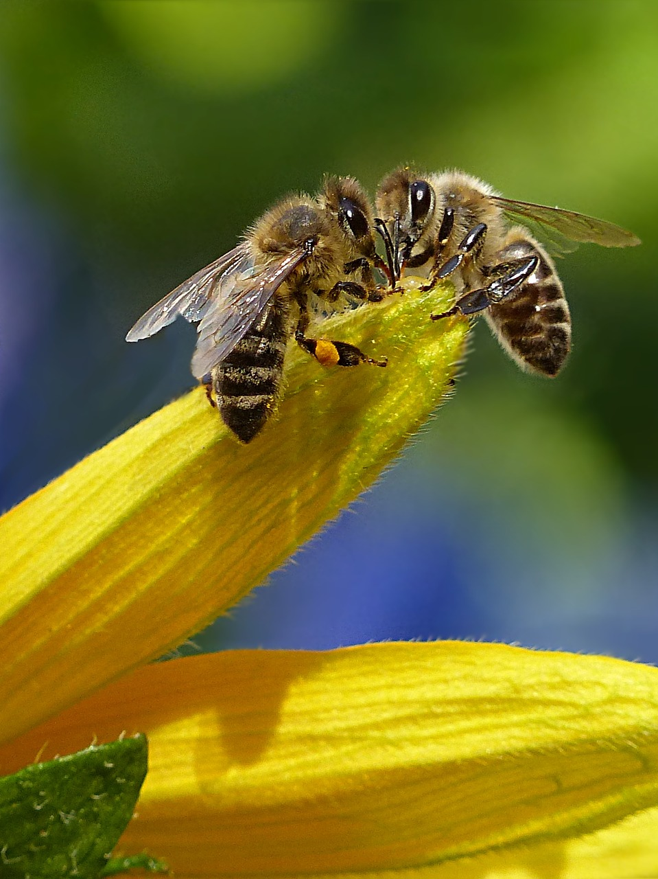
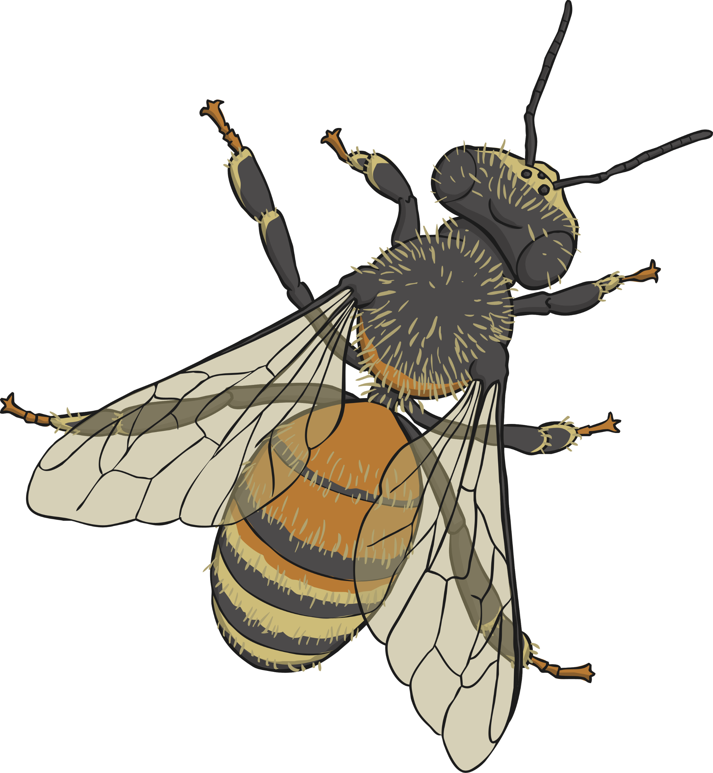
Honey Bee
Honey Bees like to live in areas with lots of flowering plants, such as gardens and meadows.
In their natural habitats, they build nests inside holes in trees and under objects to keep them safe from predators.
Humans also build beehives for them to live in - usually
wooden boxes.
In colder climates, honey bees store more honey to prepare for the winter.

Slide 9
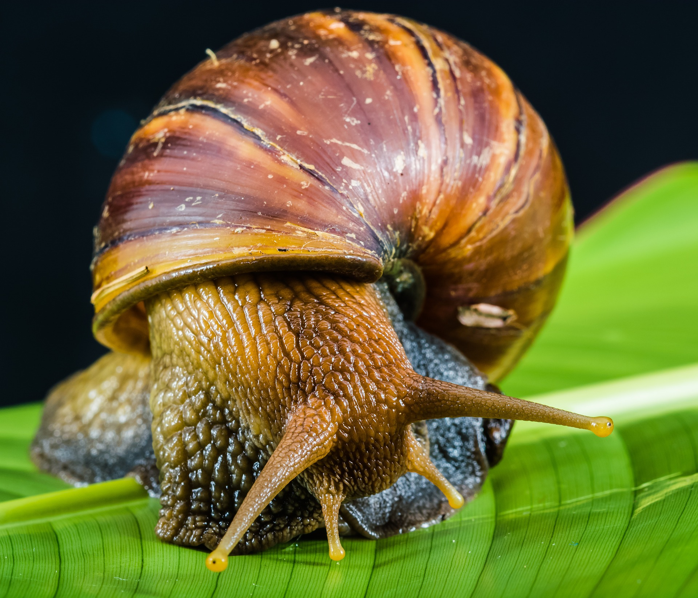
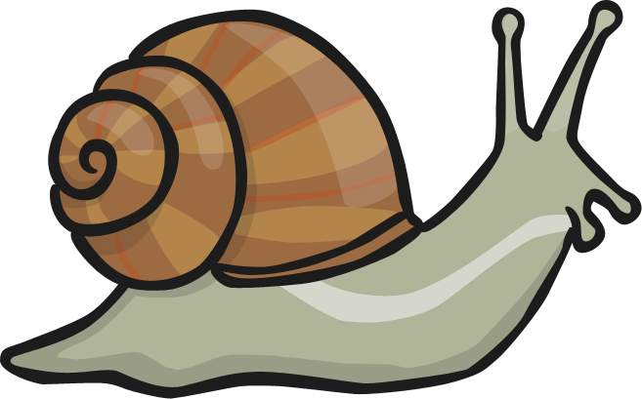
Snail
Snails can survive nearly everywhere and can be found all around the world.
Some have adapted to survive in the water and you can even find snails in the desert!
Snails prefer to stay close to rocks and plants to hide from natural predators.
Photo courtesy of forbesimages (@flickr.com) –
granted under creative commons licence - attribution

Slide 10
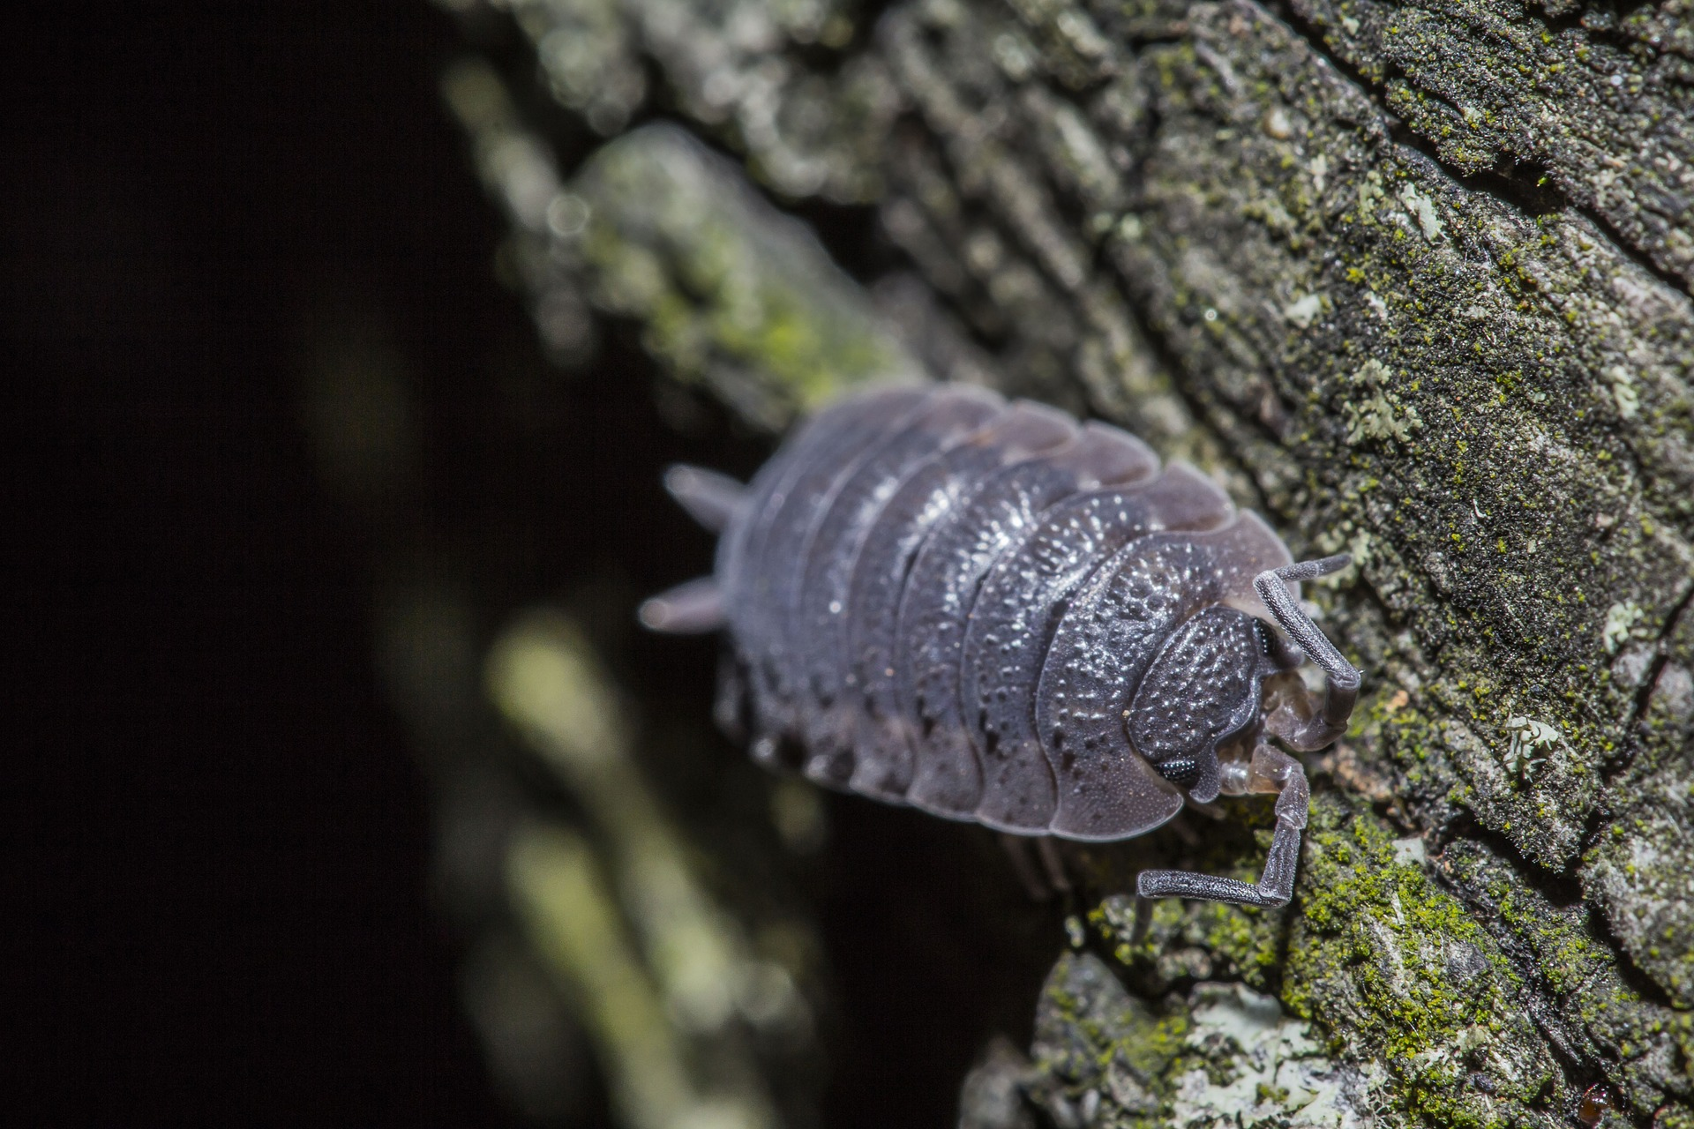
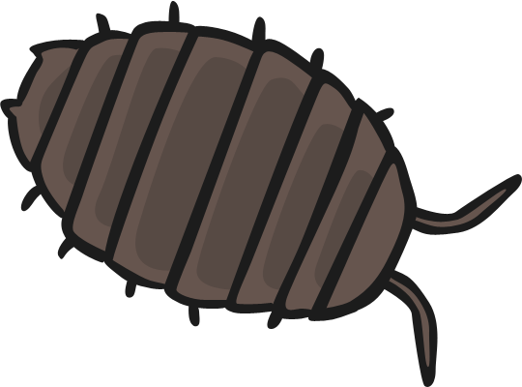
Woodlouse
Woodlice like dark damp places to hide during the day, such as compost heaps and woodland gardens.
They are the only species of crustacean that live on land and not in the water.
Woodlice can curl up into a ball to protect themselves from predators.

Slide 11
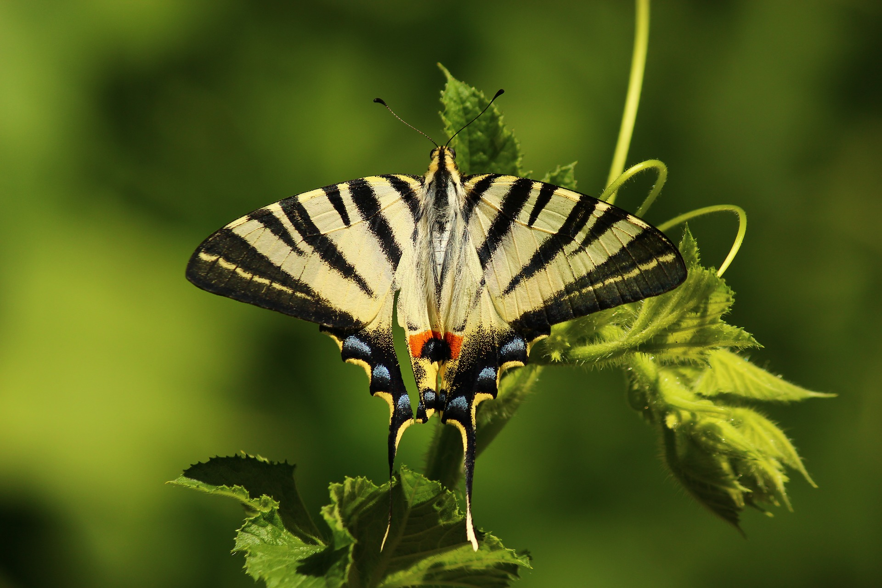
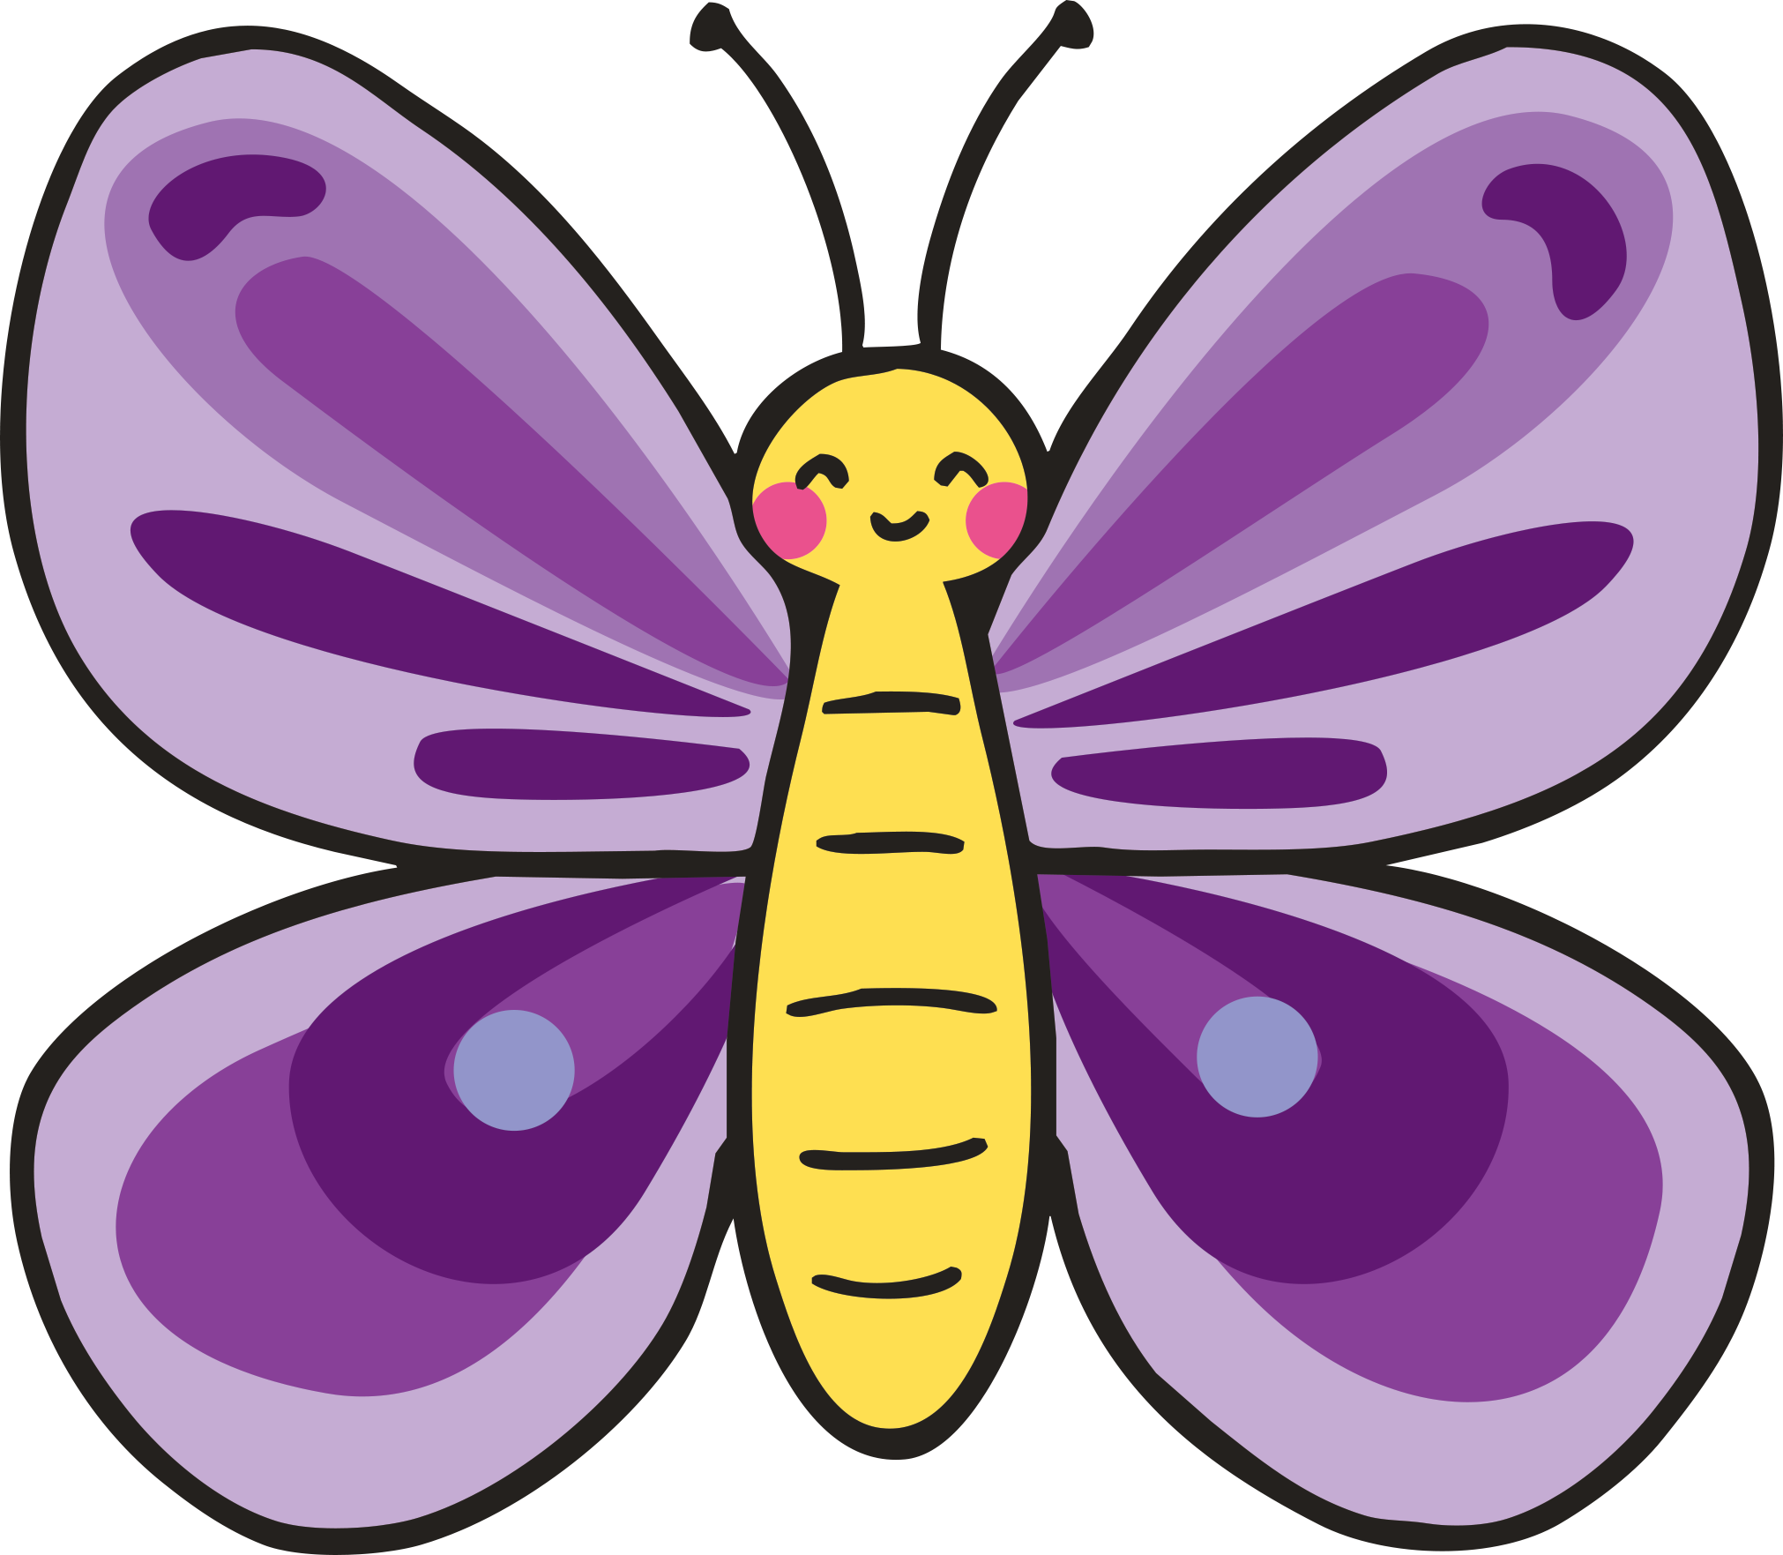
Butterfly
Butterflies can survive in varied habitats around the world. Some live during the day and others are nocturnal. Some prefer the heat of summer but others can live through Autumn and Winter. In the UK, butterflies tend to prefer grasslands with lots of wild flowers. Each plant will usually be food for a different type of caterpillar (butterfly larvae)

